Slide 1
BIL 222 System Programming-Spring 2024
Ammar Daşkın

Slide 2
Hours
Fridays at 2:30pm at B517, slides and class examples are posted on classroom
Thursdays at 3:30pm at B517
A hw/quiz will be given on github.com or in class with different tools

Slide 3
Prerequisites
A passing grade from BIL 121 C programming
A little data structures, algorithms, and computer architecture

Slide 4
Resources
Textbooks and Course Material
Lectures follow the book on the link https://github.com/angrave/SystemProgramming/wiki
https://man7.org/index.html by Michael Kerrisk.
For C programming,
you can refer to the book "The C Programming Language", Brian W Kernighan, Dennis M Ritchie,
BIL121 lecture notes: https://sites.google.com/view/adaskin/teaching/c-programming-lecture-notes
Other Books
More complete guide
The Linux Programming Interface: A Linux and UNIX System Programming Handbook, by Michael Kerrisk, https://man7.org/index.html by Michael Kerrisk.
Just for the topics in this course
Linux System Programming: Talking Directly To The Kernel And C Library Second Edition by Robert Love
Advanced Programming in the UNIX Environment 3rd Edition, by W. Richard Stevens

Slide 5
Grading policy
10% Weekly Labs/Quizzes
Each quiz covers the topics in the previous lecture
1 lowest grade is not considered in the final grade
Given through google classroom or github
30% 3-4 programming assignments (including group projects)
20% midterm exam
40% final exam

Slide 6
How to study this course?
Weekly lecture shows theory and simple implementations of the topic
You may need to take notes, some concepts or details may not be in the slides.
Labs, you practice and review the topics discussed in the lectures,
some topics that are skipped in the lectures may be included in the lab write-ups.
In hw and projects, you complete the implementations discussed in the lectures or implement some algorithms/concepts discussed in the lectures.
Function prototypes and algorithms are given or described.
Submitted through github and classroom.

Slide 7
What is this course about?
Basics of system programming
the practice of writing system software by using core system libraries
System softwares interfaces with the OS-kernel
Shell
Text editor
Debugger
System daemons
Network server
Database server

Slide 8
Why system programming?
The majority of operating systems are written at the system level
Knowledge of system programming provides you to understand how to write low level interface programs and write better high level code

Slide 9
System programming in Linux
System calls
Function invocations made from user space into the kernel
Kernel provides a mechanism for user space applications to signal the kernel to invoke a system call
C library
Standard C compiler is provided by GNU compiler collection (gcc), GNU version of cc

Slide 10
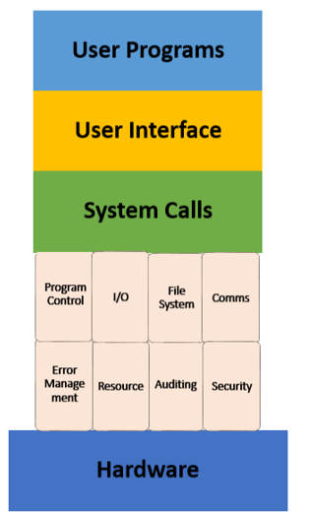
Computer OS Structure
https://www.guru99.com/system-call-operating-system.html#2

Slide 11
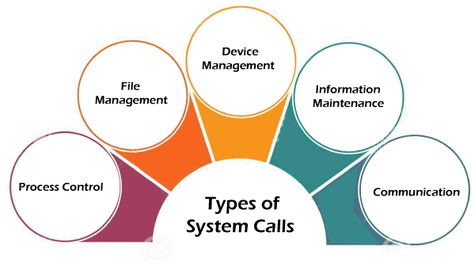
What type of system calls we can use in our system programs
https://www.javatpoint.com/system-calls-in-operating-system

Slide 12
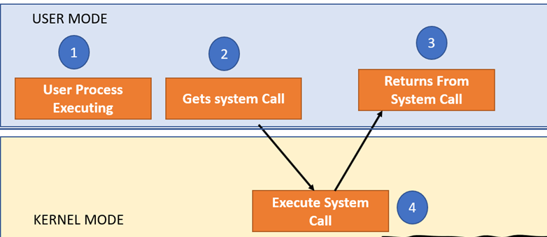
OS services the system calls!
https://www.guru99.com/system-call-operating-system.html#2

Slide 13
For portability
API (application programming interface)
Defines interfaces by which one software can be invoked from another software
Generally between a low level software and a high level software (API-user)
Example: Interfaces defined by C library for memory management and string manipulations
ABI
Binary interfaces between two software pieces on particular architecture
Guarantees that a piece of software function on any system with the same ABI

Slide 14
Compliance
Linux aims to comply with two of the POSIX and the Single UNIX Specification (SUS) standards.
POSIX (Portable Operating System Interface)
Suggested by Richard Stallman, founder of free software development
Issued by IEEE in 1988 and revised on later years
Many system calls and interfaces are standardized by POSIX
C Language standards: gcc compiler is ISO C99-compliant

Slide 15
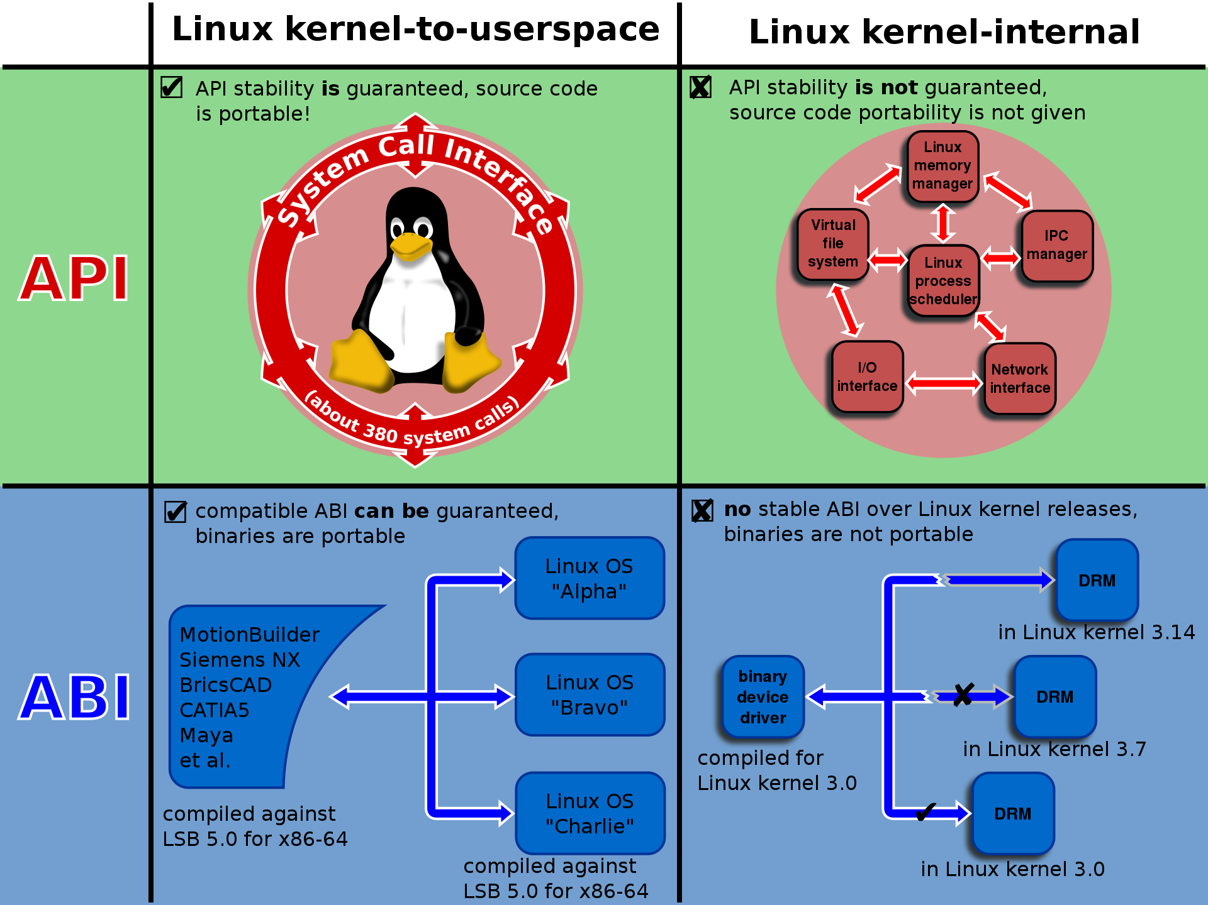
https://en.wikipedia.org/wiki/System_call
https://upload.wikimedia.org/wikipedia/commons/thumb/6/68/Linux_kernel_interfaces.svg/600px-Linux_kernel_interfaces.svg.png

Slide 16
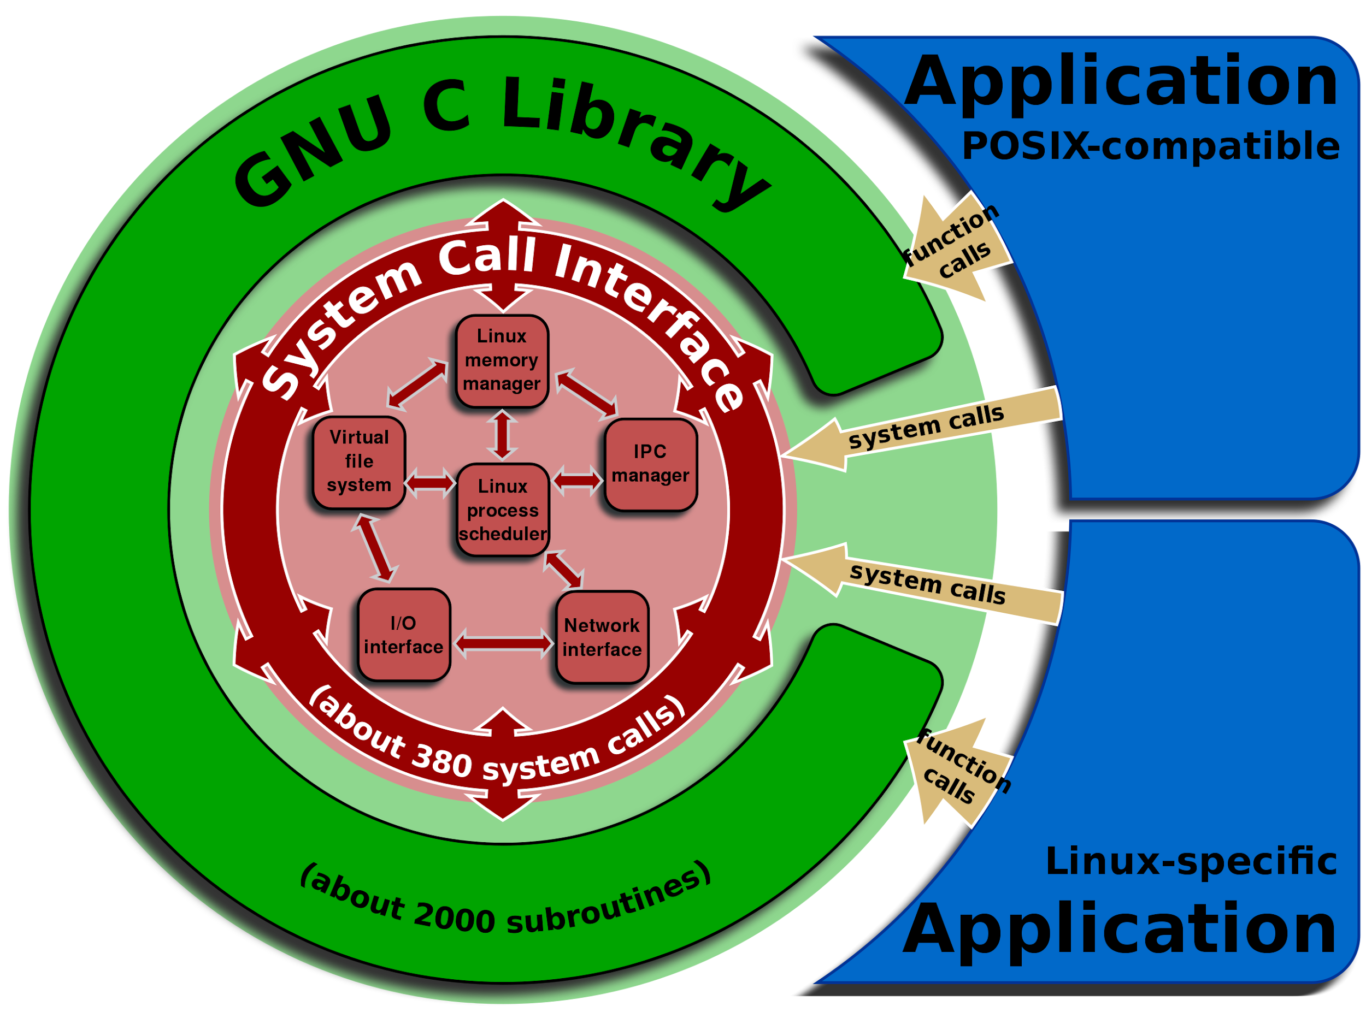
https://en.wikipedia.org/wiki/Linux_kernel_interfaces#Linux_API

Slide 17
Weekly Content
Course administrivia, git, gcc, gdb, crash course on C
Review of pointers, C memory model, makefiles
Processes
Memory allocators
Threads
Synchronization
Midterm review
Deadlock
Virtual memory & IPC
Scheduling
Networking-Socket programming
Filesystems
Signals
Final-Review

Slide 18
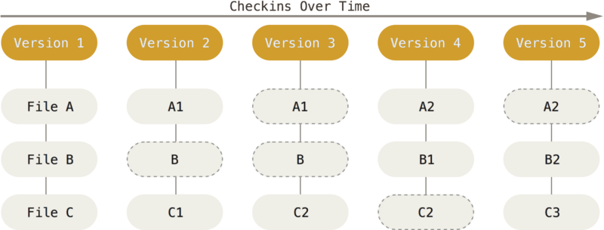
Git intro
This semester we will use github.com for assignments…
Github uses git version control system
So what is git?
A version control system such as CVS, subversion, Perforce
It stores an entire directory-called repository
https://git-scm.com/book/en/v2/Getting-Started-What-is-Git%3F

Slide 19
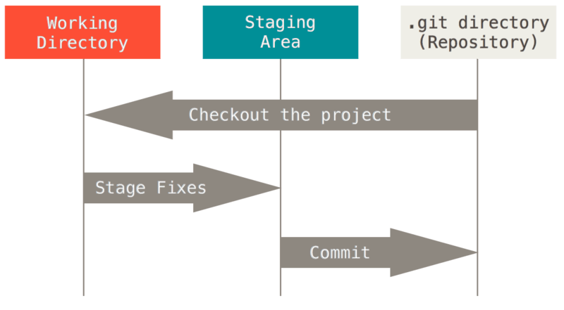
Git states (modified, staged, and committed)
https://git-scm.com/book/en/v2/Getting-Started-What-is-Git%3F

Slide 20
Initializing a repository in an existing directory
for Linux:
$ cd /home/user/my_project
for macOS:
$ cd /Users/user/my_project
for Windows:
$ cd C:/Users/user/my_project
and type:
$ git init
This creates a new subdirectory named .git that contains all of your necessary repository files
Begin tracking existing files
$ git add *.c
$ git add LICENSE
do an initial commit
$ git commit -m 'Initial project version'
https://git-scm.com/book/en/v2/Git-Basics-Getting-a-Git-Repository#ch02-git-basics-chapter

Slide 21
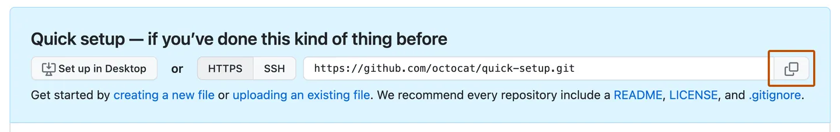
To add this to github
Create new repo on github.com
$ git remote add origin REMOTE-URL
to check if url is correct
$ git remote -v
Push changes to github.com
$ git push origin main
You have submitted your assignment
$git init -b main
$ git add .
$ git commit -m "First commit"
See for windows, macos, and linux https://docs.github.com/en/migrations/importing-source-code/using-the-command-line-to-import-source-code/adding-locally-hosted-code-to-github

Slide 22
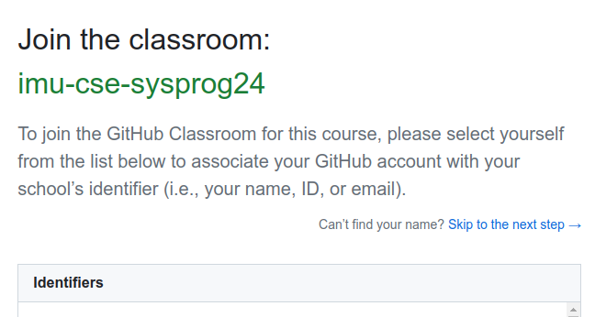
For assignments
Use the given assignment link on your browser
https://classroom.github.com/a/?????….
Choose your name in identifiers to link your github account

Slide 23
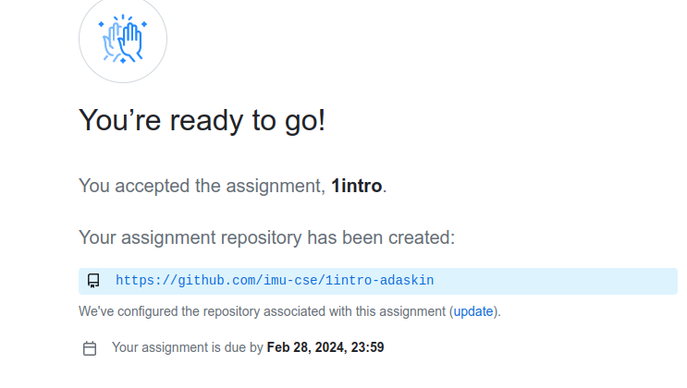
One you accepted an assignment,
click the assignment to open on browser

Slide 24
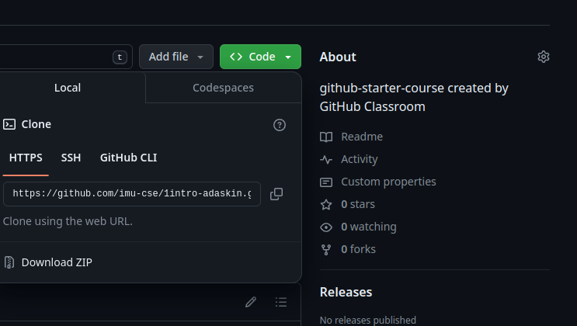
$ git clone https://github.com/YOUR-USERNAME/YOUR-REPOSITORY
$ cd YOUR-REPOSITORY
Make some changes or add files
$ echo "int main(){}" > newfile.c
$ git add newfile.c
$ git commit -m "new file added!"
$ git push origin main
You have pushed the changes to remote repo on github.comand submitted your assignment

Slide 25
For secure connection
Create ssh-key
https://docs.github.com/en/authentication/connecting-to-github-with-ssh/generating-a-new-ssh-key-and-adding-it-to-the-ssh-agent
And use gpg-key for signing commits
https://docs.github.com/en/authentication/managing-commit-signature-verification/adding-a-gpg-key-to-your-github-account

Slide 26
Crash course on C
For C programming, you can refer to "The C Programming Language", Brian W Kernighan, Dennis M Ritchie.
C-Lecture notes from BIL121:
https://sites.google.com/view/adaskin/teaching/c-programming-lecture-notes
see .c files posted on classroom

Slide 27
Program files
A program file contains all the necessary information to load an application into memory and make it run.It includes:
machine instructions
initialized data
List of library dependencies
List of memory sections that the program will use
List of undefined values in the executable that will be known until the program is loaded into memory.

Slide 28
Compiling a c program
Preprocessing:
The preprocessor expands all preprocessor directives.
Parsing:
The compiler parses the text file for function declarations, variable declarations, etc.
Assembly Generation:
The compiler then generates assembly code for all the functions after some optimizations if enabled.
Assembler (compiling assembly code):
The assembler turns the assembly into 0s and 1s and creates an object file. This object file maps names to pieces of code.
Static Linking:
The linker takes a series of objects and static libraries and resolves references of variables and functions from one object file to another.
The linker finds the main method and makes that the entry point for the function.
The linker also notices when a function is meant to be dynamically linked.
The compiler also creates a section in the executable that tells the operating system that these functions need addresses right before running.
Dynamic Linking: As the program is getting ready to be executed, the operating system looks at what libraries that the program needs and links those functions to the dynamic library.
The program is run.
$ cat main.c
#include <stdio.h>
int main() {
printf("Hello World!\n");
return 0;
}
$ gcc main.c -o main
$ ./main
Hello World!
$

Slide 29
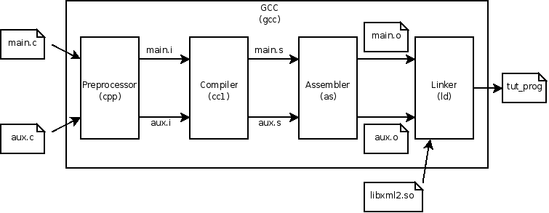
$ gcc main.c aux.c -o tut_prog
$ ./main
Hello World!
$
Img src: https://en.wikipedia.org/wiki/GNU_Compiler_Collection

Slide 30
The preprocessor
expands #define, #include, #ifdef etc preprocessor statements and generates a main.i file.
The compiler
compiles main.i, optimizes it and generates an assembly instruction: main.s
The assembler (as)
takes input assembly file main.s and generates an object file main.o
The compiler (cc or gcc) by default hides all these intermediate steps. You can use compiler options to run each step independently.
$ cat main.c
#include <stdio.h>
int main() {
printf("Hello World!\n");
return 0;
}
$ gcc main.c -o main
$ ./main
Hello World!
$

Slide 31
$ gcc -E main.c > main.i
-E stops compiler after running preprocessor
$ gcc -S main.c
-S stops compiler after assembly file generated
Assembler uses “.s” file to generate an object file
$ gcc -c main.c
Generates object file main.o
main.o has undefined symbols like printf we don’t know where it is placed
$ nm main.o
$ gcc -o main main.c
Generates executable main
printf does not have a value yet until the program is loaded
$ nm main.o
$ cat main.c
#include <stdio.h>
int main() {
printf("Hello World!\n");
return 0;
}
$ gcc main.c -o main
$ ./main
Hello World!
$
Gcc options https://gcc.gnu.org/onlinedocs/gcc/Option-Summary.html#Option-Summary

Slide 32
Loading a program
It also writes (resolves) any values in the executable to point to the functions/variables in the shared libraries.(E.g. calls to printf in main.c)
Once memory image is ready, the loader jumps to the _start entry point that calls init() of all libraries and initializes static constructors. Then it calls main() and the program begins.
_start also calls exit() when main() returns.
The loader is also called “runtime linker”.
To see dependent shared libraries
$ ldd a.out
The loader is a program that is used to run an executable file in a process.
Before the program starts running, the loader allocates space for all the sections of the executable file (text, data, bss etc)
It loads into memory the executable and shared libraries (if not loaded yet)

Slide 33
Static and Shared Libraries
Shared libraries are shared across different processes.
.so files
Does not add to the size of executable
There is only one instance of each shared library for the entire system.
Static libraries are not shared.
.a files
Add to the size of the executable
There is an instance of an static library for each process.
Static or Compilation Time– Events that happen during program building.
Example: Static linker
Dynamic or Runtime – Events that happen while program is running.
Example: Dynamic linker

Slide 34
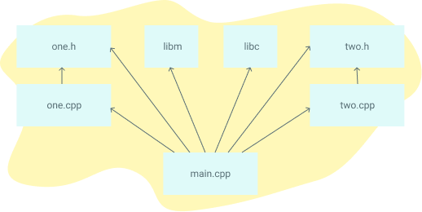
Makefiles
A simple makefile describes
rules to compile and link source and header files
and/or rules to recompile them
https://makefiletutorial.com/
https://www.gnu.org/software/make/manual/make.html#Introduction

Slide 35
Alternatives to make
Popular C/C++ alternative build systems are SCons, CMake, Bazel, and Ninja.
Microsoft Visual Studio have their own built in build tools.
For Java, there's Ant, Maven, and Gradle.
Other languages like Go and Rust have their own build tools.

Slide 36
A simple Makefile
prerequisite : An input file to create target
target … : prerequisites …
recipe
…
…
recipe : An action (a terminal command)
Makefile
hello:
echo "Hello, World"
Run with make command
$ make
echo "Hello, World"
Hello, World
$ make hello
echo "Hello, World"
Hello, World

Slide 37
A simple Makefile
target … : prerequisites …
recipe
…
…
Makefile
main:
cc main.c -o program
Run with make command
$ make
$ make main

Slide 38
Multiple Target
target … : prerequisites …
recipe
…
…
main:
cc main.c -o aprogram
run:
./aprogram
clean:
rm aprogram
$ make main
cc main.c -o aprogram
$ make run
./aprogram
hello world!
$ make clean
rm aprogram
Makefile
Run with make command
$ make

Slide 39
Multiple Target
target … : prerequisites …
recipe
…
…
Makefile
some_file: other_file
echo "This will always run, and runs second"
touch some_file
other_file:
echo "This will always run, and runs first"
$ make
echo "This will always run, and runs first"
This will always run, and runs first
echo "This will always run, and runs second"
This will always run, and runs second
touch some_file

Slide 40
Multiple Target
target … : prerequisites …
recipe
…
…
/*main.c*/
#include <stdio.h>
int printinteger(int);
int main(){
printinteger(5);
return 0;
}
Makefile
main: aux.o main.c
cc main.c aux.o -o aprogram
aux.o: aux.c
cc -c aux.c
clean:
rm -f aprogram
cleanall:
rm -f aprogram *.o
/*aux.c*/
#include <stdio.h>
int printinteger(int a){
printf("integer: %d\n", a);
return 0;
}

Slide 41
Variables
target … : prerequisites …
recipe
…
…
/*main.c*/
#include <stdio.h>
int printinteger(int);
int main(){
printinteger(5);
return 0;
}
Makefile
objects = aux.o main.o
aprogram: $(objects)
cc -o aprogram $(objects)
aux.o: aux.c
cc -c aux.c
main.o: main.c
cc -c main.c
clean:
rm aprogram $(objects)
/*aux.c*/
#include <stdio.h>
int printinteger(int a){
printf("integer: %d\n", a);
return 0;
}

Slide 42
Variables
Automatic variables
hey: one two
# Outputs "hey", since this is the target name
echo $@
# Outputs all prerequisites newer than the target
echo $?
# Outputs all prerequisites
echo $^
touch hey
one:
touch one
two:
touch two
clean:
rm -f hey one two
files := file1 file2
some_file: $(files)
echo "Look at this variable: " $(files)
touch some_file
file1:
touch file1
file2:
touch file2
clean:
rm -f file1 file2 some_file

Slide 43
Fancy rules
Static pattern rules
targets...: target-pattern: prereq-patterns ...
commands
Implicit Rules
objects = foo.o bar.o all.o
all: $(objects)
# These files compile via implicit rules
foo.o: foo.c
bar.o: bar.c
all.o: all.c
all.c:
echo "int main() { return 0; }" > all.c
%.c:
touch $@
clean:
rm -f *.c *.o all
CC = gcc # Flag for implicit rules
CFLAGS = -g # Flag for implicit rules. Turn on debug info
# Implicit rule #1: blah is built via
# the C linker implicit rule
# Implicit rule #2: blah.o is built via
#the C compilation implicit rule, because blah.c exists
blah: blah.o
blah.c:
echo "int main() { return 0; }" > blah.c
clean:
rm -f blah*
For more see https://makefiletutorial.com/

Slide 44
This week’s lab: Version control Git
This week’s lab assignment is given through github
you will create multiple c files and makefile for a solution of simple program
and submit it to github through git-commands from terminal

Slide 45
Next lecture
More on C, pointers, structures and alignments

