Slide 1
wss
Networking
https://www.csd.uoc.gr/~hy556/material/tutorials/cs556-3rd-tutorial.pdf
https://intronetworks.cs.luc.edu/
Topics:
OSI Layers
Network layer
TCP vs UDP
Port numbers
Binding ports
System Layer
Sockets(Application Programming Interfaces (API))
Application layer protocols
HTTP (get, post request)
WebSockets

Slide 2
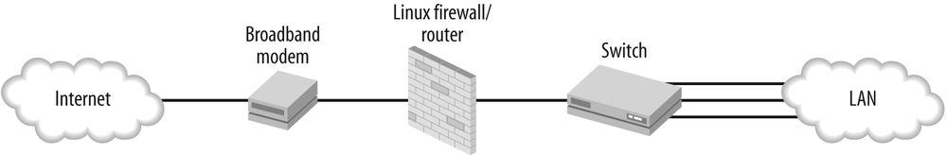
https://www.oreilly.com/library/view/linux-networking-cookbook/9780596102487/ch01.html

Slide 3
Linux Networking Commands
Basic Linux Network Commands
Top Linux Network Commands in 2024

Slide 4
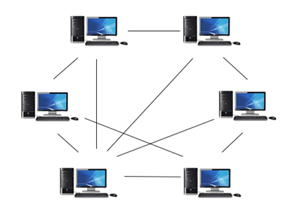
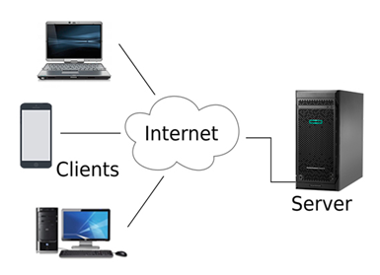
Peer to peer network
Client Server network
https://www.javatpoint.com/types-of-computer-network

Slide 5
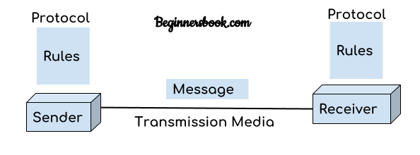
Communication

Slide 6
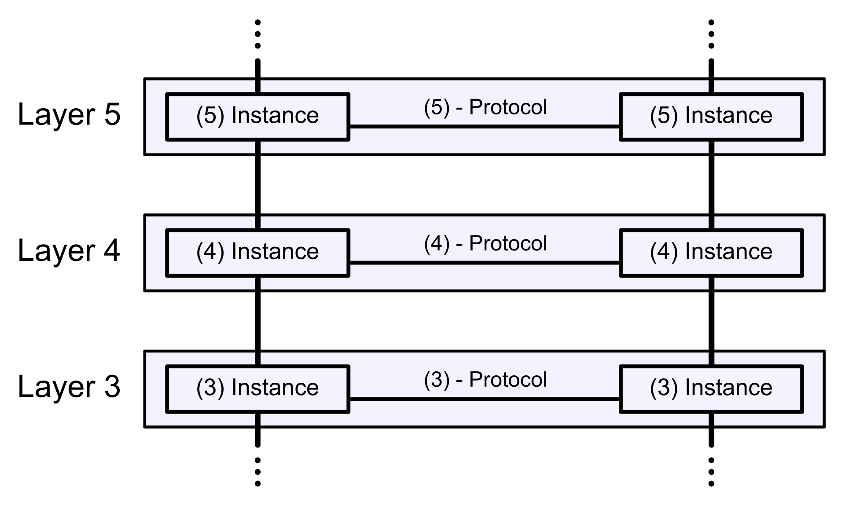
Conceptual Layering of Network Architecture
Successful communication requires a protocol(an agreement mechanism) on every layer of the systems
https://en.wikipedia.org/wiki/OSI_model

Slide 7
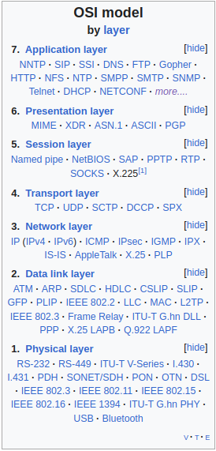
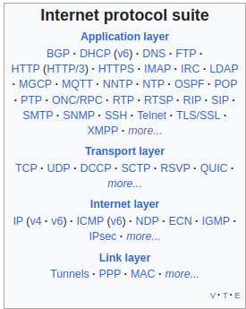
Conceptual model (NOT USED in Practice)
https://en.wikipedia.org/wiki/OSI_model
https://en.wikipedia.org/wiki/Internet_protocol_suite

Slide 8
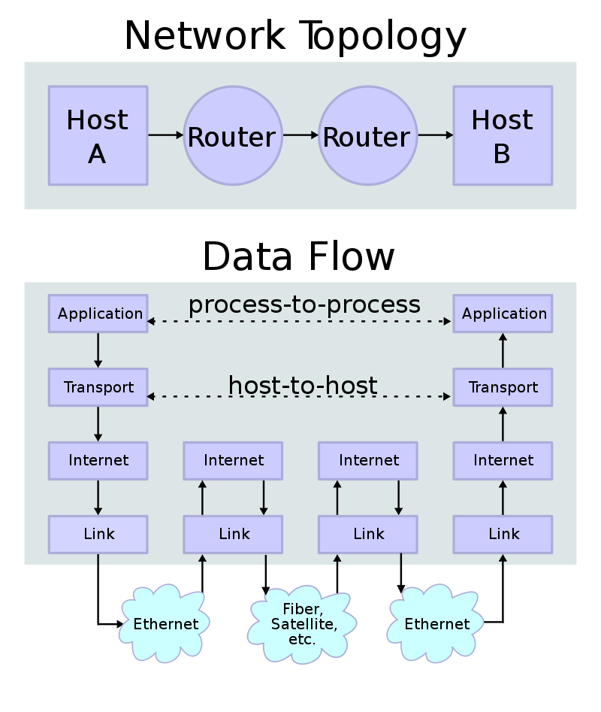
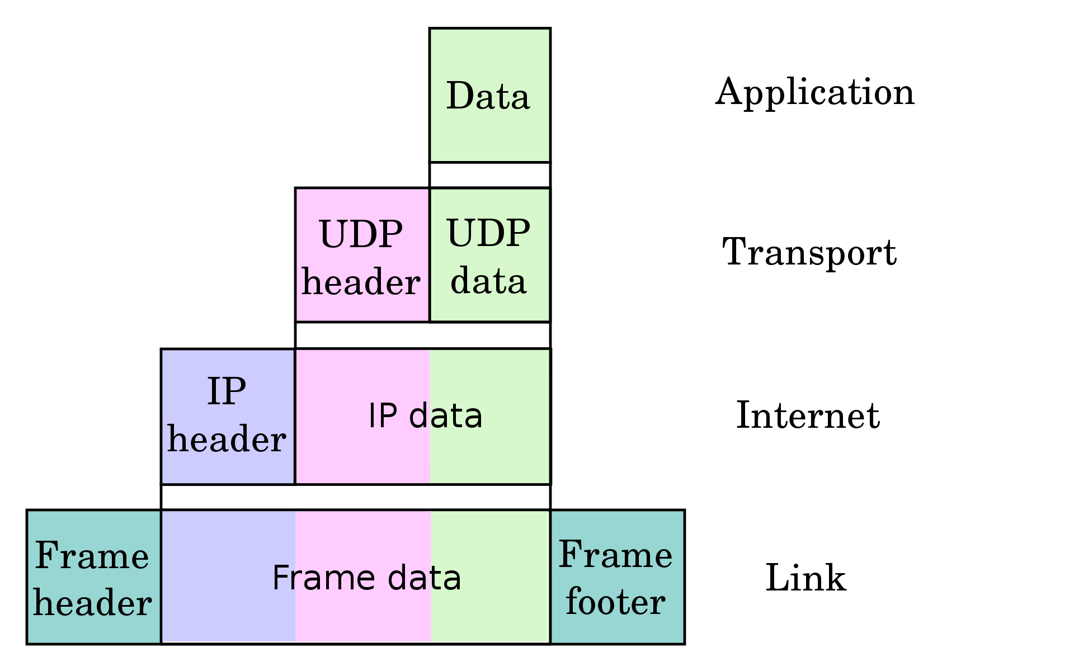
Internet protocol suite (TCP/IP model)
An example packet (the data that is transferred)
https://en.wikipedia.org/wiki/Internet_protocol_suite

Slide 9
Internet Protocol (IP)
IP has the task of delivering packets from the source host to the destination host solely based on the IP addresses in the packet headers.
Packets must contain an IP address of its destination
Packets are handled and delivered independently
Packets may lost, reordered or duplicated
https://en.wikipedia.org/wiki/Internet_protocol_suite

Slide 10
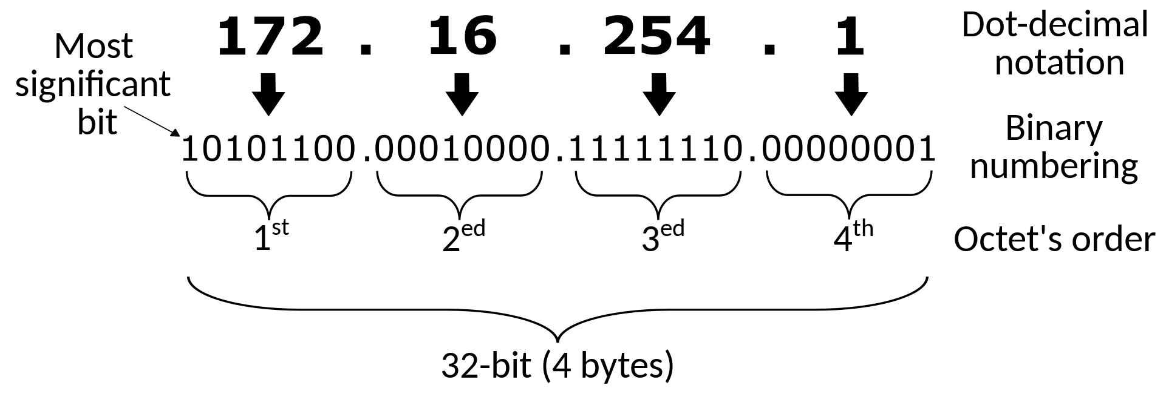
Internet Protocol (IP)
IPv4
IPv4 – 192.168.10.150
IPv6 – 3002:0bd6:0000:0000:0000:ee00:0033:6778
https://en.wikipedia.org/wiki/Internet_Protocol_version_4

Slide 11
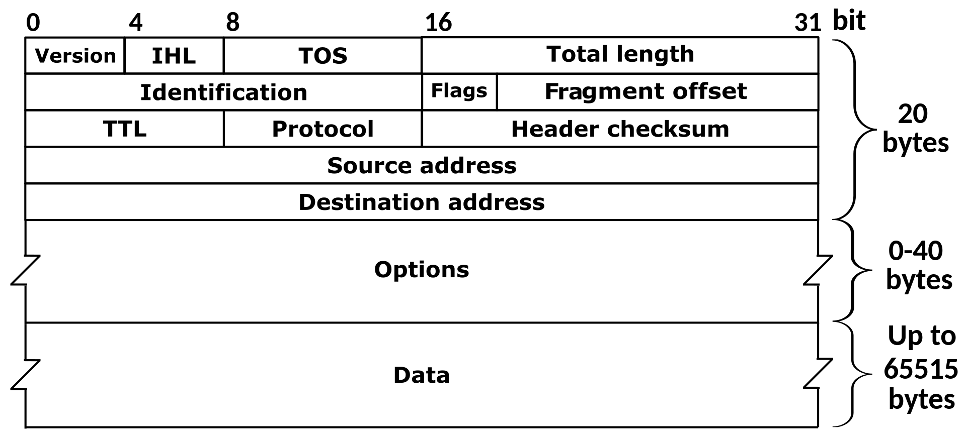
IPv4 packet
https://en.wikipedia.org/wiki/Internet_Protocol_version_4

Slide 12
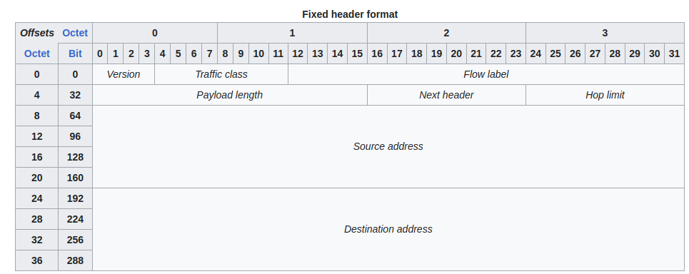
IPv6 packet header
https://en.wikipedia.org/wiki/IPv6

Slide 13
TCP vs UDP
Both use port numbers
application-specific construct serving as a communication endpoint
16-bit unsigned integer, thus ranging from 0 to 65535) to provide end-to-end transport
$ lsof -i -P -n
COMMAND PID USER FD TYPE DEVICE SIZE/OFF NODE NAME
firefox 6636 ad_public 177u IPv4 170052 0t0 TCP 10.5.1.74:35684->34.120.208.123:443 (ESTABLISHED)
firefox 6636 ad_public 189u IPv4 170051 0t0 TCP 10.5.1.74:34326->34.149.100.209:443 (ESTABLISHED)
firefox 6636 ad_public 194u IPv4 158123 0t0 TCP 10.5.1.74:51238->172.66.41.27:443 (ESTABLISHED)
chrome 8471 ad_public 234u IPv4 33288 0t0 UDP 224.0.0.251:5353
chrome 8518 ad_public 35u IPv4 3910 0t0 TCP 10.5.1.74:45734->95.183.223.253:443 (ESTABLISHED)
$ sudo netstat -tulpn
Proto Recv-Q Send-Q Local Address Foreign Address State PID/Program name
tcp 0 0 127.0.0.1:3306 0.0.0.0:* LISTEN 1531/mysqld
https://en.wikipedia.org/wiki/Internet_protocol_suite

Slide 14
TCP vs UDP
UDP: User Datagram Protocol
no acknowledgements
no retransmissions
out of order, duplicates possible
connectionless, i.e., app indicates destination for each packet
TCP: Transmission Control Protocol
reliable byte-stream channel (in order, all arrive, no duplicates)
similar to file I/O
flow control
connection-oriented
bidirectional
https://en.wikipedia.org/wiki/Internet_protocol_suite

Slide 15
Application Layer Protocols
Websockets, HTTP, HTTPS
always run WebSocket, HTTP over Transport Layer Security - Wikipedia
HTTPs, wss ( “secure” websocket)
The WebSocket API (WebSockets) - Web APIs | MDN
https://en.wikipedia.org/wiki/Internet_protocol_suite

Slide 16
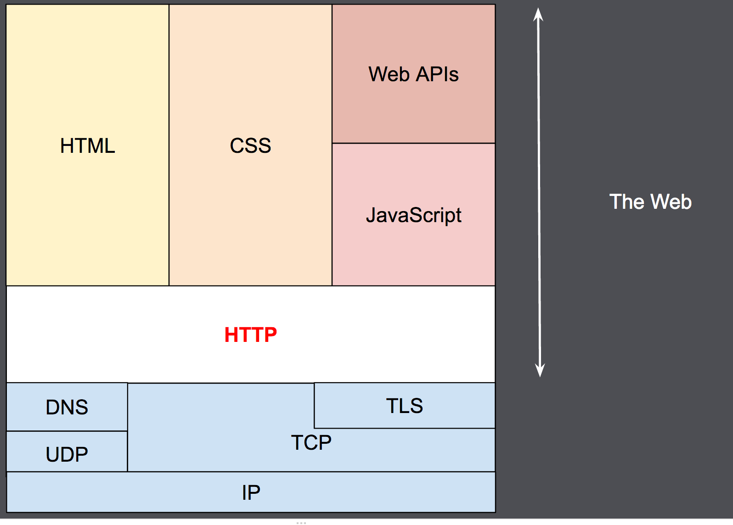
Http overview
https://developer.mozilla.org/en-US/docs/Web/HTTP/Overview

Slide 17
Socket Programming: System calls (API) for networking

Slide 18
Berkeley Sockets (System calls: API Berkeley Sockets
Sockets(Application Programming Interfaces (API)
Sockets are not protocol
We will see socket programming
That uses UDP
That uses TCP
And see kernel implementation of Transport Layer Security(TLS) encryption protocol over TCP
OpenSSL
https://www.kernel.org/doc/html/latest/networking/tls.html

Slide 19
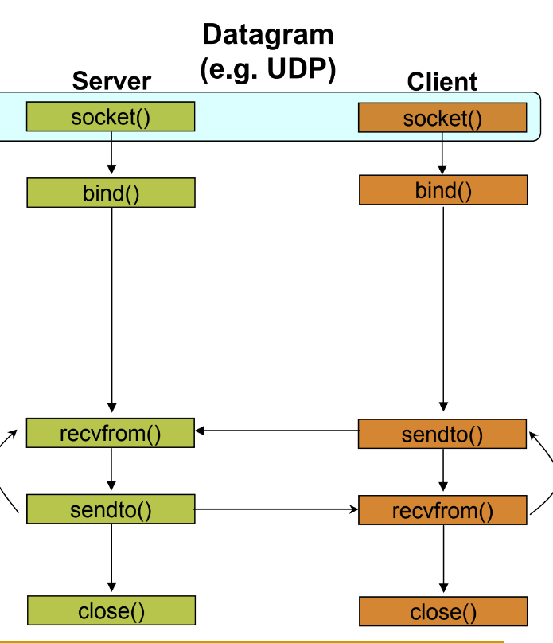
https://www.csd.uoc.gr/~hy556/material/tutorials/cs556-3rd-tutorial.pdf

Slide 20
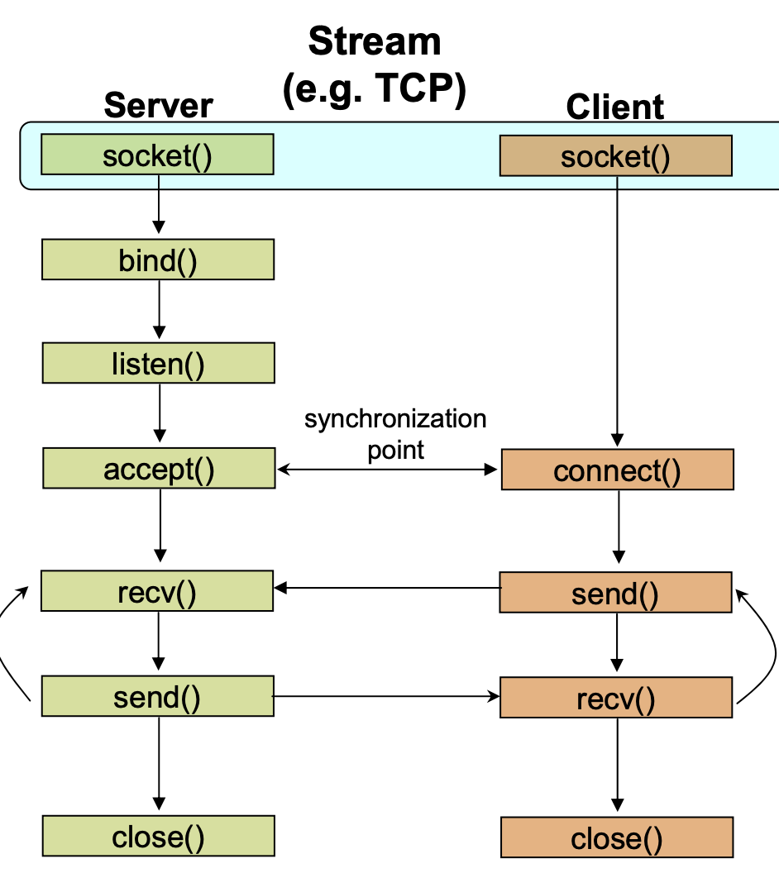
https://www.csd.uoc.gr/~hy556/material/tutorials/cs556-3rd-tutorial.pdf

Slide 21
socket()
creates an endpoint for communication and returns a file descriptor that refers to that endpoint.
#include <sys/socket.h>
int socket(int domain, int type, int protocol);
Berkeley sockets - Wikipedia
https://www.csd.uoc.gr/~hy556/material/tutorials/cs556-3rd-tutorial.pdf

Slide 22
socket()
creates an endpoint for communication and returns a file descriptor that refers to that endpoint.
#include <sys/socket.h> /*for socket*/
#include <netinet/in.h> /*for PF_INET, AF_INET, IPPPROTO_TCP and etc. */
int main(){
int sock = socket(AF_INET, SOCK_STREAM,
IPPROTO_TCP);
}

Slide 23
Socket structures ($ man sockaddr)
#include <sys/socket.h>
struct sockaddr {
sa_family_t sa_family; /* Address family */
char sa_data[]; /* Socket address */
};

Slide 24
Internet domain sockets
#include <netinet/in.h>
struct sockaddr_in {
sa_family_t sin_family; /* AF_INET */
in_port_t sin_port; /* Port number */
struct in_addr sin_addr; /* IPv4 address */
};
struct in_addr {
in_addr_t s_addr; /* IPv4 address */
};
struct sockaddr_in6 {
sa_family_t sin6_family; /* AF_INET6 */
in_port_t sin6_port; /* Port number */
uint32_t sin6_flowinfo; /* IPv6 flow info */
struct in6_addr sin6_addr; /* IPv6 address */
uint32_t sin6_scope_id; /* Set of interfaces for a scope */
};

Slide 25
UNIX domain sockets
#include <sys/un.h>
struct sockaddr_un {
sa_family_t sun_family; /* Address family */
char sun_path[]; /* Socket pathname */
};

Slide 26
Server side socket
#include <sys/socket.h> /*for socket(int domain, int type, int protocol);*/
#include <netinet/in.h> /*for PF_INET, AF_INET, IPPPROTO_TCP and etc. */
#include <arpa/inet.h> /*htonl, htons, ntohl, ntohs: convert values between host and network byte order */
#include <string.h>
#define PORT_NUMBER 5100
int main(){
struct sockaddr_in my_addr;
my_addr.sin_addr.s_addr = htonl(INADDR_ANY);
my_addr.sin_family = AF_INET;
my_addr.sin_port = htons(PORT_NUMBER);

Slide 27
Client side socket
#include <sys/socket.h> /*for socket(int domain, int type, int protocol);*/
#include <netinet/in.h> /*for PF_INET, AF_INET, IPPPROTO_TCP and etc. */
#include <arpa/inet.h> /*for htonl, htons, ntohl, ntohs: convert values between host and network byte order */
#include <string.h> /*for memset*/
#define PORT_NUMBER 5100
#define SERVER_IP_ADDRESS "127.0.0.1"
int main(){
struct sockaddr_in srv_addr;
memset(&srv_addr, 0, sizeof(srv_addr));
srv_addr.sin_addr.s_addr = inet_addr(SERVER_IP_ADDRESS);
srv_addr.sin_family = AF_INET;
srv_addr.sin_port = htons (PORT_NUMBER);

Slide 28
Server side
#define NUMBER_OF_CONNECTIONS 10
#define PORT_NUMBER 5100
int main(){
struct sockaddr_in my_addr;
my_addr.sin_addr.s_addr = htonl(INADDR_ANY);
my_addr.sin_family = AF_INET;
my_addr.sin_port = htons(PORT_NUMBER);
int sfd = socket(AF_INET, SOCK_STREAM, IPPROTO_TCP);
if(sfd == -1){
perror("socket");
exit(1);
}
if(bind(sfd, &my_addr, sizeof(my_addr)) == -1){
perror("bind");
exit(1);
}
if(listen(sfd, NUMBER_OF_CONNECTIONS) == -1){
perror("listen");
exit(1);
}

Slide 29
client side
#define PORT_NUMBER 5100
#define SERVER_IP_ADDRESS "127.0.0.1"
int main(){
struct sockaddr_in srv_addr;
memset(&srv_addr, 0, sizeof(srv_addr));
int port_number = PORT_NUMBER; /*a port number*/
srv_addr.sin_addr.s_addr = inet_addr(SERVER_IP_ADDRESS);
srv_addr.sin_family = AF_INET;
srv_addr.sin_port = htons (port_number);
int sfd = socket(AF_INET, SOCK_STREAM, IPPROTO_TCP);
if(sfd == -1){
perror("socket");
exit(1);
}
if(connect(sfd, &srv_addr, sizeof(srv_addr)) == -1){
perror("connect");
exit(1);
}
https://en.wikipedia.org/wiki/Berkeley_sockets

Slide 30
Server side-accept a connection request
struct sockaddr_in accepted_addr;
memset(&accepted_addr, 0, sizeof(accepted_addr));
socklen_t size = sizeof(accepted_addr);
int sfd_accepted = accept(sfd, (struct sockaddr *) &accepted_addr, &size);
if( sfd_accepted == -1){
perror("accept");
exit(1);
}
sfd_accepted: We have new socket for the accepted connection. This does not listen and affect the original socket.
https://en.wikipedia.org/wiki/Berkeley_sockets

Slide 31
Send message on a socket
#include <sys/socket.h>
/*With a zero flags argument, send() is equivalent to write(2)*/
ssize_t send(int sockfd, const void buf[.len], size_t len, int flags);
ssize_t sendto(int sockfd, const void buf[.len], size_t len, int flags,
const struct sockaddr *dest_addr, socklen_t addrlen);
ssize_t sendmsg(int sockfd, const struct msghdr *msg, int flags);
send(sockfd, buf, len, flags);
is equivalent to
sendto(sockfd, buf, len, flags, NULL, 0);

Slide 32
Receive message from a socket
#include <sys/socket.h>
/*With a zero flags argument, recv() is generally equivalent to read(2)*/
ssize_t recv(int sockfd, void buf[.len], size_t len,
int flags);
ssize_t recvfrom(int sockfd, void buf[restrict .len], size_t len,
int flags,
struct sockaddr *_Nullable restrict src_addr,
socklen_t *_Nullable restrict addrlen);
ssize_t recvmsg(int sockfd, struct msghdr *msg, int flags);
recv(sockfd, buf, len, flags);
is equivalent to
recvfrom(sockfd, buf, len, flags, NULL, NULL);

Slide 33
Client send and recv message
/*send recv message*/
char msg[] = "client says hi";
char buf[256] = {0};
int b = send(sfd, msg, sizeof(msg), 0);
printf("client sent %d byte msg\n", b);
int r = recv(sfd, buf, sizeof(buf), 0);
if (r != -1){
printf("client: incoming message: %.256s", buf);
}

Slide 34
Server: recv and send message
char buf[256] = {0};
/*recv send message*/
int r = recv(sfd_accepted, &buf[0], sizeof(buf), 0);
if (r != -1){
printf("server: incoming message: %.256s", buf);
char msg[] = "server says hi";
int b = send(sfd_accepted, msg, sizeof(msg), 0);
printf("server sent %d byte msg\n", b);
}

Slide 35
Full server.c
#include <sys/socket.h> /*for socket(int domain, int type, int protocol);*/
#include <netinet/in.h> /*for PF_INET, AF_INET, IPPPROTO_TCP and etc. */
#include <arpa/inet.h> /*htonl, htons, ntohl, ntohs: convert values between host and network byte order */
#include <string.h>
#include <stdio.h>
#include <stdlib.h>
#include <unistd.h>
#define NUMBER_OF_CONNECTIONS 10
#define PORT_NUMBER 5100
int main(){
struct sockaddr_in my_addr;
my_addr.sin_addr.s_addr = htonl(INADDR_ANY);
my_addr.sin_family = AF_INET;
my_addr.sin_port = htons(PORT_NUMBER);
int sfd = socket(AF_INET, SOCK_STREAM, IPPROTO_TCP);
if(sfd == -1){
perror("socket");
exit(1);
}
if(bind(sfd, (struct sockaddr *) &my_addr, sizeof(my_addr)) == -1){
perror("bind");
exit(1);
}
if(listen(sfd, NUMBER_OF_CONNECTIONS) == -1){
perror("listen");
exit(1);
}
struct sockaddr_in accepted_addr;
memset(&accepted_addr, 0, sizeof(accepted_addr));
socklen_t size = sizeof(accepted_addr);
int sfd_accepted = accept(sfd, (struct sockaddr *) &accepted_addr, &size);
if( sfd_accepted == -1){
perror("accept");
exit(1);
}
char buf[256] = {0};
/*recv send message*/
int r = recv(sfd_accepted, &buf[0], sizeof(buf), 0);
if (r != -1){
printf("server: incoming message: %.256s\n", buf);
char msg[] = "server says hi";
int b = send(sfd_accepted, msg, sizeof(msg), 0);
printf("server sent %d byte msg\n", b);
}
close(sfd_accepted);
close(sfd);

Slide 36
Full client.c
#include <sys/socket.h> /*for socket(int domain, int type, int protocol);*/
#include <netinet/in.h> /*for PF_INET, AF_INET, IPPPROTO_TCP and etc. */
#include <arpa/inet.h> /*for htonl, htons, ntohl, ntohs: convert values between host and network byte order */
#include <string.h> /*for memset*/
#include <stdio.h>
#include <stdlib.h>
#include <unistd.h>
#define PORT_NUMBER 5100
#define SERVER_IP_ADDRESS "127.0.0.1"
int main(){
struct sockaddr_in srv_addr;
memset(&srv_addr, 0, sizeof(srv_addr));
srv_addr.sin_addr.s_addr = inet_addr(SERVER_IP_ADDRESS);
srv_addr.sin_family = AF_INET;
srv_addr.sin_port = htons (PORT_NUMBER);
int sfd = socket(AF_INET, SOCK_STREAM, IPPROTO_TCP);
if(sfd == -1){
perror("socket");
exit(1);
}
if(connect(sfd, (struct sockaddr *) &srv_addr, sizeof(srv_addr)) == -1){
perror("connect");
exit(1);
}
/*send recv message*/
char msg[] = "client says hi";
char buf[256] = {0};
int b = send(sfd, msg, sizeof(msg), 0);
printf("client sent %d byte msg\n", b);
int r = recv(sfd, buf, sizeof(buf), 0);
if (r != -1){
printf("client: incoming message: %.256s\n", buf);
}
close(sfd);
}

Slide 37
Multi-thread server
for(;;){
sfd_accepted[i] = accept(sfd, (struct sockaddr *)&accepted_addr[i], &size);
if (sfd_accepted[i] == -1) {
perror("accept");
exit(1);
}
/* new_thread to handle send receive for a client */

Slide 38
Non-Blocking IO & Asynchronous IO with SIGIO

Slide 39
Making Socket Non-blocking
d = socket(AF_INET, SOCK_STREAM | SOCK_NONBLOCK, 0);
#include <fcntl.h>
int fcntl(int fd, int cmd, ... /* arg */ );
#include <sys/socket.h>
int getsockopt(int sockfd, int level, int optname,
void optval[restrict *.optlen],
socklen_t *restrict optlen);
int setsockopt(int sockfd, int level, int optname,
const void optval[.optlen],
socklen_t optlen);
SOCK_NONBLOCK: read() will return immediately with whatever bytes are available
select(2) - Linux manual page, poll(2) - Linux manual page
Both waits for an array of fds until one or more becomes ready for I/O
You can set timeout for waits

Slide 40
Asynchronous IO with signals
In Lab 13, we used SIGIO for asynchronous input from terminal and pipes(IPC):
fcntl(fd, F_SETOWN, getpid());
- This changes who gets SIGIO when a change happens on fd. Another setting is
fcntl(fd, F_SETFL, O_ASYNC);
- This enables generations of SIGIO on fd.
fcntl(fd, F_SETFL, O_NONBLOCK);
- This makes calls like read(fd,..) nonblocking.

Slide 41
From lab13
int main() {
/*...*/
fd = accept(sfd, (struct sockaddr *)&accepted_addr[i], &size);
/*...*/
fcntl(fd, F_SETOWN, getpid());
fcntl(fd, F_SETFL, O_ASYNC);
/*set signal handler*/
struct sigaction action = {0};
action.sa_handler = &sigio_handler;
if (sigaction(SIGIO, &action, NULL) == -1) {
perror("signal action");
exit(EXIT_FAILURE);
}
/*...if canread = 0, do sth else*/
/* aio_example.c*/
#include <fcntl.h>
#include <signal.h>
#include <stdio.h>
#include <stdlib.h>
#include <unistd.h>
/* See notes on why
"volatile sig_atomic_t" is better*/
volatile sig_atomic_t canread = 0;
void sigio_handler(int signo) {
canread = 1;
return;
}
For more see https://www.csd.uoc.gr/~hy556/material/tutorials/cs556-3rd-tutorial.pdf

Slide 42
Application layer protocols

Slide 43
Application Layer Protocols
Websockets, HTTP, HTTPS
always run WebSocket, HTTP over Transport Layer Security - Wikipedia
HTTPs, wss ( “secure” websocket)

Slide 44
Http overview
https://en.wikipedia.org/wiki/HTTP
https://developer.mozilla.org/en-US/docs/Web/HTTP/Overview

Slide 45
An example Http request/response
Client request
Server response
HTTP/1.1 200 OK
Date: Mon, 23 May 2005 22:38:34 GMT
Content-Type: text/html; charset=UTF-8
Content-Length: 155
Last-Modified: Wed, 08 Jan 2003 23:11:55 GMT
Server: Apache/1.3.3.7 (Unix) (Red-Hat/Linux)
ETag: "3f80f-1b6-3e1cb03b"
Accept-Ranges: bytes
Connection: close
<html>
<head>
<title>An Example Page</title>
</head>
<body>
<p>Hello World, this is a very simple HTML document.</p>
</body>
</html>
GET / HTTP/1.1
Host: www.example.com
User-Agent: Mozilla/5.0
Accept: text/html,application/xhtml+xml,application/xml;q=0.9,image/avif,image/webp,*/*;q=0.8
Accept-Language: en-GB,en;q=0.5
Accept-Encoding: gzip, deflate, br
Connection: keep-alive
https://en.wikipedia.org/wiki/HTTP

Slide 46
Websocket vs http
WebSocket - Wikipedia
WebSocket is distinct from HTTP. Both protocols are located at layer 7 in the OSI model and depend on TCP at layer 4
Although they are different, RFC 6455 states that WebSocket "is designed to work over HTTP ports 443 and 80 as well as to support HTTP proxies and intermediaries", thus making it compatible with HTTP.
Examples
The WebSocket API (WebSockets) - Web APIs | MDN(Java server, C# server, Javascript)
https://yalantis.com/blog/how-to-build-websockets-in-go/
https://www.tutorialspoint.com/websockets/websockets_quick_guide.htm

Slide 47
Transferring Structured Data
XML<part number="1976">
<name>Windscreen Wiper</name>
<description>The Windscreen wiper
automatically removes rain
from your windscreen, if it
should happen to splash there.
It has a rubber <ref part="1977">blade</ref>
which can be ordered separately
if you need to replace it.
</description>
</part>
XML Essentials - W3C
JSON
'{"name":"John", "age":30, "car":null}'
https://www.w3schools.com/js/js_json_intro.asp

Slide 48
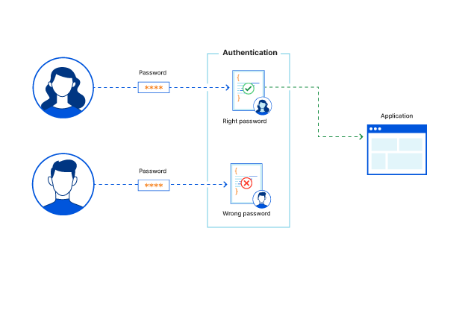
Access Management (authentication and authorization)
What is OAuth? | SAML vs. OAuth | Cloudflare
OAuth is a technical standard for authorizing users. It is a protocol for passing authorization from one service to another without sharing the actual user credentials, such as a username and password. With OAuth, a user can sign in on one platform and then be authorized to perform actions and view data on another platform.
See also OpenID What's the difference between OpenID and OAuth? - Stack Overflow
What is access control? | Authorization vs authentication | Cloudflare
What is authentication? | Cloudflare
What is SSO? | How single sign-on works | Cloudflare
What is SAML? | How SAML authentication works | Cloudflare

