Slide 1
Signals
Event -Driven Programming
Events
Event handlers
Example from Java swing: event listener, event handler
Signal programming
Signals
Signal handlers
The content for signals are copied from https://github.com/angrave/SystemProgramming/wiki

Slide 2
Event Driven Programming
Imperative or Procedural programming: code is executed by procedural order
EDP: Code is executed upon the activation of events

Slide 3
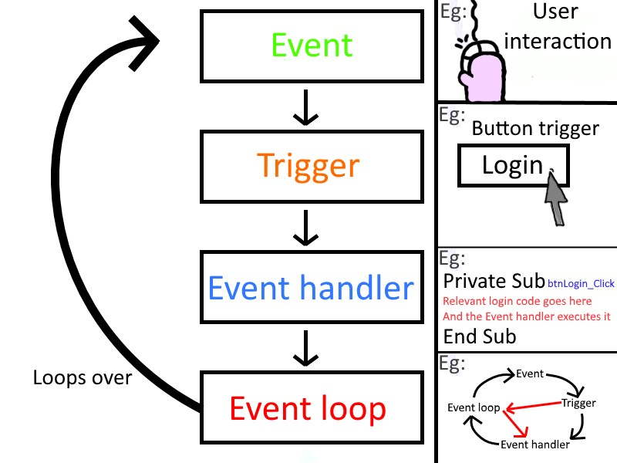
https://textbooks.cs.ksu.edu/cc410/ii-gui/13-event-driven-programming/index.html

Slide 4
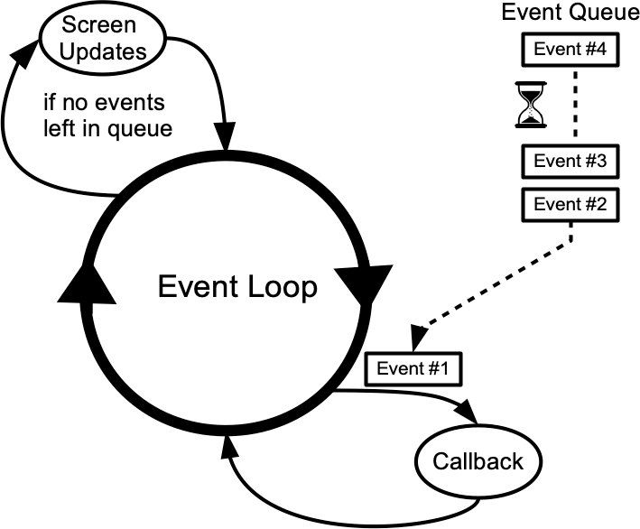
Java swing example
Bind an event to a function: Event handler (in java terminology listener)
Event loop: Runs within a GUI thread and listens for events generated by a user
https://textbooks.cs.ksu.edu/cc410/ii-gui/13-event-driven-programming/index.html

Slide 5
Example event handlers
import java.awt.event.*;
import javax.swing.*;
class MyEventHandler1 implements ActionListener{
@Override
//This is event handler-1
public void actionPerformed(ActionEvent e){
JButton b = (JButton)e.getSource();
b.setText("A Click Event");
}
}
import java.awt.event.*;
class MyEventHandler2 implements ActionListener{
@Override
//This is event handler-2
public void actionPerformed(ActionEvent e){
System.out.println("This is second handler for click event: ");
}
}

Slide 6
Both handlers are called when click-event occurs on button
import javax.swing.*;
class EventGenerator {
public static void main(String[] args){
JFrame frame = new JFrame();
JButton button = new JButton("Hi");
MyEventHandler1 handler1 = new MyEventHandler1();
MyEventHandler2 handler2 = new MyEventHandler2();
button.addActionListener(handler1);
button.addActionListener(handler2);
frame.add(button);
frame.setSize( 150, 100 );
frame.setVisible(true);
}
}

Slide 7
Signals are very similar to EDP
Standardized messages sent to a running process
Limited form of IPC

Slide 8
a bit of terminology.
A signal disposition is a per-process attribute that determines how a signal is handled after it is delivered.
Think of it as a table of signal-action pairs.
The full discussion is in the http://man7.org/linux/man-pages/man7/signal.7.html. The actions are
TERM, terminates the process
IGN, ignore
CORE, generate a core dump
STOP, stops a process
CONT, continues a process
Execute a custom function

Slide 9
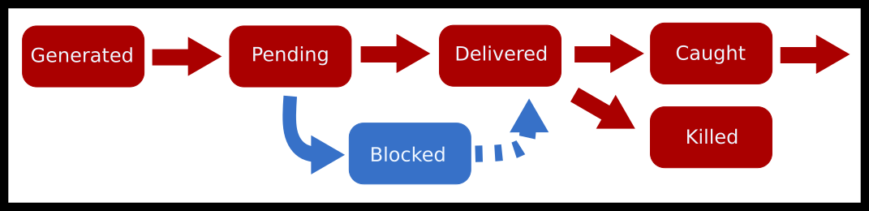
Flow chart

Slide 10
Signals can be generated in multiple ways.
The system can send an event.
For example, if a process accesses a page that it isn’t supposed to, the hardware generates an interrupt which gets intercepted by the kernel. The kernel finds the process that caused this and sends a software interrupt signal SIGSEGV.
There are other kernel events like a child being created or a process needs to be resumed.

Slide 11
Signals can be generated in multiple ways.
The user can send a signal.
For example, you are at the terminal, and you press CTRL-C.
One can also use the built-in kill to send any signal.
#include <unistd.h>
#include <stdio.h>
int main() {
printf("My pid is %d\n", getpid() );
int i = 60;
while(--i) {
write(1, ".",1);
sleep(1);
}
write(1, "Done!",5);
return 0;
}
$ ./program &
My pid is 403
...
$ kill -SIGSTOP 403
$ kill -SIGCONT 403
...

Slide 12
In c program
kill(child, SIGUSR1); // Send a user-defined signal
kill(child, SIGSTOP); // Stop the child process (the child cannot prevent this)
kill(child, SIGTERM); // Terminate the child process (the child can prevent this)
kill(child, SIGINT); // The equivalent to CTRL-C (by default closes the process)

Slide 13
Another command killall works the exact same way but instead of looking up by PID, it tries to match the name of the process. ps is an important utility that can help you find the pid of a process.
# First let's use ps and grep to find the process we want to send a signal to
$ ps au | grep myprogram
angrave 4409 0.0 0.0 2434892 512 s004 R+ 2:42PM 0:00.00 myprogram 1 2 3
#Send SIGINT signal to process 4409 (The equivalent of `CTRL-C`)
$ kill -SIGINT 4409
# Send SIGKILL (terminate the process)
$ kill -SIGKILL 4409
$ kill -9 4409
# Use kill all instead to kill a process by executable name
$ killall -l firefox

Slide 14
To send a signal to the running process, use raise or kill with getpid().
raise(int sig); // Send a signal to myself!
kill(getpid(), int sig); // Same as above

Slide 15
Summary
Processes can send messages to each by using signals.
This should be only used in low-stakes communication of events between processes.
If you are relying on signals to be the driver in your program, you should rethink your application design.
There are many drawbacks to using POSIX/Real-Time signals for asynchronous communication.
The best way to handle interprocess communication is to use, well, interprocess communication methods specifically designed for your task at hand.

Slide 16
Handling Signals(changing default behaviours)
There are strict limitations on the executable code inside a signal handler.
Most library and system calls are async-signal-unsafe, meaning they may not be used inside a signal handler because they are not re-entrant*
int func(const char *str) {
static char buffer[200];
strncpy(buffer, str, 199);
# Here is where we get paused
printf("%s\n", buffer)
}
*Thus, a signal handler cannot, in general, call standard library functions. Footnote 188 of §7.1.4 in ISO/IEC 9899:201x - Programming languages

Slide 17
Handling Signals
We execute (func(“Hello”))
The string gets copied over to the buffer completely (strcmp(buffer, “Hello”) == 0)
A signal is delivered and the function state freezes, we also stop accepting any new signals until after the handler (we do this for convenience)
We execute func("World")
Now (strcmp(buffer, “World”) == 0) and the buffer is printed out “World”.
We resume the interrupted function and now print out the buffer once again “World” instead of what the function call originally intended “Hello”
int func(const char *str) {
static char buffer[200];
strncpy(buffer, str, 199);
# Here is where we get paused
printf("%s\n", buffer)
}
Guaranteeing that your functions are signal handler safe can’t be solved by removing shared buffers.
Calling printf, which uses malloc as part of the signal handler, is unsafe and will result in undefined behavior.

Slide 18
A safe way to avoid this behavior is to set a variable and let the program resume operating.
The design pattern also helps us in designing programs that can receive signals twice and operate correctly.
int pleaseStop ; // See notes on why "volatile sig_atomic_t" is better
void handle_sigint(int signal) {
pleaseStop = 1;
}
int main() {
signal(SIGINT, handle_sigint);
pleaseStop = 0;
while (!pleaseStop) {
/* application logic here */
}
/* clean up code here */
}
Here, we need to provide a hint to the compiler and the CPU core that will execute the main() loop. We need to prevent compiler optimization.
volatile sig_atomic_t pleaseStop;

Slide 19
Sigaction (changes actions for a specific signal)
int sigaction(int signum, const struct sigaction *act, struct sigaction *oldact);
sa_handler specifies the action to be associated with signum:
The actions are:
* SIG_DFL for the default action.
* SIG_IGN to ignore this signal.
* A pointer to a signal handling function. This function
receives the signal number as its only argument.
struct sigaction {
void (*sa_handler)(int);
void (*sa_sigaction)(int, siginfo_t *, void *);
sigset_t sa_mask;
int sa_flags;
};
From man signal:q
WARNING: the behavior of signal() varies across UNIX versions, and has also varied historically across different versions of Linux. Avoid its use: use sigaction(2) instead.

Slide 20
signal(SIGALRM, myhandler);
The equivalent sigaction code is:
struct sigaction sa;
sa.sa_handler = myhandler;
sigemptyset(&sa.sa_mask);
sa.sa_flags = 0;
sigaction(SIGALRM, &sa, NULL)

Slide 21
we typically may also set the mask and the flags field.
The mask is a temporary signal mask used during the signal handler execution.
If the thread serving the signal is interrupted in the middle of a system call, the SA_RESTART flag will automatically restart some system calls that otherwise would have returned early with EINTR error.
The latter means we can simplify the rest of code somewhat because a restart loop may no longer be required.
sigfillset(&sa.sa_mask);
sa.sa_flags = SA_RESTART; /* Restart system calls if interrupted by handler */

Slide 22
Blocking Signals
A signal may be blocked, which means that it will not be delivered until it is later unblocked.
Each thread in a process has an independent signal mask, which indicates the set of signals that the thread is currently blocking.
A thread can manipulate its signal mask using pthread_sigmask().
In a single-threaded application, sigprocmask() can be used to manipulate the signal mask.
The behavior of sigprocmask in a multi-threaded process is “unspecified”!
A child created via fork inherits a copy of its parent's signal mask; the signal mask is preserved across execve.

Slide 23
Functions for manipulation of POSIX signal sets
sigset_t data type is used to represent a signal set. Returns 0 on success,
int sigemptyset (sigset_t *set);
initializes to empty (all of the defined signals are excluded).
int sigfillset (sigset_t *set);
initializes to full (include all of the defined signals.)
sigfillset(&set); // all signals
int sigaddset (sigset_t *set, int signum);
adds the signal signum to the signal set set.
All sigaddset does is modify set; it does not block or unblock any signals.
sigaddset(&set, SIGINT); // should first initialize with sig empty of fillset!
int sigdelset (sigset_t *set, int signum);
removes the signal signum from the signal set set.
int sigismember (const sigset_t *set, int signum)
tests what signals are in a signal set:
Returns 1 if it is a member.

Slide 24
int sigprocmask (int how,
const sigset_t *restrict set,
sigset_t *restrict oldset);
The how argument determines how the signal mask is changed, and must be one of the following values:
SIG_BLOCK
Block the signals in set—add them to the existing mask. In other words, the new mask is the union of the existing mask and set.
SIG_UNBLOCK
Unblock the signals in set—remove them from the existing mask.
SIG_SETMASK
Use set for the mask; ignore the previous value of the mask.
You can’t block the SIGKILL and SIGSTOP signals, but if the signal set includes these, sigprocmask just ignores them instead of returning an error status.

Slide 25
sigset_t set, oldset;
sigaddset(&set, SIGINT); // Ooops!
sigprocmask(SIG_SETMASK, &set, &oldset)
Correct code initializes the set to be all on or all off. For example,
sigfillset(&set); // all signals
sigprocmask(SIG_SETMASK, &set, NULL); // Block all the signals which can be blocked
sigemptyset(&set); // no signals
sigprocmask(SIG_SETMASK, &set, NULL); // set the mask to be empty again

Slide 26
#include <stdio.h> #include <stdlib.h>
#include <signal.h> #include <unistd.h>
int main(void){
sigset_t set, oldset, pendingset;
sigemptyset(&set);
sigaddset(&set, SIGINT);
sigprocmask(SIG_BLOCK, &set, &oldset);
printf("Old set was %8.8ld.\n", oldset);
sigpending(&pendingset);
printf("Pending set is %8.8ld.\n", pendingset);
kill(getpid(), SIGINT);
sigpending(&pendingset);
printf("Pending set is %8.8ld.\n", pendingset);
sigprocmask(SIG_UNBLOCK, &set, &oldset);
/* The program terminates with a SIGINT */
return (EXIT_SUCCESS);
}

Slide 27
Signals in Child Processes and Threads
Blocking signals is similar in multi-threaded programs to single-threaded programs with the following translation.
Use pthread_sigmask instead of sigprocmask
Block a signal in all threads to prevent its asynchronous delivery
pthread_sigmask(...); // set my mask to block delivery of some signals
pthread_create(...); // new thread will start with a copy of the same mask

Slide 28
The easiest method to ensure a signal is blocked in all threads is to set the signal mask in the main thread before new threads are created.
sigemptyset(&set);
sigaddset(&set, SIGQUIT);
sigaddset(&set, SIGINT);
pthread_sigmask(SIG_BLOCK, &set, NULL);
// this thread and the new thread will block SIGQUIT and SIGINT
pthread_create(&thread_id, NULL, myfunc, funcparam);

Slide 29
Just as we saw with sigprocmask, pthread_sigmask includes a ‘how’ parameter that defines how the signal set is to be used:
pthread_sigmask(SIG_SETMASK, &set, NULL) - replace the thread's mask with given signal set
pthread_sigmask(SIG_BLOCK, &set, NULL) - add the signal set to the thread's mask
pthread_sigmask(SIG_UNBLOCK, &set, NULL) - remove the signal set from the thread's mask

Slide 30
Even though programs from the outside can’t send signals to specific threads, you can do that internally with pthread_kill(pthread_t thread, int sig). In the example below, the newly created thread executing func will be interrupted by SIGINT
pthread_create(&tid, NULL, func, args);
pthread_kill(tid, SIGINT);
pthread_kill(pthread_self(), SIGKILL); // send SIGKILL to myself
As a word of warning pthread_kill(threadid, SIGKILL) will kill the entire process.Though individual threads can set a signal mask, the signal disposition is per-process not per-thread. This means sigaction can be called from any thread because you will be setting a signal handler for all threads in the process.

