Slide 1
Based on
https://github.com/angrave/SystemProgramming/wiki
Other resources:
Macro directives
https://gcc.gnu.org/onlinedocs/cpp/Index-of-Directives.html#Index-of-Directives
struct packing:
http://www.catb.org/esr/structure-packing/
GDB guide:
https://darkdust.net/files/GDB%20Cheat%20Sheet.pdf
Linux terminal intro-guide:
https://ubuntu.com/tutorials/command-line-for-beginners#1-overview
Content
Review of C programming
Macros,
Pointers, function pointers
and some common bugs
C Memory Model
System calls
Kernel mode, user mode
Interrupts, exceptions
Error handling
Debugging: GDB

Slide 2
Intro to C
$ gcc -E main.c > main.i
-E stops compiler after running preprocessor
$ gcc -S main.c
-S stops compiler after assembly file generated
Assembler uses “.s” file to generate an object file
$ gcc -c main.c
Generates object file main.o
main.o has undefined symbols like printf we don’t know where it is placed
$ nm main.o
$ gcc -o main main.c
Generates executable main
printf does not have a value yet until the program is loaded
$ nm main.o
$ cat main.c
#include <stdio.h>
int main() {
printf("Hello World!\n");
return 0;
}
$ gcc main.c -o main
$ ./main
Hello World!
$

Slide 3
Preprocessor
Preprocessing is a copy and paste operation that the compiler performs before actually compiling the program.
trying to redefine the internals of the C language with a preprocessor may be impossible.
they can’t be infinitely - there is a bounded depth where they need to stop.
/* Before preprocessing */
#define MAX_LENGTH 10
char buffer[MAX_LENGTH]
/* After preprocessing */
char buffer[10]

Slide 4
Macros- object like macros
An object-like macro is a simple identifier which will be replaced by a code fragment.
#define NUMBERS 1, \
2, \
3
int x[] = { NUMBERS };
/*after preprocessing
→ int x[] = { 1, 2, 3 };
*/
#define TABLESIZE BUFSIZE
#define BUFSIZE 1024
/*
TABLESIZE
→ BUFSIZE
→ 1024
*/
#define BUFSIZE 1020
#define TABLESIZE BUFSIZE
#undef BUFSIZE
#define BUFSIZE 37
https://gcc.gnu.org/onlinedocs/cpp/Macros.html#Macros

Slide 5
Macros- function like macros
A function-like macros looks like a function call, but a macro.
#define lang_init() c_init()
lang_init()
/*after preprocessing
→ c_init()
*/
#define lang_init () c_init()
lang_init()
/*
→ () c_init()()
*/
https://gcc.gnu.org/onlinedocs/cpp/Macros.html#Macros

Slide 6
Macros with arguments
#define foo(x) x, "x"
foo(bar)
/*
→ bar, "x"
*/
#define min(X, Y) ((X) < (Y) ? (X) : (Y))
x = min(a, b);
/* → x = ((a) < (b) ? (a) : (b));*/
y = min(1, 2);
/* → y = ((1) < (2) ? (1) : (2)); */
z = min(a + 28, *p);
/* → z = ((a + 28) < (*p) ? (a + 28) : (*p)); */
https://gcc.gnu.org/onlinedocs/cpp/Macros.html#Macros

Slide 7
Macro pitfalls-misnesting
#define twice(x) (2*(x))
#define call_with_1(x) x(1)
call_with_1 (twice)
/*after preprocessing
→ twice(1)
→ (2*(1))
*/
//the use of unbalanced open parentheses in a macro body is just confusing, and should be avoided.
#define strange(file) fprintf (file, "%s %d",
…
strange(stderr) p, 35)
/*→ fprintf (stderr, "%s %d", p, 35)
*/
https://gcc.gnu.org/onlinedocs/cpp/Macros.html#Macros

Slide 8
Macro pitfalls-Operator Precedence Problems
/*What is the problem here?*/
#define min(a,b) a < b ? a : b
int main() {
int x = 4;
if(min(x++, 5)) printf("%d is six", x);
int r = 10 + min(99, 100);
printf("r is %d", r);
return 0;
}
#define ceil_div(x, y) (x + y - 1) / y
a = ceil_div (b & c, sizeof (int));
/*after preprocessing
→ a = (b & c + sizeof (int) - 1) / sizeof (int);
*/
Solution: each occurrence of a macro argument name should have parentheses around it.
https://gcc.gnu.org/onlinedocs/cpp/Macros.html#Macros

Slide 9
Macro pitfalls-duplication side effects
/*What is the problem here?*/
#define min(X, Y) ((X) < (Y) ? (X) : (Y))
int main() {
int next = min (x + y, foo (z));
/*after preprocessing
→ next = ((x + y) < (foo (z)) ? (x + y) : (foo (z)));
the expression foo (z) has been substituted twice into the macro expansion.
*/
return 0;
}
https://gcc.gnu.org/onlinedocs/cpp/Macros.html#Macros

Slide 10
Macro pitfalls-swallowing semicolon
/*solution*/
#define SKIP_SPACES(p, limit) \
do { char *lim = (limit); \
while (p < lim) { \
if (*p++ != ' ') { \
p--; break; }}} \
while (0)
SKIP_SPACES (p, lim);
/*after preprocessing
expands into
do {…} while (0);
*/
#define SKIP_SPACES(p, limit) \
{ char *lim = (limit); \
while (p < lim) { \
if (*p++ != ' ') { \
p--; break; }}}
SKIP_SPACES (p, lim);
/* “;” causes problems before else */
if (*p != 0)
SKIP_SPACES (p, lim);
else …
https://gcc.gnu.org/onlinedocs/cpp/Macros.html#Macros

Slide 11
Macro conditionals
int main() {
#ifdef __GNUC__
return 1;
#else
return 0;
#endif
}
$ gcc -E main.c >main.i
…
int main() {
return 1;
}
In different compiler you would get return 0

Slide 12
C keywords
restrict
return
signed, unsigned
sizeof -an operator
static
struct, union, typedef
switch case
extern, break, const, continue
do{} while{};
enum
for (initialization; check; update) {}
if{} else{}
inline
goto (do not use in your programs)

Slide 13
C operators
++, --,
sizeof,
arithmetic operators {+,-,*,%,/},
>>/<<,
<=/>=,
==/!=, &&, ||,
!, &, |, ~,
?:,
a,b
In order of precedence
[],
->,
.,
+/-a,
*a,
&a,

Slide 14
C Data types and Operators
Char, short (short int), int, long (long int), float, double
Fixed width integers
[u]intwidth_t
char a; /*1-byte data*/
short a; /*at least 2 bytes*/
int a; /*at least 2/4 bytes*/
long a; /*at least 4/8 bytes*/
float a; /*IEEE-764 single precision floating point: 4 bytes*/
double a; /*IEEE-764 single precision floating point: 8 bytes*/

Slide 15
Shift operators
In right shift;
If the operand on the left is signed, then the integer is sign-extended. This means that if the number has the sign bit set, then any shift right will introduce 1s on the left.
If the number does not have the sign bit set, any shift right will introduce zeros on the left.
If the operand is unsigned, zeros will be introduced on the left either way.
unsigned short uns = -127; // 1111111110000001
short sig = 1; // 0000000000000001
uns << 2; //1111111000000100
sig << 2; // 0000000000000100
uns >> 2; // 1111111111100000
sig >> 2; // 0000000000000000

Slide 16
Pointers
Declarations
Reading/writing with pointers
int *ptr1;
char *ptr2;
int* ptr3, ptr4; /* ptr4 is a regular int */
int *ptr3, *ptr4; /*both pointers*/
struct person *ptr;
*ptr = 0; /* Writes some memory.*/
int a = *ptr * 2 /*reads from memory*/

Slide 17
Pointer Arithmetic
char *ptr = "Hello"; /* ptr holds the memory location of ‘H’*/
ptr += 2; /* ptr now points to the first ‘l’*/
char *ptr = "ABCDEFGH";
int *bna = (int *) ptr;
bna +=1; /* Would cause iterate by one integer space (i.e 4 bytes on some systems) */
ptr = (char *) bna;
printf("%s", ptr);
/*
POSIX standards forbid arithmetic on void pointers!
*/

Slide 18
Void pointer
void *give_me_space = malloc(10);
char *string = give_me_space;
A pointer without a type.
Void pointers are used when either the datatype is unknown or when interfacing C code with other programming languages without APIs
POSIX standards forbid arithmetic on void pointers.

Slide 19
C strings
char* str = "constant"
the string "constant" is stored in the data section.
Depending on your architecture, it is read-only,
any attempt to modify the string will cause a SEGFAULT.
char str[] = "mutable"
This is put in the global scope or the function scope for the data segment or the stack respectively
With malloc’s space, you can change that string to be whatever they want.
Don’t forget ‘\0’ to terminate a string!!!

Slide 20
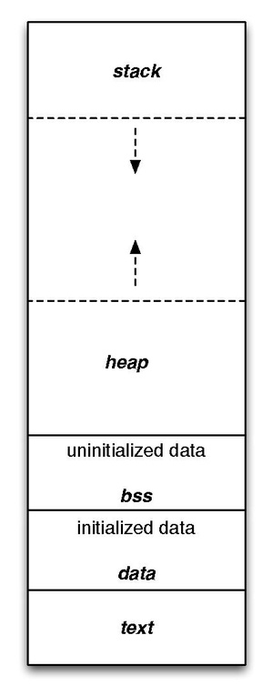
Program memory layout
stack:
a dynamically growing and shrinking segment containing stack frames.
One stack frame is allocated for each currently called function.
A frame stores the function’s local variables (so-called automatic variables), arguments, and return value.
Heap:
an area from which memory (for variables) can be dynamically allocated at run time.
The top end of the heap is called the program break.
text:
code segment, executable instructions
Data segment:
initialized global and static variables
Bss segment:
all global variables and static variables that are initialized to zero
or do not have explicit initialization in source code.
The whole segment is initialized to 0 at the start.

Slide 21
char arrays vs string constants
char array[] = "Hi!"; // array contains a mutable copy
strcpy(array, "OK");
char *ptr = "Can’t change me"; // ptr points to some immutable memory
strcpy(ptr, "Will not work");
char *str1 = "Bhuvy likes books";
char *str2 = "Bhuvy likes books";
/*two string may reside in the same memory*/
/*however, char arrays must reside in different locations*/
char arr1[] = "Bhuvy also likes to write";
char arr2[] = "Bhuvy also likes to write";

Slide 22
String arrays vs string constants
/*Common ways to initialize a string*/
#include <stdio.h>
int main() {
char *s0 = "abc";
char *s1 = "abc";
char s2[] = "abc";
char s3[]= "abc";
char s4[] = {'a', 'b', 'c', '\0'};
printf("%p, %s\n", s0, s0);
printf("%p, %s\n", s1, s1);
printf("%p, %s\n", s2, s2);
printf("%p, %s\n", s3, s3);
printf("%p, %s\n", s4, s4);
}
/* address and contents
0x563610d0f004, abc
0x563610d0f004, abc
0x7ffc82bc7d9c, abc
0x7ffc82bc7da0, abc
0x7ffc82bc7da4, abc

Slide 23
Constant pointer vs Pointer to constant
/*a constant pointer to int*/
int c = 15, d = 20;
int *const ptr2 = &c;
/*cannot change the pointer value*/
ptr2 = &d;
/*constant pointer to a constant*/
const int *const ptr3 = &a;
/*a constant variable*/
const int a = 5;
const int b = 10;
/*a pointer to a constant integer*/
const int* ptr;
ptr = &a;
*ptr = 10; /*cannot do*/
const tells the compiler that the variable cannot be written (is constant).
This will result in a compile-time error: This has no influence on the memory space where the variable is located. In Run-time it may change its value.

Slide 24
Pointers to functions
#include <stdio.h>
int intcmp(int *a, int *b){
return *a > *b;
}
int main(){
int x = 4, y = 5;
/*declaration*/
int (*comp)(void *, void *);
/*assignment with type casting*/
comp = (int (*)(void *, void *)) &intcmp;
/*function call*/
int z = (*comp)(&x, &y);
printf("%d\n", z);
return 0;
}
int (*comp) (void *, void*)
comp is a pointer to a function
The function should have two void* arguments
The function returns int
int *comp(void *, void*)/*WRONG*/
comp is a function
returning an int pointer
Pointers to functions are often used to implement polymorphism in “C”.

Slide 25
Structs and pointers
int main(){
pair obj;
pair zeros;
zeros.a1 = 0;
zeros.a2 = 0;
pair *ptr = &obj;
obj.a1 = 1;
obj.a2 = 2;
*ptr = zeros;
printf("a1: %d, a2: %d\n", ptr->a1, ptr->a2);
return 0;
}
#include <stdio.h>
typedef struct{
int a1;
int a2;
} pair;

Slide 26
Structs and pointers
#include <stdio.h>
typedef struct {
int a1;
int a2;
} pair;
int main() {
pair obj = {10, 15};
pair zeros = {0, 0};
obj = zeros;
pair *ptr = &zeros;
obj.a1 = 1;
obj.a2 = 2;
printf("a1: %d, a2: %d\n", ptr->a1, ptr->a2);
return 0;
}

Slide 27
#include <stdio.h>
typedef struct{
int a1;
int a2;
} pair;
int main(){
pair obj = {10, 15};
pair *ptr = &obj;
/*what is the value of ptr2????*/
pair *ptr2 = ptr + 1;
/*ptr2 is the next struct, since there is no next, it is invalid*/

Slide 28
C memory model
#include <stdio.h>
typedef struct{
int a1;
int a2;
} pair;
int main(){
pair obj = {10, 15};
int *ptr = (int*)&obj;
printf("a1: %d, a2: %d\n", *ptr, *(ptr+1));
return 0;
}
ptr:
&obj
obj:
10
15

Slide 29
C memory model
#include <stdio.h>
int main(){
struct contact{
char firstname[20];
char lastname[20];
unsigned int phone;
};
struct contact bhuvan;
printf(" %p\n %p\n %p\n %p\n",
&bhuvan,
&bhuvan.firstname,
&bhuvan.lastname,
&bhuvan.phone);
}
Offset of a variable is the starting address of the variable’s memory
In memory we expect
&bhuvan // 0x100
&bhuvan.firstname // 0x100 = 0x100+0x00
&bhuvan.lastname // 0x114 = 0x100+0x14
&bhuvan.phone // 0x128 = 0x100+0x28

Slide 30
C memory model: Alignment requirements
The Lost Art of Structure Packing

Slide 31
C memory model: Alignment requirements
On modern processors,
basic data types in memory is laid out in a way to make memory accesses faster.
the basic C datatypes on a vanilla ISA(instruction set architectures) doesn’t normally start at arbitrary byte addresses in memory.
These ISAs include Intel, ARM, and RISC-V
each type except char has an alignment requirement (self-aligned);
chars
can start on any byte address,
2-byte shorts
must start on an even address,
4-byte ints or floats
must start on an address divisible by 4,
8-byte longs or doubles
must start on an address divisible by 8.
Pointers
Based on word size
4-bytes for 32-bit or 8 bytes for 64 bit
Signed or unsigned
makes no difference.

Slide 32
C memory model: Padding
char *p;
char c;
int x;
char *p;
char c;
short x;
/* the 4-byte alignment requirement of x forces a gap in the layout;*/
char *p; /* 4 or 8 bytes */
char c; /* 1 byte */
char pad[3]; /* 3 bytes */
int x; /* 4 bytes */
/* the 4-byte alignment requirement of x forces a gap in the layout;*/
char *p; /* 4 or 8 bytes */
char c; /* 1 byte */
char pad[1]; /* 1 bytes */
short x; /* 2 bytes */

Slide 33
char c;
char *p;
int x;
what can we say about M and N?
N is zero, M depends on the alignment of c.
If the compiler happened to map c to the last byte of a machine word, the next byte (the first of p) would be the first byte of the next one and properly pointer-aligned. M would be zero.
/*the actual memory layout*/
char c;
char pad1[M];
char *p;
char pad2[N];
int x;

Slide 34
Structure alignment and packing
struct foo1 {
char *p;
char c;
long x;
};
a struct instance will have the alignment of its widest scalar member.
/*
x is 8-byte
struct foo1 will have 8 byte alignment*/
struct foo1 {
char *p; /* 8 bytes */
char c; /* 1 byte */
char pad[7]; /* 7 bytes */
long x; /* 8 bytes */
};

Slide 35
Structure alignment and packing
struct foo2 {
char c;
char *p;
long x;
};
Changing the order of the members will change the alignment
/*
x is 8-byte
struct foo2 will have 8 byte alignment*/
struct foo2 {
char c; /* 1 byte */
char pad[7]; /* 7 bytes */
char *p; /* 8 bytes */
long x; /* 8 bytes */
};

Slide 36
#include <stdio.h>
struct foo3 {
char *p; /* 8 bytes */
char c; /* 1 byte */
};
int main() {
struct foo3 singleton;
struct foo3 quad[4];
/*on 64 bit machine, ???*/
printf("%lu\n", sizeof(singleton));
printf("%lu\n", sizeof(quad));
return 0;
}
sizeof(struct foo3)
struct foo3 {
char *p; /* 8 bytes */
char c; /* 1 byte */
char pad[7];
};

Slide 37
More examples
sizeof(struct foo4)?
struct foo4 {
short s; /* 2 bytes */
char c; /* 1 byte */
char pad[1];
};
sizeof(struct foo5)?
char *p member in the inner struct forces the outer struct to be pointer-aligned as well as the inner.
struct foo5 {
char c; /* 1 byte*/
char pad1[7]; /* 7 bytes */
struct foo5_inner {
char *p; /* 8 bytes */
short x; /* 2 bytes */
char pad2[6]; /* 6 bytes */
} inner;
};
struct foo4 {
short s; /* 2 bytes */
char c; /* 1 byte */
};
struct foo5 {
char c;
struct foo5_inner {
char *p;
short x;
} inner;
};

Slide 38
Structure reordering
/*24 byte*/
struct foo10 {
char c; /* 1 byte */
char pad1[7]; /* 7 bytes */
struct foo10 *p; /* 8 bytes */
short x; /* 2 bytes */
char pad2[6]; /* 6 bytes */
};
/*16 byte*/
struct foo11 {
struct foo11 *p; /* 8 bytes */
short x; /* 2 bytes */
char c; /* 1 byte */
char pad[5]; /* 5 bytes */
};
struct foo10 {
char c;
struct foo10 *p;
short x;
};
struct foo11 {
struct foo11 *p;
short x;
char c;
};
In general, ordering structure fields by increasing size minimize padding.
C compilers don’t do this automatically

Slide 39
Since c11, compile time static_assert
#include <assert.h>
struct foo4 {
short s; /* 2 bytes */
char c; /* 1 byte */
};
static_assert(sizeof(struct foo4) == 4, "Check your assumptions");

Slide 40
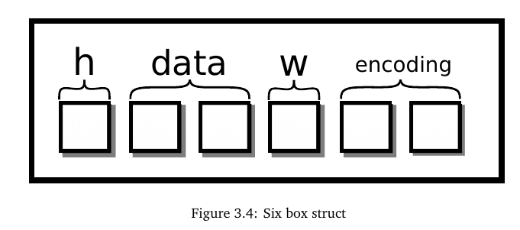
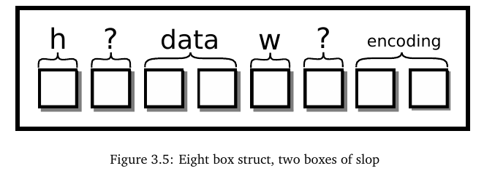
There are compiler options to enforce this
struct picture{
int height;
pixel** data;
int width;
char* encoding;
}
/*with struct packing*/
struct picture{
int height;
char slop1[4];
pixel** data;
int width;
char slop2[4];
char* encoding;
}

Slide 41
Gcc attributes
#include <stdio.h>
struct __attribute__((packed)) picture{
char height;
int** data;
int width;
char* encoding;
};
struct __attribute__((packed, aligned(4))) picture2{
char height;
int** data;
int width;
char* encoding;
};
int main(){
printf("sizes: %ld-%ld\n", sizeof(struct picture), sizeof(struct picture2));
}
packed means it will use the smallest possible space for struct
aligned(4) its address can be divided by 4
sizes: 21-24

Slide 42
Flexible array member
Requires 1-malloc instead of 2-malloc
#include <stdio.h>
#include <stdlib.h>
int main() {
struct array {
int size;
char data[];
};
struct array *var =
malloc(sizeof(*var) + 32 * sizeof(char));
var->size = 32;
var->data[0] = 5;
var->data[31] = 2;
printf("%lu-%lu\n", sizeof(struct array), sizeof(*var));
printf("size:%d \n data[31]: %d\n",
var->size, var->data[31]);
free(var);
return 0;
}
/*after c99 */
struct array {
int size;
int data[];
};
/*or before c99, a “struct-hack”
with zero-length array*/
struct array2 {
int size;
int data[0];
};

Slide 43
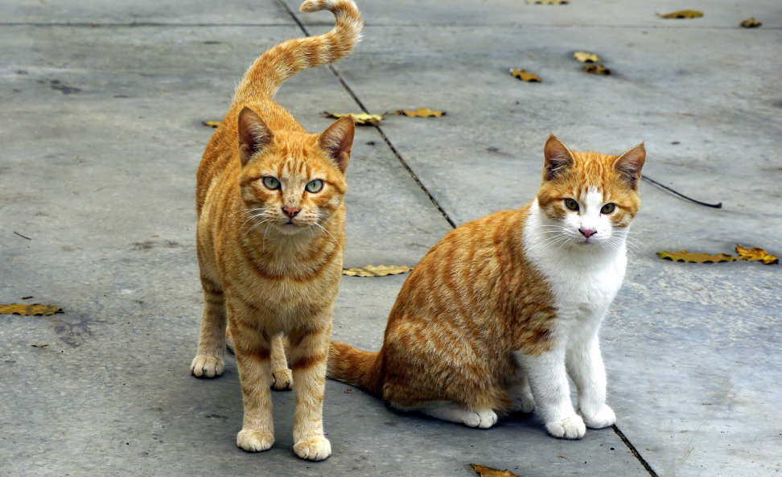
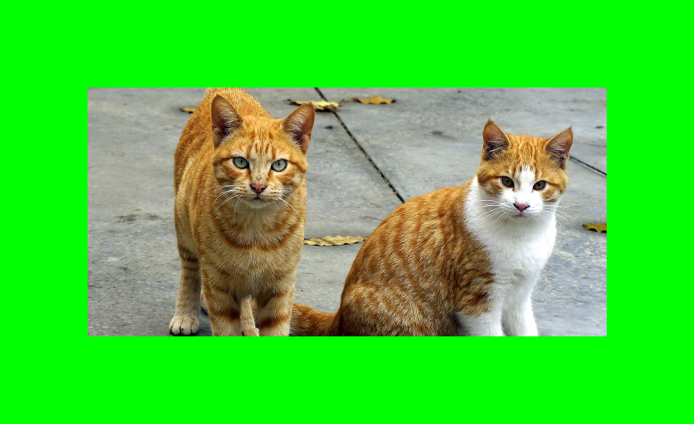
An Example
input
Put a frame around a given bitmap image
output

Slide 44
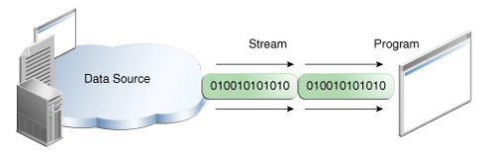
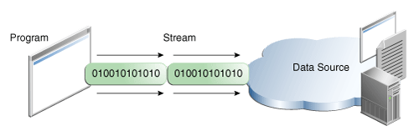
Streams
Images are taken from doc.oracle.com

Slide 45
Default streams: stdin, stdout, stderr
fopen(...)
fclose(...)
fcloseall()
To read
fputc(...), putc(...), puthcar(...), fgetc(...), getc(...), getchar(...), getc(...),
Binary read: fread()
To write
fputs(...),puts(...), fgets(...),
Binary write: fwrite()
Notes:
figures are taken from docs.oracle.com
‹#›

Slide 46
fscanf (...), fprintf (…)
setvbuf (...)
_IOFBF full buffer
_IOLBF line buffer
_IONBF without buffer
fflush(...)
12/6/16

Slide 47
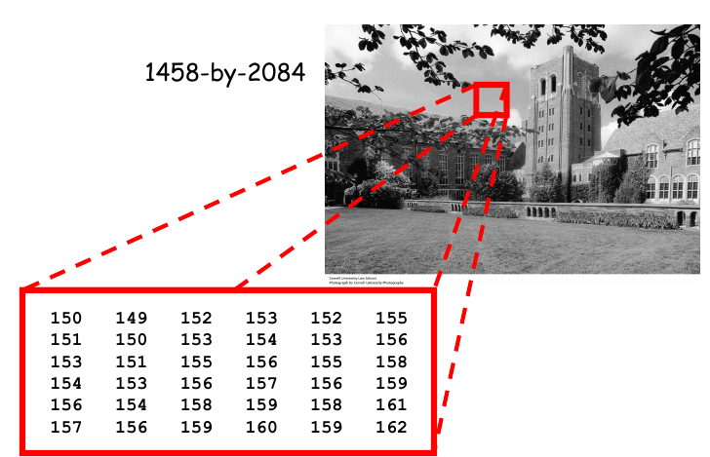
Grayscale image
8-bit
unsigned char
or
uint8_t

Slide 48
Color image
RedGreenBlue
Red: a value in [0-255]
Green: a value in [0-255]
Blue: a value in [0-255]

Slide 49
Hex dump
In Linux
$ hexdump filename
m.txt
badc
$ hexdump -c m.txt 0000000 b a d c \n 0000005

Slide 50
$ hexdump cute-animals32bit.bmp
0000000 4d42 68e2 0249 0000 0000 0046 0000 0038 0000010 0000 0f7d 0000 0973 0000 0001 0020 0003 0000020 0000 689c 0249 0b13 0000 0b13 0000 0000 0000030 0000 0000 0000 0000 ff00 0000 00ff ff00 0000040 0000 0000 0000 a500 a8b0 9b00 a0a8 9b00 0000050 9ea9 9100 96a1 9400 97a2 9d00 9ea8 9a00 0000060 97a2 9c00 97a2 a900 a4af a200 9faa 9d00 0000070 9ba5 a300 a2ac 9e00 9fa6 a500 a5ac a400 0000080 a3a8 a300 a1a7 9f00 a0a7 9e00 9da7 9e00 0000090 9ea5 9e00 9ca2 9b00 9ca1 9c00 9ea3 9f00 00000a0 a5ab a200 aab0 a000 abaf 9f00 a9ad a600 00000b0 acaf a000 a4a7 a500 a6a8 9b00 9c9e 9c00 00000c0 9fa1 9800 9b9d 8e00 9193 9200 9597 9200 00000d0 9398 9000 9196 9100 8f95 9100 8d93 9300 00000e0 8e92 9a00 9397 7c00 7677 8300 7d7e 8b00
***

Slide 51
Bitmap File Structure
Structure name | Optional | Size | Purpose | Comments
Bitmap file header | No | 14 bytes | To store general information about the bitmap image file | Not needed after the file is loaded in memory
DIB header | No | Fixed-size (7 different versions exist) | To store detailed information about the bitmap image and define the pixel format | Immediately follows the Bitmap file header
Extra bit masks | Yes | 3 or 4 DWORDs^{[5]} (12 or 16 bytes) | To define the pixel format | Present only in case the DIB header is the BITMAPINFOHEADER and the Compression Method member is set to either BI_BITFIELDS or BI_ALPHABITFIELDS
Color table | Semi-optional | Variable-size | To define colors used by the bitmap image data (Pixel array) | Mandatory for color depths ≤ 8 bits
Gap1 | Yes | Variable-size | Structure alignment | An artifact of the File offset to Pixel array in the Bitmap file header
Pixel array | No | Variable-size | To define the actual values of the pixels | The pixel format is defined by the DIB header or Extra bit masks. Each row in the Pixel array is padded to a multiple of 4 bytes in size
Gap2 | Yes | Variable-size | Structure alignment | An artifact of the ICC profile data offset field in the DIB header
ICC color profile | Yes | Variable-size | To define the color profile for color management | Can also contain a path to an external file containing the color profile. When loaded in memory as "non-packed DIB", it is located between the color table and Gap1.

Slide 52
BMP file header
Offset hex | Offset dec | Size | Purpose
00 | 0 | 2 bytes | The header field used to identify the BMP and DIB file is 0x42 0x4D in hexadecimal, same as BM in ASCII. The following entries are possible: BM Windows 3.1x, 95, NT, ... etc. BA OS/2 struct bitmap array CI OS/2 struct color icon CP OS/2 const color pointer IC OS/2 struct icon PT OS/2 pointer
02 | 2 | 4 bytes | The size of the BMP file in bytes
06 | 6 | 2 bytes | Reserved; actual value depends on the application that creates the image
08 | 8 | 2 bytes | Reserved; actual value depends on the application that creates the image
0A | 10 | 4 bytes | The offset, i.e. starting address, of the byte where the bitmap image data (pixel array) can be found.

Slide 53
DIP header
Offset (hex) | Offset (dec) | Size (bytes) | Windows BITMAPINFOHEADER^{[1]}
0E | 14 | 4 | the size of this header (40 bytes)
12 | 18 | 4 | the bitmap width in pixels (signed integer)
16 | 22 | 4 | the bitmap height in pixels (signed integer)
1A | 26 | 2 | the number of color planes (must be 1)
1C | 28 | 2 | the number of bits per pixel, which is the color depth of the image. Typical values are 1, 4, 8, 16, 24 and 32.
1E | 30 | 4 | the compression method being used. See the next table for a list of possible values
22 | 34 | 4 | the image size. This is the size of the raw bitmap data; a dummy 0 can be given for BI_RGB bitmaps.
26 | 38 | 4 | the horizontal resolution of the image. (pixel per metre, signed integer)
2A | 42 | 4 | the vertical resolution of the image. (pixel per metre, signed integer)
2E | 46 | 4 | the number of colors in the color palette, or 0 to default to 2^{n}
32 | 50 | 4 | the number of important colors used, or 0 when every color is important; generally ignored

Slide 54
char fname[] = "cute-animals32bit.bmp";
FILE *f = fopen(fname, "rb");
if (f == NULL){
perror("the file \" %s \" is not found!", fname);
return 0;
}
uint32_t offset, hsize, width, height;
uint16_t nplanes, nbits;
fseek(f, 10, SEEK_CUR);
fread(&offset, 4, 1, f);
fread(&hsize, 4, 1, f);
fread(&width, 4, 1, f);
fread(&height, 4, 1, f);
fread(&nplanes, 2, 1, f);
fread(&nbits, 2, 1, f);
printf("offset: %d, hsize: %d, \n"
"width: %d, height: %d, nplanes: %d, bits: %d",
offset, hsize, width, height, nplanes,
nbits);
fclose(f);

Slide 55
Copy content[0-offset] to another file
/*storage for the data upto offset of image data*/
uint8_t *fheader = (uint8_t *)malloc(sizeof(uint8_t)*offset);
/*rewind to the beginning*/
rewind(infile);
/*read and write the header upto offset*/
fread(fheader, 1, offset, infile);
fwrite(fheader, 1, offset, outfile);

Slide 56
User defined types
Struct
Bitfield
Enumeration
typedef

Slide 57
Put frame to new file
uint32_t apixel = 0; /*storage for a pixel data*/
uint32_t FRAME_COLOR = 255<<1 | 255<<16 |255<<8; /*a-r-g-b-0*/
rewind(infile);
fseek(infile,offset,SEEK_CUR);/*go to image data*/
for(int i = height; i > 0; i--){
for(int j = 0; j < width; j++){
/*read a pixel (4byte)*/
fread(&apixel, 4, 1, infile);
/*write the pixel to outfile */
if(j < 500 || i < 500 || i > height-500 || j> width-500){
fwrite(&FRAME_COLOR, 4, 1, outfile);
}else{
fwrite(&apixel,4,1, outfile);
}
}
}
BGRX, the storage in bmp file
https://en.wikipedia.org/wiki/BMP_file_format#Pixel_storage

Slide 58
Struct for 32-bit pixel data
Image data is little endian!
Rgba in reverse order
struct pixel{
uint8_t b;
uint8_t g;
uint8_t r;
uint8_t a;
} apixel;
struct pixel{
unsigned char b;
unsigned char g;
unsigned char r;
unsigned char a;
} apixel;

Slide 59
Bit fields
You cannot get the address of bitfields!
&apixel.b
Their order may change
Be careful whether the machine is little or big endian!
struct pixel{
unsigned int b:8;
unsigned int g:8;
unsigned int r:8;
unsigned int a:8;
} apixel;

Slide 60
Another example
struct page{
unsigned int pt_pres: 1; /* page is present? */
unsigned int pt_write : 1; /* page is writable? */
unsigned int pt_user: 1; /* is use level protection? */
unsigned int pt_pwt: 1; /* write through for this page? */
unsigned int pt_pcd: 1; /* cache disable for this page? */
unsigned int pt_acc: 1; /* page was accessed? */
unsigned int pt_dirty : 1; /* page was written? */
unsigned int pt_mbz: 1; /* must be zero */
unsigned int pt_global: 1; /* should be zero in 586 */
unsigned int pt_avail : 3; /* for programmer's use */
unsigned int pt_base: 20; /* location of page? */
} pt_t;

Slide 61
Example use
union page {
uint32_t all;
struct {
unsigned int pt_pres : 1; /* page is present? */
unsigned int pt_write : 1; /* page is writable? */
unsigned int pt_user : 1; /* is use level protection? */
unsigned int pt_pwt : 1; /* write through for this page? */
unsigned int pt_pcd : 1; /* cache disable for this page? */
unsigned int pt_acc : 1; /* page was accessed? */
unsigned int pt_dirty : 1; /* page was written? */
unsigned int pt_mbz : 1; /* must be zero */
unsigned int pt_global : 1; /* should be zero in 586 */
unsigned int pt_avail : 3; /* for programmer's use */
unsigned int pt_base : 20; /* location of page? */
} __attribute__((packed)) page;
} __attribute__((packed)) pt_t;
pt_t.all = 5; // try 5 << 9;
printf("%u-%u-%u-%u \n", pt_t.page.pt_pres, pt_t.page.pt_write,
pt_t.page.pt_user, pt_t.page.pt_avail);
Most machines are little endian.

Slide 62
typedef union {
uint32_t pixel;
struct {
uint8_t b;
uint8_t g;
uint8_t r;
uint8_t a; /* a or x in argb, xrgb */
}__attribute__((packed));
} Pixel;
/*similar to this*/
char pixel[] = {0,0,0,0}; //{b,g,r,a}
Pixel p;
p.pixel = 0x12345678;
/* integers in little endian: p.b = 78, p.g = 56, p.r = 34, p.a = 12 */

Slide 63
uint32_t FRAMECOLOR = 0 << 24 | 255 << 16 | 0 << 8 | 0; /*a-r-g-b*/
#define FRAMESIZE 50
Pixel p; /*storage for a pixel data*/
p.pixel = 0;
for (int i = height - 1; i >= 0; i--) {
for (int j = 0; j < width; j++) {
fread(&p.pixel, 4, 1, infile);
/*write the pixel to outfile */
if (j < FRAMESIZE || i < FRAMESIZE || i > height - FRAMESIZE ||
j > width - FRAMESIZE) {
fwrite(&FRAMECOLOR, 4, 1, outfile);
} else {
fwrite(&p.b, 1, 1, outfile);
fwrite(&p.g, 1, 1, outfile);
fwrite(&p.r, 1, 1, outfile);
fwrite(&p.a, 1, 1, outfile);
}
}
}

Slide 64
C functions and System calls

Slide 65
Common C functions
POSIX mantra; “Everything is a file”
Everything is a file descriptor
an integer.
int file_fd = open(...);
int network_fd = socket(...);
int kernel_fd = epoll_create1(...);
These are all references to the kernel’s file descriptor table (a table of objects).
File descriptors are simply pointers to these objects.
Operations on these objects
open, close, allocation, deallocation
are done through system calls.
The program interacts with these objects using the API specified through system calls and library functions.

Slide 66
System calls
A system call is a request made by an active process (through traps or software interrupts) for a service performed by the kernel.
Examples:
input/output (i.e., any movement of information to or from the combination of the CPU and main memory)
creation of a new process.
And many more https://man7.org/linux/man-pages/man2/syscalls.2.html
User processes
cannot perform privileged operations
request OS to do so on their behalf by issuing system calls

Slide 67
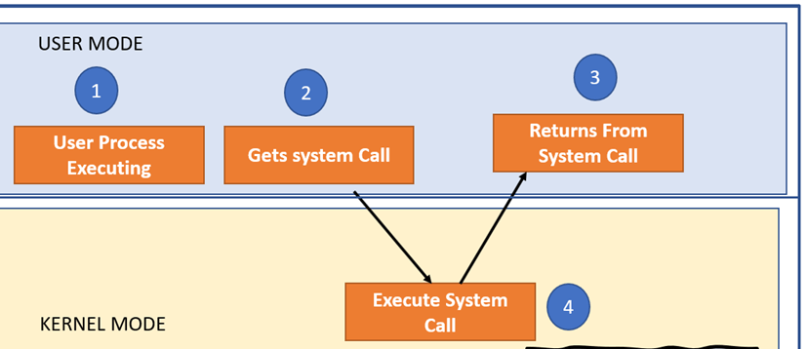
Why do we need a system call?
(Privileged mode)
https://www.guru99.com/system-call-operating-system.html#2

Slide 68
How do we switch(transition) to kernel mode?
Arch/ABI Instruction System Ret Ret Error Notes
call # val val2
───────────────────────────────────────────────────────────────────
alpha callsys v0 v0 a4 a3 1, 6
arc trap0 r8 r0 - -
arm/OABI swi NR - r0 - - 2
arm/EABI swi 0x0 r7 r0 r1 -
arm64 svc #0 w8 x0 x1 -
blackfin excpt 0x0 P0 R0 - -
i386 int $0x80 eax eax edx -
ia64 break 0x100000 r15 r8 r9 r10 1, 6
m68k trap #0 d0 d0 - -
microblaze brki r14,8 r12 r3 - -
mips syscall v0 v0 v1 a3 1, 6
nios2 trap r2 r2 - r7
…
x86-64 syscall rax rax rdx - 5
x32 syscall rax rax rdx - 5
xtensa syscall a2 a2 - -
https://man7.org/linux/man-pages/man2/syscall.2.html

Slide 69
#include <unistd.h>
int main(int argc, char *argv[]){
write(1, "Hello World\n", 12); /* write "Hello World" to stdout */
_exit(0); /* exit with error code 0 (no error) */
}
x86-32 equivalent assembly code
_start:
movl $4, %eax ; use the `write` [interrupt-flavor] system call
movl $1, %ebx ; write to stdout
movl $msg, %ecx ; use string "Hello World"
movl $12, %edx ; write 12 characters
int $0x80 ; make system call
movl $1, %eax ; use the `_exit` [interrupt-flavor] system call
movl $0, %ebx ; error code 0
int $0x80 ; make system call
https://en.wikibooks.org/wiki/X86_Assembly/Interfacing_with_Linux

Slide 70
#include <unistd.h>
int main(int argc, char *argv[]){
write(1, "Hello World\n", 12); /* write "Hello World" to stdout */
_exit(0); /* exit with error code 0 (no error) */
}
x86-64 equivalent assembly code
_start:
movq $1, %rax ; use the `write` [fast] syscall
movq $1, %rdi ; write to stdout
movq $msg, %rsi ; use string "Hello World"
movq $12, %rdx ; write 12 characters
syscall ; make syscall
movq $60, %rax ; use the `_exit` [fast] syscall
movq $0, %rdi ; error code 0
syscall ; make syscall
https://en.wikibooks.org/wiki/X86_Assembly/Interfacing_with_Linux

Slide 71
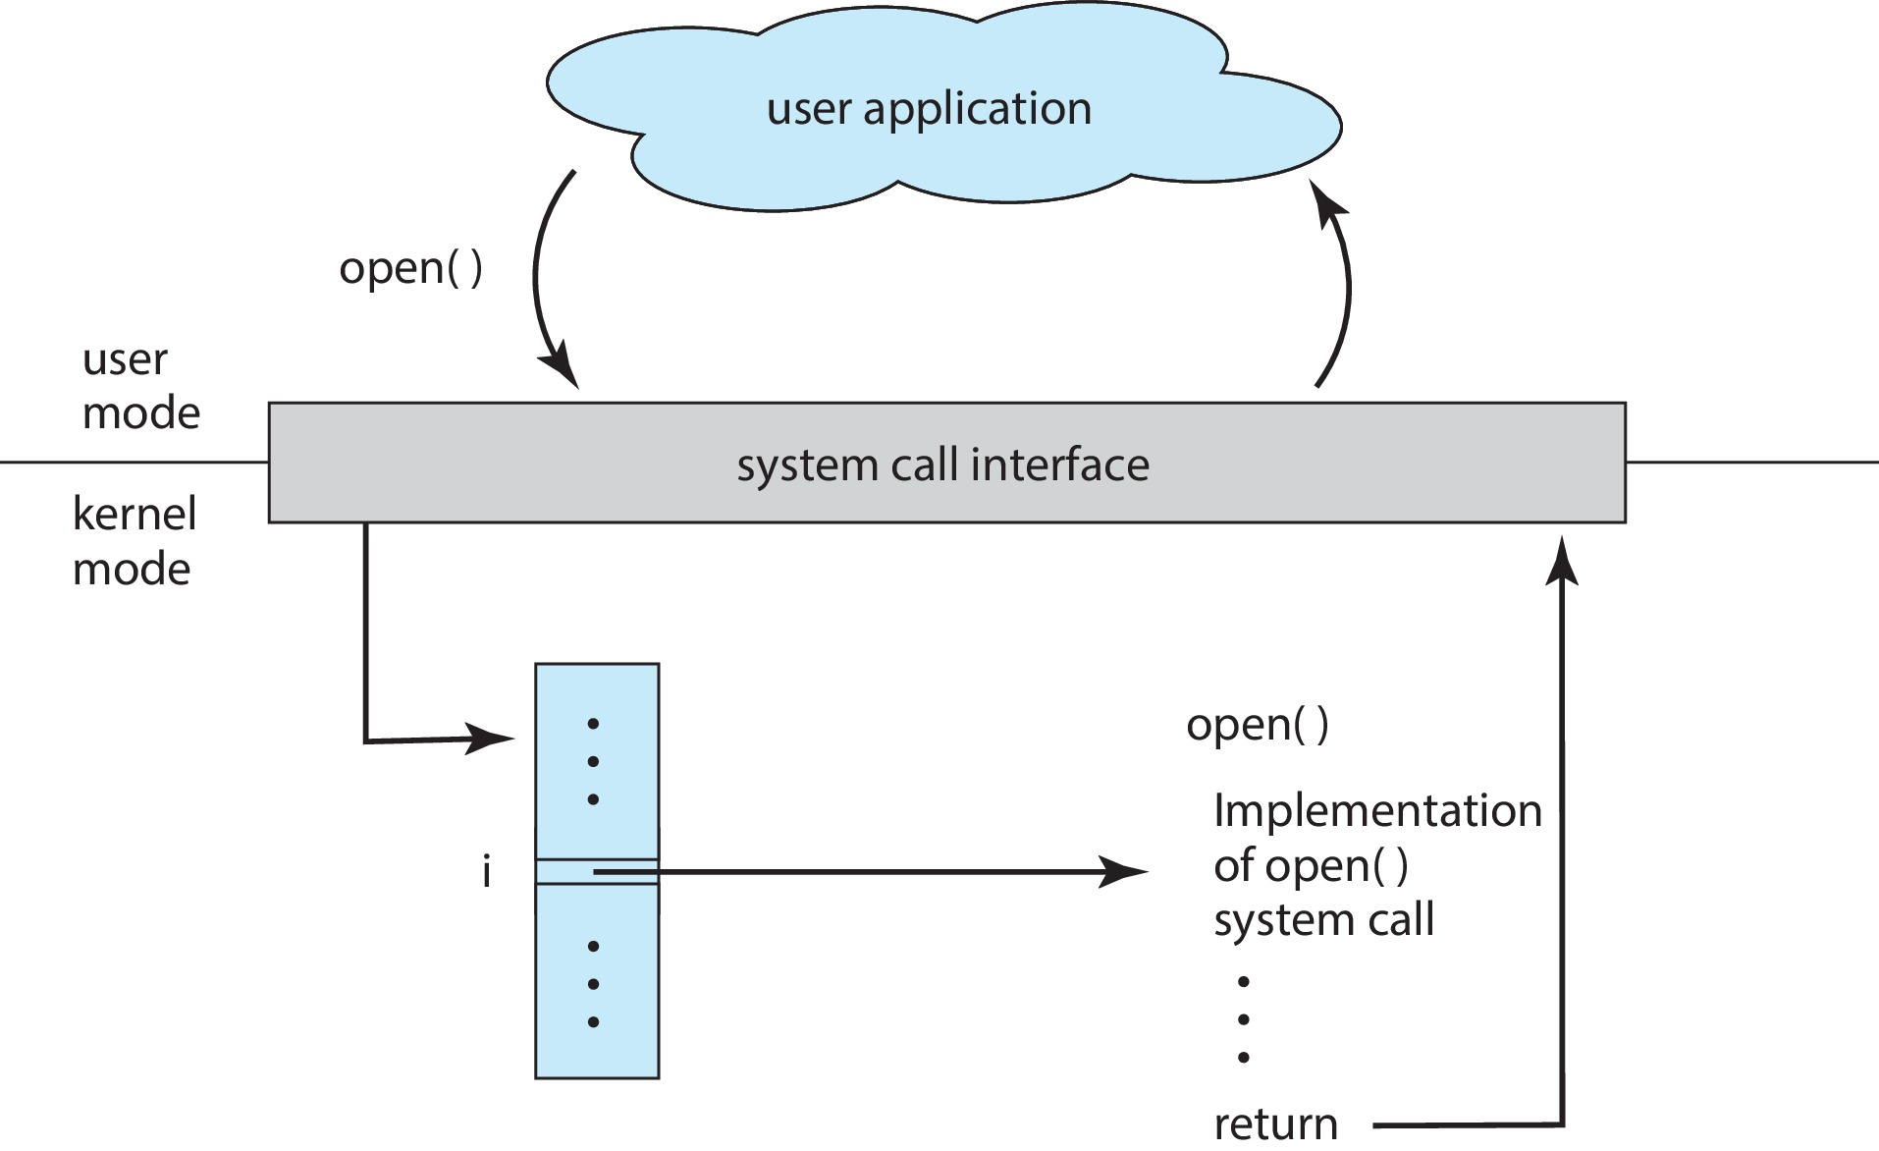
API – System Call – OS Relationship
Operating System Concepts Tenth Edition by Avi Silberschatz, Peter Baer, Galvin Greg Gagne
Notes:
‹#›

Slide 72
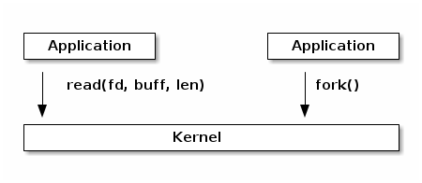
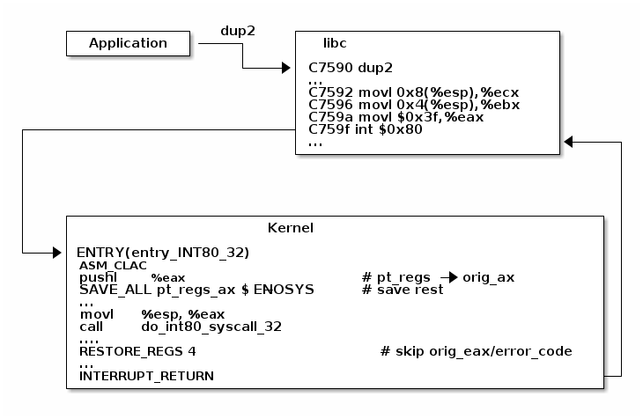
Example dup2() on x86
System calls are specific assembly instructions that
setup information to identify the system call and its parameters
trigger a kernel mode switch
retrieve the result of the system call
https://linux-kernel-labs.github.io/refs/heads/master/lectures/syscalls.html

Slide 73
Some definitions
Interrupt
A signal to the kernel from a hardware or a software that indicates an event need “immediate” attention
Hardware interrupts: the pressing of a key on the keyboard, a movement of the mouse.
Software interrupts (e.g. int 0x80)
requests by an application program to operating systems
each interrupt is associated with an interrupt handler
CPU switch control to an interrupt handler
The execution of the program resumes after the interrupt is handled

Slide 74
trap vs exception vs interrupt
An exception is an unexpected event occurs because of the execution of an instruction (synchronous event).
Division by zero
CPU detects this:
Exception Types
Traps,
Breakpoint, Trap, Syscalls, division by zero
faults,
Memory faults(Page fault),
aborts
Hardware interrupt is an unexpected event from outside the processor.
Software interrupt (e.g., int 0x80) is generated by the application programs(similar to traps).
https://stackoverflow.com/questions/3149175/what-is-the-difference-between-trap-and-interrupt

Slide 75
Summary and warnings
A system call is an operation that the kernel carries out.
First, the operating system prepares a system call.
Next, the kernel executes the system call to the best of its ability in kernel space (a privileged operation).
int file_fd = open(...);
We got access to a file descriptor object.
write(file_fd, "Hello!", 6);
writes some bytes to the file descriptor object that represents a file
System calls are expensive.
Their cost in terms of time and CPU cycles has recently been decreased, but try to use them as sparingly as possible.
this operation could fail for several reasons:
the file is no longer valid,
the hard drive failed,
the system was interrupted etc.

Slide 76
C system call-abstractions
Many C functions are abstractions that call the correct underlying system call
The implementations are different based on the platforms.
Common C functions
man pages are organized into sections:
Section 2 are system calls
man -S2 open
Section 3 are C libraries
man -S3 printf

Slide 77
Handling Errors
In Java and C++ errors handled through exceptions
Arguments against exceptions
Exceptions make control flow harder to understand.
Exception oriented languages need to keep stack traces and maintain jump tables.
Exceptions may be complex objects.
There are a few arguments for exceptions as well
Exceptions can come from several layers deep.
Exceptions help reduce global state.
Exceptions differentiate business logic and normal flow.

Slide 78
C stderr, error messages
#include <stdio.h>
#include <stdlib.h>
main(){
int dividend = 20, divisor = 0, quotient;
if (divisor == 0){
fprintf(stderr, "Division by zero! Exiting...\n");
exit(-1); /*=exit(EXIT_FAILURE)*/
}
quotient = dividend / divisor;
fprintf(stderr, "Value of quotient : %d\n", quotient);
exit(0); /*=exit(EXIT_SUCCES)*/
}

Slide 79
Handling Errors: errno
C does not provide direct support for error handling (also known as exception handling).
-1 and NULL are used to indicate errors
In Linux, global variable errno is assigned to the code
errno can be used to identify the problem
strerror() and perror() can be used to display the error message associated with errno
errno
value Error
1 /* Operation not permitted */
2 /* No such file or directory */
3 /* No such process */
4 /* Interrupted system call */
5 /* I/O error */
6 /* No such device or address */
7 /* Argument list too long */
8 /* Exec format error */
9 /* Bad file number */
10 /* No child processes */
11 /* Try again */
12 /* Out of memory */
13 /* Permission denied */

Slide 80
#include <errno.h>
#include <stdio.h>
#include <string.h>
int main(){
FILE *f = fopen("/does/not/exist.txt", "r");
if (NULL == f){
fprintf(stderr, "Errno is %d\n", errno);
fprintf(stderr, "Description is %s\n", strerror(errno));
perror("Description is ");
}
}

Slide 81
Common Bugs in C Programs
void mystrcpy(char *dest, char *src){
// void means no return value
while (*src) {
dest = src; src++; dest++;
}
}
while( *src ) {*dest = *src; src ++; dest++; }
*dest = *src;
while( (*dest++ = *src++ )) {};/*bad coding practice!*/
/***************************************/
int *p = malloc(sizeof(int));
free(p);
*p = 123; /* Oops! - Dangling pointer!
Writing to memory we don’t own anymore */
free(p); /* Oops! - Double free! */
p = NULL; // No dangling pointers

Slide 82
/*returning automatic variables*/
int *f(){
int result = 42;
static int imok;
return &imok; /* OK - static variables are not on the stack */
return &result; /* Not OK*/
}

Slide 83
/*in sufficient memory*/
struct User {
char name[100];
};
typedef struct User user_t;
user_t *user = (user_t *)malloc(sizeof(user));
In the above example, we needed to allocate enough bytes for the struct. Instead, we allocated enough bytes to hold a pointer.
/*the correct code*/
user_t *user = (user_t *)malloc(sizeof(user_t));

Slide 84
/*buffer overflow/underflow*/
#define N (10)
int i = N, array[N];
for( ; i >= 0; i--) array[i] = i;
gets(array); /*WRONG!: Let’s hope the input is shorter than my array!*/
/*Do NOT use gets, very unsafe!!!*/
/*alternative fgets*/

Slide 85
/*Strings require strlen(s)+1 bytes*/
/* returns a copy of ’input’ */
char *strdup(const char *input){
char *copy;
copy = malloc(sizeof(char *)); /* nope! this allocates space for
a pointer, not a string */
copy = malloc(strlen(input)); /* Almost...but what about the
null terminator? */
copy = malloc(strlen(input) + 1); /* That’s right. */
strcpy(copy, input); /* strcpy will provide the null terminator */
return copy;
}

Slide 86
/*Using uninitialized variables*/
int myfunction(){
int x;
int y = x + 2;
/*Assuming Uninitialized memory will be zeroed:
Automatic (temporary variables) and heap allocations may contain random bytes or garbage.*/
void myfunct(){
char array[10];
char *p = malloc(10);

Slide 87
/*Equality vs equal*/
int p1, p2;
p1 = p2 = 0;
int answer = 3; // Will print out the answer.
if (answer = 42){
printf("The answer is %d", answer);
}
if (42 = answer){ /*compiler will catch the error*/
printf("The answer is %d", answer);
}
/*Extra Semicolons*/
for (int i = 0; i < 5; i++);
printf("Printed once");
while (x < 10);
x++; // X is never incremented

Slide 88
Using a debugger
GDB is short for the GNU Debugger.
A program that helps you track down errors by interactively debugging
them.
It can start and stop your program, look around, and put in ad hoc constraints and checks.
-g option add debugging information to your program
gcc –g –o hello hello.c

Slide 89
Intro to gdb
gdb programname
or
gdb programname core
to examine the coredump as if the program was running and had just faulted.
In GDB
run or r: runs the program
bt: backtrace when a segfault occurs
p: print the value of a variable
Google gdb cheat sheet to get a list of commands in gdb

Slide 90
Setting breakpoints programmatically
int main() {
int val = 1;
val = 42;
asm("int $3"); /* generates interrupt*/
val = 7;
}
$ gcc main.c -g -o main
$ gdb --args ./main
(gdb) r
[...]
Program received signal SIGTRAP, Trace/breakpoint trap.
main () at main.c:6
6
val = 7;
(gdb) p val
$1 = 42

Slide 91
gdb progname
(gdb)
Then set a breakpoint in the main function.
(gdb) break main
A breakpoint is a marker in your program that will make the program stop and return control back to gdb.
Now run your program.
(gdb) run
If your program has arguments, you can pass them after run.
Your program will stop when it reaches “main()”
gdb>
(gdb) step
It will run the next line of code and stop. If it is a function call, it will enter into it
(gdb) next
It will run the next line of code and stop. If it is a function call, it will not enter the function and it will go through it.

Slide 92
(gdb) break functionname
Set a breakpoint in a function
(gdb) break 66
It will set a break point in line 66 of the current file.
(gdb) break filename:linenumber
It will set a break point at a line in a specific file.
(gdb) print var
Prints the value of a variable.
E.g.
(gdb) print i
$1 = 5
(gdb) print s1
$1 = 0x10740 "Hello"
(gdb) print stack[2]
$1 = 56
(gdb) print stack
$2 = {0, 0, 56, 0, 0, 0, 0, 0, 0, 0}
(gdb)

Slide 93
Memory leaks (demo with valgrind)
valgrind package (eg, in debian sudo apt install valgrind)
https://valgrind.org/docs/manual/quick-start.html

