Slide 1
Multi-Thread Programming-II
Concurrency and parallel computing content and images are copied from POSIX Threads Programming | LLNL HPC Tutorials
review of threads and race conditions,
parallel computation,
parallelizing problems
data and task parallelism,
thread pools,
coroutines,
green threads, Goroutines

Slide 2
Review: concurrency
In computer science, concurrency is the ability of different parts or units of a program, algorithm, or problem to be executed out-of-order or in partial order, without affecting the final outcome.
Operations are concurrent if they can progress independently at the same time
Computers run many programs at the same time.
Even a single application may be expected to do multiple things at a time.
A word processor program is expected to respond keyboard, mouse events at the same time.
Software that can do multiple things at the same time are called concurrent software

Slide 3
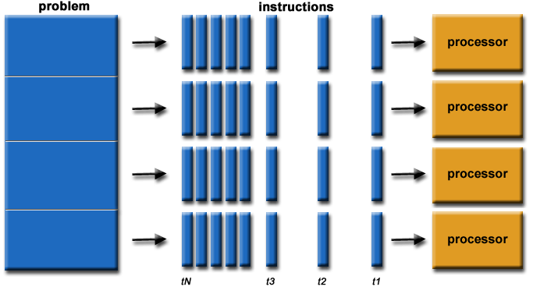
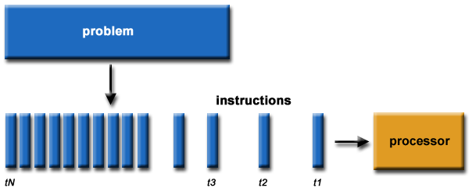
Parallel computing
Parallelism: splitting tasks into subtasks
Parallel computing: running subtasks (concurrent parts) parallel in multiple processor
Parallel computing
Serial computing

Slide 4
Thread
Lightweight processes are called threads (software thread).
A thread is a sequence of computation that can run in parallel with other threads.
Every program has at least one thread of computation.
Main thread
A program with two or more threads is generally referred to as a multithreaded program.
A multithreaded program is generally used to speed up the solution to a problem.

Slide 5
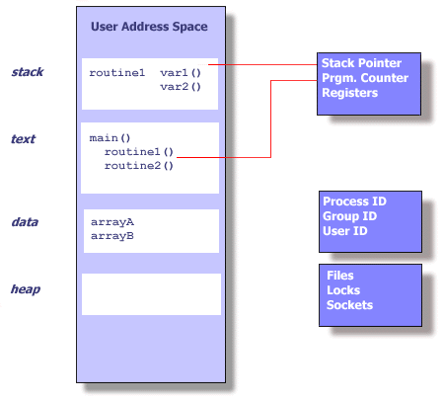
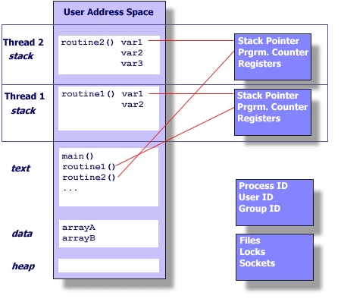
Processes vs Threads
Thread maintains only its own Stack pointer,Registers, Scheduling properties (such as policy or priority), Set of pending and blocked signals,Thread specific data.
pthread library allocates some stack space and uses the clone function call to start the thread at that stack address.
Process
Each process has its own virtual address space
fork() is expensive

Slide 6
Creating separate processes is useful
When more security is desired. For example, Chrome browser uses different processes for different tabs.
When running an existing and complete program then a new process is required, for example starting ‘gcc’.
When you are running into synchronization primitives and each process is operating on something in the system.
When you have too many threads – the kernel tries to schedule all the threads near each other which could cause more harm than good.
When you don’t want to worry about race conditions
If one thread blocks in a task (say IO) then all threads block. Processes don’t have that same restriction.
When the amount of communication is minimal enough that simple IPC needs to be used.

Slide 7
Creating threads is more useful
When you want to leverage the power of a multi-core system to do one task
When you can’t deal with the overhead of processes
When you want communication between the processes simplified
When you want to threads to be part of the same process

Slide 8
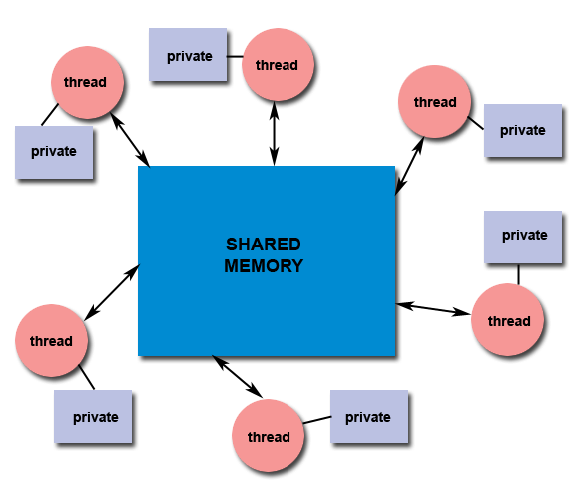
Shared memory model
All threads have access to the same global, shared memory
Threads also have their own private data
Programmers are responsible for synchronizing access (protecting) globally shared data.

Slide 9
Review: Creating a thread
#include <pthread.h>
int pthread_create(pthread_t *thread,
const pthread_attr_t *attr,
void *(*start_routine)(void*),
void *arg);
On success returns 0
On error, it returns error code
pthread_create creates a new thread and makes it executable.
This routine can be called any number of times from anywhere within your code. pthread_create arguments:
thread: A unique identifier for the new thread returned by the subroutine.
attr: You can specify a thread attributes object, or NULL for the default values.
start_routine: The new thread starts execution by invoking this function
arg: A single argument that may be passed to start_routine.
It must be passed by reference as a pointer cast of type void.
NULL may be used if no argument is to be passed.
/*example*/
pthread_t *thread;
int r = pthread_create(&thread, NULL, func, &arg);
if (r != 0)
perror("pthread_create");

Slide 10
Review: Thread termination
The execution of a thread terminates in one of the following ways:
The thread’s start function performs a return specifying a return value for the thread.
The thread calls pthread_exit()
void pthread_exit(void *retval);
Terminates the calling thread
retval specifies the return value of the thread
This value is available to another thread in the same process that calls pthread_join()
retval should point to the heap not to the stack!
Note: exit() exits the entire process and sets the process’ exit value. This is equivalent to return (); in the main method.

Slide 11
Issues in shared resources
Threads can share information via global variables
Multiple threads should not attempt to modify the same variable at the same time
Or one thread should not try to read the variable while another thread is modifying it
Race condition: threads are "racing" to access/change the data at the same time
At least one thread are modifying(writing) the data
The resulting change in data depends on the thread scheduling algorithm
the outcome of a program depends on how the kernel schedules the threads (could produce inaccurate results).
int count = 0;
void *increment(void *n) {
int j;
for (j = 0; j < *((int *)n); j++) {
count++;
}
}
count++ done in 3 steps:
Get the current value from &count
Increment by 1
Store back in &count

Slide 12
Race condition: An example bank transaction
Thread 1 | Thread 2 | Balance
Read balance: $1000 |  | $1000
 | Read balance: $1000 | $1000
 | Deposit $200 | $1000
Deposit $200 |  | $1000
Update balance $1000+$200 |  | $1200
 | Update balance $1000+$200 | $1200

Slide 13
Thread interleaving
In assembly, assume data is stored in eax
mov eax, DWORD PTR [rbp-4] ;Loads int_ptr
add eax, eax ;Does the addition
mov DWORD PTR [rbp-4], eax ;Stores it back
void *thread_main(void *p) {
int x = *p;
x += x;
*p = x;
return NULL;
}
int main() {
int data = 1;
pthread_t one, two;
pthread_create(&one, NULL, thread_main, &data);
pthread_create(&two, NULL, thread_main, &data);
pthread_join(one, NULL);
pthread_join(two, NULL);
printf("%d\n", data);
return 0;
}

Slide 14
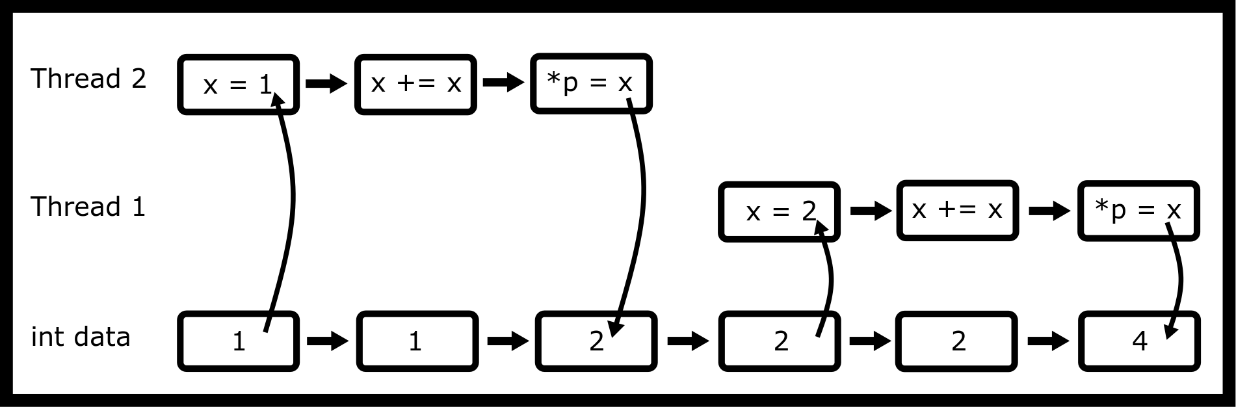
Consider the access pattern
void *thread_main(void *p) {
int x = *p;
x += x;
*p = x;
return NULL;
}
int main() {
int data = 1;
pthread_t one, two;
pthread_create(&one, NULL,
thread_main, &data);
pthread_create(&two, NULL,
thread_main, &data);
pthread_join(one, NULL);
pthread_join(two, NULL);
printf("%d\n", data);
return 0;
}
This access pattern will cause the variable data to be 4.
The problem is when the instructions are executed in parallel (next slide).

Slide 15
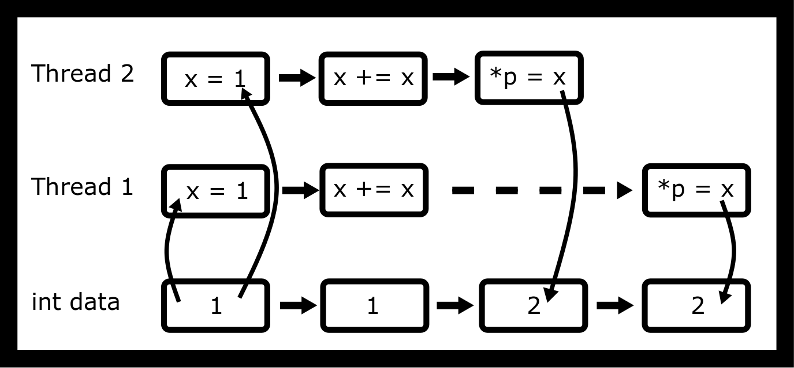
Consider the access pattern
void *thread_main(void *p) {
int x = *p;
x += x;
*p = x;
return NULL;
}
int main() {
int data = 1;
pthread_t one, two;
pthread_create(&one, NULL,
thread_main, &data);
pthread_create(&two, NULL,
thread_main, &data);
pthread_join(one, NULL);
pthread_join(two, NULL);
printf("%d\n", data);
return 0;
}
This access pattern will cause the variable data to be 2.
This is undefined behavior and a race condition.
What we want is one thread to access the part of the code at a time.

Slide 16
Thread interleaving
But when compiled with -O2, assembly output is a single instruction.
# Optimized way of doing the add
shl dword ptr [rdi]
It doesn’t fix the problems that the hardware itself may experience a race condition because we as programmers didn’t tell the hardware to check for it. The easiest way is to add the lock prefix (Guide #ref-guide2011intel, 1120).
void *thread_main(void *p) {
int x = *p;
x += x;
*p = x;
return NULL;
}
int main() {
int data = 1;
pthread_t one, two;
pthread_create(&one, NULL, thread_main, &data);
pthread_create(&two, NULL, thread_main, &data);
pthread_join(one, NULL);
pthread_join(two, NULL);
printf("%d\n", data);
return 0;
}

Slide 17
Race condition example-1: multi threads executing increment()
for (int i = 0; i < NTHREADS; i++){
int r = pthread_join(tids[i], NULL);
if (r != 0){
perror("join");
exit(-1);
}
}
printf("value of count: %d\n", count);
}
#include <pthread.h>
#include <stdio.h>
#include <stdlib.h>
#define NTHREADS 2
int main(){
pthread_t tids[NTHREADS];
int n = 10000;
for(int i = 0; i < NTHREADS; i++){
int r = pthread_create(&tids[i],
NULL, increment, &n);
if( r != 0){
perror("thread creation");
exit(-1);
}
}

Slide 18
example-2: passing ref is WRONG!
#include <stdio.h>
#include <unistd.h>
#include <pthread.h>
void* myfunc(void* ptr) {
int i = *((int *) ptr);
printf("%d \n", i);
return NULL;
}
int main() {
/*Each thread gets a different value
of i to process*/
int i;
pthread_t tid;
for(i =0; i < 10; i++) {
pthread_create(&tid, NULL, myfunc, &i); //ERROR
}
pthread_exit(NULL);
}
// correct way, passing value of i
pthread_create(&tid, NULL, myfunc, (void *)i);
You may see an output 1 7 8 8 8 8 8 8 8 10

Slide 19
Multi-thread-unsafe function
#include <stdio.h>
#include <string.h>
#include <unistd.h>
#include <pthread.h>
char *to_message(int num) {
static char result [256];
if (num < 10) sprintf(result, "%d : blah blah" , num);
else strcpy(result, "Unknown");
return result;
}
Some of the provided functions are not thread safe!
E.g.: asctime, getenv, strtok, strerror
Programs involving thread-unsafe functions may suffer from a race condition

Slide 20
Multi-thread-safe function
#include <stdio.h>
#include <string.h>
#include <unistd.h>
#include <pthread.h>
int to_message_r(int num, char *buf, size_t nbytes){
size_t written;
if (num < 10){
written = snprintf(buf, nbytes, "%d : blah blah", num);
}else{
strncpy(buf, "Unknown", nbytes);
buf[nbytes] = '\0';
written = strlen(buf) + 1;
}
return written <= nbytes;
}
Instead of making the function responsible for the memory, we made the caller responsible!
A lot of programs, and hopefully your programs, have minimal communication needed.
Often a malloc call is less work than locking a mutex or sending a message to another thread.

Slide 21
Creating thread before fork() results in unexpected errors!
#include <pthread.h>
#include <stdio.h>
#include <unistd.h>
static pid_t child = -2;
void *sleepnprint(void *arg) {
printf("%d:%s starting up...\n", getpid(), (char *) arg);
while (child == -2) {sleep(1);} /* Later we will use condition
variables */
printf("%d:%s finishing...\n",getpid(), (char*)arg);
return NULL;
}
int main() {
pthread_t tid1, tid2;
pthread_create(&tid1,NULL, sleepnprint, "New Thread One");
pthread_create(&tid2,NULL, sleepnprint, "New Thread Two");
child = fork();
printf("%d:%s\n",getpid(), "fork()ing complete");
sleep(3);
printf("%d:%s\n",getpid(), "Main thread finished");
pthread_exit(NULL);
return 0; /* Never executes */
}
When fork() is called, only the calling thread is duplicated in the child process
You can use pthread_atfork(): However, avoid creating threads before forking unless you fully understand the limitations and difficulties of this approach.

Slide 22
Parallel computation: Parallelizing programs
In order to make your program multithread, you need to find concurrent parts of the program
Parallel computation can be done at different levels
Bit-level parallelism,
Instruction-level parallelism,
Data parallelism,
Task parallelism.
Data parallelism
the same calculation is performed on the same or different sets of data.
Sum of array elements
Task parallelism:
entirely different calculations can be performed on either the same or different sets of data

Slide 23
Embarrassingly Parallel Problems
An embarrassingly parallel problem is any problem that needs little effort to turn parallel.
Eg. merge sort
Another example is parallel map. Say we want to apply a function to an entire array, one element at a time.
https://en.wikipedia.org/wiki/Embarrassingly_parallel
void merge_sort(int *arr, size_t len){
if(len > 1){
// Merge Sort the left half
// Merge Sort the right half
// Merge the two halves
}
}
int *map(int (*func)(int), int *arr, size_t len){
int *ret = malloc(len*sizeof(*arr));
for(size_t i = 0; i < len; ++i) {
ret[i] = func(arr[i]);
}
return ret;
}

Slide 24
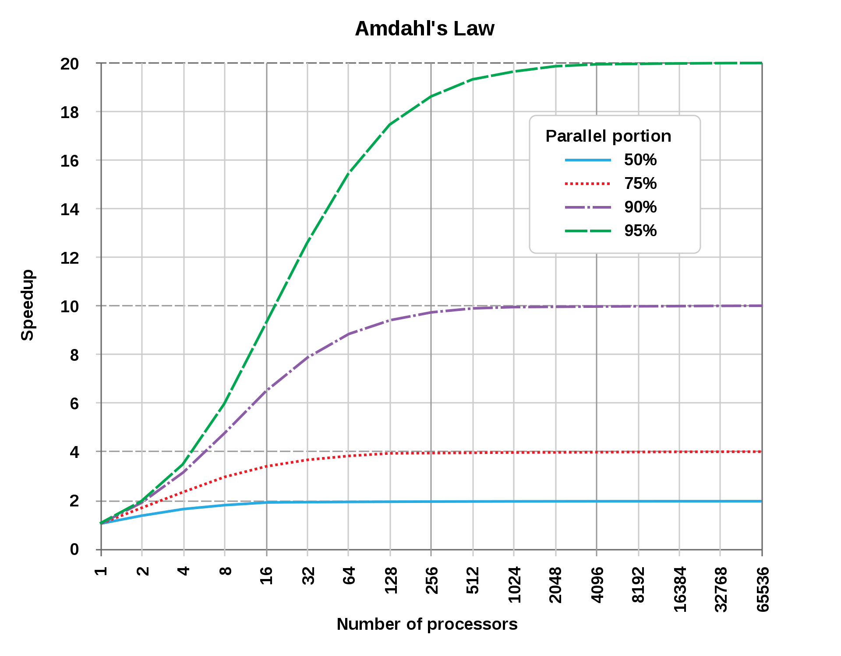
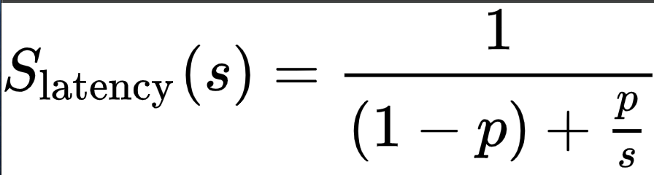
Amdahl's Law
Given that your CPU has multiple real cores, you will see a speedup following https://en.wikipedia.org/wiki/Amdahl’s_law.

Slide 25
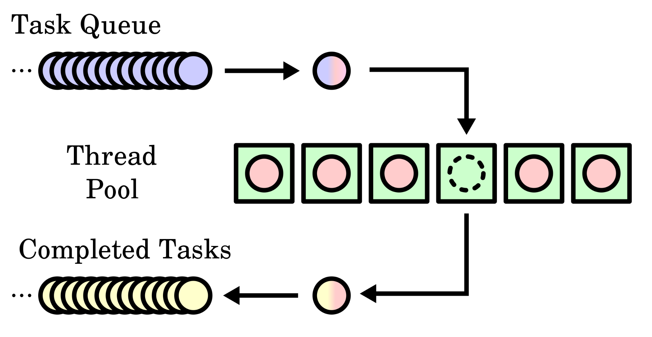
Thread Pools

Slide 26
How to Implement Thread Pools in C
Task queue:
A queue of function pointers
Thread Pool
A list of threads running a function
The function takes the next task from the queue and executes it.
If there is no task, it waits for a task
Need synchronization on thread queue!

Slide 27
Coroutines (cooperatively multitasked subroutines)
User level language abstraction (they are stackless)
subroutines for cooperative multitasking
Coroutines provide concurrency, because they allow tasks to be performed out of order or in a changeable order, without changing the overall outcome,
but they do not provide parallelism, because they do not necessarily execute multiple tasks simultaneously.
Can be used with a multi-threaded dispatcher
https://en.wikipedia.org/wiki/Coroutine

Slide 28
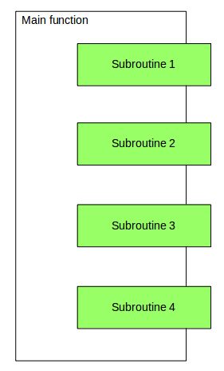
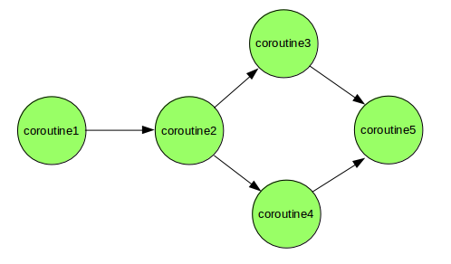
Unlike standard subroutines, program with coroutines has multiple entry point
https://www.geeksforgeeks.org/coroutine-in-python

Slide 29
Python example
How to implement this in C?
def print_name(prefix):
print("Searching prefix:{}".format(prefix))
while True:
name = (yield)
if prefix in name:
print(name)
calling coroutine, nothing will happen
corou = print_name("Dear")
# This will start execution of coroutine and
# Prints first line "Searching prefix..."
# and advance execution to the first yield expression
corou.__next__()
# sending inputs
corou.send("Atul")
corou.send("Dear Atul")
corou.close()
https://www.geeksforgeeks.org/coroutine-in-python/

Slide 30
Goroutines (Green threads)
Go language user level thread routines
Thread scheduler at the user level managed by Go runtime)
Stackless
package main
import (
"fmt"
"time"
)
func say(s string) {
for i := 0; i < 5; i++ {
time.Sleep(100 * time.Millisecond)
fmt.Println(s)
}
}
func main() {
go say("world") // new goroutine
say("hello")
}

Slide 31
Next
Multi-thread and process synchronization

