Slide 1
Synchronization & deadlock
Reader-writer problem
Review of producer-consumer problem
Ring buffer (queue) implementation with condition variables & semaphores
Deadlock, livelock
Dining philosopher problem & different solutions
examples

Slide 2
Reader-writer problem
Readers: only reads the data and does not update/change the data
Writers: both reads and writes the data
allow multiple readers to access the data at the same time when there is no writing.
To avoid data corruption, only one thread at a time may modify (write) the data structure and no readers may be reading at that time.
Problem: how can we efficiently synchronize multiple readers and writers such that multiple readers can read together, but a writer gets exclusive access?

Slide 3
First attempt with mutex
void read() {
lock(&m)
// do read stuff
unlock(&m)
}
void write() {
lock(&m)
// do write stuff
unlock(&m)
}
No data corruption!
But, only one reader can access the data. Readers wait for other readers

Slide 4
Second attempt
void read() {
while(writing) {/*spin*/}
reading = 1
// do read stuff
reading = 0
}
void write() {
while(reading || writing) {/*spin*/}
writing = 1
// do write stuff
writing = 0
}
Race condition: multiple readers and the writers at the same time

Slide 5
With condition variables
Condition ok to read
Readers can access/read when no writers
Condition ok to write
Writers can access/update/write when no readers or writers
Only one thread should manipulate state variables (reading, writing) at a time.
Critical section

Slide 6
Reader
pthread_cond_wait performs 3 actions.
it atomically unlocks the mutex
and then sleeps
(until it is woken by pthread_cond_signal or pthread_cond_broadcast).
the awoken thread must re-acquire the mutex lock before returning.
Thus only one thread can actually be running inside the critical section.
read() {
lock(&m)
while (writing)
cond_wait(&cv, &m)
reading++;
/* Read here! */
reading--
cond_signal(&cv)
unlock(&m)
}
Solution to Reader-Writer problem?
if any writers are writing, a reader will enter the cond_wait.
OK!
Only one reader can read!
because readers did not unlock the mutex.

Slide 7
A better version for multiple readers
read() {
lock(&m)
while (writing)
cond_wait(&cv, &m)
reading++;
unlock(&m)
/* Read here! */
lock(&m)
reading--
cond_signal(&cv)
unlock(&m)
}
Solution to Reader-Writer problem?
if any writers are writing, a reader will enter the cond_wait.
OK!
only one thread can be executing code inside the critical section at any time!
Readers can read at the same time
Does this mean that a writer and reader could read and write at the same time?
No!
cond_wait requires the thread re-acquire the mutex lock before returning.

Slide 8
Writer
Explanation
This uses pthread_cond_signal. This will only wake up one thread.
If many readers are waiting for the writer to complete, only one sleeping reader will be awoken from their slumber.
The reader and writer should use cond_broadcast so that all threads should wake up and check their while-loop condition.
write() {
lock(&m);
while (reading || writing)
cond_wait(&cv, &m);
writing++;
/* Write here! */
writing--;
cond_signal(&cv);//or cond_broadcast
unlock(&m);
}
Problem with this solution
Starvation: If readers are constantly arriving then a writer will never be able to proceed (the ‘reading’ count never reduces to zero).

Slide 9
Last attempt
implement a bounded-wait for the writer.
If a writer arrives they will still need to wait for existing readers
however future readers must be placed in a “holding pen” and wait for the writer to finish.
The plan is when a writer arrives, and before waiting for current readers to finish, register our intent to write by incrementing a counter ‘writer’

Slide 10
Final writer solution
writer() {
lock(&m)
writers++
while (reading || writing)
cond_wait(&cv, &m)
writing++
unlock(&m)
// perform writing here
lock(&m)
writing--
writers--
cond_broadcast(&cv)
unlock(&m)
}
Readers wait for the writers

Slide 11
final reader solution
read() {
lock(&m)
/*check if any writers waiting*/
while(writers)
cond_wait(&cv,&m)
/* No need to wait while(writing here) because it only exits the above loop when writing is zero*/
while(writing)
cond_wait(&cv,&m)
reading++
unlock(&m)
/* Read here! */
lock(&m)
reading--
cond_signal(&cv)
unlock(&m)
}
Readers wait for the writers
Writers have higher priority

Slide 12
Review: consumer-producer problem
a finite-size buffer
and two classes of threads, producers and consumers,
producers: put items into the buffer
consumers: take items out of the buffer
A producer must wait until the buffer has space before it can put something in,
and a consumer must wait until something is in the buffer before it can take something out.
A condition variable represents a queue of threads waiting for some condition to be signaled.

Slide 13
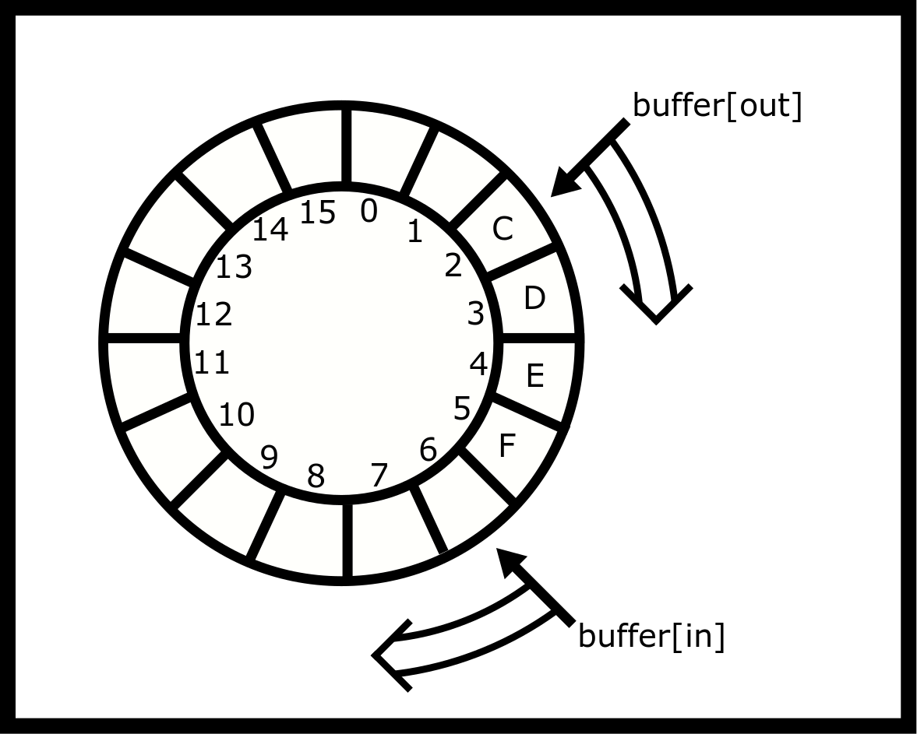
Ring buffer
A ring buffer is a simple, usually fixed-sized, storage mechanism
where contiguous memory is treated as if it is circular,
and two index counters keep track of the current beginning and end of the queue.
As an array
void *buffer[16];
unsigned int in = 0, out = 0;

Slide 14
Ring buffer queue operations
void *buffer[16];
unsigned int in = 0, out = 0;
void enqueue(void *value) {
buffer[in] = value;
in++; /* Advance the index for next time */
if (in == 16) in = 0; /* Wrap around! */
}
void *dequeue() {
void *result = buffer[out];
out++;
if (out == 16) out = 0;
return result;
}
No control for buffer overflow/underflow!
if (in == 16) in = 0;
Using (in % 16) may cause problems if in is too big
b[ (in++) & (N-1) ] = value;

Slide 15
Multithread solution: incorrect attempt
#define N 16
void *b[N]
int in = 0, out = 0;
p_m_t lock; sem_t s1,s2;
void init() {
p_m_init(&lock, NULL);
sem_init(&s1, 0, 16);
sem_init(&s2, 0, 0);
}
enqueue(void *value) {
p_m_lock(&lock)
sem_wait( &s1 )
b[ (in++) & (N-1) ] = value
sem_post(&s1)
p_m_unlock(&lock)
}
The enqueue method waits and posts on the same semaphore (s1) and similarly with enqueue and (s2)
we decrement the value and then immediately increment the value,
so by the end of the function the semaphore value is unchanged!
The initial value of s1 is 16,
the semaphore will never be reduced to zero
enqueue will not block if the ring buffer is full
so overflow is possible.

Slide 16
void init() {
p_m_init(&lock, NULL);
sem_init(&s1, 0, 16);
sem_init(&s2, 0, 0);
}
void *dequeue(){
p_m_lock(&lock)
sem_wait(&s2)
void *result = b[(out++) & (N-1) ]
sem_post(&s2)
p_m_unlock(&lock)
return result
}
The initial value of s2 is zero, so calls to dequeue will always block and never return!
The order of mutex lock and sem_wait will need to be swapped; however, this example is so broken that this bug has no effect!

Slide 17
Another incorrect attempt
void init() {
sem_init(&s1,0,16); sem_init(&s2,0,0);
}
enqueue(void *value){
sem_wait(&s2);
p_m_lock(&lock);
b[ (in++) & (N-1) ] = value;
p_m_unlock(&lock);
sem_post(&s1);
}
void *dequeue(){
sem_wait(&s1);
p_m_lock(&lock)
void *result = b[(out++) & (N-1)];
p_m_unlock(&lock);
sem_post(&s2);
return result;
}
The initial value of s2 is 0. Enqueue will block on the first call to sem_wait even though the buffer is empty!
The initial value of s1 is 16. Dequeue will not block on the first call to sem_wait even though the buffer is empty - Underflow! The dequeue method will return invalid data.
The code does not satisfy Mutual Exclusion. Two threads can modify in or out at the same time! The code appears to use mutex lock. Unfortunately, the lock was never initialized with pthread_mutex_init() or PTHREAD_MUTEX_INITIALIZER - so the lock may not work (pthread_mutex_lock may simply do nothing)

Slide 18
Correct implementation: enqueue
#include <pthread.h>
#include <semaphore.h>
#define N (16) // N must be 2^i
void *b[N]
int in = 0, out = 0
p_m_t lock = PTHREAD_MUTEX_INITIALIZER;
sem_t countsem, spacesem;
void init() {
sem_init(&countsem, 0, 0);
sem_init(&spacesem, 0, 16);
}
enqueue(void *value){
/* wait if there is no space left:*/
sem_wait( &spacesem )
p_m_lock(&lock)
b[ (in++) & (N-1) ] = value
p_m_unlock(&lock)
/* increment the count of the number of items*/
sem_post(&countsem)
}

Slide 19
Correct implementation: dequeue
#include <pthread.h>
#include <semaphore.h>
#define N (16) // N must be 2^i
void *b[N]
int in = 0, out = 0
p_m_t lock = PTHREAD_MUTEX_INITIALIZER;
sem_t countsem, spacesem;
void init() {
sem_init(&countsem, 0, 0);
sem_init(&spacesem, 0, 16);
}
void *dequeue(){
/* Wait if there are no items in the buffer*/
sem_wait(&countsem);
p_m_lock(&lock);
void *result = b[(out++) & (N-1)];
p_m_unlock(&lock);
/* Increment the count of the number of spaces*/
sem_post(&spacesem);
return result
}

Slide 20
Exercises
void *dequeue(){
/* Wait if there are no items in the buffer*/
sem_wait(&countsem);
p_m_lock(&lock);
void *result = b[(out++) & (N-1)];
p_m_unlock(&lock);
/* Increment the count of the number of spaces*/
sem_post(&spacesem);
return result
}
What would happen if the order of sem_wait and pthread_mutex_lock calls were swapped?
What would happen if the order of pthread_mutex_unlock and sem_post calls were swapped?

Slide 21
Ring buffer as a consumer-producer with cvs
typedef struct {
char buf[BSIZE];
int occupied;
int in; /*index of in*/
int out; /*index of out*/
pthread_mutex_t mutex;
pthread_cond_t more; /*there is item*/
pthread_cond_t less; /*there is room*/
} buffer_t;
void enqueue(buffer_t *b, char item){
pthread_mutex_lock(&b->mutex);
while (b->occupied >= BSIZE)
pthread_cond_wait(&b->less, &b->mutex);
assert(b->occupied < BSIZE);
b->buf[b->in++] = item;
b->in &= BSIZE-1;
b->occupied++;
pthread_cond_signal(&b->more);
pthread_mutex_unlock(&b->mutex);
}
https://docs.oracle.com/cd/E19455-01/806-5257/6je9h032r/index.html#sync-ex-33

Slide 22
char dequeue(buffer_t *b){
char item;
pthread_mutex_lock(&b->mutex);
while(b->occupied <= 0){
pthread_cond_wait(&b->more, &b->mutex);
}
item = b->buf[b->out++];
b->out &= BSIZE-1;
b->occupied--;
pthread_cond_signal(&b->less);
pthread_mutex_unlock(&b->mutex);
return(item);
}
Dequeue is a consumer
Enqueue is a producer
https://docs.oracle.com/cd/E19455-01/806-5257/6je9h032r/index.html#sync-ex-33

Slide 23
Deadlock
Example
Thread 1 holds lock A and requests lock B
Thread 2 holds lock B and requests lock A
Deadlock occurs when
Threads that are already holding locks request new locks
The requests for new locks are made concurrently
Two or more threads form a circular chain in which each thread waits for a lock which is held by the next thread in the chain
Deadlock describes a situation where two or more threads are blocked forever, waiting for each other.

Slide 24
Livelock
A thread often acts in response to the action of another thread. If the other thread's action is also a response to the action of another thread, then livelock may result.

Slide 25
Starvation
Starvation describes a situation where a thread is unable to gain regular access to shared resources and is unable to make progress.

Slide 26
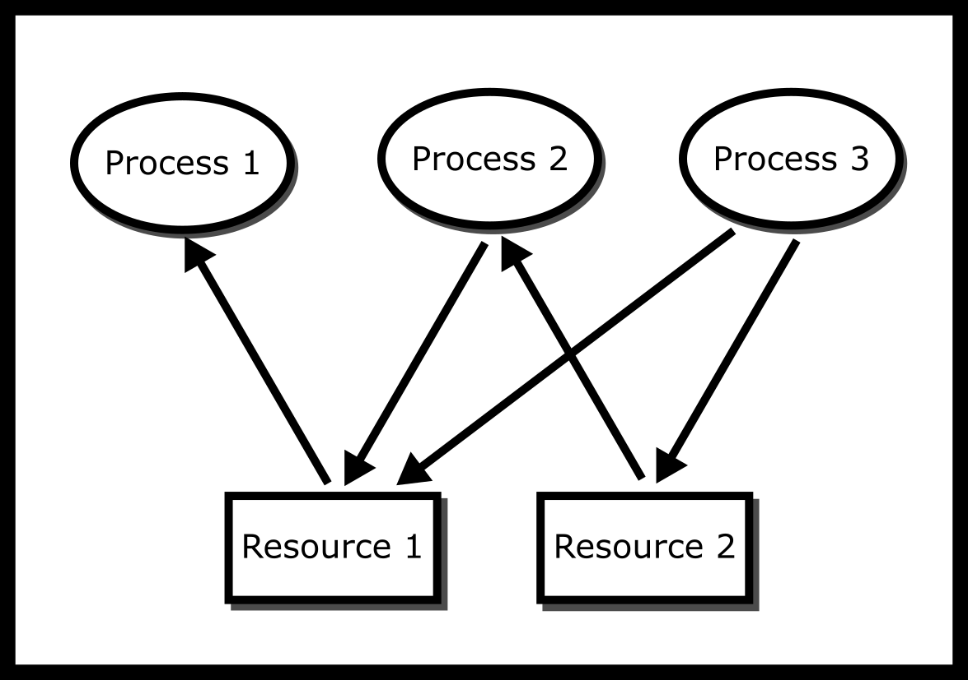
Deadlock: Resource allocation graphs
If there is a cycle in the Resource Allocation Graph and each resource in the cycle provides only one instance, then the processes will deadlock.
We can detect a deadlock by traversing the graph and searching for a cycle using a graph traversal algorithm, such as the Depth First Search (DFS).

Slide 27
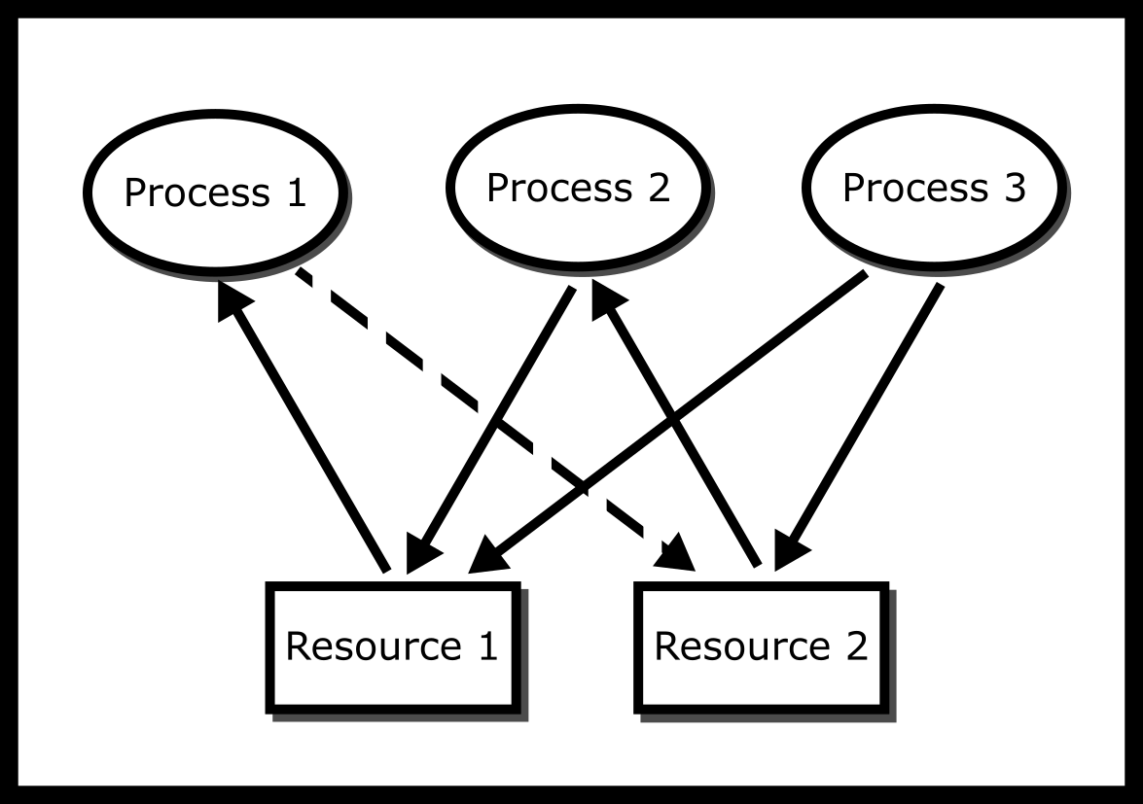
Deadlock: Resource allocation graphs
If there is a cycle in the Resource Allocation Graph and each resource in the cycle provides only one instance, then the processes will deadlock.
We can detect a deadlock by traversing the graph and searching for a cycle using a graph traversal algorithm, such as the Depth First Search (DFS).

Slide 28
Coffman conditions
Mutual Exclusion: No two processes can obtain a resource at the same time.
Circular Wait: There exists a cycle in the Resource Allocation Graph:
there exists a set of processes {P1,P2,. . . } such that P1 is waiting for resources held by P2, which is waiting for P3,. . . , which is waiting for P1.
Hold and Wait: Once a resource is obtained, a process keeps the resource locked.
No Pre-emption: Nothing can force the process to give up a resource.
Proof in the book
See also simulations in https://en.wikipedia.org/wiki/Deadlock#Individually_necessary_and_jointly_sufficient_conditions_for_deadlock
Deadlock can happen if and only if the four Coffman conditions are satisfied.

Slide 29
Approaches to solve deadlock
Ostrich algorithm:
ignore the deadlock, prevent processes from context-switching
"to stick one's head in the sand and pretend there is no problem".
Used in most operating systems
Banker’s algorithm
https://en.wikipedia.org/wiki/Banker%27s_algorithm
How much of each resource each process could possibly request ("MAX")
How much of each resource each process is currently holding ("ALLOCATED")
How much of each resource the system currently has available ("AVAILABLE")

Slide 30
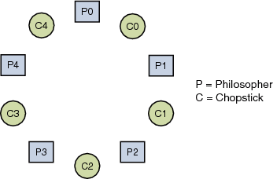
Dining philosopher problem
Five philosophers, numbered zero to four, are sitting at a round table, thinking.
As time passes, different individuals become hungry and decide to eat.
There is a platter of noodles on the table but each philosopher only has one chopstick to use.
In order to eat, they must share chopsticks.
The chopstick to the left of each philosopher (as they sit facing the table) has the same number as that philosopher.
https://docs.oracle.com/cd/E19205-01/820-0619/geosb/index.html

Slide 31
think until the left fork is available; when it is, pick it up
think until the right fork is available; when it is, pick it up
eat for a fixed amount of time
put the right fork down
put the left fork down
think for a fixed amount of time
repeat

Slide 32
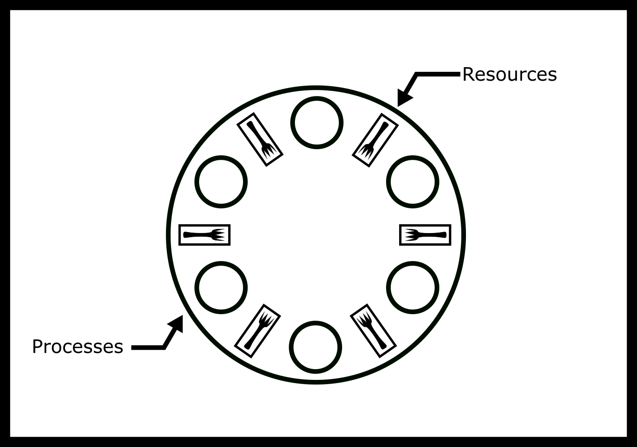
Dining philosopher problem
philosopher(){
while(true){
think()
pick(left_chopstick)
pick(right_chopstick)
eat()
putdown_chopsticks()
}
}

Slide 33
Dining philosopher problem
void *philosopher1(void *arg) {
long i = (long)arg;
pthread_mutex_t *left = &chopsticks[i];
pthread_mutex_t *right = &chopsticks[(i + 1) % 5];
while (1) {
printf("id %ld: state: %.10s \n", i, "thinking!");
printf("id %ld: state: %.10s \n", i, "hungry!");
pthread_mutex_lock(left);
pthread_mutex_lock(right);
/*eat(left, right);*/
printf("id %ld: state: %.10s \n", i, "eating");
pthread_mutex_unlock(right);
pthread_mutex_unlock(left);
printf("id %ld: state: %.10s \n", i, "done!");
}
}

Slide 34
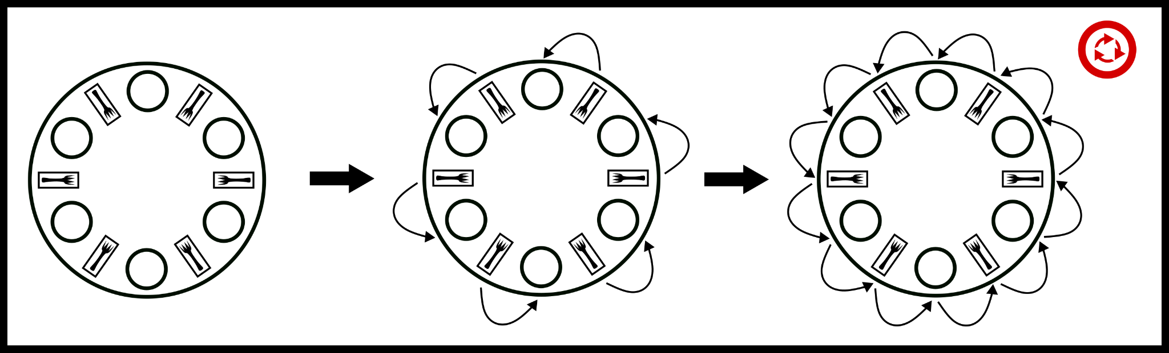
How deadlock occurs?
What if everyone picks up their left chopstick and is waiting on their right chopstick?
resource allocation graph that shows how the system could be deadlocked

Slide 35
Break hold and wait
void *philosopher2(void *arg) {
long i = (long)arg;
pthread_mutex_t *left = &chopsticks[i];
pthread_mutex_t *right = &chopsticks[(i + 1) % 5];
while (1) {
/*think()*/
int l = pthread_mutex_trylock(left);
if (!l) { sleep(1); continue;}
int r = pthread_mutex_trylock(right);
if (!r) {
pthread_mutex_unlock(left);
sleep(1); continue;
}
// sleep(1); /*eat(left, right);*/
printf("id %ld: state: %.10s \n", i, "eating");
pthread_mutex_unlock(left);
pthread_mutex_unlock(right);
printf("id %ld: state: %.10s \n", i, "done!");
}
}
scenario-1: If it’s not available, they put the fork down and try again.
No deadlock in this scenario!
scenario-2: all the philosophers pick up their left at the same time
try to grab their right,
put their left down,
pick up their left, try to grab their right and so on.
LIVELOCK

Slide 36
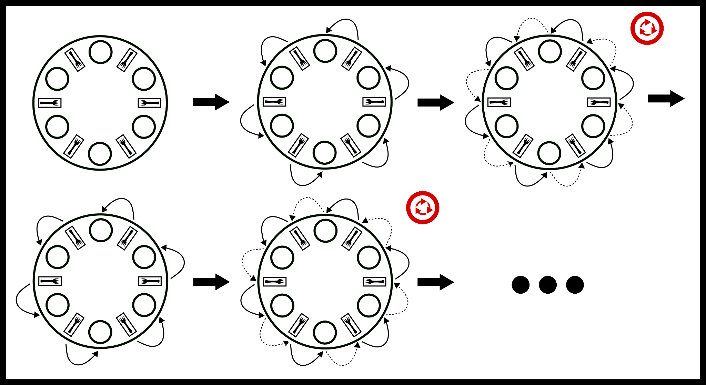
LIVELOCK: a time evolution of the break hold and wait would look like.

Slide 37
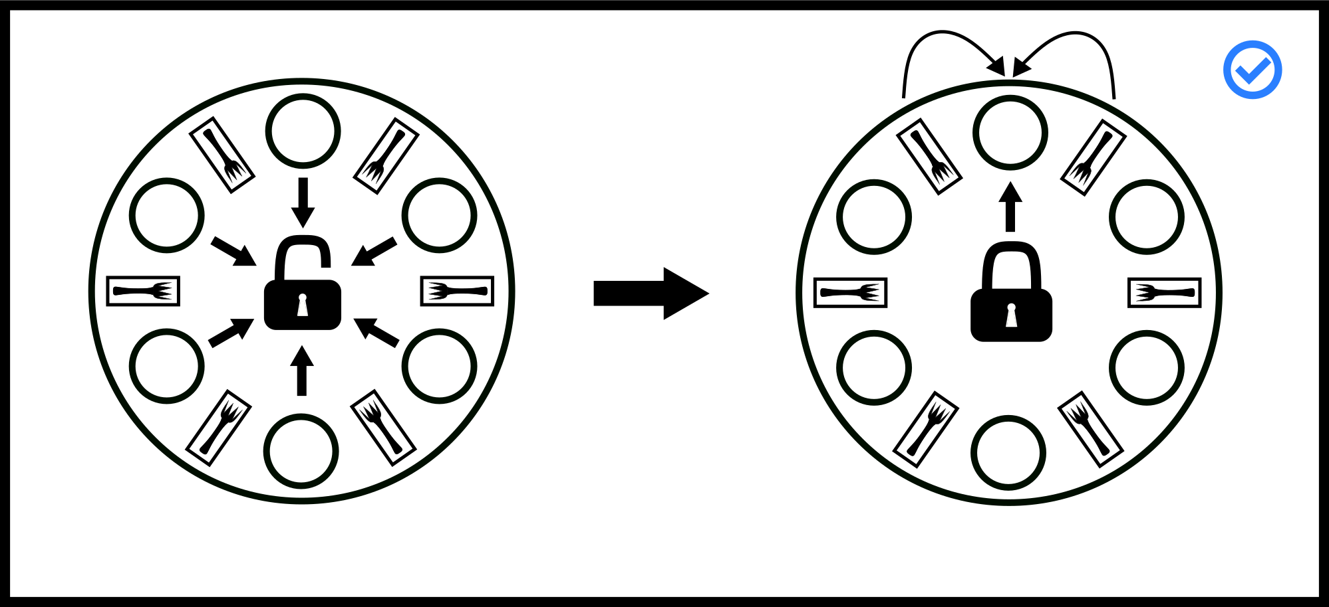
Arbitrator solution
A philosopher can only pick up both or none by introducing an arbitrator, e.g., a waiter
Waiter can be implemented as a mutex
Works but parallelism is reduced
All philosophers wait for waiter

Slide 38
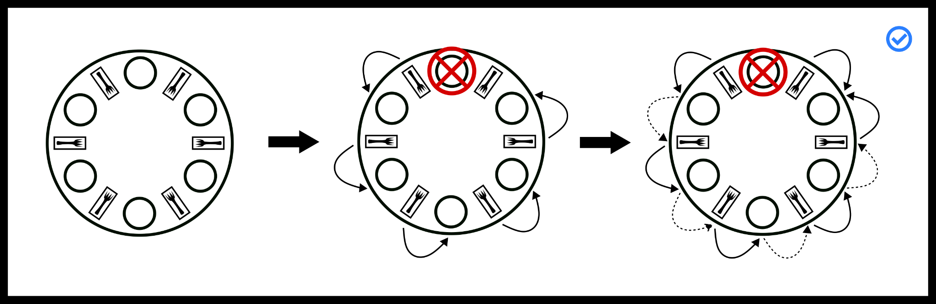
Stalling solution (leaving table)
Remove philosophers until deadlock is not possible. No circular wait means deadlock is not possible.

Slide 39
Partial (hierarchical) Ordering (Dijkstra's solution)
Assign a number to each philosopher and chopstick
A philosopher can choose two chopsticks
i,
i+1 %5
Each philosopher takes the lower numbered chopstick first
P0-C0,
P2-C2,
P3-C3,
P4-cannot take C0
The highest numbered philosopher does not have any chopy stick.
Then each gets the higher numbered chopstick
P4 is able to get C5 and eat

Slide 40
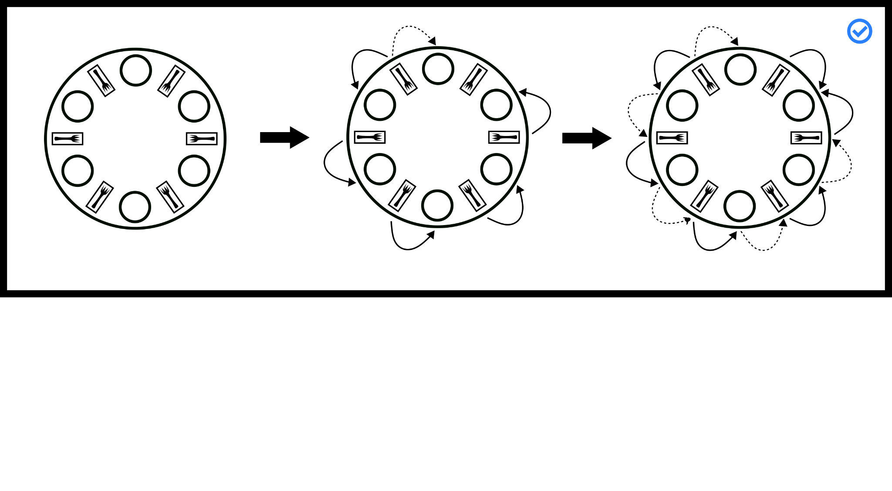
Partial (hierarchical) ordering (Dijkstra's solution)
Each process picks only lower numbered chopstick first, then the higher numbered chopstick.

