Slide 1
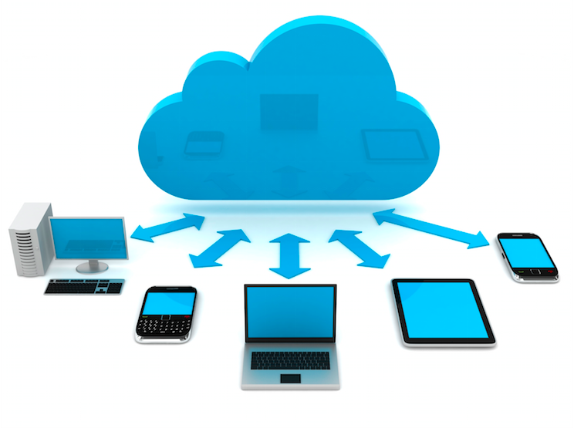
CLOUD COMPUTING

Slide 2
What is Cloud?
The term Cloud refers to a Network or Internet. In other words, we can say that Cloud is something, which is present at remote location. Cloud can provide services over public and private networks, i.e., WAN, LAN or VPN.
Applications such as e-mail, web conferencing, customer relationship management (CRM) execute on cloud.

Slide 3
What is cloud Computing??
The practice of using a network of remote servers hosted on the Internet to store, manage, and process data, rather than a local server or a personal computer .
Cloud Computing refers to manipulating, configuring, and accessing the hardware and software resources remotely. It offers online data storage, infrastructure, and application.

Slide 4
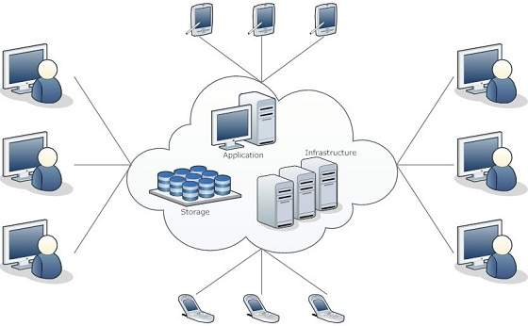

Slide 5
Types of Clouds
Public Cloud
Private Cloud
Hybrid Cloud
Community Cloud
Advantages
Reduced hardware cost
Unlimited storage and reliability
Reduced cost
Location independence, availability and compatibility
Easier group collaboration
Disadvantages
Internet Connection
Data integrity and security
New technology and incompleteness

Slide 6
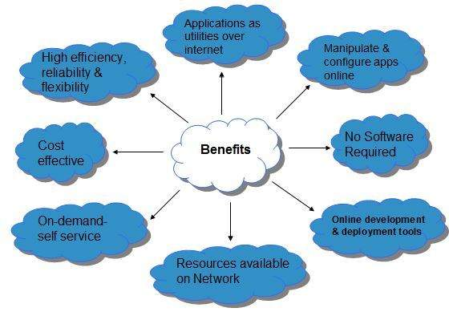

Slide 7
High-Performance Computing
In high-performance computing systems, a pool of processors (processor machines or central processing units [CPUs]) connected (networked) with other resources like memory, storage, and input and output devices, and the deployed software is enabled to run in the entire system of connected components.
HPC include a small cluster of desktop computers or personal computers (PCs) to the fastest supercomputers. HPC systems are normally found in those applications where it is required to use or solve scientific problems.

Slide 8
Parallel Computing
Parallel computing is also one of the facets of HPC. Here, a set of processors work cooperatively to solve a computational problem. These processor machines or CPUs are mostly of homogeneous type.
One can distinguish between conventional (also known as serial or sequential or Von Neumann) computers and parallel computers in the way the applications are executed.
In serial or sequential computers, the following apply:
• It runs on a single computer/processor machine having a single CPU.
• A problem is broken down into a discrete series of instructions.
• Instructions are executed one after another.

Slide 9
In parallel computing, since there is simultaneous use of multiple processor machines, the following apply:
• It is run using multiple processors (multiple CPUs).
• A problem is broken down into discrete parts that can be solved concurrently.
• Each part is further broken down into a series of instructions.
• Instructions from each part are executed simultaneously on different processors.
• An overall control/coordination mechanism is employed.

Slide 10
Distributed Computing Paradigms
Distributed computing is also a computing system that consists of multiple computers or processor machines connected through a network, which can be homogeneous or heterogeneous, but run as a single system.
P2P Computing
Grid Computing
Cluster Computing
Cloud Computing
Jungle Computing

Slide 11
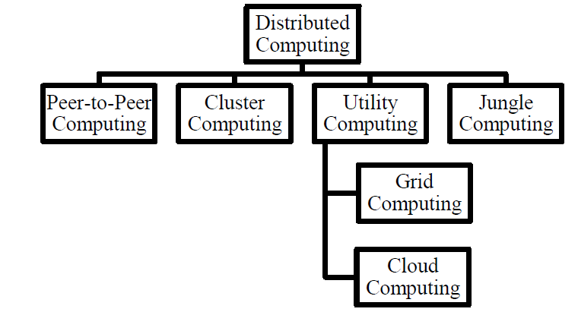
Classification of Distributed computing

Slide 12
Challenges in Distributed computing
Transparency
Flexibility
Reliability
Performance
Scalability

Slide 13
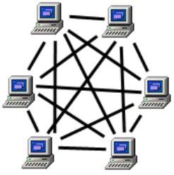
Peer-to-Peer Computing
It has been working primarily on the scalability issues inherent in distributing resources over a large number of networked processes.
The system is self-organizing with distributed control.

Slide 14
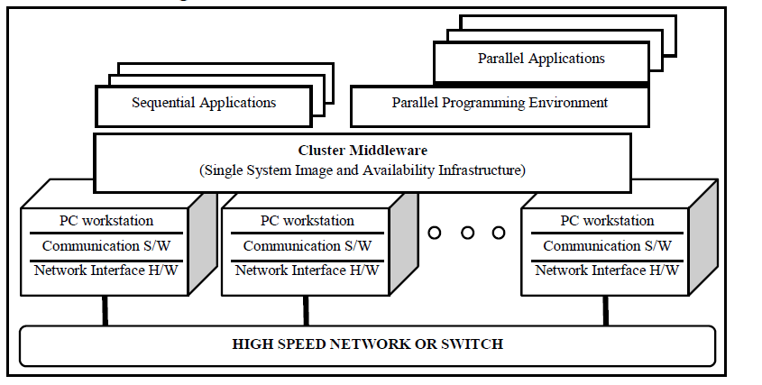
Cluster Computing
A cluster computing comprises a set of independent or stand-alone computers and a network interconnecting them.
.

Slide 15
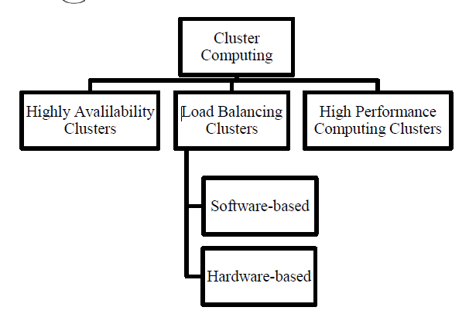
Cluster Computing Classification

Slide 16
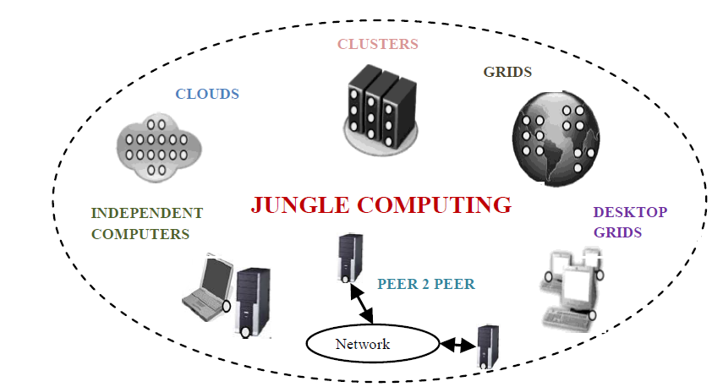
Utility Computing
It is envisioned to be the next generation of Information Technology evolution that depicts how computing needs of users can be fulfilled in the future IT industry.
Grid Computing
The aim of Grid computing is to enable coordinated resource sharing and problem solving in dynamic, multi-institutional virtual organizations.
Jungle Computing
It is a simultaneous combination of heterogeneous, hierarchical, and distributed computing resources.
Jungle computing refers to the use of diverse, distributed and highly non-uniform high performance computer systems to achieve peak performance .

Slide 17
Biocomputing
Biocomputing systems use the concepts of biologically derived or simulated molecules (or models) that perform computational processes in order to solve a problem.
Biocomputing provides the theoretical background and practical tools for scientists to explore proteins and DNA.
Biocomputing lead to a better understanding of life and the molecular causes of certain diseases.

Slide 18
Mobile Computing
In mobile computing, the processing (or computing) elements are small (i.e., handheld devices) and the communication between various resources is taking place using wireless media.
Mobile computing–based applications are becoming very important and rapidly evolving with various technological advancements as it allows users to transmit data from remote locations to other remote or fixed locations.
Quantum Computing
Quantum computers are millions of times faster than even our most powerful supercomputers today.
Quantum computing works differently on the most fundamental level than the current technology, and although there are working prototypes, these systems have not so far proved to be alternatives to today’s silicon-based machines.

Slide 19
Optical Computing
Optical computing system uses the photons in visible light or infrared beams, rather than electric current, to perform digital computations.
An electric current flows at only about 10% of the speed of light. This limits the rate at which data can be exchanged over long distances and is one of the factors that led to the evolution of optical fiber.
Nanocomputing
Nanocomputing refers to computing systems that are constructed from nanoscale components.
The silicon transistors in traditional computers may be replaced by transistors based on carbon nanotubes.
The successful realization of nanocomputers relates to the scale and integration of these nanotubes or components.

