Slide 1
Deep Learning

Slide 2

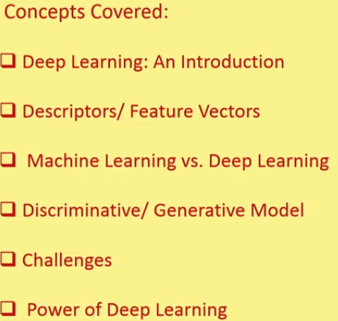

Slide 3
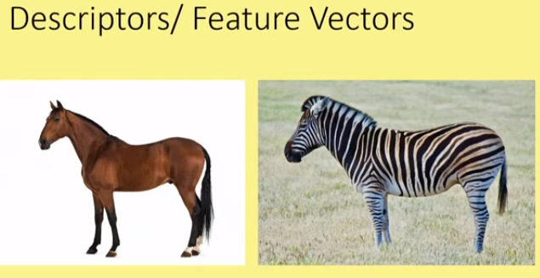
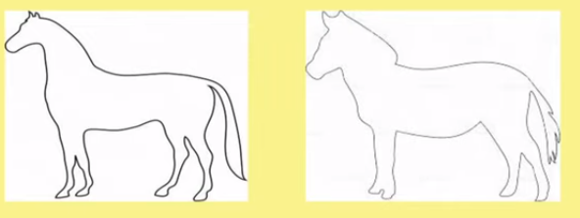

Slide 4

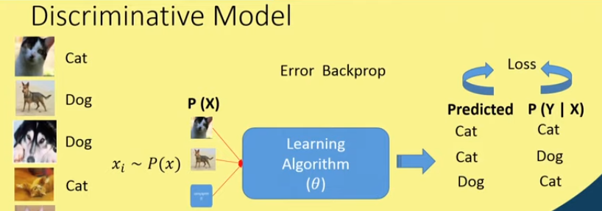
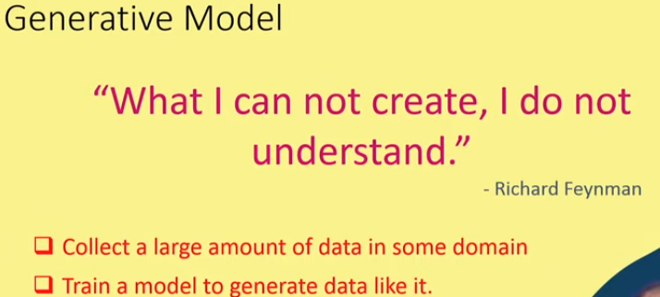

Slide 5
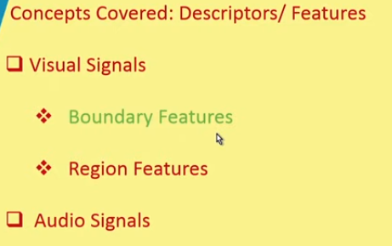
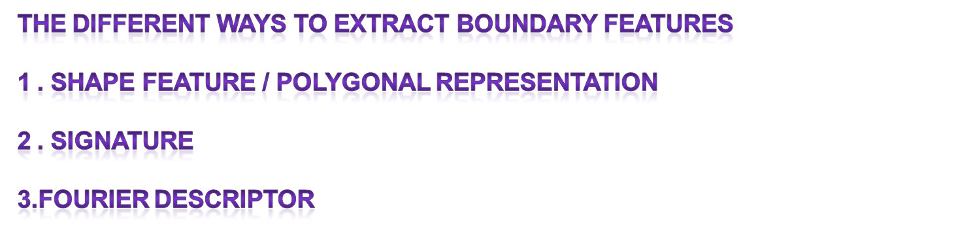

Slide 6
SIGNATURE DESCRIPTOR
THE PLOT OF THE DIFFERENT BOUNDARY POINTS FROM THE CENTRIOD OF THE SHAPE TAKEN AT VARIOUS DIRECTIONS IS KNOWN AS SIGNATURE DESCRIPTOR

Slide 7
EFFECT OF THE TRUNCATION OF THE COEFFICIENTS IN FOURIER DESCRIPTOR
FULL SHAPE OF THE BOUNDARY WILL NOT BE RE CONSTRUCTED.
LOWER ORDER SIGNALS WILL GIVE YOU THE TREND OF THE SIGNAL WHERE AS HIGHER ORDER SIGNALS WILL GIVE YOU THE DETAILED INFORMATION OF THE SIGNAL.

Slide 8
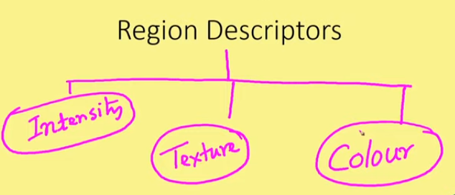
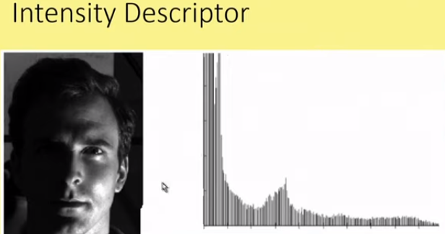
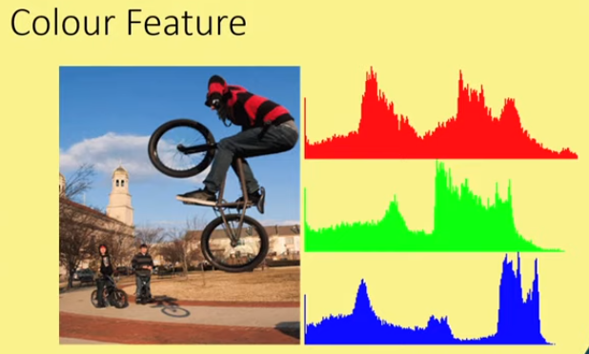

Slide 9
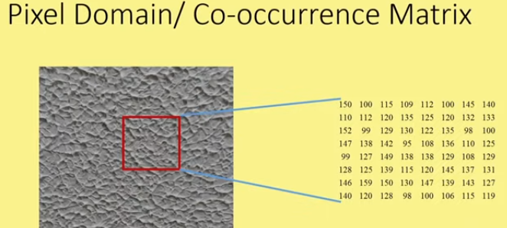
TEXTURE DESCRIPTOR:
THE TEXTURE OF THE REGION PROVIDES MEASURES OF SMOOTHNESS ,COARSENESS AND REGULARITY

Slide 10
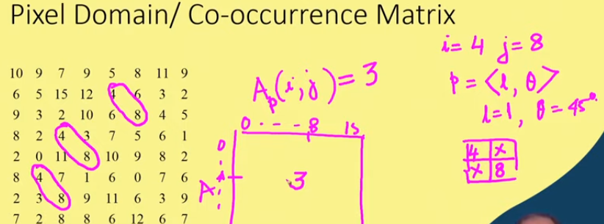
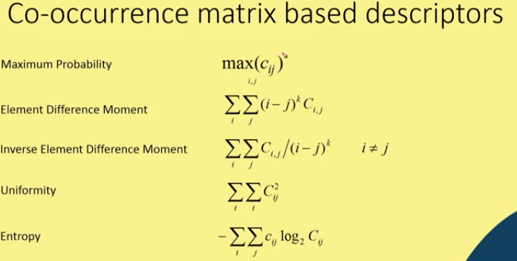

Slide 11
FEATURES IN THE FREQUENCY DOMAIN:
WAVELET TRANSFORMATION:
The Wavelet Transform uses a series of functions called wavelets, each with a different scale.
Breaks the signal into different frequency sub bands
and then you compute the energies in the sub bands and put those different energies of different sub bands as different features
:

Slide 12
GABOR TRANSFORMATION
Gabor transformation is nothing but a filter which is cosine modulated gaussian envelope and that can be oriented in various directions
as it is cosine modulated gaussian we have 3 parameters:
1. Scale : Variance of the gaussian that tells u abut the scale
2. Frequency of the cosine
3.orientation

Slide 13
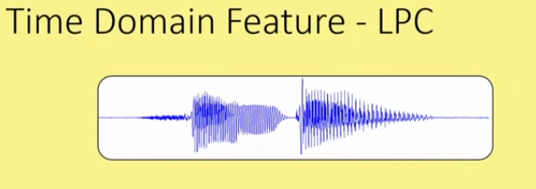
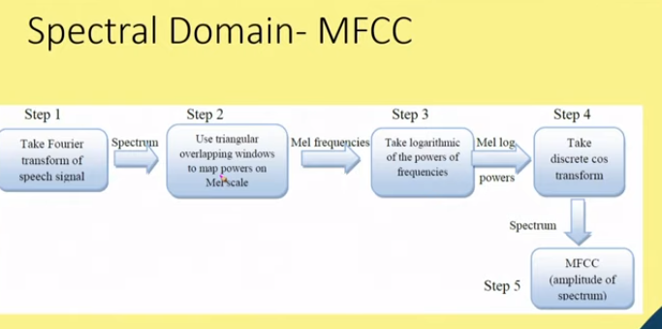
We have different filter quotients by varying these 3 parameters: 1.linear predictive coding coefficient
2.Mel frequency coding coefficient (mfcc)

Slide 14
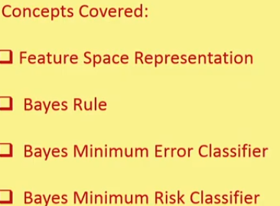
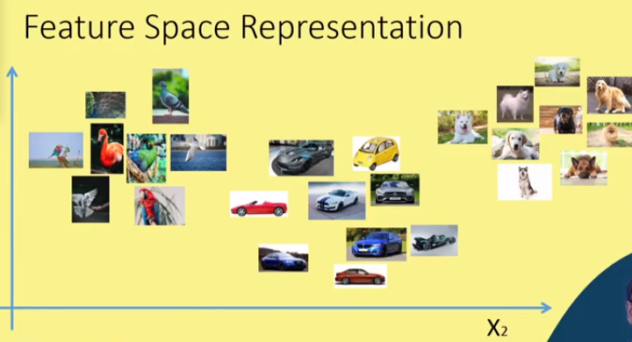
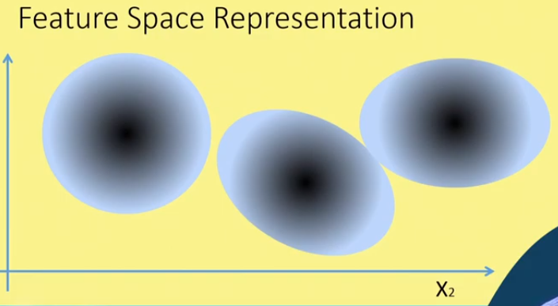

Slide 15
BAYES RULE AND
BAYES MINIMUM ERROR CLASSIFIER
X- feature vector
Wi → class
P(X/Wi) → class conditional probability density function
P(Wi/X) → aposterior probability density function
P(wi) → aprior probability

Slide 16


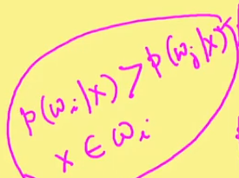
BAYES RULE

Slide 17
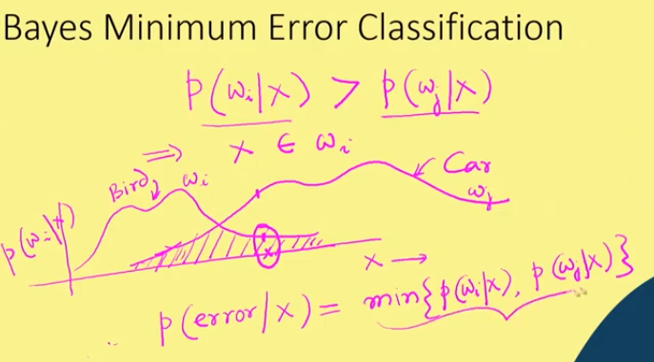

Slide 18
BAYES MINIMUM RISK CLASSIFIER
Bayes minimum RISK classifier is more general form of baye’s minimum ERROR classifier
In the sense that in case of bayes minimum error classifier we have considered only 2 classes.

Slide 19


BAYES MINIMUM RISK CLASSIFIER
If we have c number of classes then varies from 1 to c
: 1.......c(true states of nature)
We have to consider set of actions
: j varies from 1tok
: 1.....k (actions)
X- is a d- dimensional feature vector

Slide 20
But what makes baye’s risk classifier is different from baye’s minimum error classifier is introduction of LOSS function
Loss function : we took action alpha-i but true state of nature is j
So we have to take action for which above risk is minimum

Slide 21

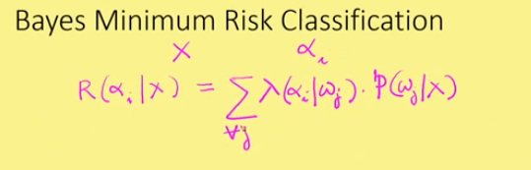
Here is a posterior probability
i.e total risk involved is

Slide 22

We have to compute this risk for all alpha values j varies from ( 1 to k)
We have to consider minimum risk action
WHERE

