Slide 1
CS601PC:MACHINE LEARNING
III CSE E
ASHA
KMIT

Slide 2
Textbook
Tom M. Mitchell
Machine Learning
McGraw-Hill, New York

Slide 3
Unit-1 chapter-3

Slide 4
CHAPTER-3 Decision Tree Learning
CONTENTS:
Introduction
Decision Tree Representation
Appropriate problems for Decision Tree Learning
The basic Decision Tree Learning Algorithm
Hypothesis space search in Decision Tree Learning
Inductive bias in Decision Tree Learning
Issues in Decision Tree Learning
summary

Slide 5
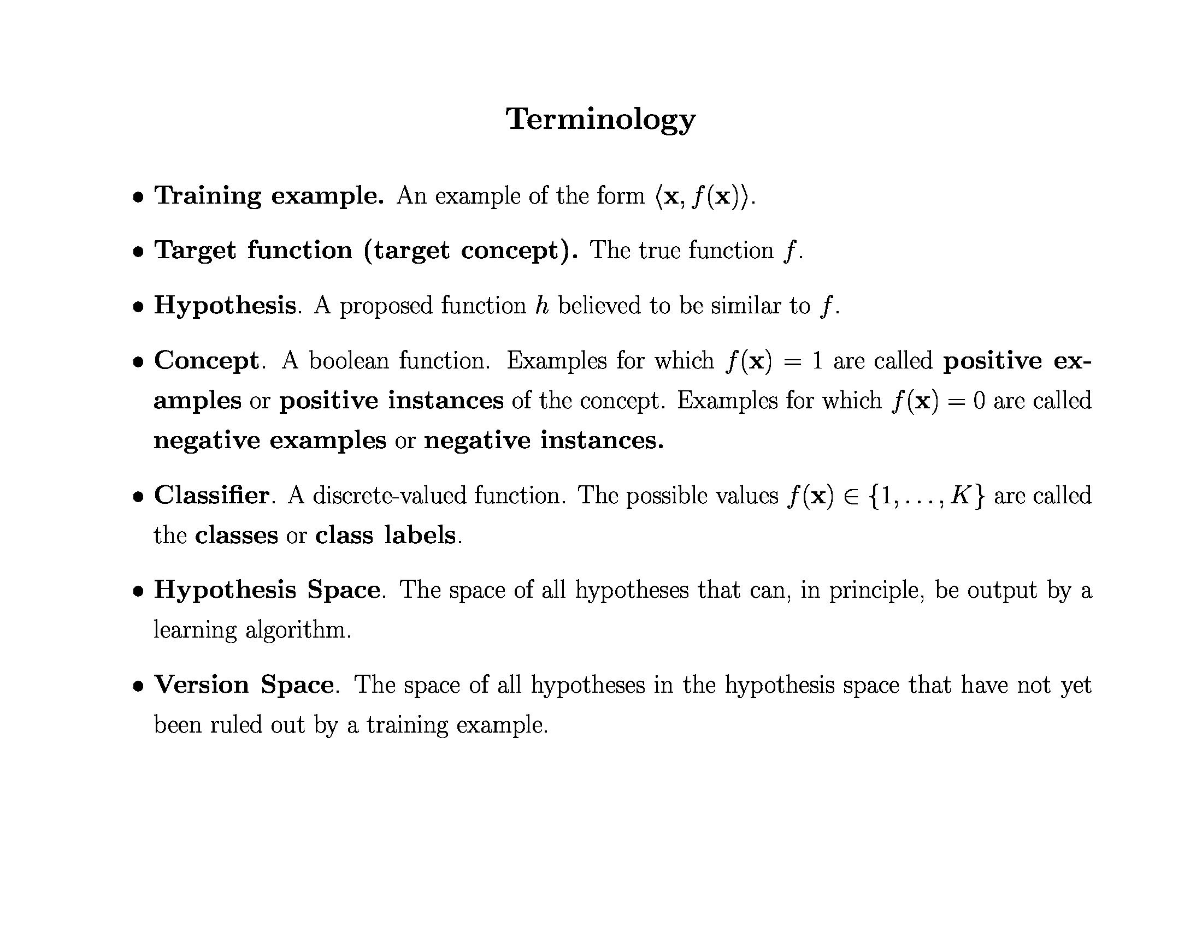

Slide 6
Outline
Decision Tree Representations
ID3 and C4.5 learning algorithms (Quinlan 1986)
CART learning algorithm (Breiman et al. 1985)
Entropy, Information Gain
Overfitting

Slide 7
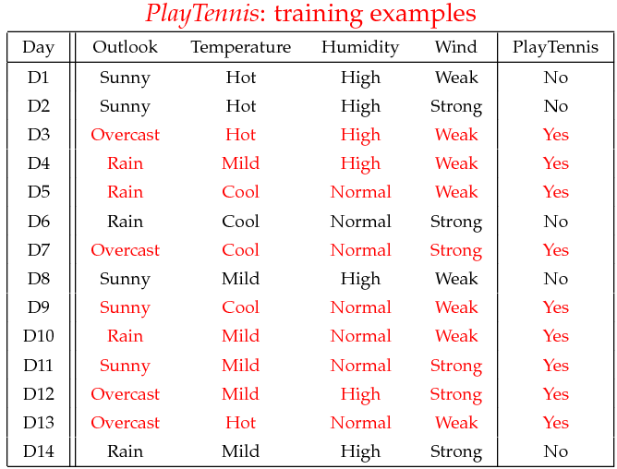
Training Data Example: Goal is to Predict When This Player Will Play Tennis?

Slide 10
Numeric Attributes
Use thresholds to convert numeric attributes into discrete values
Outlook
Sunny
Rain
Overcast
Humidity
Wind
Play
>= 10 MPH
< 10 MPH
>= 75%
< 75%
Don’t play
Play
Don’t play
Play

Slide 11
Entropy

Slide 12
Entropy is like a measure of impurity…

Slide 13
Entropy
50-50 class split
Maximum disorder
1.0
0.5
All positive
Pure distribution
% of example that are positive
.00 .50 1.00

Slide 14
Entropy

Slide 15
Entropy (disorder) is bad Homogeneity is good
Let S be a set of examples
Entropy(S) = -P log₂(P) - N log₂(N)
P is proportion of pos example
N is proportion of neg examples
0 log 0 == 0
Example: S has 9 pos and 5 neg Entropy([9+, 5-]) = -(9/14) log₂(9/14) - (5/14)log₂(5/14)
-(0.6428)LOG2(0.6428)-(0.357)LOG2(0.357)
= 0.940

Slide 16
Information Gain
Measure of expected reduction in entropy
Resulting from splitting along an attribute
Σ
v ∈ Values(A)
Gain(S,A) = Entropy(S) - (|Sv| / |S|) Entropy(Sv)
Where Entropy(S) = -P log₂(P) - N log₂(N)

Slide 17
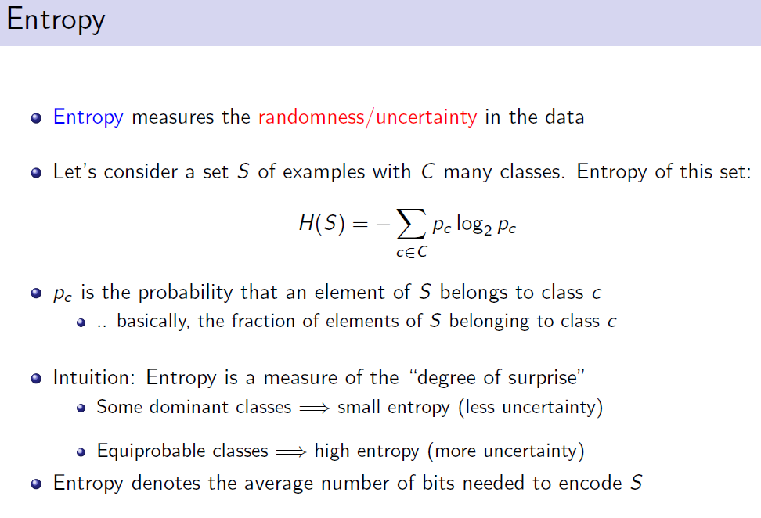

Slide 18
Information Gain

Slide 19
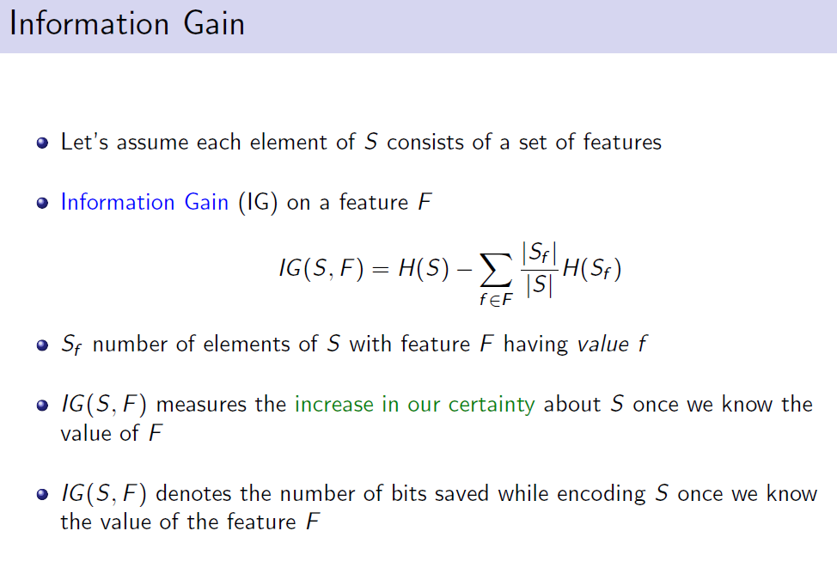

Slide 20
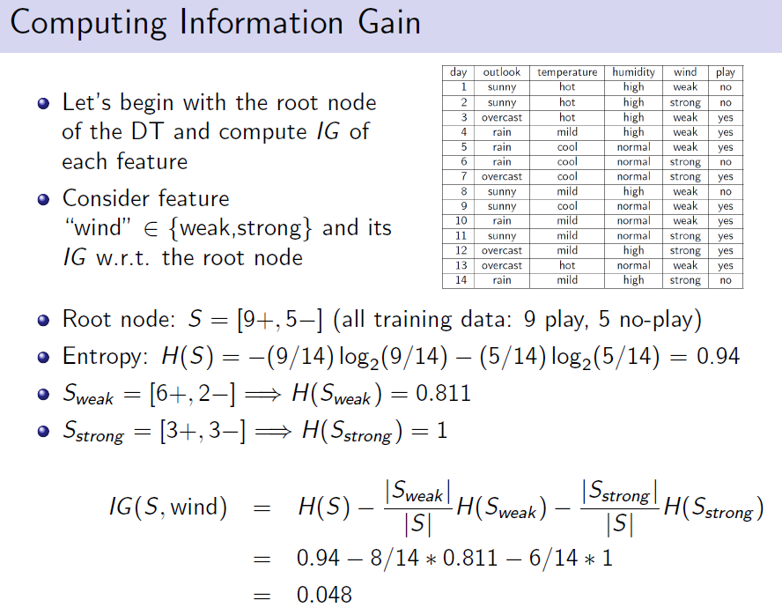

Slide 21
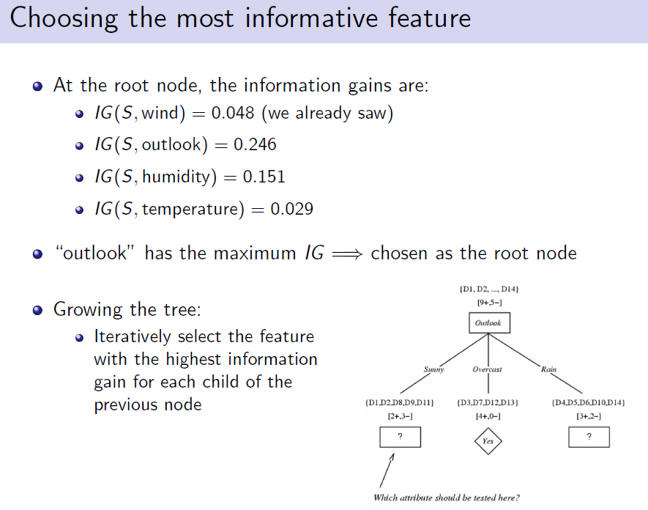

Slide 22
Gain of Splitting on Wind
Values(wind)=weak, strong
S = [9+, 5-]
Day Wind Tennis?
d1 weak n
d2 s n
d3 weak yes
d4 weak yes
d5 weak yes
d6 s n
d7 s yes
d8 weak n
d9 weak yes
d10 weak yes
d11 s yes
d12 s yes
d13 weak yes
d14 s n
S_{weak} = [6+, 2-]
S_{s} = [3+, 3-]
Gain(S, wind)
= Entropy(S) - (|S_{v}| / |S|) Entropy(S_{v})
= Entropy(S) - 8/14 Entropy(S_{weak})
- 6/14 Entropy(S_{s})
= 0.940 - (8/14) 0.811 - (6/14) 1.00
= .048
Σ
v ∈ {weak, s}

Slide 23
Decision Tree Algorithm
BuildTree(TraingData)
Split(TrainingData)
Split(D)
If (all points in D are of the same class)
Then Return
For each attribute A
Evaluate splits on attribute A
Use best split to partition D into D1, D2
Split (D1)
Split (D2)

Slide 24
Training Example

Slide 26
One Step Later
Good day for tennis?
Outlook
Sunny
Rain
Overcast
Humidity
Don’t Play
[2+, 3-]
Play
[4+]
High
Normal
Don’t play
[3-]
Play
[2+]

Slide 27
Recurse Again
Good day for tennis?
Outlook
Sunny
Medium
Overcast
Humidity
Day Temp Humid Wind Tennis?
d4 m h weak yes
d5 c n weak yes
d6 c n s n
d10 m n weak yes
d14 m h s n
High
Low

Slide 28
One Step Later: Final Tree
Good day for tennis?
Outlook
Sunny
Rain
Overcast
Humidity
Wind
Play
[4+]
Strong
Weak
High
Normal
Don’t play
[2-]
Play
[3+]
Don’t play
[3-]
Play
[2+]

Slide 29
Non-Boolean Features
Features with multiple discrete values
Multi-way splits
Test for one value versus the rest
Group values into disjoint sets
Real-valued features
Use thresholds
Regression
Splits based on mean squared error metric

Slide 30
Hypothesis Space Search
You do not get the globally optimal tree!
Search space is exponential.

Slide 31
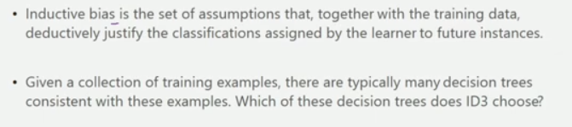
INDUCTIVE BIAS IN DECISION TREE LEARNING

Slide 32
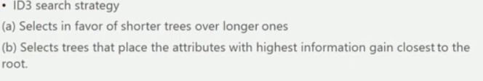
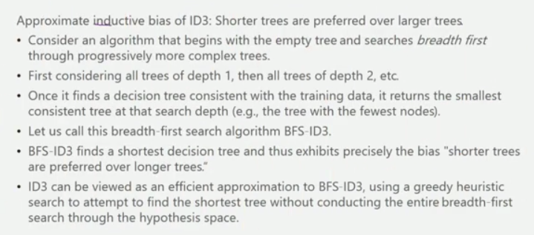

Slide 33
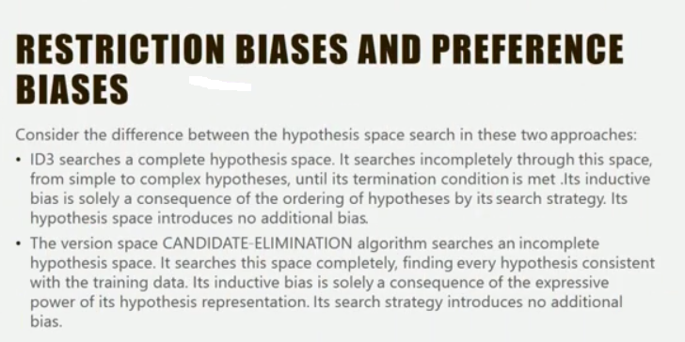

Slide 34
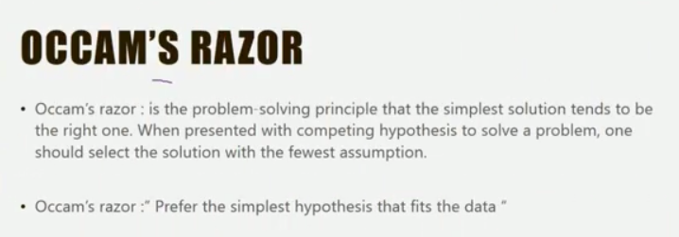
WHY PREFER SHORT HYPOTHESIS

Slide 35
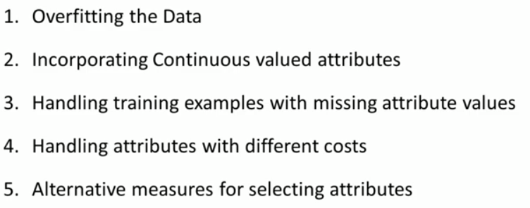
ISSUES IN DECISION TREE LEARNING

Slide 36
Overfitting

Slide 37
Overfitting in Decision Trees

Slide 38
Validation Data is Used to Control Overfitting
Prune tree to reduce error on validation set

Slide 39
Overfitting
On training data
On test data
Accuracy
0.9
0.8
0.7
0.6
Number of Nodes in Decision tree

Slide 40
Overfitting Definition
DT is overfit when exists another DT’ and
DT has smaller error on training examples, but
DT has bigger error on test examples
Causes of overfitting
Noisy data, or
Training set is too small
Solutions
Reduced error pruning
Early stopping
Rule post pruning

Slide 41
Reduced Error Pruning
Split data into train and validation set
Repeat until pruning is harmful
Remove each subtree and replace it with majority class and evaluate on validation set
Remove subtree that leads to largest gain in accuracy
Test
Tune
Tune
Tune

Slide 42
Reduced Error Pruning Example
Outlook
Sunny
Rain
Overcast
Humidity
Wind
Play
Strong
Weak
High
Low
Don’t play
Play
Don’t play
Play
Validation set accuracy = 0.75

Slide 43
Reduced Error Pruning Example
Outlook
Sunny
Rain
Overcast
Don’t play
Wind
Play
Strong
Weak
Don’t play
Play
Validation set accuracy = 0.80

Slide 44
Reduced Error Pruning Example
Outlook
Sunny
Rain
Overcast
Humidity
Play
Play
High
Low
Don’t play
Play
Validation set accuracy = 0.70

Slide 45
Reduced Error Pruning Example
Outlook
Sunny
Rain
Overcast
Don’t play
Wind
Play
Strong
Weak
Don’t play
Play
Use this as final tree

Slide 46
Early Stopping
On training data
On test data
On validation data
Accuracy
Remember this tree and use it as the final classifier
0.9
0.8
0.7
0.6
Number of Nodes in Decision tree

Slide 47
Post Rule Pruning
Split data into train and validation set
Prune each rule independently
Remove each pre-condition and evaluate accuracy
Pick pre-condition that leads to largest improvement in accuracy
Note: ways to do this using training data and statistical tests

Slide 48
Conversion to Rule
Outlook
Sunny
Rain
Overcast
Humidity
Wind
Play
Strong
Weak
High
Low
Don’t play
Play
Don’t play
Play
Outlook = Sunny ∧ Humidity = High ⇒ Don’t play
Outlook = Sunny ∧ Humidity = Low ⇒ Play
Outlook = Overcast ⇒ Play
…

Slide 49
Example
Outlook = Sunny ∧ Humidity = High ⇒ Don’t play
Validation set accuracy = 0.68
Outlook = Sunny ⇒ Don’t play
Validation set accuracy = 0.65
Humidity = High ⇒ Don’t play
Validation set accuracy = 0.75
Keep this rule

Slide 50
Summary
Overview of inductive learning
Hypothesis spaces
Inductive bias
Components of a learning algorithm
Decision trees
Algorithm for constructing trees
Issues (e.g., real-valued data, overfitting)

