Slide 1
CS601PC:MACHINE LEARNING
III CSM
A SRINIVAS
SSIT

Slide 2
Textbook
Tom M. Mitchell
Machine Learning
McGraw-Hill, New York

Slide 3
Unit-1 chapter-2

Slide 4
CHAPTER-2 Concept learning and the General-to-specific ordering
CONTENTS:
Introduction
A concept learning task
Concept learning as search
Find-S:Finding a Maximally specific Hypotheses
Version spaces and the CANDIDATE-Elimination algorithm with remarks
Inductive bias

Slide 5
Concept Learning
Concepts or Categories
“birds”
“car”
“situations in which I should study more in order to pass the exam”
Concept
some subset of objects or events defined over a larger set, or a boolean valued function defined over this larger set.

Slide 6
Learning
inducing general functions from specific training examples
Concept Learning
acquiring the definition of a general category given a sample of positive and negative training examples of the category

Slide 7
A Concept Learning Task
Target Concept
“days on which Aldo enjoys water sport”
Hypothesis
vector of 6 constraints (Sky, AirTemp, Humidity, Wind, Water, Forecast, EnjoySport )
Each attribute (“?”, single value or “0”)
e.g. <?, Cold, High, ?, ?, ?>

Slide 8
HYPOTHESIS
A hypothesis is an explanation for something.
It is a provisional idea, an educated guess that requires some evaluation.
A good hypothesis is testable; it can be either true or false.

Slide 9
What Is a Hypothesis in Machine Learning?
An example of a model that approximates the target function and performs mappings of inputs to outputs is called a hypothesis in machine learning.
Learning for a machine learning algorithm involves navigating the chosen space of hypothesis toward the best or a good enough hypothesis that best approximates the target function.
Learning is a search through the space of possible hypotheses for one that will perform well, even on new examples beyond the training set.

Slide 10
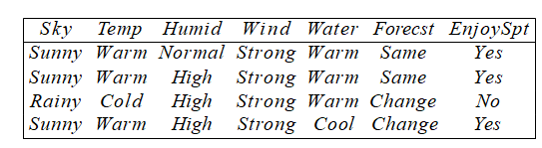
Training Examples for EnjoySport
What is the general concept?

Slide 11
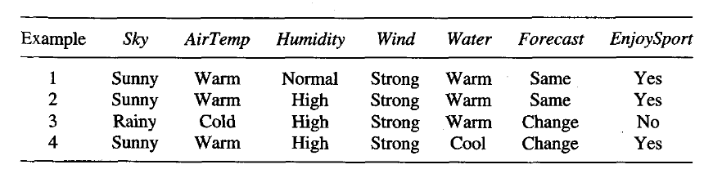
Inferring a boolean-valued function from training examples of its input and output.
Ex: Enjoy water sport or not

Slide 12

? --- Any value is acceptable
--- No value is acceptable
Any specific attribute value.
For example some player enjoying sport on sunny day and in warm water independent of other attribute values then hypothesis can be represented as
<sunny,?,?,?,warm,?>
On any day player enjoys sport then
hypothesis is <?,?,?,?,?,?>
On no day player enjoys sport then
hypothesis is

Slide 13
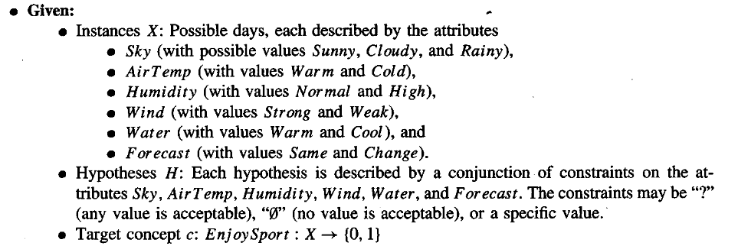


Slide 14
NOTATION
Given :
instances (X): set of iterms over which the concept is defined.
target concept (c) : c : X → {0, 1}
training examples (positive/negative) : <x,c(x)>
training set D: available training examples
set of all possible hypotheses: H
Determine :
to find h(x) = c(x) (for all x in X)

Slide 15
Inductive Learning Hypothesis
Inductive Learning Hypothesis
Any good hypothesis over a sufficiently large set of training examples will also approximate the target function. well over unseen examples.

Slide 16
Concept Learning as Search
Issue of Search
to find training examples hypothesis that best fits training examples
Kinds of Space in EnjoySport
3*2*2*2*2 = 96: instant space
5*4*4*4*4 = 5120: syntactically distinct hypotheses within H
1+4*3*3*3*3 = 973: semantically distinct hypotheses

Slide 17
Search Problem
efficient search in hypothesis space(finite/infinite)

Slide 18
Approaches to learning algorithms
The choice of the hypothesis
space reduces the number of
hypotheses.
Brute force search
Enumerate all possible hypotheses and evaluate
Highly inefficient even for small EnjoySport example
|X| = 3.2.2.2.2= 96 distinct instances
Large number of syntactically distinct hypotheses (0’s, ?’s)
EnjoySport: |H| = 5.4.4.4.4.4=5120
Fewer when consider h’s with 0’s
Every h with a 0 is empty set of instances (classifies instance as neg)
Hence # semantically distinct h’s is:
1+ (4.3.3.3.3.3) = 973
EnjoySport is VERY small problem compared to many
Hence use other search procedures.
Approach 1: Search based on ordering of hypotheses
Approach 2: Search based on finding all possible hypotheses using
a good representation of hypothesis space
All hypotheses that fit data

Slide 19
General-to-specific ordering of hypotheses
Instances X
Hypotheses H
Specific
x
1
h
1
h₃
x₂
h ₂
General
x₁= <Sunny, Warm, High, Strong, Cool, Same>
h ₁= <Sunny, ?, ?, Strong, ?, ?>
x = <Sunny, Warm, High, Light, Warm, Same>
h = <Sunny, ?, ?, ?, ?, ?>
2
2
h = <Sunny, ?, ?, ?, Cool, ?>
3

Slide 20
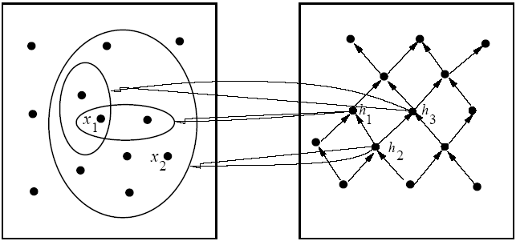
Ordering on Hypotheses
Instances X
Hypotheses H
specific
general
x₁=⟨Sunny Warm High Strong Cool Same⟩
x₂=⟨Sunny Warm High Light Warm Same⟩
h₁=⟨Sunny ? ? Strong ? ?⟩
h₂=⟨Sunny ? ? ? ? ?⟩
h₃=⟨Sunny ? ? ? Cool ?⟩
h is more general than h′( h ≥_{g} h′) if for each instance x, h′(x) = 1 → h(x) = 1
Which is the most general/most specific hypothesis?

Slide 21

FINDING A MAXIMALLY SPECIFIC HYPOTHESIS
Most specific hypothesis
After first example
After Second example

Slide 22
Third example is negative example, so no change in the hypothesis.
After fourth example

Slide 23
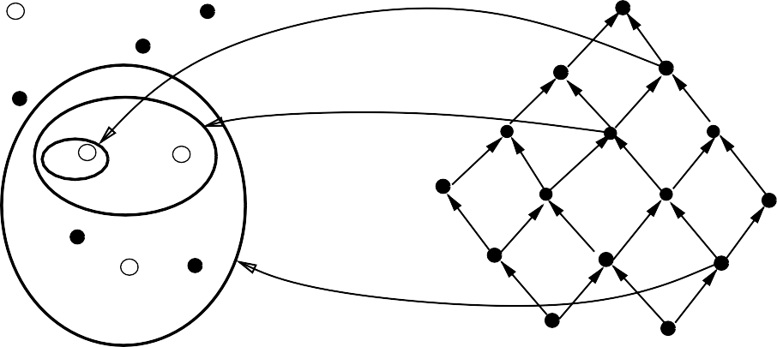
Hypothesis Space Search by Find-S
Instances X
Hypotheses H
-
h₀
Specific
x ₃
h
1
x +
_{x}+
^{h} 2,3
1
2
_{x}+
h ₄
General
4
h₀ = <∅, ∅, ∅, ∅, ∅, ∅>
x
= <Sunny Warm Normal Strong Warm Same>, +
h₁ = <Sunny Warm Normal Strong Warm Sam
1
x ₂ = <Sunny Warm High Strong Warm Same>, +
x ₃ = <Rainy Cold High Strong Warm Change>, - x ₄ = <Sunny Warm High Strong Cool Change>, +
h₂ = <Sunny Warm ? Strong Warm Same>
h = <Sunny Warm ? Strong Warm Same>
3
h = <Sunny Warm ? Strong ? ? >
4

Slide 24
Find-S Algorithm
Assumes
There is hypothesis h in H describing target function c
There are no errors in the TEs
Procedure
Initialize h to the most specific hypothesis in H (what is this?)
For each positive training instance x
For each attribute constraint a_{i} in h
If the constraint a_{i} in h is satisfied by x
do nothing
Else
replace a_{i} in h by the next more general constraint that is satisfied by x
Output hypothesis h
Note
There is no change for a negative example, so they are ignored.
This follows from assumptions that there is h in H describing target function c (ie.,for this h, h=c)
and that there are no errors in data. In particular, it follows that the hypothesis at any stage cannot be changed by neg example.
Assumption: Everything except the positive
examples is negative

Slide 25
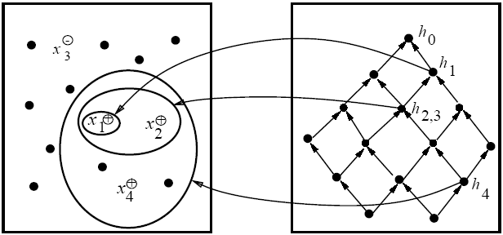
Example of Find-S
Instances X
Hypotheses H
specific
general
h₀=⟨∅ ∅ ∅ ∅ ∅ ∅⟩
h₁=⟨Sunny Warm Normal Strong Warm Same⟩
h₂=⟨Sunny Warm ? Strong Warm Same⟩
h₃=⟨Sunny Warm ? Strong Warm Same⟩
h₄=⟨Sunny Warm ? Strong ? ?⟩
x₁=⟨Sunny Warm Normal Strong Warm Same⟩ +
x₂=⟨Sunny Warm High Strong Warm Same⟩ +
x₃=⟨Rainy Cold High Strong Warm Change⟩ −
x₄=⟨Sunny Warm High Strong Cool Change⟩ +

Slide 26
Complaints about Find-S
Can't tell whether it has learned concept
Can't tell when training data inconsistent
Picks a maximally speci c h (why?)
Depending on H, there might be several!

Slide 27
Problems with Find-S
Problems:
Throws away information!
Negative examples
Can’t tell whether it has learned the concept
Depending on H, there might be several h’s that fit TEs!
Picks a maximally specific h (why?)
Can’t tell when training data is inconsistent
Since ignores negative TEs
But
It is simple
Outcome is independent of order of examples
Why?
What alternative overcomes these problems?
Keep all consistent hypotheses!
Candidate elimination algorithm

Slide 28
REVISION(FIND-S)
Find-S algorithm is a basic concept learning algorithm in machine learning.
Find-S algorithm finds the most specific hypothesis that fits all the positive examples. We have to note here that the algorithm considers only those positive training example.
Find-S algorithm starts with the most specific hypothesis and generalizes this hypothesis each time it fails to classify an observed positive training data.
Hence, Find-S algorithm moves from the most specific hypothesis to the most general hypothesis.

Slide 29
Important Representation :
? indicates that any value is acceptable for the attribute.
specify a single required value ( e.g., Cold ) for the attribute.
ϕindicates that no value is acceptable.
The most general hypothesis is represented by: {?, ?, ?, ?, ?, ?}
The most specific hypothesis is represented by : {ϕ, ϕ, ϕ, ϕ, ϕ, ϕ}

Slide 30
Steps Involved In Find-S :
Start with the most specific hypothesis. h = {ϕ, ϕ, ϕ, ϕ, ϕ, ϕ}
Take the next example and if it is negative, then no changes occur to the hypothesis.
If the example is positive and we find that our initial hypothesis is too specific then we update our current hypothesis to general condition.
Keep repeating the above steps till all the training examples are complete.
After we have completed all the training examples we will have the final hypothesis when can used to classify the new examples.

Slide 31
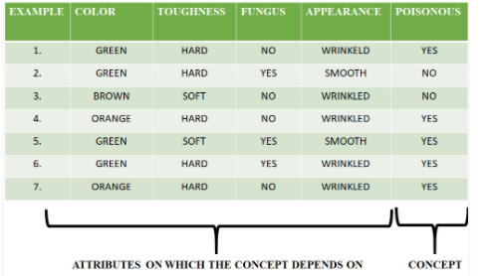
EXAMPLE2: Consider the following data set having the data about which particular seeds are poisonous

Slide 32
First we consider the hypothesis to be more specific hypothesis. Hence, our hypothesis would be : h = {ϕ, ϕ, ϕ, ϕ, ϕ, ϕ}
Consider example 1 :
The data in example 1 is { GREEN, HARD, NO, WRINKLED }. We see that our initial hypothesis is more specific and we have to generalize it for this example. Hence, the hypothesis becomes : h = { GREEN, HARD, NO, WRINKLED }
Consider example 2 : Here we see that this example has a negative outcome. Hence we neglect this example and our hypothesis remains the same. h = { GREEN, HARD, NO, WRINKLED }
Consider example 3 : Here we see that this example has a negative outcome. Hence we neglect this example and our hypothesis remains the same. h = { GREEN, HARD, NO, WRINKLED }

Slide 33
Consider example 4 : The data present in example 4 is { ORANGE, HARD, NO, WRINKLED }. We compare every single attribute with the initial data and if any mismatch is found we replace that particular attribute with general case ( ” ? ” ). After doing the process the hypothesis becomes : h = { ?, HARD, NO, WRINKLED }
Consider example 5 : The data present in example 5 is { GREEN, SOFT, YES, SMOOTH }. We compare every single attribute with the initial data and if any mismatch is found we replace that particular attribute with general case ( ” ? ” ). After doing the process the hypothesis becomes : h = { ?, ?, ?, ? } Since we have reached a point where all the attributes in our hypothesis have the general condition, the example 6 and example 7 would result in the same hypothesizes with all general attributes. h = { ?, ?, ?, ? }
Hence, for the given data the final hypothesis would be : Final Hyposthesis: h = { ?, ?, ?, ? }

Slide 34
Consistent Hypotheses and Version Space
A hypothesis h is consistent with a set of training examples D of target concept c if h(x) = c(x) for each training example ⟨x, c(x)⟩ in D
Note that consistency is with respect to specific D.
Notation: Consistent (h, D) ≡ ∀⟨x, c(x)⟩∈D :: h(x) = c(x)
The version space, VS_{H,D} , with respect to hypothesis space H and training examples D, is the subset of hypotheses from H consistent with D
Notation: VS_{H,D} = {h | h ∈ H ∧ Consistent (h, D)}

Slide 35
List-Then-Eliminate Algorithm
VersionSpace ← list of all hypotheses in H
For each training example ⟨x, c(x)⟩
remove from VersionSpace any hypothesis h for which h(x) ≠ c(x)
Output the list of hypotheses in VersionSpace
This is essentially a brute force procedure

Slide 36
Example of Find-S, Revisited
Instances X
Hypotheses H
specific
general
h₀=⟨∅ ∅ ∅ ∅ ∅ ∅⟩
h₁=⟨Sunny Warm Normal Strong Warm Same⟩
h₂=⟨Sunny Warm ? Strong Warm Same⟩
h₃=⟨Sunny Warm ? Strong Warm Same⟩
h₄=⟨Sunny Warm ? Strong ? ?⟩
x₁=⟨Sunny Warm Normal Strong Warm Same⟩ +
x₂=⟨Sunny Warm High Strong Warm Same⟩ +
x₃=⟨Rainy Cold High Strong Warm Change⟩ −
x₃=⟨Sunny Warm High Strong Cool Change⟩ +

Slide 37
Version Space for this Example
S
{ }
⟨Sunny Warm ? Strong ? ?⟩
⟨Sunny ? ? Strong ? ?⟩
⟨Sunny Warm ? ? ? ?⟩
⟨? Warm ? Strong ? ?⟩
G
{ , }
⟨Sunny ? ? ? ? ?⟩
⟨? Warm ? ? ? ?⟩

Slide 38
Representing Version Spaces
Want more compact representation of VS
Store most/least general boundaries of space
Generate all intermediate h’s in VS
Idea that any h in VS must be consistent with all TE’s
Generalize from most specific boundaries
Specialize from most general boundaries
The general boundary, G, of version space VS_{H,D} is the set of its maximally general members consistent with D
Summarizes the negative examples; anything more general will cover a negative TE
The specific boundary, S, of version space VS_{H,D} is the set of its maximally specific members consistent with D
Summarizes the positive examples; anything more specific will fail to cover a positive TE

Slide 39
Theorem
Every member of the version space lies between the S,G boundary
VS_{H,D} = {h | h ∈ H ∧ ∃s∈S ∃g∈G (g ≥ h ≥ s)}
Must prove:
1) every h satisfying RHS is in VS_{H,D;}
2) every member of VS_{H,D} satisfies RHS.
For 1), let g, h, s be arbitrary members of G, H, S respectively with g>h>s
s must be satisfied by all + TEs and so must h because it is more general;
g cannot be satisfied by any – TEs, and so nor can h
h is in VS_{H,D} since satisfied by all + TEs and no – TEs
For 2),
Since h satisfies all + TEs and no – TEs, h ≥ s, and g ≥ h.

Slide 40
Candidate Elimination Algorithm
G ← maximally general hypotheses in H
S ← maximally specific hypotheses in H
For each training example d, do
If d is positive
Remove from G every hypothesis inconsistent with d
For each hypothesis s in S that is inconsistent with d
Remove s from S
Add to S all minimal generalizations h of s such that
1. h is consistent with d, and
2. some member of G is more general than h
Remove from S every hypothesis that is more general than another hypothesis in S

Slide 41
Candidate Elimination Algorithm (cont)
If d is a negative example
Remove from S every hypothesis inconsistent with d
For each hypothesis g in G that is inconsistent with d
Remove g from G
Add to G all minimal specializations h of g such that
1. h is consistent with d, and
2. some member of S is more specific than h
Remove from G every hypothesis that is less general than another hypothesis in G
Essentially use
Pos TEs to generalize S
Neg TEs to specialize G
Independent of order of TEs
Convergence guaranteed if:
no errors
there is h in H describing c.

Slide 42
Training Examples for EnjoySport
What is the general concept?

Slide 43
Example
Recall : If d is positive
Remove from G every hypothesis inconsistent with d
For each hypothesis s in S that is inconsistent with d
Remove s from S
Add to S all minimal generalizations h of s that are specializations of a hypothesis in G
Remove from S every hypothesis that is more general than another hypothesis in S
S₀
{⟨∅ ∅ ∅ ∅ ∅ ∅⟩}
G₀
{⟨? ? ? ? ? ?⟩}
⟨Sunny Warm Normal Strong Warm Same⟩ +
S₁
{⟨Sunny Warm Normal Strong Warm Same⟩}
G₁
{⟨? ? ? ? ? ?⟩}

Slide 44
Example (contd)
S₁
{⟨Sunny Warm Normal Strong Warm Same⟩}
G₁
{⟨? ? ? ? ? ?⟩}
⟨Sunny Warm High Strong Warm Same⟩ +
S₂
{⟨Sunny Warm ? Strong Warm Same⟩}
G₂
{⟨? ? ? ? ? ?⟩}

Slide 45
Example (contd)
S₂
{⟨Sunny Warm ? Strong Warm Same⟩}
Recall: If d is a negative example
G₂
{⟨? ? ? ? ? ?⟩}
Remove from S every hypothesis inconsistent with d
For each hypothesis g in G that is inconsistent with d
Remove g from G
Add to G all minimal specializations h of g that generalize some hypothesis in S
Remove from G every hypothesis that is less general than another hypothesis in G
⟨Rainy Cold High Strong Warm Change⟩ −
Current G boundary is incorrect
So, need to make it more specific.
S₃
{⟨Sunny Warm ? Strong Warm Same⟩}
{ }
G₃
⟨Sunny ? ? ? ? ?⟩
, ⟨? Warm ? ? ? ?⟩
, ⟨? ? ? ? ? Same⟩

Slide 46
Example (contd)
Why are there no hypotheses left relating to:
⟨ Cloudy ? ? ? ? ?⟩
The following specialization using the third value
⟨? ? Normal ? ? ?⟩,
is not more general than the specific boundary
The specializations ⟨? ? ? Weak ? ?⟩,
⟨? ? ? ? Cool ?⟩ are also inconsistent with S
{⟨Sunny Warm ? Strong Warm Same⟩}

Slide 47
Example (contd)
S₃
{⟨Sunny Warm ? Strong Warm Same⟩}
G₃
{⟨Sunny ? ? ? ? ?⟩, ⟨? Warm ? ? ? ?⟩, ⟨? ? ? ? ?Same⟩}
⟨Sunny Warm High Strong Cool Change⟩ +
S₄
{⟨Sunny Warm ? Strong ? ?⟩}
G₄
{⟨Sunny ? ? ? ? ?⟩, ⟨? Warm ? ? ? ?⟩}

Slide 48
Example (contd)
⟨Sunny Warm High Strong Cool Change⟩ +
Why does this example remove a hypothesis from G?:
⟨? ? ? ? ? Same⟩
This hypothesis
Cannot be specialized, since would not cover new TE
Cannot be generalized, because more general would cover negative TE.
Hence must drop hypothesis.

Slide 49
Version Space of the Example
S
{⟨Sunny Warm ? Strong ? ?⟩}
⟨Sunny ? ? Strong ? ?⟩
⟨Sunny Warm ? ? ? ?⟩
⟨? Warm ? Strong ? ?⟩
S
G
{⟨Sunny ? ? ? ? ?⟩, ⟨? Warm ? ? ? ?⟩}
version
space
G

Slide 50
REVISION(CANDIDATE ELIMINATON ALGORITHM)
The candidate elimination algorithm incrementally builds the version space given a hypothesis space H and a set E of examples. The examples are added one by one; each example possibly shrinks the version space by removing the hypotheses that are inconsistent with the example. The candidate elimination algorithm does this by updating the general and specific boundary for each new example.
You can consider this as an extended form of Find-S algorithm.
Consider both positive and negative examples.
Actually, positive examples are used here as Find-S algorithm (Basically they are generalizing from the specification).
While the negative example is specified from generalize form.

Slide 51
Concept learning: Concept learning is basically learning task of the machine (Learn by Train data)
General Hypothesis: Not Specifying features to learn the machine.
G = {‘?’, ‘?’,’?’,’?’…}: Number of attributes
Specific Hypothesis: Specifying features to learn machine (Specific feature)
S= {‘pi’,’pi’,’pi’…}: Number of pi depends on number of attributes.
Version Space: It is intermediate of general hypothesis and Specific hypothesis. It not only just written one hypothesis but a set of all possible hypothesis based on training data-set.

Slide 52
Algorithm:
Step1: Load Data set
Step2: Initialize General Hypothesis and Specific Hypothesis.
Step3: For each training example
Step4: If example is positive example if attribute_value == hypothesis_value: Do nothing else: replace attribute value with '?' (Basically generalizing it)
Step5: If example is Negative example Make generalize hypothesis more specific.

Slide 54
Algorithmic steps:
Initially : G = [[?, ?, ?, ?, ?, ?], [?, ?, ?, ?, ?, ?], [?, ?, ?, ?, ?, ?], [?, ?, ?, ?, ?, ?], [?, ?, ?, ?, ?, ?], [?, ?, ?, ?, ?, ?]]
S = [Null, Null, Null, Null, Null, Null]
For instance 1 : <'sunny','warm','normal','strong','warm ','same'> and positive output.
G1 = G
S1 = ['sunny','warm','normal','strong','warm ','same']
For instance 2 : <'sunny','warm','high','strong','warm ','same'> and positive output.
G2 = G
S2 = ['sunny','warm',?,'strong','warm ','same']
For instance 3 : <'rainy','cold','high','strong','warm ','change'> and negative output.
G3 = [['sunny', ?, ?, ?, ?, ?], [?, 'warm', ?, ?, ?, ?], [?, ?, ?, ?, ?, ?], [?, ?, ?, ?, ?, ?], [?, ?, ?, ?, ?, ?], [?, ?, ?, ?, ?, 'same']]
S3 = S2
For instance 4 : <'sunny','warm','high','strong','cool','change'> and positive output.
G4 = G3
S4 = ['sunny','warm',?,'strong', ?, ?]
At last, by synchronizing the G4 and S4 algorithm produce the output.

Slide 55
Output :
G = [['sunny', ?, ?, ?, ?, ?], [?, 'warm', ?, ?, ?, ?]]
S = ['sunny','warm',?,'strong', ?, ?]

Slide 56
Remarks on version space and candidate elimination algorithm
Will the candidate elimination algorithm converge to the correct hypothesis
What training example should the learner request next?
How can partially learned concepts be used?

Slide 57
Convergence of algorithm
Convergence guaranteed if:
no errors
there is h in H describing c.
Ambiguity removed from VS when S = G
Containing single h
When have seen enough TEs
If have false negative TE, algorithm will remove every h consistent with TE, and hence will remove correct target concept from VS
If observe enough TEs will find that S, G boundaries converge to empty VS

Slide 58
Which Next Training Example?
S
{⟨Sunny Warm ? Strong ? ?⟩}
⟨Sunny ? ? Strong ? ?⟩
⟨Sunny Warm ? ? ? ?⟩
⟨? Warm ? Strong ? ?⟩
G
{⟨Sunny ? ? ? ? ?⟩, ⟨? Warm ? ? ? ?⟩}
Order of examples matters for intermediate sizes of S,G; not for the final S, G
Αssume learner can choose the next TE
Should choose d such that
Reduces maximally the number of hypotheses in VS
Best TE: satisfies precisely 50% hypotheses;
Can’t always be done
Example:
⟨Sunny Warm Normal Weak Warm Same⟩ ?
If pos, generalizes S
If neg, specializes G

Slide 59
Classifying new cases using VS
S
{⟨Sunny Warm ? Strong ? ?⟩}
⟨Sunny ? ? Strong ? ?⟩
⟨Sunny Warm ? ? ? ?⟩
⟨? Warm ? Strong ? ?⟩
G
{⟨Sunny ? ? ? ? ?⟩, ⟨? Warm ? ? ? ?⟩}
Use voting procedure on following examples:
⟨Sunny Warm Normal Strong Cool Change⟩
⟨Rainy Cool Normal Weak Warm Same⟩
⟨Sunny Warm Normal Weak Warm Same⟩
⟨Sunny Cold Normal Strong Warm Same⟩

Slide 60
Inductive bias
A biased hypothesis space
An unbiased learner
The fultility of bias free training

Slide 61
Effect of incomplete hypothesis space
Preceding algorithms work if target function is in H
Will generally not work if target function not in H
Consider following examples which represent target function
“sky = sunny or sky = cloudy”:
⟨Sunny Warm Normal Strong Cool Change⟩ Y
⟨Cloudy Warm Normal Strong Cool Change⟩ Y
⟨⟨Rainy Warm Normal Strong Cool Change⟩ N
If apply CE algorithm as before, end up with empty VS
After first two TEs, S= ⟨? Warm Normal Strong Cool Change⟩
New hypothesis is overly general
it covers the third negative TE!
Our H does not include the appropriate c
Need more expressive hypotheses

Slide 62
Incomplete hypothesis space
If c not in H, then consider generalizing representation of H to contain c
For example, add disjunctions or negations to representation of hypotheses in H
One way to avoid problem is to allow all possible representations of h’s
Equivalent to allowing all possible subsets of instances as defining the concept of EnjoySport
Recall that there are 96 instances in EnjoySport; hence there are 2⁹⁶ possible hypotheses in full space H
Can do this by using full propositional calculus with AND, OR, NOT
Hence H defined only by conjunctions of attributes is biased (containing only 973 h’s)

Slide 63
Unbiased Learners and Inductive Bias
BUT if have no limits on representation of hypotheses
(i.e., full logical representation: and, or, not), can only learn examples…no generalization possible!
Say have 5 TEs {x1, x2, x3, x4, x5}, with x4, x5 negative TEs
Apply CE algorithm
S will be disjunction of positive examples (S={x1 OR x2 OR x3})
G will be negation of disjunction of negative examples (G={not (x4 or x5)})
Need to use all instances to learn the concept!
Cannot predict usefully:
TEs have unanimous vote
other h’s have 50/50 vote!
For every h in H that predicts +, there is another that predicts -

Slide 64
Unbiased Learners and Inductive Bias
Approach:
Place constraints on representation of hypotheses
Example of limiting connectives to conjunctions
Allows learning of generalized hypotheses
Introduces bias that depends on hypothesis representation
Need formal definition of inductive bias of learning algorithm

Slide 65
Inductive Syst and Equiv Deductive Syst
Inductive bias made explicit in equivalent deductive system
Logically represented system that produces same outputs (classification) from inputs (TEs, instance x, bias B) as CE procedure
Inductive bias (IB) of learning algorithm L is any minimal set of assertions B such that for any target concept c and training examples D, we can logically infer value c(x) of any instance x from B, D, and x
E.g., for rote learner, B = {}, and there is no IB
Difficult to apply in many cases, but a useful guide

Slide 66
Inductive Bias and specific learning algs
Rote learners:
no IB
Version space candidate elimination algorithm:
c can be represented in H
Find-S: c can be represented in H;
all instances that are not positive are negative

Slide 67
Computational Complexity of VS
The S set for conjunctive feature vectors and tree-structured attributes is linear in the number of features and the number of training examples.
The G set for conjunctive feature vectors and tree-structured attributes can be exponential in the number of training examples.
In more expressive languages, both S and G can grow exponentially.
The order in which examples are processed can significantly affect computational complexity.

Slide 68
Summary Points
1. Concept learning as search through H
2. General-to-speci c ordering over H
3. Version space candidate elimination algorithm
4. S and G boundaries characterize learner's uncertainty
5. Learner can generate useful queries
6. Inductive leaps possible only if learner is biased
7. Inductive learners can be modelled by equivalent deductive systems

