Slide 1

Rapid Electrical Support Team
Ad Astra Şadi Arif Yüksel Ahmet Berkay Öz Mustafa Emre Tufan Mehmet Tunahan Türkmen

Slide 2
Range anxiety and a lack of charging infrastructure are top concerns for consumers in most countries*
Lack of Charging Infrastructure
Driving Range
Time Required to Charge
*Gathered from Deloitte 2021 Global Automotive Consumer Study.

Slide 3
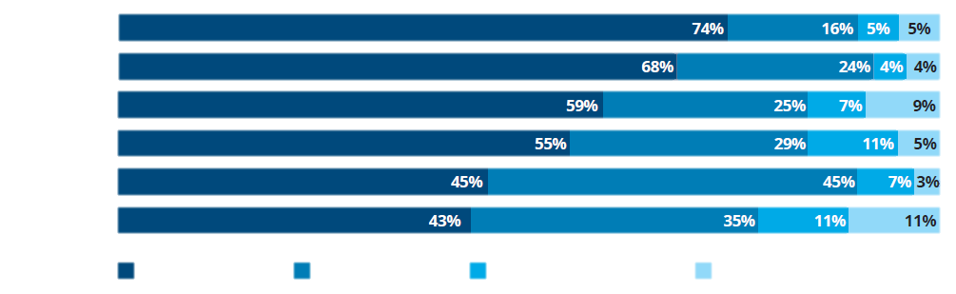
Consumer Powertrain Preferences For Their Next Vehicle
Non-Gasoline/Diesel(ICE) YoY
2020 | 2021
41% | 26%
49% | 32%
51% | 41%
57% | 45%
63% | 55%
58% | 57%
USA
India
Germany
China
Japan
Rep. of Korea
Gasoline/
Diesel(ICE)
Hybrid
Electric(HEV)
Battery Electric (BEV)
Other
Intention to buy a gasoline or diesel vehicle jumps back up, as consumers may be looking for the comfort of affordable, tried, and tested technology in uncertain times.**
**Gathered from Deloitte 2021 Global Automotive Consumer Study.

Slide 4
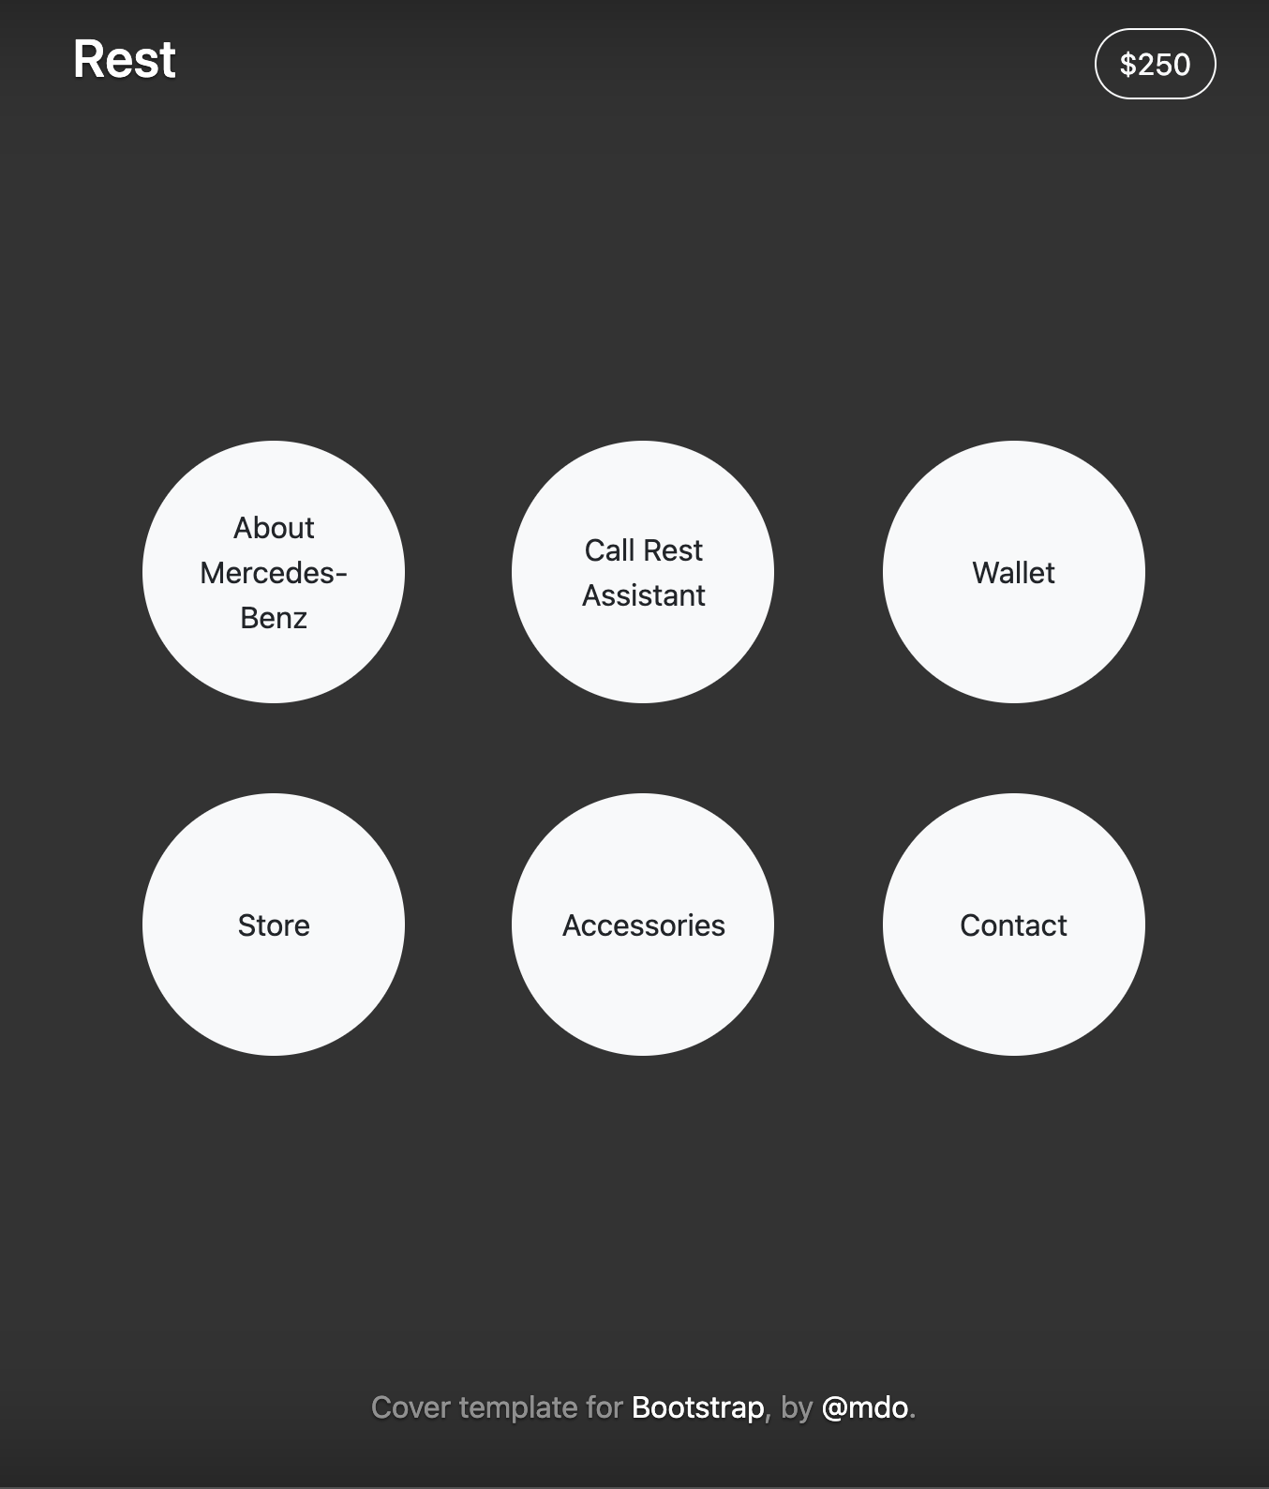
R.E.S.T.
Subscription
Live Monitoring with Notifications
Nearest Service Mapping
Appointment Management
Pick-Up Service
Change/Repairs
Blockchained Wallet → R.E.S.T.-Coin
Flexible Payment Methods

Slide 5
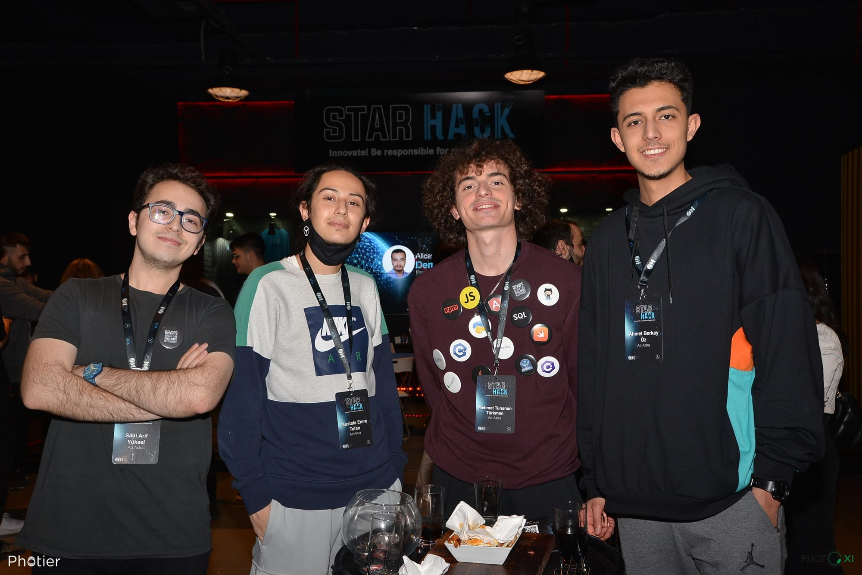
Get R.E.S.T, nevermind the rest.

Slide 6
Greatest concerns regarding all-battery-powered electric vehicles
Concern | United States | Germany | Japan | Rep. of Korea | China | India
Driving Range | 28% | 28% | 22% | 11% | 25% | 13%
Lack of Charging Infrastructure | 25% | 22% | 29% | 32% | 20% | 26%
Cost/Price Premium | 20% | 16% | 23% | 17% | 9% | 16%
Time Required to Charge | 13% | 13% | 15% | 18% | 13% | 14%
Safety Concerns | 8% | 12% | 10% | 19% | 29% | 25%
Lack of Choice | 4% | 5% | 1% | 3% | 4% | 6%
Other | 2% | 4% | 0% | 0% | 0% | 0%
Top Concerns
Range anxiety and a lack of charging infrastructure are top concerns for consumers in most countries.*
*Gathered from Deloitte 2021 Global Automotive Consumer Study.

