Slide 1
University Photography Project Architecture
Chris Katz
Alissa Cooper
Ashish Datta

Slide 2
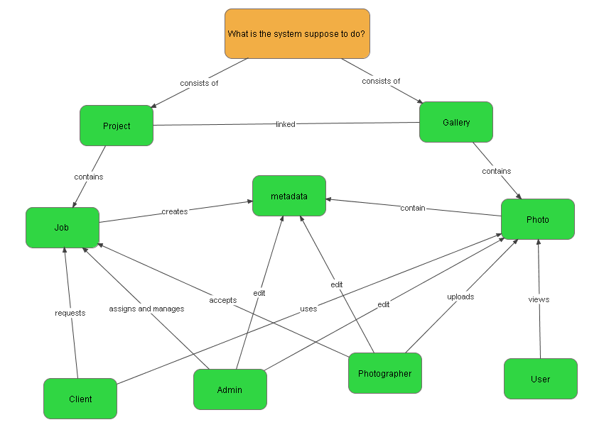
Concept Map

Slide 3
Module Viewpoint
Tufts Photography Website
Tufts LDAP System
User Options Page
Photo Archive Interface
Jobs Manager
Legend:
Module
Control Flow

Slide 4
LAMP Stack
App
Symfony
PHP
Apache/MySQL
Linux

Slide 5
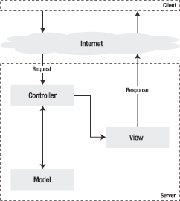
MVC Pattern

Slide 6
Class Diagram
Legend:
Uses
Contains
LDAP Auth
Inherits
Classes
Log
Project
User
Job
Shoot
Bill
Attachment
Photographer
Admin
Client

Slide 7
Allocation Viewpoint
Task | Chris | Ashish | Alissa
LDAP Interface | X
User Options Page |  |  | X
Jobs Manager UI |  |  | X
Jobs Manager Model | X | X
Jobs Manager Business Logic | X | X | X
Jobs Manager Testing |  |  | X
Photo Archive Interface |  | X
Legend:
Primary Person Responsible X

