Slide 1
Android JNI

Slide 2
JNI
Enables programmers to write native methods to handle situations when an application cannot be written entirely in the Java programming language

Slide 3
JNI
extern "C"
JNIEXPORT void JNICALL Java_ClassName_MethodName
(JNIEnv *env, jobject obj, jstring javaString)
{
const char *nativeString = env->GetStringUTFChars(javaString, 0);
//Do something with the nativeString
env->ReleaseStringUTFChars(javaString, nativeString);
}

Slide 4
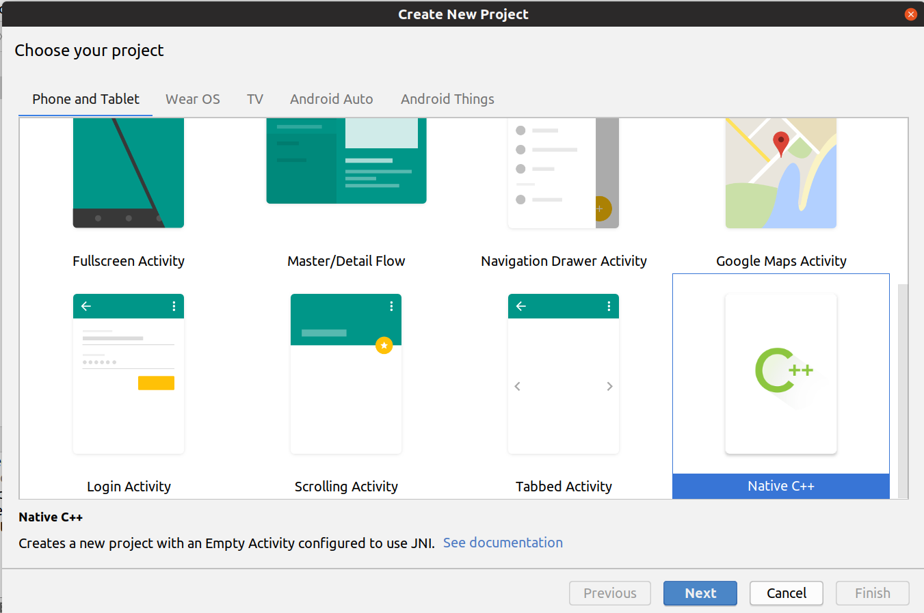
JNI in Android
Add C++ code

Slide 5
The Cmake file
CMake is an open-source, cross-platform family of tools designed to build, test and package software.
CmakeLists.txt
  add_library
  find_library
  target_link_libraries

Slide 6
Building using CMake
externalNativeBuild {
cmake {
path "src/main/cpp/CMakeLists.txt"
}
}

Slide 7
Wrapping C code
Include the library (usually in the app or main activity class)
static {
System.loadLibrary("native-lib");
}
Declare a native wrapper using the native keyword:
public native String stringFromJNI();
(no body)

Slide 8
Calling Java methods from native
jclass cls = (*env)->GetObjectClass(env, obj);
jmethodID mid = (*env)->GetMethodID(env, cls, "callback", "(I)V");
if (mid == 0)
return;
printf("In C, depth = %d, about to enter Java\n", depth);
(*env)->CallVoidMethod(env, obj, mid, depth);

Slide 9
Mapping methods
Signature Java Type
Z boolean
B byte
C char
S short
I int
J long
F float
D double
L fully-qualified-class ; fully-qualified-class
[ type type[]

Slide 10
Let’s read some mapping
(Ljava/lang/String;)Ljava/lang/String;
([Ljava/lang/String;)V
More on JNI: http://journals.ecs.soton.ac.uk/java/tutorial/native1.1/implementing/method.html
https://developer.android.com/ndk/samples/sample_hellojni

Slide 11
And for geeks
https://developer.android.com/ndk/samples/sample_na

Slide 12
Let’s read some mapping
(Ljava/lang/String;)Ljava/lang/String;
([Ljava/lang/String;)V
More on JNI: http://journals.ecs.soton.ac.uk/java/tutorial/native1.1/implementing/method.html
https://developer.android.com/ndk/samples/sample_hellojni

