Slide 1
OpenGL – hello triangle

Slide 2
The graphics pipeline
The 3D view
Shaders
GLSL

Slide 3
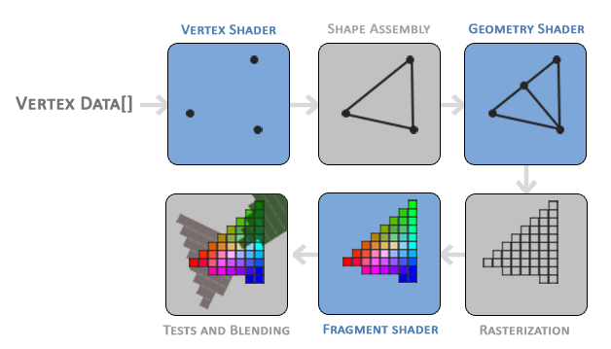
The graphics pipeline

Slide 4
Vertex & Vertex data
normalized device coordinates
float vertices[] = {
-0.5f, -0.5f, 0.0f,
0.5f, -0.5f, 0.0f,
0.0f, 0.5f, 0.0f
};

Slide 5
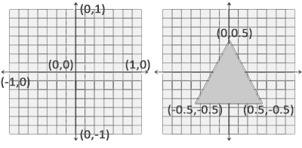
Vertex & Vertex data
normalized device coordinates

Slide 6
Preparing to pass data to vertex shader
creating memory on the GPU where we store the vertex data
configure how OpenGL should interpret the memory
specify how to send the data to the graphics card

Slide 7
Preparing to pass data to vertex shader
unsigned int VBO;
glGenBuffers(1, &VBO);
glBindBuffer(GL_ARRAY_BUFFER, VBO);
//Copy the vertices into the buffer’s memory
glBufferData(GL_ARRAY_BUFFER, sizeof(vertices), vertices, GL_STATIC_DRAW);

Slide 8
Preparing to pass data to vertex shader
GL_STATIC_DRAW: the data will most likely not change at all or very rarely.
GL_DYNAMIC_DRAW: the data is likely to change a lot.
GL_STREAM_DRAW: the data will change every time it is drawn.

Slide 9
Build vertex shader to
GL_STATIC_DRAW: the data will most likely not change at all or very rarely.
GL_DYNAMIC_DRAW: the data is likely to change a lot.
GL_STREAM_DRAW: the data will change every time it is drawn.

Slide 10
Build a fragment shader to
GL_STATIC_DRAW: the data will most likely not change at all or very rarely.
GL_DYNAMIC_DRAW: the data is likely to change a lot.
GL_STREAM_DRAW: the data will change every time it is drawn.

