Slide 1

DATA 609: Mathematical Modeling Techniques for Data Analytics
Homework 1

Slide 2
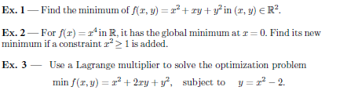
Module 1 Homework

