Slide 1

DATA 609: Mathematical Modeling Techniques for Data Analytics
Homework 3

Slide 2
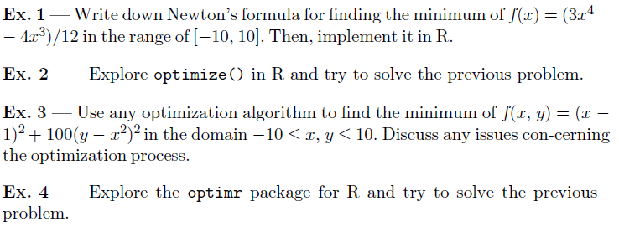
Module 3 Homework

