Slide 1

DATA 609: Mathematical Modeling Techniques for Data Analytics
Homework 4

Slide 2
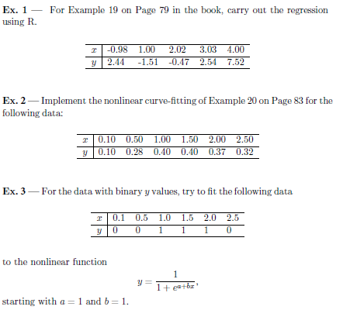
Module 4 Homework

