Slide 1

DATA 609: Mathematical Modeling Techniques for Data Analytics
Homework 5

Slide 2
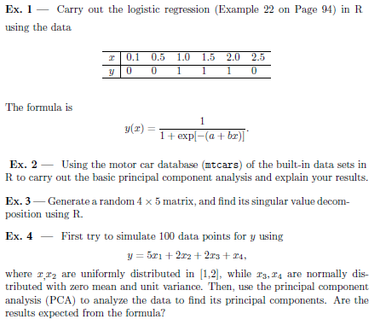
Module 5 Homework

