Slide 1

DATA 609: Mathematical Modeling Techniques for Data Analytics
Homework 6

Slide 2
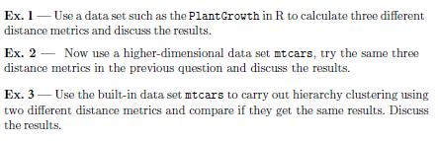
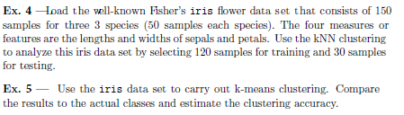
Module 6 Homework

