Slide 1

DATA 609: Mathematical Modeling Techniques for Data Analytics
Homework 7

Slide 2
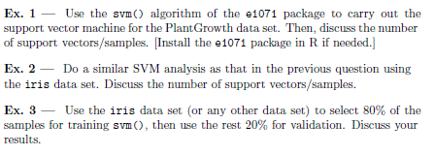
Module 7 Homework

