Slide 1
Network Security Subproject 3- Website Authentication
TA: CKChen
Mail: ckchen(at)cs.nctu.edu.tw

Slide 2
Outline
Project Overview
SubProject2 Review
SubProject3
Introduction
MITM
CA and Trust Chain
Grading Policy
Summary

Slide 3
Project Overview – Secure Message Board
In this semester, a secure message board system will be segregated into 3 subprojects.
A handful of security issues are included
Cryptography
Network Forensics
SSL
Individual project
No plagiarism is allowed.

Slide 4
Project Roadmap
Term Project – Secure Message Board
Subproject 1- Message Board with Encrypted Message
Subproject 2- Design and Defense of Password Thief
Subproject 3 - Website Authentication

Slide 5



Project Review
In previous subproject, we already have a website
Encrypt message in storage
Encrypt communication
Previous project, we concentrate on issue of confidential.
This project, we will practice issue of authentication
Server OS
Msg Board
Storage

Slide 6
Introduction
In this subproject, you need to …
Build a MITM(Man In The Middle) program to attack their website.
Construct a trusted certificate sign by TA’s certificate (and key) which can used to authenticate their website.

Slide 7
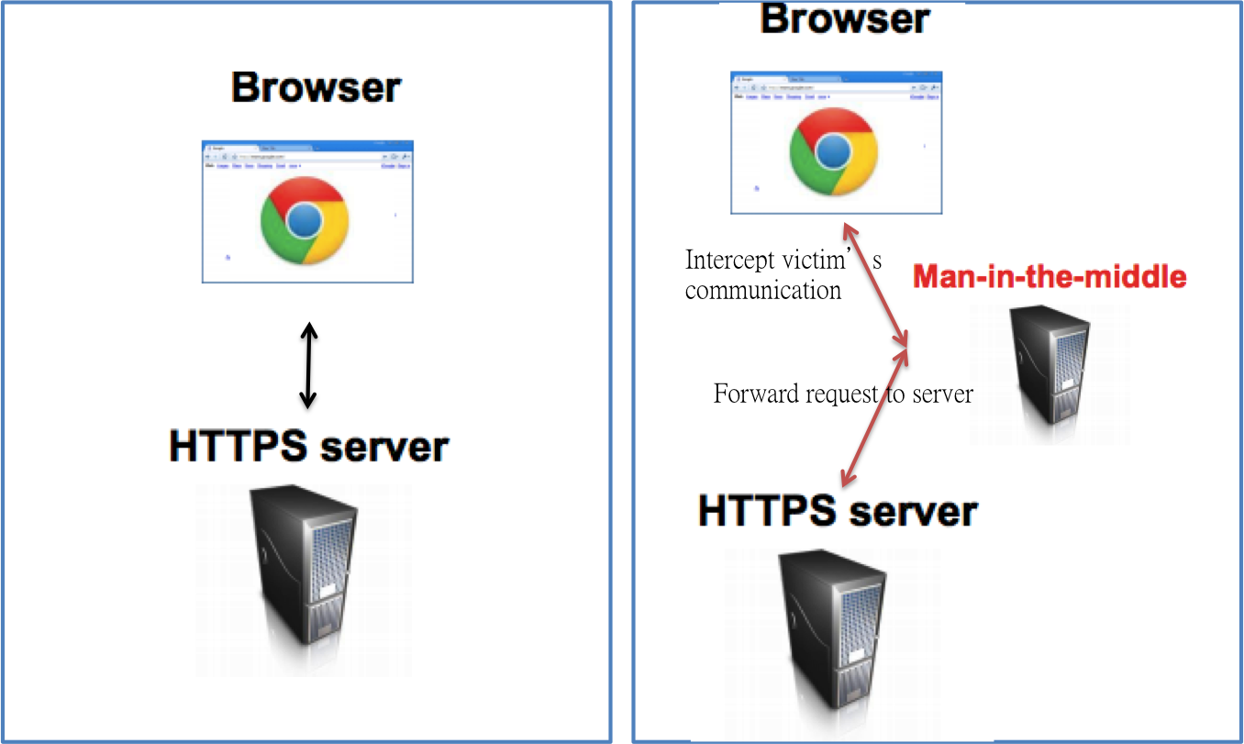
Environment
In this project, students will need three machine
Attacker’s machine (VM)
Legal website (VM) with public ip address
Victim Machine

Slide 8
Requirement
Students should upload following things to E-campus
MITM program source code(with fake certificate)
Report
Address of you website, which contain a certificate signed by TA’s certificate (include in report).
Deadline
2014.06.08

Slide 9
MITM
MITM is an approach to attack website without strong authentication.
The attacker first intercepts communicate between victim and server.
Then attacker pretends itself as server and forward the message between server and victim.
Attacker can monitor and modify message between server and victim

Slide 10
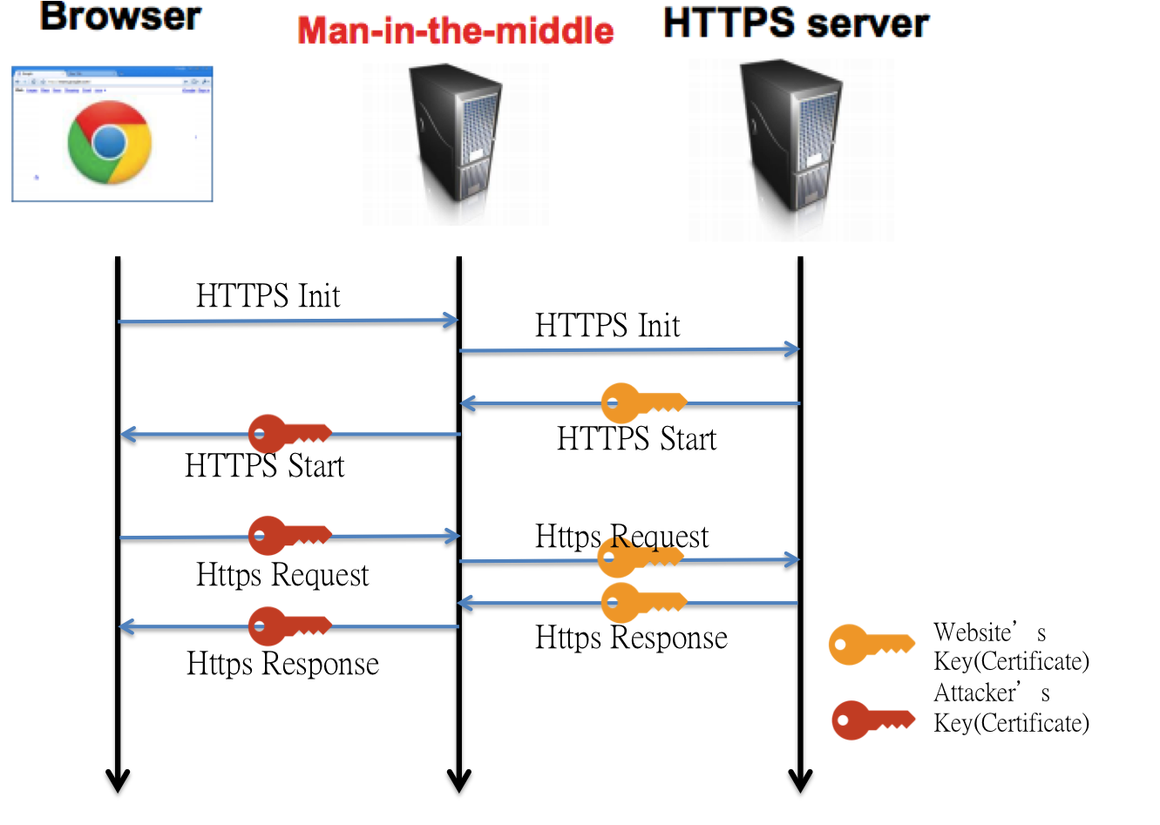
MITM Flow

Slide 11
Step of MITM
Create a fake certificate just like previous subproject.
Intercept user’s communication
Implement MITM program

Slide 12
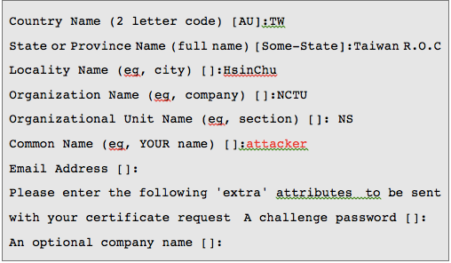
Create a Fake Certificate
Just like previous project

Slide 13
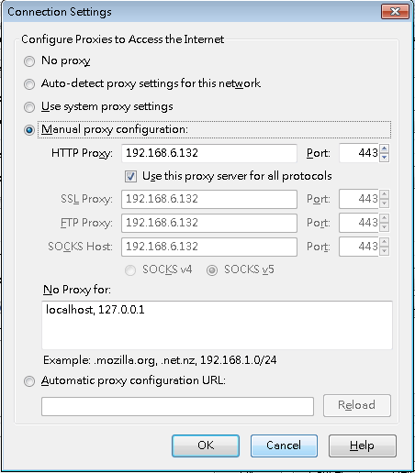
Intercept user’s communication
Configure the browser using attacker’s machine as proxy.
Use 443 as proxy port
Attacker’s Address

Slide 14
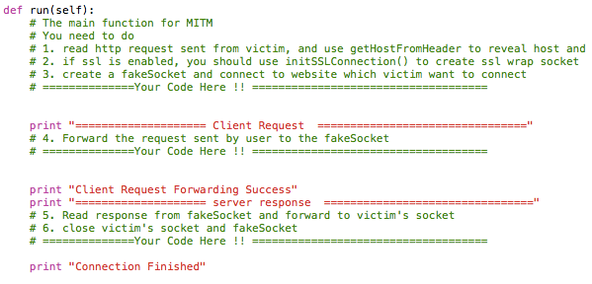
Implement MITM Program
TA will provide a template program, student need to write the following part
Main flow of MITM attack (run function)
Establish HTTPS/HTTP connection(initSSLConnection, CreateSocketAndConnectToOriginDst)
Parsing HTTP Header(getHostFromHeader)

Slide 15
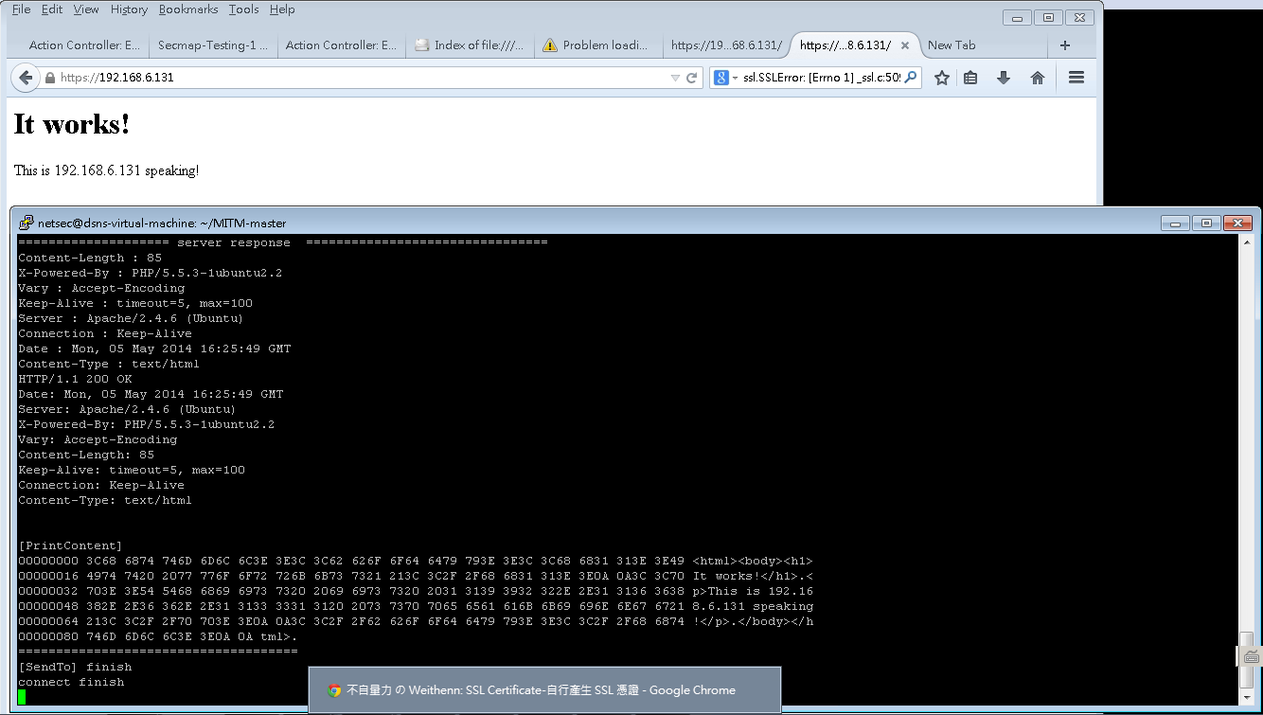
Expected Result of MITM
User connect to 192.168.6.131 with https
Attacker at 192.168.6.132 can record the message

Slide 16
CA and Trust Chain
To against MITM attack, students are asked to build a small trust chain
TA will provide a certificate and private key of that certificate
Students should use certificate and key to sign their website certificate

Slide 17
Step for CA
Download TA’s certificate and private key
Generate private key of your website
Generate certificate request
Generate website’s certificate

Slide 18
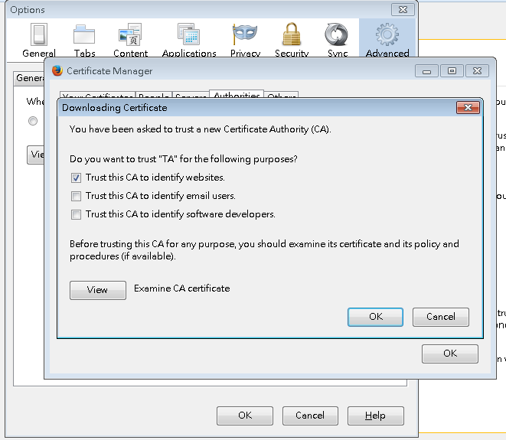
Step 1
Download TA’s certificate and private key
Link(pem)(key)
Add certificate to your browser

Slide 19
Step 2 & Step 3
Use openssl command to generate private key of your website.
Use openssl to generate certificate request by your private key
#openssl genrsa –out <website ip>.key 2048
#openssl req -new -key <key file> -out <domain name or ip>.req

Slide 20
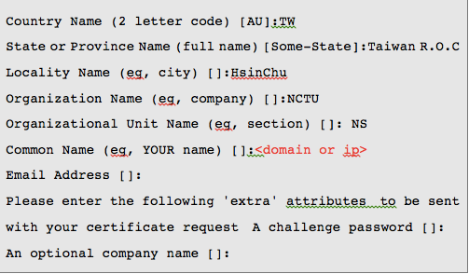
Step 3 - cont

Slide 21
Step 4
With the TA’s key and certificate, website’s certificate can be generate by the certificate request.
#openssl x509 -req -days 3650 -sha1 -extfile /etc/ssl/openssl.cnf
-extensions v3_req -CA <TA’s certificate> -CAkey <TA’s key>
-CAserial rootca.srl -CAcreateserial -in <certificate request file>
-out <ip or domain name>.crt

Slide 22
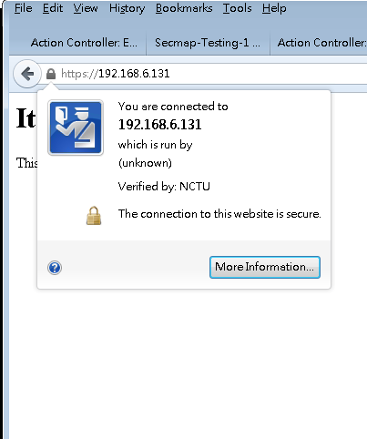
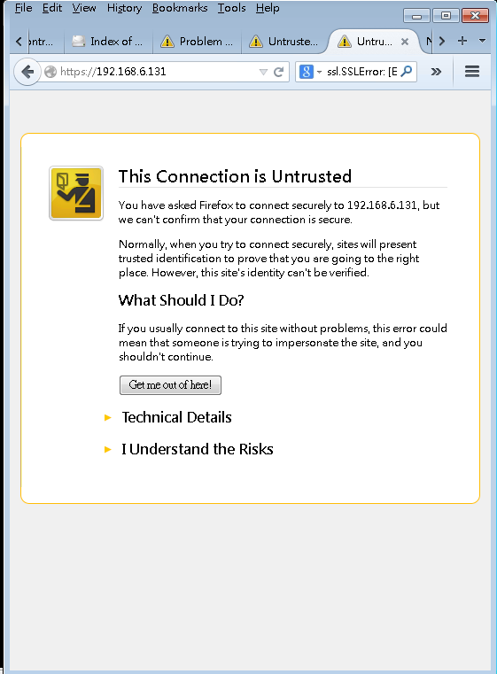
Expected Result of CA
Normal Browsing
Under MITM Attack

Slide 23
Grading Policy
MITM program – 40 %
Website Certificate – 30 %
Report – 30 %, your report must contain
Implementation details about MITM program
Steps you used to generate website’s certificate
Further research/reading about authentication and MITM

Slide 24
Reference
http://www.devsec.org/info/ssl-cert.html
http://en.wikipedia.org/wiki/Man-in-the-middle_attack
https://www.openssl.org/docs/HOWTO/certificates.txt
http://blog.philippheckel.com/2013/07/01/how-to-use-mitmproxy-to-read-and-modify-https-traffic-of-your-phone/
http://en.wikipedia.org/wiki/List_of_HTTP_header_fields
http://www.forensicswiki.org/wiki/Proxy_server

Slide 25
Reading List
http://dl.acm.org/citation.cfm?id=1512329
http://link.springer.com/chapter/10.1007/978-3-642-33167-1_12#page-1
https://www.linshunghuang.com/papers/mitm.pdf
https://blackhat.com/presentations/bh-europe-09/Marlinspike/blackhat-europe-2009-marlinspike-sslstrip-slides.pdf

