Slide 1
Simulating MLB At-Bats

Slide 2
The GOAL
Build a tool that takes in a statistical picture of a hitter and a pitcher, along with some environmental factors, and returns a distribution of possible outcomes of that interaction.

Slide 3
Background: Approach
Idea of an interaction
What statistics can be used to judge players?
Can players be described by a statistical matrix?
https://tht.fangraphs.com/can-we-predict-hitters-change-based-on-how-pitchers-approach-them/

Slide 4
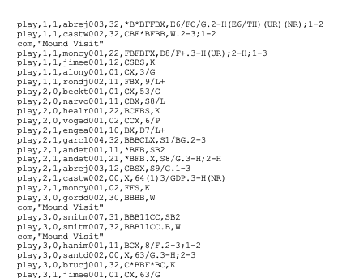
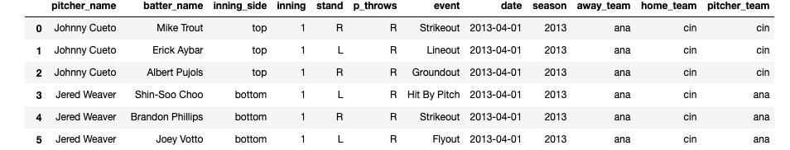
BAckGROund: The DATA
Extensive player data
Play by play with play outcomes over a large sample sheet
Good news: Baseball data is everywhere!
Retrosheet, MLB.com, Baseball Savant
Formatting, extracting had difficult formatting, R required
Working with text data difficult
The community can help
About 900k events

Slide 5
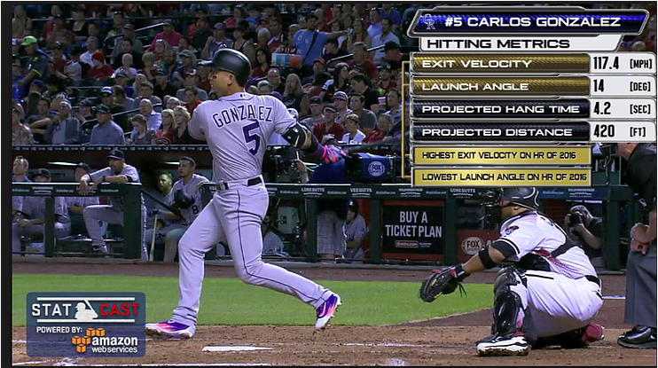
Background: New Age v Older Data
What player data is necessary to judge players?
Outcomes based: Fangraphs
Physical-based: Statcast
When does the data stabilize?
What sample size is required
https://www.coverfoursports.com/post/working-with-data-getting-statcast-data-in-r

Slide 6
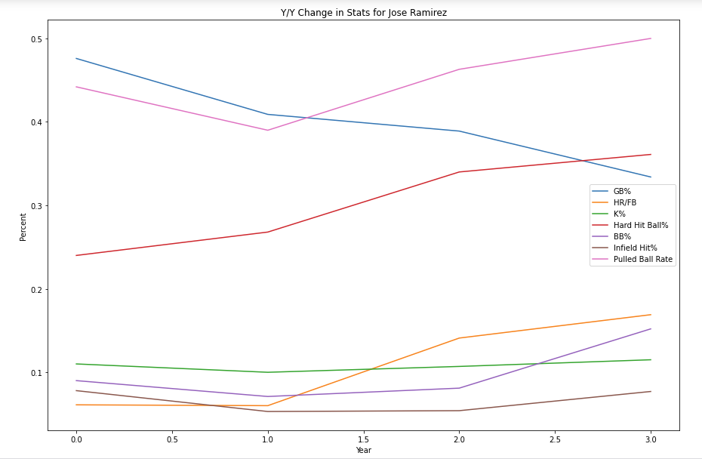
EDA: Significant Data
Pure bias variance trade-off
Informative input vector vs. future use
What can be included that is also reproducible?
Accounting for year over year baseline change

Slide 7
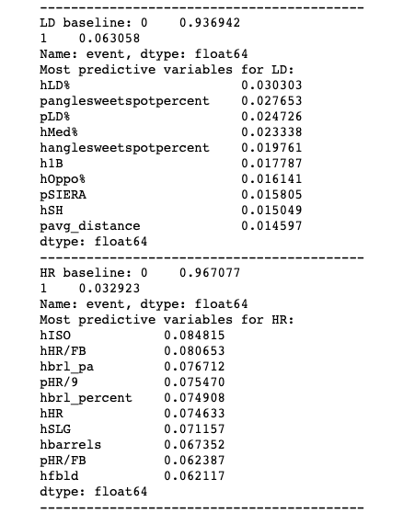
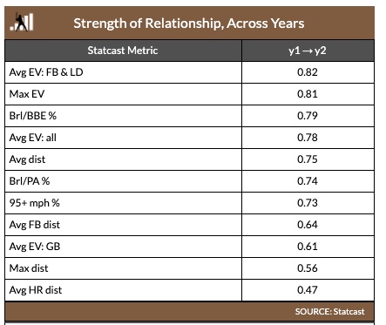
EDA: Features to Consider
Use correlation to see what features are predictive for each outcome
Use previous studies done by analytics websites like Fangraphs, Hardball Times

Slide 8
Fitting the Model: Neural Net
‘Softmax’ best for multiclass classification
Data leakage is OK here!
Due to time constraints, different configurations were done by hand
Room for improvement
Never going to be able to improve all that much above percentage of highest class
.24 K v .28 accuracy

Slide 9
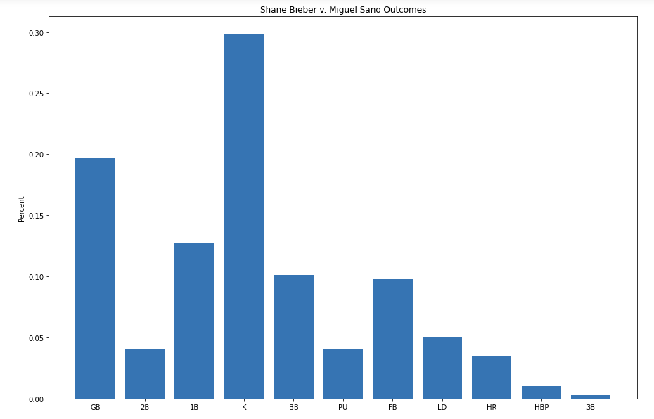
Classifying vs. Distribution
Want the probabilities of softmax, not predictions
Dealing with issues of unbalanced classes difficult
Using Categorical Accuracy, TopKCategorical Accuracy
Struggles to assess situations with lower chances of major outcomes

Slide 10
FunCTionalIZE Model
Define the simAB function
In take pitcher/hitter names and seasons to pull stats from
Options to change batter/pitcher handedness
Construct input array into shape required for the neural network
Return output into easily distilled format
https://shlabotnikreport.wordpress.com/tag/2001-mlb-showdown/

Slide 11
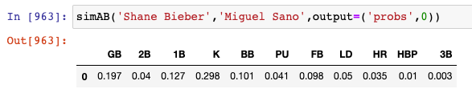
Distribution

Slide 12
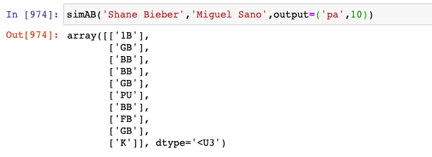
Individual Results

Slide 13
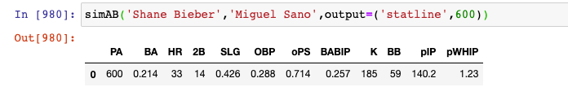
Stats Over a number of PA

Slide 14
Further Areas of Search
Baseball Wise:
Customize ballpark
Customize weather
Add pitcher fatigue, runners on base, other game contexts
Include MAP estimate builder within function
Batted Ball Dilemma, Statcast Data
Computation Wise:
Fit more neural networks
Attempt to further correct unbalanced classes issues
Compress outcomes

Slide 15


Next Steps: Game Simulation
Roughly 300 conditional statements/loops
Feed in lineup of hitters and pitchers
Situations very rough
No sac bunting, stealing, base running complexity
Extra conditionals required for relief pitcher specification
SimAB = ‘GB’
SimAB(next hitter in lineup array, pitcher)

Slide 16
A Big THANK YOU

