Slide 1
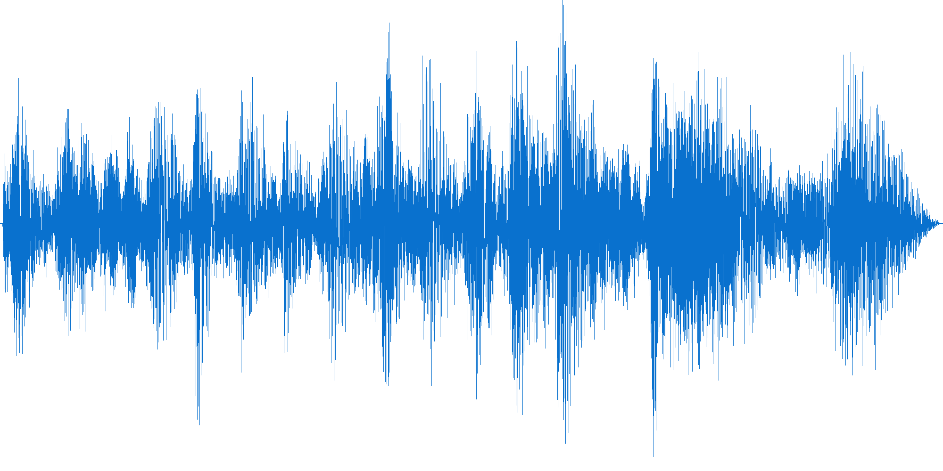
WHOI MATLAB Tutorials Summer 2020
Day 4: Signal Processing
Ian Jones (he/him)
Joint Program Student, Biology Department
Advisor: Aran Mooney

Slide 2
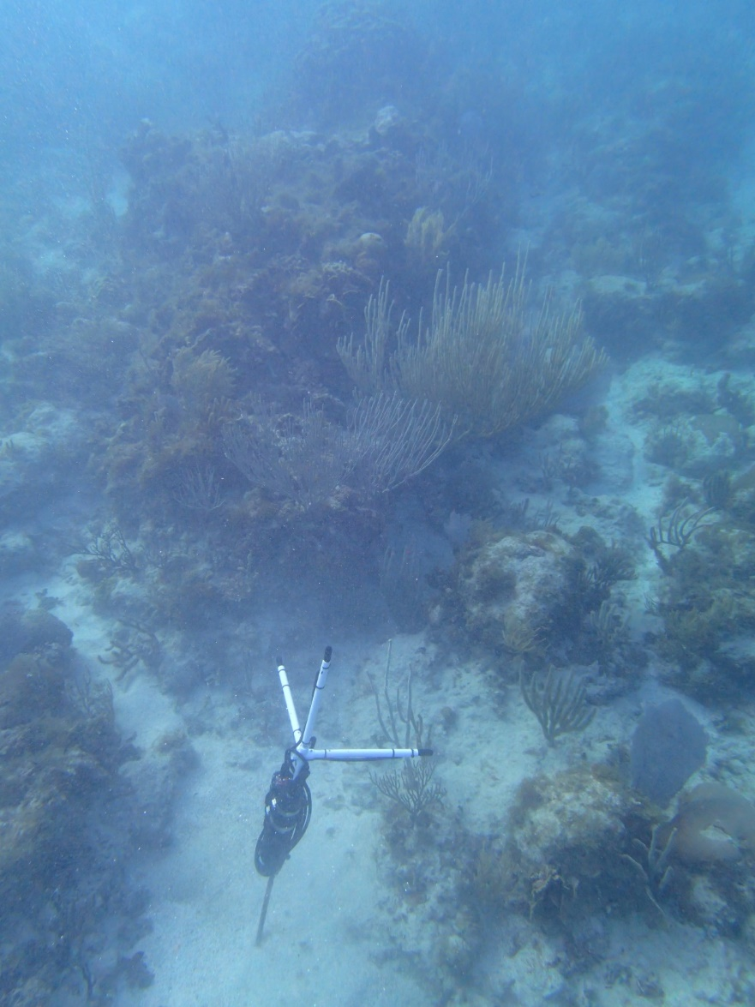
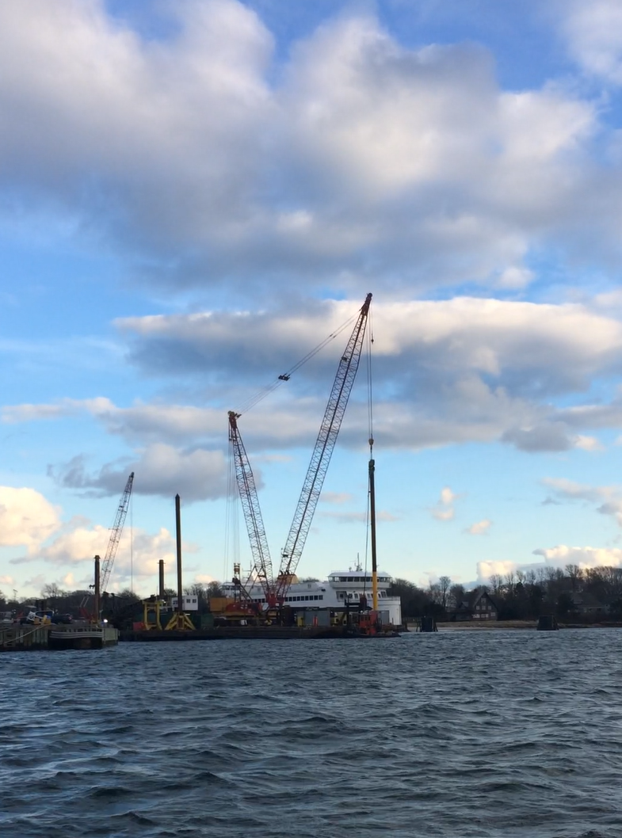
Types of (acoustic) signals I process:
Coral reef sounds
Pile driving sounds
Notes:
Example today will be of a short (30 s file) of acoustic data – of coral reef sounds, but techniques/tools today are applicable to many types of signals/time series data where you want to assess the frequencies, or periodicities of your data: for example, you may want to investigate long-term patterns in SST, tidal cycles, seismic data, ect.

Slide 3
Digital Sampling:
Digitized signal is recorded at a chosen sample rate
This could be in units of Hz, i.e. samples/second
Longer time series could have samples/day, samples/month, etc.
For ANY signal, frequencies of can only be resolved up to half the sample rate; this upper frequency limit is called the Nyquist frequency¹
So when collecting data, make sure your sample rate is at least twice the highest frequency you want to analyze.
Notes:
https://en.wikipedia.org/wiki/Nyquist_frequency

Slide 4
Time domain:
Waveform of pile driving sound

Slide 5
Frequency, (aka ‘spectral’) domain:
Spectrum of pile driving sound

Slide 6
Spectrogram: Time and Frequency
Spectrogram of pile driving sound

