Slide 1
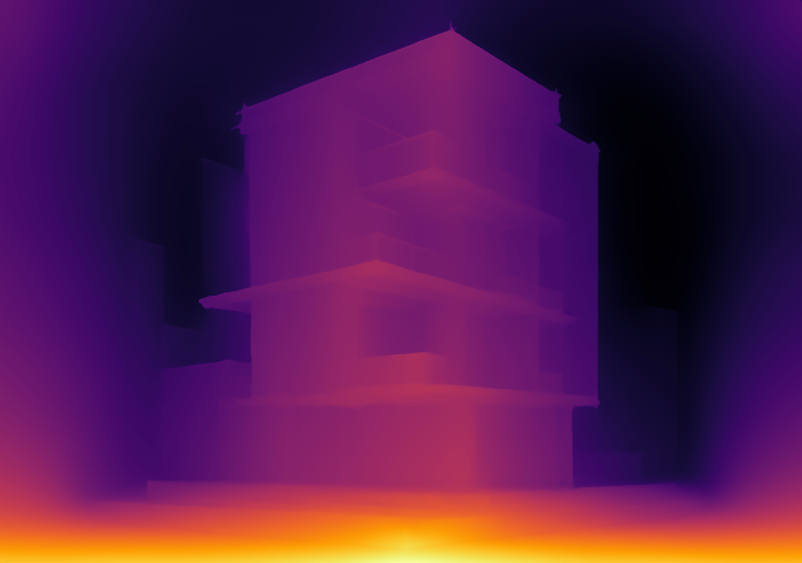
Sketch → 3D
Reconstructing pre-photograph scenes from hand-drawn sketches
Wang Qiaopei · Peng Shiqi
Building on Talwar & Laasri, 3D Reconstruction from Sketches (arXiv:2505.14621)

Slide 2
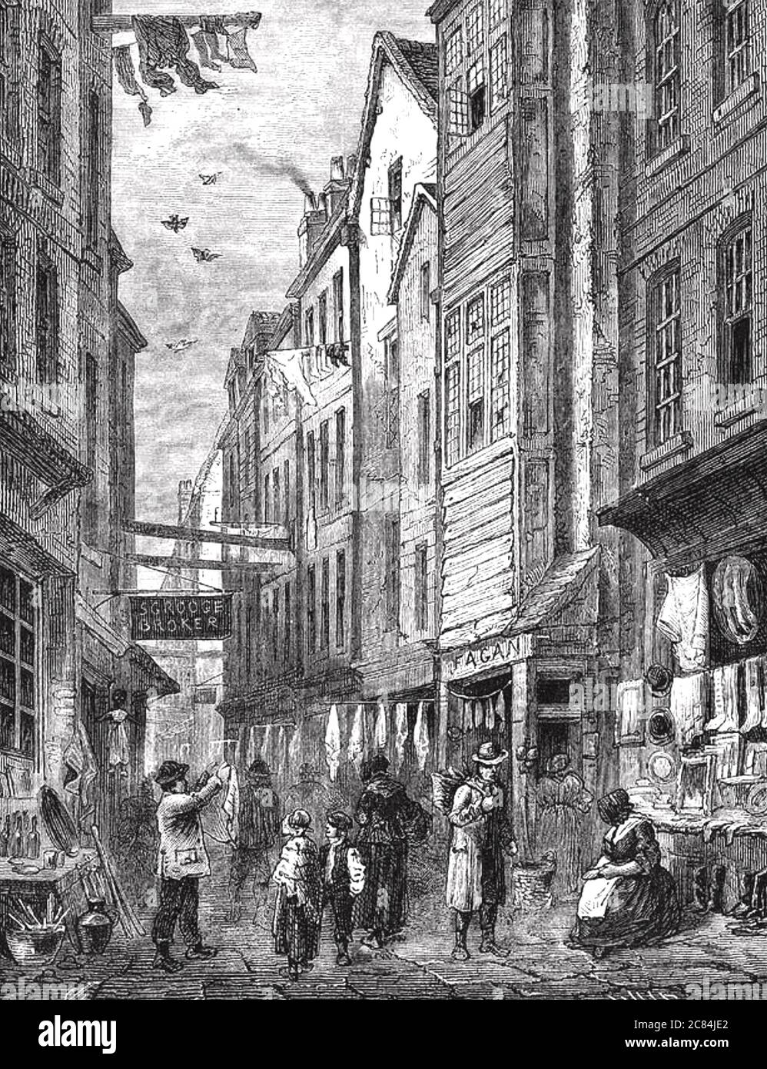
MOTIVATION
Why reconstruct 3D from drawings?
Cameras are recent — countless streets and buildings survive only as drawings.
Field Lane: a London slum in Dickens’ Oliver Twist, long demolished. No photos exist — only 1800s engravings.
Goal: turn such sketches into a 3D street you can explore.
Field Lane engraving, 1840s (Holborn, London)

Slide 3
BACKGROUND
Prior work & its limits
Base pipeline (Talwar & Laasri): sketch → CycleGAN → MegaDepth → 3D surface
1
2
3
CycleGAN is fragile
MegaDepth is dated
Stitching fails
Sketch→photo style transfer is sensitive to drawing style and needs training.
The 2018 depth model is hard to deploy and trained only on outdoor photos.
Combining multiple sketches by feature matching “completely fails” on real drawings.

Slide 4
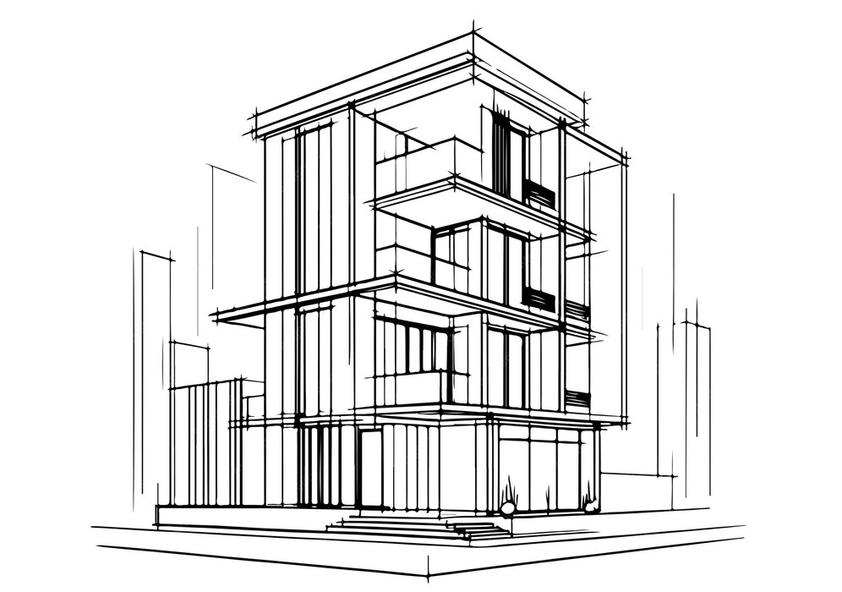
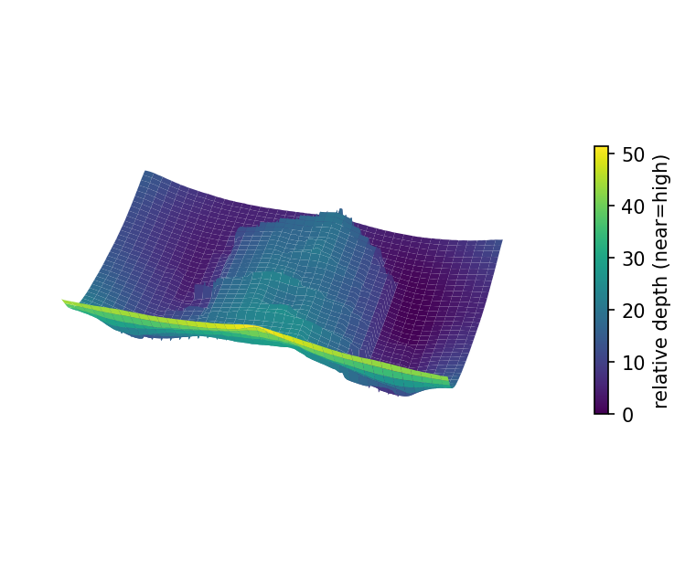
OVERVIEW
Our approach: three contributions
→
→
sketch
depth
3D surface
1
Foundation depth + cleaning Drop CycleGAN; run Depth Anything V2 on the sketch, with a cleaning stage for real noisy drawings.
2
Depth-space fusion Fuse multiple sketches in depth space (not image stitching) — robust to style.
3
Interactive viewer A Three.js viewer lifts the sketch into an explorable 3D surface.

Slide 5
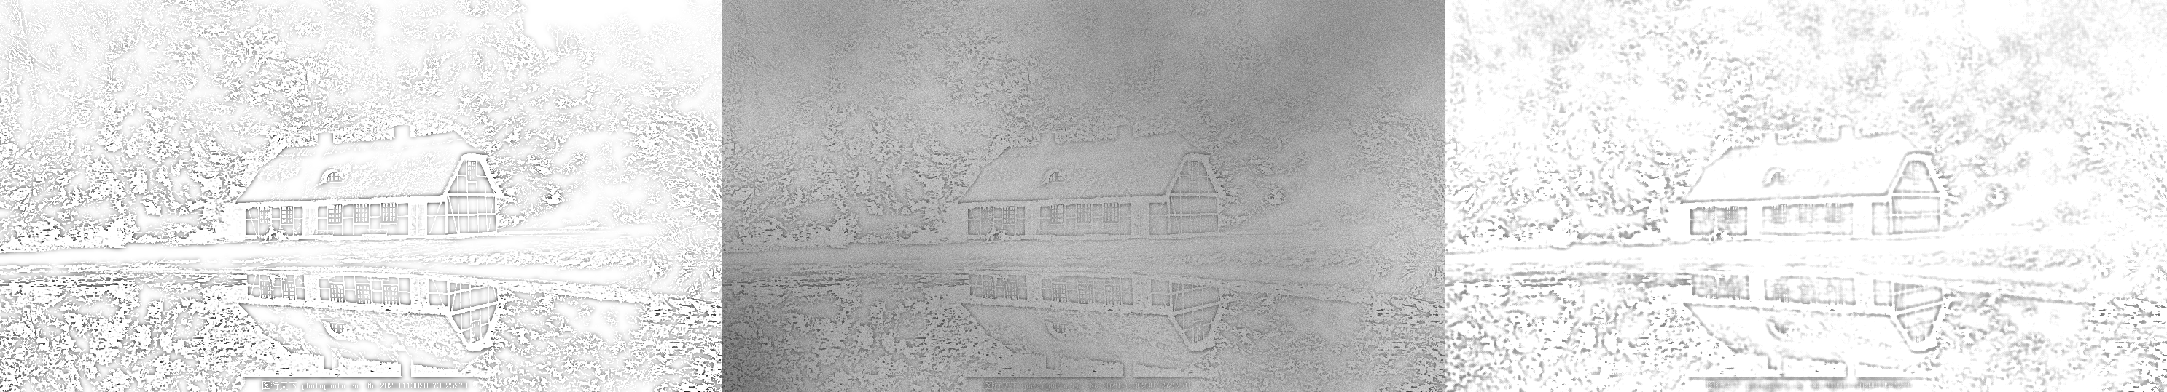
METHOD · 1
Foundation depth + targeted cleaning
Depth Anything V2 (2024) reads the sketch directly — no CycleGAN needed.
Cleaning targets real-world damage: denoise, illumination normalization, CLAHE.
Each step undoes a specific corruption (noise / uneven light / low contrast).
clean sketch → realistic degradation → after our cleaning

Slide 6
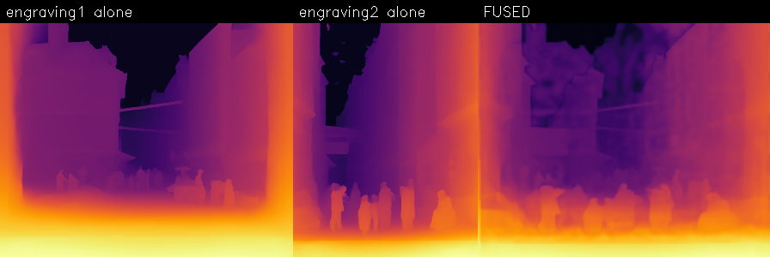
METHOD · 2
Multi-sketch depth-space fusion
Image-space stitching fails on real sketches.
We align in depth space with dense ECC registration (not sparse features).
Fuse confidence-weighted — tolerant of style differences, suppresses noise.
per-sketch depth (left, middle) → fused depth (right)

Slide 7
EVALUATION
Results & a useful negative result
r = 0.94
0.87 → 0.96
shading: cut
sketch depth vs. real-photo depth (no CycleGAN)
cleaning recovers degraded sketches (corr.)
ablation showed synthetic shading hurts — we removed it
Metric: no 3D ground truth for drawings, so we compare to the real photo’s depth via paired (photo, sketch) data.
Key insight: a strong foundation model is enough — the fragile style-transfer step is unnecessary.
We honestly ablated our own idea (shading) and dropped it when it didn’t help.

Slide 8
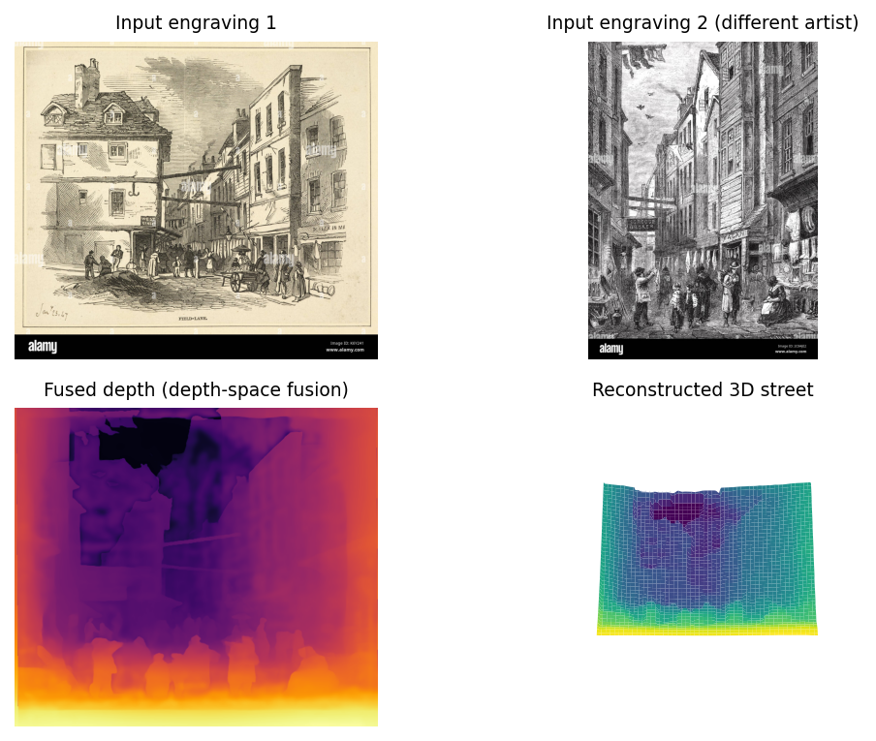
CASE STUDY
Field Lane: the original scene, rebuilt
Two 1840s engravings by different artists.
Despite different line styles, dense alignment + depth fusion give one coherent street.
Foreground figures are near; the alley recedes into depth.
Explore it live in the Three.js viewer.

Slide 9
Takeaways
A 2024 foundation depth model removes the fragile CycleGAN step (r = 0.94 vs. photo depth).
Cleaning measurably restores fidelity on degraded, real-world sketches.
Fusing in depth space succeeds where image stitching fails — shown on real Field Lane engravings.
An honest ablation removed a component (synthetic shading) that did not help.
An interactive viewer lets anyone explore the reconstructed 3D street.
Future work: metric depth · occlusion completion · optional ControlNet for highly stylized drawings

