Slide 1

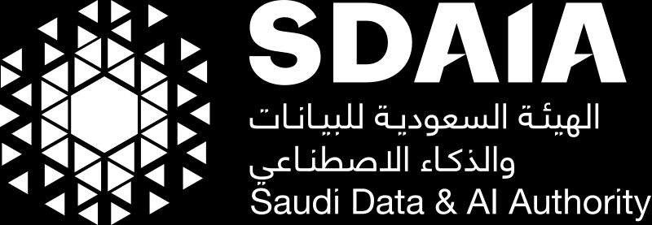

T5 AI Data Analysis bootcamp – 2023

Slide 2


Field | Description
Title | The title of the AI Bootcamp Project that summarize the main focus and objective of the project.
Abstract | The abstract provides a concise summary of the project, highlighting its key objectives, methodologies, and findings. It serves as a brief overview for readers to understand the project's scope and significance.
Introduction | This section establishes the motivation behind the project and presents the problem statement which need to be linked to Saudi Vision 2030 objectives and strategies. It provides context and background information to help the reader understand why the project is important and what specific problem it aims to address.
Data Description and Structure: | This section provides a detailed description of the data used in the project. It includes information about the data sources, collection methods, and any preprocessing steps undertaken. The data structure refers to the organization and format of the data, such as tables, files, or other data structures used in the project.
Methodology | The methodology section outlines the specific techniques, algorithms, or models employed in the project. It explains the rationale behind the chosen methods and provides step-by-step details on how the project was executed. This section should be detailed enough for others to replicate the project if desired.
Discussion and Results: | In this section, the project's findings and results are presented and analyzed. The discussion interprets the results, compares them with previous research or expectations, and provides insights into the implications and significance of the findings and how the obtained solution has on impact on achieving objectives of Saudi Vision 2030. It may also address any limitations or challenges encountered during the project.
Conclusion and Future Work | The conclusion summarizes the main findings of the project and restates its significance. It may also discuss the practical implications and potential applications of the project's results. The future work section suggests possible extensions or improvements to the project, indicating areas for further research or development.
Team

Slide 3
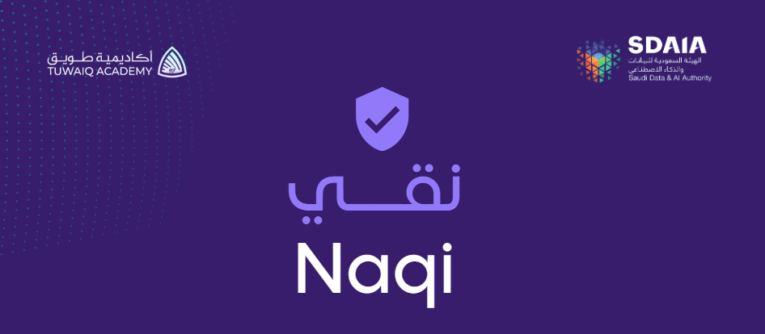
Title
Naqi - نقي

Slide 4
Abstract
Naqi aims to assist the Audiovisual Media Authority (GCAM) in monitoring violations of advertising content laws on social media. Powered by AI, Naqi diligently filters audiovisual content, ensuring that only compliant content is displayed. This initiative streamlines the monitoring process, enhance a responsible online environment where Audiovisual Media Authority laws in Saudi Arabia, particularly those pertaining to advertising content, are upheld.

Slide 5
Introduction
The Naqi project is designed to support the Audiovisual Media Authority (GCAM) in monitoring violations of advertising content laws on social media platforms. By leveraging AI technology, Naqi efficiently filters audiovisual content, promoting a responsible online environment that upholds the advertising content regulations set by the Audiovisual Media Authority in Saudi Arabia. The project aligns with the objectives and strategies of Saudi Vision 2030, which emphasizes the importance of regulating and enforcing advertising content laws to foster a compliant and thriving digital ecosystem.

Slide 6
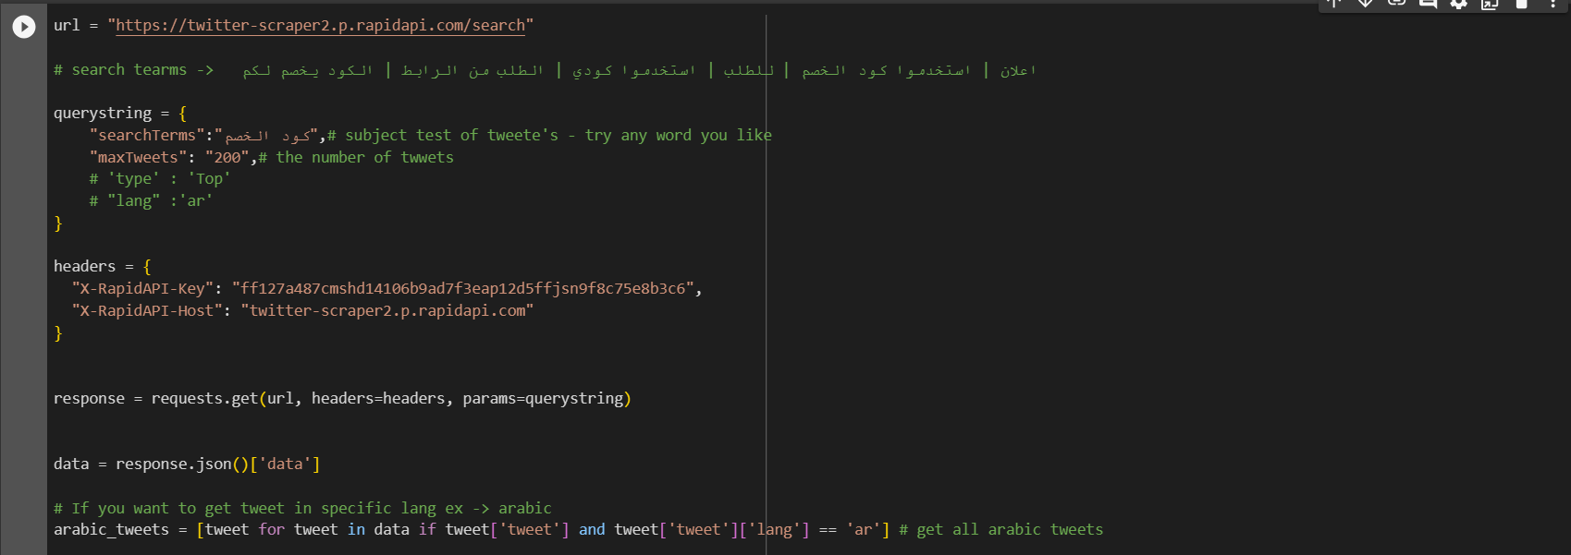
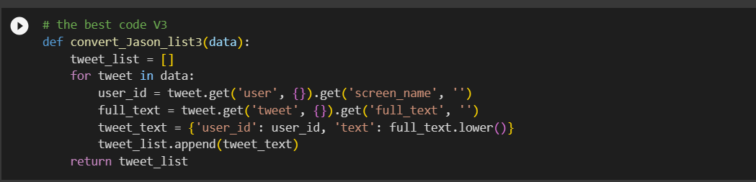
Data Description and Structure
Data collection method
In this project, the data is collected from Twitter and Snapchat using the Rapid API platform. This tool enabled us to gather valuable and real dataset for analysis and further project development which are :
X Dataset (4594 rows × 3 columns)
Mawthooq Dataset (include Ad licensed content creators )
Snapchat Data set
Preprocessing
Targeting Arabic(Saudi Dialect) Ad content from an API along with structured and unstructured data involved many levels of preprocessing that are :
Step 1 : parsing Flattening Nested JSON
API Code + passing JSON
Flattening Nested JSON

Slide 7
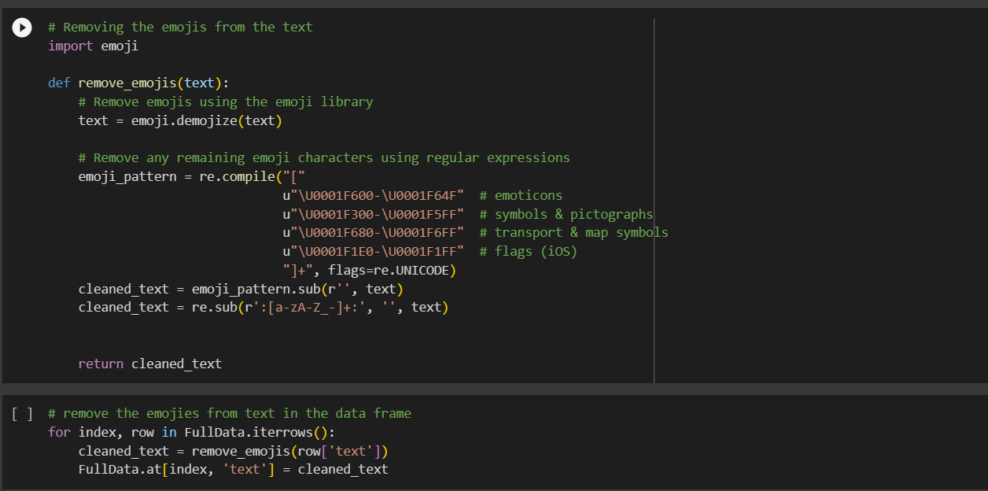
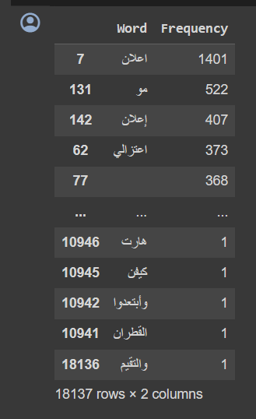
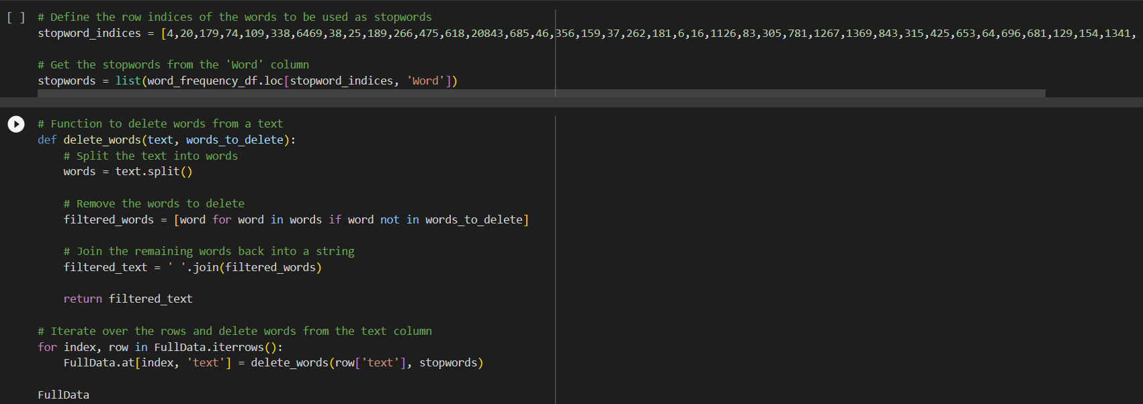
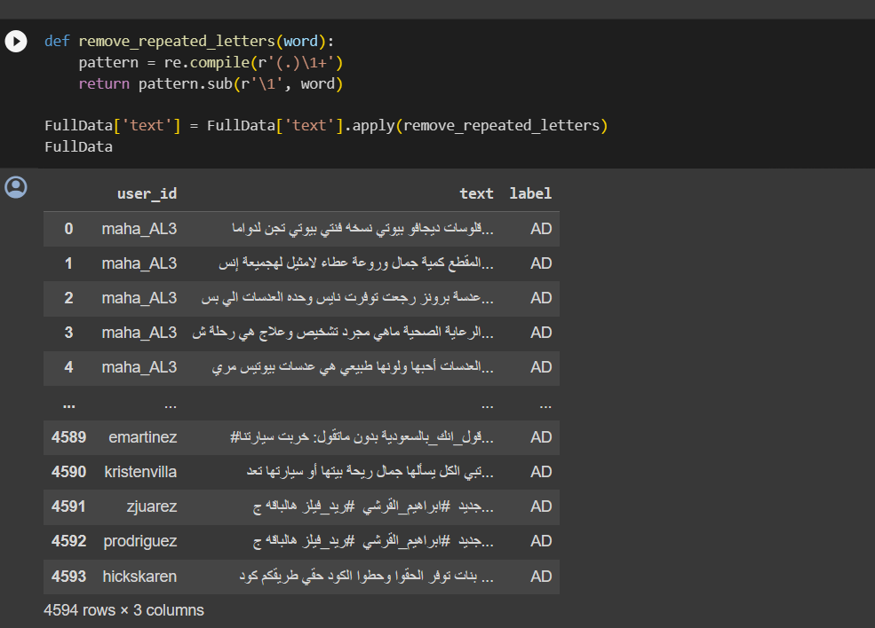
Data Description and Structure
Step 2 : Remove noise (the non-textual content)
Removing Emojis form Text
Step 3 : Clean the Data
stop words
Remove repeated letters
Created Saudi Delict stop word list
Function that removes Saudi Delict stop words
Removing repeated letters

Slide 8
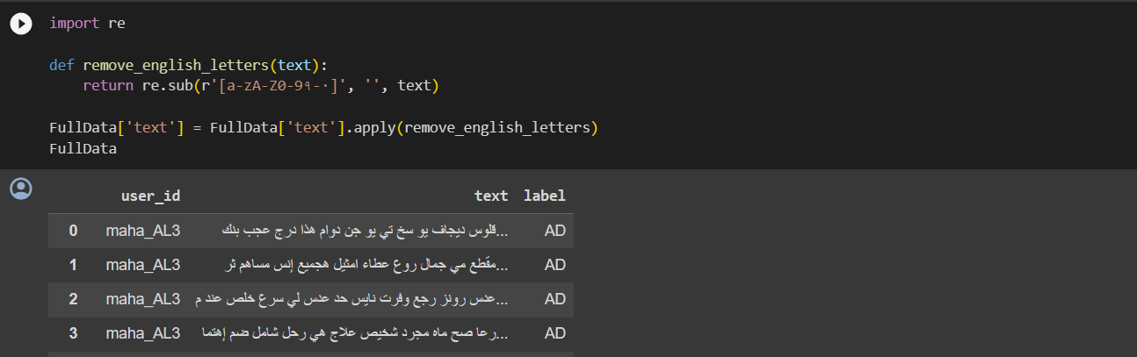
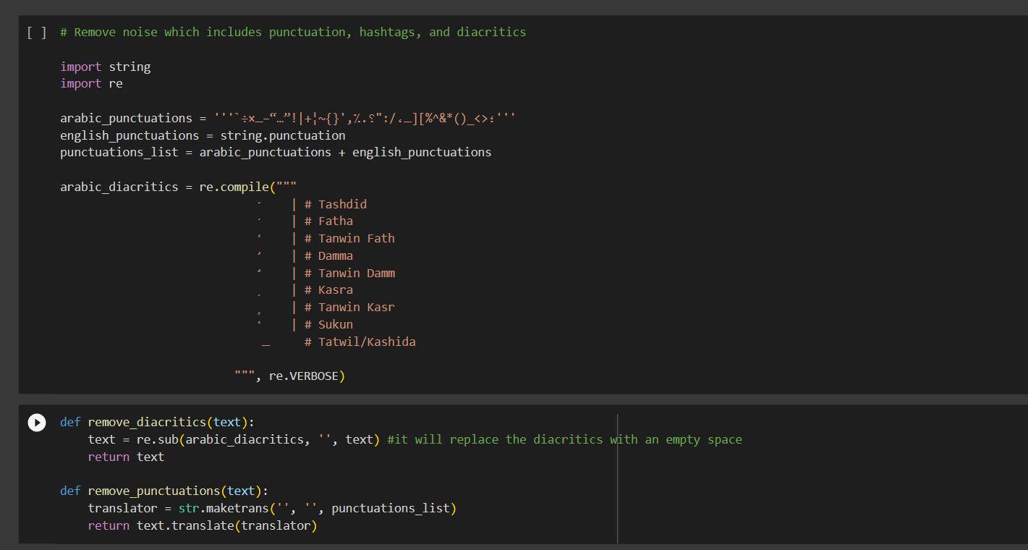
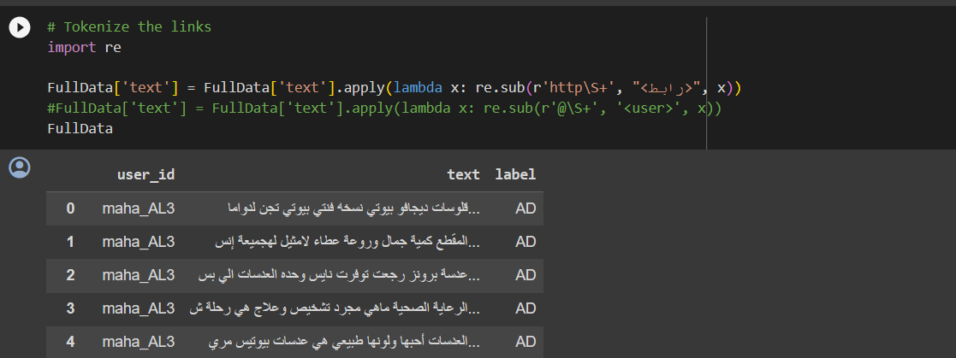
Data Description and Structure
Step 3 : Clean the Data
Remove English letters, numbers, and Arabic numbers.
Remove punctuation, hashtags, and diacritics
Replacing the 'https://colab.research.google.com/' with <رابط >>> ,
Remove English letters, numbers, and Arabic numbers
Remove punctuation, hashtags, and diacritics
Replacing the 'https://colab.research.google.com/' with رابط

Slide 9
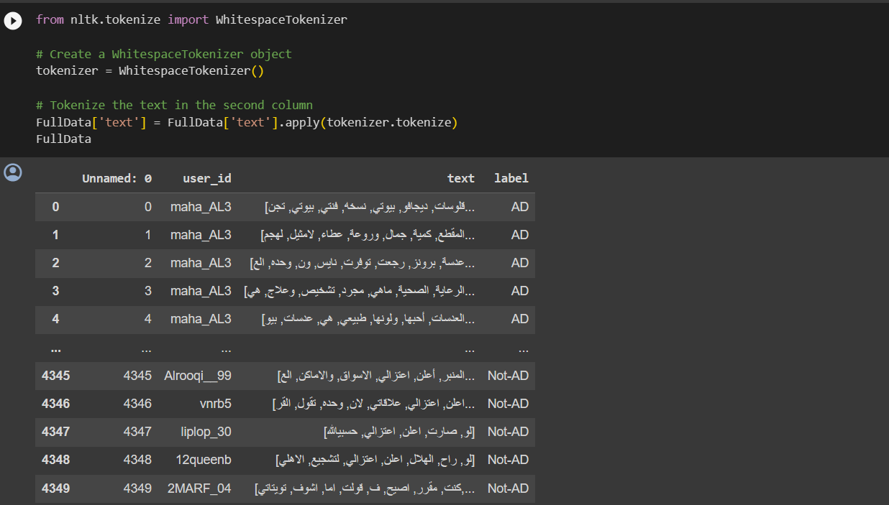
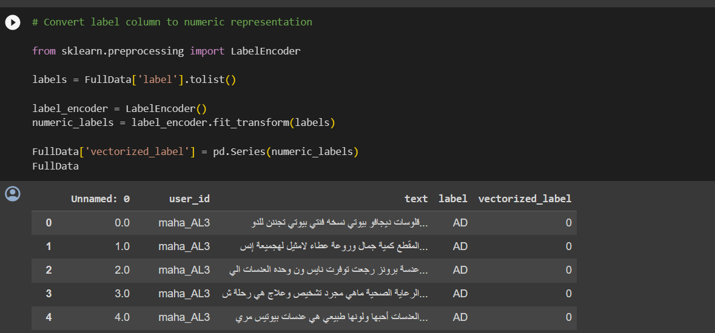
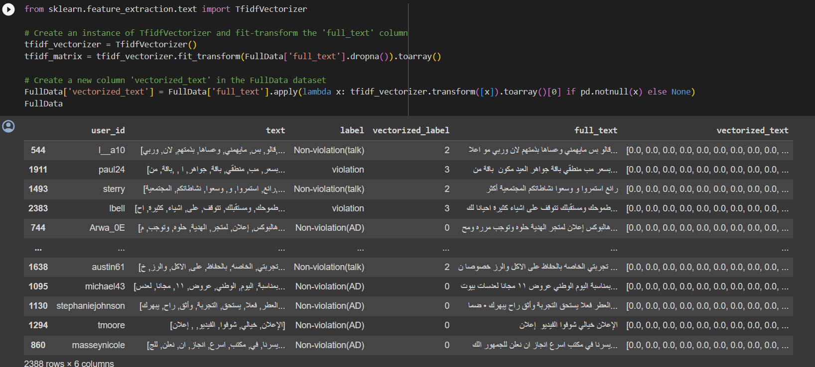
Data Description and Structure
Step 4 : Data Transformation (Vectorization , Tokenization )
Tokenization
One hot encoding
Vectorization
Tokenization with WhitespaceTokenizer
Categorical one hot encoder
Tfdif Vectorization

Slide 10
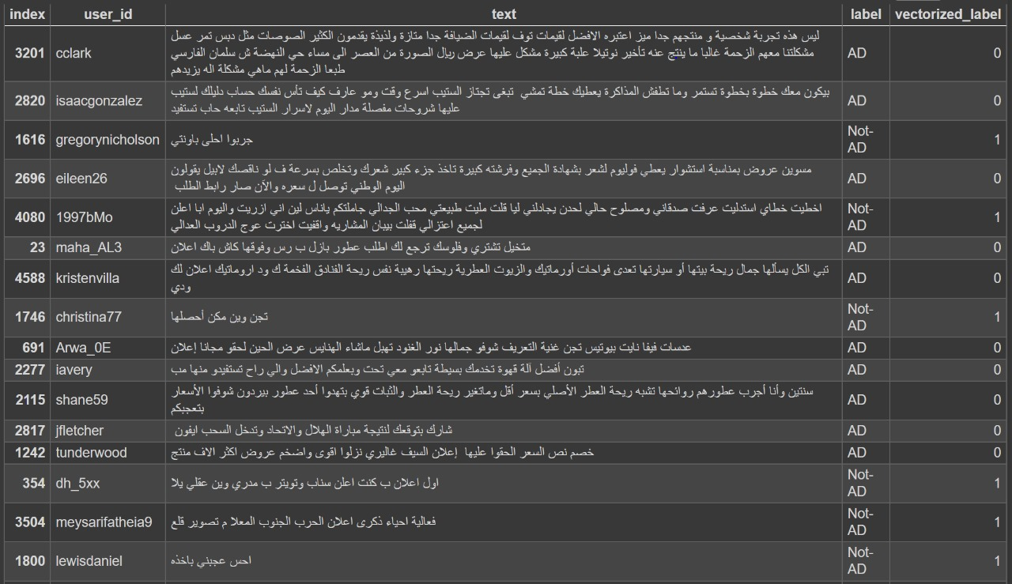
Data Description and Structure
Data Structure
This project contains two main features X Ads , Snapchat Ads and Mawthooq Dataset :
X Ad features data structure
Data frame with the following columns 7 as ;
user_id (user screen name on X )
full_text (full text of the tweet )
vectorized_text (Tfdif vectors )
predicted_class(0 = AD , 1 = not-AD )
predicted_class_name(Advertisement , Not_Advertisement)
Licensed(Yes , No)
X Data frame

Slide 11
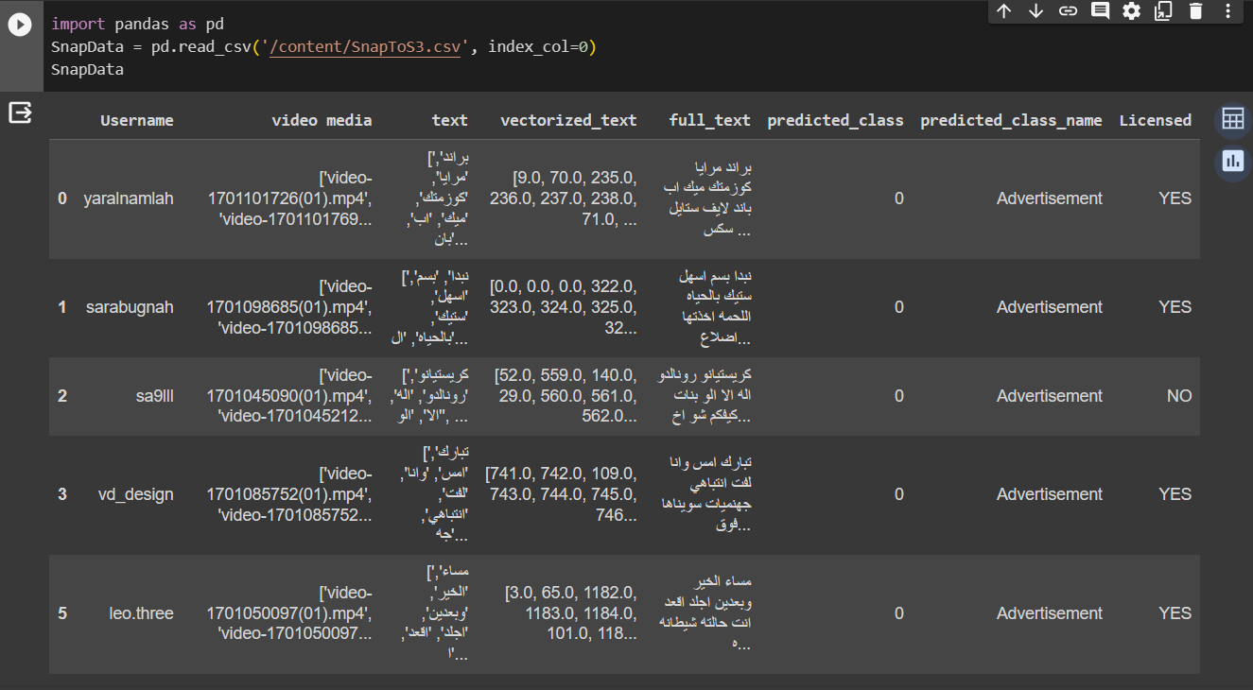
Data Description and Structure
SanpChat Ad features data structure
Data frame with the following columns 8 as ;
Username (user screen name on snapchat )
Video media(mp4 media of snap )
Text(list of recognized text from video )
full_text (full String of recognized text )
predicted_class(0 = AD , 1 = not-AD )
predicted_class_name(Advertisement , Not_Advertisement)
Licensed(Yes , No)
Snap chat Data frame

Slide 12
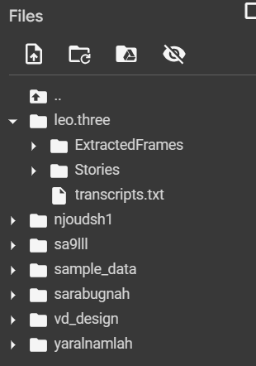
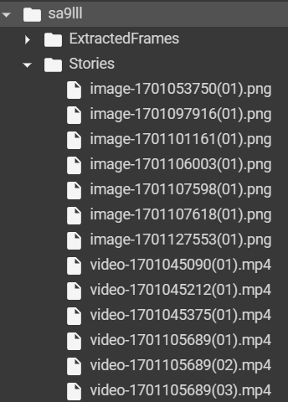
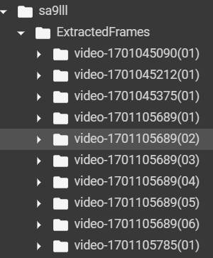
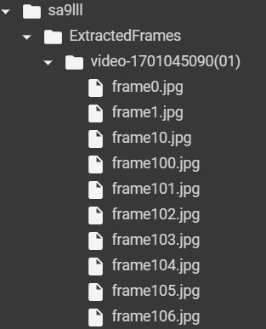
Data Description and Structure
SanpChat Ad features data structure
Folder tree data structure represented as ;
Root directory ( each user screen name on snapchat )
(mp4 media of snap )
Stories sub directory (media files .mp4 , .png and .wav)
Extracted frames sub directory (mp4 file frames for OCR )
Video frames sub directory (for each video in extracted frames directory confatins jpg)
Transcript.txt ( recognized text from mp4 files )
Root directory
Stories sub directory
Extracted frames sub directory
Video frames sub directory

Slide 13
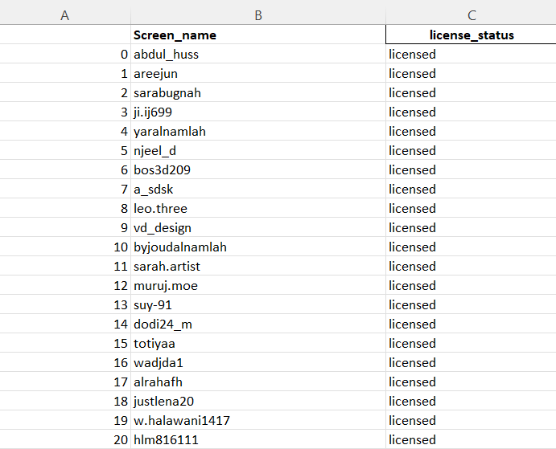
Data Description and Structure
Mawthooq lincencd dataset structure , the purpose of creation is to mimic the GCAM data set of licensed users , created using rabid Api .
Data frame with the following columns 2 as ;
Screen_name (user screen name on X or Snapchat )
Lincense_statues (if the provide screen name has Mawthooq Lincense )
Mawthooq Dataset
Extracted fraes sub directory

Slide 14
Methodology
The project involves two processes as we worked with data from both Twitter and Snapchat platforms.
1. Data Collection:
- To demonstrate the model's applicability in real-world scenarios, we collected data from the actual platforms. The data collection process included gathering Tweets, Snaps, and information about licensed users from Mawthoq.
2. Text Preprocessing:
- The text preprocessing stage aimed to clean and prepare the collected data for further analysis. The following steps were performed:
- Noise Removal: Non-textual content, such as emojis, stopwords, repeated letters, unrelated mentions and hashtags, punctuation, diacritics, and variations in letter shapes, were removed. Additionally, the word "اعلان" (advertisement) was detached from the surrounding letters to standardize its representation.
- Label Encoding: The labels column, indicating whether the text is an advertisement or not, was converted into a numeric representation using LabelEncoder.

Slide 15
Methodology
3. Model Training:
- A model was trained to classify Arabic text as either an advertisement or non-advertisement. The following steps were followed:
- Model Architecture: A bidirectional LSTM model was built from scratch. The model utilized AraBertv0.2-Large-Twitter embeddings to enhance performance on the Arabic text classification task.
- Training Data: The model was trained on the collected dataset. Using AraBert weights reduced the chances of encountering out-of-vocabulary issues since the dataset was specifically gathered by us.
4. License Verification:
- To simulate real-world processes, the model verifies whether the advertiser holds a license issued by the Mawthooq platform.
5. Advertising Compliance Text Check:
- The model checks if the advertiser includes the word "اعلان" (advertisement) in the text, as required by the AudioVisual Media Authority. Additionally, OCR (Optical Character Recognition) is utilized to extract text from images accompanying the tweets, and videos are converted to text using the SpeechRecognition library for further analysis.

Slide 16
Methodology
6. Organization Name Identification:
- OpenAI and LangChain technology are employed to identify the organization to which the advertisement is directed.
7. Unlicensed Advertiser Detection:
- If the advertiser does not possess a license, the organization's name is displayed. This step serves as a check for organizations to verify the advertiser's licensing status before entering into a contract.
By following these steps, the project aims to replicate and automate the process of advertisement classification, license verification, and compliance checking in real-world scenarios.

Slide 17
Discussion and Results
The Naqi project successfully assists the Audiovisual Media Authority (GCAM) in monitoring violations of advertising content laws on social media. By utilizing AI technology, Naqi filters audiovisual content to ensure compliance. This streamlines the monitoring process, creating a responsible online environment that upholds Saudi Arabia's advertising content regulations. The project's results align with the objectives of Saudi Vision 2030, contributing to a compliant and thriving digital ecosystem. It is important to address any limitations or challenges encountered during the project to ensure ongoing improvements.

Slide 18
Conclusion and Future Work
Conclusion:
Naqi is a valuable initiative for the field of digital advertising, which is experiencing tremendous growth within the Kingdom of Saudi Arabia.
The project is ambitious... but it is achievable with the support of SDAIA and GCAM. By working together, we can create a safe, reliable, and beneficial digital future for all Saudis.
Future work:
1- Applying the module to other social network like Instagram and TikTok.
2- Violating multiple items, such as customs and traditions, and advertising a product prohibited in the Kingdom of Saudi Arabia.
3- Violating the exploitation of children for nefarious purposes.

Slide 19
Team
SARAH ALDAKHIL
ASEEL ALTALHAH
RAZAN ALHASSAN
RAGHAD ALADAWI

