Slide 1
Disney analytics case study
Ada Zhu

Slide 2
Viewership Summary of Each Network

Slide 3
Viewership Summary of Each Network
Network_name | Total_Visit | Avg_Min_Per_Visit | Duration_Hr
NBC | 1,138,746 | 13.1 | 247,784
CBS | 1,075,893 | 12.3 | 219,972
ABC | 875,264 | 11.6 | 169,110
FOX | 845,642 | 12.3 | 173,038
Total amount of hours spent on each network is attributable to the total visits
Average minutes spent on each visit is similar across the four networks

Slide 4
Total Visits in Sep - Oct
Sharp increase in total visits in October
Seems to be caused by the increase in the number of series across all 4 networks

Slide 5
Total Visits in Sep - Oct
Network_name | Household_Count | Total_Visit | Visit_Per_Household
NBC | 37,058 | 1,138,746 | 30.7
CBS | 36,392 | 1,075,893 | 29.6
ABC | 35,118 | 875,264 | 24.9
FOX | 36,349 | 845,s642 | 23.3
The count of Household is similar across the four networks
Total visits on each network are attributable to the visits per household

Slide 6
ABC Household Summary

Slide 7
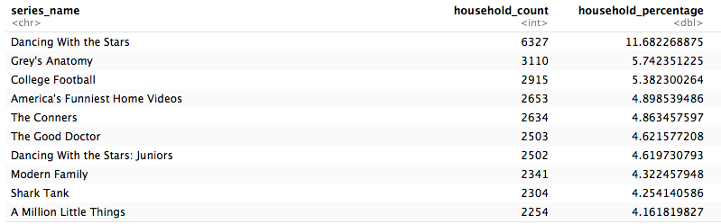
Top Ten Shows

Slide 8
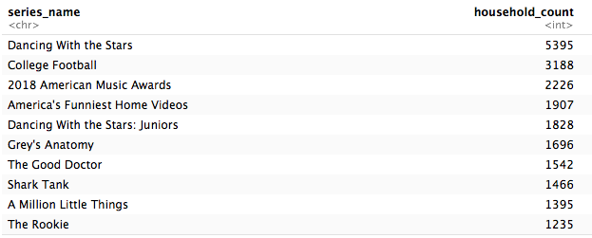
Number of Household Reached on Premiere Day

Slide 9
Average Statistics of ABC Household
Average series watched: 7 series
Average episode watched: 11 episodes
Average time spent: 288 minutes

Slide 10
Predict Household Likelihood to watch A Million Little Things

Slide 11
Variables
Episode start time
Number of previous episodes watched
Total amount of time spent on watching previous episodes
Event length in minutes
Binary column: 1 for live-watch, 0 for no-live-watch
Unbalanced data – more no-live-watch than live-watch

Slide 12
Models
Measures | Ridge Regression (%) | Random Forest (%)
Accuracy | 98.36 | 98.27
Sensitivity | 96.71 | 96.94
Specificity | 99.99 | 99.61

Slide 13
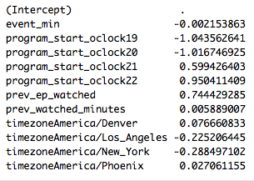
Estimated Model Coefficients - Ridge Regression

Slide 14
Future Scope
Incorporate demographic information to further analyze viewership patterns
Analyze the impact of the length of each episode
Consider the difference among different genres
News v.s entertainment
Define active viewers
Wait time till next visit -- active period

Slide 15
THANK YOU

