Slide 1


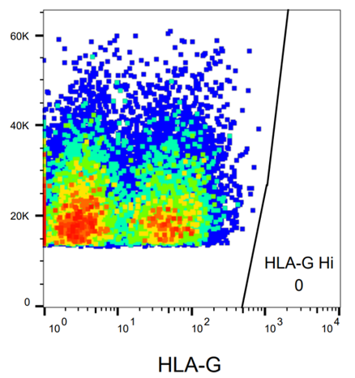
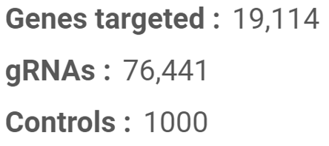
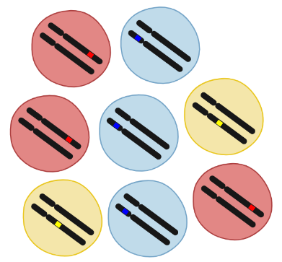
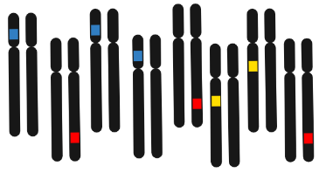
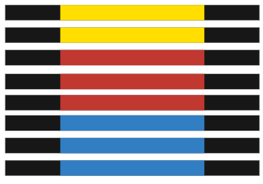
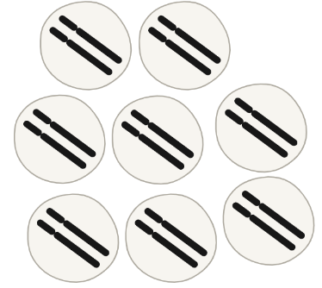
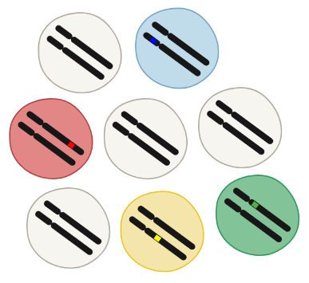
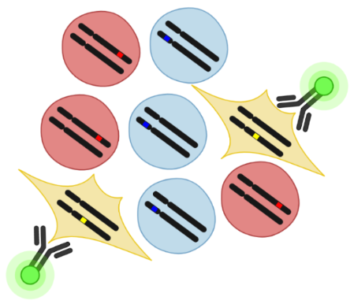
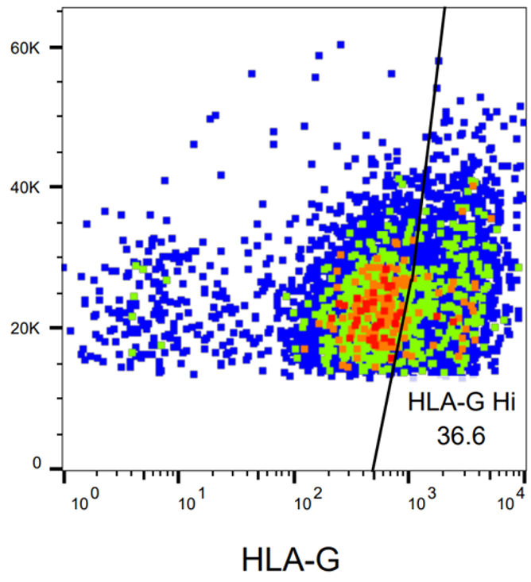

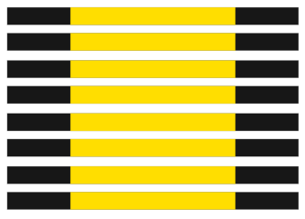
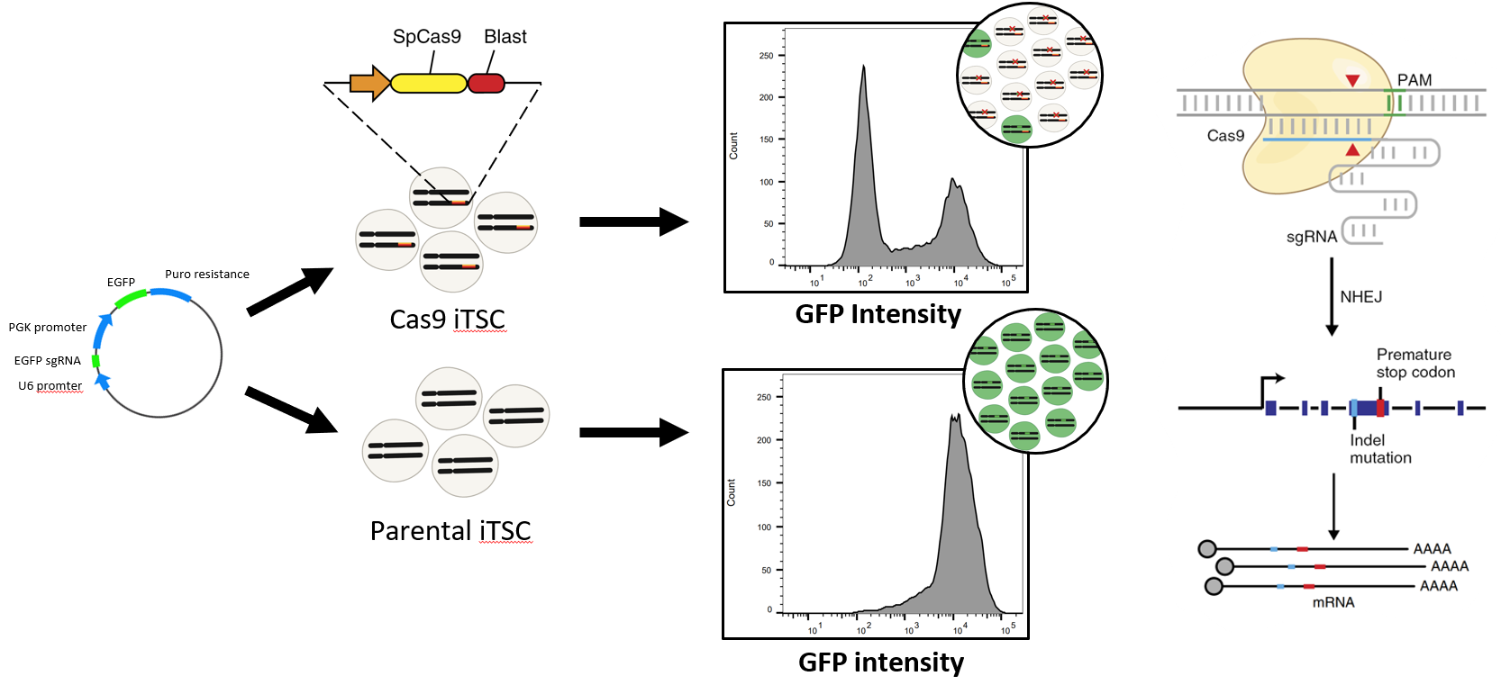
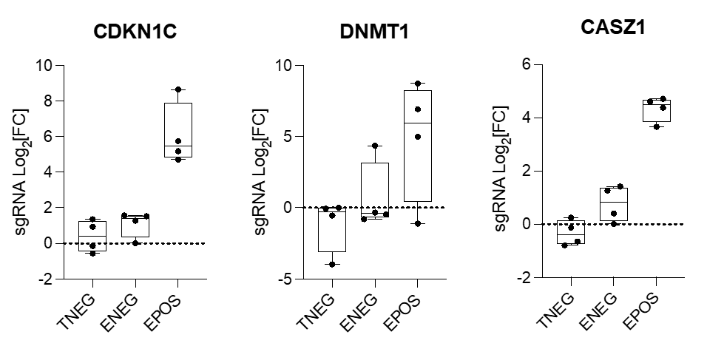
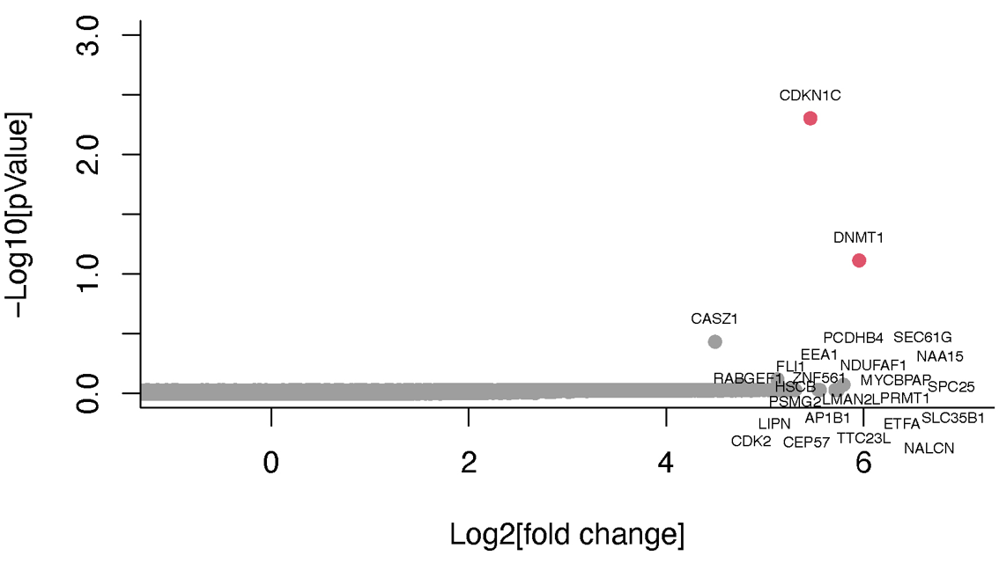
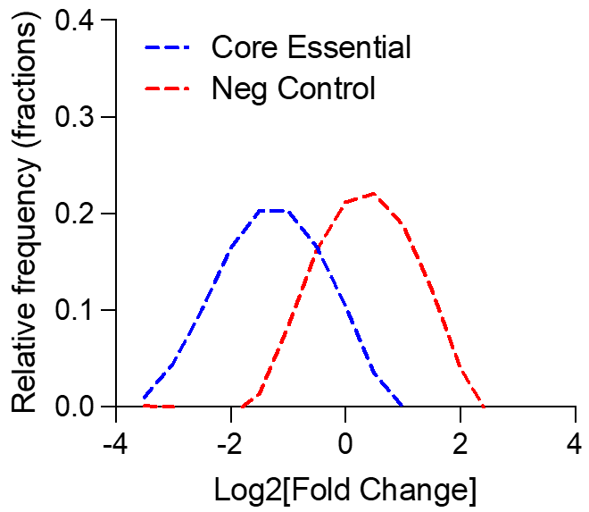
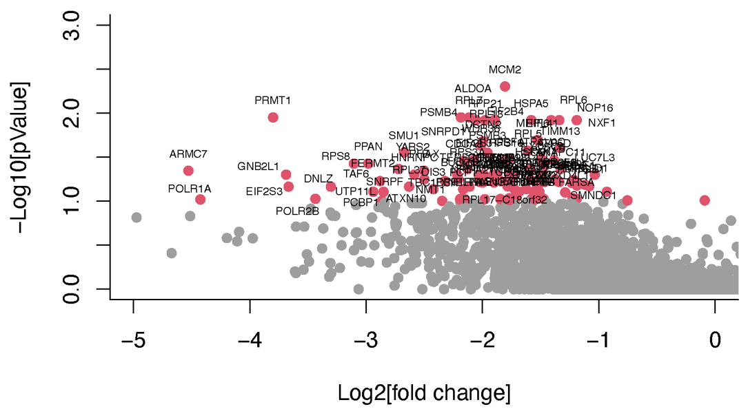
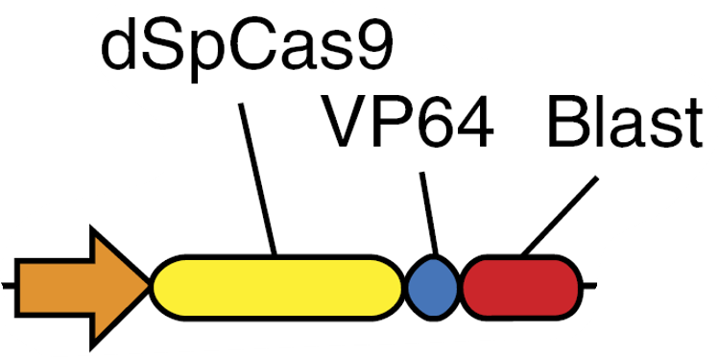
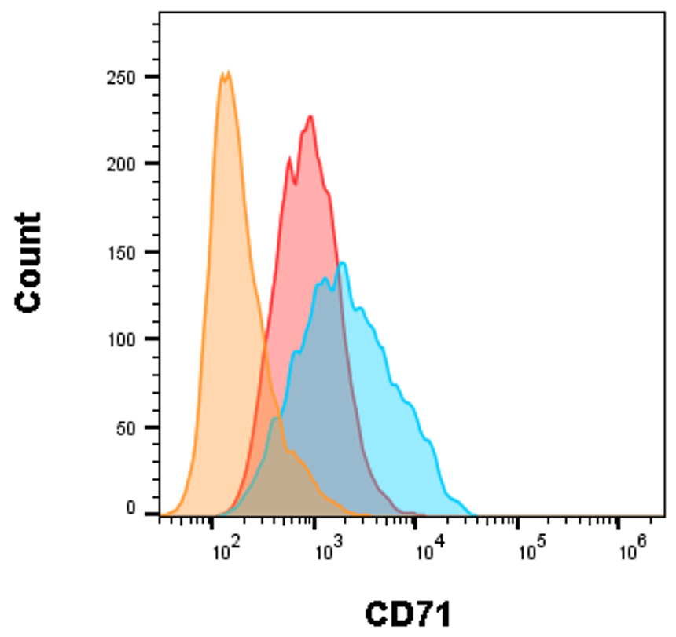
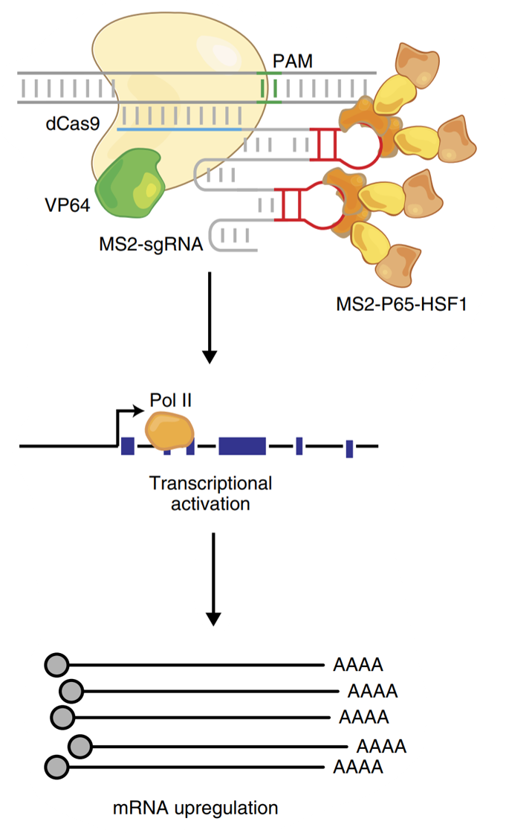
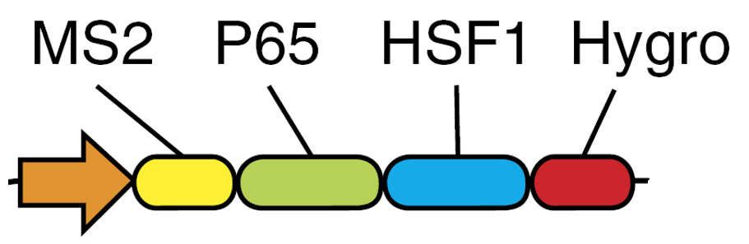



Dissecting Human Trophoblast Differentiation via Genetic Screening
Jacob Paynter^{1,2,3}, Jia Ping Tan^{1,2,3}, Xiaodong Liu^{1,2,3}, Murray Manning⁴, Natasha Tuano⁴, Luis F Malaver-Ortega⁵,
Joseph Chen^{1,2,3}, Joseph Rosenbluh^{4,5}, Jose M. Polo^{1,2,3}.
¹Department of Anatomy and Developmental Biology, Monash University, Clayton, Victoria, Australia. ²Development and Stem Cells Program, Monash Biomedicine Discovery Institute, Clayton, Victoria, Australia. ³Australian Regenerative Medicine Institute, Monash University, Clayton, Victoria, Australia. ⁴Cancer Research Program and Department of Biochemistry and Molecular Biology, Biomedicine Discovery Institute, Monash University, Clayton, Victoria, Australia. ⁵Functional Genomics Platform, Monash University, Clayton, VIC, Australia.
Introduction
Genome-scale CRISPR-Cas9 knockout screen
Extravillous trophoblast cells (EVTs) are essential to the function of the human placenta, interacting with maternal cells and remodeling the maternal spiral arteries throughout development. Defective EVT differentiation and subsequent invasion into the decidua have been associated with pregnancy complications such as early onset pre-eclampsia and foetal growth restriction. However, the mechanisms of EVT differentiation are largely unknown. Recently developed protocols have allowed the maintenance of human trophoblast stem cells (TSCs) in vitro that can differentiate into trophoblast cell subtypes including EVTs. Here, we investigate candidate genes from pooled CRISPR screens that appear to regulate TSC to EVT differentiation. We anticipate that this work will provide a greater understanding of placental development which will guide approaches to treat a range of pregnancy related disorders.
The Cas9+ iTSCs are transduced with a pooled sgRNA library targeting 19,114 genes, containing four sgRNAs per gene and 1000 non-targeting control sgRNAs. Over time, cells that lose function of genes that are essential to survival will become depleted in the culture due to cell death. Fourteen days after transduction, we induce EVT differentiation and separate cell populations via FACS based on HLA-G expression, which is a definitive marker for EVTs. Perturbations that enhance or impair EVT differentiation will result in more or less of these cells respectively appearing in the HLA-G +ve population. Because we used lentivirus to introduce the sgRNAs the genomes will be ‘stamped’ with the sequence of the sgRNA and these can be read by DNA sequencing. Hence, the relative abundance of sgRNA reads between the samples will identify genes causing the phenotype.
Pooled sgRNA Library
Model – Human Induced Trophoblast Stem Cells
No diff control
Genomic DNA isolation
PCR and sequencing
Our lab has recently derived induced trophoblast stem cell (iTSC) lines from reprogrammed human dermal fibroblasts. We generate an iTSC line stably expressing the S. Pyogenes Cas9 nuclease by transducing them with a lentiviral vector harbouring a Cas9 expression cassette. This line is then assessed for Cas9 activity with a vector expressing GFP as well as a sgRNA targeting the GFP coding sequence. In the absence of Cas9 activity, the cells are expected to show close to 100% GFP expression as seen in the parental line. In the Cas9+ line however, nuclease activity will generate frameshift mutations in the GFP coding sequence, disrupting expression of the protein.
Transduction
Differentiation
FACS
Cas9 iTSC line
EVT diff
Loss-of-function Candidates that Enhance EVT Differentiation
We observe genes that are enriched in the HLA-G +ve fraction of the EVT diff sample (EPOS) relative to undifferentiated controls (TNEG). Two genes show strong enrichment with a log10 pValue greater than one suggesting that their loss of function enhances the efficiency of EVT differentiation (A). The spread in log fold change for each of the four sgRNAs targeting the top three hits can be visualized in (B). Also shown is the HLA-G –ve fraction of the EVT diff sample (ENEG) which, as expected, shows similar enrichment to TNEG.
A
B
Loss-of-function Candidates that Inhibit TSC growth
Gain-of-function Perturbations
The performance of the screen is benchmarked using sgRNAs targeting a panel of core essential genes, the loss of which is expected to result in cell death, hence depletion of cells harboring these sgRNAs over time. The change in representation is calculated by comparing the sgRNA read abundance in the sample vs that of the pooled library plasmid DNA. As expected, we observe negative enrichment of core essential genes while negative control (non-targeting) sgRNAs show little change (A). Genes expected to inhibit iTSC growth can be identified based on the P value of their fold change in representation (B).
We have implemented a CRISPR activation system called synergistic activation mediator (SAM) that uses a catalytically inactive Cas9 and a modified sgRNA to recruit trans-activator proteins to a specific locus. The assembled SAM complex behaves as a synthetic transcriptional activator by action of effector domains VP64, p65, and HSF1. We generate an iTSC line stably expressing the SAM components by co-transducing them with lentiviral expression vectors for the dCas9-VP64 and PP7-p65-HSF1 fusion proteins. We then assess the activity of this line by transducing cells with a CD71 sgRNA expression vector and measuring expression of CD71 protein on the cell surface after seven days. The SAM iTSC line shows a modest upregulation of CD71 relative to the parental line. We anticipate this cell line will be useful for discovering additional regulators of EVT differentiation via gain-of-function perturbations.
A
B
Unstained
Parental
SAM iTSCs
Future Work
Target validation – Our screen has identified three genes that may enhance EVT differentiation upon loss of function. We are currently confirming this by generating knockout iTSCs lines for each gene individually, measuring changes in the efficiency of EVT differentiation and confirming reduced expression of the target genes.
Mechanistic studies – Once our candidate genes have been confirmed to be regulating EVT differentiation, we will next design experiments to determine their mechanism of action.

