Slide 1
Azure DevOps Pipelines for the Infrastructure Automator
Adam Bertram

Slide 2
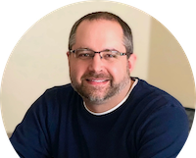
Adam (the Automator) Bertram
Microsoft MVP
Blogger (adamtheautomator.com)
Freelance Writer
Published Author
PowerSheller since Monad
RC Car Enthusiast (if they’re not broke)
Stock trader (if I’m not broke)

