Slide 1
Horned Grebe (Podiceps auritus)
VI = 206
FM
VA
EXP
1
CCS
2
3
4
5
HS

Slide 2
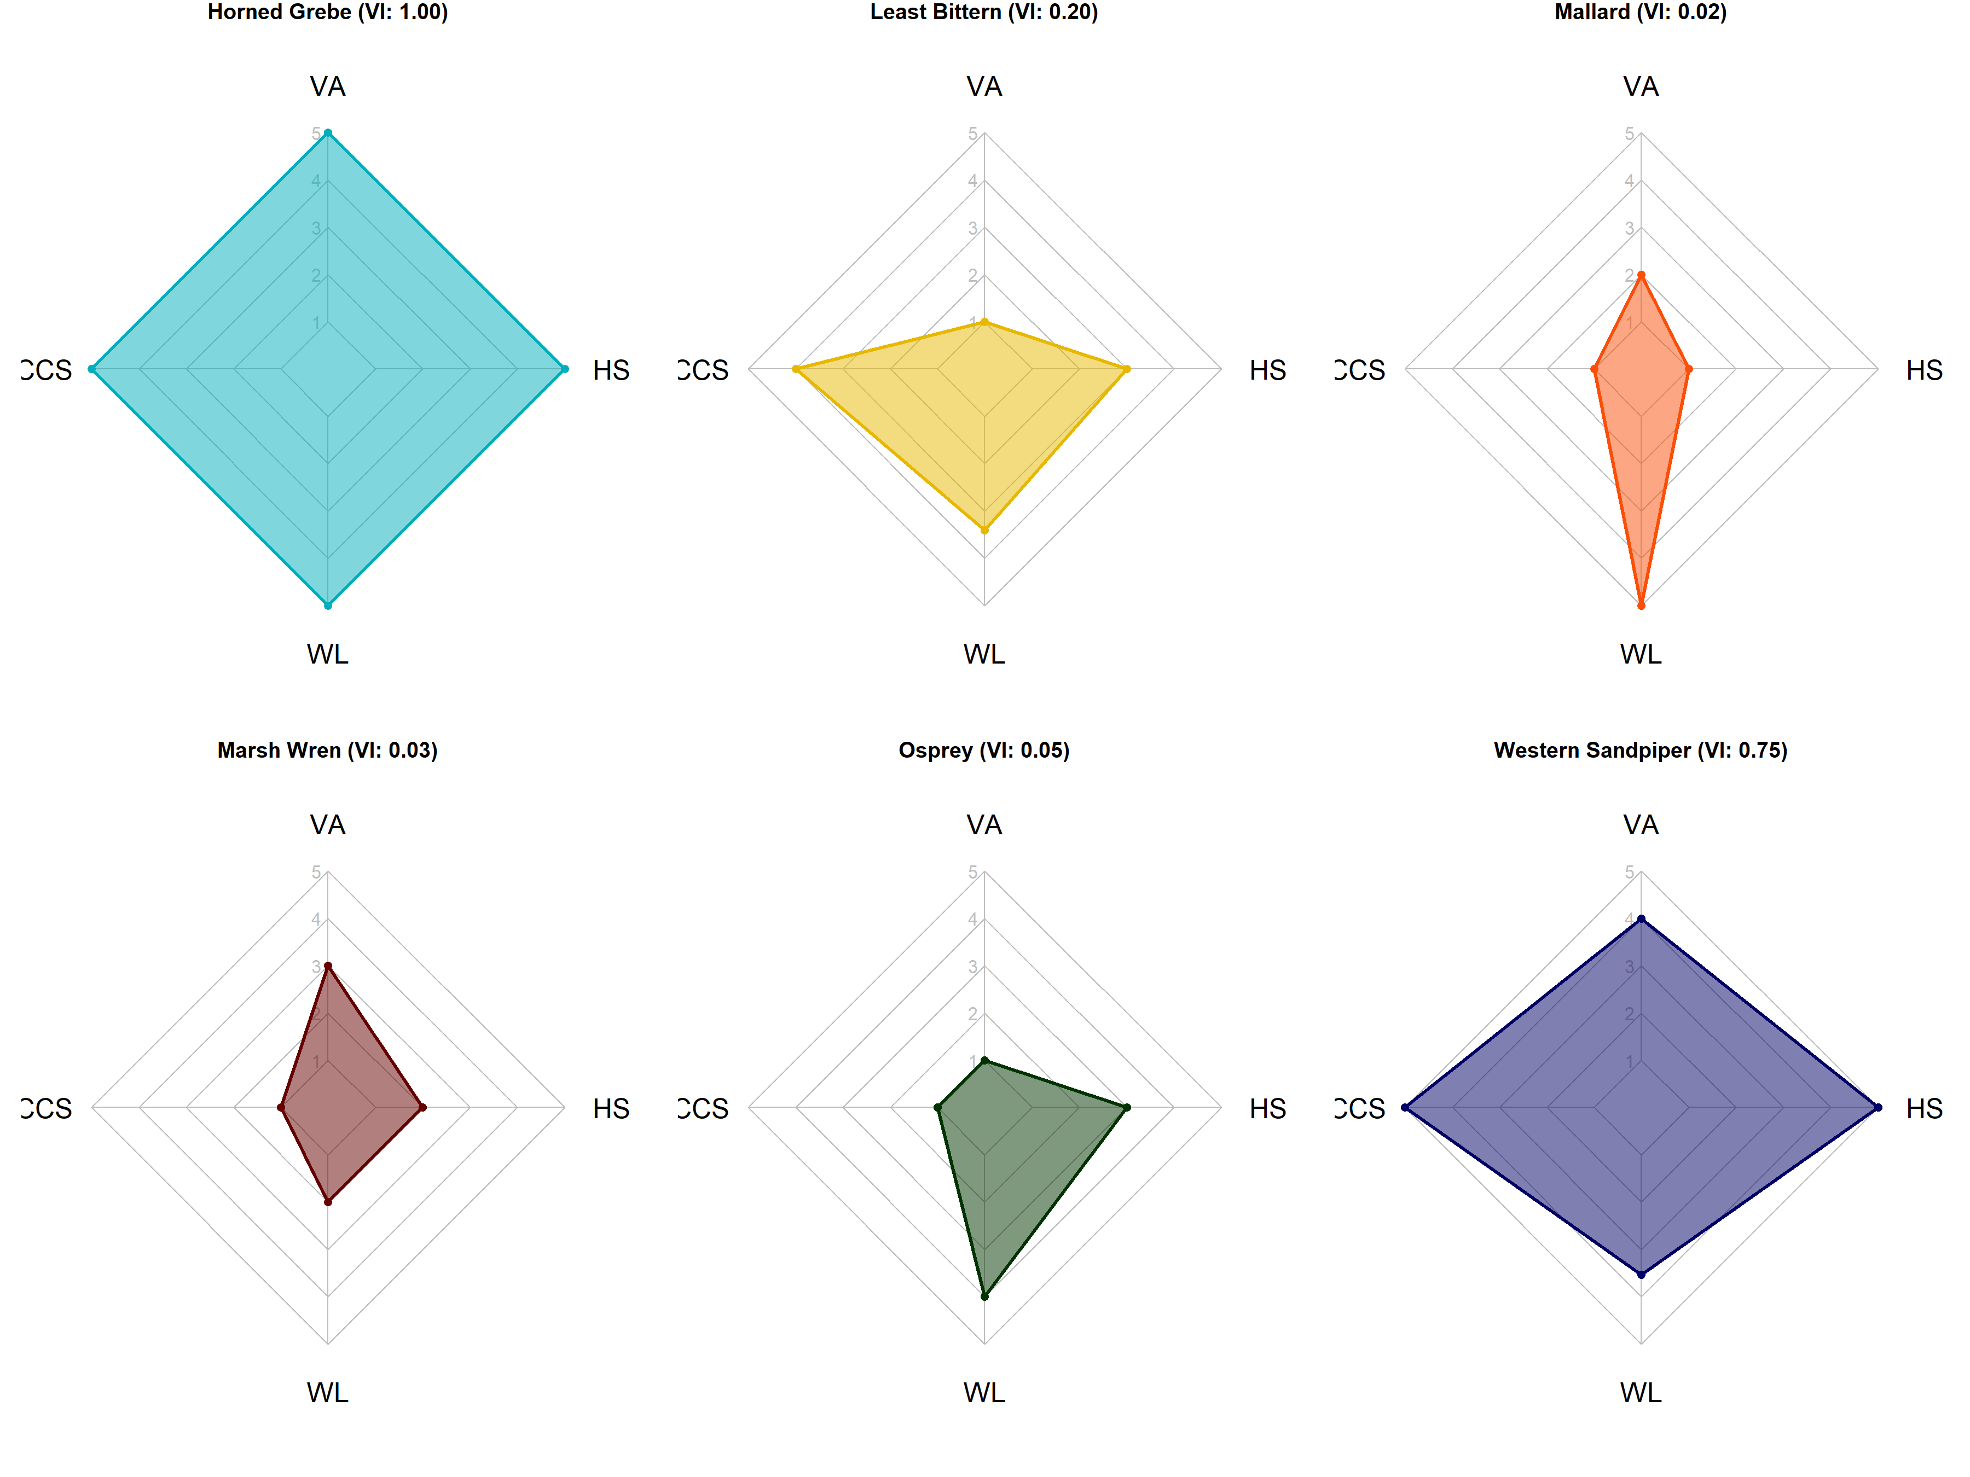
Horned Grebe (VI: 1.00)
Least Bittern (VI: 0.20)
Mallard (VI: 0.02)
CCS
CCS
CCS
FM
FM
FM
Marsh Wren (VI: 0.03)
Osprey (VI: 0.05)
Western Sandpiper (VI: 0.75)
CCS
CCS
CCS
FM
FM
FM

Slide 3
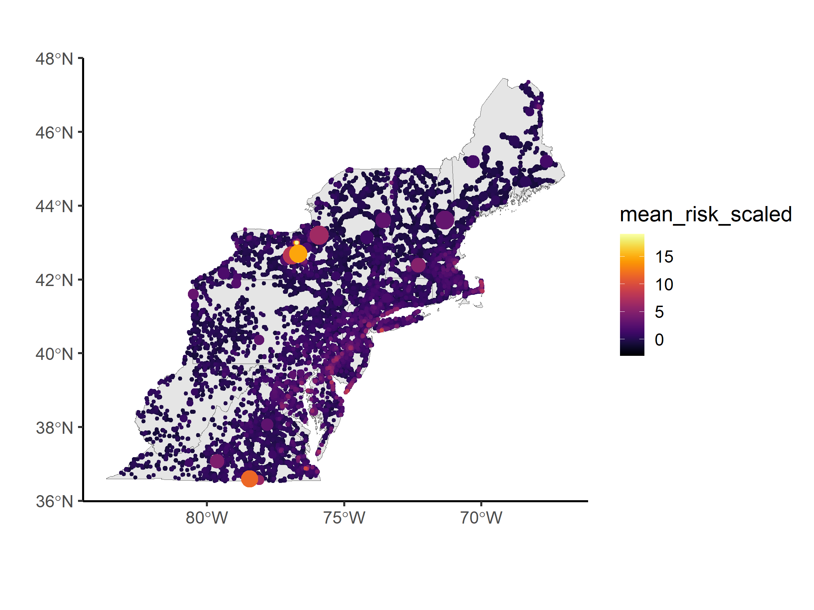
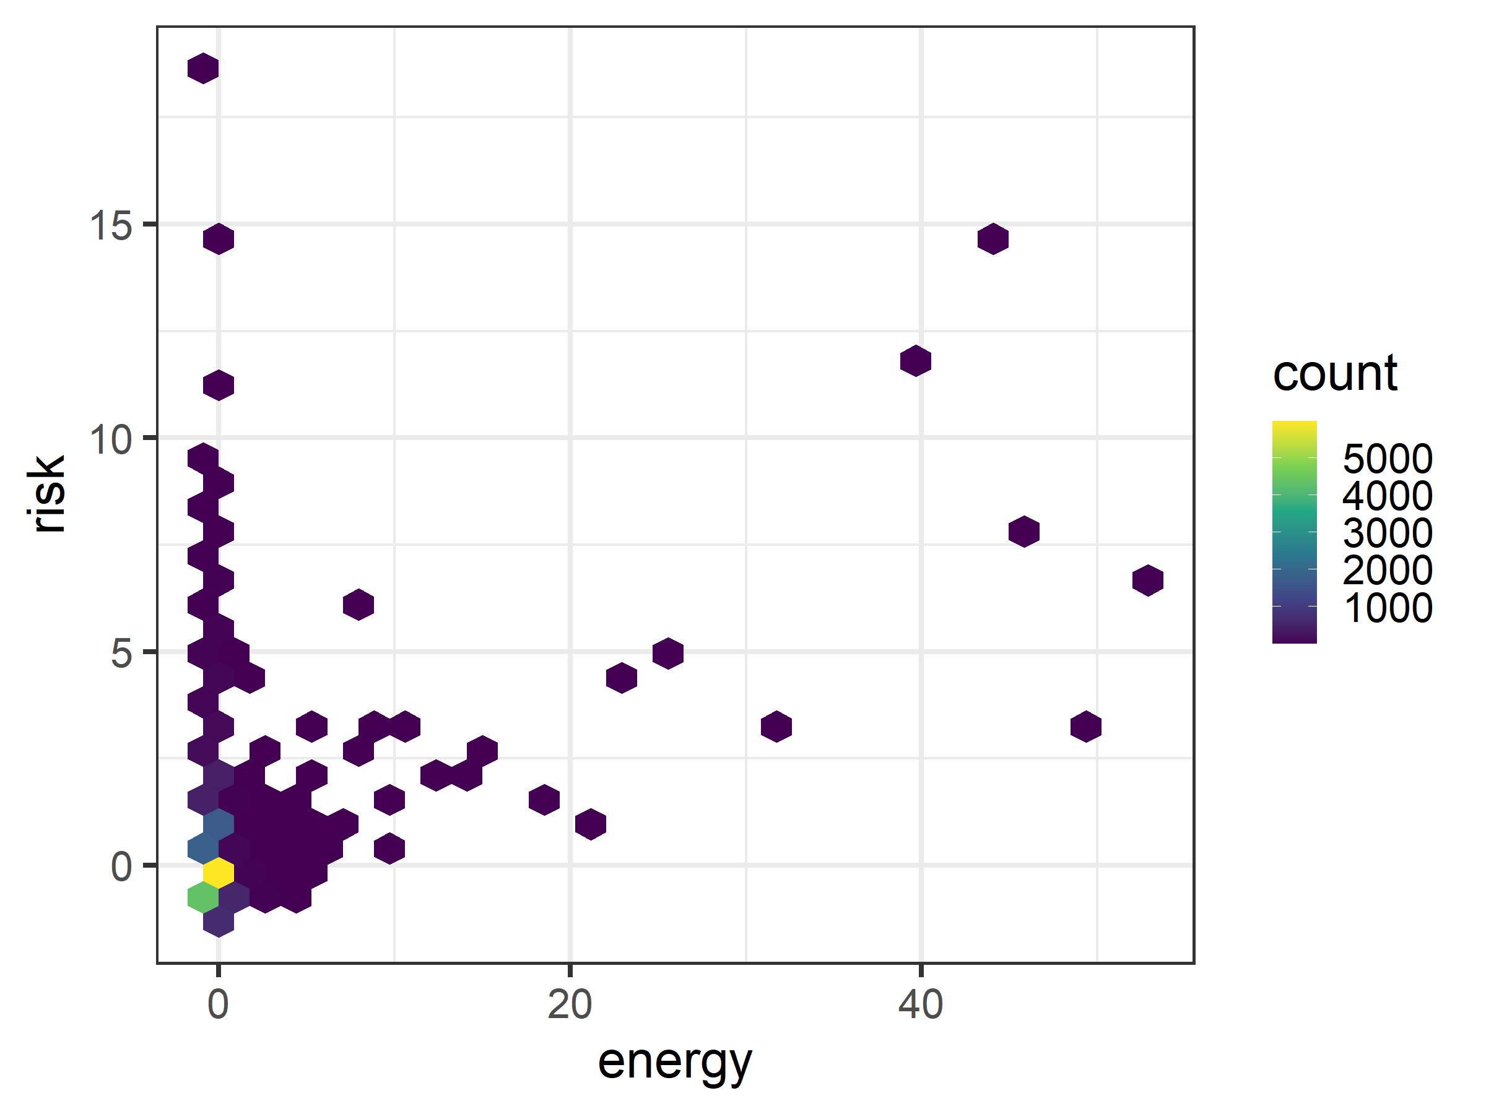
a)
b)

