Slide 1

Collision
Risk
Conservation
Concern
Habitat
Susceptibility
$$VI= \frac{FM+VA}{2}∗{CCS}_{max}∗HS$$

Slide 2
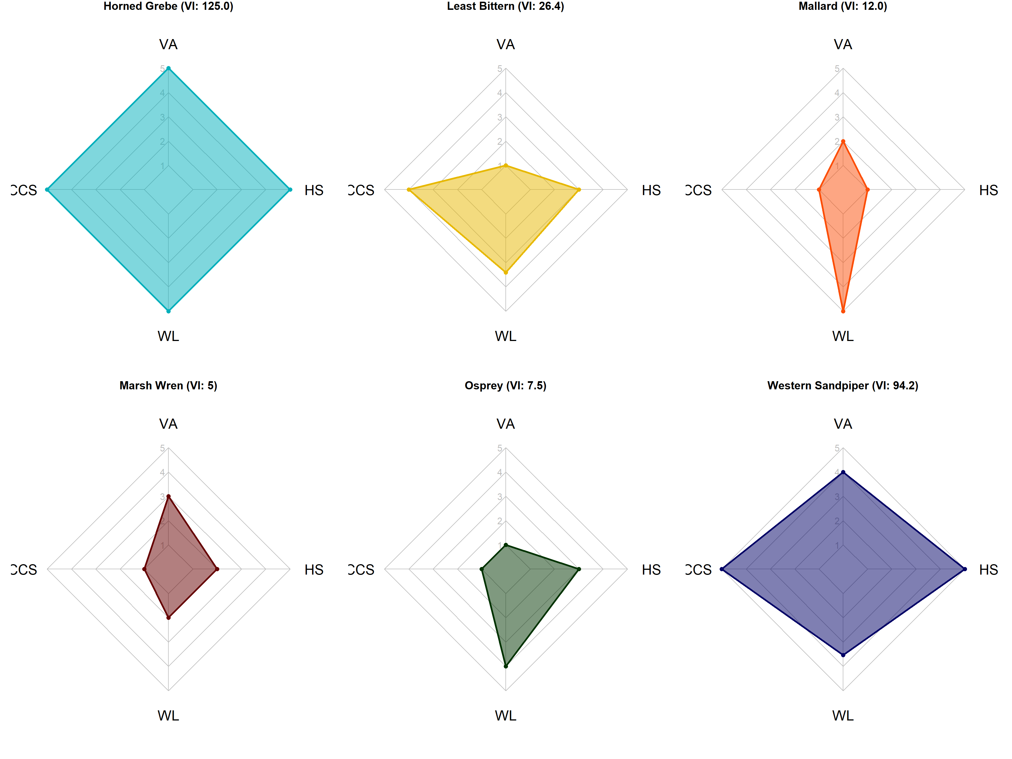
Horned Grebe (VI: 125.0)
Least Bittern (VI: 26.4)
Mallard (VI: 12.0)
CCS
CCS
CCS
FM
FM
FM
Marsh Wren (VI: 5.0)
Osprey (VI: 7.5)
Western Sandpiper (VI: 94.2)
CCS
CCS
CCS
FM
FM
FM

