Slide 1
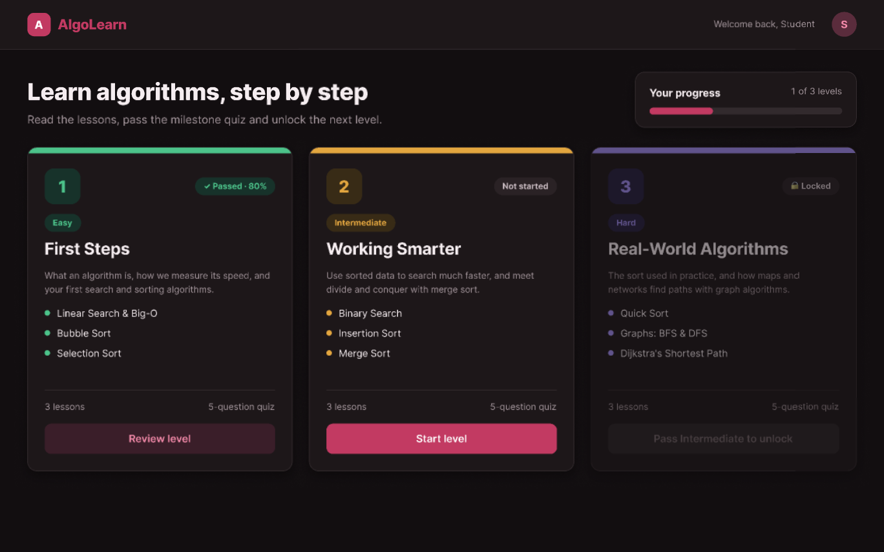
AlgoLearn
A
Short lessons, live animations and a quiz that unlocks the next level.
First presentation · Design & team
SD Squad
Toumani Adib · Alhamad Solaiman · Youssef Jelassi · Feryel
Notes:
Hello everyone, we are SD Squad and this is AlgoLearn. AlgoLearn is an app that teaches algorithms step by step. Today we show the idea, how our team is organised, how we work with GitHub and Trello, and the full Figma design with a clickable prototype. The working Java software comes in our second presentation.

Slide 2
Algorithms are hard to learn from text alone
The idea
AlgoLearn is a desktop app where students learn classic algorithms one level at a time. Every lesson explains the idea in plain words, shows real Java code, and lets you watch the algorithm run.
1
2
3
4
Read the lesson
›
Watch it run
›
Take the quiz
›
Level up
A short explanation, the steps, Java code and the time complexity.
An animation shows every comparison and swap, step by step.
5 questions at the end of the level, with feedback on every answer.
Score 60% or more and the next level opens.
AlgoLearn · SD Squad
2
Notes:
Many students find algorithms hard because books only give text and code. In AlgoLearn the student follows four steps: read a short lesson, watch the algorithm run as an animation, take a 5-question quiz, and with 60% or more the next level unlocks. So learning is small steps with a clear goal.

Slide 3
Three levels, from first steps to real-world algorithms
Content
1
Easy
2
Intermediate
3
Hard
First Steps
Working Smarter
Real-World Algorithms
Linear Search & Big-O
Binary Search
Quick Sort
Bubble Sort
Insertion Sort
Graphs: BFS & DFS
Selection Sort
Merge Sort
Dijkstra's Shortest Path
3 lessons · 5-question quiz
3 lessons · 5-question quiz
3 lessons · 5-question quiz
Pass mark: 60%. Get at least 3 of 5 questions right in a level's milestone quiz to unlock the next level.
AlgoLearn · SD Squad
3
Notes:
The content has three levels with three lessons each, so nine lessons in total. Easy covers linear search, Big-O, bubble sort and selection sort. Intermediate covers binary search, insertion sort and merge sort. Hard covers quick sort, graph search with BFS and DFS, and Dijkstra's shortest path. Each level ends with a 5-question milestone quiz, and you need 60 percent, so 3 out of 5, to unlock the next level.

Slide 4
Who does what in Phase 1
Team
T
S
Y
F
Toumani Adib
Alhamad Solaiman
Youssef Jelassi
Feryel
UI/UX design
Learning material
Quiz questions
Presentation
Designed every screen, the design system and the clickable prototype in Figma.
Wrote the 9 lessons: explanation, steps, Java code and complexity.
Wrote the 15 milestone quiz questions with answers and explanations.
Built this presentation: the idea, the team, our workflow and the design.
Everyone commits to the same GitHub repository and keeps their own cards on Trello.
AlgoLearn · SD Squad
4
Notes:
We are four members and each person has one clear job in Phase 1. Toumani designed the app in Figma: all screens, the design system and the prototype. Solaiman wrote the learning material, the nine lessons. Youssef wrote the fifteen quiz questions with the right answers and explanations. And I, Feryel, made this presentation. Everyone works in the same GitHub repository and has their own Trello cards.

Slide 5
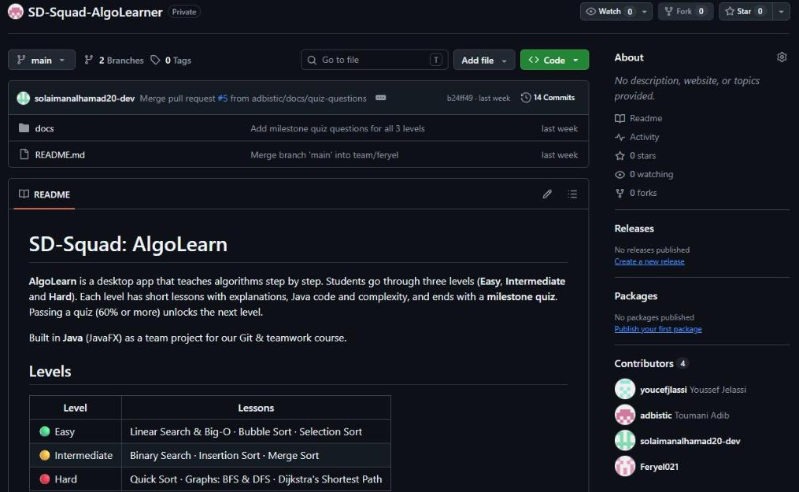
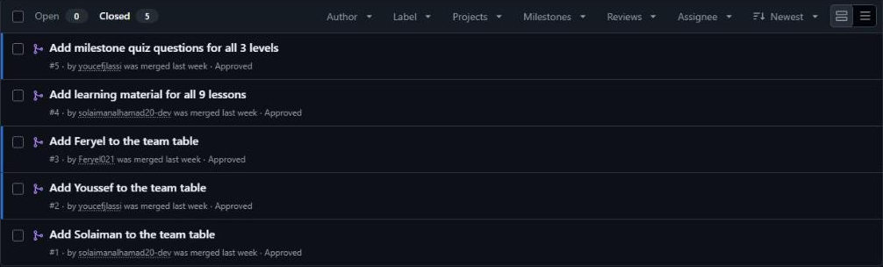
Our GitHub repository
Workflow
Every pull request was reviewed and approved before merging.
4
contributors
Toumani, Solaiman, Youssef and Feryel all commit to the same repository.
How every change gets in
Branch
›
Pull request
›
Review
›
Merge
AlgoLearn · SD Squad
5
Notes:
This is our real GitHub repository. It is private and all four of us are contributors, as you see on the right of the page. We never push straight to main: each task gets its own branch, then a pull request, a teammate reviews and approves it, and then it is merged. For example, Solaiman's learning material and Youssef's quiz questions both came in through pull requests.

Slide 6
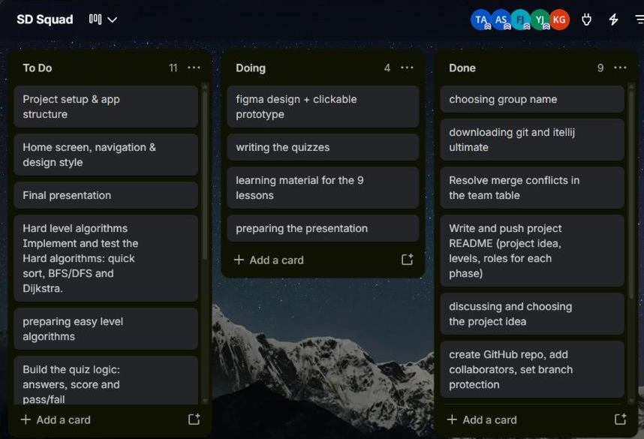
Our Trello board
Workflow
Every member creates their own cards and moves them from To Do to Done as they work.
To Do
Tasks planned but not started yet
Doing
What each member is working on right now
Done
Finished tasks, kept as a record of our work
AlgoLearn · SD Squad
6
Notes:
This is our real Trello board with three lists. To Do holds the tasks we planned but have not started, like the Phase 2 Java work. Doing shows what each of us is working on right now, and Done keeps the finished tasks, like setting up the GitHub repository. Each member creates and moves their own cards.

Slide 7
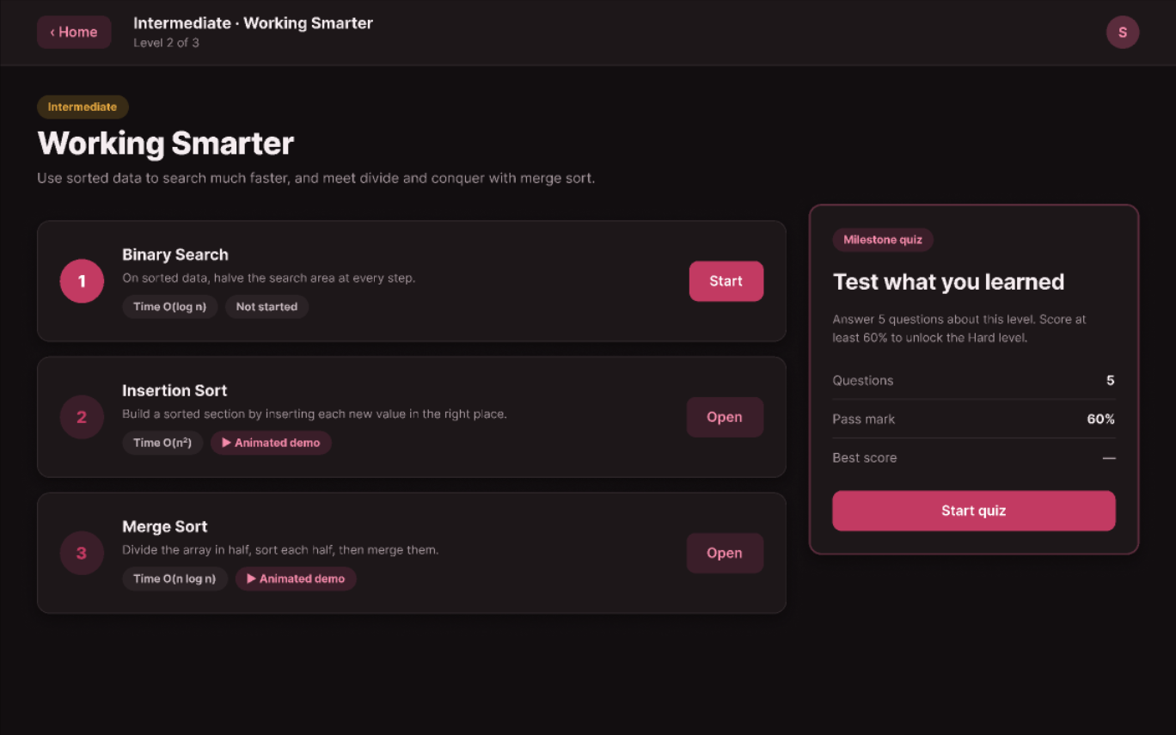
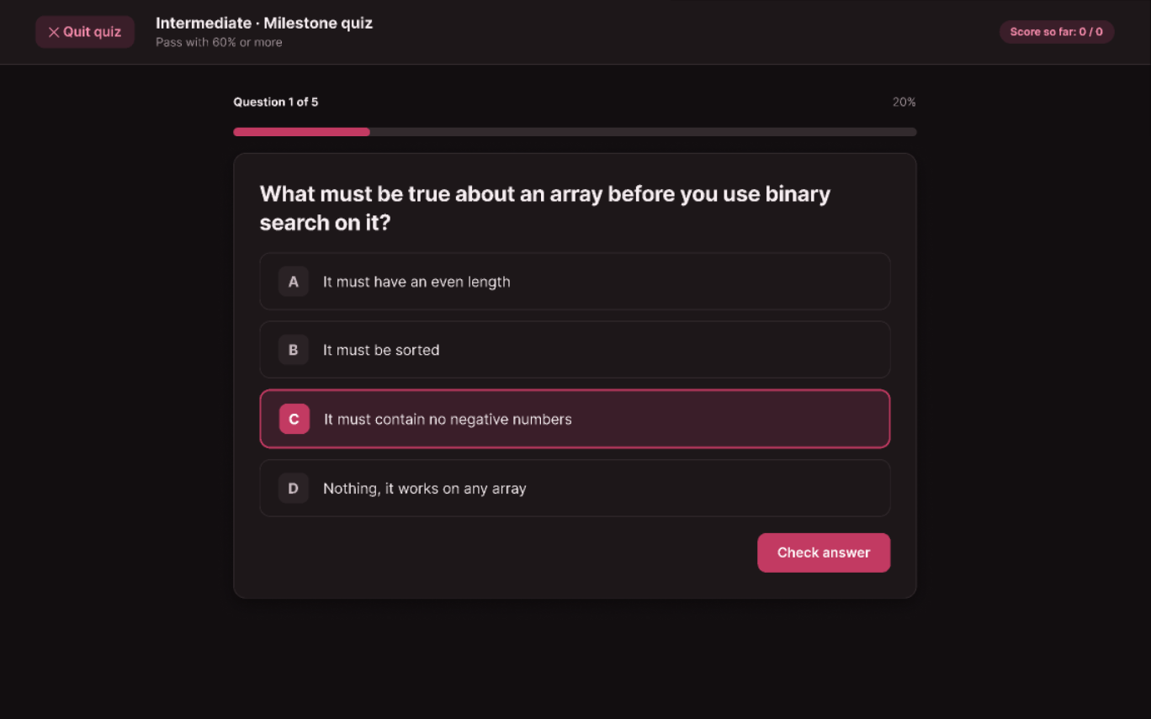
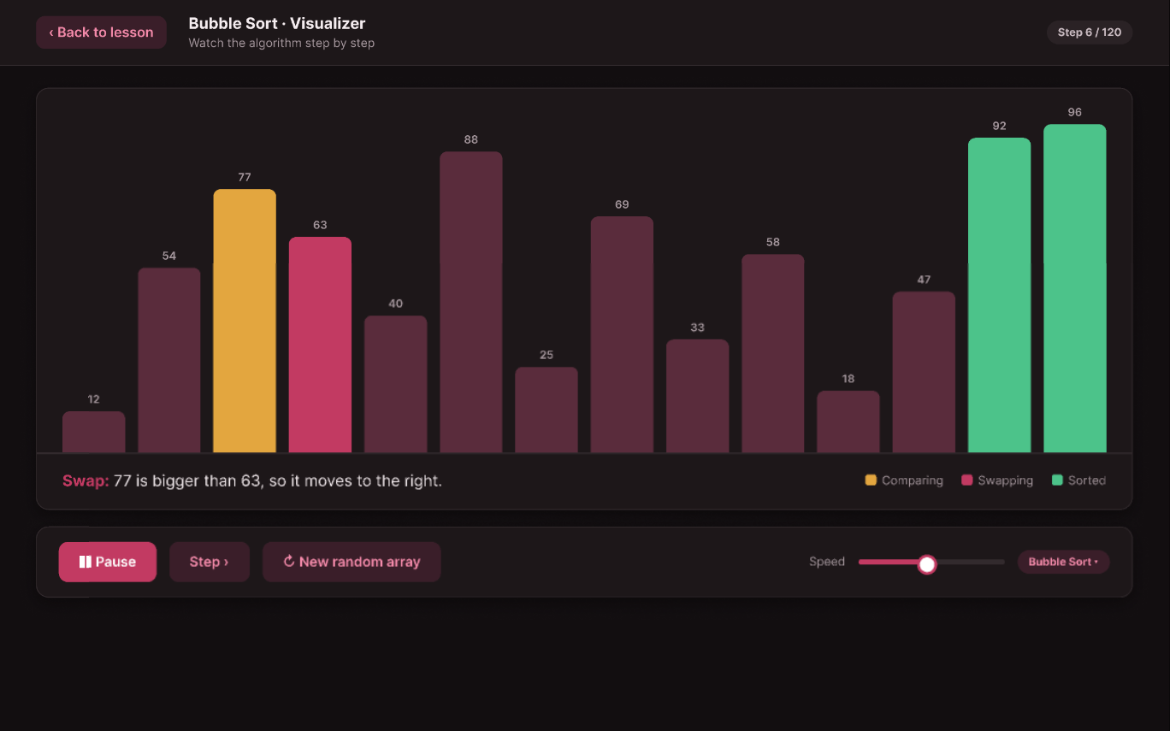
From idea to clickable prototype
Figma
16 screens, one design system and a prototype you can click through like the real app.
Notes:
Now the main part: the design. Everything was designed in Figma before writing any code. There are 16 screens, a design system with colours, text styles and components, and a clickable prototype.

Slide 8
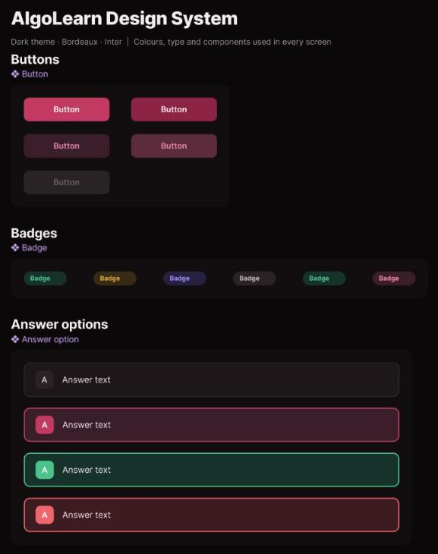
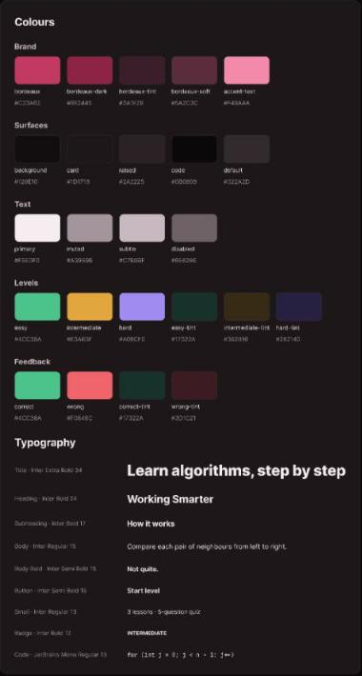
One design system behind every screen
Design system
Colours
One bordeaux brand colour on dark surfaces, plus a colour for each level: green, amber and purple.
Type
One font (Inter) in 9 text styles, from 34 pt titles down to 13 pt code.
Components
Buttons, badges and answer options with states (hover, selected, correct, wrong), reused on every screen.
AlgoLearn · SD Squad
8
Notes:
Before drawing screens, Toumani built a small design system. It has the colours: one bordeaux brand colour on a dark background, and one colour per level. It has the text styles with one font, Inter. And it has reusable components: buttons, badges and answer options, each with different states. Because every screen uses the same pieces, the app looks consistent, and changing one component updates all screens.

Slide 9
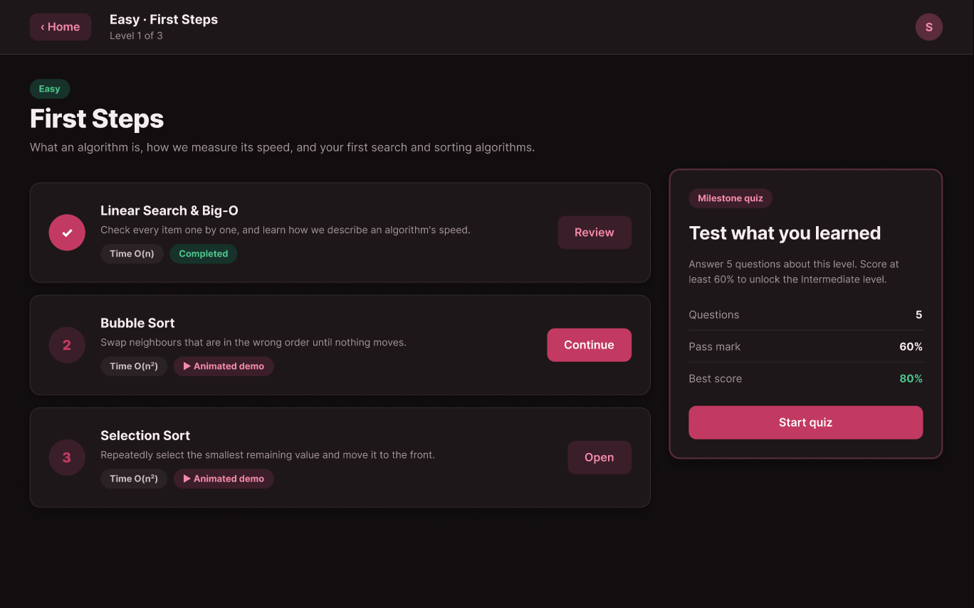
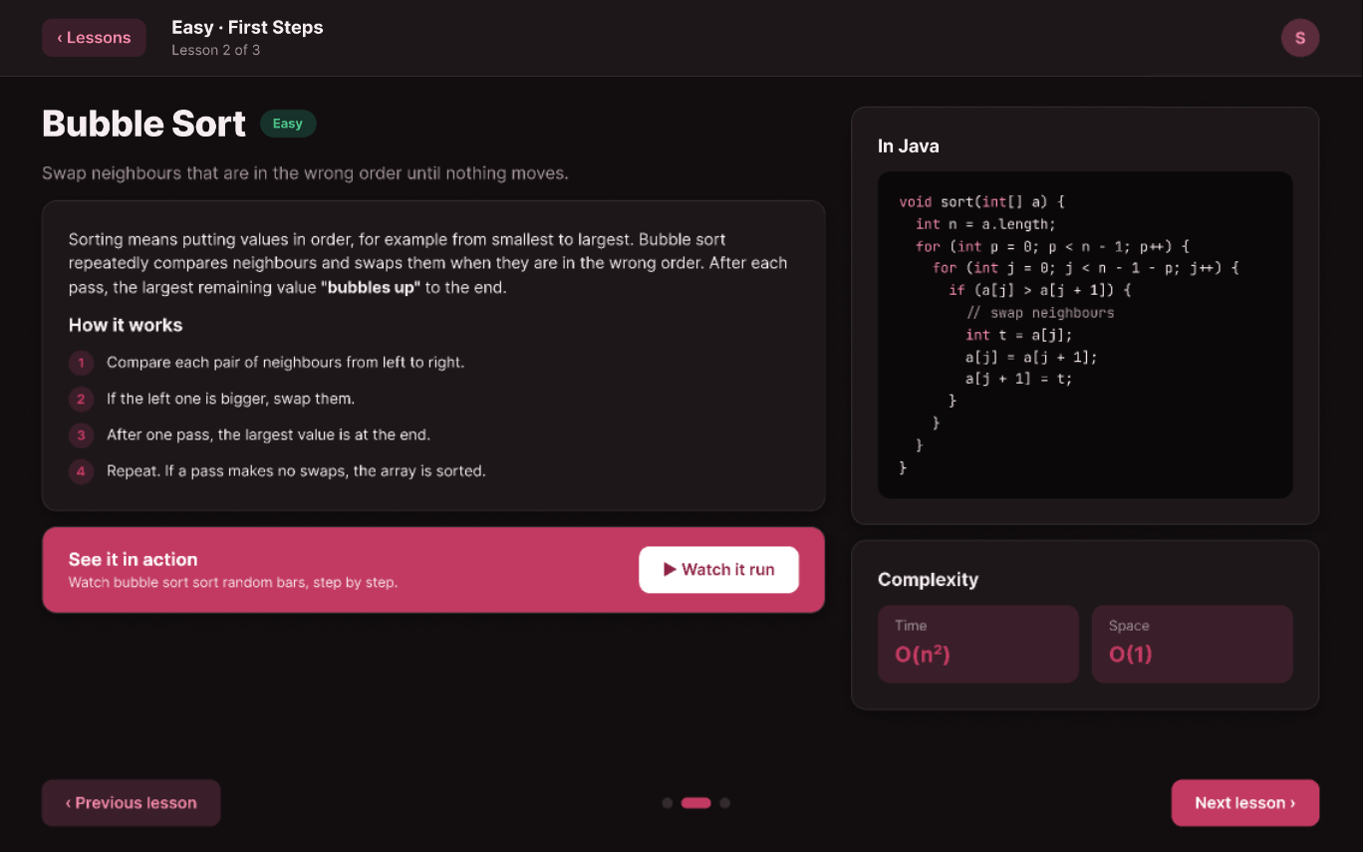
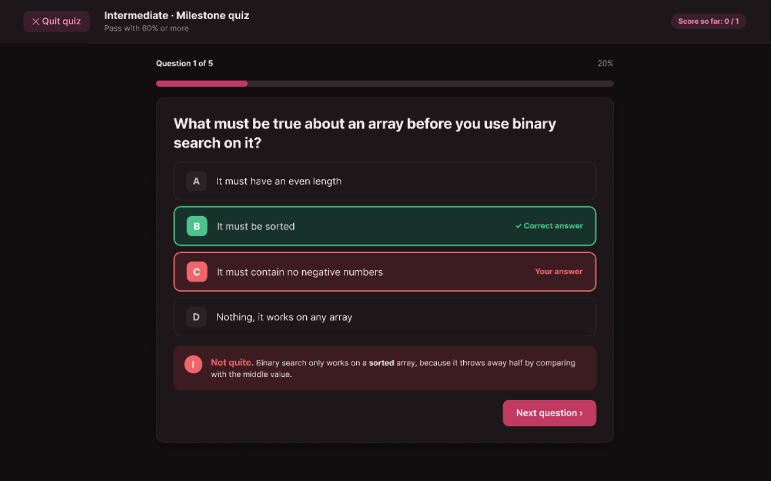
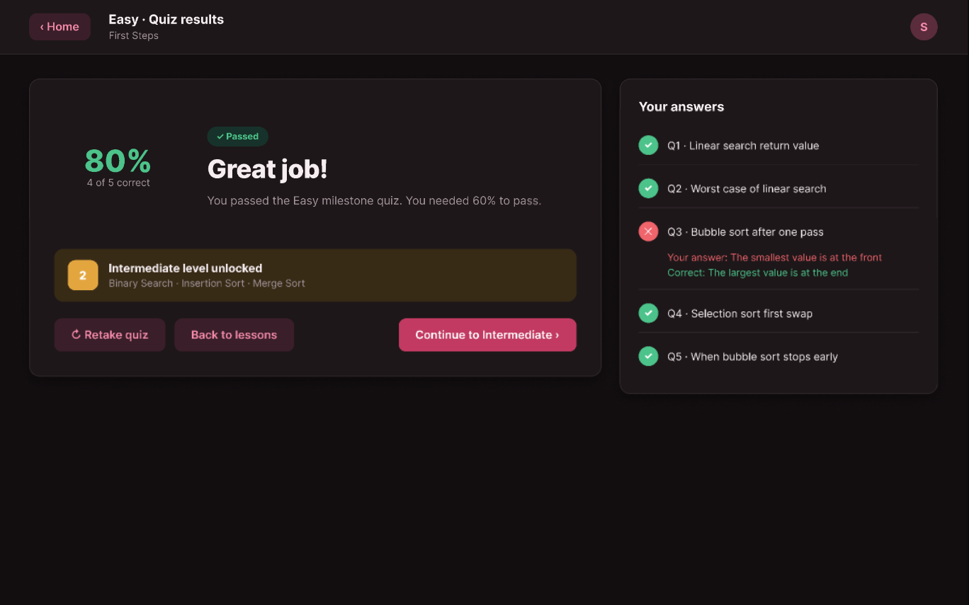
How a student moves through the app
User flow
›
›
›
›
›
Home
Level
Lesson
Quiz
Feedback
Results
Pick a level
See the 3 lessons
Read and watch
Answer 5 questions
Learn from mistakes
Next level unlocked
From any lesson “Watch it run” opens the sorting visualizer.
Below 60% retake the quiz or go back to the lessons.
AlgoLearn · SD Squad
9
Notes:
This is the path of a student. On Home you pick a level. The level page shows its three lessons. In a lesson you read the explanation and can press Watch it run to see the animation. Then you take the quiz, get feedback after each answer, and the results page tells you if the next level is unlocked. If you score below 60 percent, you can retake the quiz.

Slide 10
Home and level pages
Screens
Home
Level page
All three levels and your progress. Hard stays locked until Intermediate is passed.
The three lessons with their status, plus the milestone quiz card.
AlgoLearn · SD Squad
10
Notes:
Here are the first two screens. Home shows the three levels as cards, with a colour for each level, the lessons inside, and a progress bar. Hard is locked until you pass Intermediate. The level page lists the three lessons with their status, and on the right the milestone quiz card shows the questions, the pass mark and your best score.

Slide 11
Lessons you can read and watch
Screens
Plain explanation
What the algorithm does, in simple words and numbered steps.
Real Java code
The same code students will write, with highlighting.
Complexity
Time and space in Big-O, for every algorithm.
AlgoLearn · SD Squad
11
Notes:
This is a lesson page, here bubble sort. On the left is the explanation with numbered steps, on the right the Java code and the complexity. The bordeaux box opens the visualizer, shown small on the right. It animates the array as bars: yellow means comparing, pink means swapping and green means sorted.

Slide 12
Milestone quiz with instant feedback
Screens
1 Answer
2 Feedback
3 Results
Pick one of four options and press Check answer.
The right answer turns green, a wrong one red, with a short explanation.
Your score, which answers were wrong, and the next level unlocked.
15 questions in total 5 per level, each with an explanation, so a wrong answer still teaches something.
AlgoLearn · SD Squad
12
Notes:
Each level ends with the milestone quiz. The student picks an answer and presses Check answer. The feedback screen shows the correct answer in green, the wrong one in red, and explains why. At the end, the results page shows the score and which questions were wrong, and if the score is 60 percent or more, the next level is unlocked.

Slide 13
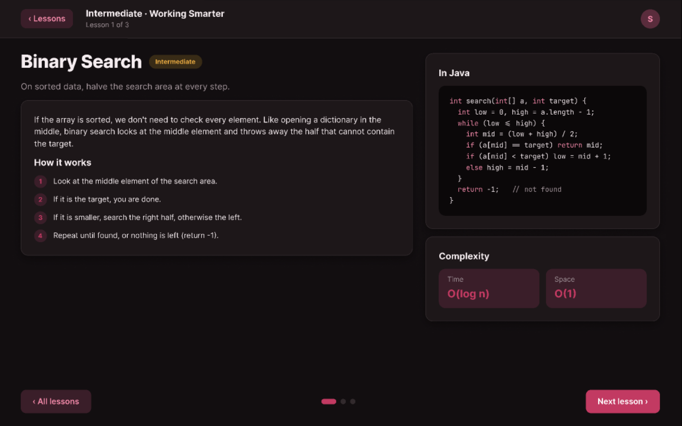
Try it: the clickable prototype
Prototype
Every button leads to the right screen, so the design can be tested like the real app.
1
Home › Start level
2
Binary Search › Next lesson
3
Merge Sort › Start quiz
4
Check answer › Next question
5
Results › Continue
Open the prototype ›
AlgoLearn · SD Squad
13
Notes:
The design is not only pictures, it is a clickable prototype. Every button goes to the correct screen. Let us show the demo path: from Home we start the Intermediate level, go through the lessons, start the quiz, check an answer and see the results. The button on this slide opens the prototype in the browser.

Slide 14
Phase 2: building the real app in Java
Next steps
We turn this design into a working desktop app. Each member builds one part and tests it.
T
Toumani
App structure, navigation, home screen and visual style
Java 21
JavaFX
Maven
JUnit tests
Solaiman
S
Easy level and the quiz engine
Phase 1
Done
Y
Youssef
Design, lessons and quiz questions
Intermediate level and saving progress
Phase 2
Next
F
Feryel
Working Java app, shown in our second presentation
Hard level, graph algorithms and the sorting visualizer
AlgoLearn · SD Squad
14
Notes:
In Phase 2 we build the real app in Java with JavaFX for the interface, Maven to build it and JUnit for tests. Toumani builds the app structure, navigation, the home screen and the visual style. Solaiman builds the Easy level and the quiz engine. Youssef builds the Intermediate level and progress saving. And I build the Hard level with the graph algorithms and the sorting visualizer.

Slide 15
Thank you
A
Questions?
SD Squad
Toumani Adib · Alhamad Solaiman · Youssef Jelassi · Feryel
Notes:
Thank you for listening. We are happy to answer your questions.

