Slide 1

An Experimental Exploratory Data Analysis for a Classification Task – Workshop
https://github.com/claudio1975/SDS2020
SDS2020 – 25/06/2020
Organizer: Claudio Giorgio Giancaterino

Slide 2

Motivation

Slide 3

Data Wrangling
Data Cleaning
Data
Storytelling
Data Science Workflow
Exploratory Data Analysis
Deployment
Model Validation
Modeling
Pre-Processing

Slide 4
The goal is to expand the traditional Exploratory Data Analysis in a wider pipeline by an experimental approach that step by step, with an iterative approach, look for the impact of each action into the behaviour of models
Exploratory Data & Models Analysis

Slide 5
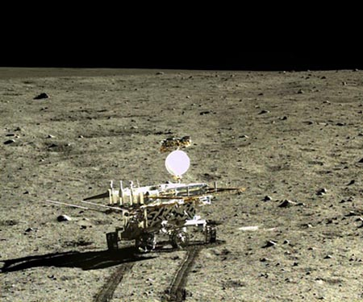
Let’s get started with the journey

Slide 6

Step_0
Have a peek of your data, understanding dimensions of the data set, data types and summary statistics of each attributes, also with the help of some autoEDA tools
(https://github.com/mstaniak/autoEDA-resources)

Slide 7
Step_1
Group data set into data types, Encode Categorical Variables, and have a look the performance of several baseline models (by previous data standardization & split data set).

Slide 8
Type of Variables
Variables
Categorical
Numerical
Date / Time
Ordinal
Nominal
Discrete
Continuous

Slide 9
Examples:
-Ordinal Variables:
Days of the week (Monday=1, Tuesday=2,…, Sunday=7)
-Nominal Variables:
Country of Birth(Italy, Switzerland, Germany)
-Discrete Variables:
Number of credit cards of a borrower(1,2,…5)
-Continuous Variables:
House Price(100.000 $, 45.000 $, 125.000 $)

Slide 10
Categorical encoding
It’s a process used to transform each category string by a numerical representation
The goal is:
-To produce variables that can be used to train machine learning models
-To build predictive features from labels

Slide 11
One Hot Encoding
It’s the process used to transform each categorical variable by boolean variables (dummy variables) marked with 0 or 1 values to highlight if a category is present in each observation.
One Hot Encoding into k dummy variables
City
Zurich
Milan
Milan
Zurich
Munich
Zurich
1
0
0
1
0
Milan
0
1
1
0
0
Munich
0
0
0
0
1

Slide 12
One Hot Encoding into k-1 dummy variables
City
Zurich
Milan
Milan
Zurich
Munich
Zurich
1
0
0
1
0
Milan
0
1
1
0
0

Slide 13
Label Encoding
It’s the process used to replace labels with numbers from 1 to n distinct categories of the variable.
City
Zurich
Milan
Milan
Zurich
Munich
City
1
2
2
1
3

Slide 14
Target Encoding
With target encoding, each category is replaced with the probability of the target value for samples having that category. The “target value” is the value of our model is trying to predict.
City
Zurich
Milan
Milan
Zurich
Munich
Target
1
0
1
1
0
City
1
0,5
0,5
1
0
 | Target
City | 0 | 1 | Probability(1)
Zurich | 0 | 2 | 1
Milan | 1 | 1 | 0,5
Munich | 1 | 0 | 0

Slide 15
Step_1
Wokshop session:
https://github.com/claudio1975/SDS2020/blob/master/notebooks/workshop/0_An_Experimental_EDA_for_a_classification_task.ipynb
https://github.com/claudio1975/SDS2020/blob/master/notebooks/workshop/1_An_Experimental_EDA_for_a_classification_task.ipynb
Laboratory Session:
https://github.com/claudio1975/SDS2020/blob/master/notebooks/laboratory/0_Lab_Experimental_EDA_for_a_classification_task.ipynb
https://github.com/claudio1975/SDS2020/blob/master/notebooks/laboratory/1a_Lab_An_Experimental_EDA.ipynb
https://github.com/claudio1975/SDS2020/blob/master/notebooks/laboratory/1b_Lab_An_Experimental_EDA.ipynb
https://github.com/claudio1975/SDS2020/blob/master/notebooks/laboratory/1c_Lab_An_Experimental_EDA.ipynb
Challenge yourself:
https://github.com/claudio1975/SDS2020/blob/master/notebooks/laboratory/exercises/1a_Ex_An_Experimental_EDA.ipynb
https://github.com/claudio1975/SDS2020/blob/master/notebooks/laboratory/exercises/1b Ex_An_Experimental_EDA.ipynb
https://github.com/claudio1975/SDS2020/blob/master/notebooks/laboratory/exercises/1c_Ex_An_Experimental_EDA.ipynb

Slide 16
Step_2
Fulfill the previous step with Data Cleaning activity: manage Missing Values. Then check out the performance of several baseline models (by previous data standardization & split data set).

Slide 17
Missing Data Imputation
It’s the process used to replace missing data with statistical estimates of the missing values.
Mean/Median/Mode imputation
It’s the process based to replace all occurrences
of missing values within a variable by the mean/median/mode.
Gender
Male
Male
Female
Male
Gender
Male
Male
Male
Female
Male
Mode = Male

Slide 18
Last Observation Carried Forward (LOCF)/ Next Observation Carried Forward (NOCB)
It’s the process used to replace missing data with the last observed value/the first observed value after the missing value.
Gender
Female
Male
Female
Male
Gender
Female
Female
Male
Female
Male
Input = LOCF

Slide 19
Random Sample Imputation
It's the process used to replace missing data with a random observation extracted by the available observations of the variable.
Gender
Female
Male
Female
Gender
Female
Male
Male
Female
Female
Input = Random Sample

Slide 20
Step_2
Wokshop session:
https://github.com/claudio1975/SDS2020/blob/master/notebooks/workshop/2_An_Experimental_EDA_for_a_classification_task.ipynb
Laboratory session:
https://github.com/claudio1975/SDS2020/blob/master/notebooks/laboratory/2a_Lab_An_Experimental_EDA.ipynb
https://github.com/claudio1975/SDS2020/blob/master/notebooks/laboratory/2b_Lab_An_Experimental_EDA.ipynb
https://github.com/claudio1975/SDS2020/blob/master/notebooks/laboratory/2c_Lab_An_Experimental_EDA.ipynb
Challenge yourself:
https://github.com/claudio1975/SDS2020/blob/master/notebooks/laboratory/exercises/2a_Ex_An_Experimental_EDA.ipynb
https://github.com/claudio1975/SDS2020/blob/master/notebooks/laboratory/exercises/2b_Ex_An_Experimental_EDA.ipynb
https://github.com/claudio1975/SDS2020/blob/master/notebooks/laboratory/exercises/2c_Ex_An_Experimental_EDA.ipynb

Slide 21
Step_3
Fulfill the previous step with the traditional Exploratory Data Analysis and Feature Selection. Then check out the performance of several baseline models (by previous data standardization & split data set).

Slide 22
Exploratory Data Analysis
Univariate Analysis
Bivariate/Multivariate Analysis
Visualization
Statistical Analysis
Statistical Analysis
Visualization

Slide 23
Data Visualization
-Categorical Variables:
Bar Chart, Pie Chart, Grouped/Stacked Chart
-Numerical Variables:
Histogram, Box Plot, Density Plot, Line Plot, Scatter Plot, Correlation Plot

Slide 24
Statistical Analysis
(Univariate Approach)
-Categorical Variables:
Class Distribution, Frequency Distribution
-Numerical Variables:
Summary Statistics (mean, median, max, min, variance/standard deviation, skewness, kurtosis)

Slide 25
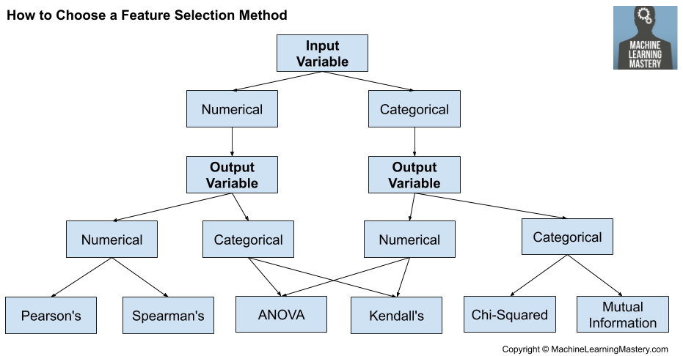
Feature Selection
(Bivariate Statistical Analysis)
How to Choose a Feature Selection Method For Machine Learning

Slide 26
Step_3
Wokshop session:
https://github.com/claudio1975/SDS2020/blob/master/notebooks/workshop/3_An_Experimental_EDA_for_a_classification_task.ipynb
Laboratory session:
https://github.com/claudio1975/SDS2020/blob/master/notebooks/laboratory/3a_Lab_An_Experimental_EDA.ipynb
https://github.com/claudio1975/SDS2020/blob/master/notebooks/laboratory/3b_Lab_An_Experimental_EDA.ipynb
https://github.com/claudio1975/SDS2020/blob/master/notebooks/laboratory/3c_Lab_An_Experimental_EDA.ipynb
Challenge yourself:
https://github.com/claudio1975/SDS2020/blob/master/notebooks/laboratory/exercises/3a_Ex_An_Experimental_EDA.ipynb

Slide 27
Step_4
Fulfill the previous step with another Data Cleaning activity: Manage Outliers. Then check out the performance of several baseline models (by previous data standardization & split data set).

Slide 28
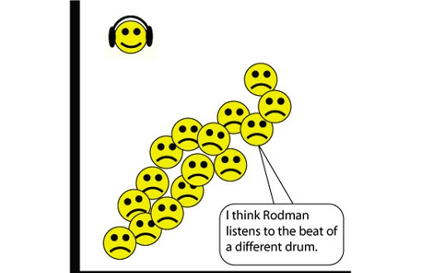
Handling Outliers
An outlier is an observation that is unlike the other observations. They are extreme values that fall far away of the other observations.

Slide 29
Capping with the inter-quantile range
This approach is suitable for skewed distributions. It caps outliers within two boundaries based on the interquartile range (IQR).
Upper Limit: 75th quantile + IQR*1.5
Lower Limit: 25th quantile - IQR*1.5

Slide 30
Capping with the Quantiles
This approach is suitable for Normal distributions.
It caps outliers within two boundaries.
Upper Limit: 95th quantile
Lower Limit: 5th quantile

Slide 31
Capping with the Gaussian Approximation
This approach is suitable for Normal distributions.
It caps outliers within two boundaries.
Upper Limit: mean + 3*standard deviation
Lower Limit: mean – 3*standard deviation

Slide 32
Step_4
Wokshop session:
https://github.com/claudio1975/SDS2020/blob/master/notebooks/workshop/4_An_Experimental_EDA_for_a_classification_task.ipynb
Laboratory session:
https://github.com/claudio1975/SDS2020/blob/master/notebooks/laboratory/4a_Lab_An_Experimental_EDA.ipynb
https://github.com/claudio1975/SDS2020/blob/master/notebooks/laboratory/4b_Lab_An_Experimental_EDA.ipynb
https://github.com/claudio1975/SDS2020/blob/master/notebooks/laboratory/4c_Lab_An_Experimental_EDA.ipynb
Challenge yourself:
https://github.com/claudio1975/SDS2020/blob/master/notebooks/laboratory/exercises/4a_Ex_An_Experimental_EDA.ipynb

Slide 33
Step_5
Fulfill the previous step with Feature Engineering on Numerical Variables. Then check out the performance of several baseline models (by previous data standardization & split data set).

Slide 34
Feature Engineering
It’s the process used to build new features to improve performance of machine learning.
-Categorical Variables:
Encoding
-Numerical Variables:
Arithmetical Features, Variable Transformation, Discretization

Slide 35
Step_5
Wokshop session:
https://github.com/claudio1975/SDS2020/blob/master/notebooks/workshop/5_An_Experimental_EDA_for_a_classification_task.ipynb
Laboratory session:
https://github.com/claudio1975/SDS2020/blob/master/notebooks/laboratory/5a_Lab_An_Experimental_EDA.ipynb
Challenge yourself:
https://github.com/claudio1975/SDS2020/blob/master/notebooks/laboratory/exercises/5a_Ex_An_Experimental_EDA.ipynb

Slide 36
Step_6
Fulfill the previous step applying Resampling method to manage Imbalanced data set. Compare results of models with previous steps and choice the best one. Evaluate Feature Importance for a better interpretability (by previous data standardization & split data set).

Slide 37
Imbalanced Classification
It’s a classification predictive modeling problem where the number of observations of the data set for each class may not be balanced, so the distribution of classes is not equal and it’s skewed.
Tacticts to face imbalanced classes:
-Collect more data
-Change performance metric
-Resample the data set
-Generate synthetic samples
-Try different machine learning models
-Try penalized machine learning models
-Look at the problem from another point of view

Slide 38
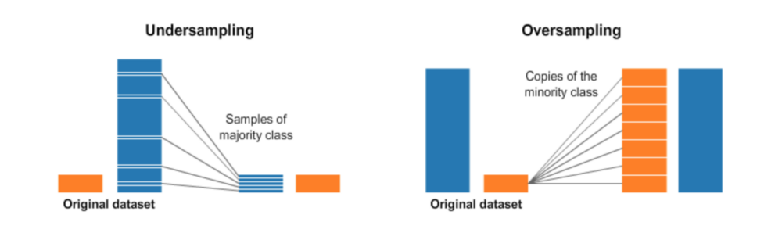
Undersampling & Oversampling
-Oversampling: randomly sample (with replacement) the minority class to reach the same size of the majority class
-Undersampling: randomly subset the majority class to reach the same size of the minority class.

Slide 39
Smote
SMOTE (Synthetic Minority Over-sampling Technique) is an over-sampling method that creates synthetic samples from the minority class instead of creating copies from it.

Slide 40
Feature Importance
Feature importance consists on assigning scores to input features of a predictive model that indicates the relevance of each feature when making a prediction.
-Coefficients as Feature Importance
-Decision Tree Feature Importance
-Permutation Feature Importance
-SHAP Values

Slide 41
Step_6
Wokshop session:
https://github.com/claudio1975/SDS2020/blob/master/notebooks/workshop/6_An_Experimental_EDA_for_a_classification_task.ipynb
Laboratory session:
https://github.com/claudio1975/SDS2020/blob/master/notebooks/laboratory/6a_Lab_An_Experimental_EDA.ipynb
https://github.com/claudio1975/SDS2020/blob/master/notebooks/laboratory/6b_Lab_An_Experimental_EDA.ipynb
https://github.com/claudio1975/SDS2020/blob/master/notebooks/laboratory/6c_Lab_An_Experimental_EDA.ipynb
Challenge yourself:
https://github.com/claudio1975/SDS2020/blob/master/notebooks/laboratory/exercises/6a_Ex_An_Experimental_EDA.ipynb

Slide 42
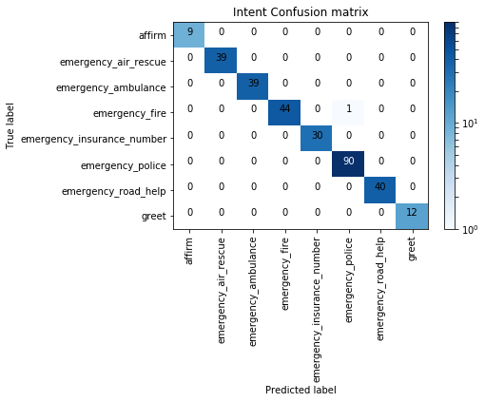
Performance Metric Overwiev
Confusion Matrix: A breakdown of predictions into a table showing correct predictions in the diagonal and the types of incorrect predictions made (off-diagonal). Good predictions coming from the higher diagonal values of the confusion matrix.
Predicted label
True Positive | False Negative
False Positive | True Negative
True label

Slide 43
F1 score
F1 score is the harmonic average between recall and precision. It measures how precise is the classifier and how robust is the classifier.
-Precision: captures the fraction of positive predictions that are actually positive.
-Recall: captures fraction of positive data correctly identified by the model.
Optimistic model: high recall, low precision
Pessimistic model: high precision, low recall

Slide 44
Models Overwiev

Slide 45
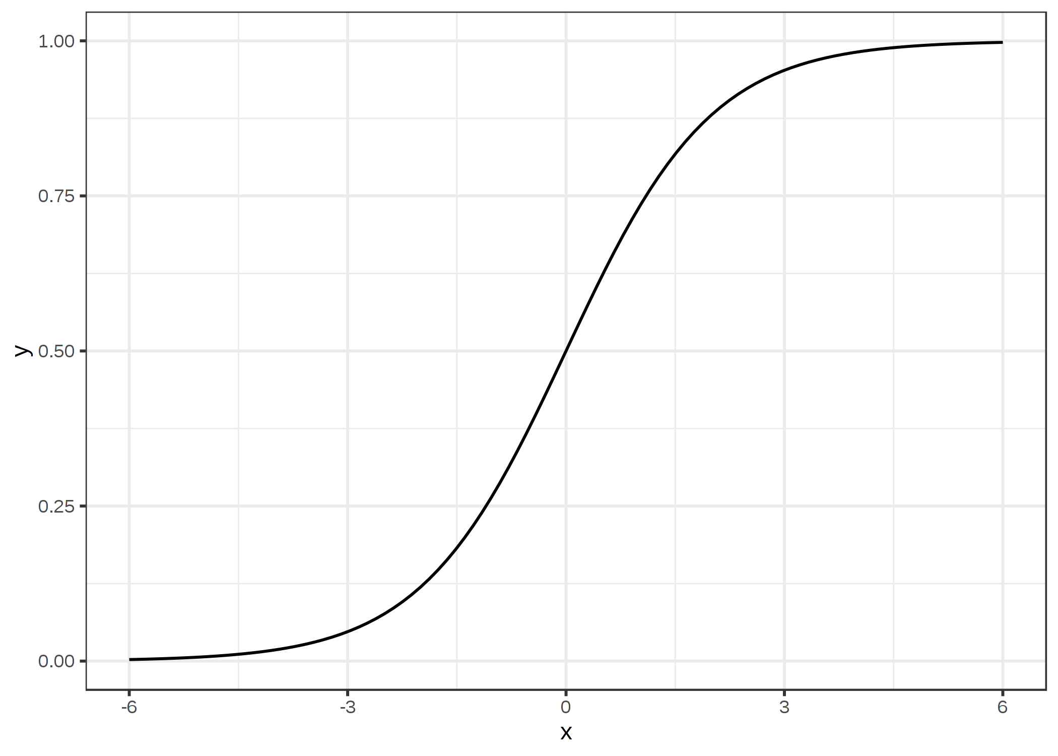
Logistic Regression
Logistic Regression as GLM
It models the probabilities for classification tasks with a binary value instead of a numeric value.
Instead of fitting a straight line or hyperplane, the logistic regression model uses the logistic function to squeeze the output of a linear equation between 0 and 1.

Slide 46
Decision Trees
Tree enables to segment the predictor space into a number of simple regions defined according to the covariates.
There is a top-down, greedy approach that is known as recursive binary splitting.
For each Region the prediction is set as the Region average.

Slide 47
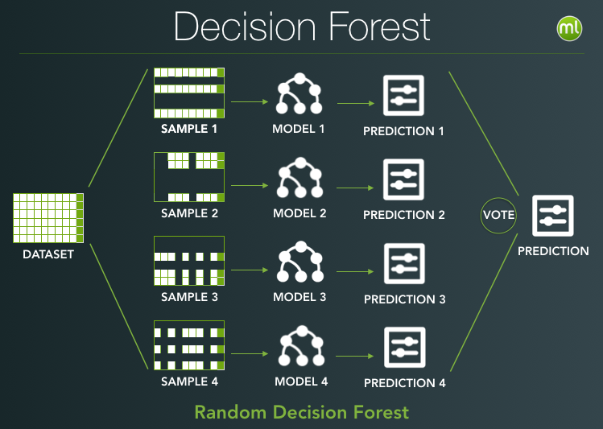
Bagging & Random Forest
Bagging (a contraction of bootstrap-aggregation) is a general aggregation scheme, which generates bootstrap samples with replacement from the original data set creating in this way new different data sets. A decision tree is estimated from each new data set, and the predictions for each tree are averaged obtaining the final prediction.
Random Forest uses bagging methodology with an improvement: it applies decorrelates trees. In this way the variance is reduced when is done the average on each prediction models.

Slide 48
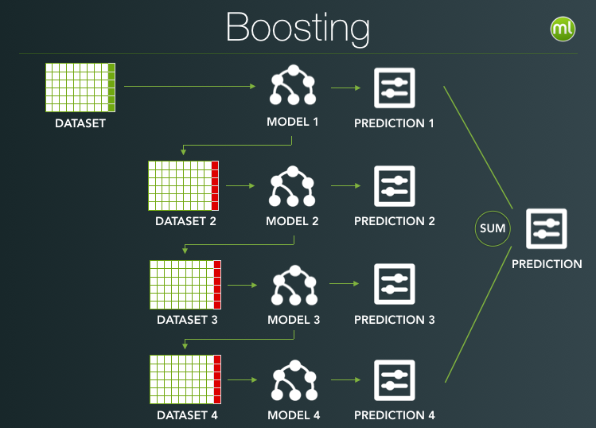
AdaBoost & Gradient Boosting Machine
AdaBoost exploit Bagging concept that uses Random Forest technique, except that the collection of trees is grown sequentially: each tree is grown using information from previously grown trees. This is carried out by building a single model from the training data, then adding new models on the errors made by existing models, in order to correct the predictions of the previous model. AdaBoost increases the accuracy modifying the weights applied to the sample distribution at each iteration.
Gradient Boosting Machine makes a small tweak to AdaBoost applying Gradient Descent to minimize the Loss Function.

Slide 49
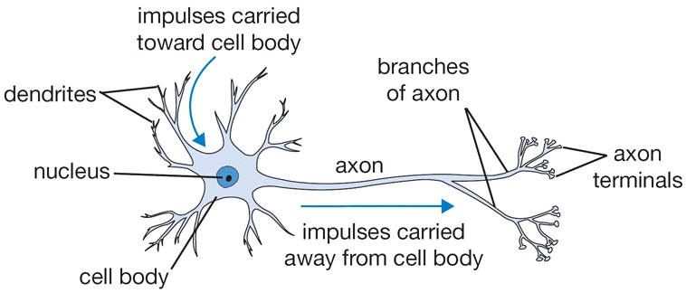
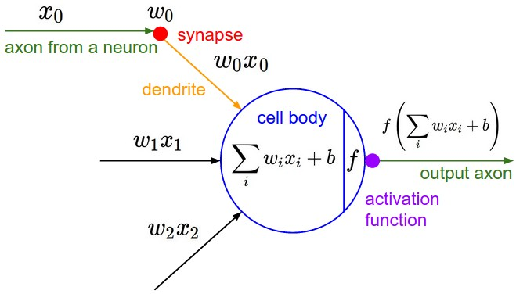
Artificial Neural Network
Artificial Neural Networks are inspired by neuroscience, ANN are formed by a set of computing units, or neurons, connected in various ways.
Each neuron receives input from each neuron in the preceding layer and feeds its output to
every neuron in the next layer. They are called networks because they are a combination of different functions, so they extend linear models applying a non linear transformation, called activaction function to the linear combination of the inputs coming from preceding layers.

Slide 50
References
-T. Hastie, R. Tibshirani, G. James, D. Witten, An Introduction to Statistical Learning, Springer, 2017
-Christoph Molnar, Interpretable Machine Learning, A Guide for Making Black Box Models Explainable, 2020
-Jason Brownlee, Machine Learning Mastery with Python, Understand your data, Create Accurate models and work projects end-to-end, 2019
-Soledad Galli, Python Feature Engineering CookBook, Packt, 2020
-A Ferrario, R. Hämmerli, On Boosting: Theory and Applications, 2019

Slide 51
THANKS
Contact:
c.giancaterino@gmail.com
https://www.linkedin.com/in/claudiods/

