Slide 1
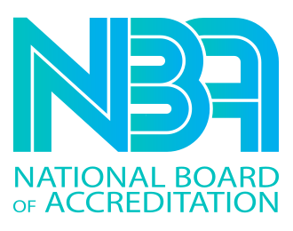




GALGOTIAS COLLEGE OF ENGINEERING AND TECHNOLOGY
DEPARTMENT OF COMPUTER SCIENCE
& ENGINEERING

Slide 2
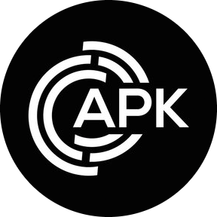
TECHNOTHON- 2023
Team Name – Team.apk
Name of team members – Aman Dogra
Prabal Sharma
Kishan Tripathi
City, State –Greater Noida , U.P.

Slide 3


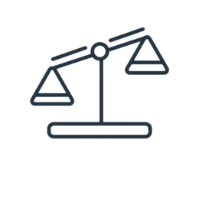






TECHNOTHON- 2023
PROBLEM
STATEMENT
PROPOSED
SOLUTION
TECHNICAL
FEASIBILITY
SOCIETAL
IMPACT
ENVIRONMENTAL
SUSTAINABILITY

Slide 4

TECHNOTHON- 2023
PROBLEM
STATEMENT
Students lack access to a 24/7 quality education assistant.
Existing text assistants are limited in their ability to answer any question effectively.
Language models (LLMs) used for learning can provide incorrect, factually inaccurate, or biased answers.
Students face challenges in obtaining accurate and reliable information from language models.
Language models do not offer the opportunity for personalized guidance

Slide 5

TECHNOTHON- 2023
PROPOSED
SOLUTION
Android chat app enabling students to ask questions on any topic and receive comprehensive explanations from the GPT-3.5 Turbo model.
Integration of teachers/mentors into the chat platform for personalized guidance and clarification of doubts.
User-friendly interface - easy for students to use & learn on the go

Slide 6
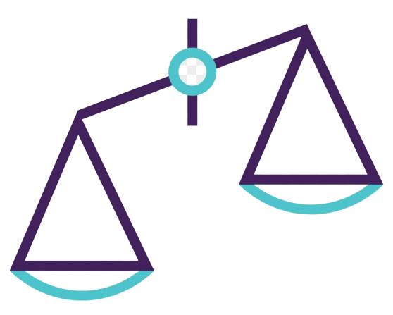
TECHNOTHON- 2023
TECHNICAL
FEASIBILITY
Android Studio: Utilizing Android Studio, a widely-used integrated development environment (IDE) for Android app development, allows for efficient coding and debugging in Java and XML.
Firebase Integration: Leveraging Firebase's robust platform provides seamless user authentication and real-time chat database functionality, enabling smooth communication between users and mentors.
GPT-3.5 Turbo Integration: OpenAI's GPT-3.5 Turbo model can be integrated into the app using OpenAI's API, allowing for natural language processing and intelligent responses to user queries.

Slide 7

TECHNOTHON- 2023
SOCIETAL
IMPACT
Accessible 24/7 learning support: The app offers round-the-clock access to a quality education assistant, providing students with on-demand assistance for their learning needs.
Personalized learning experience: Through the GPT-3.5 Turbo model, students can receive tailored explanations and guidance on any topic, promoting individualized learning paths.
Mentorship and collaboration: The app facilitates mentorship by connecting students with registered teachers, fostering a collaborative learning environment and providing personalized guidance and support.

Slide 8

TECHNOTHON- 2023
ENVIRONMENTAL
SUSTAINABILITY
Reduced paper consumption: By providing an electronic platform for learning and assistance, the app helps reduce the need for printed materials, contributing to paper conservation and minimizing deforestation.
Energy-efficient learning: Unlike traditional classroom settings, the app utilizes digital resources, reducing the energy consumption associated with physical infrastructure such as lighting, heating, and cooling.
Global reach, minimal carbon footprint: The app enables students from anywhere to access educational support, eliminating the need for travel and reducing carbon emissions associated with commuting to physical learning centers.

Slide 9
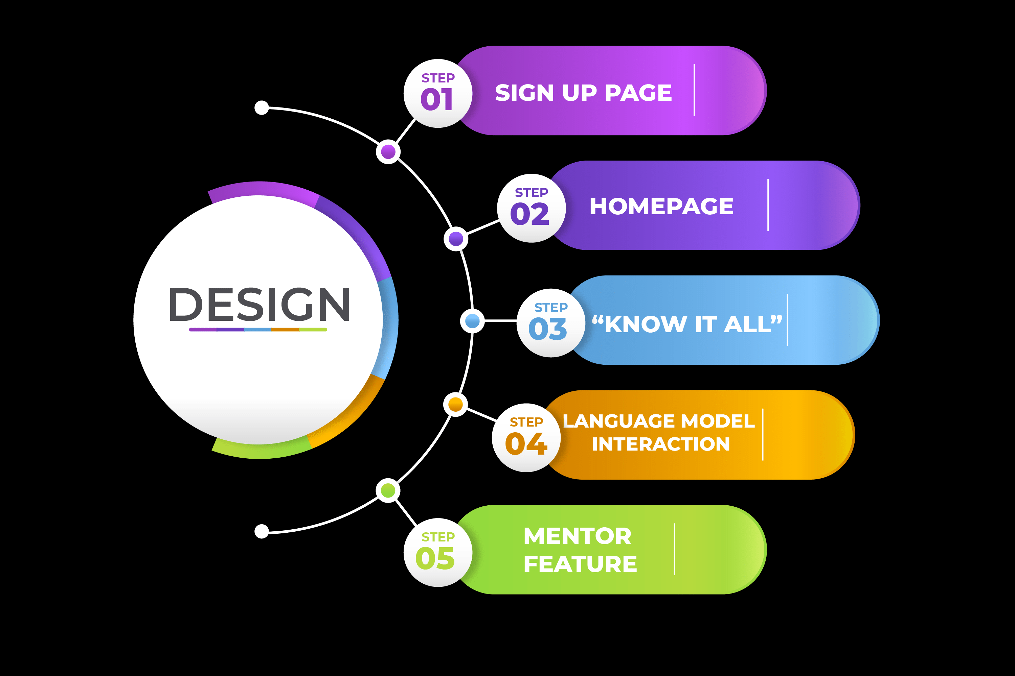





TECHNOTHON- 2023

Slide 10
TECHNOTHON- 2023
THE END

