Slide 1
CUDA: Modelo de Hardware
Pedro Alonso y Adrián Castelló
Universitat Politècnica de València

Slide 2
Hardware implementation: Architecture
The CUDA architecture is built around a scalable array of multithreaded Streaming Multiprocessors (SMs).
The blocks of the grid are enumerated and distributed to multiprocessors.
The threads of a thread block execute concurrently on one multiprocessor.
Multiple thread blocks can execute concurrently on one multiprocessor.
As thread blocks terminate, new blocks are launched on the vacated multiprocessors.

Slide 3
Hardware implementation: Architecture
A multiprocessor (SM) is designed to execute hundreds of threads concurrently.
It employs a unique architecture called SIMT (Single- Instruction, Multiple-Thread).
The instructions are pipelined to leverage instruction-level parallelism (ILP) within a single thread, as well as thread-level parallelism (TLP) extensively through simultaneous hardware multithreading.
Instructions (unlike in CPU cores) are issued in order: no branch prediction and no speculative execution.

Slide 4
SIMT
SIMT (Single-Instruction, Multiple-Thread).
The multiprocessor creates, manages, schedules, and executes threads in groups of 32 parallel threads called warps.
There also half-warps and quarter-warps.
The warp scheduler partitions the block into warps.
Individual threads composing a warp start together at the same program address, but they have their own instruction address counter and register state and are therefore free to branch and execute independently.

Slide 5
SIMT
When a multiprocessor is given one or more thread blocks to execute, it partitions them into warps and each warp gets scheduled by a warp scheduler for execution.
A warp executes one common instruction at a time
  Full efficiency is realized when all 32 threads of a warp agree on
  their execution path.
  If threads of a warp diverge via a data-dependent conditional branch, the warp serially executes each branch path taken, disabling threads that are not on that path, and when all paths complete, the threads converge back to the same execution path.
  Branch divergence occurs only within a warp.

Slide 6
SIMT
Prior to NVIDIA Volta, warps used a single program counter shared amongst all 32 threads in the warp together with an active mask specifying the active threads of the warp. This can lead in some situations to deadlocks.
Starting with the NVIDIA Volta architecture, Independent Thread Scheduling allows full concurrency between threads, regardless of warp. The GPU maintains execution state per thread, including a program counter and call stack, and can yield execution at a per-thread granularity, either to make better use of execution resources or to allow one thread to wait for data to be produced by another. Much more flexibility: threads can now diverge and reconverge at sub-warp granularity.

Slide 7
Thread Multithreading
The execution context (program counters, registers, etc.) for each warp processed by a multiprocessor is maintained on-chip during the entire lifetime of the warp:
  switching from one execution context to another has no cost,
  at every instruction issue time, a warp scheduler selects a warp that has threads ready to execute its next instruction and issues the instruction to those threads.
Each multiprocessor (SM) has a set of 32-bit registers that are partitioned among the warps.
Each multiprocessor (SM) has a shared memory that is partitioned among the thread blocks.

Slide 8
A Streaming Multiprocessor
SM
A Streaming Multiprocessor (SM) in
the Tesla G80 (2006) architecture is composed of:
  8 Scalar Processors (SP)
  1 Double Precision unit (DP)
  16 KBytes Shared Memory
  Bank of 32 bit registers (8192 registers)
  A read only cache for Constant and Texture Memory
For a given kernel, the number of active blocks and warps that can reside and be processed together on the multiprocessor for a given kernel depends on:
  The number of registers the kernel compiles to.
  How much shared memory the kernel requires.
Cache
SP
SP
SP
SP
SP
SP
SP
SP
Double prec. Unit
Shared Memory

Slide 9
Thread Multithreading
There are also a maximum number of resident blocks and a maximum number of resident warps per multiprocessor.
These limits as well the amount of registers and shared memory available on the multiprocessor are a function of the compute capability of the device.
The total number of warps in a block is as follows:
  T is the number of threads per block,
  W_{size} is the warp size, which is equal to 32,
  ceil(x, y) is equal to x rounded up to the nearest multiple of y.

Slide 10
Chip G90 of the GeForce 8800 GTX
SM
Cache
TPC
TPC
TPC
TPC
SP
SP
SP
SP
SP
SP
TPC
TPC
TPC
TPC
SP
SP
Double prec. Unit
Shared Memory
Global Memory

Slide 11
deviceQuery
Device 0: "Tesla C2070"
CUDA Driver Version: 4.0
CUDA Runtime Version: 4.0
CUDA Capability Major/Minor version number: 2.0
Total amount of global memory: 5636554752 bytes
Multiprocessors x Cores/MP = Cores: 14 (MP) x 32 (Cores/MP) = 448 (Cores)
Total amount of constant memory: 65536 bytes
Total amount of shared memory per block: 49152 bytes
Total number of registers available per block: 32768
Warp size: 32
Maximum number of threads per block: 1024
Maximum sizes of each dimension of a block: 1024 x 1024 x 64
Maximum sizes of each dimension of a grid: 65535 x 65535 x 65535
Maximum memory pitch: 2147483647 bytes
Texture alignment: 512 bytes
Clock rate: 1.15 GHz
Concurrent copy and execution: Yes
Run time limit on kernels: No
Integrated: No
Support host page-locked memory mapping: Yes
Compute mode: Default (multiple host threads can use this device simultaneously)
Concurrent kernel execution: Yes
Device has ECC support enabled: No
Device is using TCC driver mode: Yes

Slide 12
Fermi Architecture (GF100)

Slide 13
Fermi Architecture
The first Fermi based GPU, implemented with 3.0 billion transistors, features up to 512 CUDA cores.
A CUDA core executes a floating point or integer instruction per clock for a thread.
The 512 CUDA cores are organized in 16 SMs of 32 cores each.
The GPU has six 64-bit memory partitions, for a 384-bit memory interface, supporting up to a total of 6 GB of GDDR5 DRAM memory.
A host interface connects the GPU to the CPU via PCI-Express. The GigaThread global scheduler distributes thread blocks to SM thread schedulers.

Slide 14
Fermi SM

Slide 15
Fermi SM
Each CUDA processor has a fully pipelined integer arithmetic logic unit (ALU) and floating point unit (FPU).
Prior GPUs used IEEE 754-1985 floating point arithmetic. The Fermi architecture implements the new IEEE 754-2008 floating-point standard.
Fermi architecture provides the fused multiply-add (FMA) instruction for both single and double precision arithmetic.
  FMA improves over a multiply-add (MAD) instruction by doing the multiplication and addition with a single final rounding step, with no loss of precision in the addition.
  FMA is more accurate than performing the operations separately.
Each SM has 16 load/store units, allowing source and destination addresses to be calculated for sixteen threads per clock.

Slide 16
Fermi SM
Special Function Units (SFUs) execute transcendental instructions such as sin, cosine, reciprocal, and square root.
  Each SFU executes one instruction per thread, per clock;
  a warp executes over eight clocks.
  The SFU pipeline is decoupled from the dispatch unit, allowing the dispatch unit to issue to other execution units while the SFU is occupied.
The SM schedules threads in groups of 32 parallel threads (warps).
  Each SM features two warp schedulers and two instruction dispatch units, allowing two warps to be issued and executed concurrently.
  Fermi’s dual warp scheduler selects two warps, and issues one instruction from each warp to a group of sixteen cores, sixteen load/store units, or four SFUs.
Each SM has 64 KB of on-chip memory that can be configured as 48 KB of Shared memory with 16 KB of L1 cache or as 16 KB of Shared memory with 48 KB of L1 cache.

Slide 17
Concurrent kernel execution
Concurrent kernel execution allows programs that execute a number of small kernels to utilize the whole GPU.

Slide 18
Kepler GK110
7.1 billion transistors.
GK110 was designed to be a parallel processing powerhouse for Tesla® and the HPC market.
1 TFlop of double precision throughput with greater than 80%
DGEMM efficiency versus 60-65% on the prior Fermi architecture.
Up to 3x the performance per watt of Fermi.
New features:
  Dynamic Parallelism: kernels launching kernels.
  Hyper-Q: enables multiple CPU threads or processes to launch work on a single GPU simultaneously.
  Grid Management Unit: Stops-resumes grid execution.
  NVIDIA GPUDirect™: Family of technologies that enhance data movement.

Slide 20
Streaming Multiprocessor (SMX)

Slide 21
The SMX schedules threads in groups of 32 parallel threads (warps).
  Each SMX features four warp schedulers and eight instruction dispatch units, allowing four warps to be issued and executed concurrently.
  Kepler’s quad warp scheduler selects four warps, and two independent instructions per warp can be dispatched each cycle.
Unlike Fermi, which did not permit double precision instructions to be paired with other instructions, Kepler GK110 allows double precision instructions to be paired with other instructions.

Slide 22
Fermi-Kepler comparison

Slide 23
Maxwell GM10x and GM20x
Maxwell
  First generation GM10x, and second generation GM20x.
  The Streaming Multiprocessor (SMM) up to 128 scalar processors (power of 2).
  Example: GTX Titan X: architecture GM200, 6 Graphics Processing Clusters with 4 SMM each: 3072 scalar processors.
  256KB to 3MB of L2.
  Up 12GB of GDDR5 memory.
  Clock cycle: ~1.0 GHz.

Slide 24
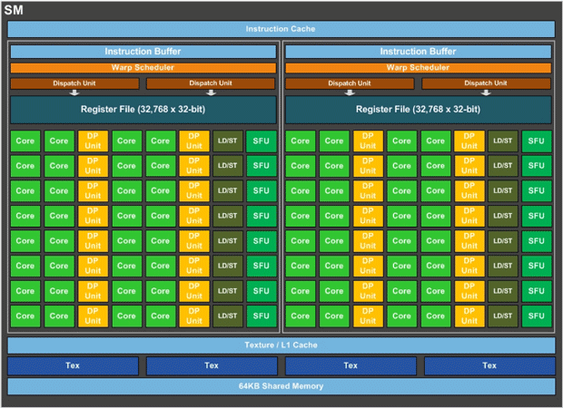
Pascal GP100 SM

Slide 25
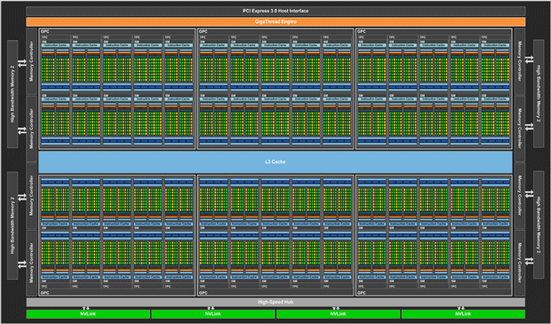
Pascal GP100 GPU

Slide 26
Pascal GP100
NVLink™
  NVIDIA’s new high speed, high bandwidth interconnect for maximum application scalability
HBM2
  Fast, high capacity, extremely efficient CoWoS (Chip-on-Wafer-on-Substrate) stacked memory architecture
Unified Memory
16nm FinFET
  Enables more features, higher performance, and improved power efficiency
Performance
  5.3 TFLOPS of double precision floating point (FP64) performance
  10.6 TFLOPS of single precision (FP32) performance
  21.2 TFLOPS of half-precision (FP16) performance

Slide 27
Volta V100
12 GB HBM2
5120 CUDA cores
  6 GPC
  80 SMs
640 Tensor Cores (8 per SM).
12nm
Performance:
  7.8 teraFLOPS double-precision
  15.7 teraFLOPS single-precision
  125 teraFLOPS for Deep Learning.

Slide 28
Turing TU102
CUDA cores (SM, Streaming Multiprocessor)
  Compute Capability 7.5
  Traditional rasterized shaders and compute
  Concurrent execution of integer and floating point operations
Ray-tracing (RT) cores
  bounding volume hierarchy acceleration[6]
  shadows, ambient occlusion, lighting, reflections
Tensor (AI) cores
  Artificial intelligence
  Large matrix operations
  Deep Learning Super Sampling (DLSS)
Memory controller with GDDR6/HBM2 support
DisplayPort 1.4a with Display Stream Compression (DSC) 1.2
PureVideo Feature Set J hardware video decoding
…

Slide 29
Ampere GA100
Nuevas precisiones (Tensor Float (TF32) y coma flotante 64 (FP64)).
Utilización de precision mixta y nuevos tipos de dato (FP16, bfloat16, int8 e int4).
GPU multiinstancia (MIG).
Tercera generación de NVIDIA® NVLink®: duplica el ancho de banda directo de GPU a GPU hasta 600 gigabytes por segundo.
Ancho de banda de memoria de 2 terabytes por Segundo.

Slide 30
GPUs actuales
Ada Lovelace:
  Compute capability 8.9.
  4th-generation Tensor Cores with FP8, FP16, bfloat16, TensorFloat-32 (TF32)
Hopper:
  Compute capability 9.
  First to implement the transformer engine. The transformer engine accelerates computations by dynamically reducing them from higher numerical precisions (i.e., FP16) to lower precisions that are faster to perform (i.e., FP8) when the loss in precision is deemed acceptable.
Blackwell:
  CUDA Compute Capability 10.0 and Compute Capability 12.0 are added with Blackwell.
  Fifth-generation Tensor Cores for AI.
  Second-generation Transformer Engine.
  Support for MXFP4 and MXFP6.

Slide 31
Listado de GPUs y arquitecturas
Listado de GPUs y arquitecturas anteriores.
Listado de productos GPU actuales.
Características por capacidad computacional.

Slide 32
Memory Hierarchy
CUDA threads may access data from multiple memory spaces during their execution.
Each thread has private local memory.
Each thread block has shared memory visible to all threads of the block and with the same lifetime as the block.
All threads have access to the same global memory.
Two additional read-only memory spaces accessible by all threads: the constant and texture memory spaces.
The global, constant, and texture memory spaces are persistent across kernel launches by the same application.

Slide 33
Memory Hierarchy
Thread
Thread memory
Local memory
Block
Block memory
Shared memory
Kernel A
Device memory
Global memory
…
Kernel B
…

Slide 34
Memory Spaces
Grid
Block 0
Block 1
Shared Memory
Shared Memory
Thread (0,0)
Thread (0,1)
Thread (0,0)
Thread (0,1)
Registers
Registers
Registers
Registers
Local Memory
Local Memory
Local Memory
Local Memory
Thread (1,0)
Thread (1,1)
Thread (1,0)
Thread (1,1)
Registers
Registers
Registers
Registers
Local Memory
Local Memory
Local Memory
Local Memory
Host Memory
Device Memory
Global
Constant
Texture

Slide 35
Device memory
Device memory can be allocated either as linear memory or as CUDA arrays (for Texture and Surface Memory).
Linear memory is typically allocated using cudaMalloc() and freed using cudaFree() and data transfer between host memory and device memory are typically done using cudaMemcpy() (or cudaMallocPitch() and cudaMalloc3D()).

Slide 36
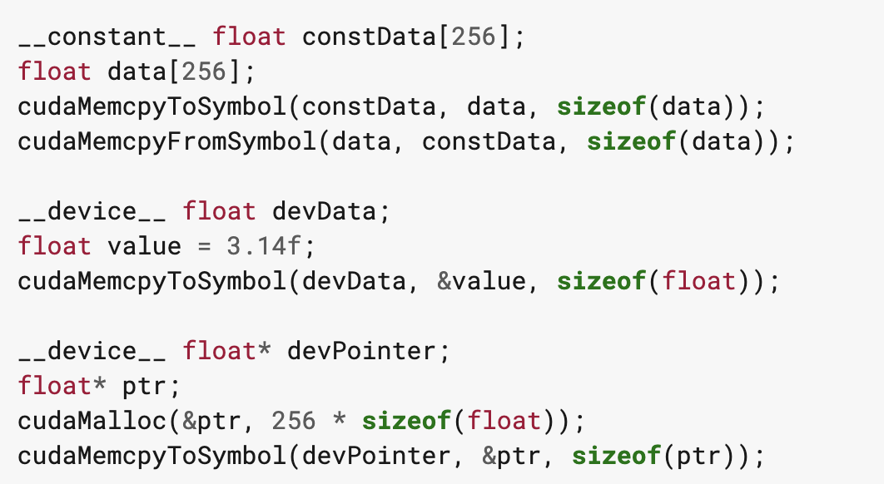
Device memory
cudaMemcpyToSymbol() is used to copy from host to the device memory.
cudaMemcpyFromSymbol() is used to copy from the device memory to host.
cudaGetSymbolAddress() is used to retrieve the address pointing to the memory allocated for a variable declared in global memory space. The size of the allocated memory is obtained through cudaGetSymbolSize().

Slide 37
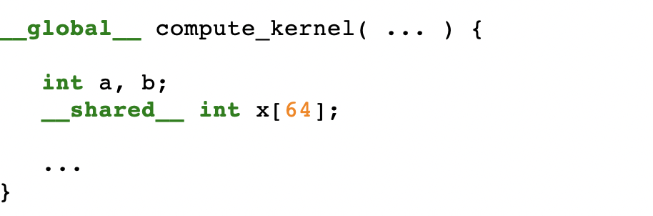
Shared Memory
Shared memory is allocated using the __shared__ memory space specifier.
Shared memory is expected to be much faster than global memory.
Shared memory is divided into equally-sized memory modules (banks), which can be accessed simultaneously. Any memory read or write request made of n addresses that fall in n distinct memory banks can therefore be serviced simultaneously, yielding an overall bandwidth that is n times as high as the bandwidth of a single module.

Slide 38
Example: c = A * v
A * v = c
x
x
x
x
x
x
x
x
x
x
x
x
x
x
x
x
x
x
x
x
x
x
x
x
x
Shared Memory
x x x x x x x x x x x x
0
1
2
3
4
x x x x x x x x x x x x
x x x x x x x x x x x x
x x x x x x x x x x x x
x x x x x x x x x x x x
x x x x x x x x x x x x
threadIdx.x = 0 copies v into shared memory

Slide 39
Example: c = A * v

Slide 40
Example: c = A * v

Slide 41
Registers
Registers are even faster than shared memory.
Care must be taken not to exceed the total number of registers. Memory allocated to registers that exceed the limit will be allocated to local memory, which is actually global memory.

Slide 42
Local memory
Local memory accesses only occur for some automatic variables:
  Arrays for which it cannot determine that they are indexed with constant quantities,
  Large structures or arrays that would consume too much register space,
  Any variable if the kernel uses more registers than available (this is also known as register spilling).
The compiler reports total local memory usage per kernel (lmem) when compiling with the --ptxas-options=-v option.
The local memory space resides in device memory.

Slide 43
Distributed Shared Memory
Thread block clusters (compute capability 9.0) provide the ability for threads in a thread block cluster to access shared memory of all the participating thread blocks in a cluster.
This partitioned shared memory is called Distributed Shared Memory, and the corresponding address space is called Distributed shared memory address space.
Threads that belong to a thread block cluster, can read, write or perform atomics in the distributed address space, regardless whether the address belongs to the local thread block or a remote thread block.
Whether a kernel uses distributed shared memory or not, the shared memory size specifications, static or dynamic is still per thread block.
The size of distributed shared memory is just the number of thread blocks per cluster multiplied by the size of shared memory per thread block.
Accessing data in distributed shared memory requires all the thread blocks to exist.
This resource needs the use of Cooperative Groups.

Slide 44
Other memories
Constant memory:
  The constant memory space resides in device memory and is cached in the constant cache.
  Requests are serviced at the throughput of the constant cache in case of a cache hit.
Texture and Surface Memory:
  Both memory spaces reside in device memory and are cached in texture cache, so a texture fetch or surface read costs one memory read from device memory only on a cache miss, otherwise it just costs one read from texture cache.
  Texture cache is optimized for 2D spatial locality, so threads of the same warp that read texture or surface addresses that are close together in 2D will achieve best performance.
  Reading device memory through texture or surface fetching present some benefits.

