Slide 1
Quasiperiodic Kicked Rotor
Aditya Chincholi

Slide 2
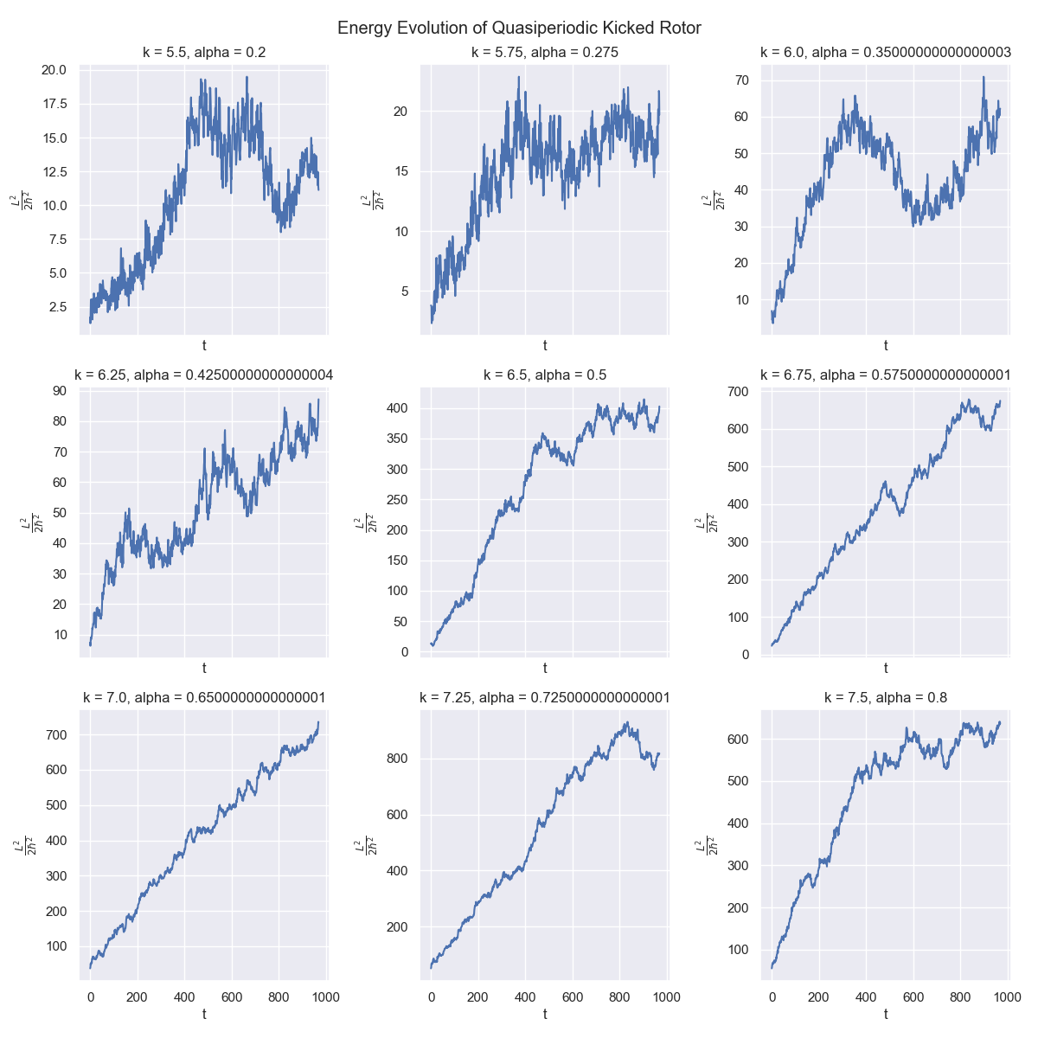

Slide 3
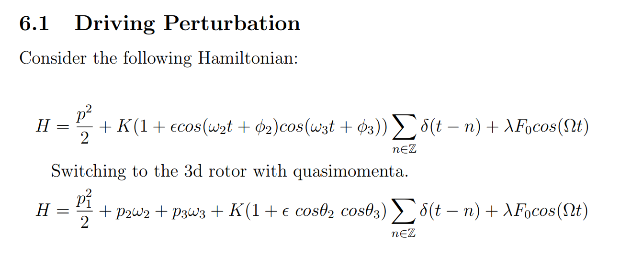

Slide 4
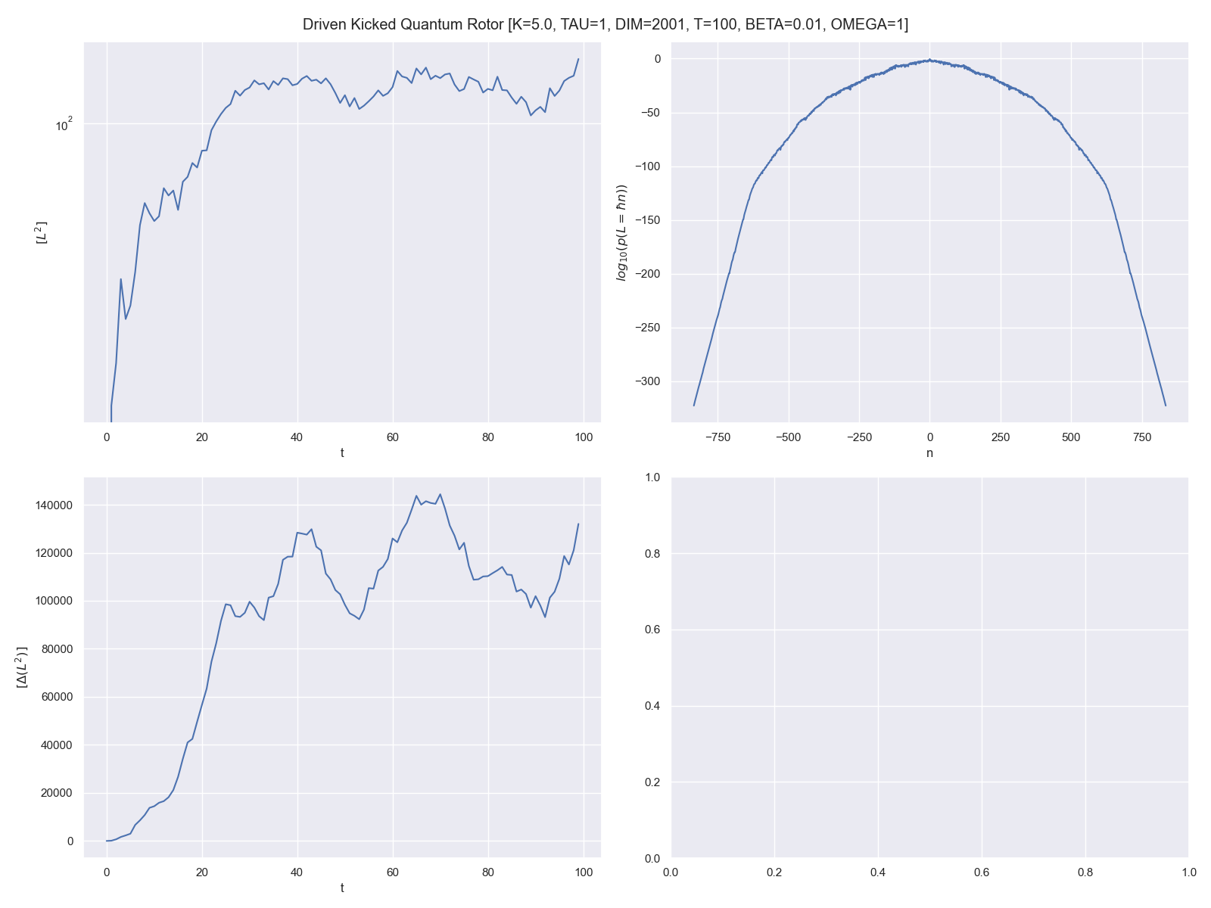

Slide 5
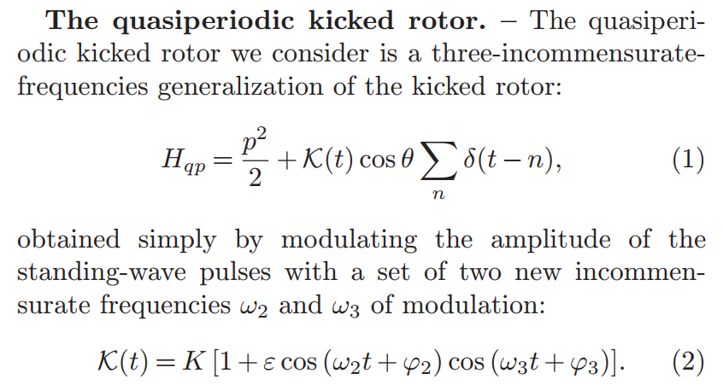

Slide 6
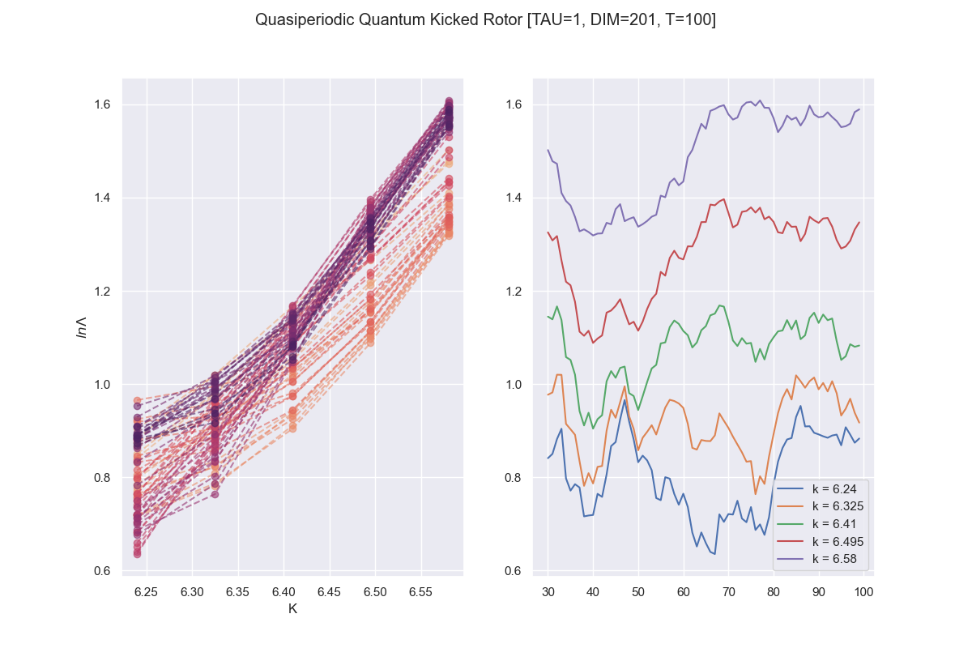
t

Slide 7
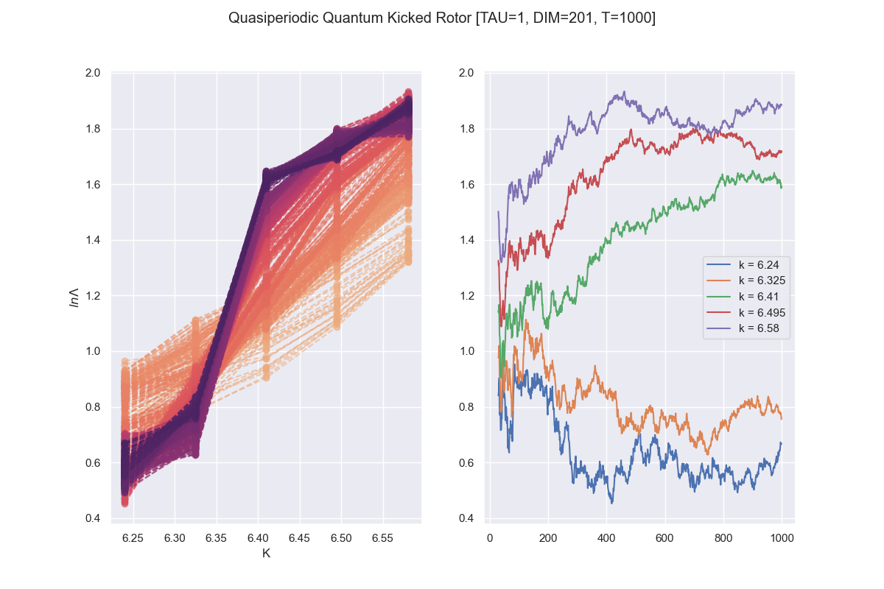
t

Slide 8
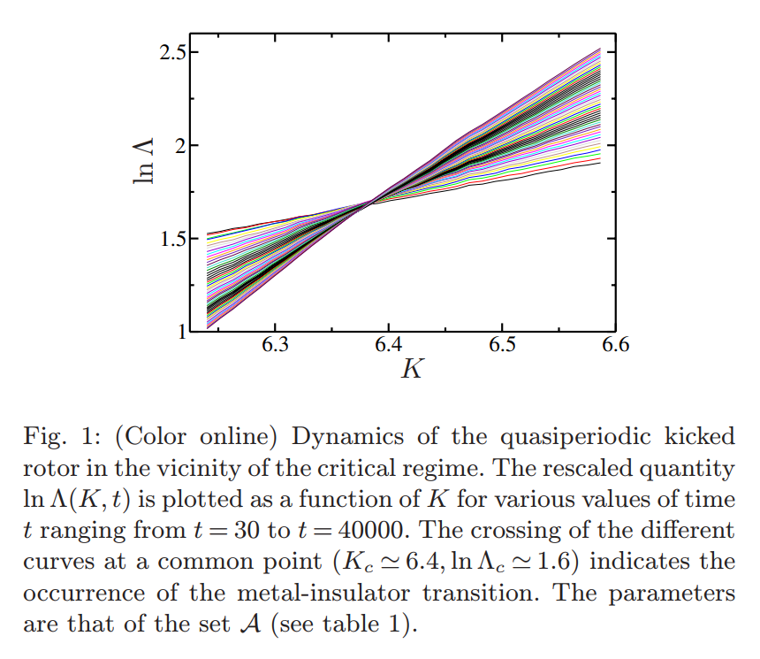

Slide 9
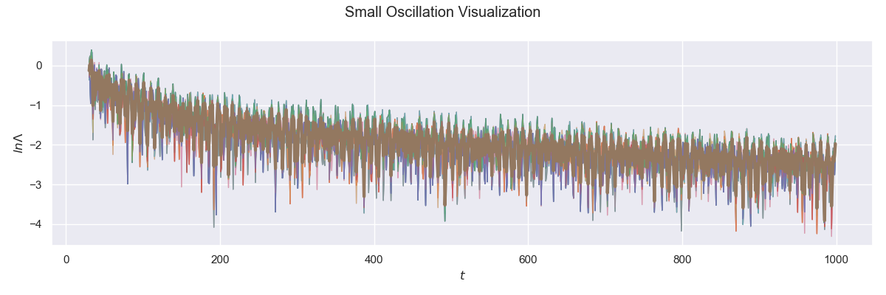

Slide 10
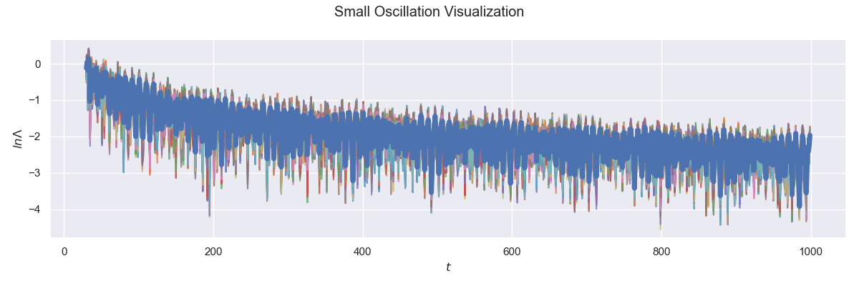

Slide 11
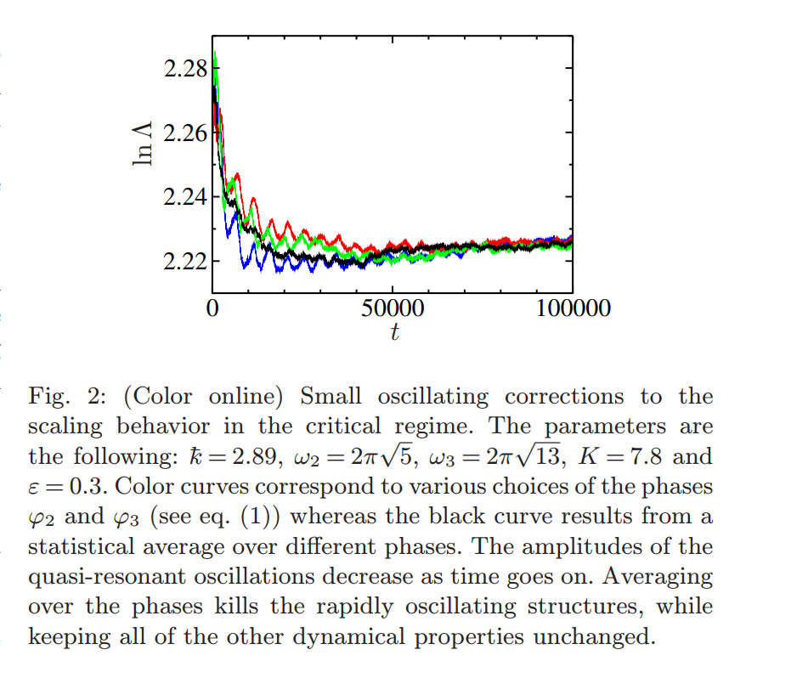

Slide 12
“We computed ln Λ for times up to t = 10⁶ kicks with an accuracy of 0.15%. To achieve this accuracy more than 1000 initial conditions are required. To analyze data over the full range of times t ∈ [10³,10⁶], we fit the model eq. (12) to the data.”
For context, my run with 1000 timesteps, 201 dimensional space and 100 initial conditions of (φ2, φ3) took around 2 hrs.

