Slide 1
Quasiperiodic Kicked Rotor
Aditya Chincholi

Slide 2
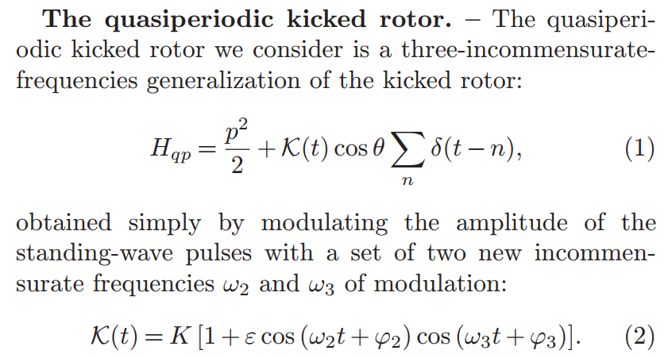

Slide 3
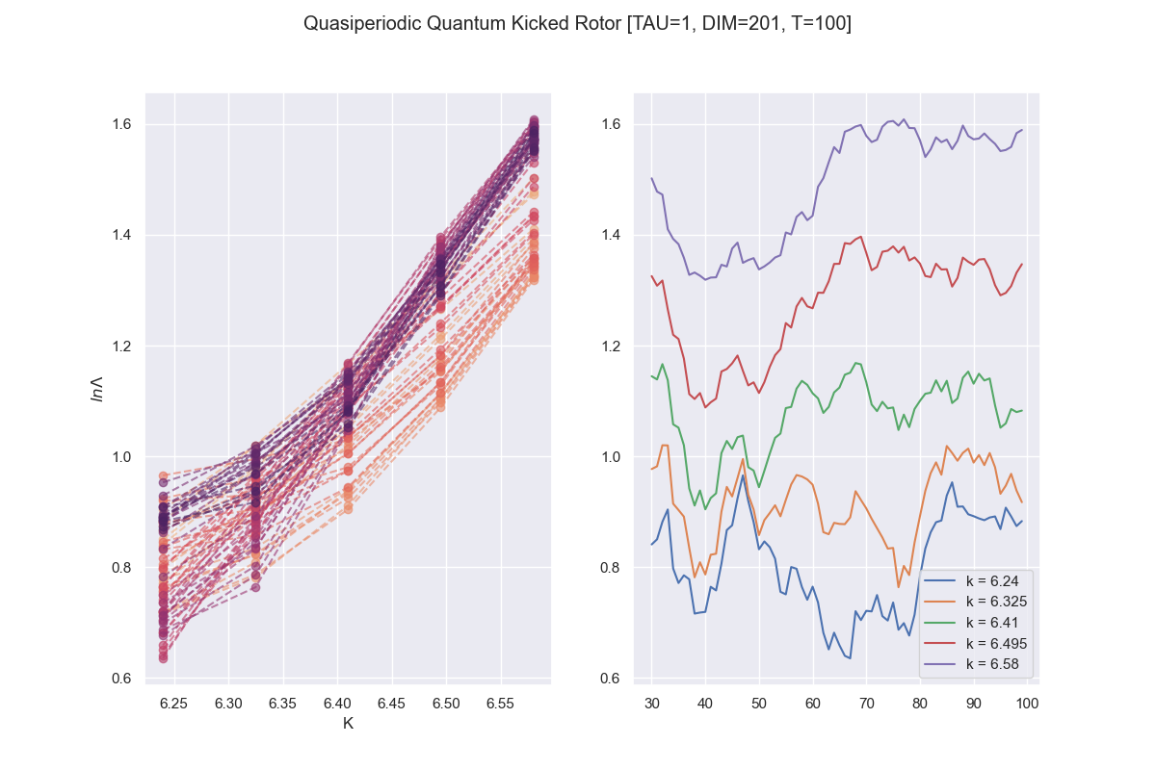
t

Slide 4
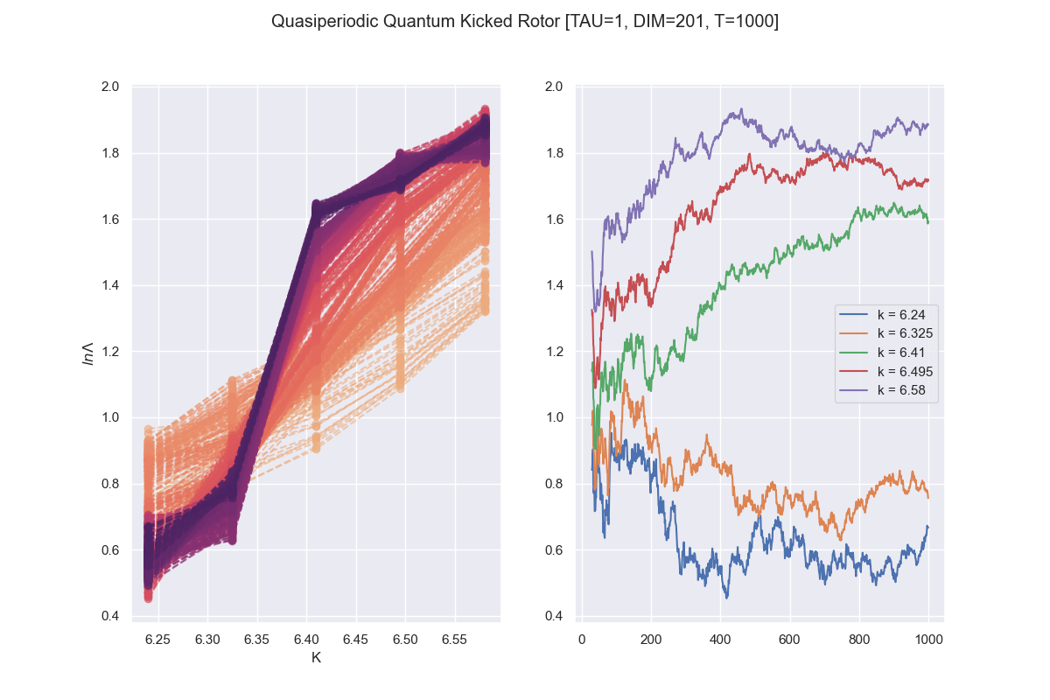
t

Slide 5
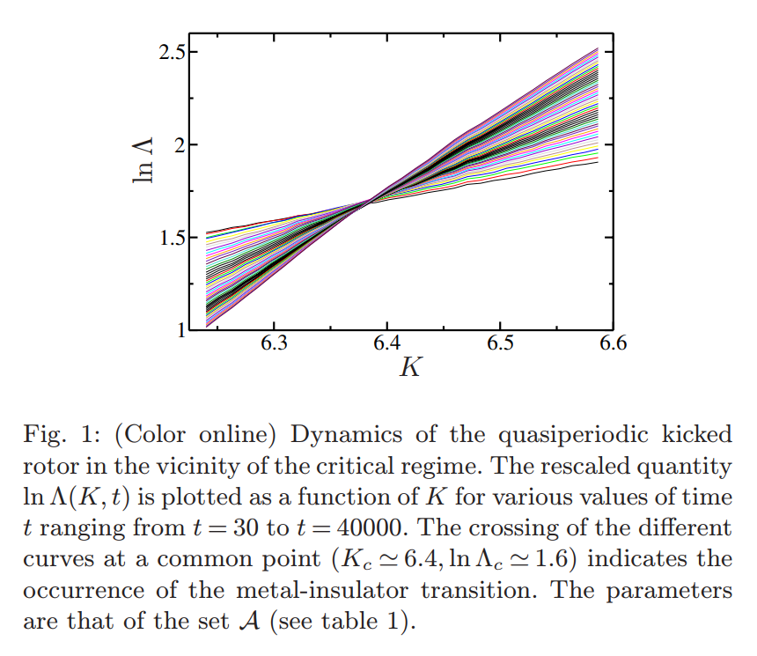

Slide 6
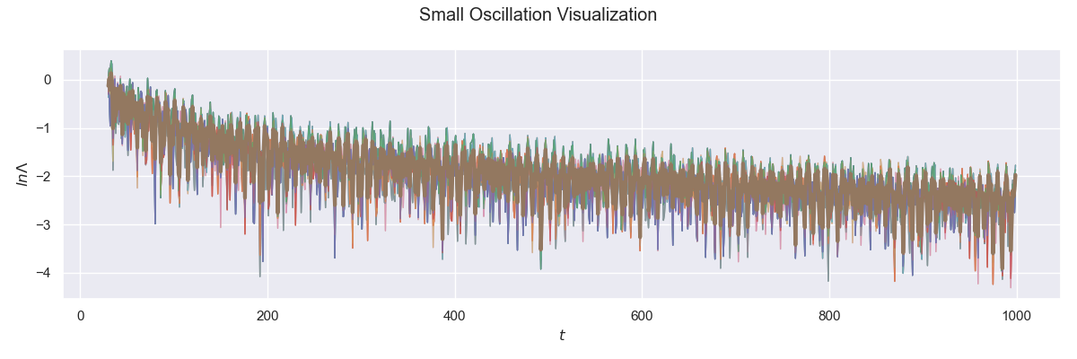

Slide 7
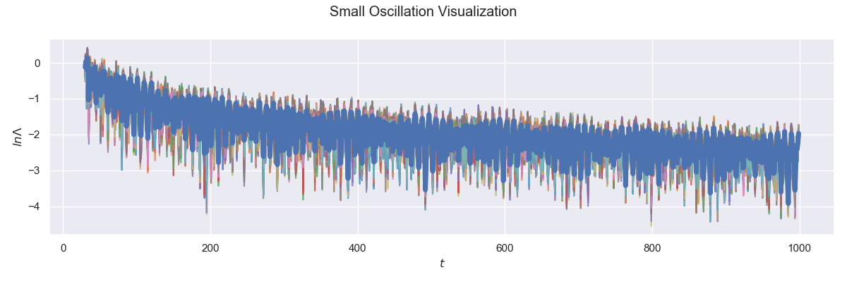

Slide 8
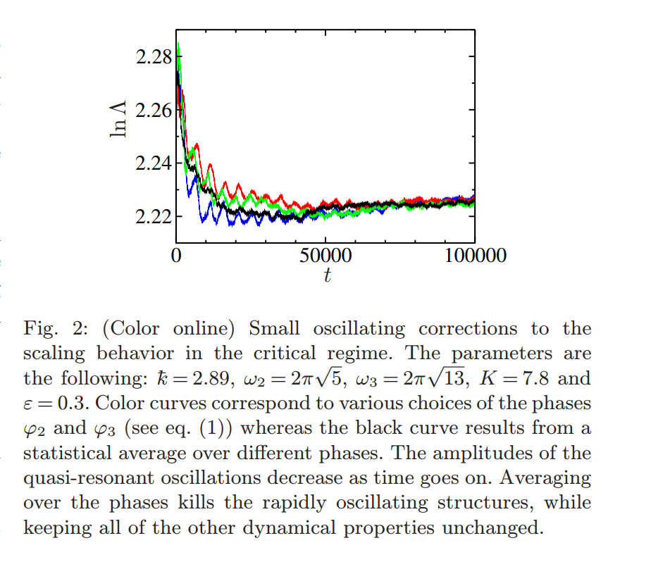

Slide 9
“We computed ln Λ for times up to t = 10⁶ kicks with an accuracy of 0.15%. To achieve this accuracy more than 1000 initial conditions are required. To analyze data over the full range of times t ∈ [10³,10⁶], we fit the model eq. (12) to the data.”
For context, my run with 1000 timesteps, 201 dimensional space and 100 initial conditions of (φ2, φ3) took around 2 hrs.

