Slide 1
Localization in Quantum Kicked Rotor
Aditya Chincholi

Slide 2
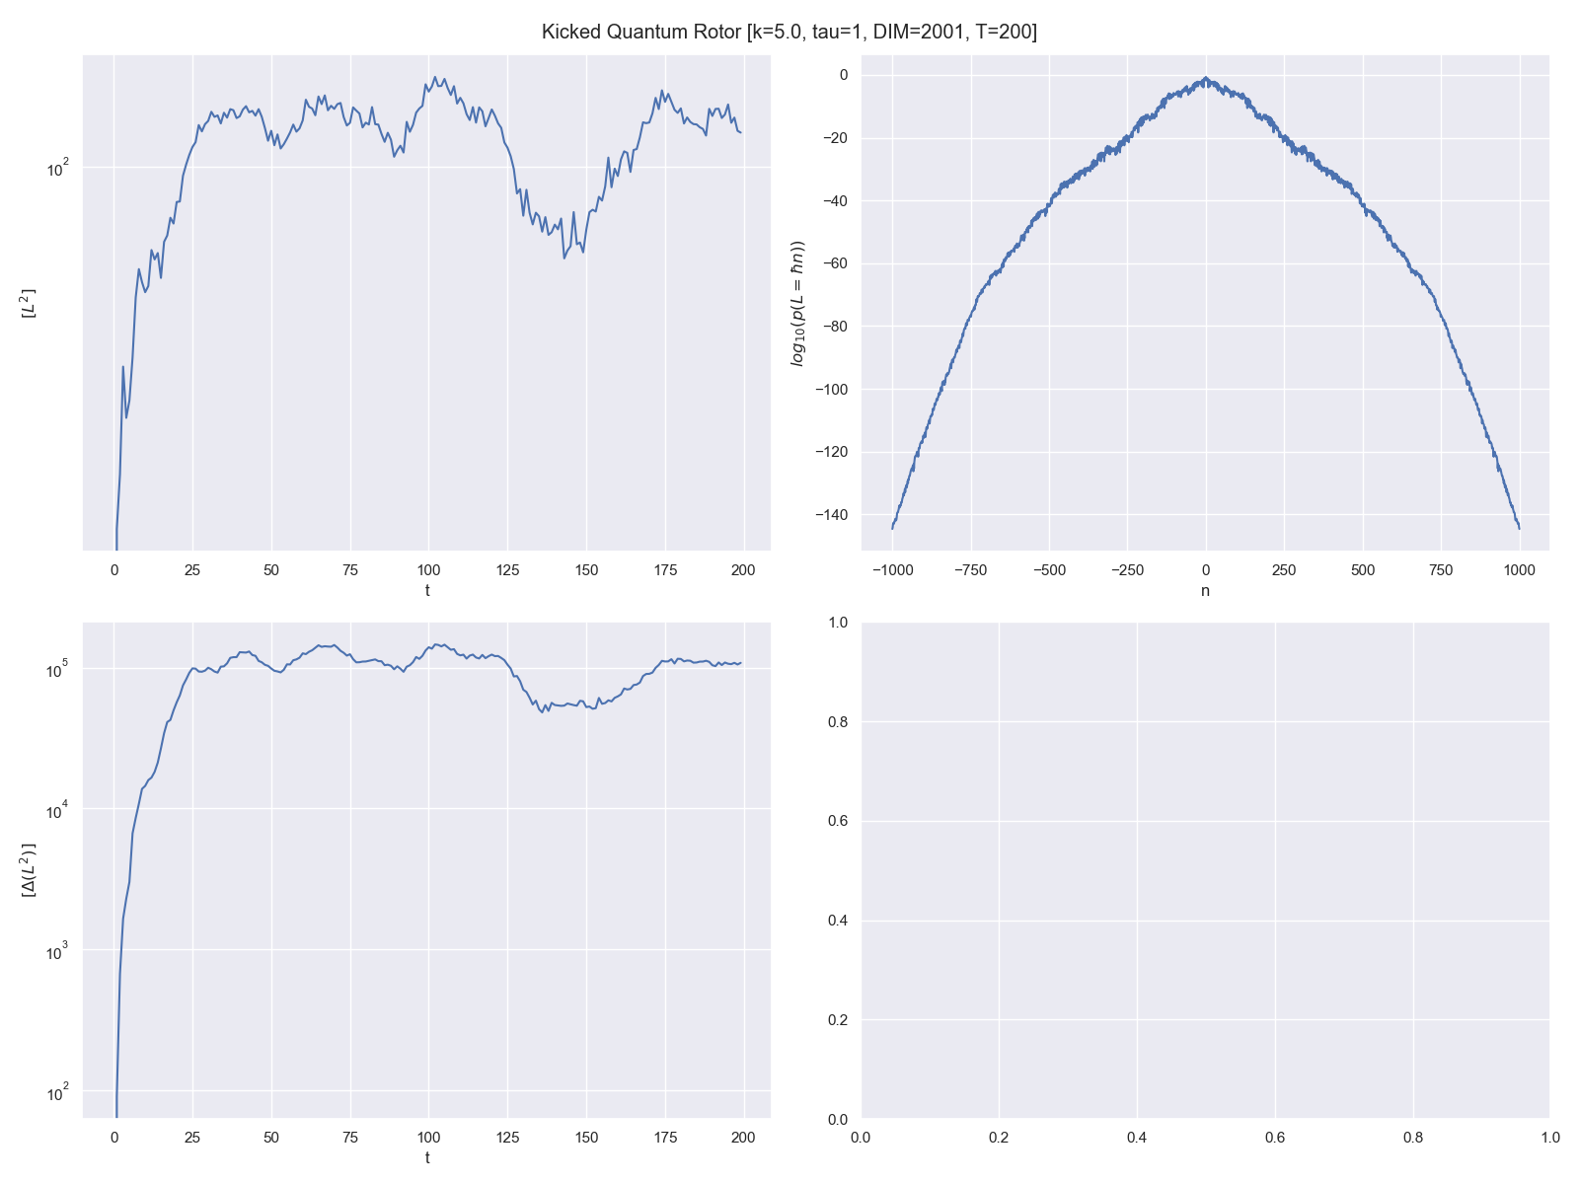
Probability distribution of L values at the end of the simulation.
Expectation Value of L² with Time
T = 200
DIM = 2001 [-1000 to +1000]
Since the probability of L = 1000 ℏ is ~10⁻¹⁴⁰ I think we can go to higher timesteps without much problems.
Variance of the L² distribution with Time

Slide 3
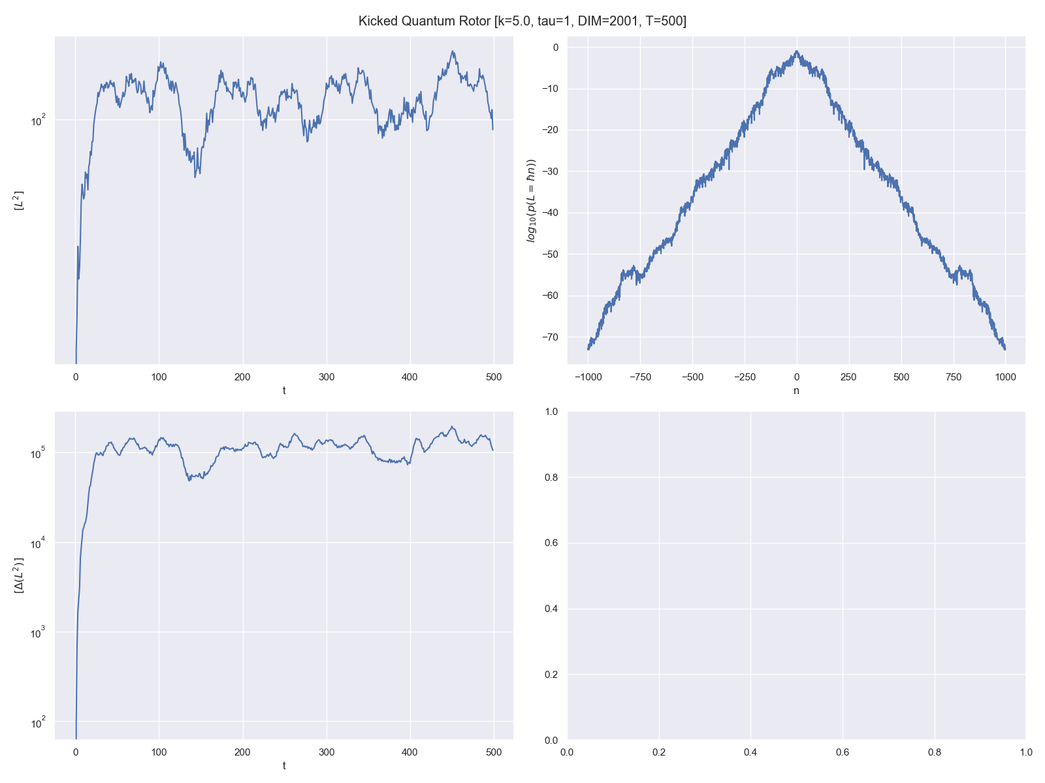
T = 500
DIM = 2001 [-1000 to +1000]
Since the probability of L = 1000 ℏ is ~10⁻⁷⁰ I think we can go to higher timesteps without much problems.

Slide 4
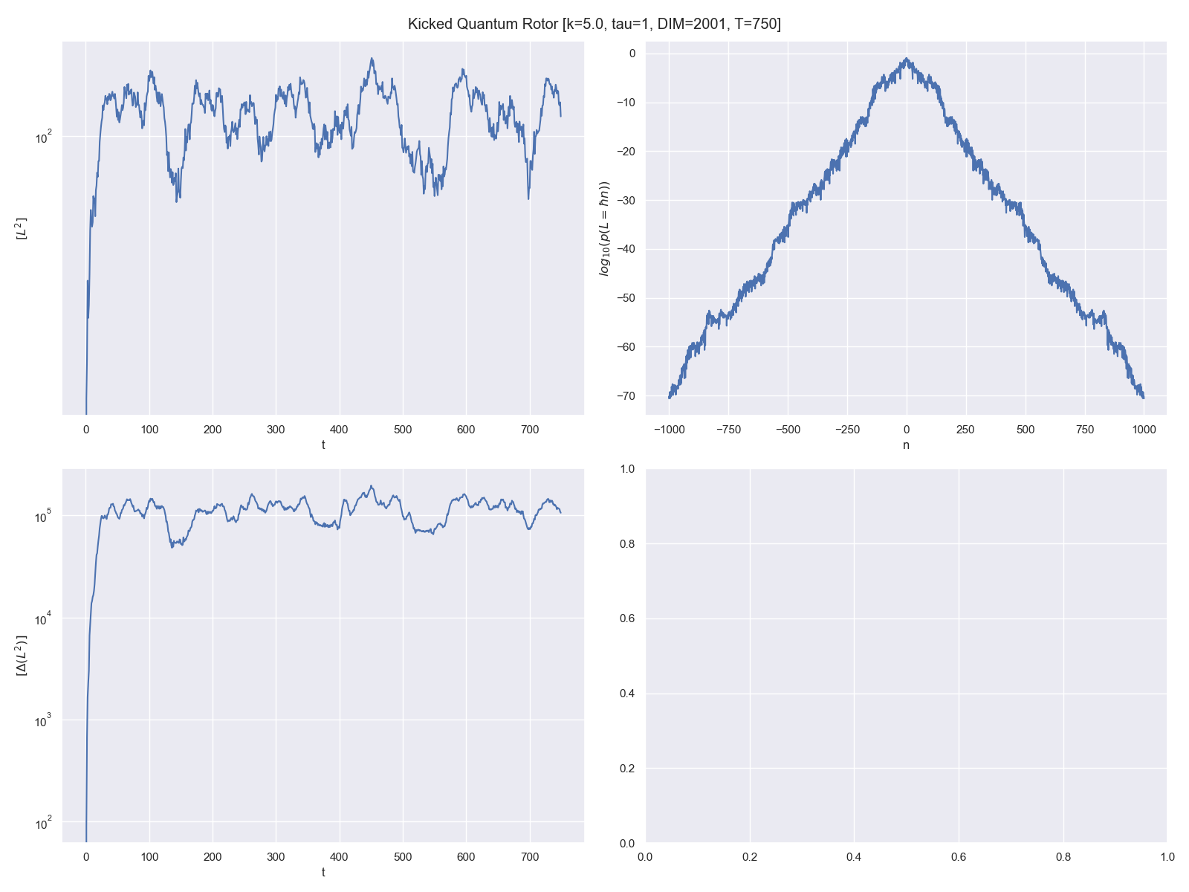
T = 750
DIM = 2001 [-1000 to +1000]
Since the probability of L = 1000 ℏ is ~10⁻⁷⁰ I think we can go to higher timesteps without much problems. (Can we?)

Slide 5
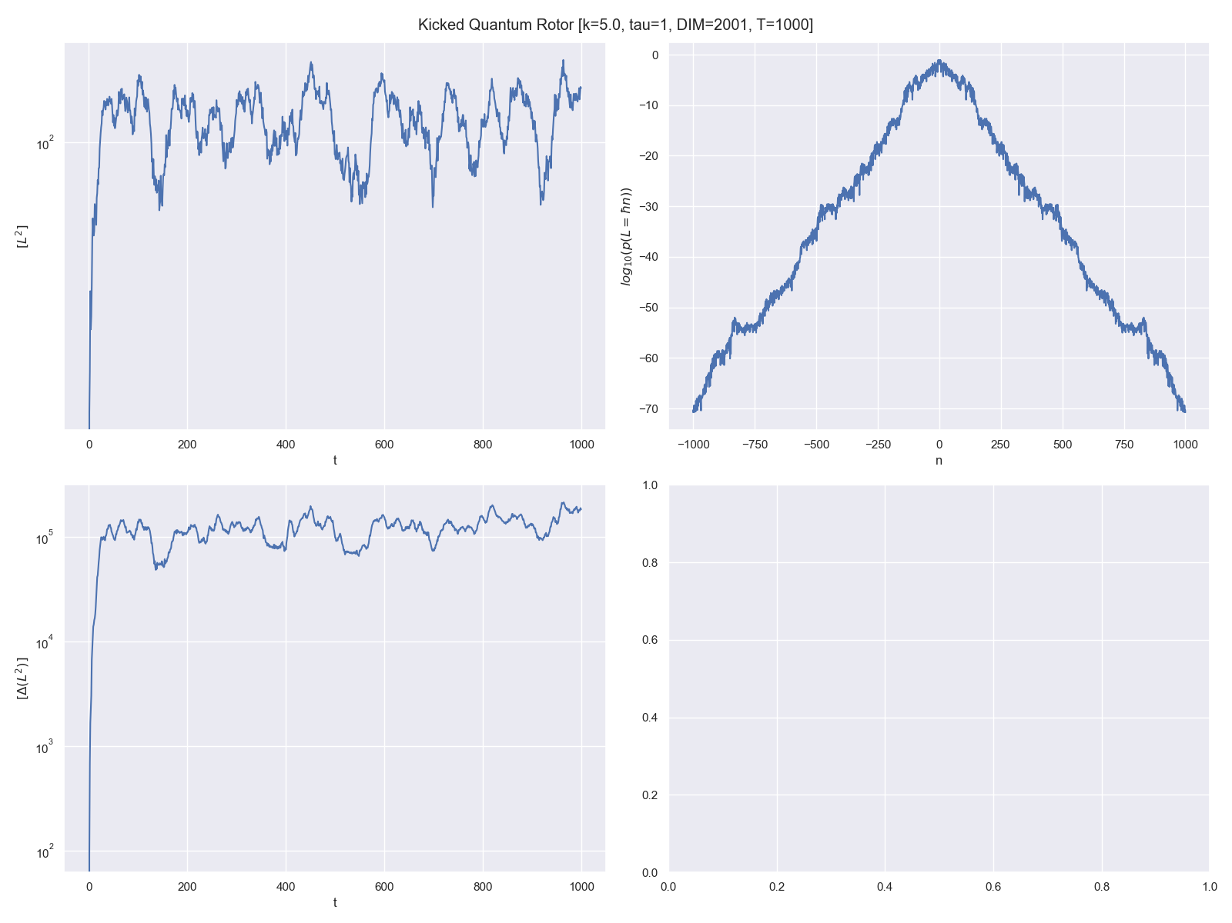
T = 1000
DIM = 2001 [-1000 to +1000]
P(L = 1000 ℏ) seems to be stuck near ~10⁻⁷⁰. Is this a sign that we need higher DIM?

Slide 6
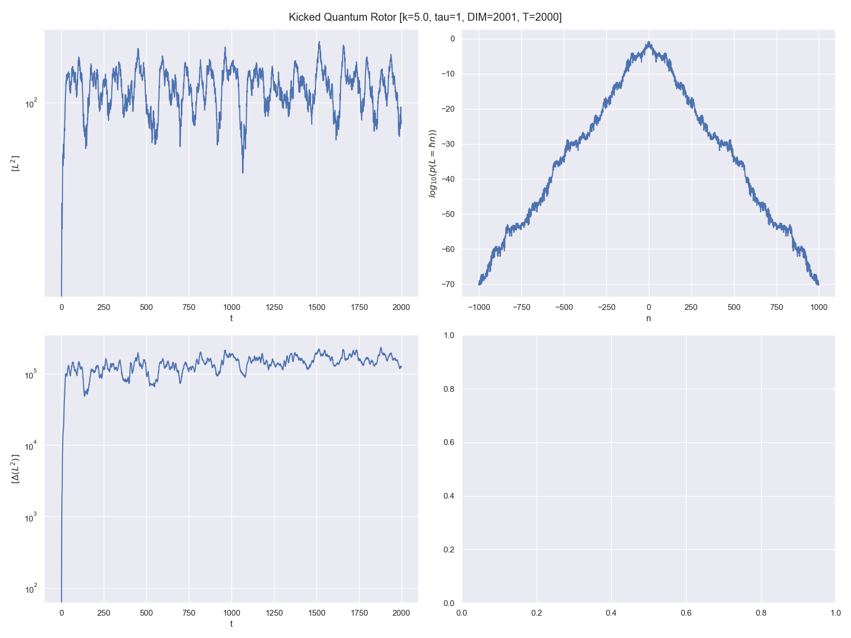
T = 2000
DIM = 2001 [-1000 to +1000]
I just tried this out for the sake of it.

Slide 7
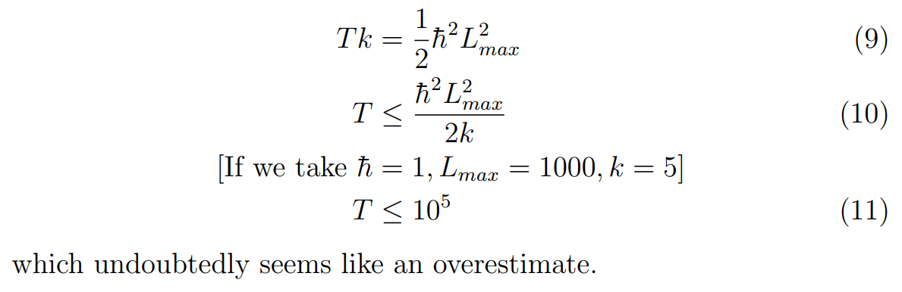
Naïve Energy Balance

