Slide 1
Perturbed Quantum Kicked Rotor Simulation
Aditya Chincholi

Slide 2
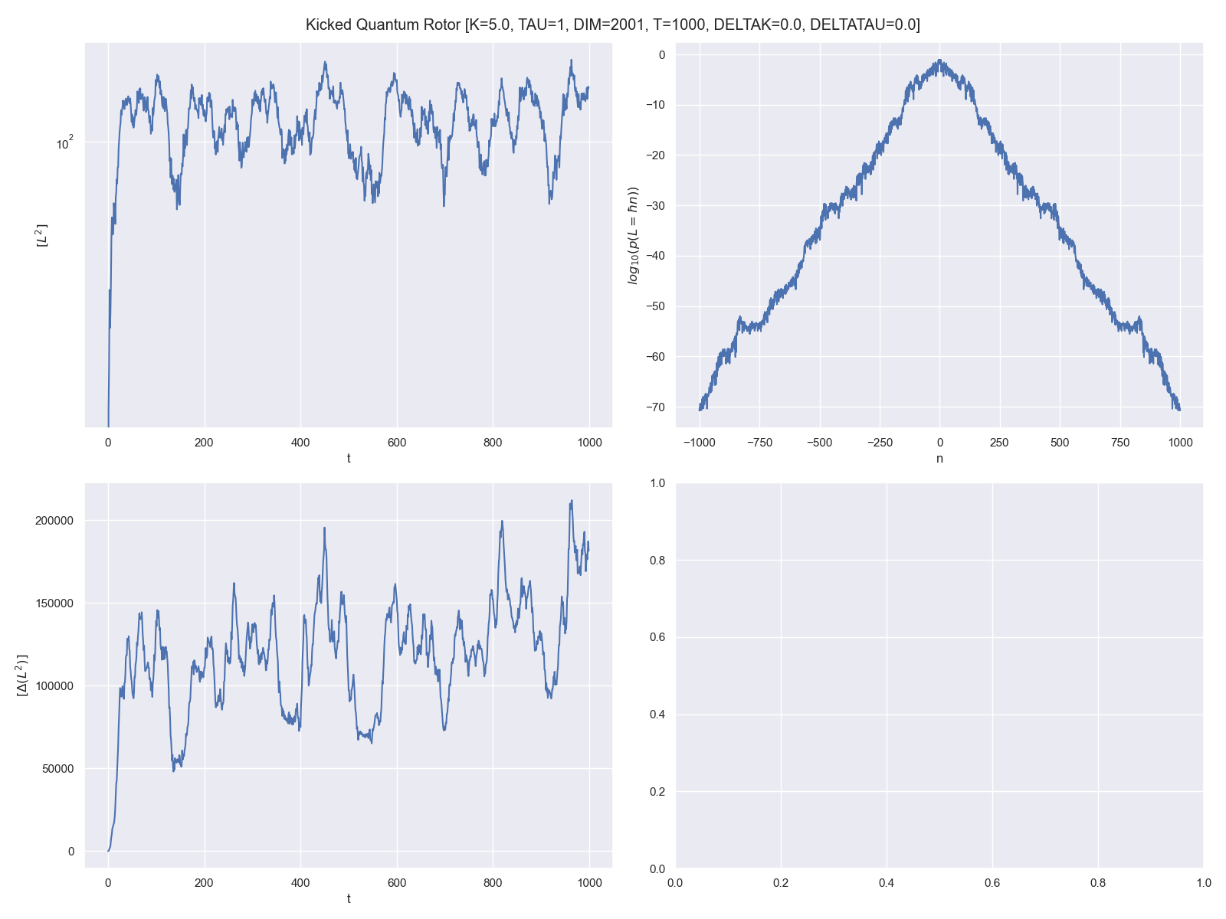
Base Case
T = 1000
DIM = 2000 [-1000, 1000]
K = 5.0
τ = 1

Slide 3
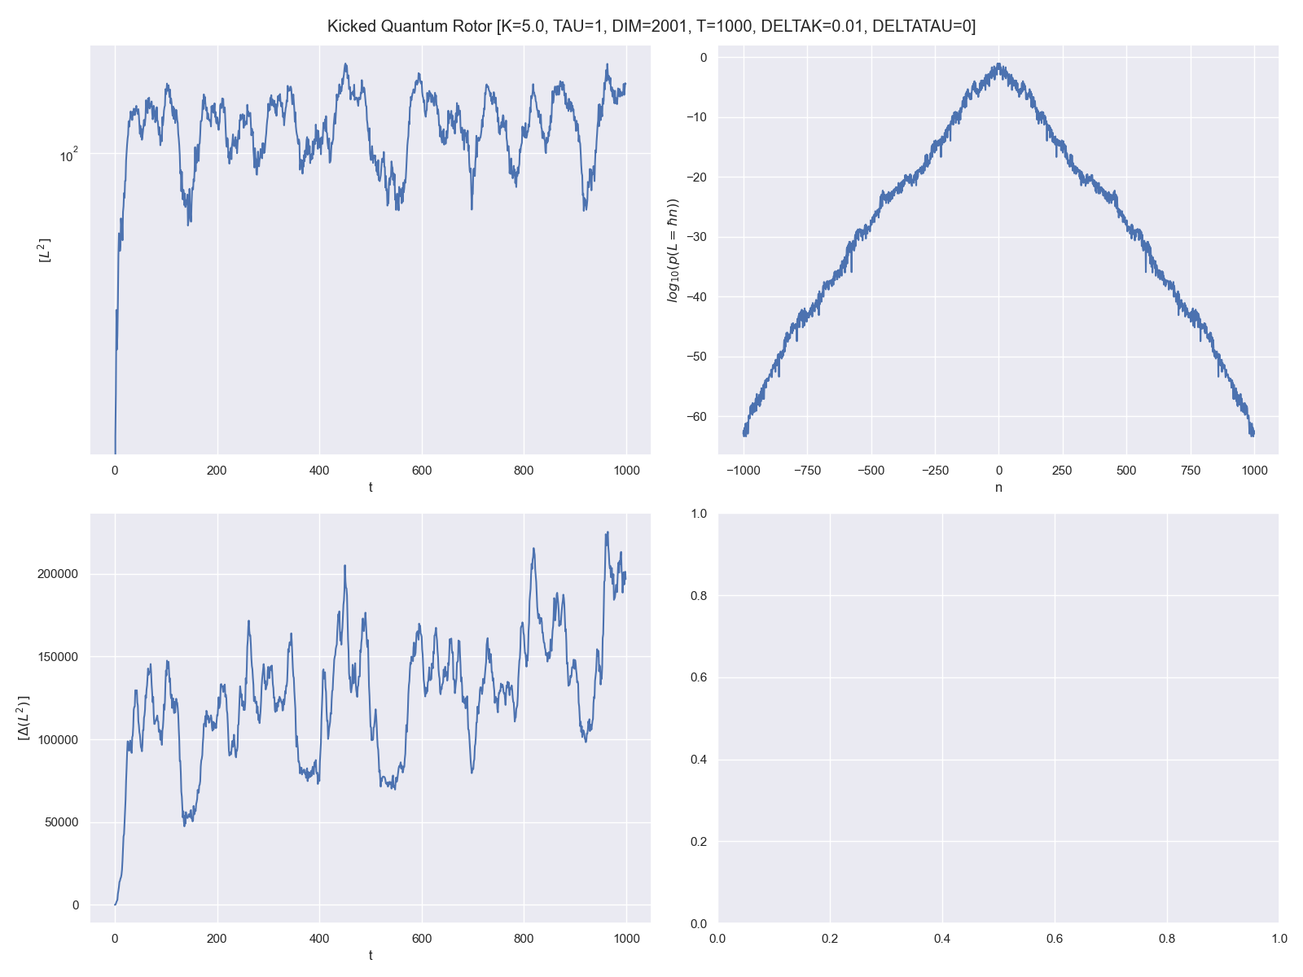
T = 1000
DIM = 2000 [-1000, 1000]
Kick Strength Varied
δK = 0.01 (0.2 %)
Uniform Distribution

Slide 4
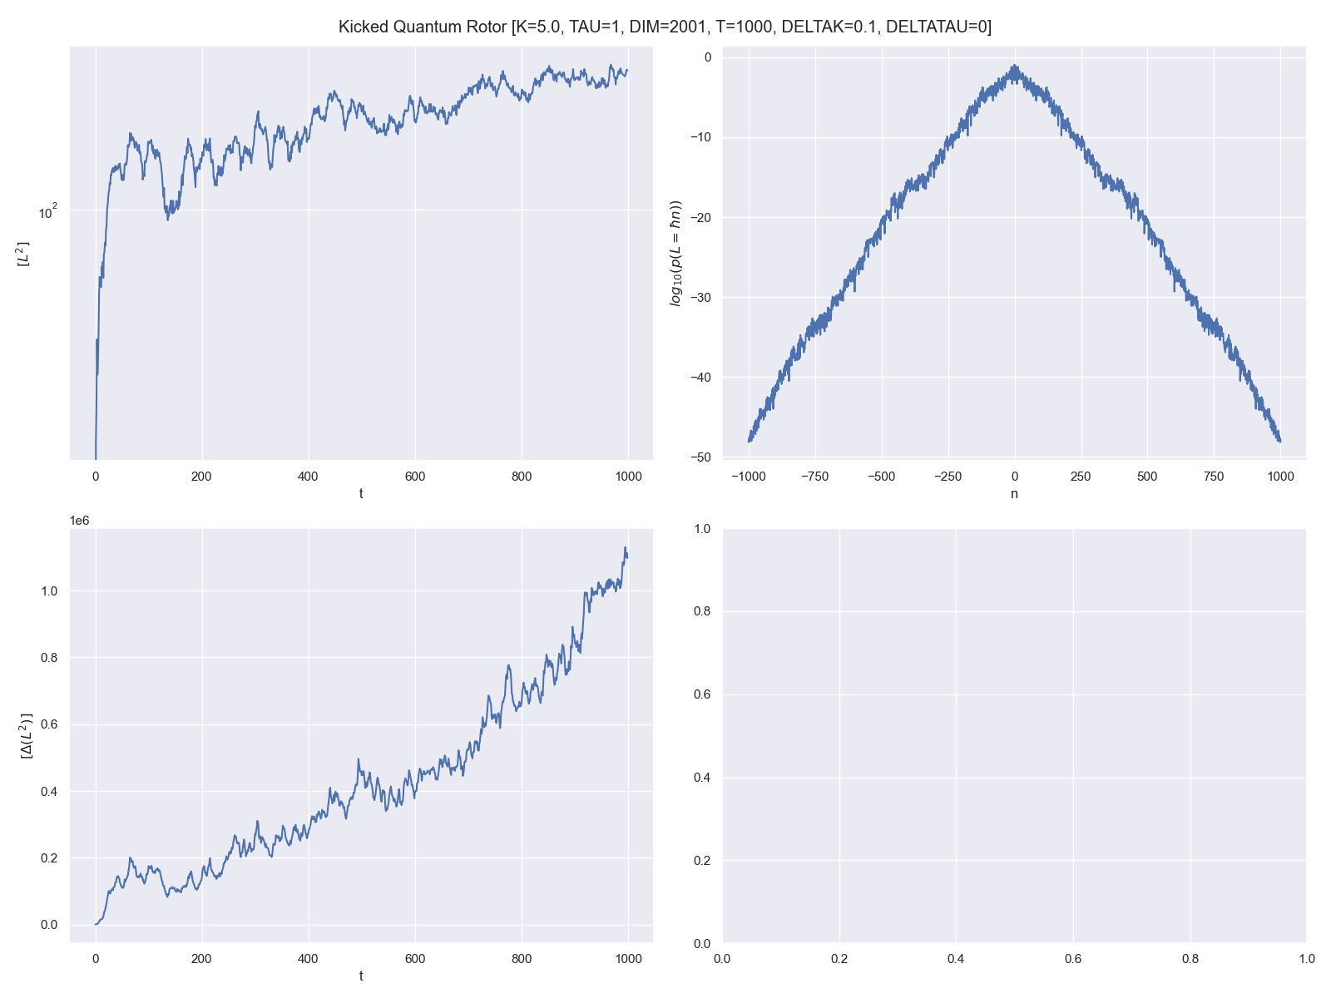
T = 1000
DIM = 2000 [-1000, 1000]
Kick Strength Varied
δK = 0.1 (2 %)
Uniform Distribution

Slide 5
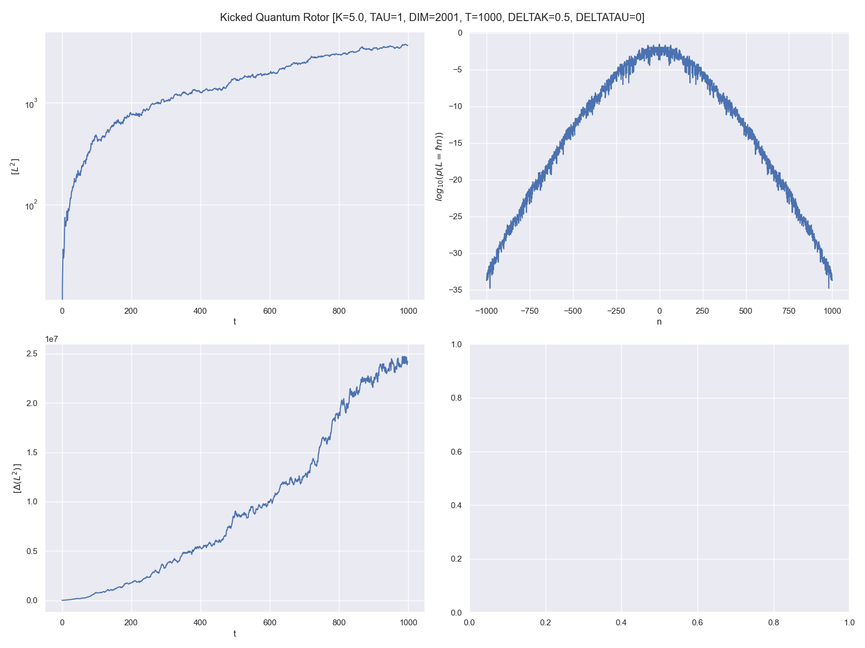
T = 1000
DIM = 2000 [-1000, 1000]
Kick Strength Varied
δK = 0.5 (10 %)
Uniform Distribution

Slide 6
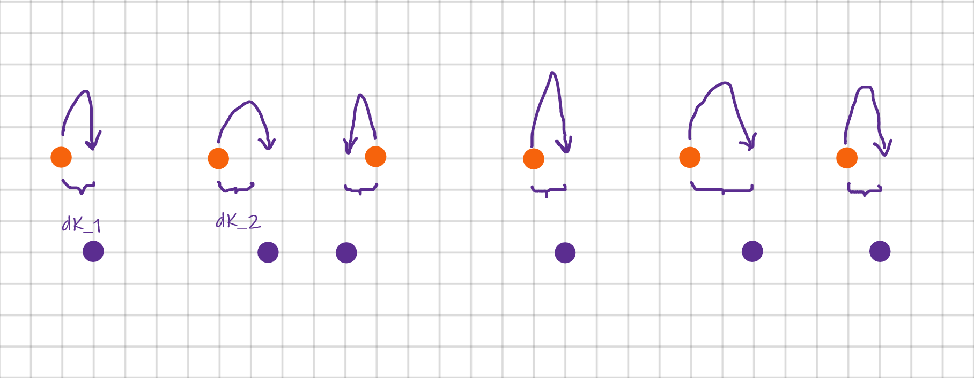
Direct Periodic Perturbation

Slide 7
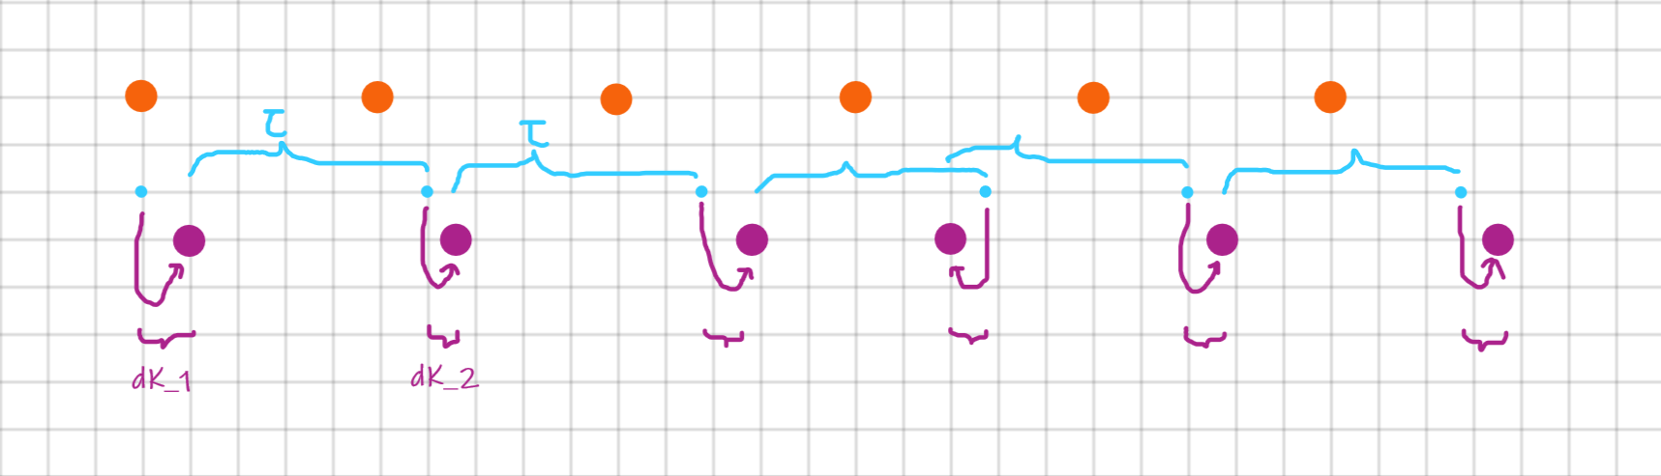
Cumulative Periodic Perturbation

Slide 8
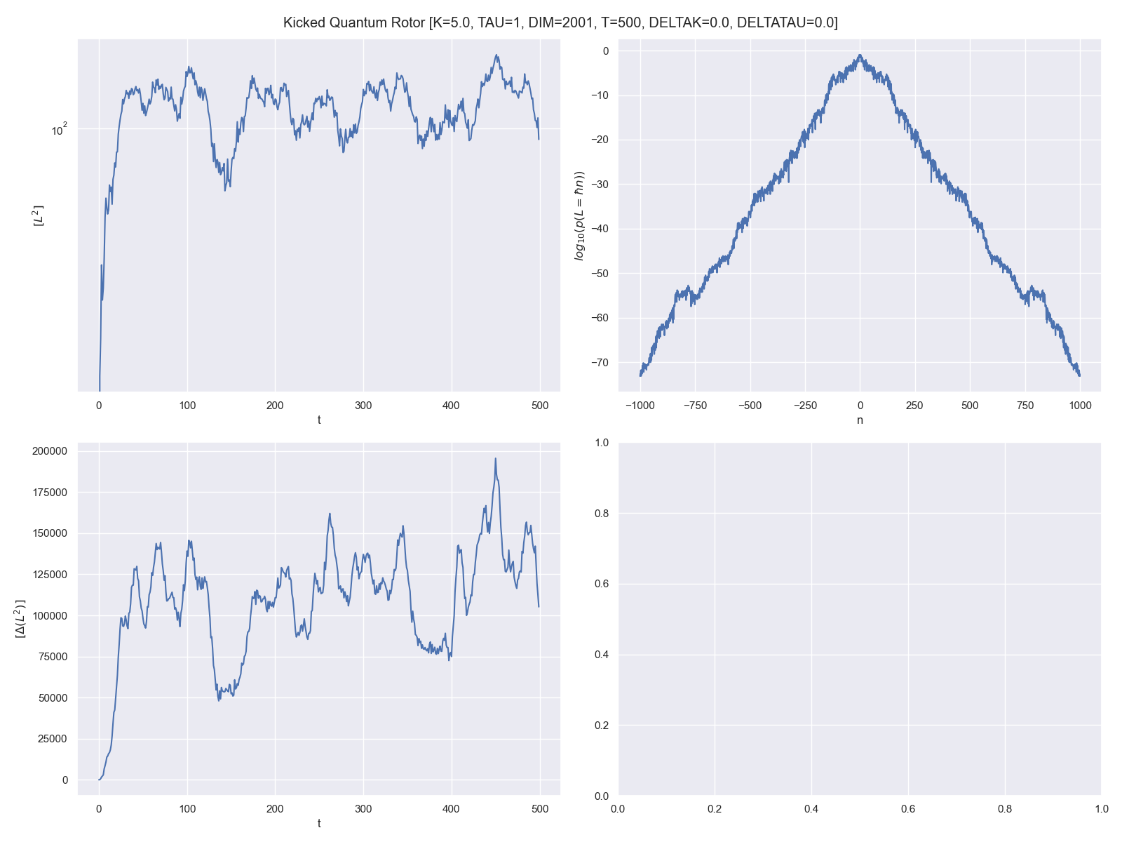
Base Case
T = 500
DIM = 2000 [-1000, 1000]
K = 5.0
τ = 1

Slide 9
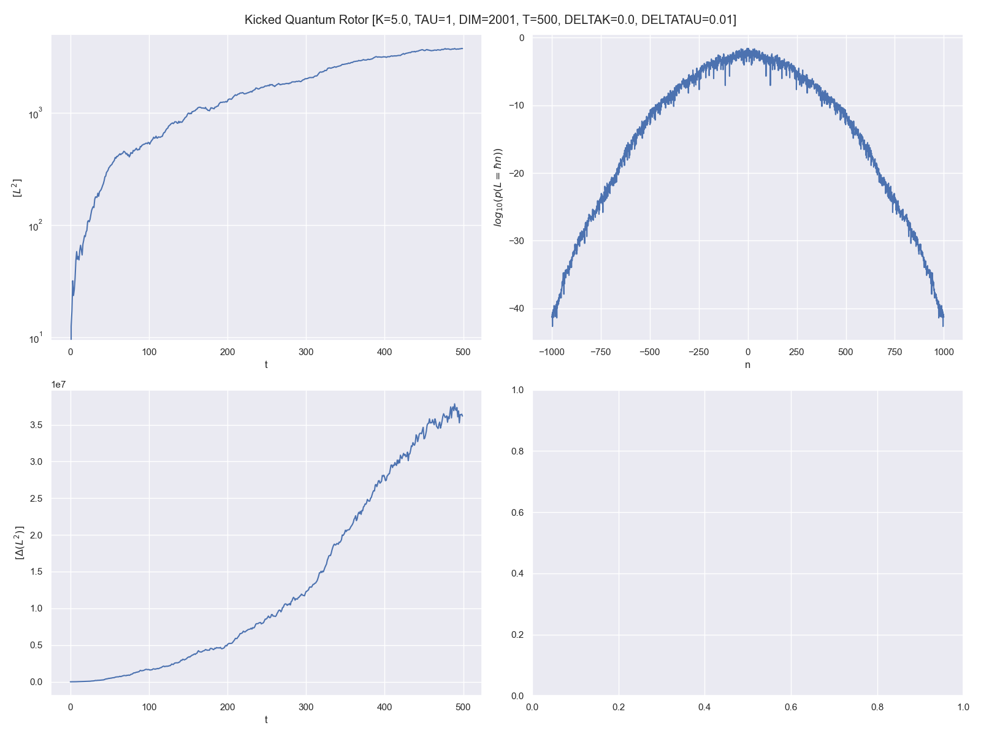
T = 500
DIM = 2000 [-1000, 1000]
Time Period Varied
δτ = 0.01 (1 %)
Uniform Distribution Differences

Slide 10
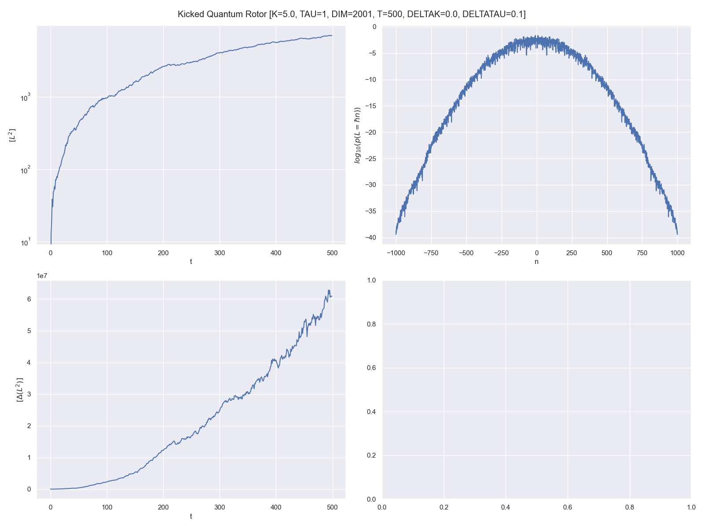
T = 500
DIM = 2000 [-1000, 1000]
Time Period Varied
δτ = 0.1 (10 %)
Uniform Distribution Differences

Slide 11
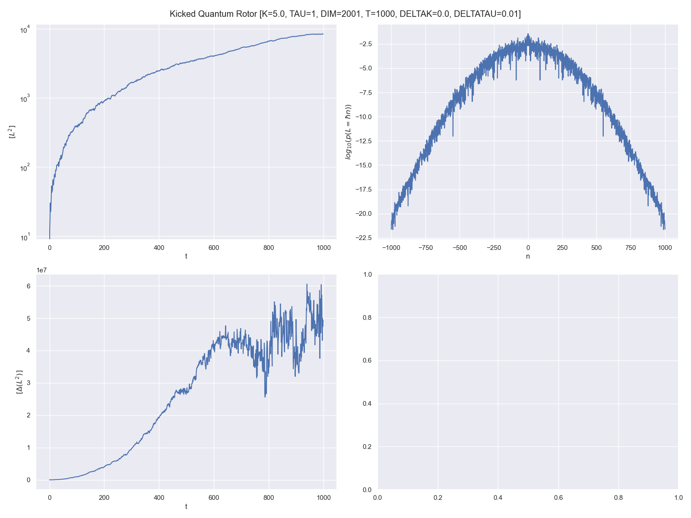
T = 500
DIM = 2000 [-1000, 1000]
Time Period Varied
δτ = 0.1 (10 %)
Uniform Distribution Differences

Slide 12
T = 500
DIM = 2000 [-1000, 1000]
Time Period Varied
δτ = 0.1 (10 %)
Uniform Distribution Differences

Slide 14
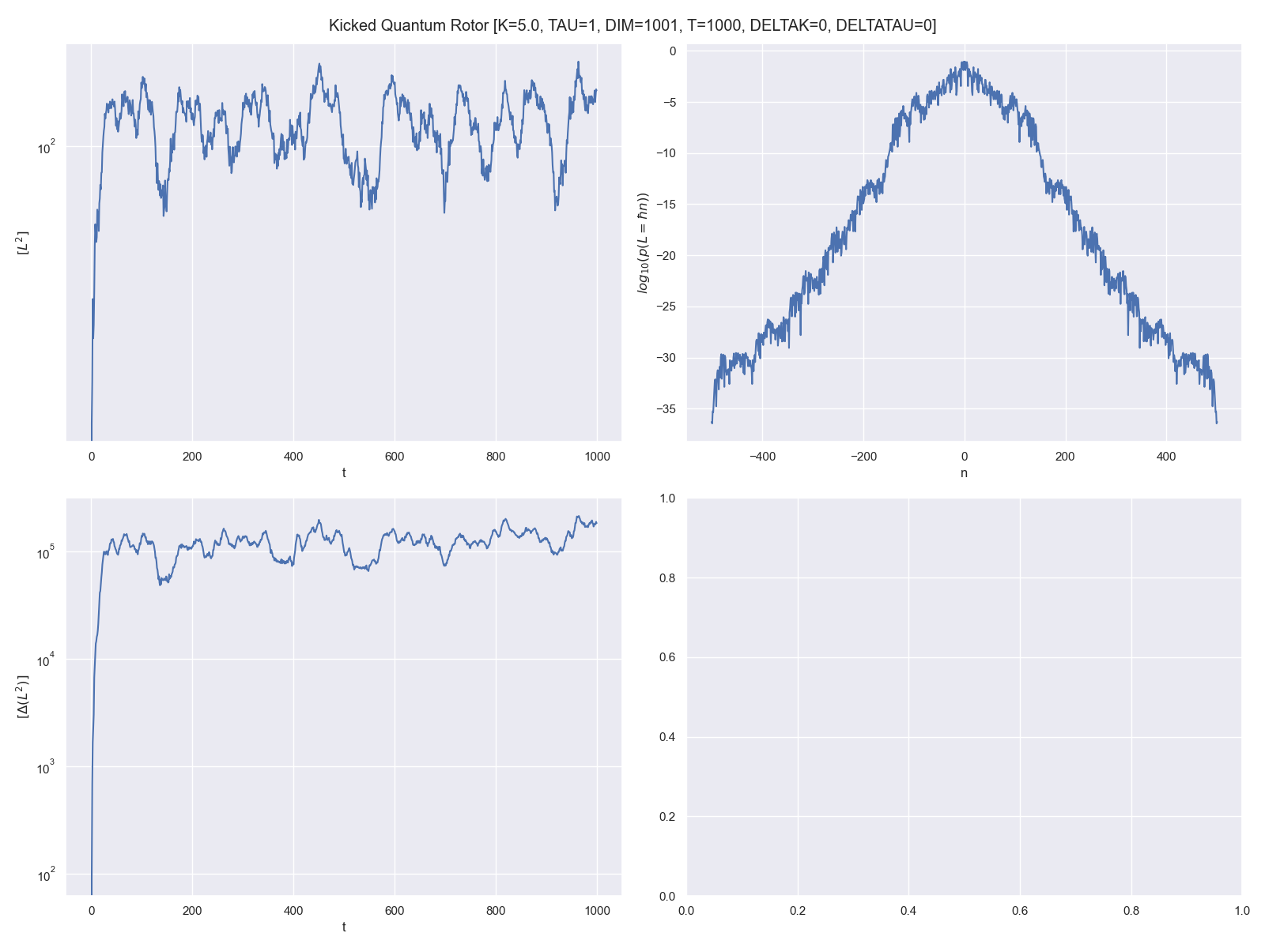
Base Case
T = 1000
DIM = 2000 [-1000, 1000]
K = 5.0
τ = 1

