Slide 1
Localization in Spin-orbit Coupled Anderson Model
Aditya Chincholi

Slide 2
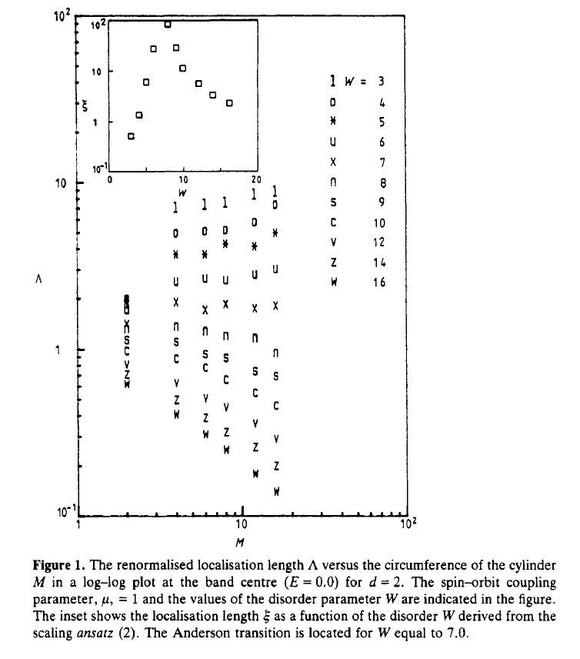
Evangelou, Zhou 1987

Slide 3
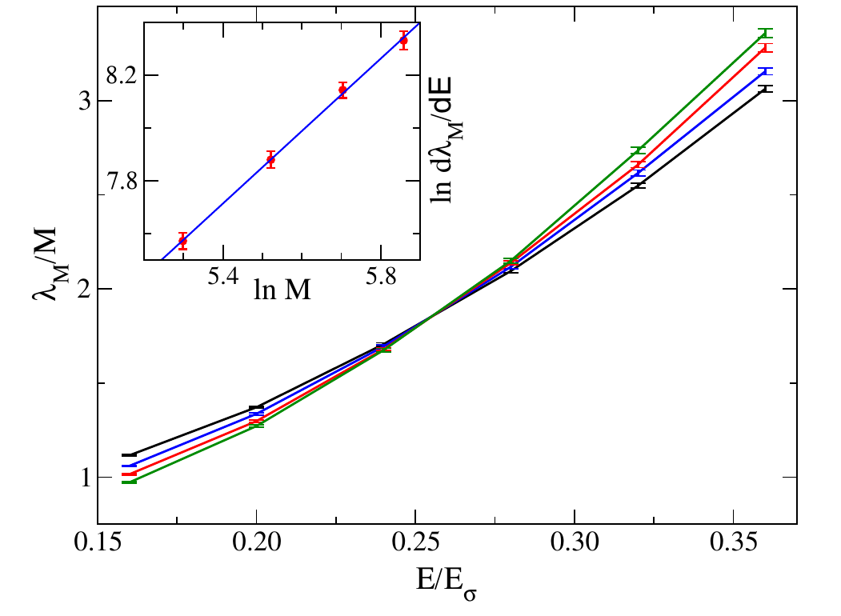
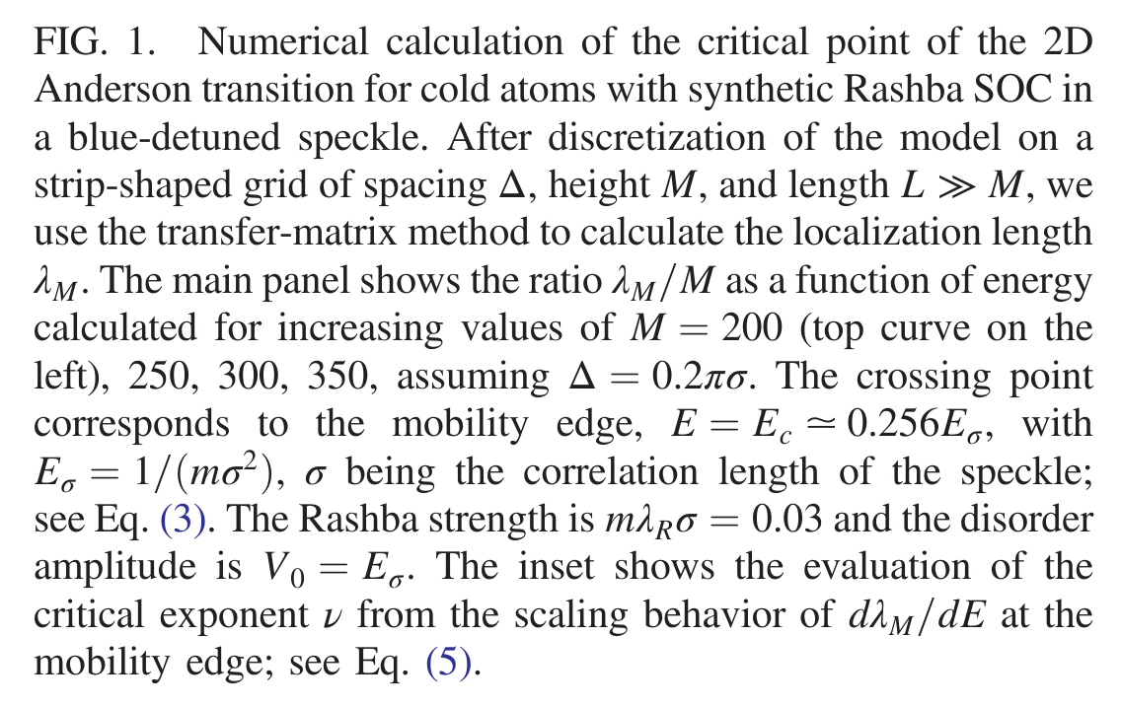
Orso 2017

Slide 4
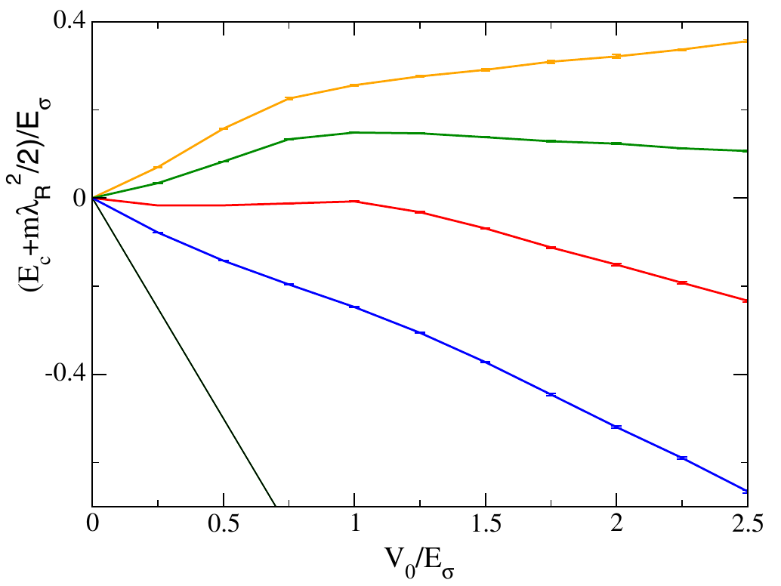
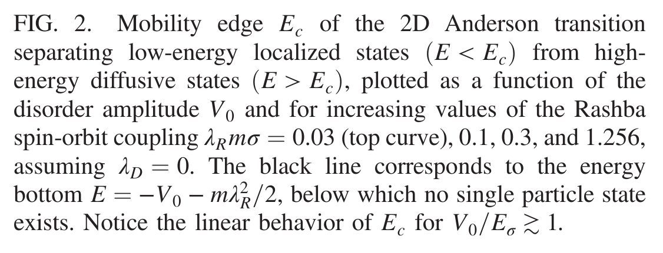
Orso 2017

Slide 5
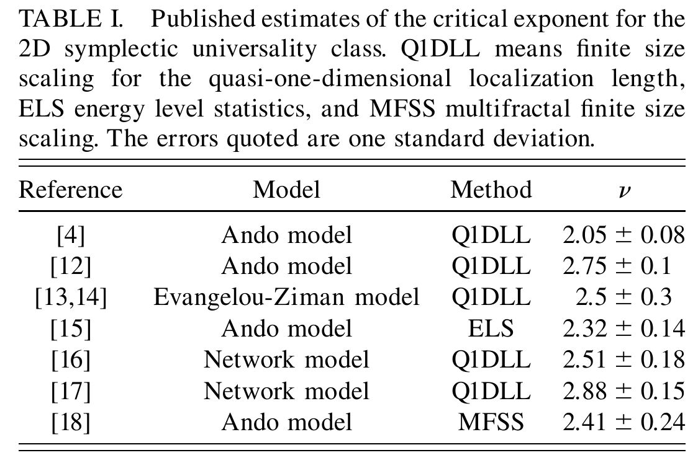
Asada, Slevin, Otsuki 2002

Slide 6
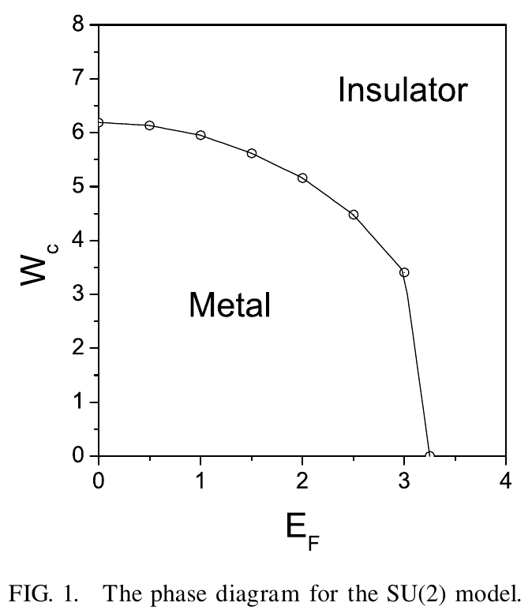
Asada, Slevin, Otsuki 2002

Slide 7
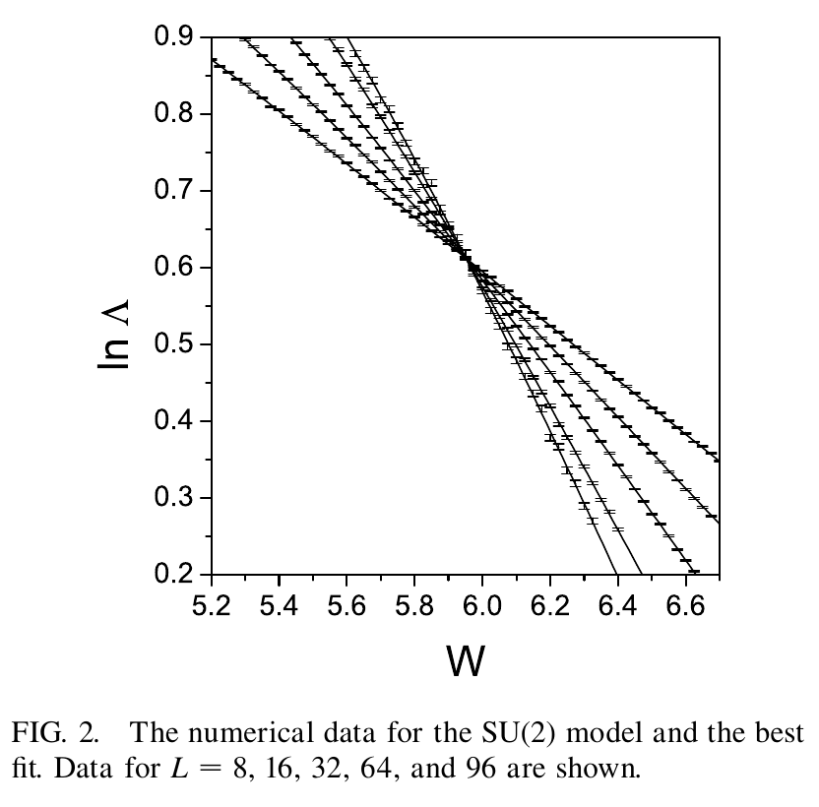
Asada, Slevin, Otsuki 2002

Slide 8
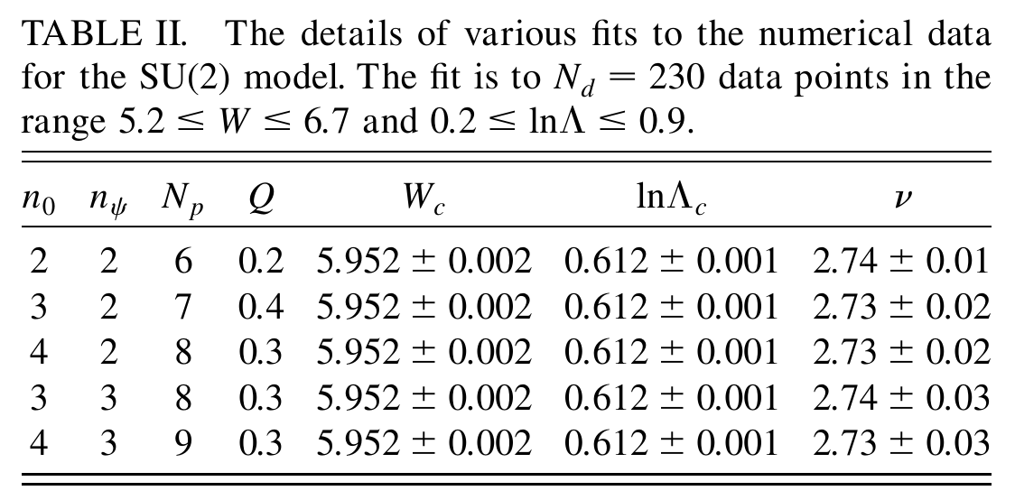
Asada, Slevin, Otsuki 2002

Slide 9
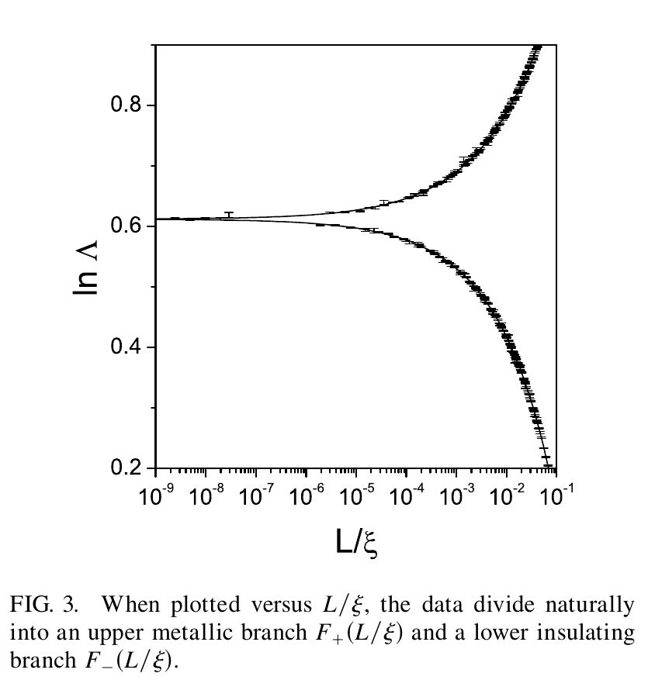
Asada, Slevin, Otsuki 2002

