Slide 1
Localization in Spin-orbit Coupled Disordered Systems
Aditya Chincholi
Indian Institute of Science Education and Research, Pune
Supervised by: Dr Rajdeep Sensarma
Tata Institute of Fundamental Research, Mumbai

Slide 2
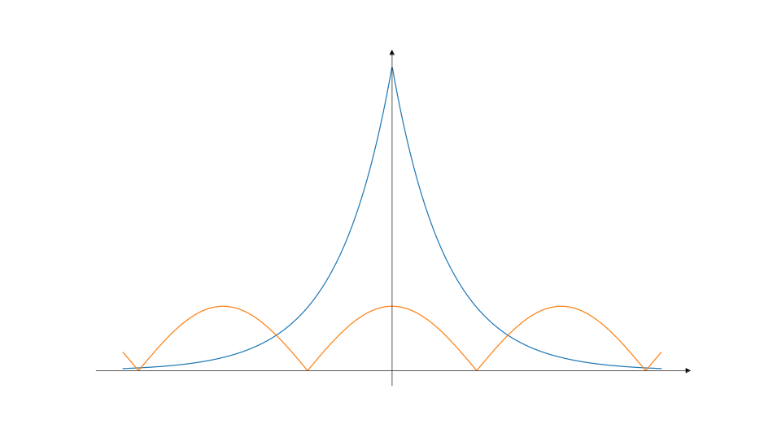
What Is Localization?
Put a particle at r, then even after a long time it stays at r.
More rigorously,

Slide 3
What is Localization?
Inverse Participation Ratio (IPR) is defined as
For a localized wavefunction, IPR remains constant even if the system size is increased.
For delocalized wavefunction, IPR scales as 1/N with system size.

Slide 4
What Is Disorder?
Impurities or scatterers in the sample
Usually random / quasirandom
All materials created in a lab have it.
Actually leads to some very interesting phenomena.

Slide 5
Localization Due To Disorder
Anderson localization (Anderson, P. W. “Absence of Diffusion in Certain Random Lattices.” Physical Review 109, no. 5, 1958)
Quantum interference due to scattering from disorder leads to suppression of diffusion

Slide 6
In 1D
Wavefunctions are always localized for non-zero disorder
Localization length is of the order of the transport mean free path l:
Ref: Anderson, P. W. Physical Review 109, no. 5, 1958: 1492–1505

Slide 7
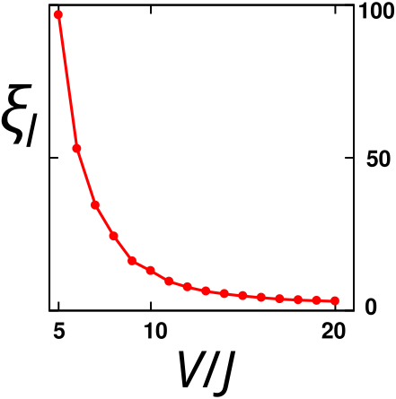
In 2D
Localization should occur for non-zero disorder
But localization lengths can be very large
Upper bound for the range in which non-zero disorder leads to localization
Weak Localization correction terms are needed
Ref: Abrahams, E., P. W. Anderson, D. C. Licciardello, and T. V. Ramakrishnan. Physical Review Letters 42, no. 10, 1979: 673–76
Img Ref: Chakraborty, Ahana, Pranay Gorantla, and Rajdeep Sensarma. Physical Review B 102, no. 22 (December 21, 2020): 224306

Slide 8
Weak Localization
Path P and it’s time reversed counterpart Q
interfere in a constructive manner leading to
“coherent backscattering”
P
Q

Slide 9
In 3D
We see a phase transition: localized phase to delocalized phase (aka metal-insulator transition)
Appearance of a mobility edge
Delocalized Phase
(Metal)
Localized Phase
(Insulator)

Slide 10
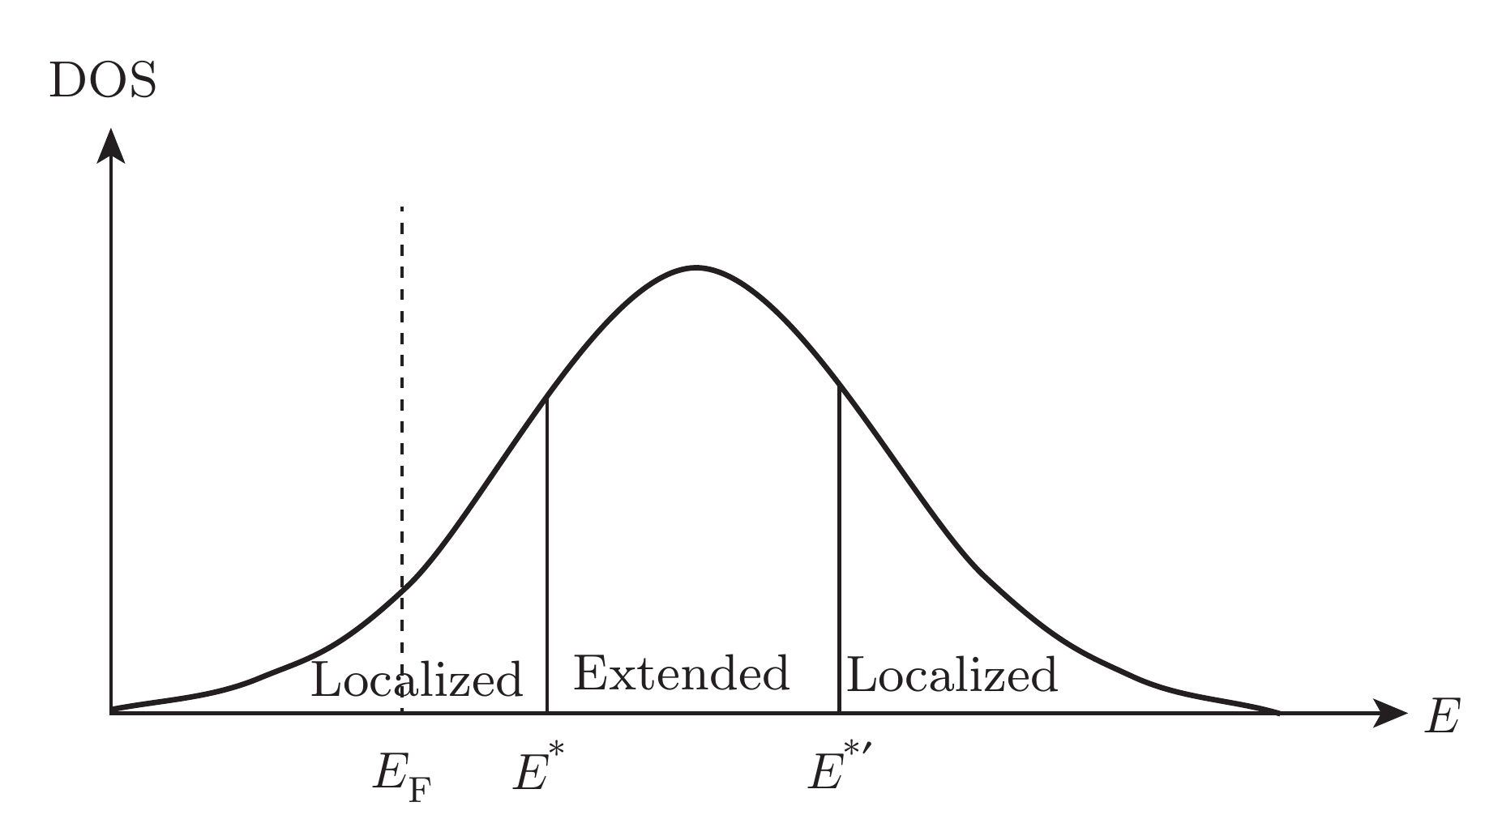
In 3D
Mobility Edge is an energy level with the wavefunctions on one side being localized and the other side being delocalized.
For high disorder, the
middle region narrows
and vanishes past the
critical disorder.
Ref: Girvin, S., & Yang, K. (2019). Modern Condensed Matter Physics. Cambridge: Cambridge University Press

Slide 11
What is Spin-Orbit Coupling?
The spin magnetic moment couples with the magnetic moment of the orbital motion
Rashba coupling:

Slide 12
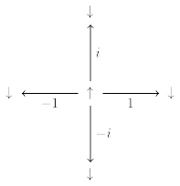
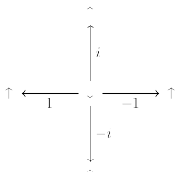
What Is Spin-orbit Coupling?

Slide 13
Why Spin-orbit Coupling?
Destroys the weak localization effect as the time reversed path now has opposite spins.
We see a phase transition
in 2D now
P
Q

Slide 14
What Is In The Literature?
(Evangelou, S. N., and T. Ziman, Journal of Physics C: Solid State Physics 20, no. 13 (May 1987): L235–40) showed that the transition exists in 2D if we add spin-orbit coupling.
The exponent for the phase transition has been calculated to high degrees of accuracy (Asada, Yoichi, Keith Slevin, and Tomi Ohtsuki. Physical Review Letters 89, no. 25, 2002: 256601)
Calculations are done for some parameters or for some modifications, but full phase space not documented anywhere.

Slide 15
What Did We Want?
We wanted to ask a question about the information about the initial state that is retained by our system over long times. (More on that later)
But we need to know what the Phase Space looks like.
So we calculated that first

Slide 16
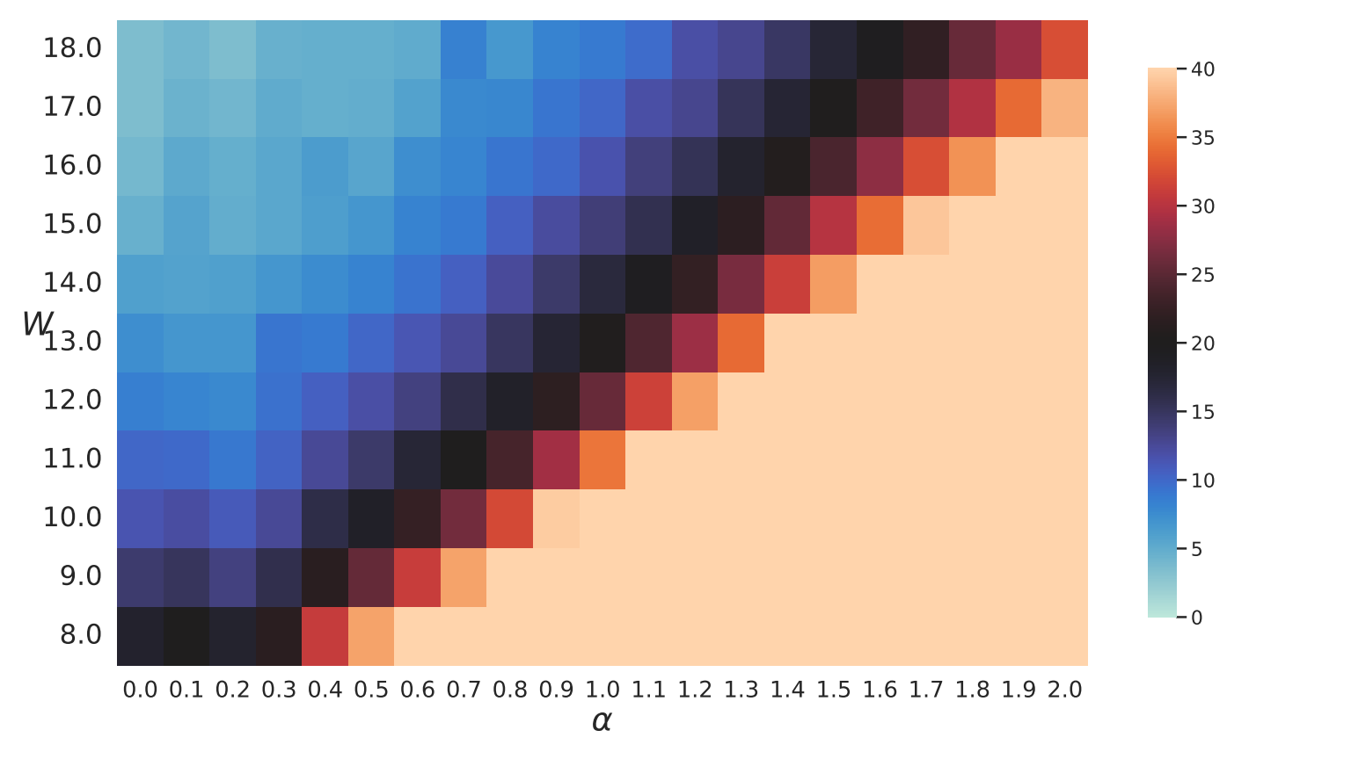
What Did We Find?

Slide 17
How Did We Find It?
Localization Length can be calculated in several ways:
Scaling of IPR ( ) with the system size
Green’s Function goes as . The square of the green’s function also has a nice expression for the long time limit.
For 1D, it can be calculated using the energy spectrum.

Slide 18
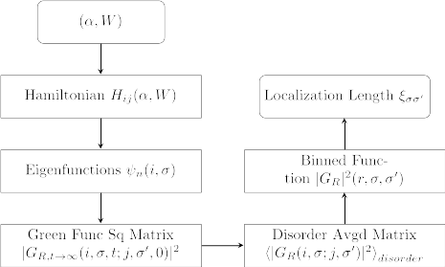
Overview of Method

Slide 19
System

Slide 20
Green’s Function
For the long time limit, we get the square of the green’s function to be
This quantity is not translationaly invariant, we need to average over many disorder realizations in order to get a translationally invariant quantity.

Slide 21
Binning and Fitting
We construct a curve from the matrix by binning it:
The curve shows exponential decay of the form So we fit an exponential to it to get the value of

Slide 22
Overview of Method

Slide 23
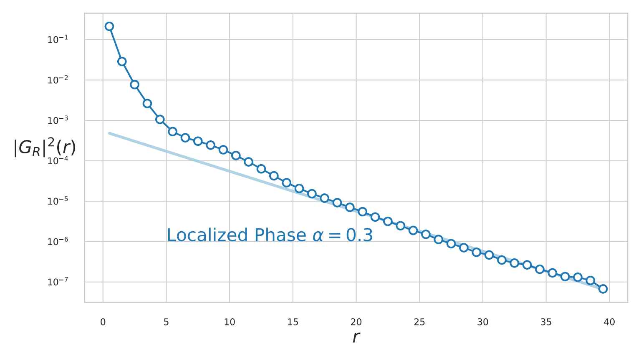

Slide 24
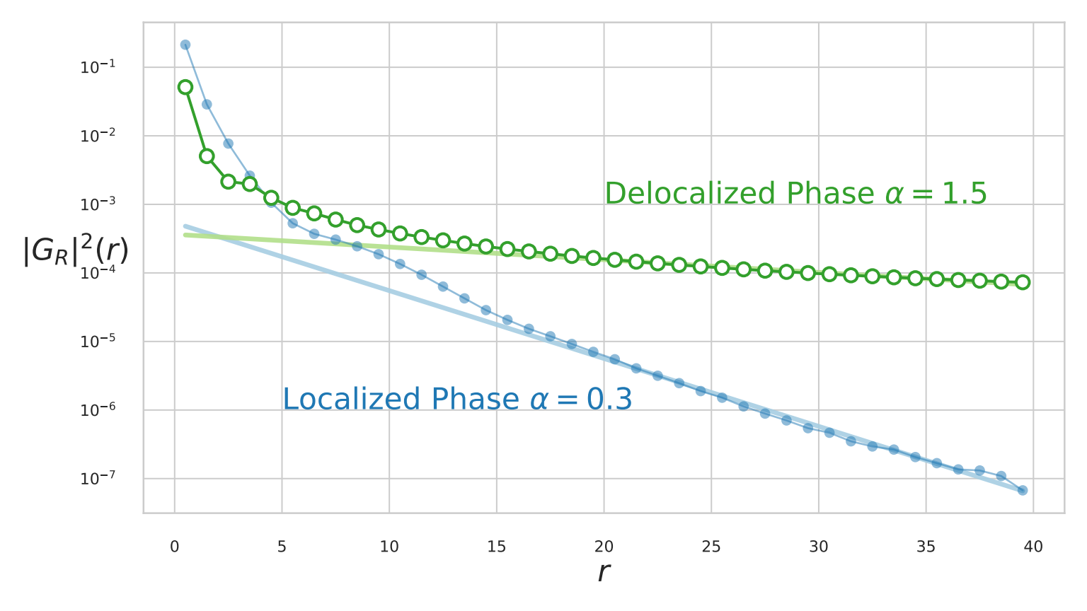

Slide 25
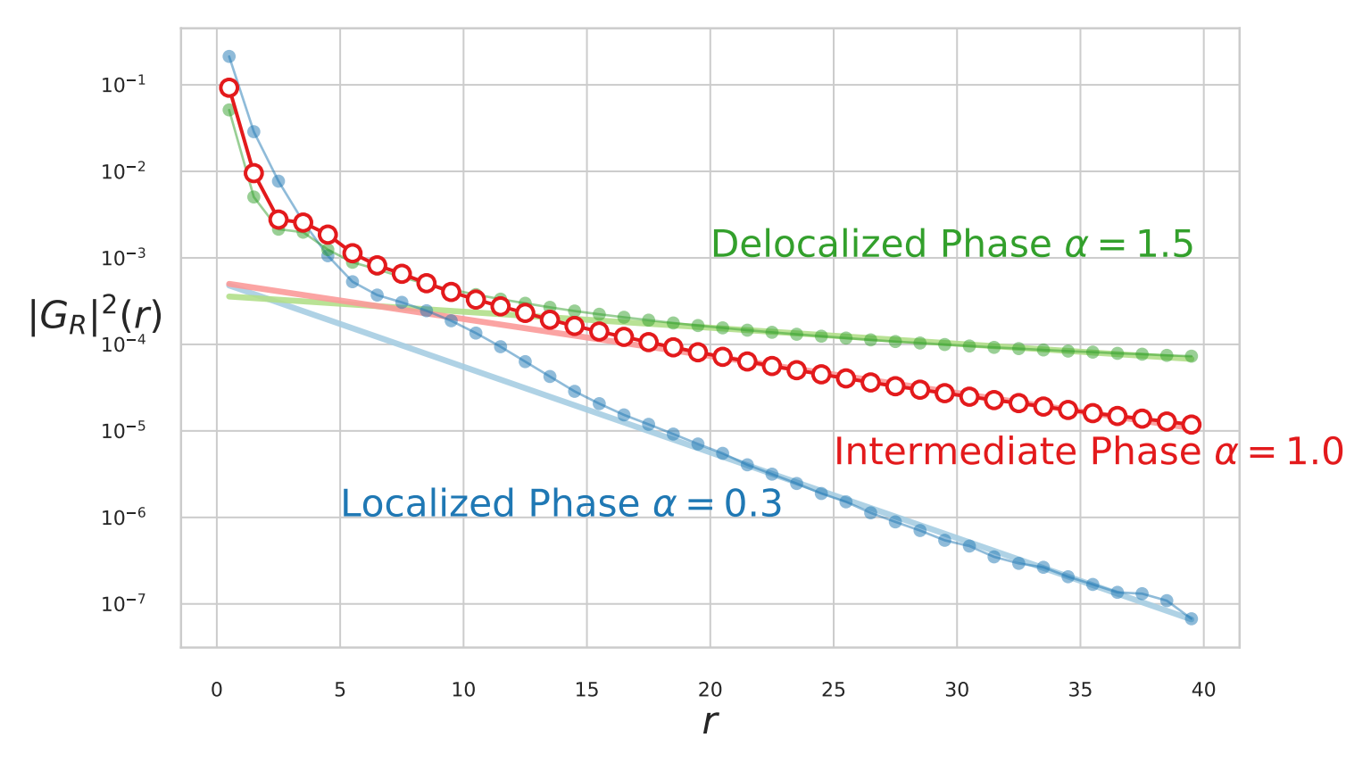

Slide 26
Finite Size
makes no physical sense. Such measurements are unreliable.
We need a good threshold that allows us to draw a line as to what localization lengths we can reliably calculate in our finite system.

Slide 27
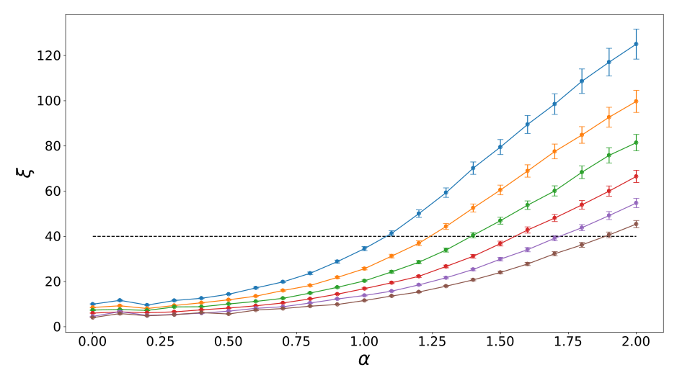
Localization Lengths
For Different Disorder Strengths

Slide 28
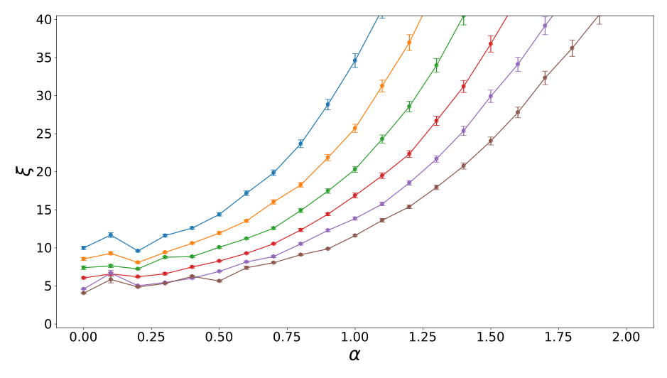
Low Disorder
High Disorder

Slide 29
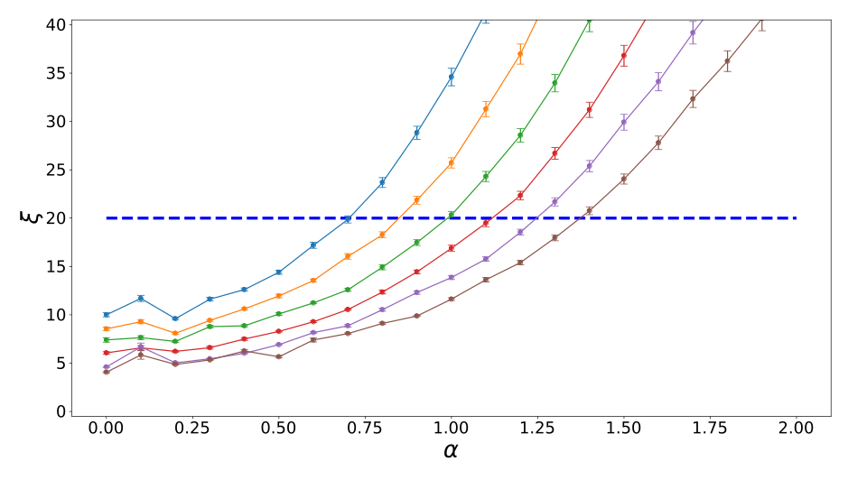
Localization Lengths
For Different Disorder Strengths

Slide 30
Mean Localization Length

Slide 31

Up-Up Localization Length

Slide 32
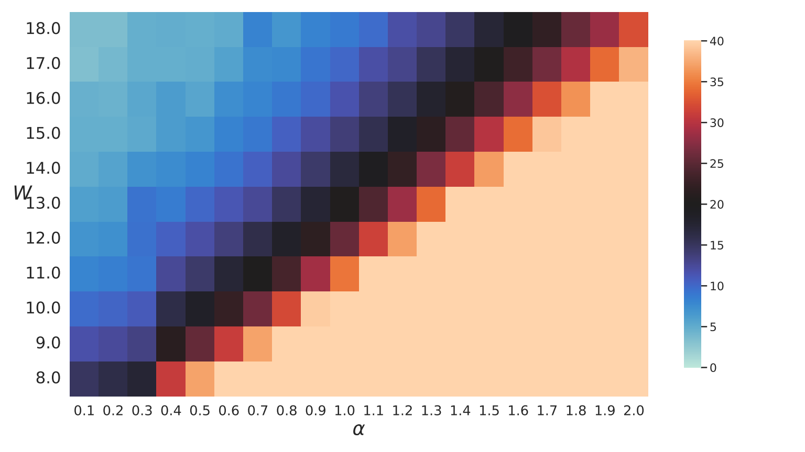
Up-Down Localization Length

Slide 33
Why Did We Find This?
In disordered systems without spin-orbit coupling, the system retains memory about its initial state.
Initial state with the sites in set A occupied and set B are unoccupied
After long times, is particle density on A different from that on B?

Slide 34
Memory of Initial States
The 2D Anderson model does retain information about its initial states
Imbalance:
Ref: Chakraborty, Ahana, Pranay Gorantla, and Rajdeep Sensarma. Physical Review B 102, no. 22 (December 21, 2020): 224306.

Slide 35
Memory of Initial States
To study imbalance in our system, we need to know how the localization length over the phase space since the imbalance depends on it strongly.
Hence we calculated the phase space.

Slide 36
Imbalance in Spin Systems
For spin systems, we have two densities involved: charge/particle density and spin density
These are linked by the spin-orbit coupling
Dynamics could transform imbalance in one to imbalance in the other

Slide 37
Next Steps?
Imbalance for different initial states. Is information about initial states retained with spin?
Can certain spin patterns/charge patterns show interesting behaviour in terms of localization and imbalance?
Energy dependence and mobility edge

Slide 38
Appendix

