Slide 1
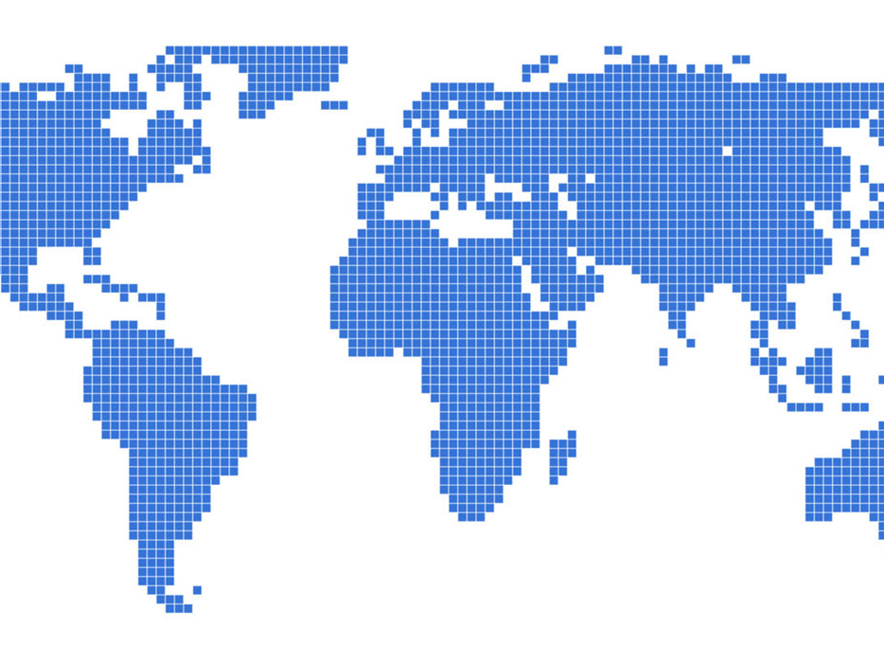
Travel Info with Foursquare
Choi Hyun Bin

Slide 2

Why travel info?
Although traveling is a pure joy, preparing it is full of agony.
Foursquare API provides great amount of quality datas about locations.(caffe, restaurant etc)
Using this data will allow tourists to easily decide where to go when they are in a specific city.

Slide 3
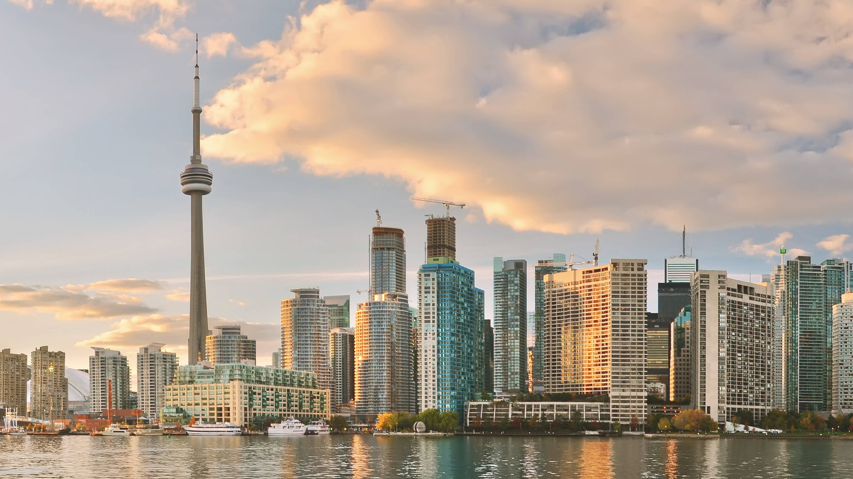
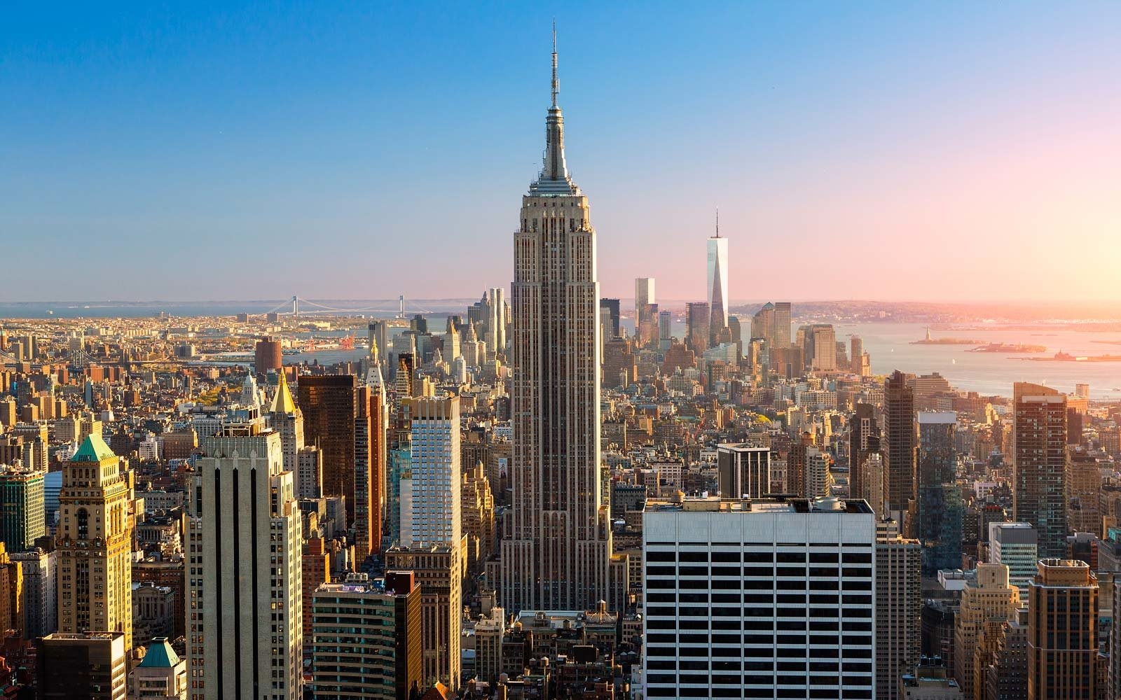
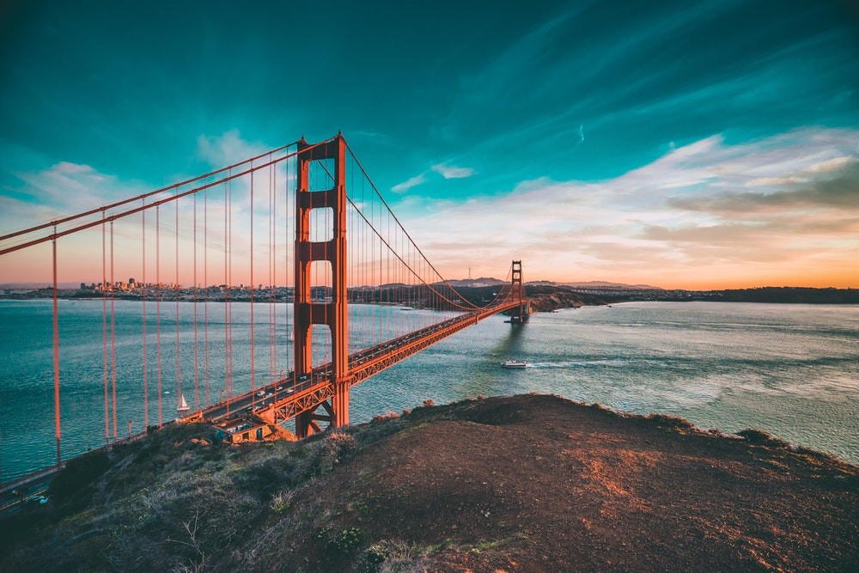
Toronto
New York
San Francisco
Regions(These cities were used throughout the capstone projects and also will be used for this project)

Slide 4
Objectives
First of all, the geojson data for each city’s neighborhood is required.
Then, analyzing the data using the Foursquare API.
Use clustering to identify each area and its category.

Slide 5
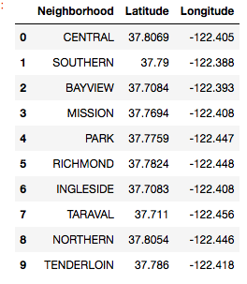
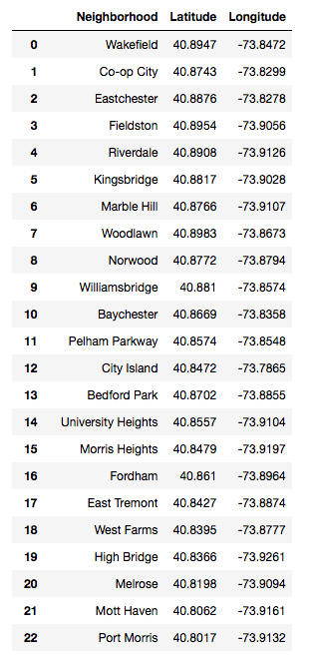
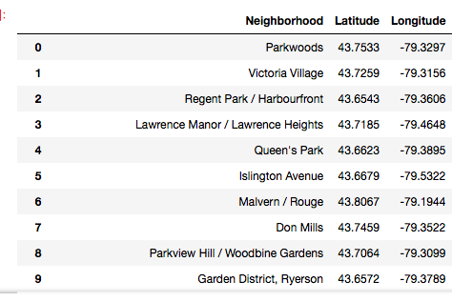
Geographical data(data frame)
San Francisco
New York
Toronto

Slide 6
Results

Slide 7
Using techniques such as K-means clustering, I was able to get results about common venues of each city
This information can be really helpful to tourists since they can focus on what they are trying to experience most during their travel.(food, culture, sport etc)
These techniques also provides the visualization of clustering of each city

Slide 8
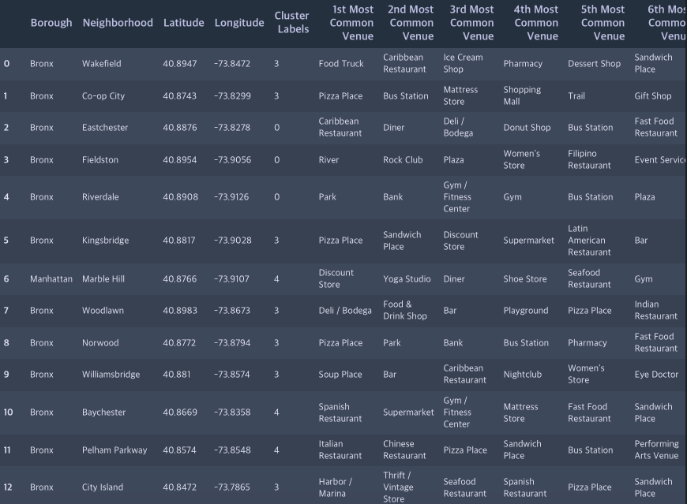
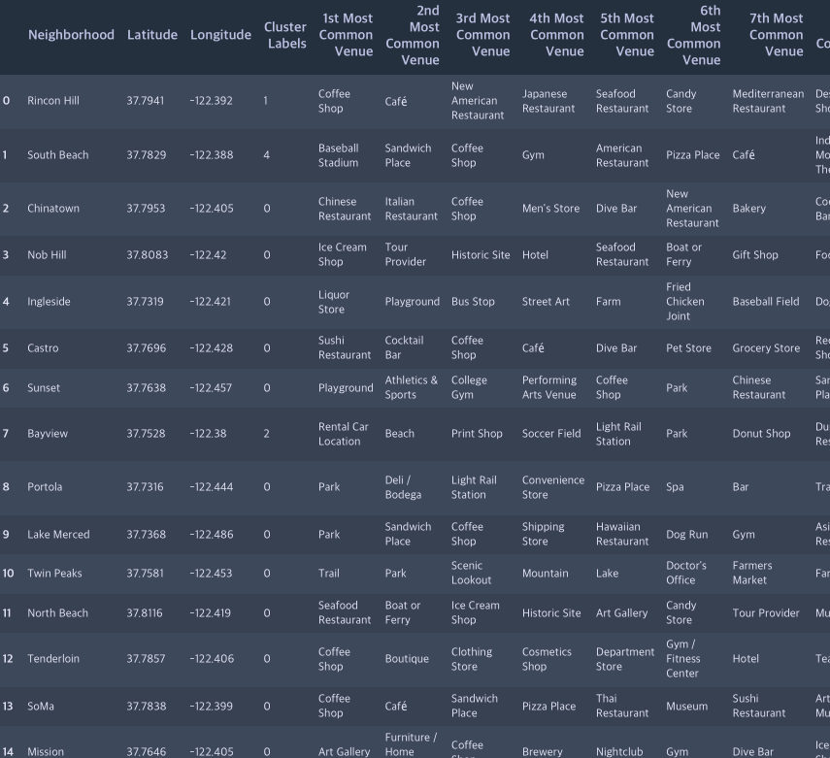
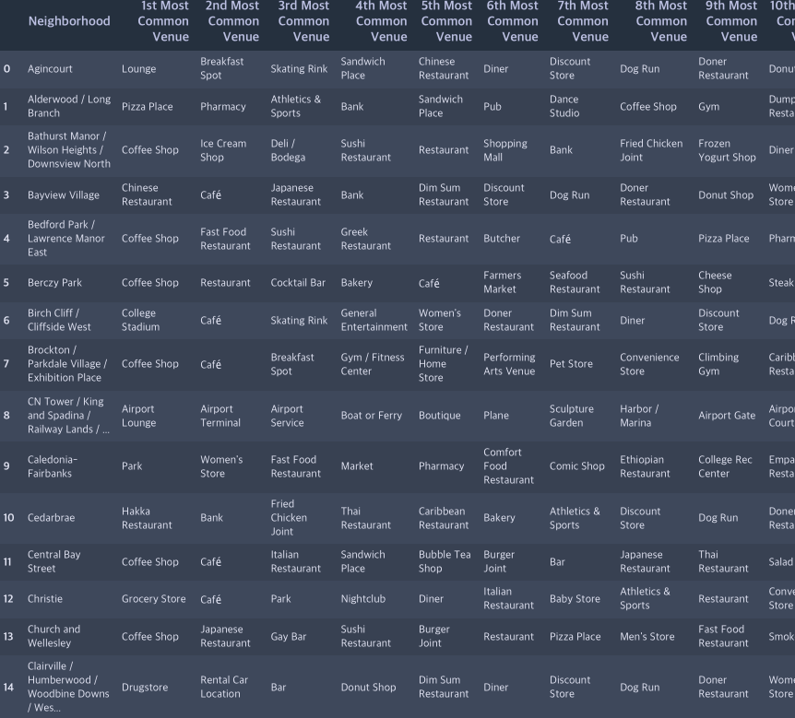
New York
San Francisco
Results of common venues of each city
Toronto

Slide 9
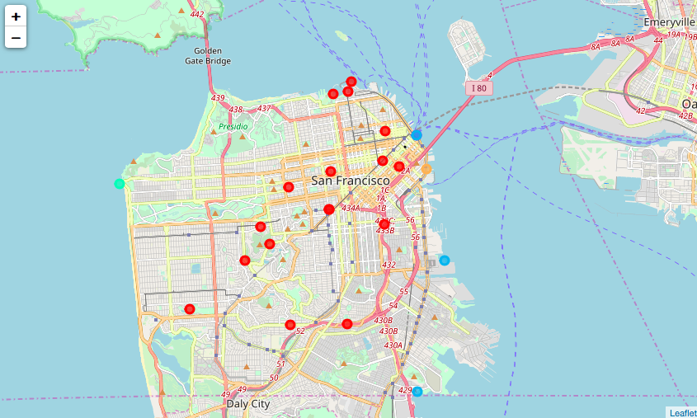
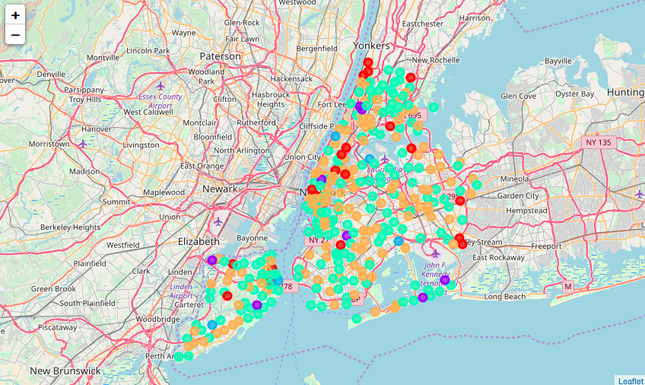
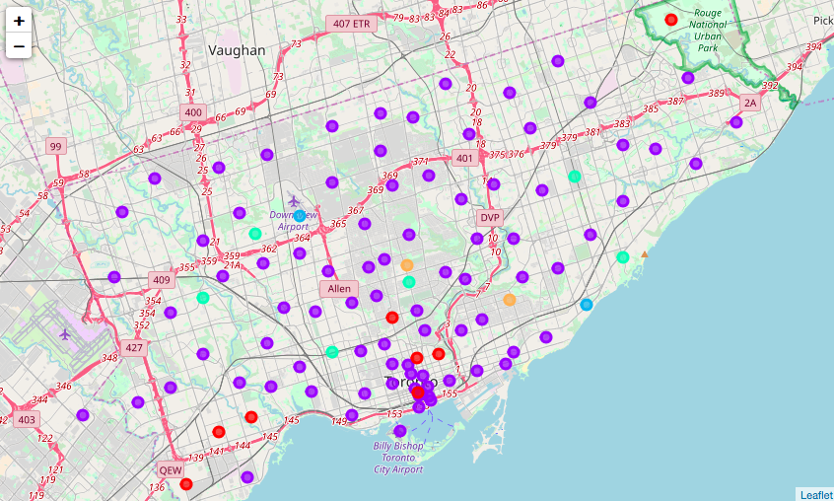
San Francisco
New York
Clustering Results of each city
Toronto

Slide 10
Personal recommendation
It seems New York is appropriate for tourists who are looking for the urban experience(various urban infrastructures and facilities )
Toronto can also be appropriate for tourist who are looking for urban experience
All three cities would provide tourists rich ‘foodie’ experience(They all have various restaurants as well as cafe)

