Slide 1

Presented by: Aniruddha Dutta Chowdhury
© 2008 Zycus Inc. All rights reserved

Slide 2
Agenda
Current Applications Status & Challenge
Framework.
  Direct Hierarchy Based.
  Current Application State Based.
Persistence.
Implementation.
Presented by: Aniruddha Dutta Chowdhury
© 2008 Zycus Inc. All rights reserved

Slide 3
Current Applications Status & Challenge
Applications are having different entity (user / group / company / setup) objects. iSource(com.b2emarkets.shared.certificate.ICertificate), iDiscover(com.zycus.zsd.user.bo.ZSDUser), iContract(com.cobra.util.objects.User), iAnalyze(com.nova.userdatapersistence.UserNovaAppData).
Presented by: Aniruddha Dutta Chowdhury
© 2008 Zycus Inc. All rights reserved

Slide 4
Direct Hierarchy Based
In this approach when ever any entity (user / role / group / company / setup) requests for any resource’s permission then a hierarchy for that entity needs to be present in the system.
The hierarchy is application specific, so the application will required to provide the hierarchy.
The hierarchy is required to identify the entity level.
Presented by: Aniruddha Dutta Chowdhury
© 2008 Zycus Inc. All rights reserved

Slide 5
Current Application State Based
This will be based upon current setup, current company and that also to be setup by application. If user level permission asked and user not found in entry then current company’s permission will be picked up. This is not direct hierarchy, means all entity might not have direct relation.
Presented by: Aniruddha Dutta Chowdhury
© 2008 Zycus Inc. All rights reserved

Slide 6
Persistence
Basic level can be taken up by keeping in property file.
A bit advanced not the best is XML.
Save all data in database and reading needs to be optimised as not all always query from database but check with update time.
Presented by: Aniruddha Dutta Chowdhury
© 2008 Zycus Inc. All rights reserved

Slide 7
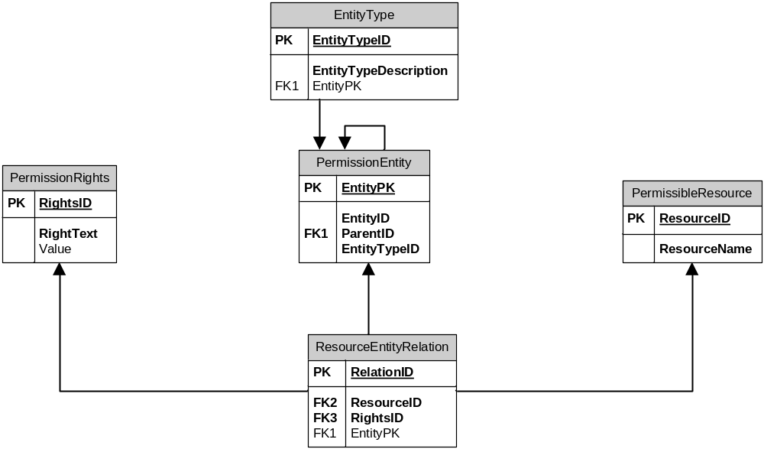
Persistence
Presented by: Aniruddha Dutta Chowdhury
© 2008 Zycus Inc. All rights reserved

Slide 8
Implementation
OPEN…
Presented by: Aniruddha Dutta Chowdhury
© 2008 Zycus Inc. All rights reserved

