Slide 1

Gotto Job
GROUP 1 DEPLOYABLES

Slide 2
Team Members
Product Owner (PO) – Vamshidhar Kodakandla
Scrum Master (SM) – Adrina Colaco
Dev Lead – Suny Shekher
DevOps Lead – Maleesha Ranawaka
Development Team
Suny Shekher (Building)
Hassan Hassan (Building)
Santhosh Kumar Raju (GitHub)
Sonam Tamang (GitHub)
Sirisha Molugu (Testing)
Maleesha Ranawaka (Deployment/Ops)

Slide 3
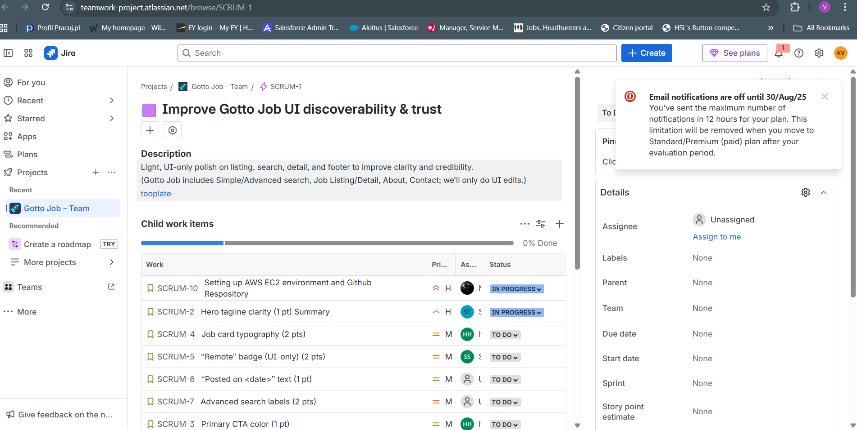
Created the Epic
Jira Epic: https://teamwork-project.atlassian.net/jira/software/projects/SCRUM/summary?atlOrigin=eyJpIjoiYzlkYzk3MzJmNzZmNDVlNTg2NjI1OWE5OTg5OTVjYzgiLCJwIjoiaiJ9

Slide 4
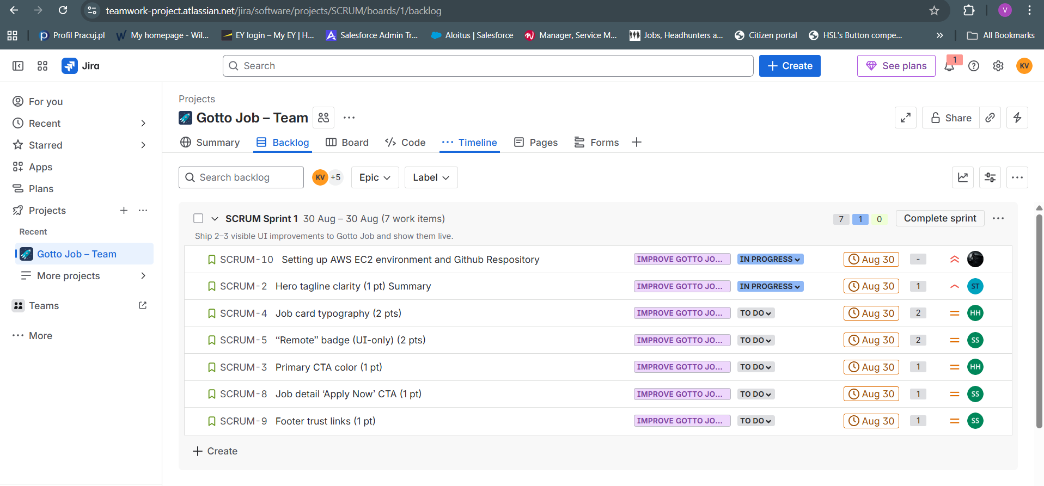
Created the Product Backlog
Product Backlog

Slide 5
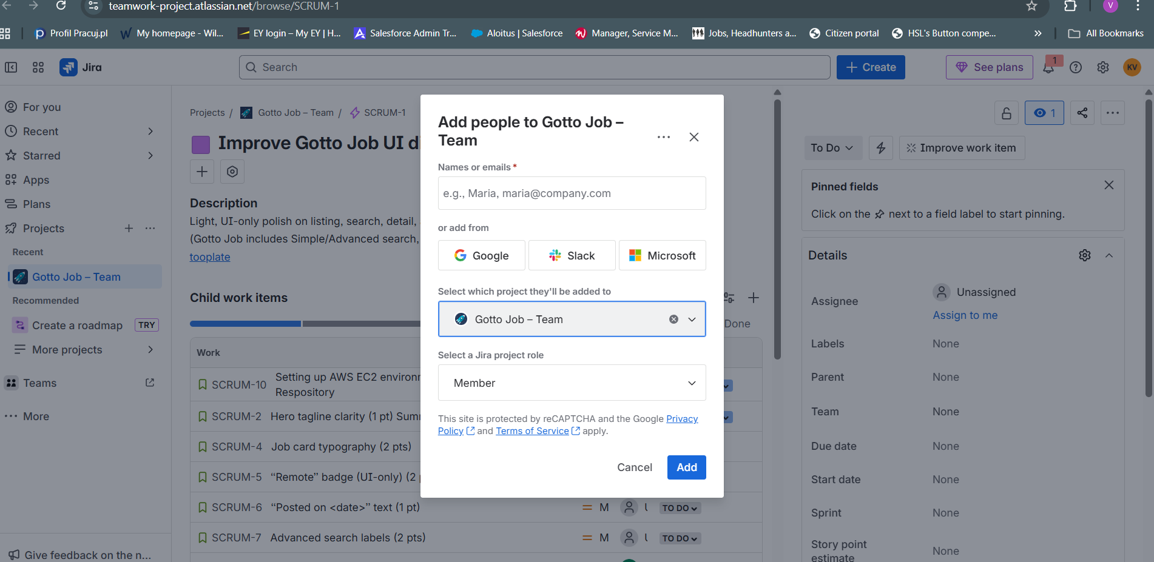
Sprint Planning
Sprint Start

Slide 6
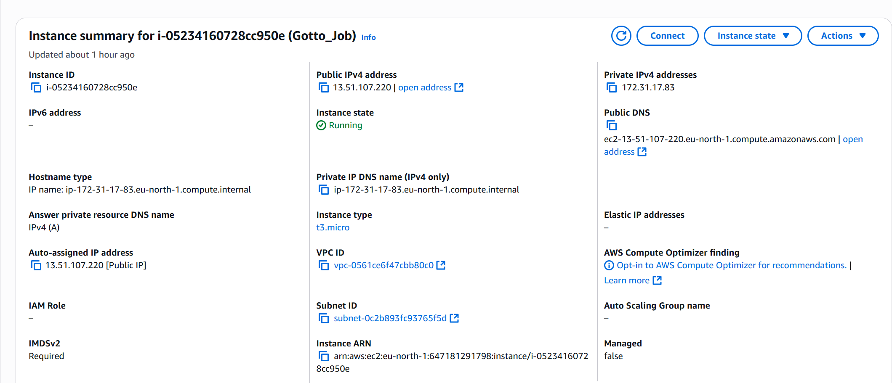
Cloud Deployment
EC2

Slide 7
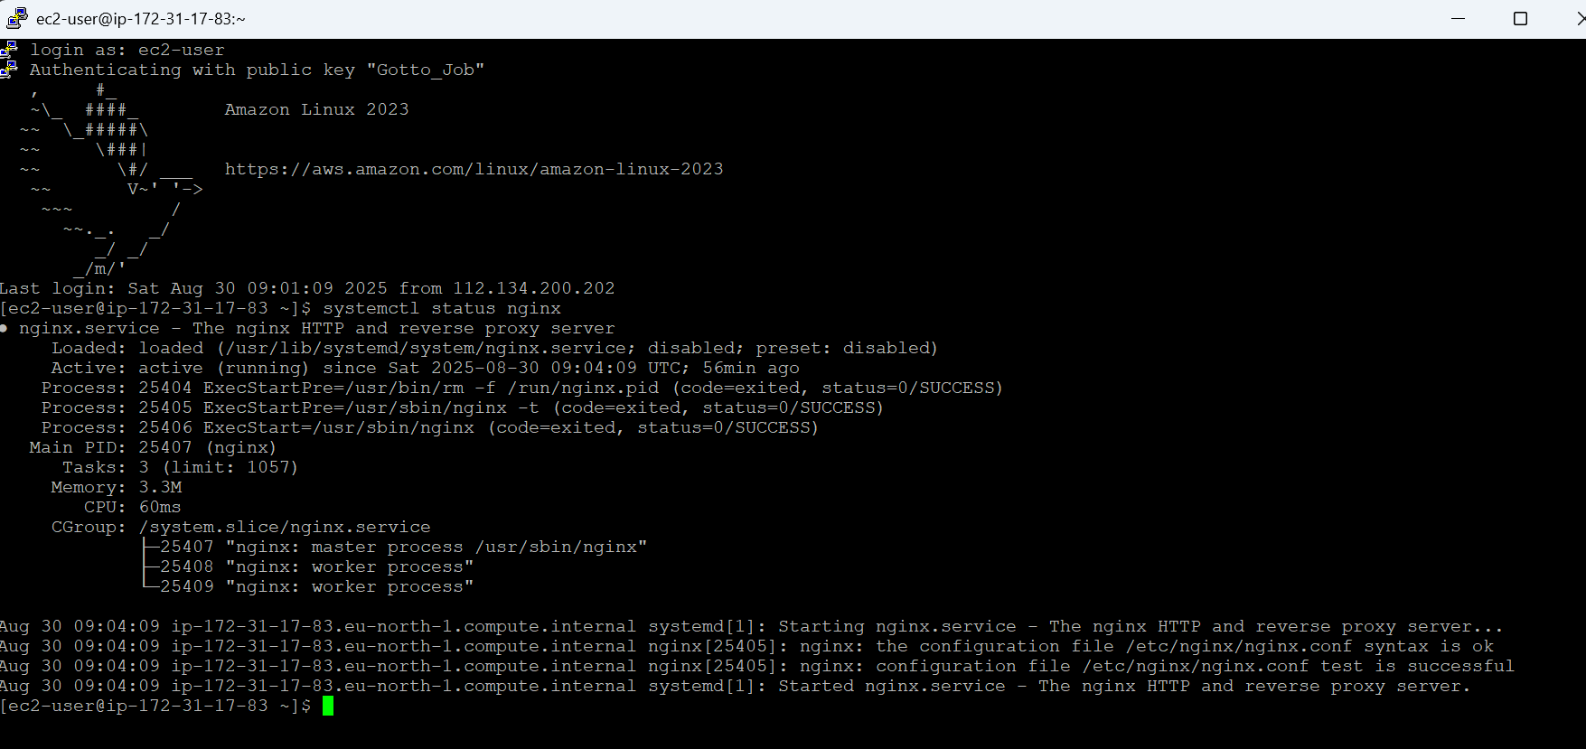
Installations
NGINX Installation

Slide 8
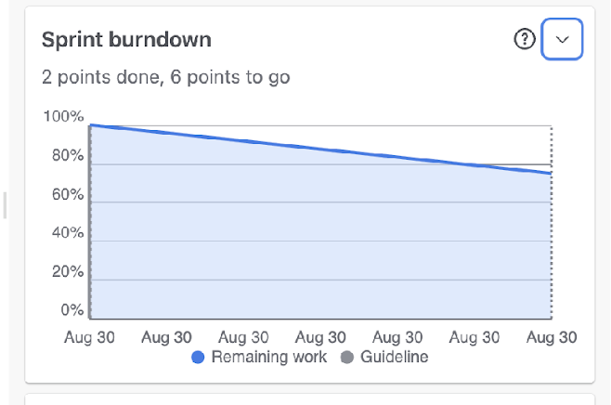
Reports → Burndown
Sprint Burndown Captured while sprint was Still in progress.

Slide 9
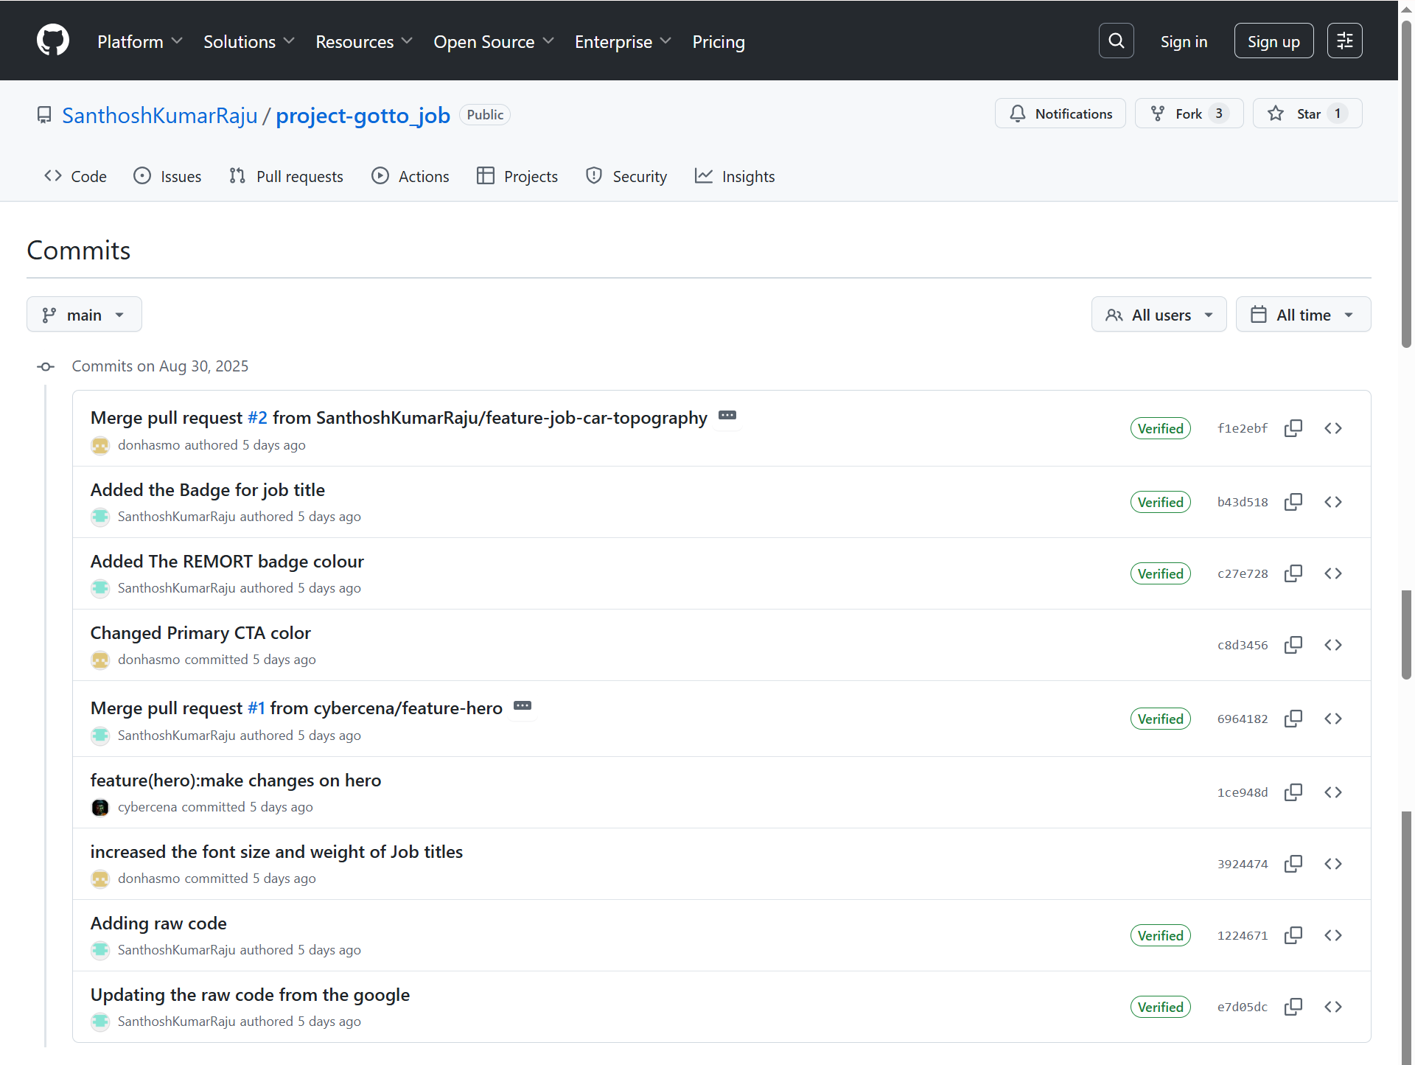
GitHub
https://github.com/SanthoshKumarRaju/project-gotto_job.git

Slide 10

Final URL - Shipped one small increment
http://13.51.107.220/

Slide 11
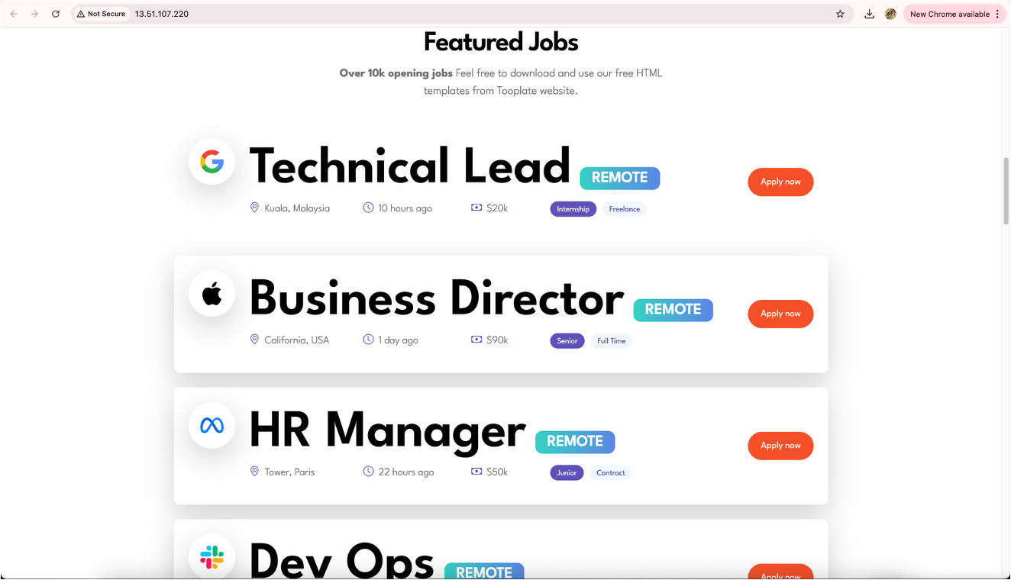
Some More changes showing up in Prod

Slide 12
THANK YOU
Group 1 Deployables

