Slide 1
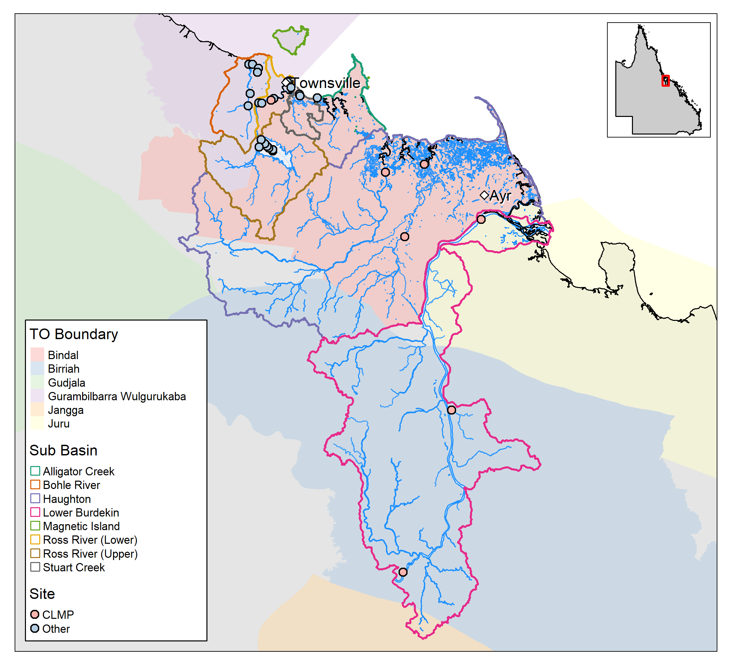
Stuart Creek
Bohle River
Alligator Creek
Ross River
Barratta Creek
Haughton River
Burdekin River

