Slide 1
Topic. What Scale to use?
Issue. Min and Max ranges change year-on-year. Thus, hard to compare year-on-year.
Solution. Use a fixed scale that doesn’t change each year.
Options.
No change
Use min-mean and max-mean from past 30 years (1991 – 2020)
Use min-mean and max-mean from all data (1911 – 2023)
Use absolute min and absolute max from past 30 years (1991 – 2020)
Use absolute min and absolute max from all data (1911 – 2023)
Question. What is the different between “min-mean” and “absolute min” etc.
Answer. Next slides.

Slide 2
How is Annual Data Calculated?

Slide 3
Aug
Sept
Oct
Annual
2 | 1 | 1 | 2 | 4
5 | 2 | 4 | 2 | 3
5 | 1 | 2 | 3 | 1
5 | 6 | 6 | 3 | 5
6 | 6 | 3 | 4 | 6
1 | 3 | 2 | 3 | 2
2 | 2 | 5 | 3 | 0
1 | 3 | 3 | 5 | 4
5 | 4 | 1 | 4 | 5
1 | 2 | 4 | 4 | 5
…
Aug
Sept
Oct
Annual
Min: 1
Max: 6
Mean: 3.5
Min: 0
Max: 5
Mean: 2.9
Min: 1
Max: 11
Mean: 6.4

Slide 4
How are “min-mean”, “absolute min”, etc. calculated?

Slide 5
Annual, Fyear: 2021
Annual, Fyear: 2022
Annual, Fyear: 2023
Min: …
Max: …
Mean: …
Min: 2
Max: 16
Mean: 7.9
Min: 1
Max: 11
Mean: 6.4
All Data (1911 – 2023)
30-year Climate Normal (1991 – 2020)
Current Fyear (2023)
Absolute Min: …
Min Mean: …
Max Mean: …
Absolute Max: …
Absolute Min: 1
Min Mean: 6.4
Max Mean: 7.9
Absolute Max: 16
Absolute Min: 1
Min Mean: 6.4
Max Mean: 6.4
Absolute Max: 11

Slide 6
Visualise Each Option

Slide 7
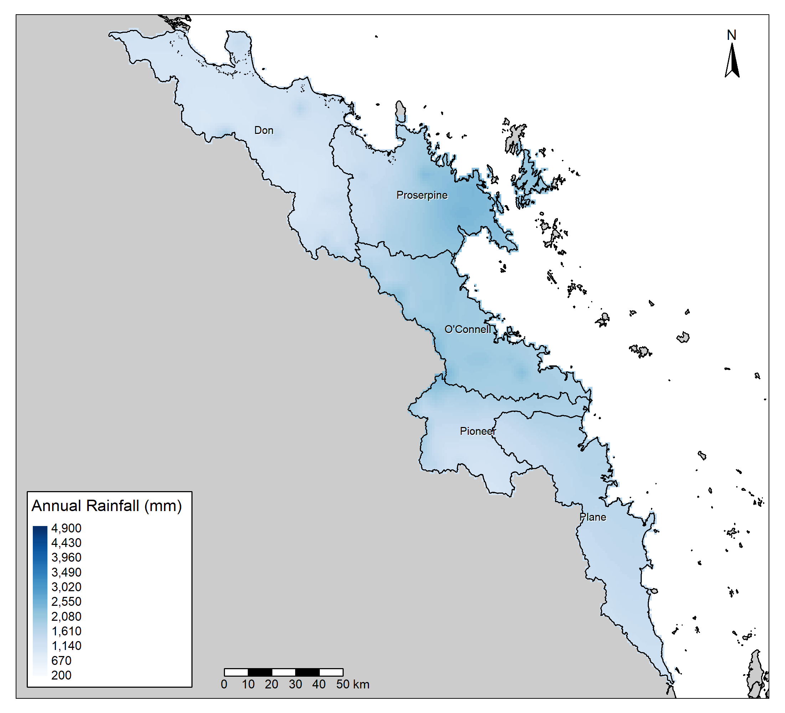
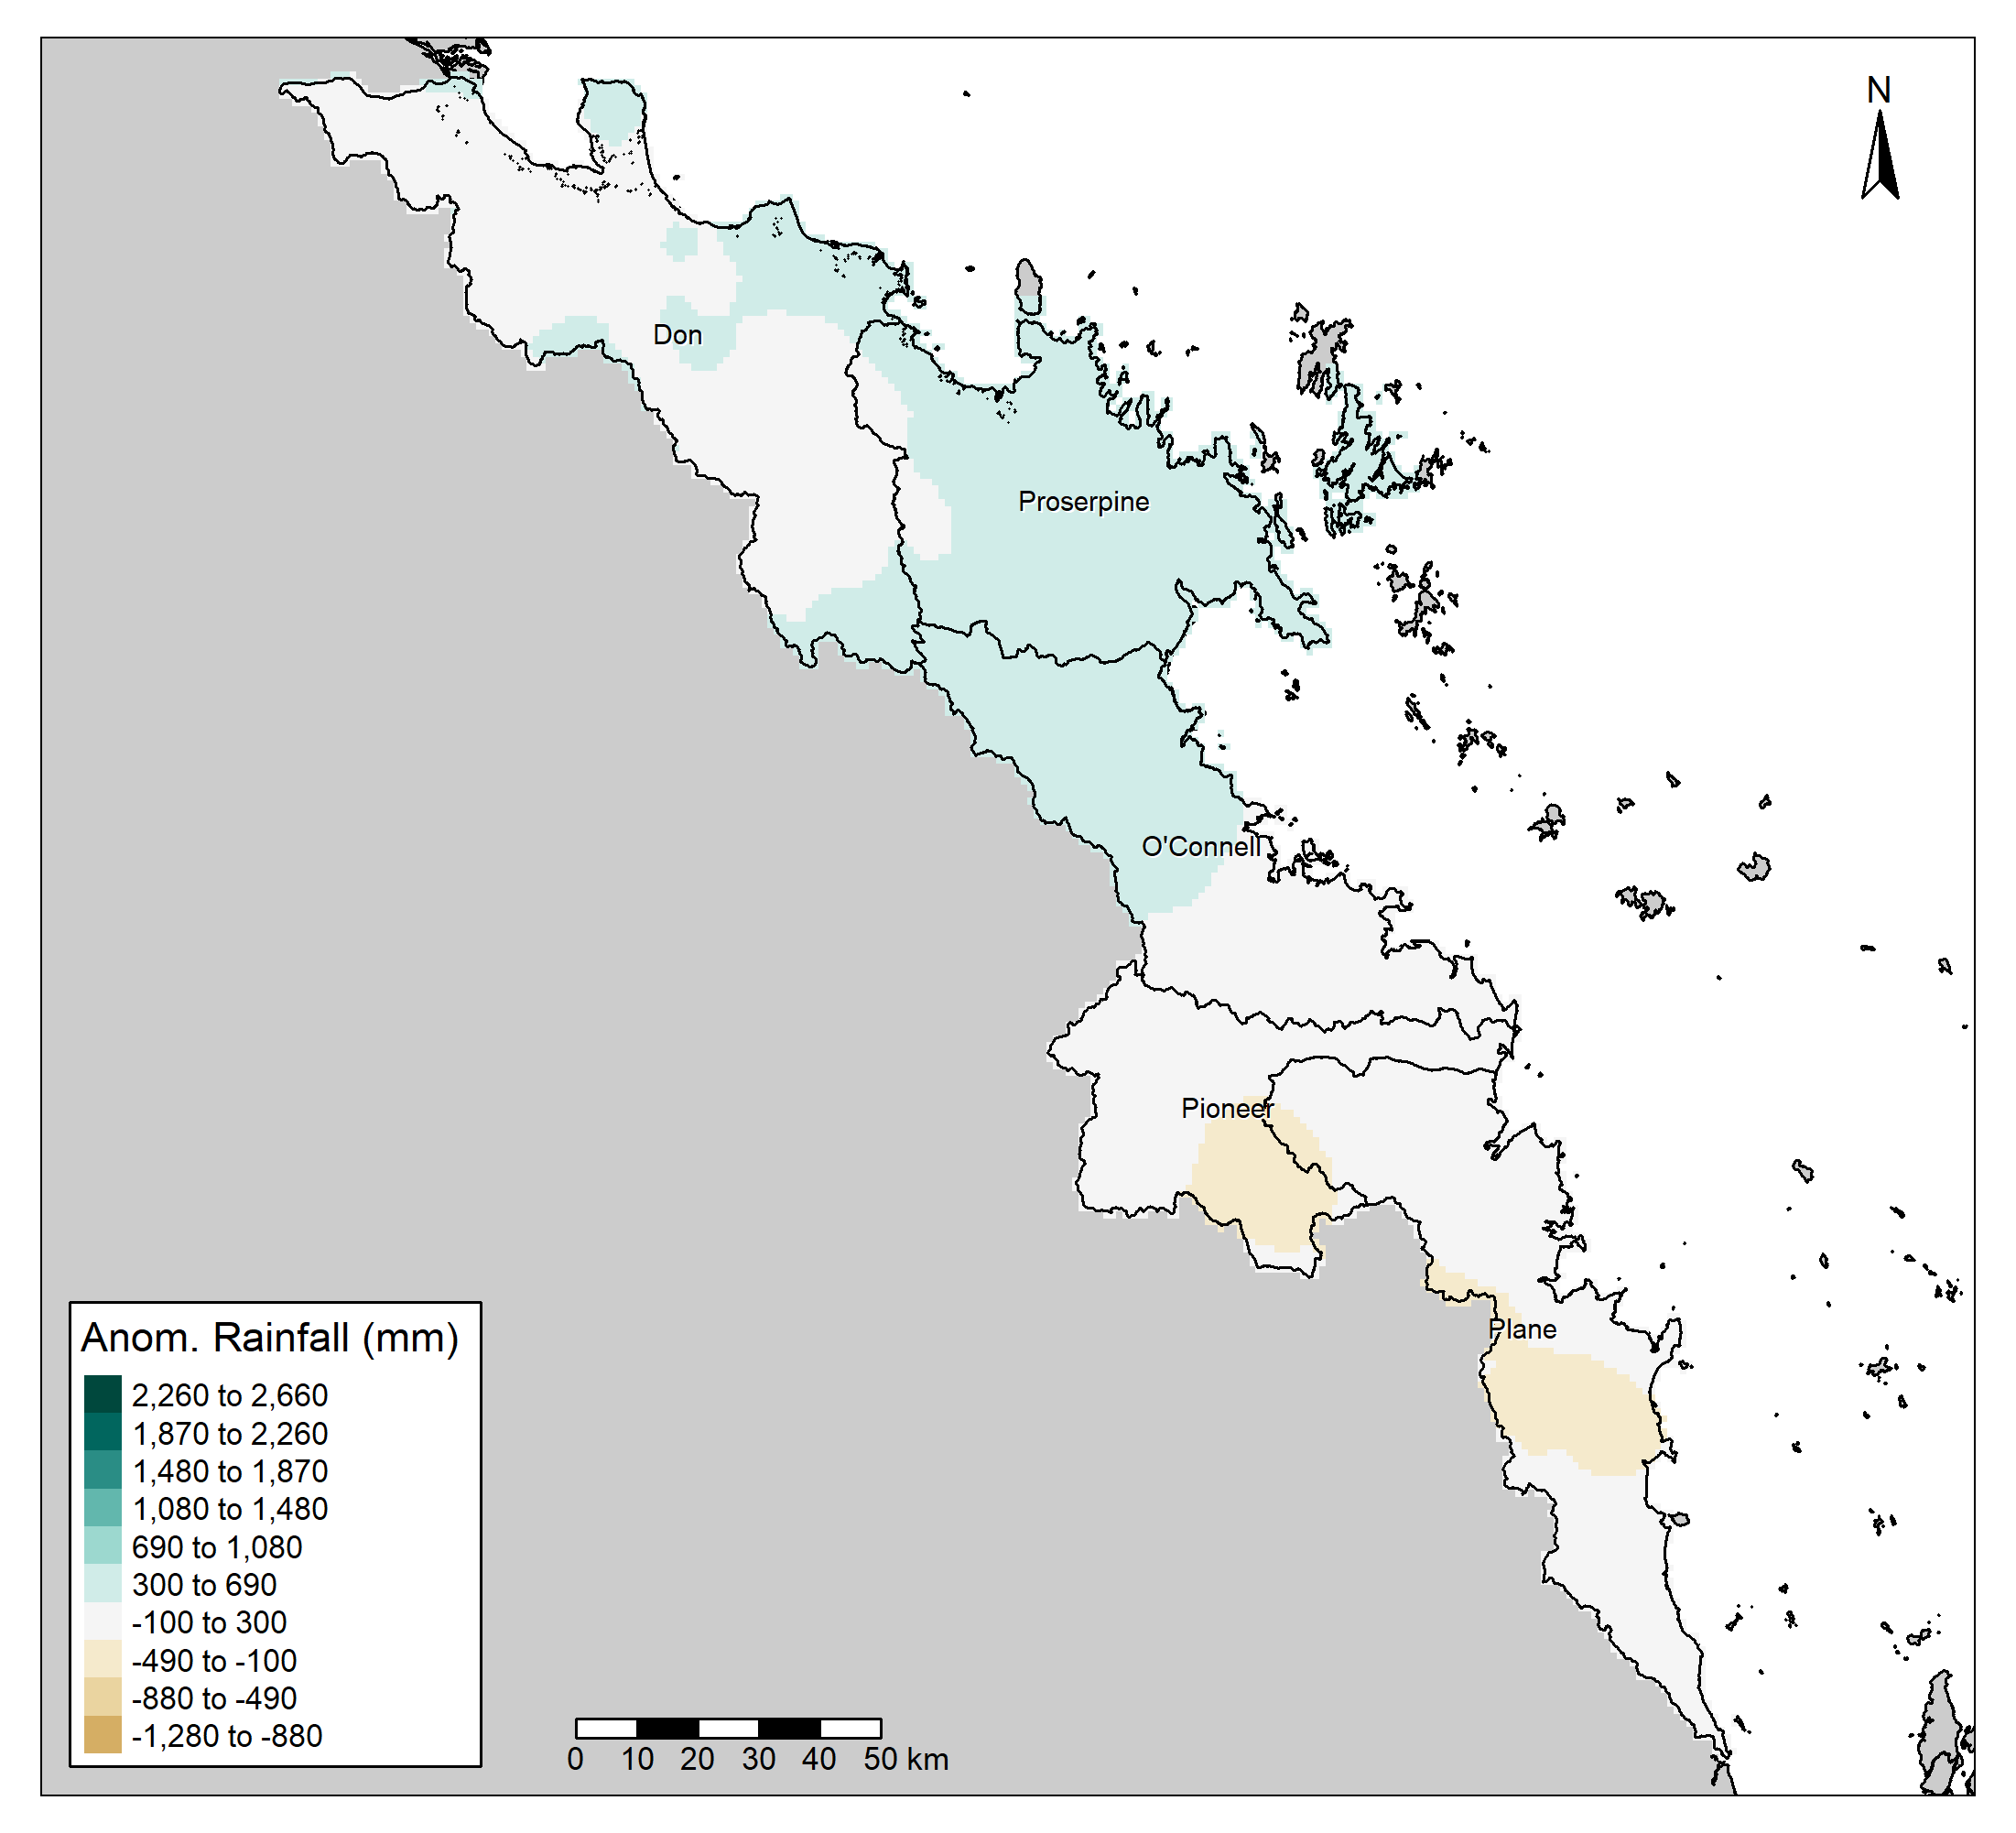
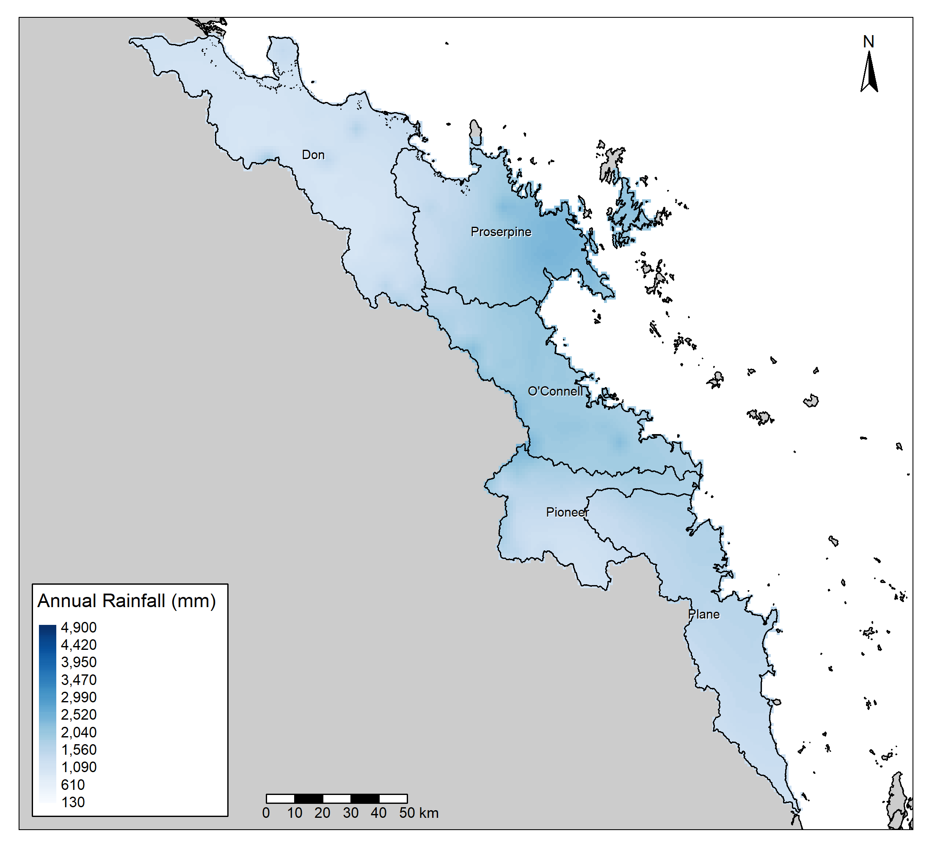
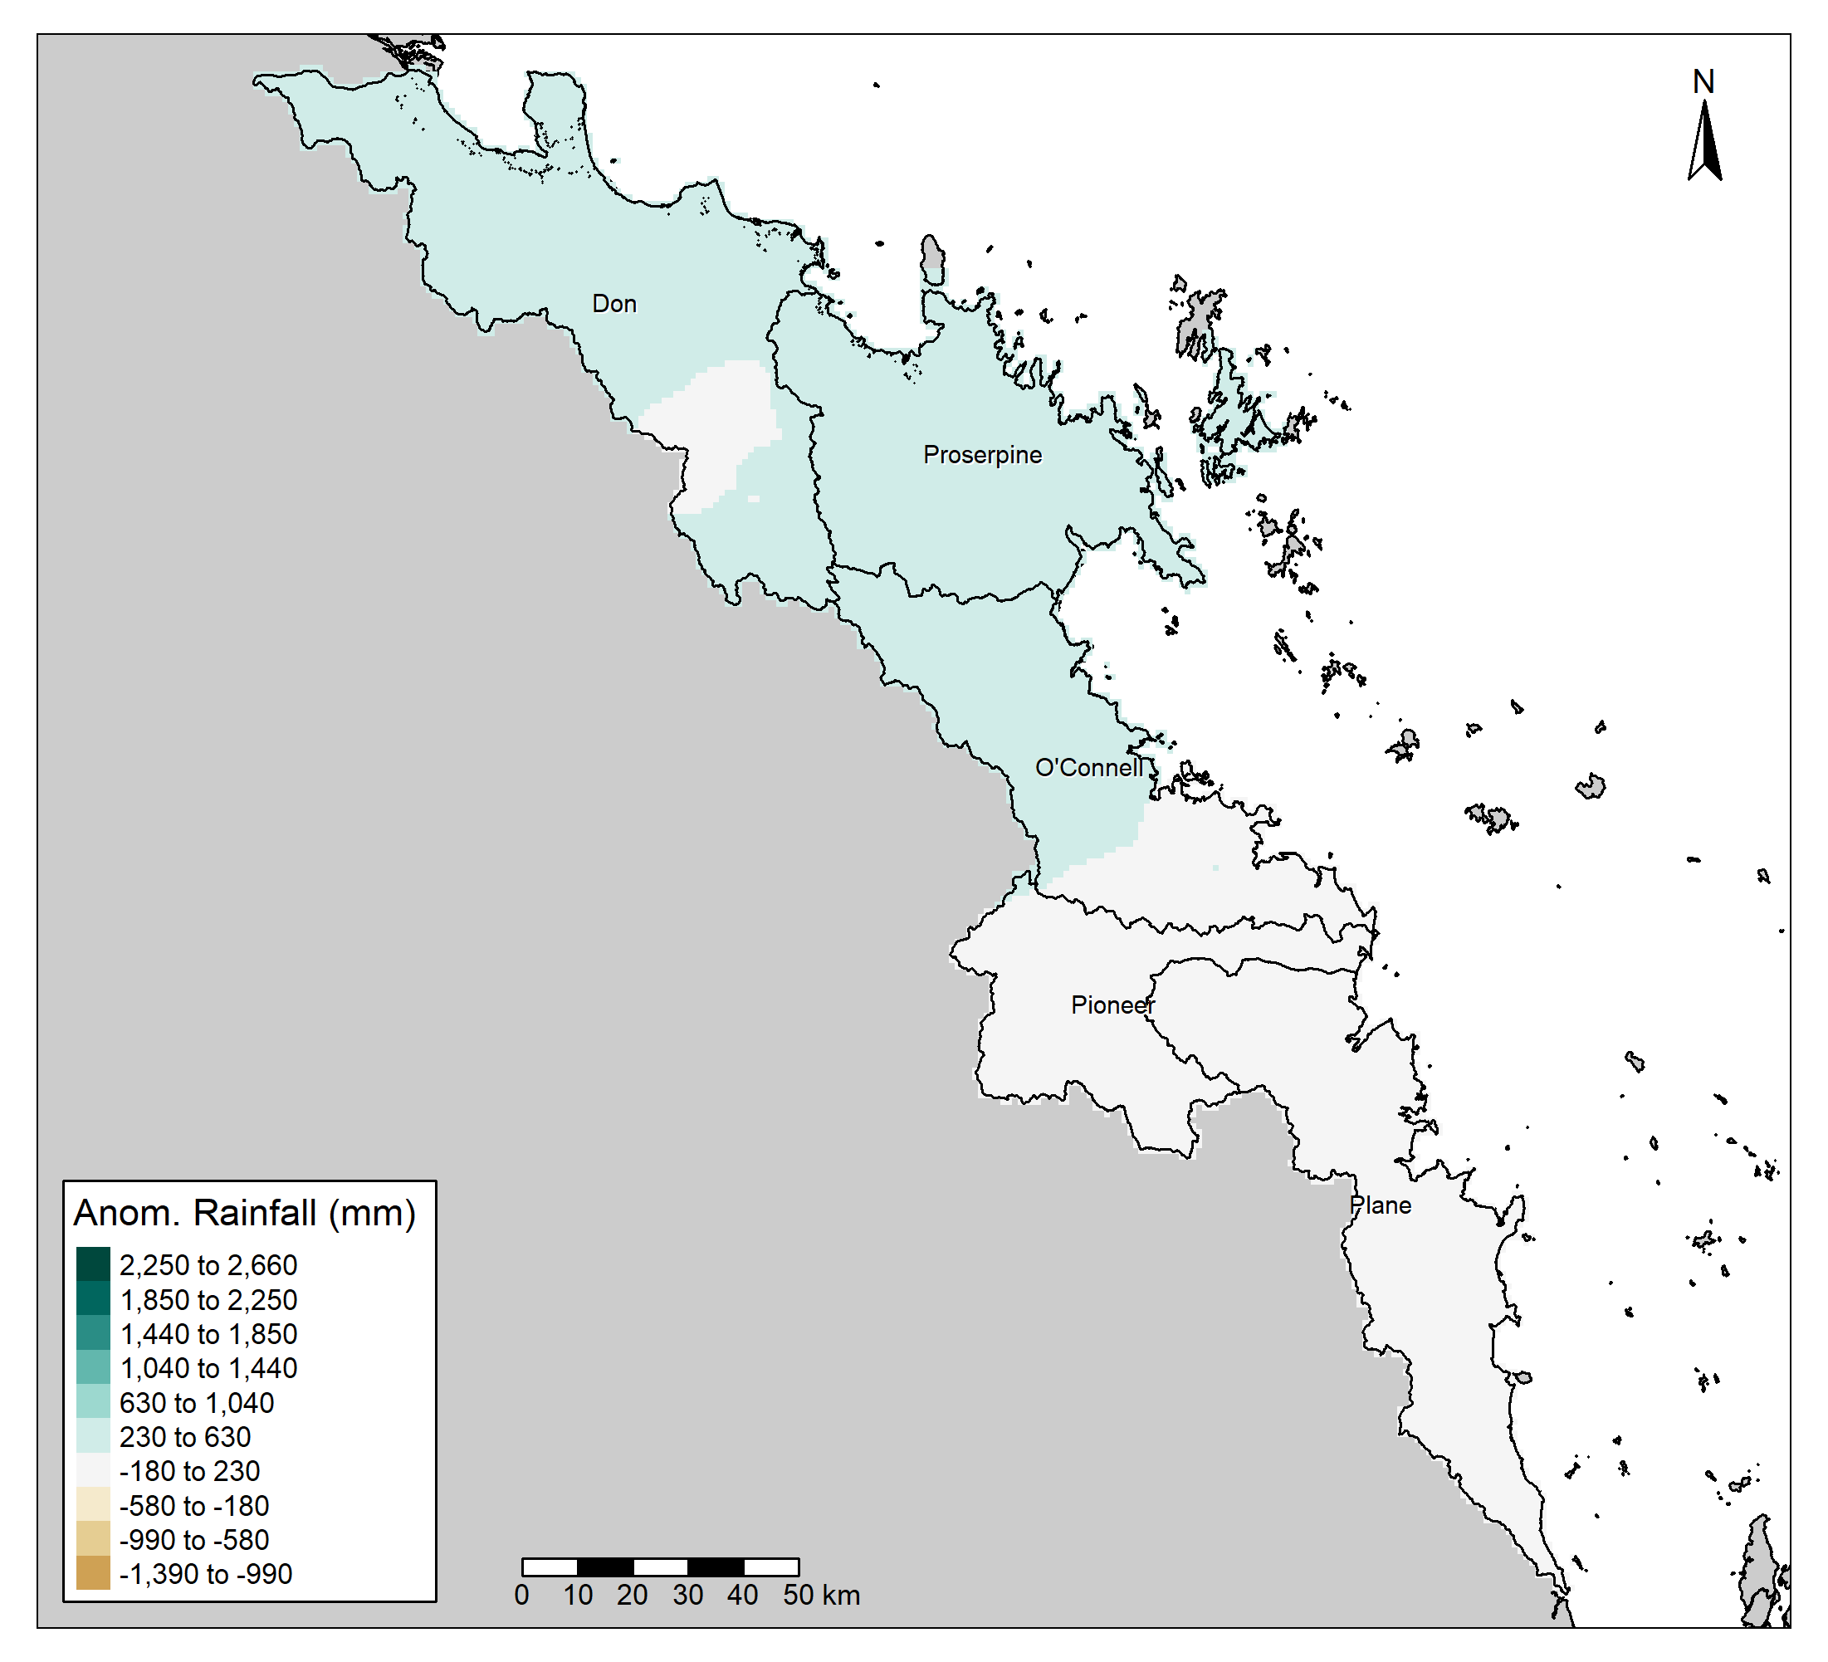
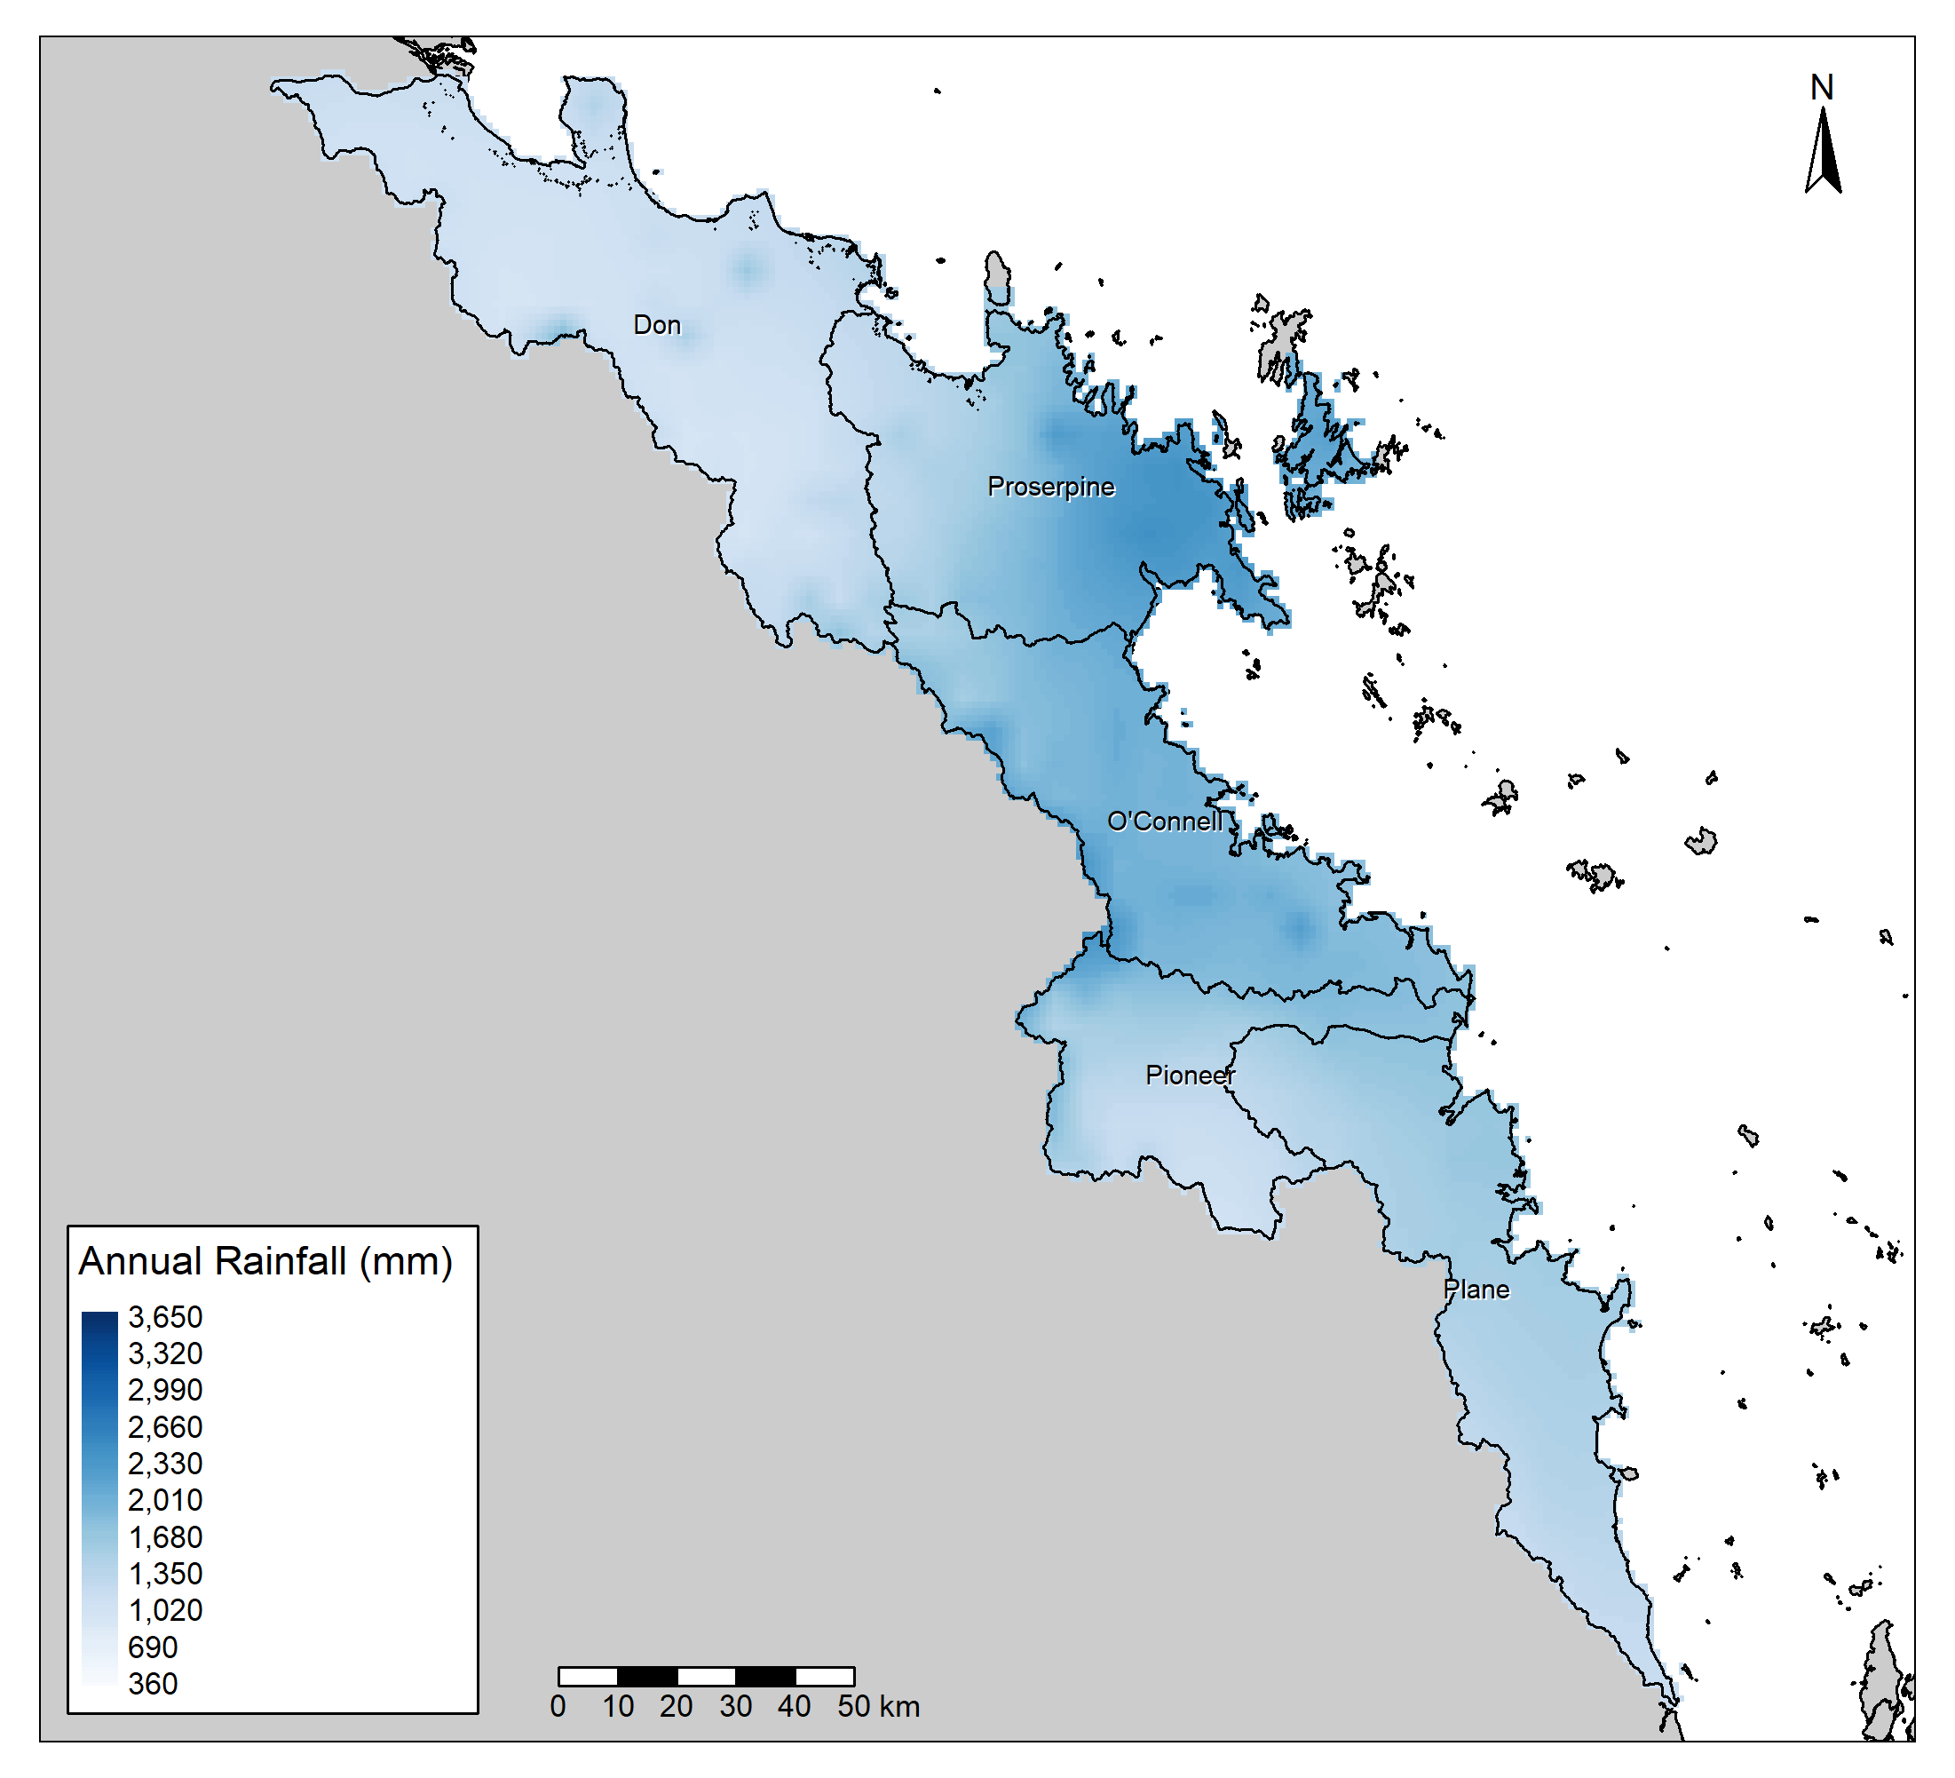

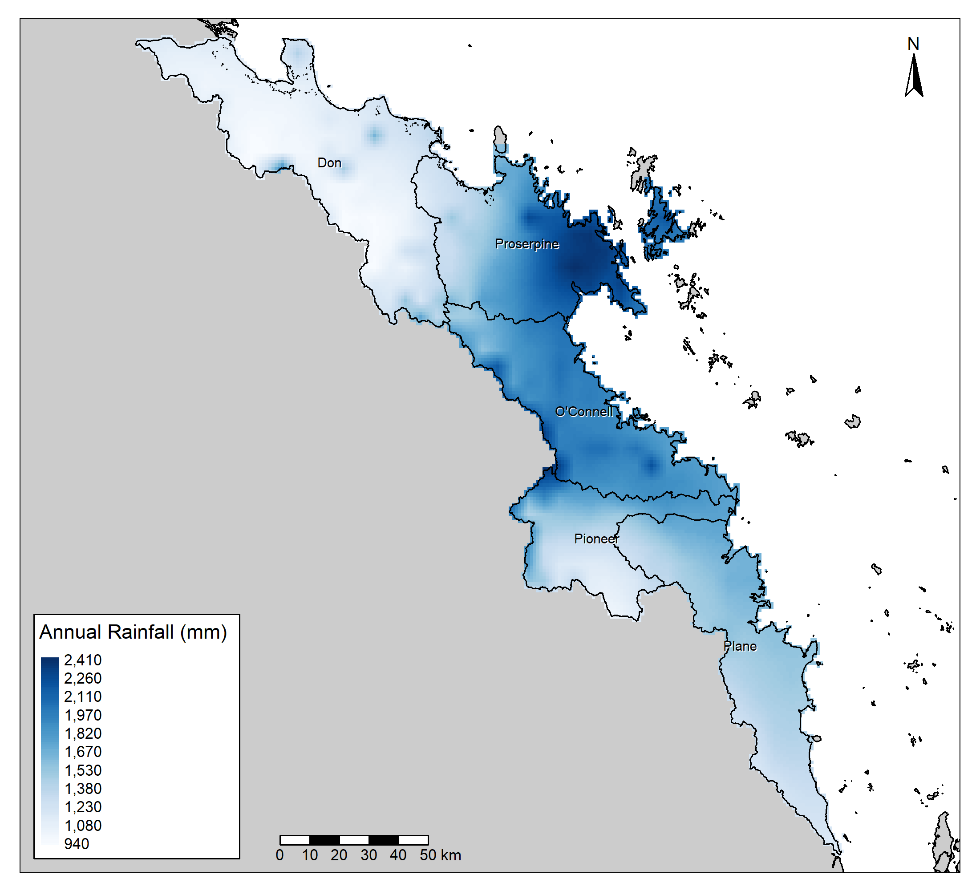
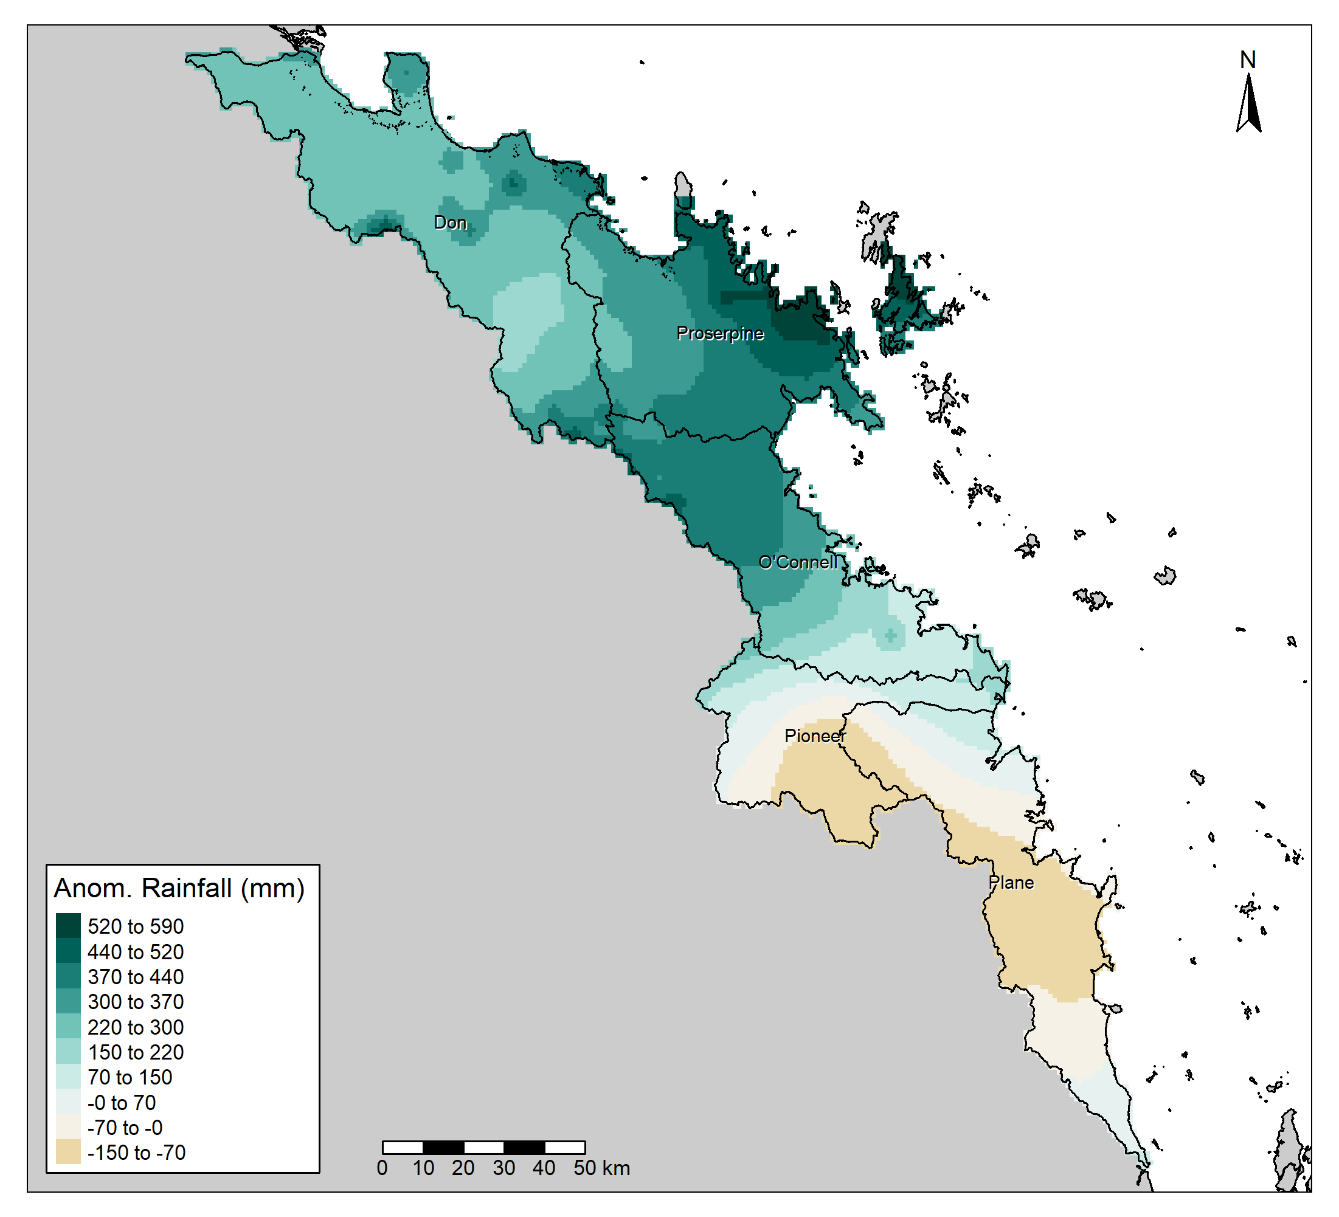
30-year,
Absolute:
All,
Absolute:
30-year,
Mean:
All, Mean:
Current Year:

Slide 8
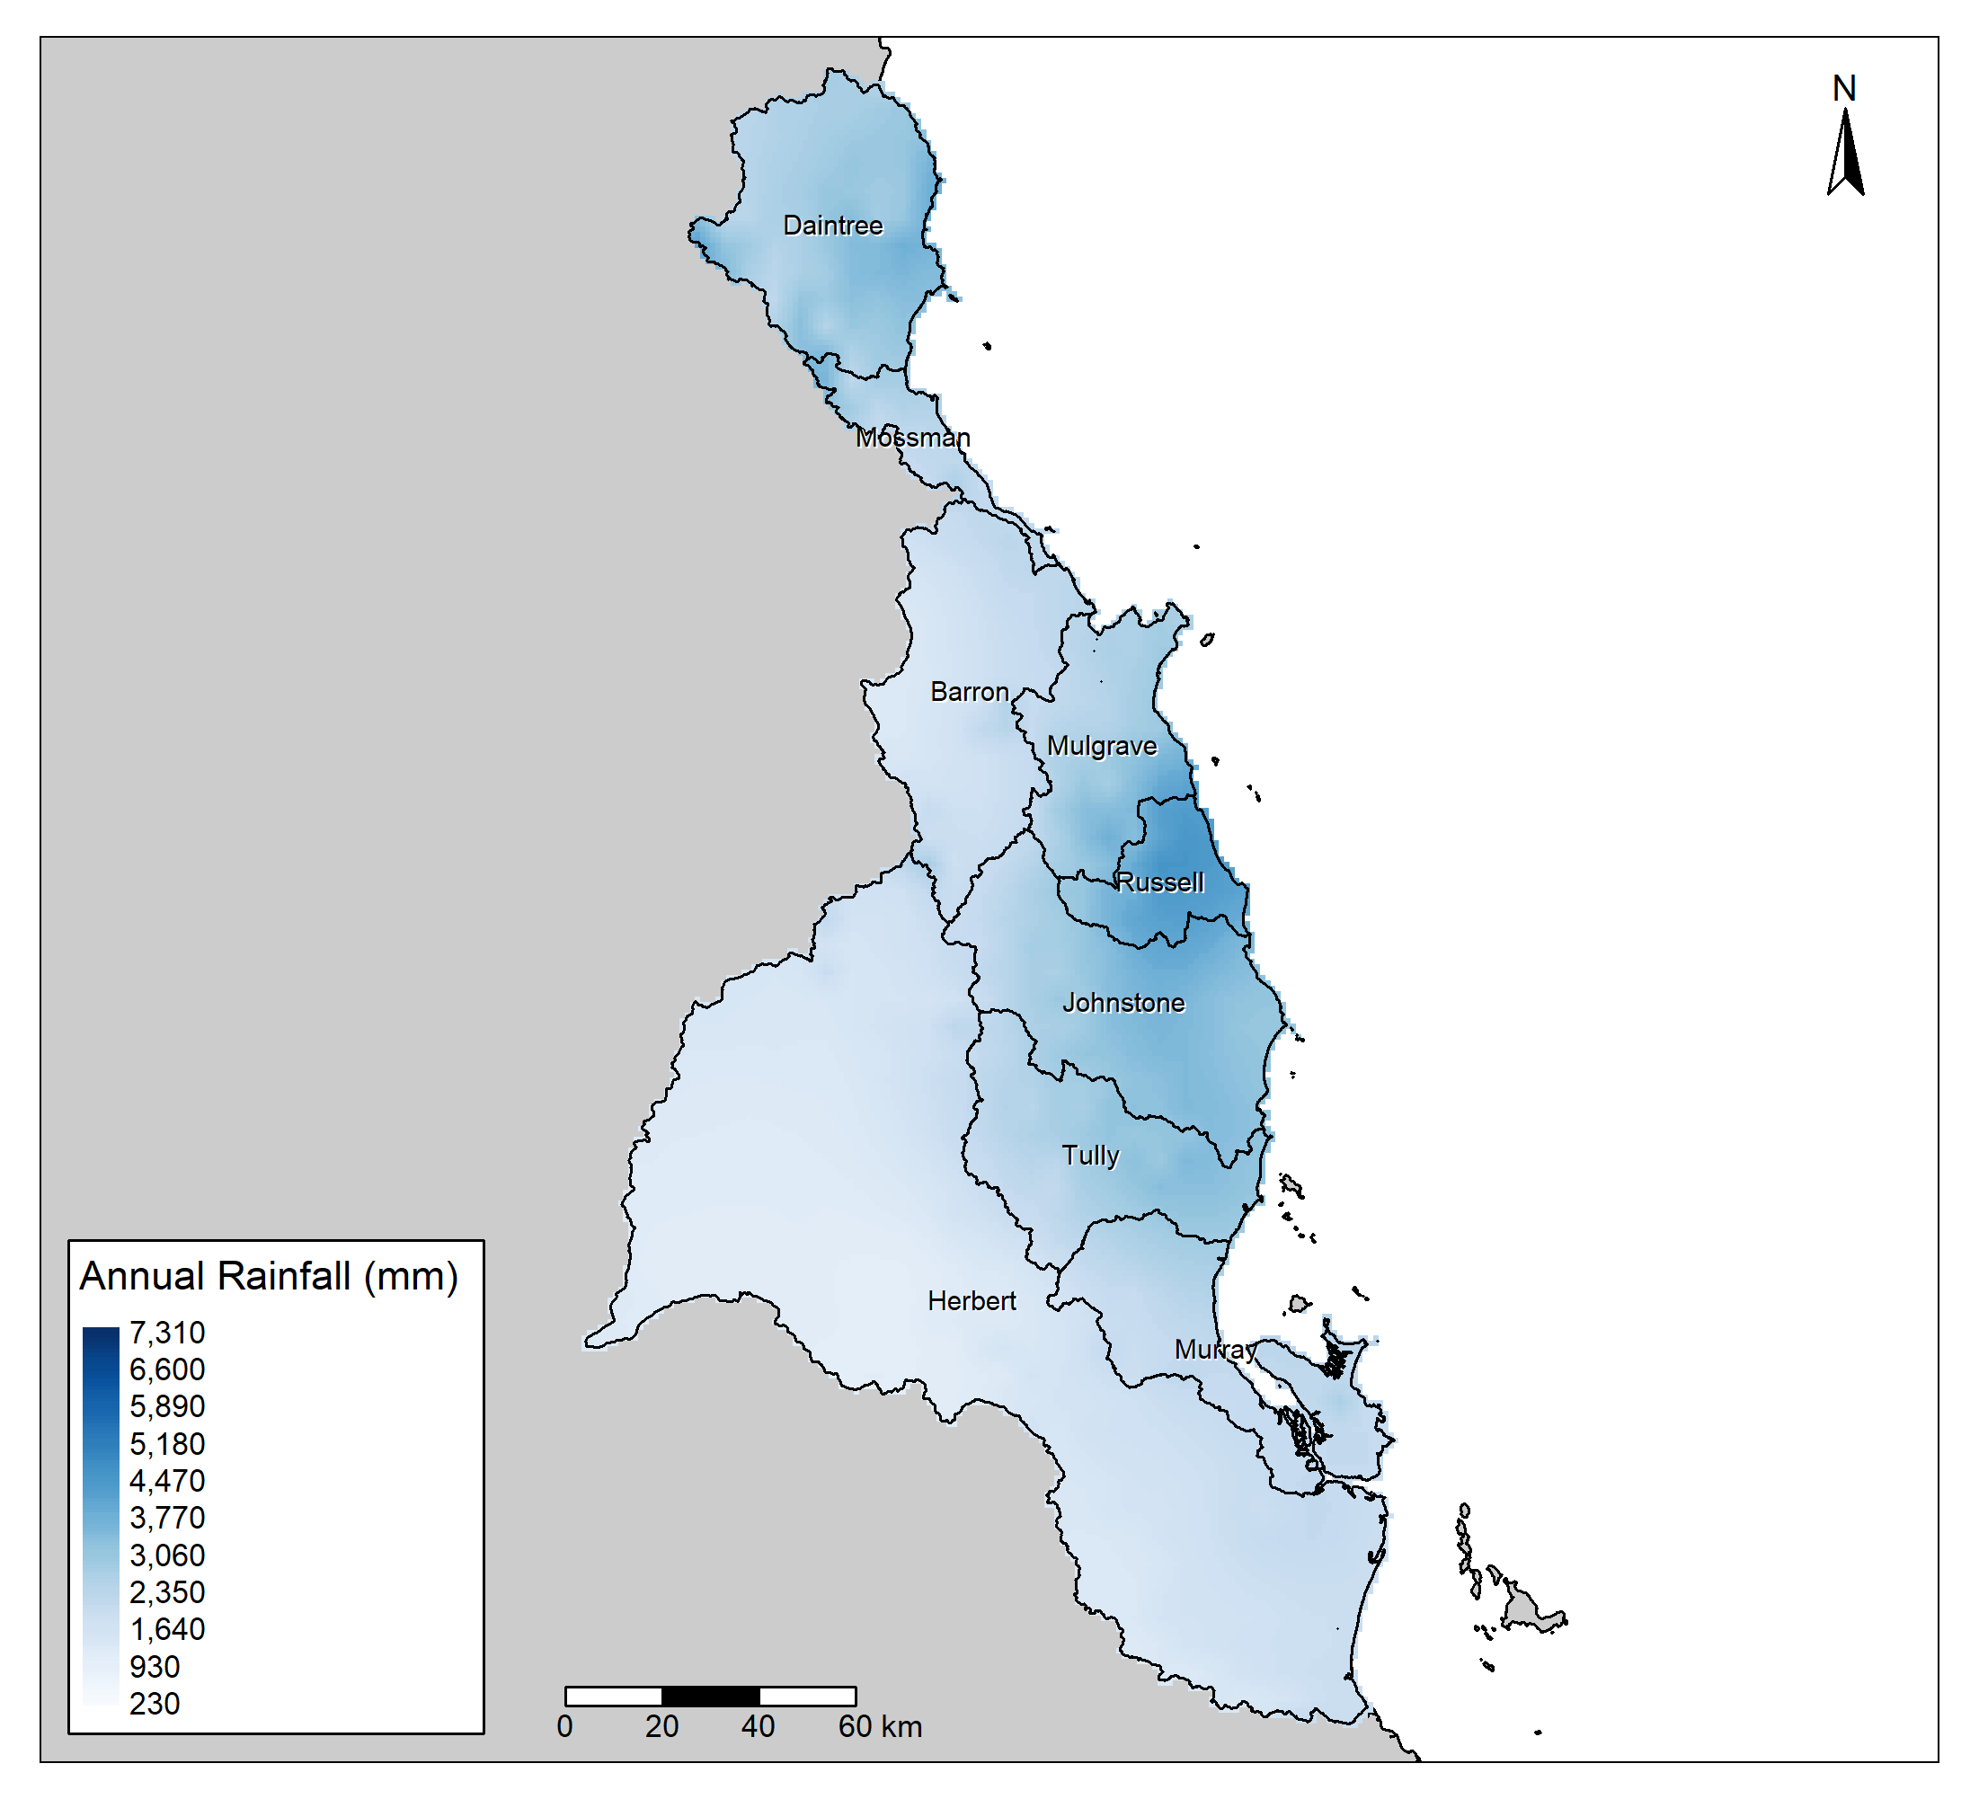
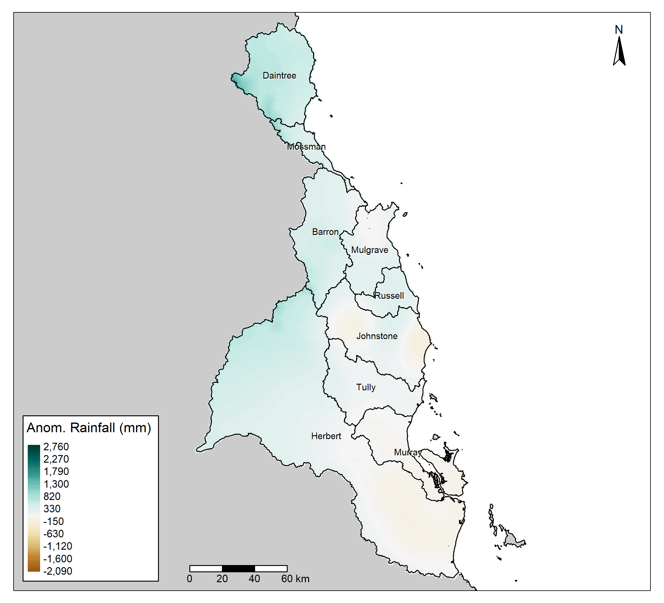


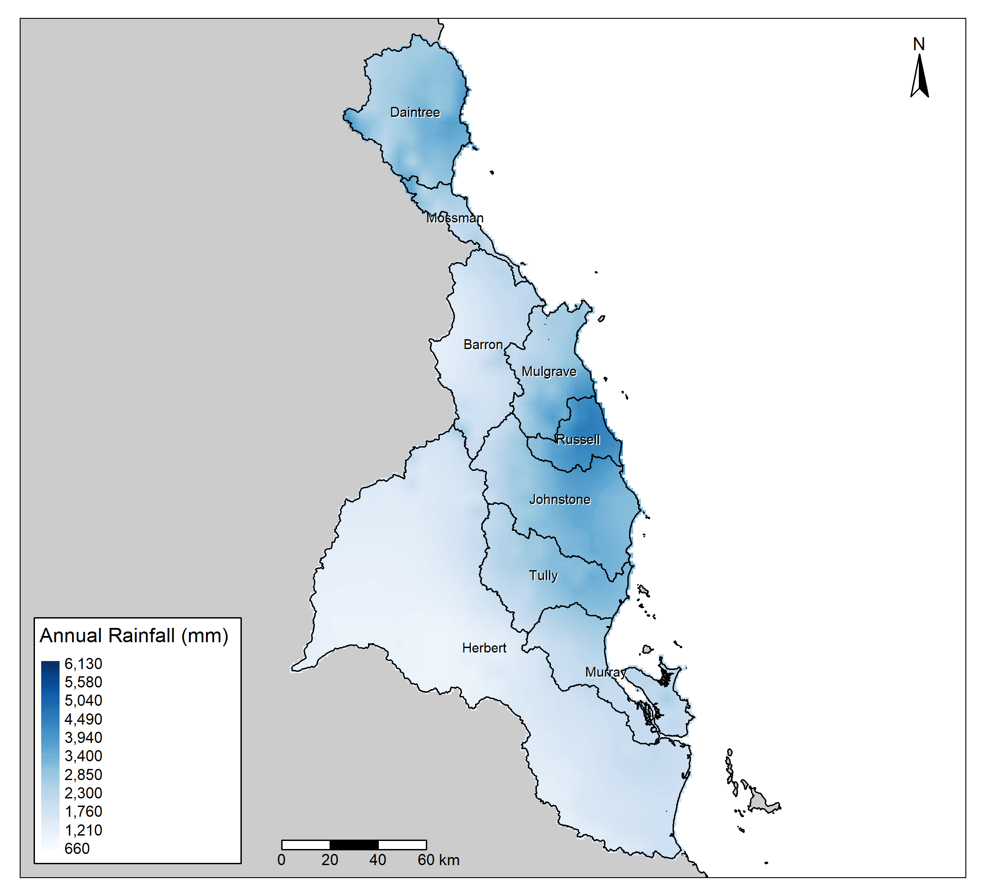
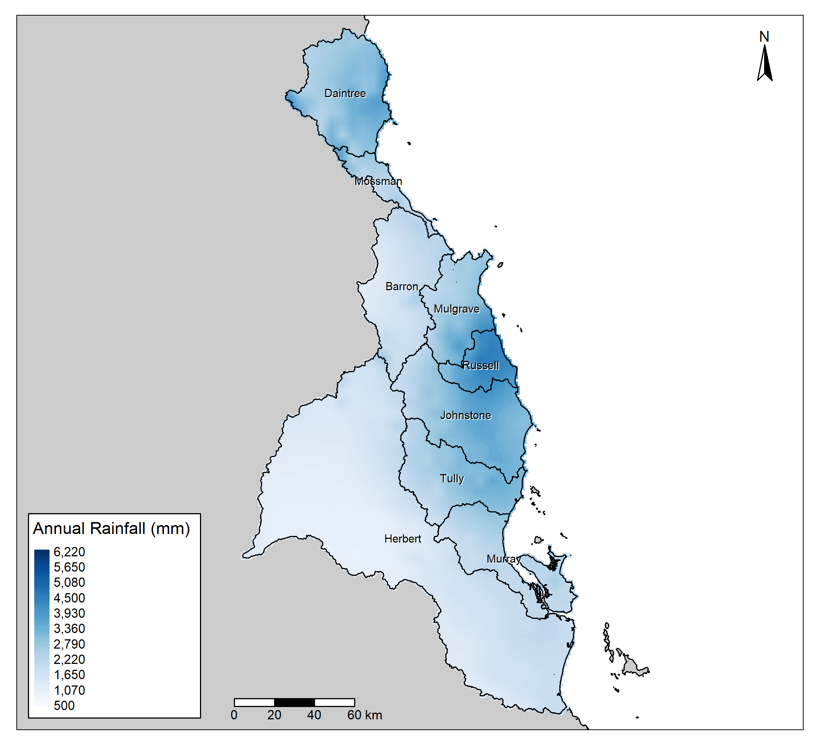
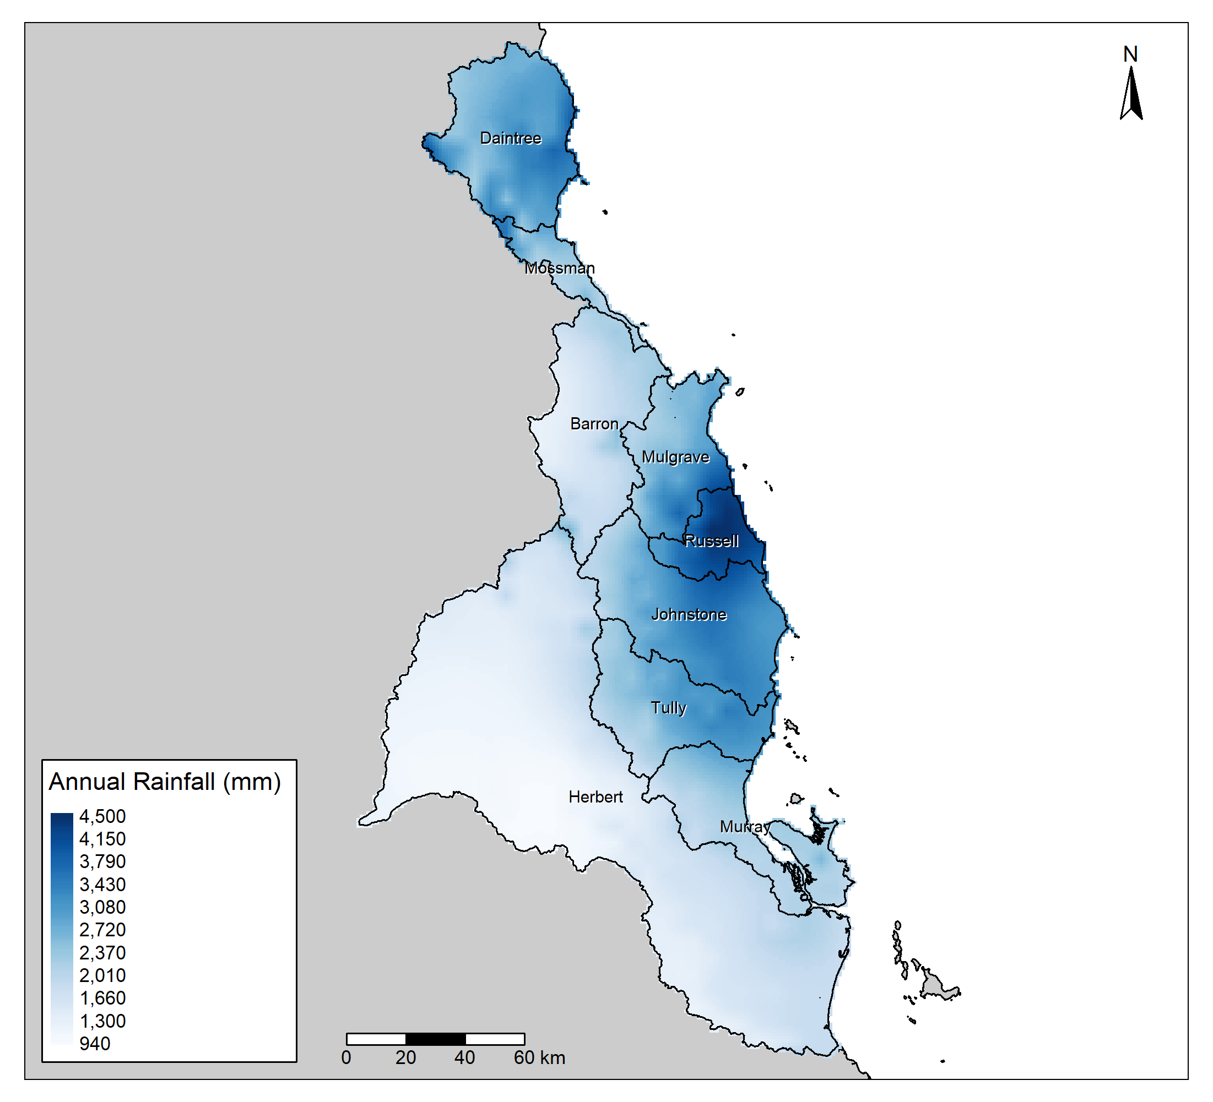
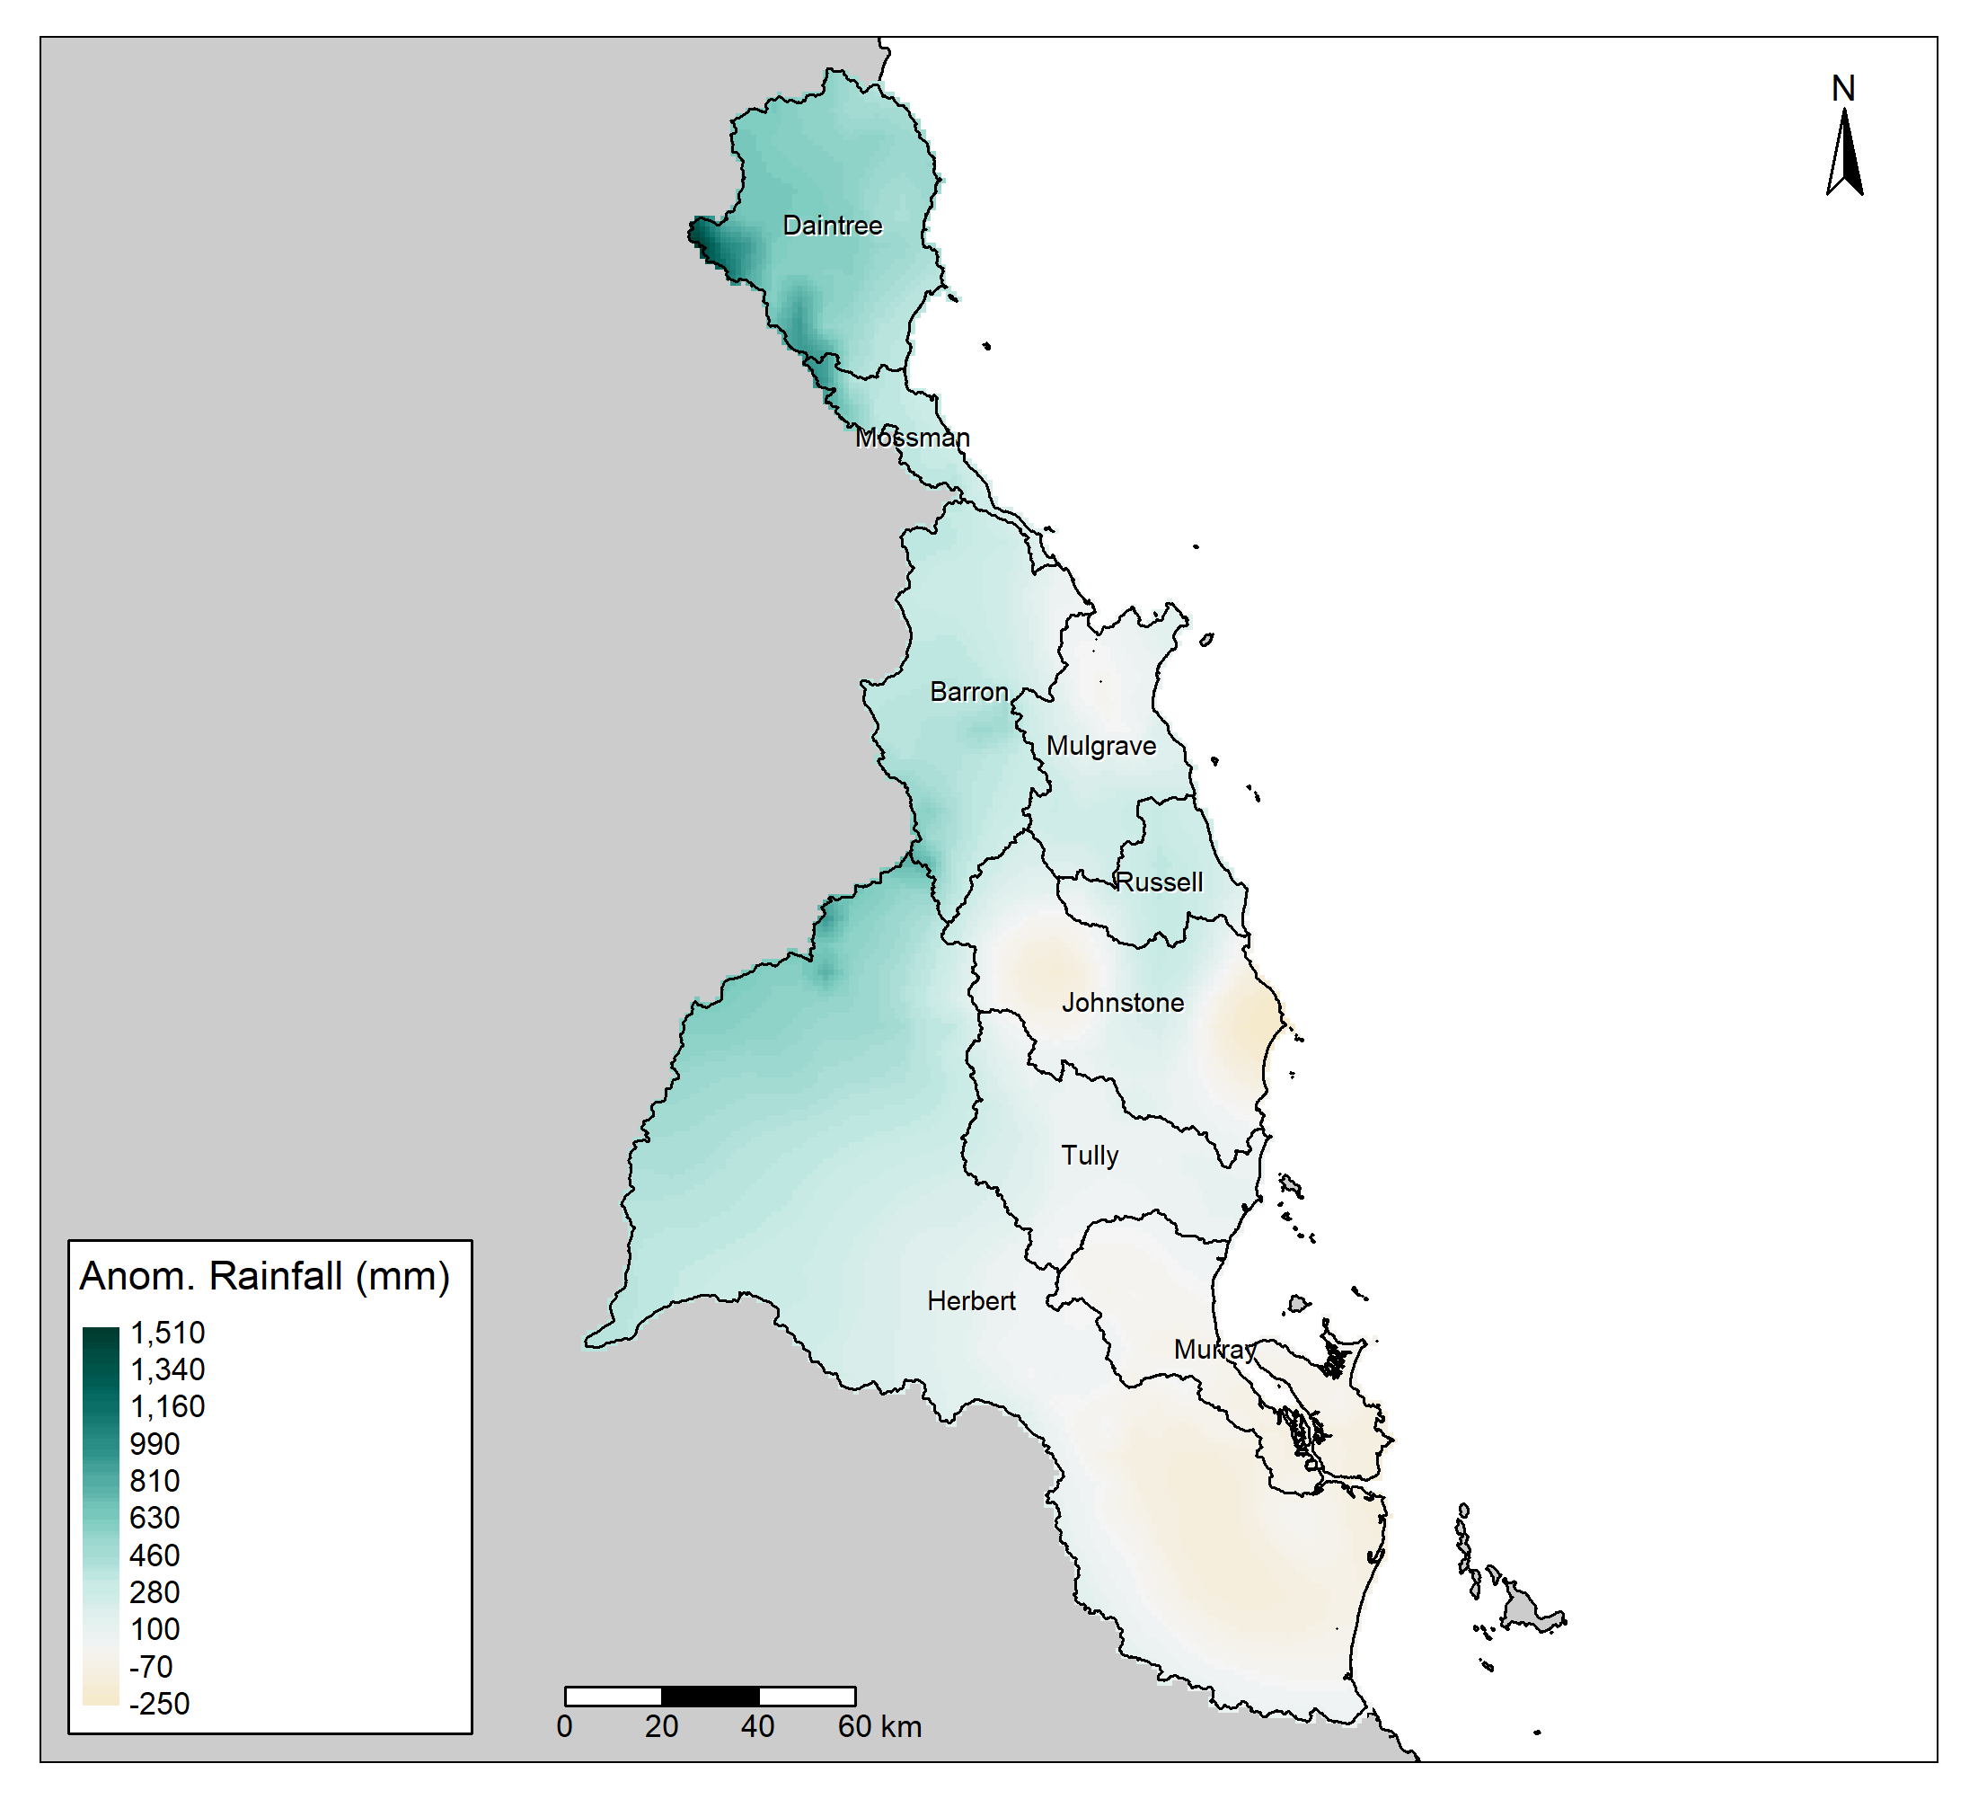
30-year,
Absolute:
All,
Absolute:
30-year,
Mean:
All, Mean:
Current Year:

Slide 9
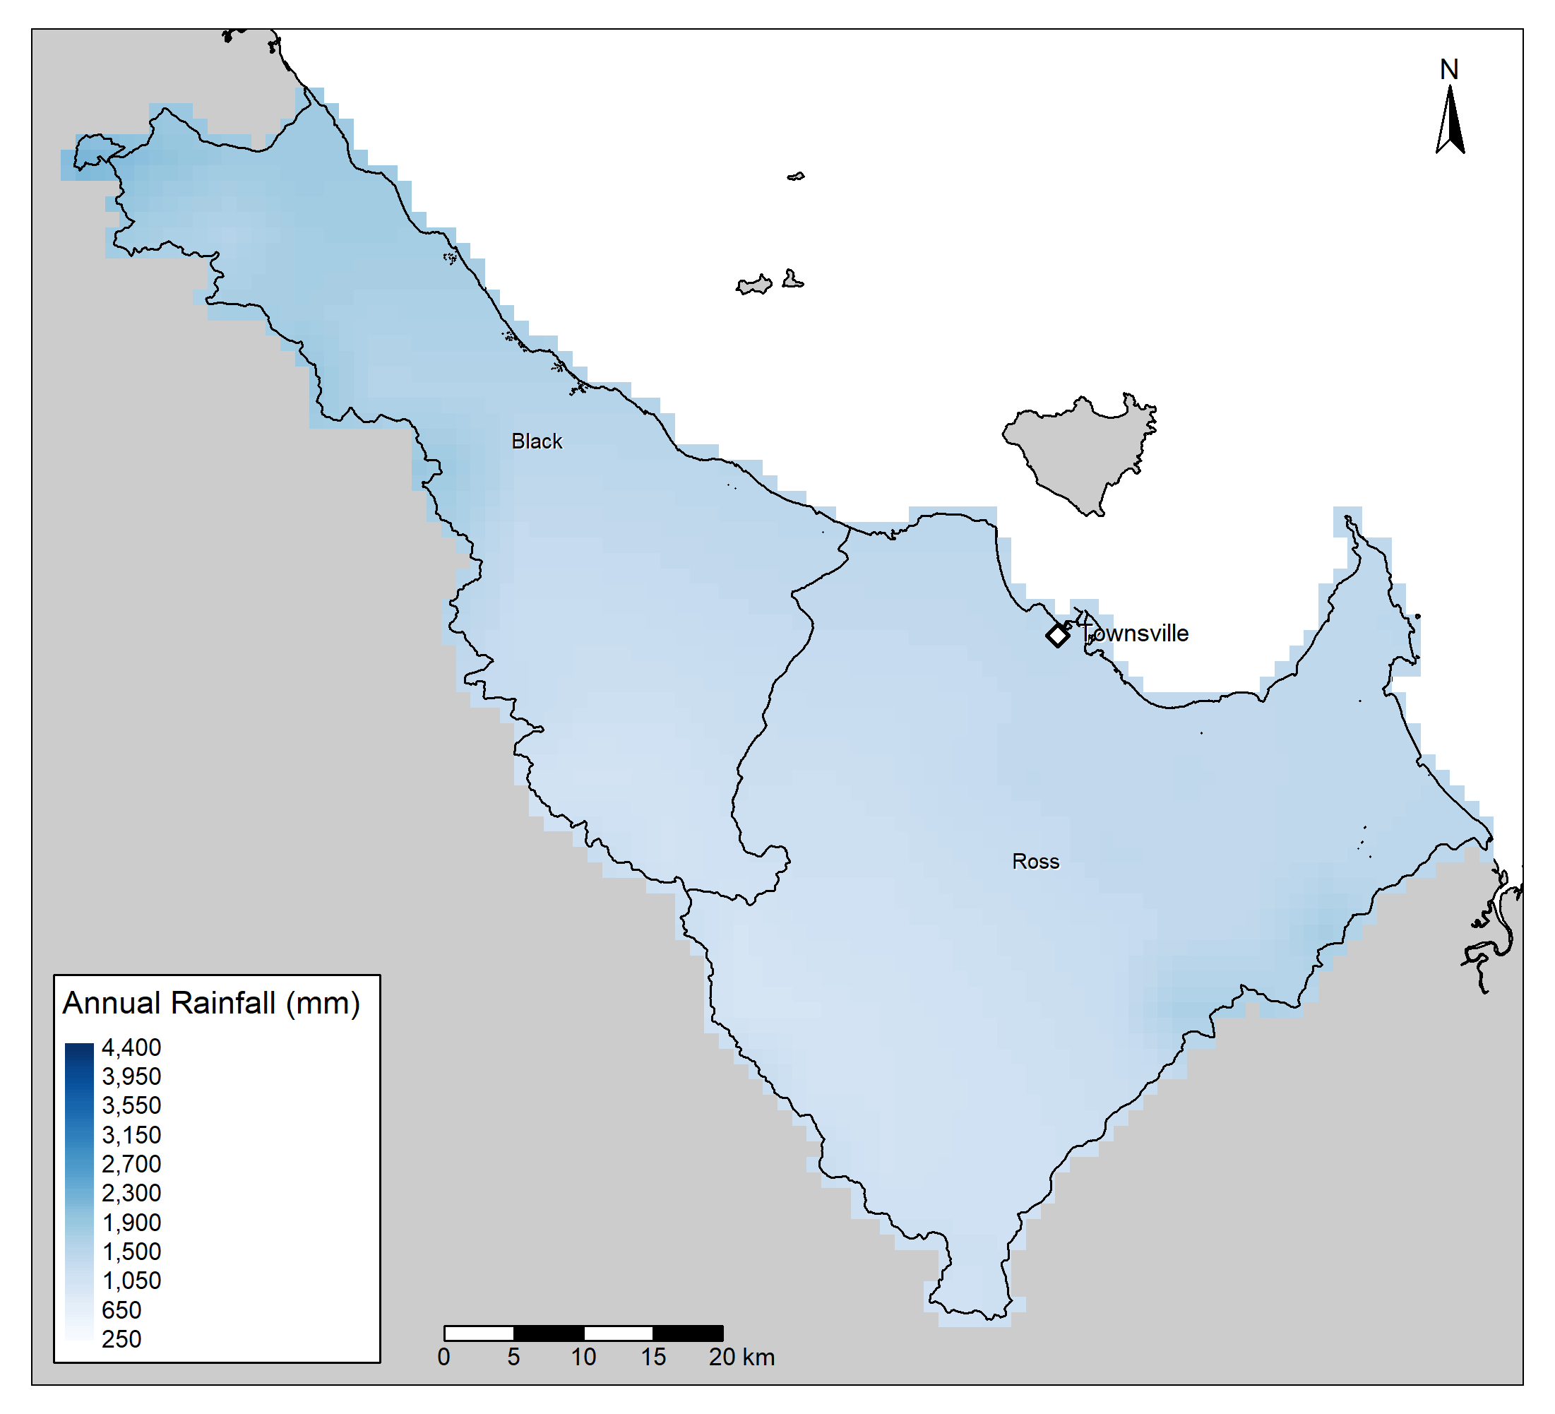
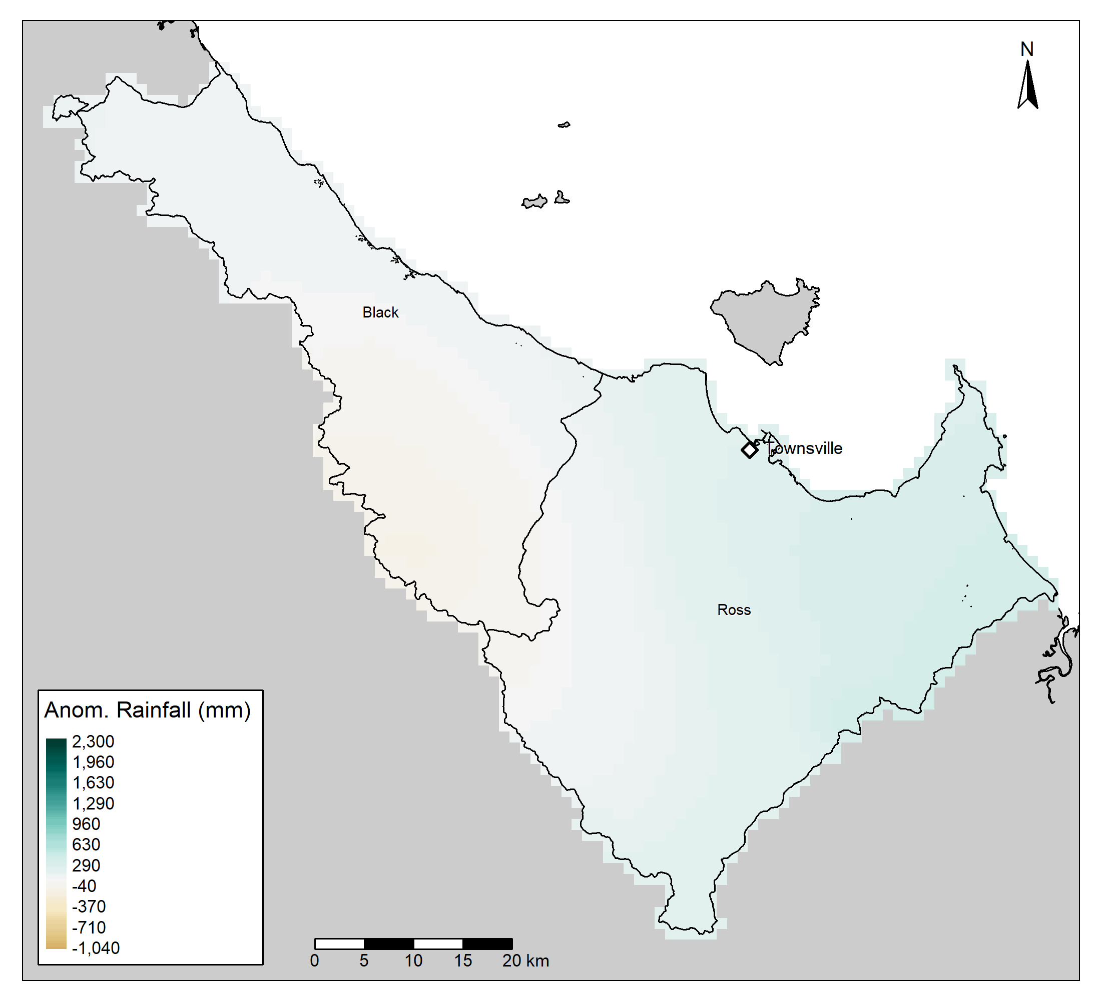
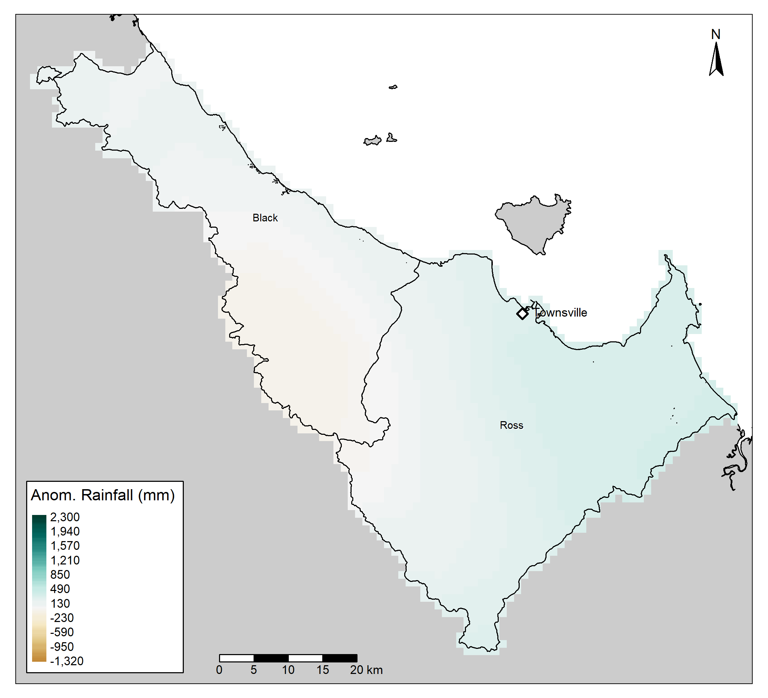
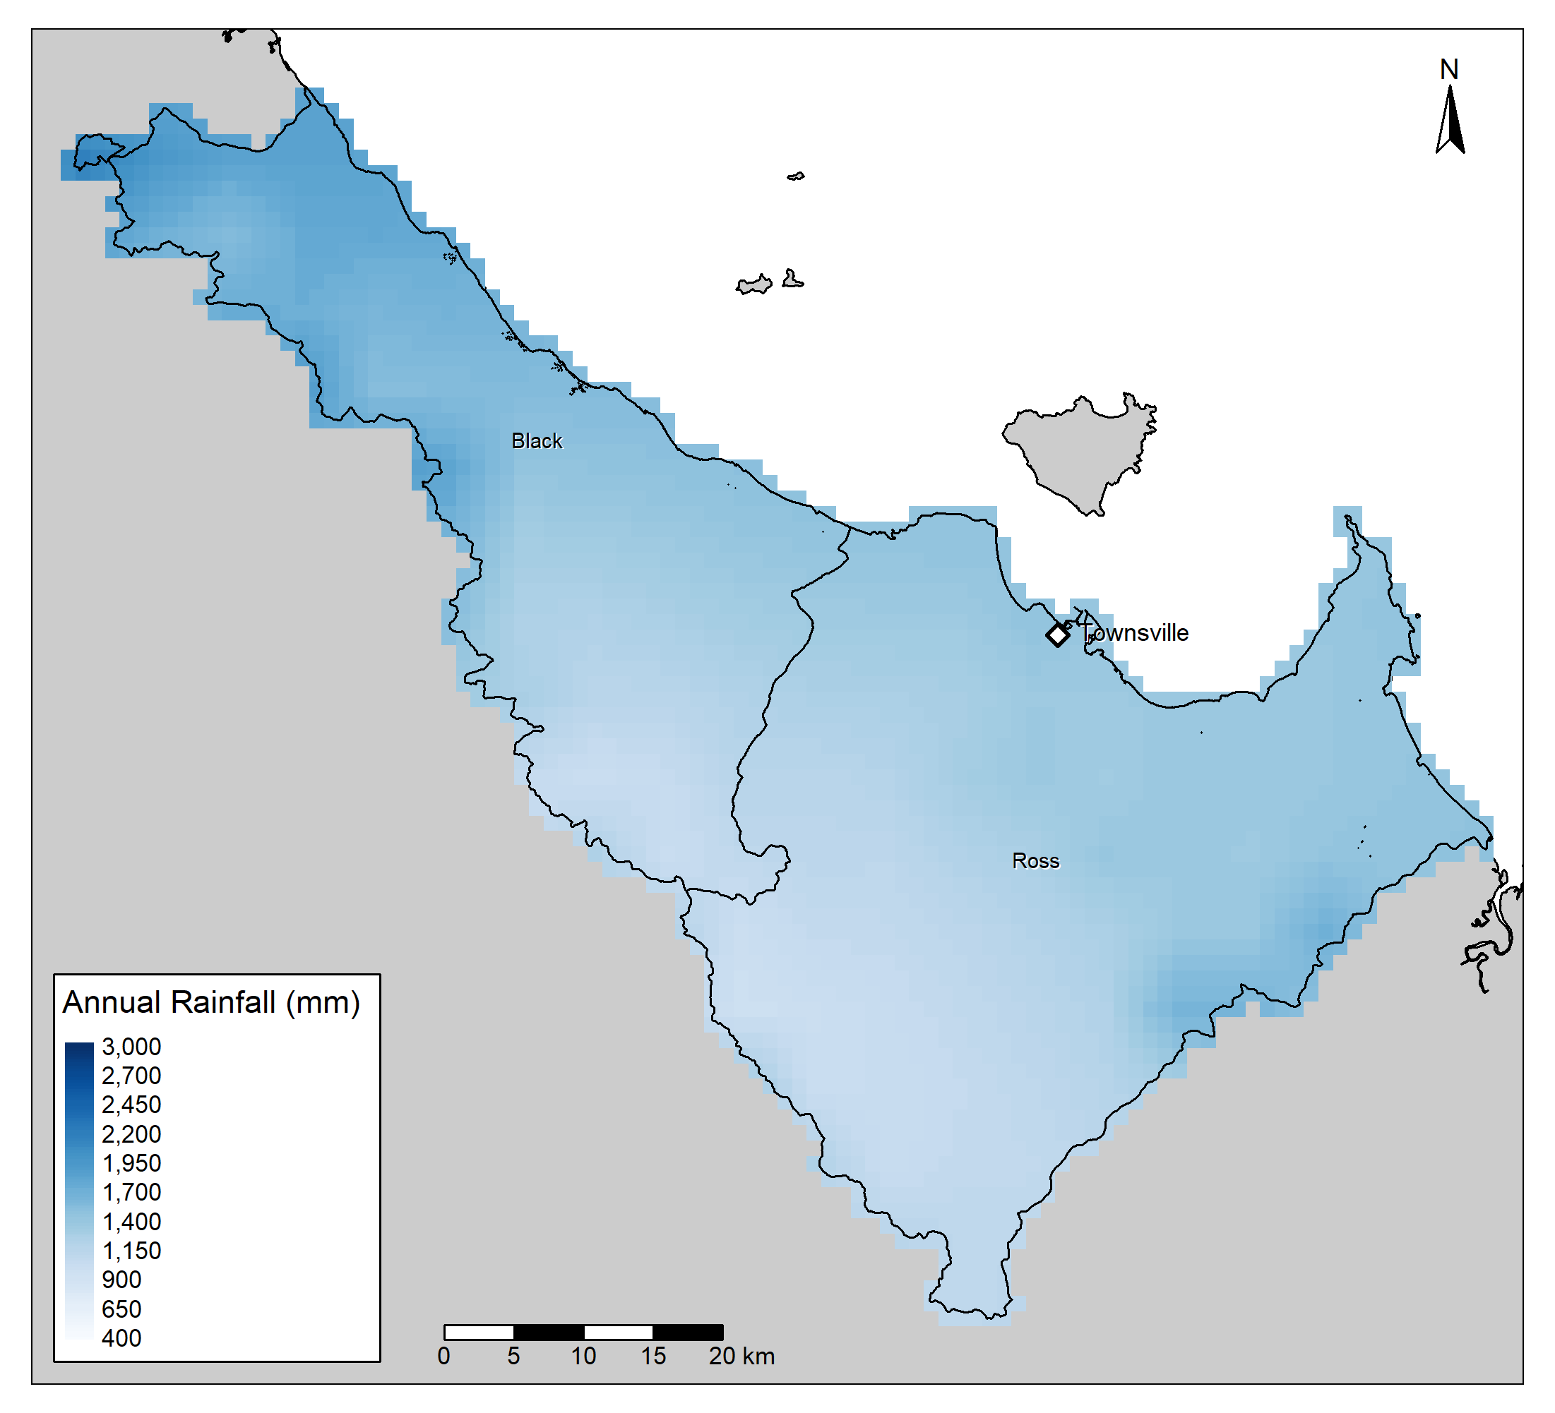
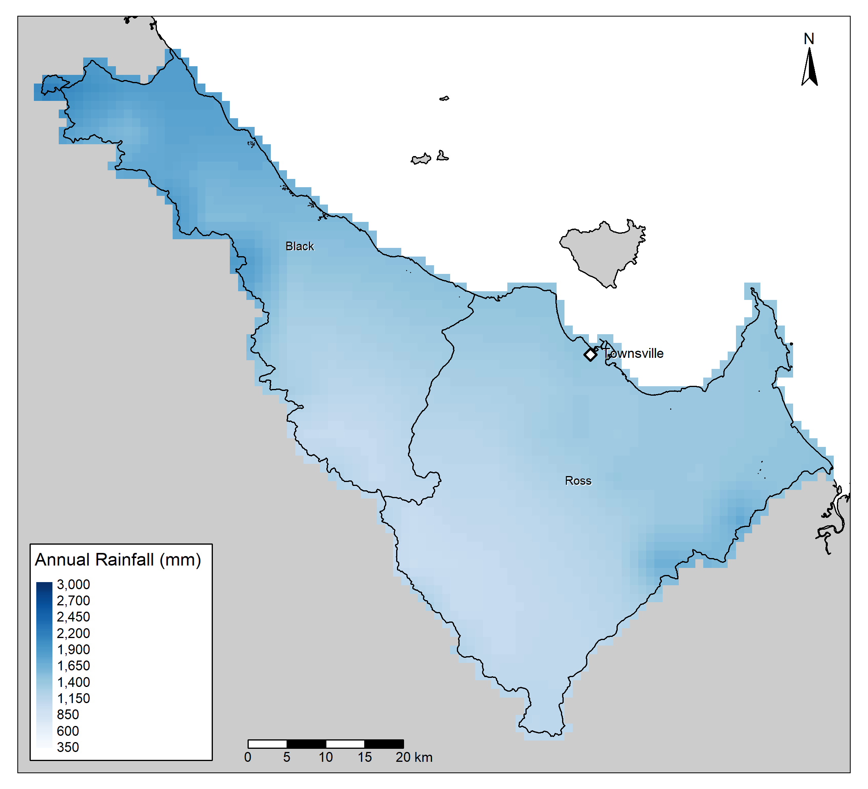
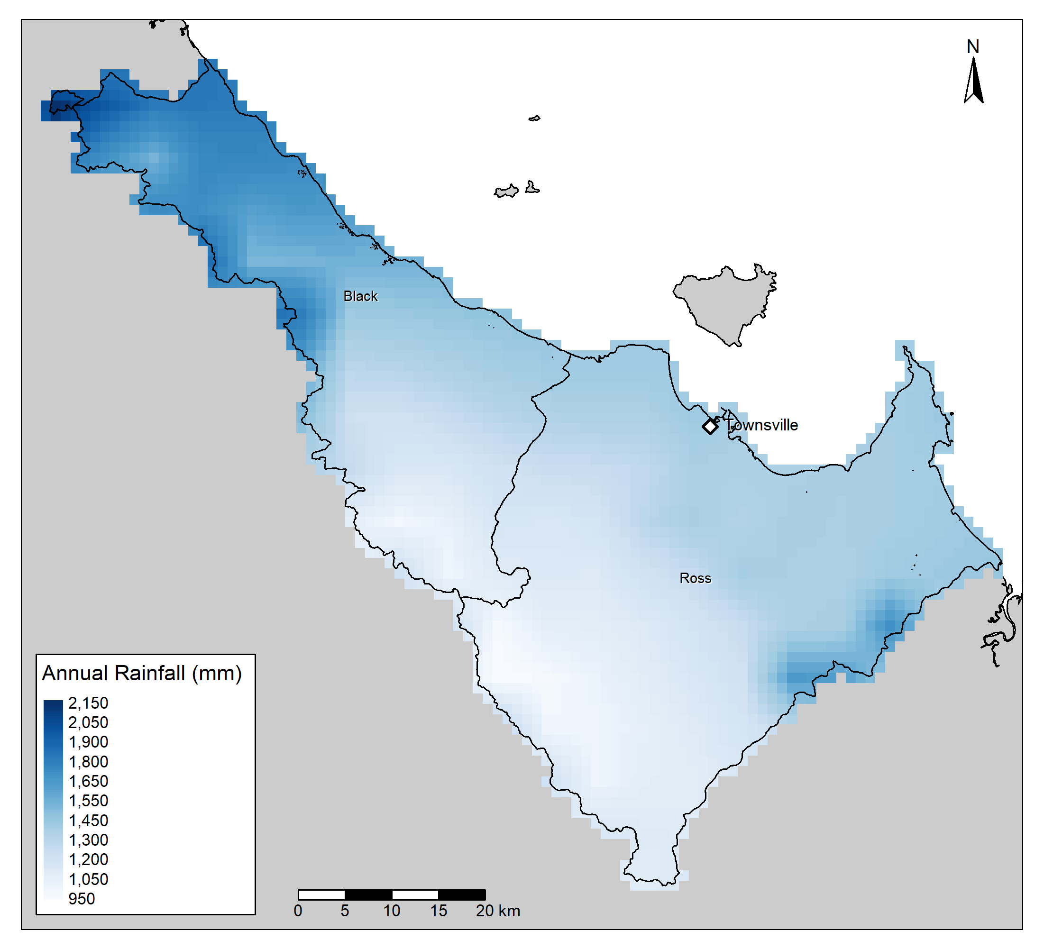
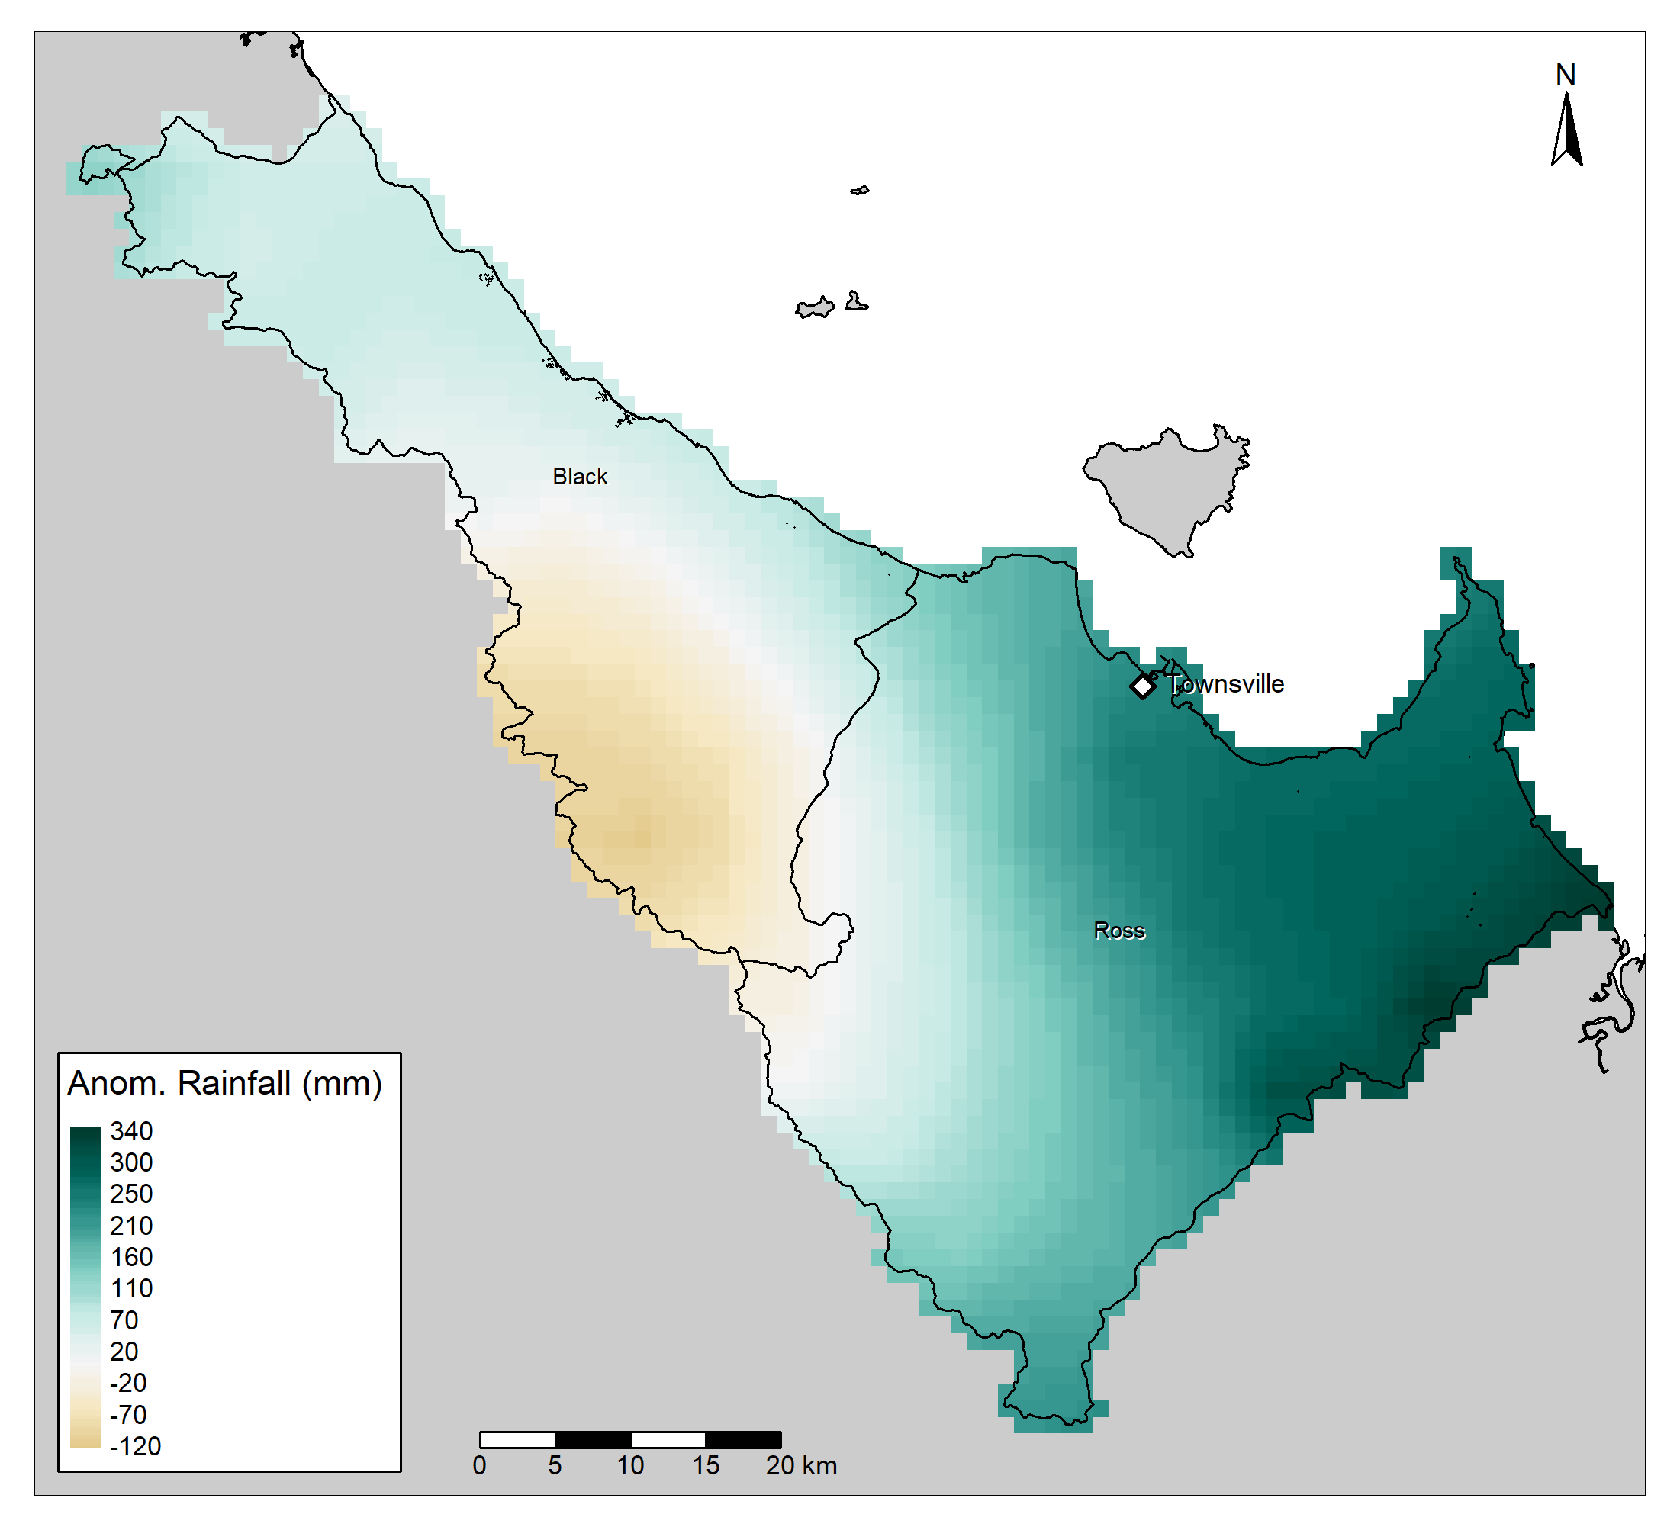
30-year,
Absolute:
All,
Absolute:
30-year,
Mean:
All, Mean:
Current Year:

Slide 10
Continuous Vs Binned

Slide 11
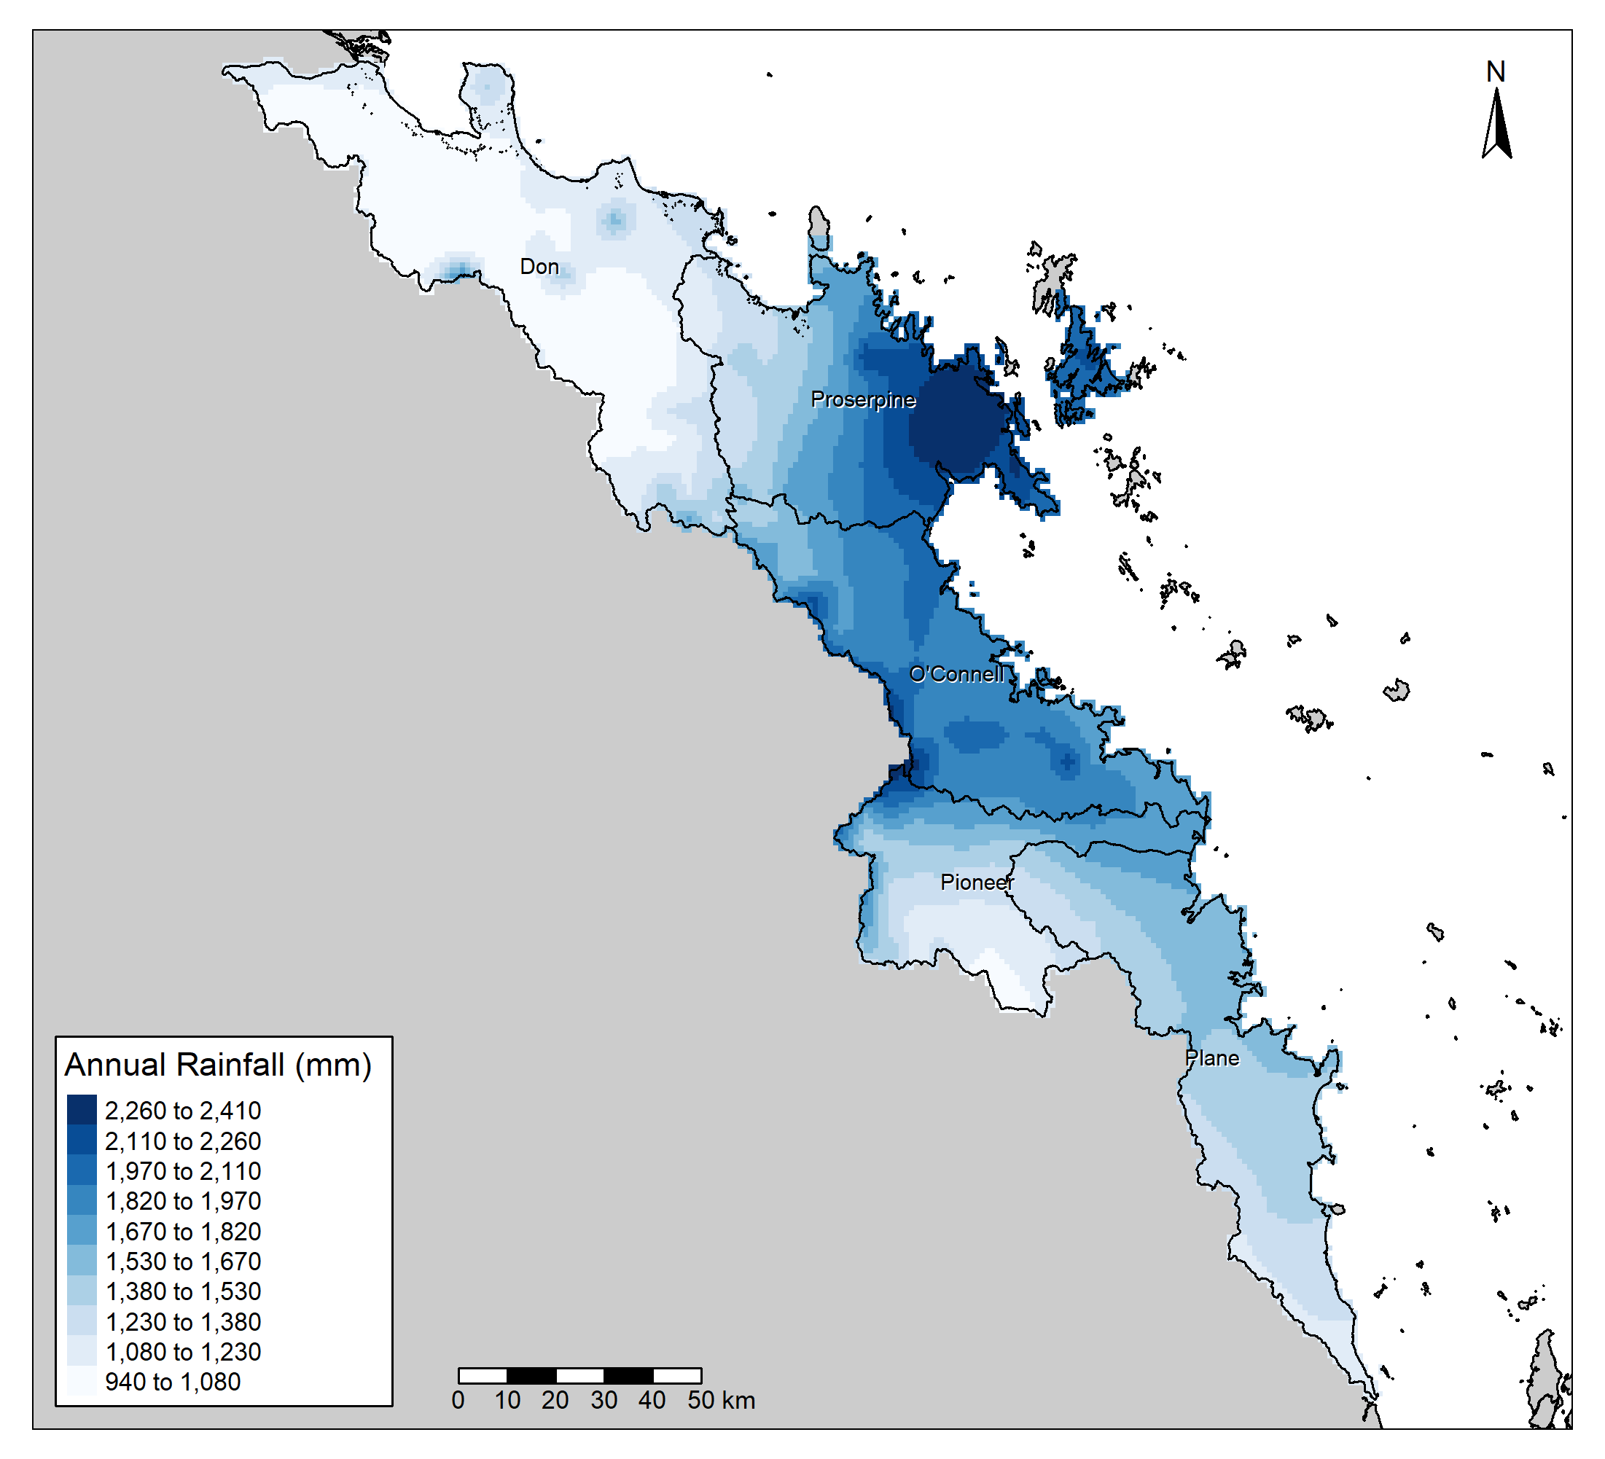
When looking at current year, mostly an aesthetic choice.

Slide 12
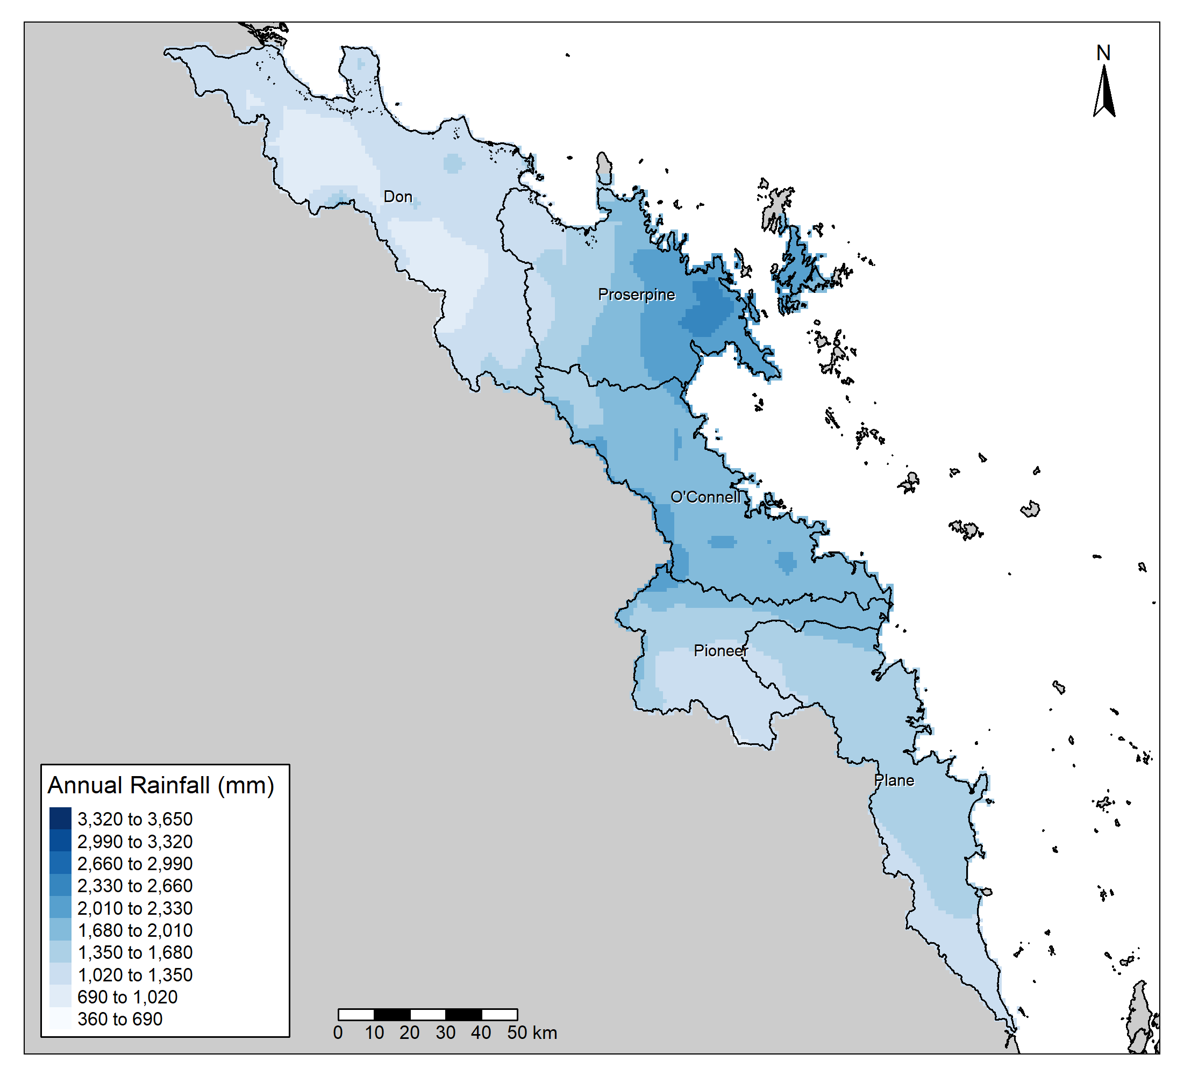
When looking at 30-year, or all data, binned is easier to distinguish differences.

Slide 13
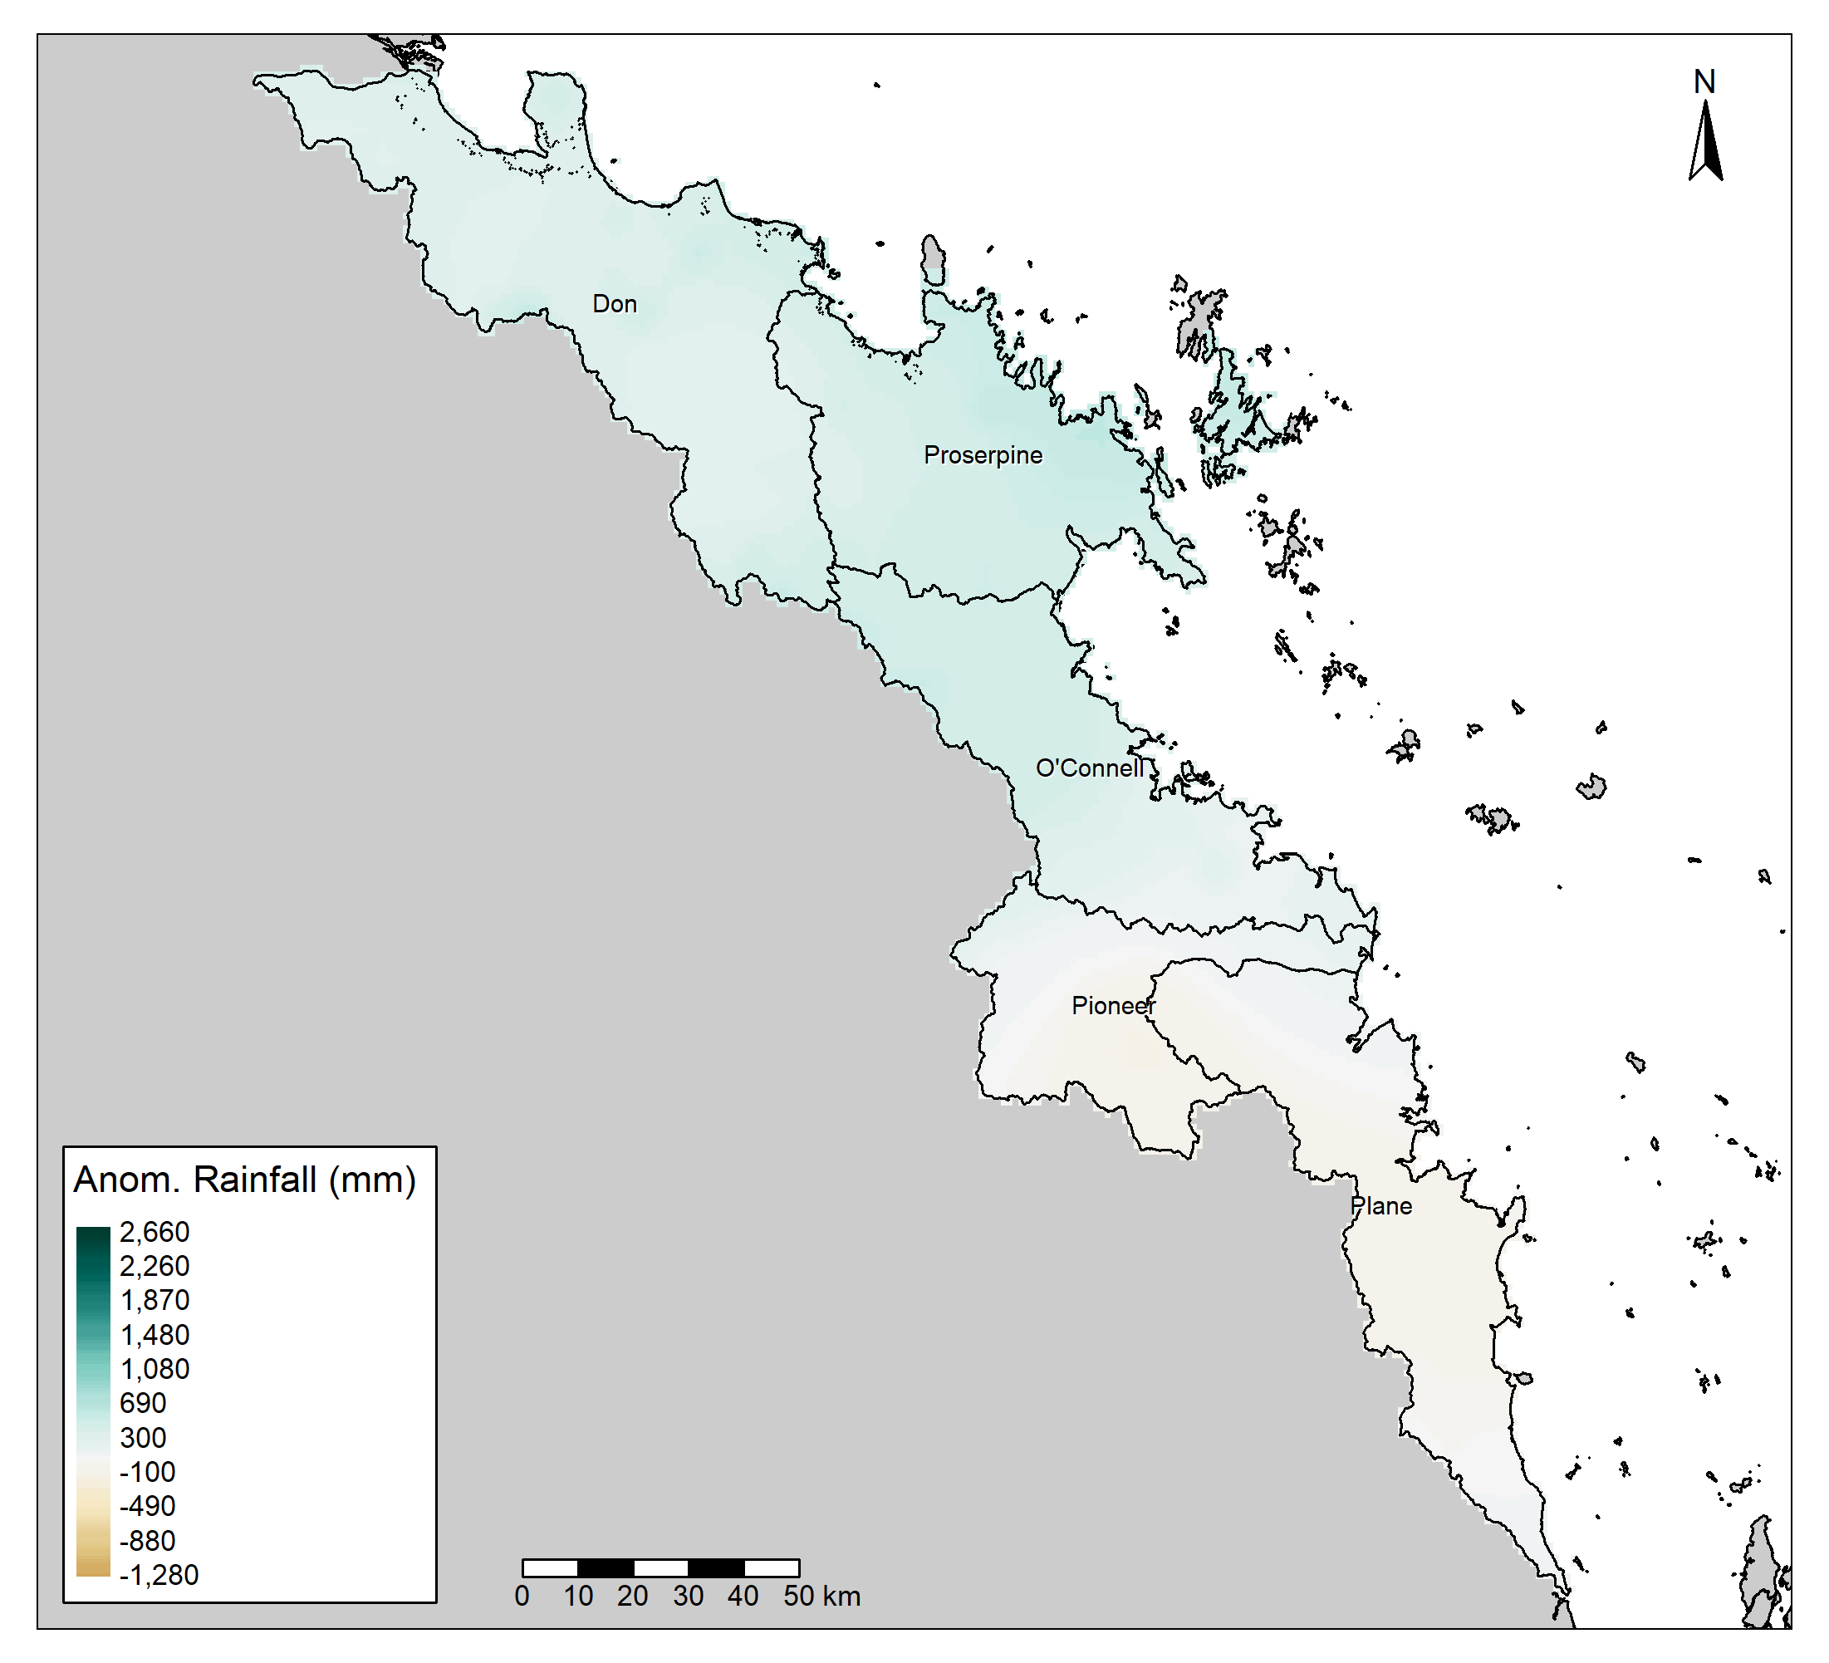
Particularly for the Anomaly Maps.

Slide 14
Recommendation

Slide 15
Don’t change the legend.
The visual should be the important part.
A “washed out” map is of no use.
A scale that encompasses the extreme highs and lows of the past 30 or 100 years is of no use.
The map is not for exact values.
Exact values are provided in the tables.

