Slide 1
Total Stream Length =
Length of:

Slide 2
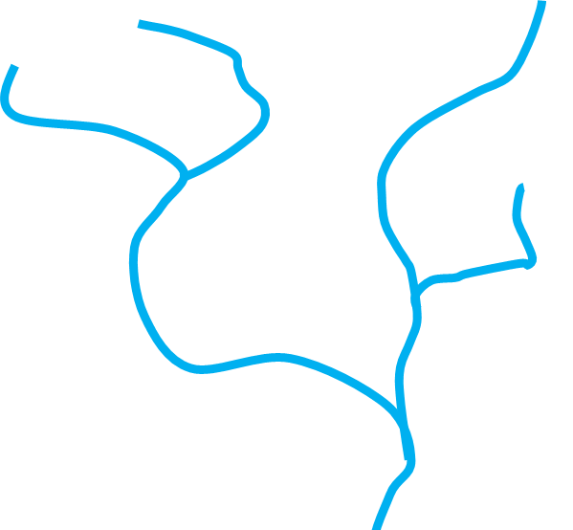
Total Stream Length =
Length of:
Uninterrupted Length above
Barrier A = Length of:
Barrier A

Slide 3

Total Stream Length =
Length of:
Uninterrupted Length above
Barrier A = Length of:
Uninterrupted Length above
Barrier B = Length of:
Barrier D
Barrier A

Slide 4

Total Stream Length =
Length of:
Uninterrupted Length above
Barrier A = Length of:
Barrier C
Uninterrupted Length above
Barrier B = Length of:
Barrier D
Uninterrupted Length above
Barrier C = Length of:
Barrier A

Slide 5
Total Stream Length =
Length of:
Uninterrupted Length above
Barrier A = Length of:
Barrier C
Uninterrupted Length above
Barrier B = Length of:
Barrier D
Uninterrupted Length above
Barrier C = Length of:
Barrier A
Uninterrupted Length above Barrier A =
Length of: minus length of:

Slide 6
Uninterrupted Length above
Barrier D = Length of:
Barrier D
Uninterrupted Length above Barrier C =
Length of: minus length of:
Barrier C
Uninterrupted Length above Barrier A =
Length of: minus
(length of: plus, length of: )
Barrier D
Barrier A

Slide 7
Barrier D
BD
Barrier C
BC
BB
Barrier B
Barrier A
BA

Slide 8
Using fake data, example calculations:
Total upstream length, regardless of any interruptions:
Barrier A original area = 10
Barrier B original area = 8
Barrier C original area = 6
Barrier D original area = 2
Total uninterrupted length (starting at deepest node):
Barrier D: 2 = 2
Barrier C: 6 – 2 = 4
Barrier B: 8 = 8
Barrier A: 10 – (4+2) = 4
BD
BC
BB
BA

Slide 9
A more complicated example, with the order in which to calculate lengths
1st
2nd
3rd
4th
5th
6th

Slide 10
Without visualising, and without a node network, it is impossible to know how these three segments would be connected
3 (4km)
1 (1km)
2 (1km)
3 (5km)
2 (2km)
2 (2km)
3 (5km)
3 (5km)
2 (2km)
1 (1km)
1 (1km)
1 (1km)
Barrier A
Barrier A
Barrier A

