Slide 1

N3 Spatial Analysis: Spatial Naming Style Guide
Adam Shand, Healthy Waters Partnership

Slide 2
This slide deck explains the spatial classifications used in the Northern Three Spatial Analysis repository.
An overview can be found on P3-4.
Definitions on P5-13.
And a naming/phrasing style guide on P14.

Slide 3
There are nine levels of classification used in the Northern Three Spatial Analysis repository that have specific definitions and names. These are (in descending order):
Region
Basin/Zone
Sub-Basin/Sub-Zone
Watercourse/Geographic Area
Site
Plus, the wildcard classification (i.e. cannot be assigned in descending order):
Environment

Slide 4
These nine levels of classification are used throughout the Northern Three repository and must adhere to rigid definitions. Quick examples are as follows:
Classification | Example |  | Classification | Example
Region | Dry Tropics |  | Region | Dry Tropics
Basin | Black |  | Zone | Cleveland Bay
Sub-Basin | Bohle |  | Sub-Zone | Enclosed Coastal
Watercourse | Louisa Creek |  | Geographic Area | Enclosed Coastal (Inside Port Zone)
Site | LOU6.0 |  | Site | RR07
Environment | Freshwater |  | Environment | Inshore Marine

Slide 5
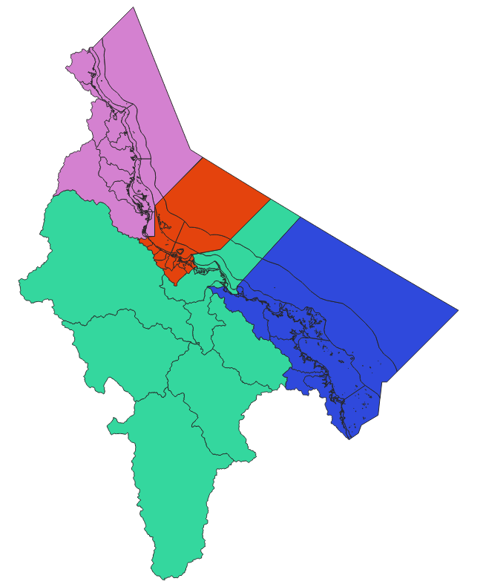
Region
A region is the largest classification
It is equal to the entire reporting area of a partnership team
A region can contain multiples of any other classification
Examples of regions are:
Dry Tropics
Wet Tropics
Mackay Whitsunday Isaac
Burdekin

Slide 6
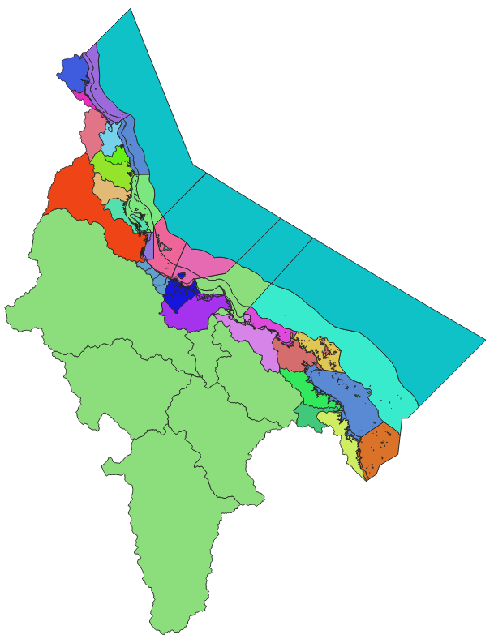
Basin/Zone
A basin is the second largest classification
It is equal to the term “basin” as defined by the EPP documents
It is the land equivalent of a zone
Examples of basins are:
Ross Basin
Daintree Basin
Proserpine Basin

Slide 7
Basin/Zone
A zone is the second largest classification
It is the marine equivalent of a basin
It does not have a defined meaning outside of the Northern Three partnership, it was created out of necessity.
Examples of zones are:
Cleveland Bay (HWP)
Southern Zone (MWI)
Palm Island Zone (WT)
Offshore Zone (per region)

Slide 8
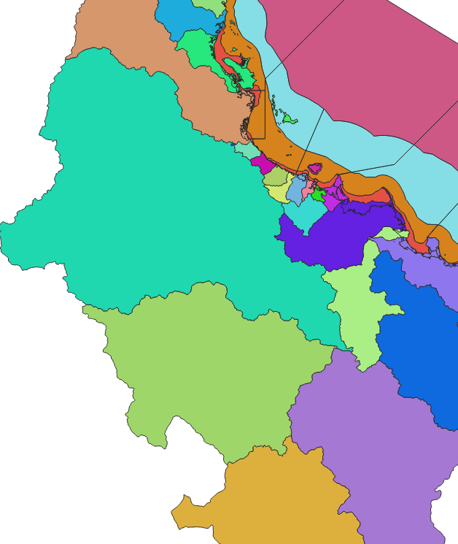
Sub-Basin/Sub-Zone
A sub-basin is the third largest classification
It is equal to the term “sub-basin” as defined by the EPP documents
It is the land equivalent of a sub-zone
Sub-basins are used exclusively by the Healthy Waters Partnership
Examples of sub-basins are:
Alligator Creek Sub Basin
Crystal Creek Sub Basin

Slide 9
Sub-Basin/Sub-Zone
A sub-zone is the third largest classification
It is the marine equivalent of a sub-basin
It does not have a defined meaning outside of the Northern Three partnership, it was created out of necessity
Sub-ones are used exclusively by the Healthy Waters Partnership
Examples of sub-zones are:
Cleveland Bay Enclosed Coastal Sub Zone
Halifax Bay Open Coastal Sub Zone

Slide 10
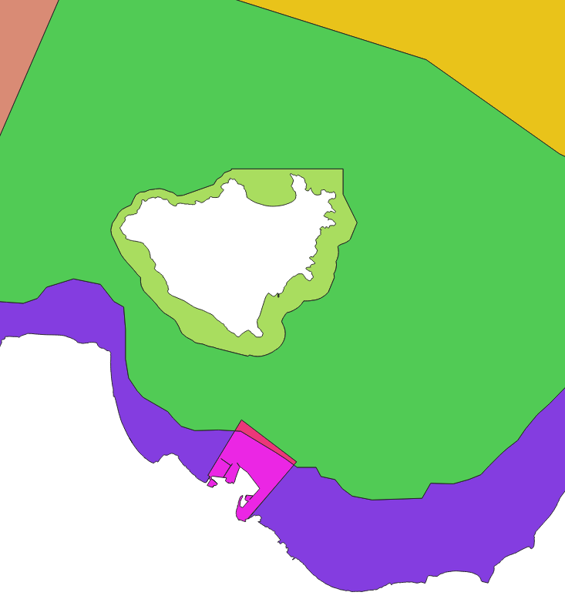
Watercourse/Geographic Area
A watercourse is the fourth largest classification
It is the land equivalent of a geographic area
Its spatial outline is not used within the repository and is used sparingly within the Healthy Waters Partnership technical report
Examples of watercourses are:
Blacks Weir
Gleesons Weir
Aplins Weir
(all within the Lower Ross Sub-Basin)

Slide 11
Watercourse/Geographic Area
A geographic area is the fourth largest classification
It is the marine equivalent of a watercourse
Geographic areas are used exclusively by the Healthy Waters Partnership
Geographic areas do have a spatial footprint and are used to determine Water Quality Objectives
Examples of geographic areas are:
Cleveland Bay Enclosed Coastal Inside Port Zone
Cleveland Bay Enclosed Coastal Outside Port Zone

Slide 12
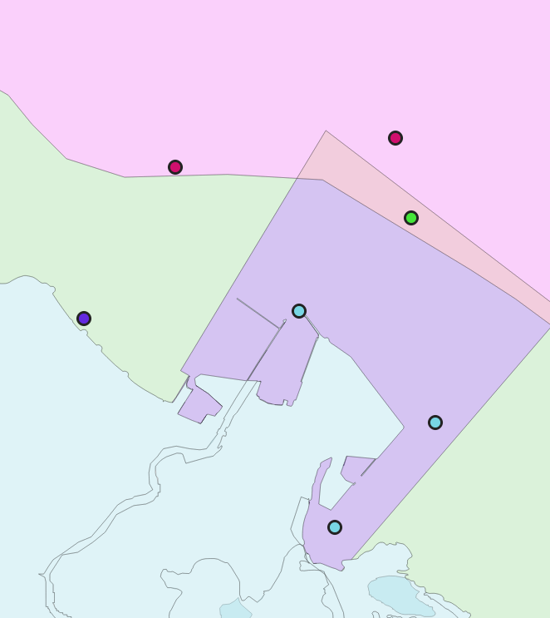
Site
A site is the lowest spatial classification
A site is a singular point, a singular sampling location
Sites are universal across all partnerships
Sites inherit all above classifications, i.e. each site will have an associated region, basin/zone, sub basin/sub zone, etc.
Examples of sites are:
RR07 (HWP)
Holborn Island (MWI)
BUR2 (WT)

Slide 13
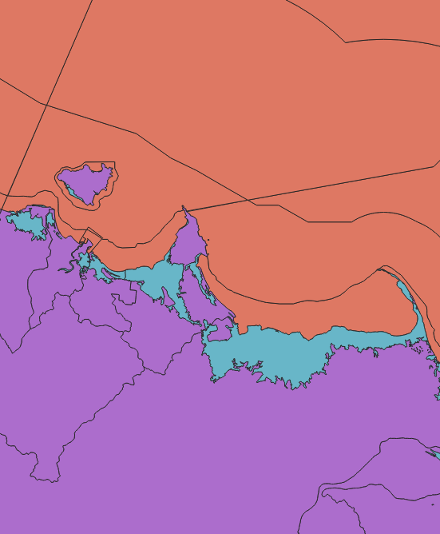
Environment
An environment is a separate spatial classification and pertains to watertypes
An environment can be combined with any other spatial classification (although some combinations make more sense than others)
Examples of environments are:
Freshwater
Estuarine
Marine
Examples of environment combinations are:
Black Freshwater Basin
Cleveland Bay Inshore Marine Zone

Slide 14
Tips
Naming Style
Wet Tropics and MWI only use some levels of spatial classifications. When a level is not used, the previous level is repeated. I.e.:
Region: Wet Tropics
Basin: Daintree
Sub-Basin: Daintree
Watercourse: Daintree
Site: XYZ
Although there is no new information, all levels of classification are required as both the HWP and WT/MWI spatial information is processed together. Thus, all columns must be present for all three datasets to be able to be used together.
HWP uses all levels of spatial classifications. So, repeats are only needed in some specific scenarios, e.g.:
The Halifax Bay Zone has no geographic areas within it, so each geographic area is simply a repeat of the sub-zone above it
The Upper Ross Sub Basin has no distinct watercourses within it, so the watercourse is equal to the sub basin.
The exact style used for naming is still being develop, however as a guide:
Environment can be inserted almost anywhere:
Black Basin Freshwater Environment
Black Freshwater Basin
“Zone” is only included if the zone is not a proper noun:
Cleveland Bay
Northern Zone
Capitalization should always be used when writing text (i.e. with methods and technical report)
Use the term “area” as a generic term to refer to all/any spatial classification without being specific. E.g.:
“There are three areas: the Black Basin, the Cleveland Bay Inshore Marine Environment, and the Upper Ross Sub-Basin.”

