Slide 1
2.4x7.3cm image
0.329 ratio
5x15.21

Slide 2
5cmx15.21cm Placeholder Image

Slide 3
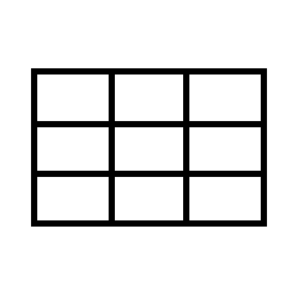

Slide 4
5cmx15.21cm Placeholder Image
The range to loop over.
for (i in 1:10){function}
The current loop.
The thing to repeat.
5cmx15.21cm Placeholder Image

Slide 5



5cmx15.21cm Placeholder Image

Slide 6

5cmx15.21cm Placeholder Image

Slide 7
5cmx15.21cm Placeholder Image

Slide 8

“Vectorise!”
“Loop!”
5cmx15.21cm Placeholder Image

Slide 9
eReefs P1
eReefs P2
eReefs P3
5cmx15.21cm Placeholder Image

Slide 10



R
5cmx15.21cm Placeholder Image

Slide 11
5cmx15.21cm Placeholder Image

Slide 12







my_current_script.qmd
R
Project Directory
produces
my_output(s).file

Slide 13
/scripts
my_current_script.qmd
R
Project Directory
produces
my_output(s).file

Slide 14
/scripts
/climate_scripts
my_current_script.qmd
R
Project Directory
produces
my_output(s).file

Slide 15

/scripts
/climate_scripts
my_current_script.qmd
R
Project Directory
produces
/outputs
my_output(s).file

Slide 16
/scripts
/climate_scripts
my_current_script.qmd
R
Project Directory
produces
/outputs
/climate_scripts
my_output(s).file

Slide 17
/scripts
/climate_scripts
my_current_script.qmd
R
Project Directory
produces
mirror of script path
/outputs
/climate_scripts
/my_current_script
my_output(s).file

Slide 18
Example Data
Longitude
153.1
153.2
153.3
…
-19.1
-19.2
Latitude
-19.3
…
-25m
0m
01-01-2019
Depth
02-01-2019
03-01-2019
Time

Slide 19
Example Data
MARGIN = 1 (Row, Latitude)
MARGIN preserves the dimension(s) you give it
Etc.

Slide 20
Example Data
MARGIN = 2 (Column, Longitude)
Etc.

Slide 21
Example Data
MARGIN = 3 (Depth)

Slide 22
Example Data
MARGIN = 4 (Time)

Slide 23
Example Data
MARGIN = 2 & 4 (Longitude and Time)
Etc.

Slide 24
Example Data
MARGIN = 1 & 2 (Latitude & Longitude)
Etc.

Slide 25
Example Data
MARGIN = 1, 2 & 3 (Latitude, Longitude & Depth)
Etc.

Slide 26


Hill A
Hill B

Slide 27






