Slide 1
2.4x7.3cm image
0.329 ratio
5x15.21

Slide 2
5cmx15.21cm Placeholder Image

Slide 3


Slide 4
The range to loop over.
for (i in 1:10){function}
The current loop.
The thing to repeat.
5cmx15.21cm Placeholder Image

Slide 5

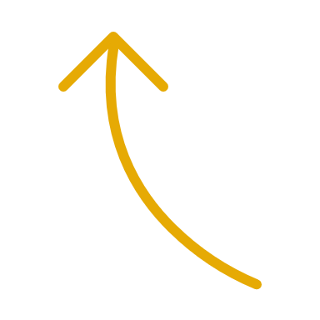


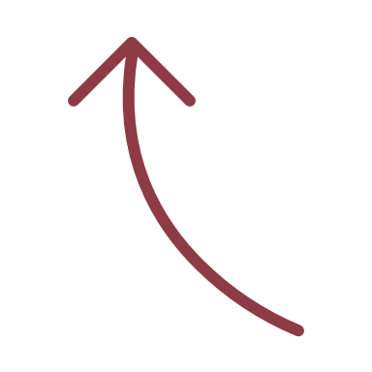
5cmx15.21cm Placeholder Image

Slide 6

V4
V3
5cmx15.21cm Placeholder Image

Slide 7
5cmx15.21cm Placeholder Image

Slide 8
“func”
“func”
“func”
map( )
function_name <- function(inputs){code}
“func”
“func”
“func”
“func” (for short)
for (i in 1:10){“func”}
5cmx15.21cm Placeholder Image

