Slide 1
HW3
學生:林奇鋒

Slide 2

Data Preprocess

Slide 3
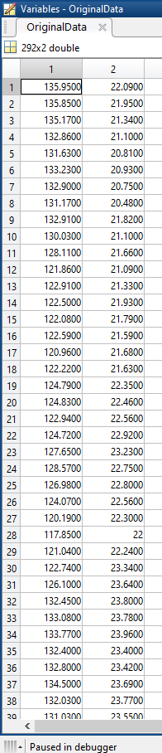
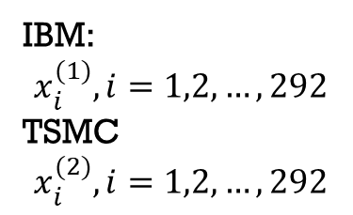
Data
TSMC:2016/01/04~2017/03/01
IBM:2016/01/04~2017/03/01
Number Of Data:292
IBM:
$$x_{i}^{(1)},i=1,2,…,292$$
TSMC
$$x_{i}^{(2)},i=1,2,…,292$$

Slide 4

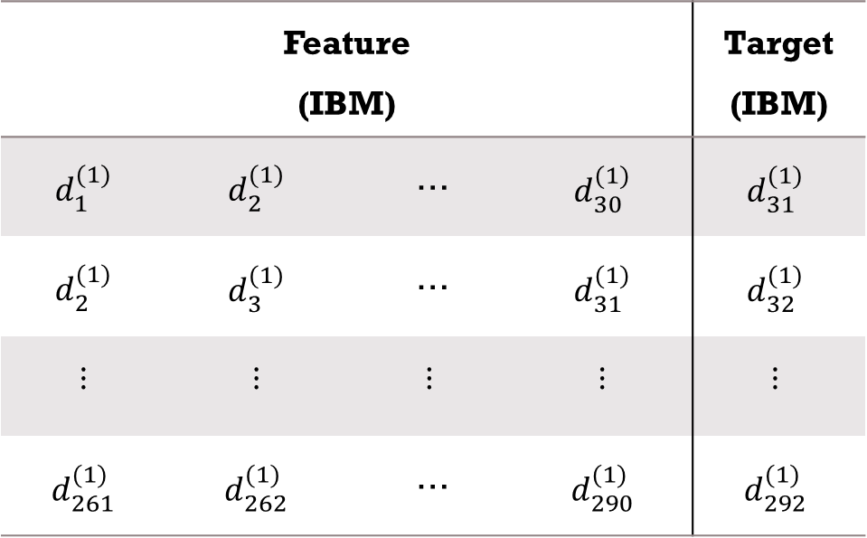
Data Preprocess
一次差分
$$x_{i+1}^{(1)}−x_{i}^{(1)}=d_{i}^{(1)},i=1,2,…,291$$
Number Of Data:292
Feature (IBM) |  |  |  | Target (IBM)
$$d_{1}^{(1)}$$ | $$d_{2}^{(1)}$$ | … | $$d_{30}^{(1)}$$ | $$d_{31}^{(1)}$$
$$d_{2}^{(1)}$$ | $$d_{3}^{(1)}$$ | … | $$d_{31}^{(1)}$$ | $$d_{32}^{(1)}$$
$$⋮$$ | $$⋮$$ | $$⋮$$ | $$⋮$$ | $$⋮$$
$$d_{261}^{(1)}$$ | $$d_{262}^{(1)}$$ | … | $$d_{290}^{(1)}$$ | $$d_{292}^{(1)}$$
做一次差分
Number Of Data:291
30天漲跌當作特徵
Number Of Feature:30
30天漲跌當作特徵

Slide 5
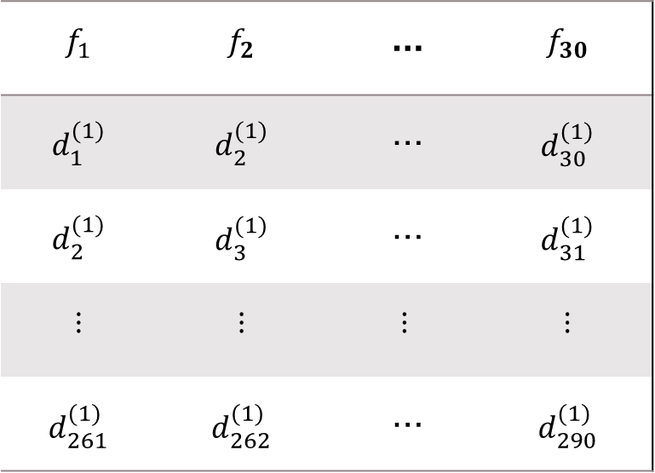
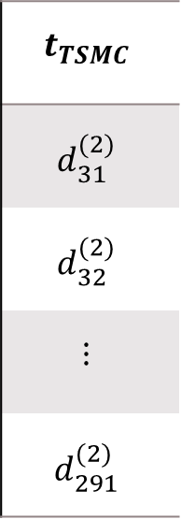
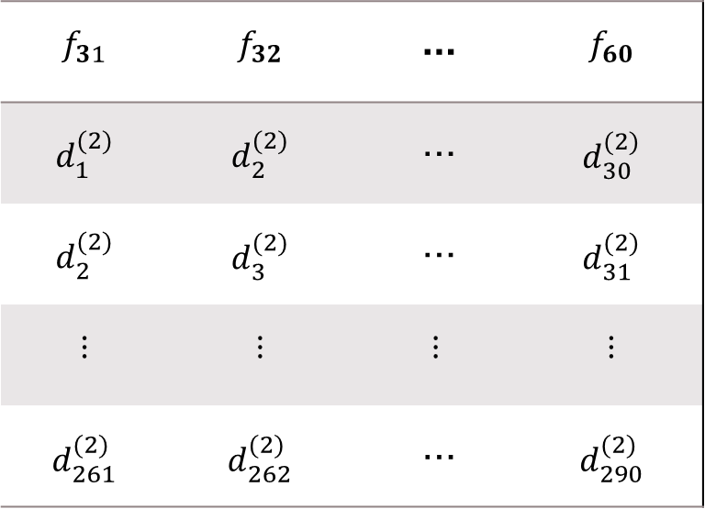
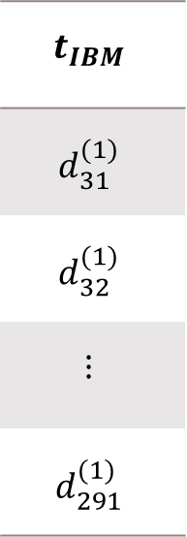
Data Matrix
IBM
TSMC
Target
$$f_{1}$$ | $$f_{2}$$ | … | $$f_{30}$$
$$d_{1}^{(1)}$$ | $$d_{2}^{(1)}$$ | … | $$d_{30}^{(1)}$$
$$d_{2}^{(1)}$$ | $$d_{3}^{(1)}$$ | … | $$d_{31}^{(1)}$$
$$⋮$$ | $$⋮$$ | $$⋮$$ | $$⋮$$
$$d_{261}^{(1)}$$ | $$d_{262}^{(1)}$$ | … | $$d_{290}^{(1)}$$
$$f_{31}$$ | $$f_{32}$$ | … | $$f_{60}$$
$$d_{1}^{(2)}$$ | $$d_{2}^{(2)}$$ | … | $$d_{30}^{(2)}$$
$$d_{2}^{(2)}$$ | $$d_{3}^{(2)}$$ | … | $$d_{31}^{(2)}$$
$$⋮$$ | $$⋮$$ | $$⋮$$ | $$⋮$$
$$d_{261}^{(2)}$$ | $$d_{262}^{(2)}$$ | … | $$d_{290}^{(2)}$$
$$t_{IBM}$$
$$d_{31}^{(1)}$$
$$d_{32}^{(1)}$$
$$⋮$$
$$d_{291}^{(1)}$$
$$t_{TSMC}$$
$$d_{31}^{(2)}$$
$$d_{32}^{(2)}$$
$$⋮$$
$$d_{291}^{(2)}$$

Slide 6
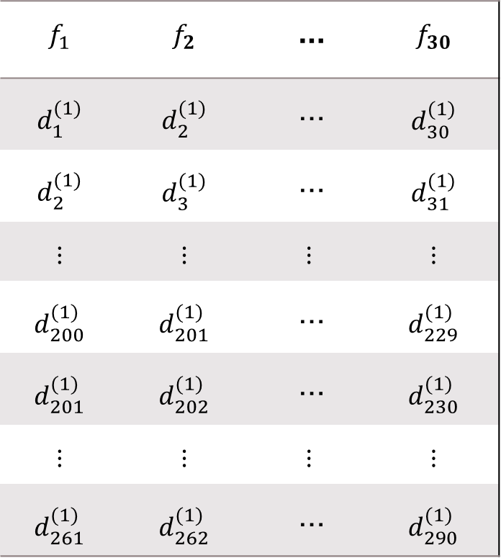
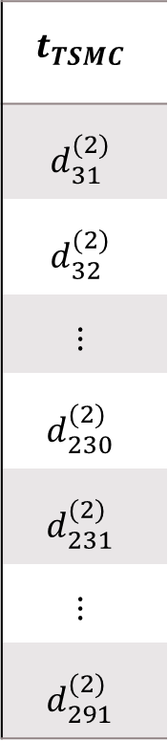
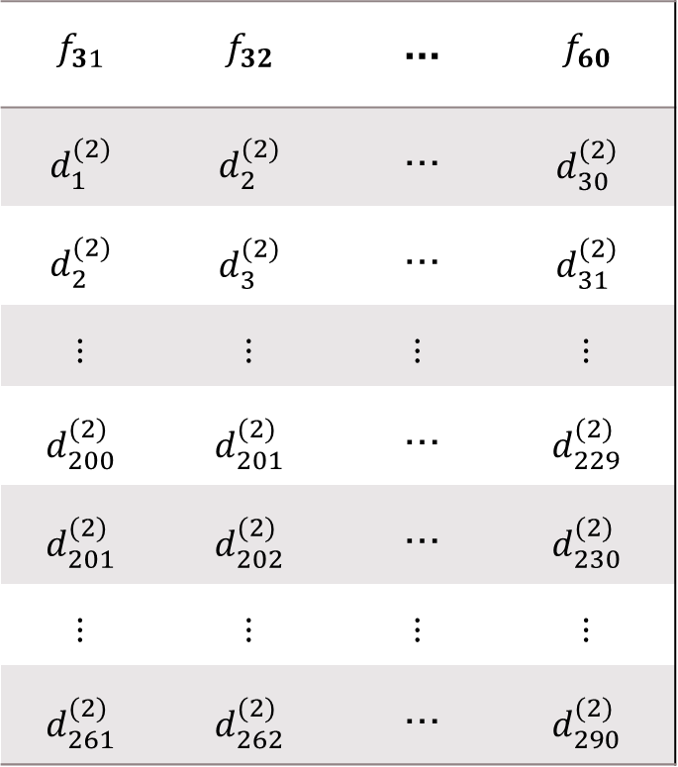
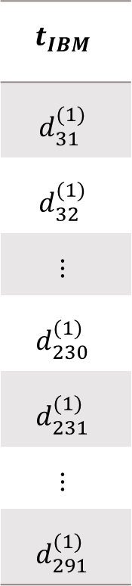
Data Matrix
$$f_{1}$$ | $$f_{2}$$ | … | $$f_{30}$$
$$d_{1}^{(1)}$$ | $$d_{2}^{(1)}$$ | … | $$d_{30}^{(1)}$$
$$d_{2}^{(1)}$$ | $$d_{3}^{(1)}$$ | … | $$d_{31}^{(1)}$$
$$⋮$$ | $$⋮$$ | $$⋮$$ | $$⋮$$
$$d_{200}^{(1)}$$ | $$d_{201}^{(1)}$$ | … | $$d_{229}^{(1)}$$
$$d_{201}^{(1)}$$ | $$d_{202}^{(1)}$$ | … | $$d_{230}^{(1)}$$
$$⋮$$ | $$⋮$$ | $$⋮$$ | $$⋮$$
$$d_{261}^{(1)}$$ | $$d_{262}^{(1)}$$ | … | $$d_{290}^{(1)}$$
$$f_{31}$$ | $$f_{32}$$ | … | $$f_{60}$$
$$d_{1}^{(2)}$$ | $$d_{2}^{(2)}$$ | … | $$d_{30}^{(2)}$$
$$d_{2}^{(2)}$$ | $$d_{3}^{(2)}$$ | … | $$d_{31}^{(2)}$$
$$⋮$$ | $$⋮$$ | $$⋮$$ | $$⋮$$
$$d_{200}^{(2)}$$ | $$d_{201}^{(2)}$$ | … | $$d_{229}^{(2)}$$
$$d_{201}^{(2)}$$ | $$d_{202}^{(2)}$$ | … | $$d_{230}^{(2)}$$
$$⋮$$ | $$⋮$$ | $$⋮$$ | $$⋮$$
$$d_{261}^{(2)}$$ | $$d_{262}^{(2)}$$ | … | $$d_{290}^{(2)}$$
$$t_{IBM}$$
$$d_{31}^{(1)}$$
$$d_{32}^{(1)}$$
$$⋮$$
$$d_{230}^{(1)}$$
$$d_{231}^{(1)}$$
$$⋮$$
$$d_{291}^{(1)}$$
$$t_{TSMC}$$
$$d_{31}^{(2)}$$
$$d_{32}^{(2)}$$
$$⋮$$
$$d_{230}^{(2)}$$
$$d_{231}^{(2)}$$
$$⋮$$
$$d_{291}^{(2)}$$
Training
Testing

Slide 7


Entropy
$$H(x)=\int{p_{d}\left(x\right)log⁡(\frac{1}{p_{d}\left(x\right)})dx}$$
If$p_{d}\left(x\right)>$1，log part is negative，so we have to change formula:
$$H(x)=\int{p_{d}\left(x\right)log⁡(\frac{φ_{1}}{p_{d}\left(x\right)})dx}$$
$$φ_{1}=max(1,ε+max\left(p_{d}\left(x\right)\right))$$
,where $ε={1×10}^{−10}$
Notes:
max($p_{d}$(x))=getPdf(x)
Function getPdf(data)
pd=fitdist(data,'kernel');
domain=linspace(pd.mean-5*pd.std,pd.mean+5*pd.std,500);
output=pdf(pd, domain);

Slide 8
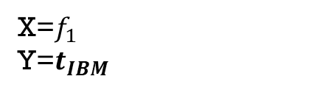
Pdf(IBM)
X=$f_{1}$
Y=$t_{IBM}$
Notes:
Xarea=0.9996
Yarea=0.9972
YX+area=0.9999
YX-area=0.9999
Y較高，但是Y|X+和Y|X-變低，也就是機率變平均，entropy(混亂程度變高)，可以解釋成特徵1對Y造成負面影響

Slide 9
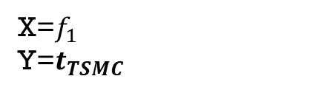
pdf
X=$f_{1}$
Y=$t_{TSMC}$
Notes:
Xarea=0.9996
Yarea=0.9999
YX+area=0.9999
YX-area=0.9999
Y較高，但是Y|X+和Y|X-變低，也就是機率變平均，entropy(混亂程度變高)，可以解釋成特徵1對Y造成負面影響

Slide 10
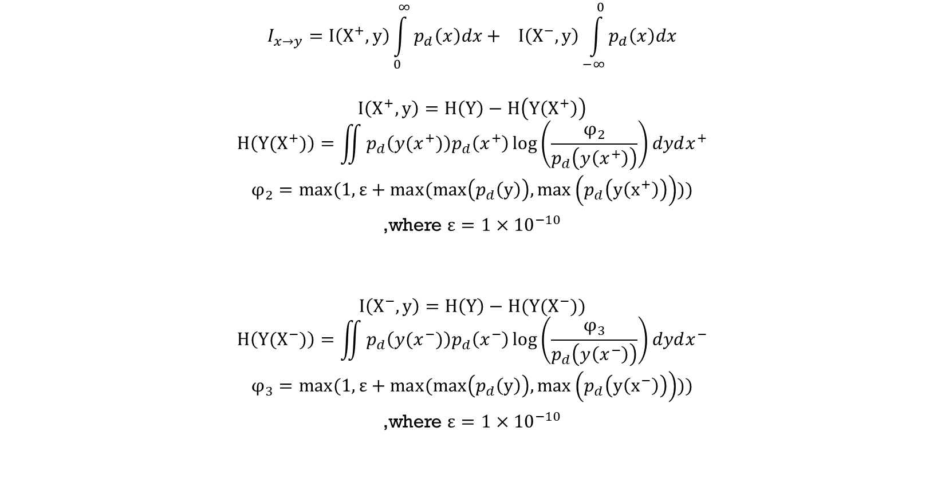
Influence Information:
$$I_{x→y}=I\left(X^{+},y\right)\int_{0}^{∞}{p_{d}\left(x\right)dx}+ I\left(X^{−},y\right)\int_{−∞}^{0}{p_{d}\left(x\right)dx}$$
$$I\left(X^{+},y\right)=H\left(Y\right)−H\left(Y\left(X^{+}\right)\right)$$
$$H\left(Y(X^{+})\right)=\iint{p_{d}\left(y(x^{+})\right)p_{d}\left(x^{+}\right)\log\left(\frac{φ_{2}}{p_{d}\left(y\left(x^{+}\right)\right)}\right)dydx^{+}}$$
$$φ_{2}=max(1,ε+max(max\left(p_{d}\left(y\right)\right),max\left(p_{d}\left(y\left(x^{+}\right)\right)\right)))$$
,where $ε={1×10}^{−10}$
$$I\left(X^{−},y\right)=H\left(Y\right)−H(Y(X^{−}))$$
$$H\left(Y(X^{−})\right)=\iint{p_{d}\left(y(x^{−})\right)p_{d}\left(x^{−}\right)\log\left(\frac{φ_{3}}{p_{d}\left(y\left(x^{−}\right)\right)}\right)dydx^{−}}$$
$$φ_{3}=max(1,ε+max(max\left(p_{d}\left(y\right)\right),max\left(p_{d}\left(y\left(x^{−}\right)\right)\right)))$$
,where $ε={1×10}^{−10}$

Slide 11
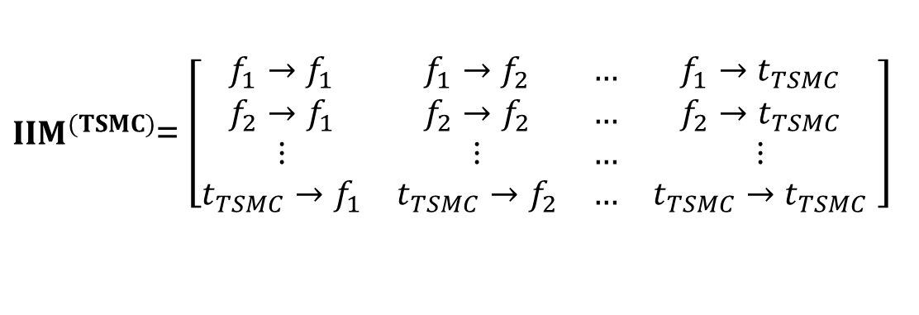
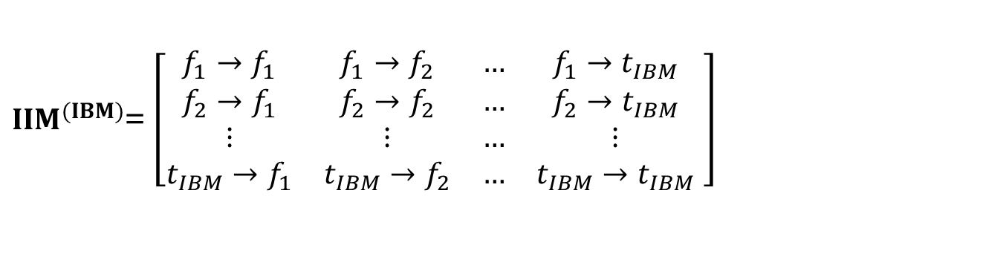
Influence Information Matrix
target
$IIM^{(IBM)}$= $\left[\begin{matrix}f_{1}→f_{1} & f_{1}→f_{2} & … & f_{1}→t_{IBM} \\ f_{2}→f_{1} & f_{2}→f_{2} & … & f_{2}→t_{IBM} \\ ⋮ & ⋮ & … & ⋮ \\ t_{IBM}→f_{1} & t_{IBM}→f_{2} & … & t_{IBM}→t_{IBM}\end{matrix} \right]$
$IIM^{(TSMC)}$= $\left[\begin{matrix}f_{1}→f_{1} & f_{1}→f_{2} & … & f_{1}→t_{TSMC} \\ f_{2}→f_{1} & f_{2}→f_{2} & … & f_{2}→t_{TSMC} \\ ⋮ & ⋮ & … & ⋮ \\ t_{TSMC}→f_{1} & t_{TSMC}→f_{2} & … & t_{TSMC}→t_{TSMC}\end{matrix} \right]$
target

Slide 12
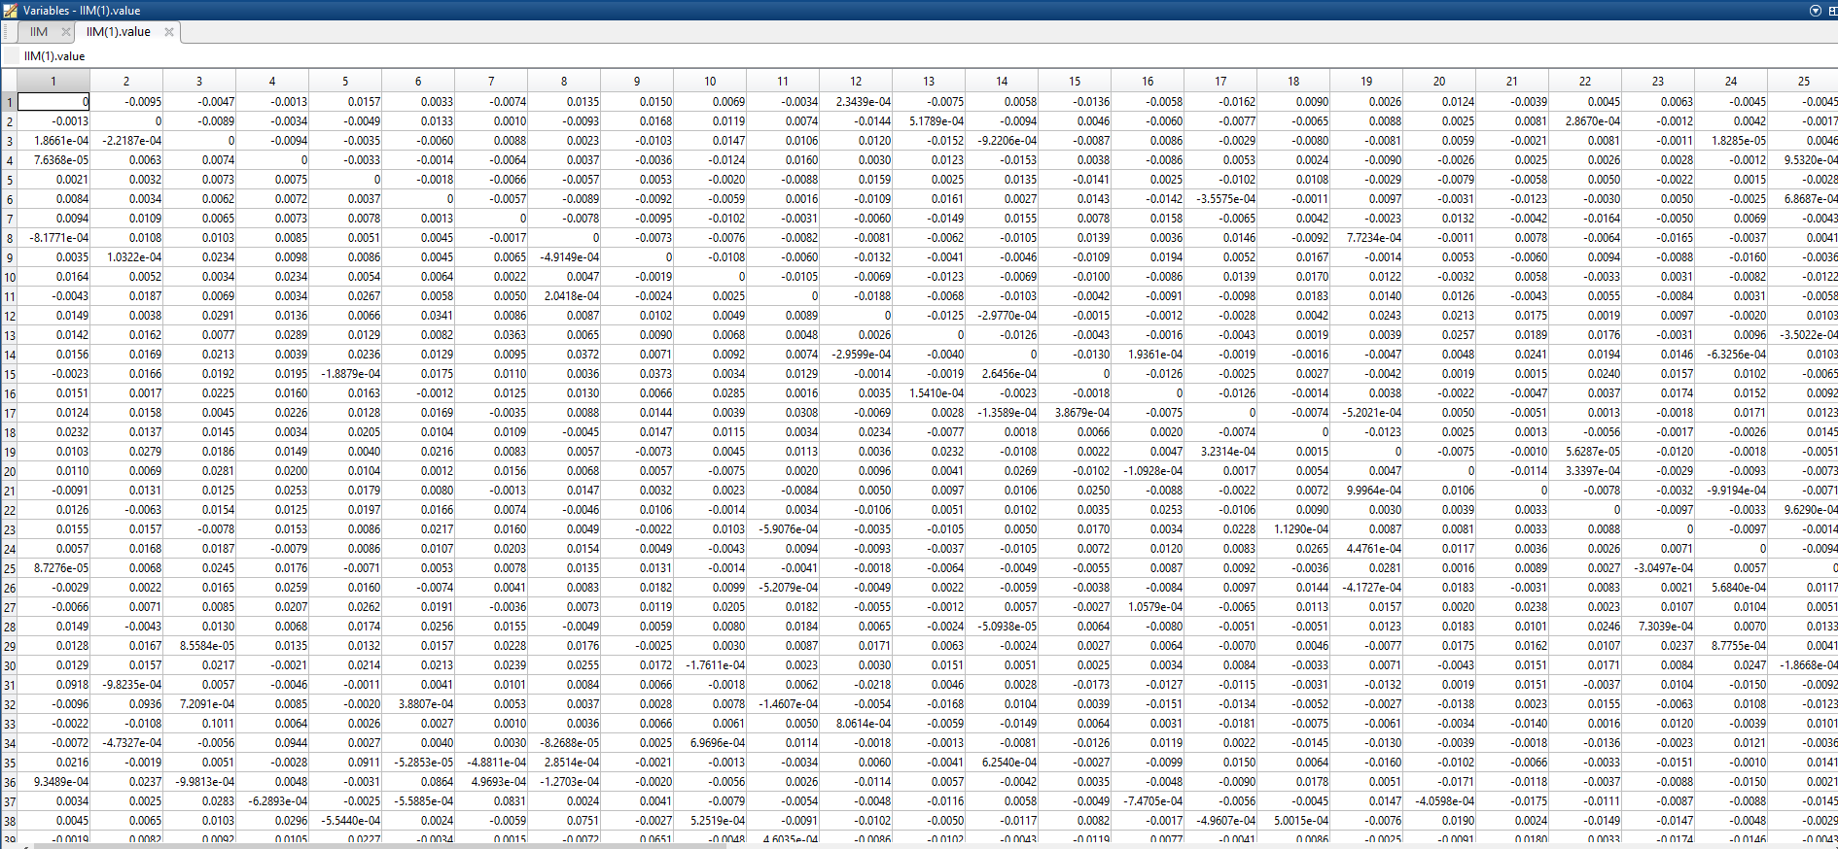
Influence Information Matrix(IBM)

Slide 13
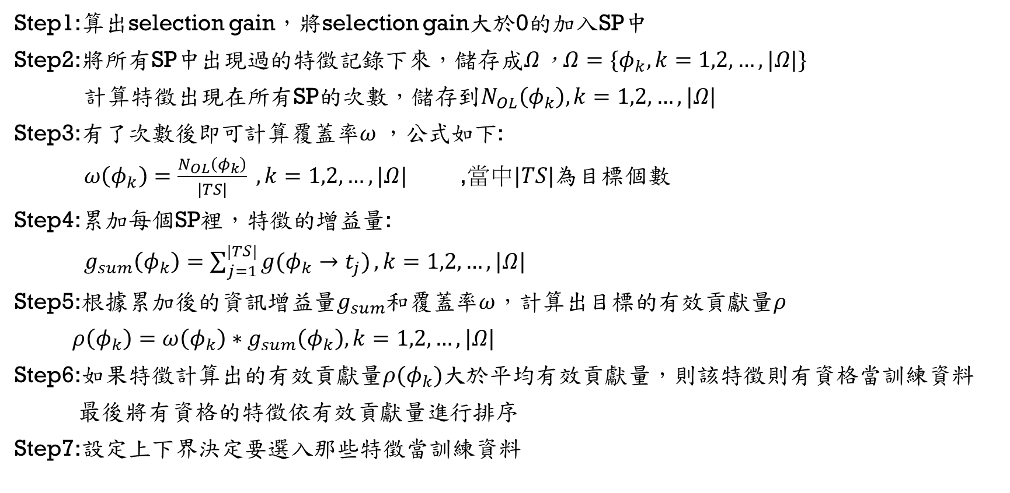
Multi-Target Feature selection
Step1:算出selection gain，將selection gain大於0的加入SP中
Step2:將所有SP中出現過的特徵記錄下來，儲存成$Ω$，$Ω=\{φ_{k},k=1,2,…,|Ω|\}$
計算特徵出現在所有SP的次數，儲存到$N_{OL}\left(φ_{k}\right),k=1,2,…,|Ω|$
Step3:有了次數後即可計算覆蓋率$ω$，公式如下:
$ω\left(φ_{k}\right)=\frac{N_{OL}\left(φ_{k}\right)}{|TS|} ,k=1,2,…,|Ω|$ ,當中$|TS|$為目標個數
Step4:累加每個SP裡，特徵的增益量:
$g_{sum}\left(φ_{k}\right)=\sum_{j=1}^{|TS|}{g(φ_{k}→t_{j})},k=1,2,…,|Ω|$
Step5:根據累加後的資訊增益量$g_{sum}$和覆蓋率$ω$，計算出目標的有效貢獻量$ρ$
$ρ\left(φ_{k}\right)=ω\left(φ_{k}\right)∗g_{sum}\left(φ_{k}\right),k=1,2,…,|Ω|$
Step6:如果特徵計算出的有效貢獻量$ρ(φ_{k})$大於平均有效貢獻量，則該特徵則有資格當訓練資料
最後將有資格的特徵依有效貢獻量進行排序
Step7:設定上下界決定要選入那些特徵當訓練資料

Slide 14
Step1:
算出selection gain

Slide 15
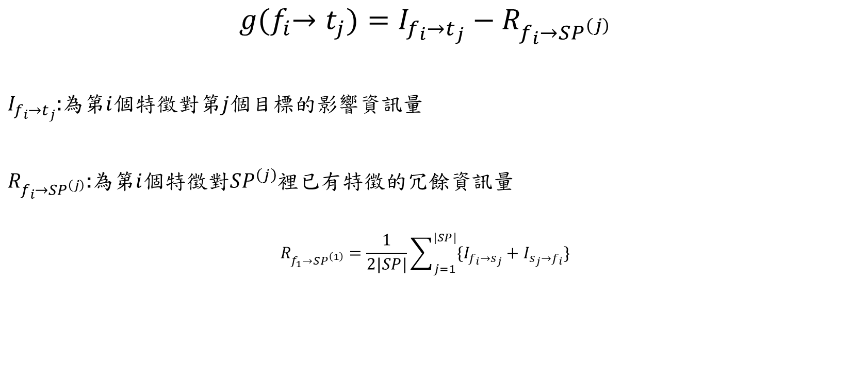
Multi-Target Feature selection
Step1
$$g{(f}_{i}→t_{j})=I_{f_{i}→t_{j}}−R_{f_{i}→SP^{\left(j\right)}}$$
$I_{f_{i}→t_{j}}$:為第$i$個特徵對第$j$個目標的影響資訊量
$R_{f_{i}→SP^{\left(j\right)}}$:為第$i$個特徵對$SP^{\left(j\right)}$裡已有特徵的冗餘資訊量
$$R_{f_{1}→SP^{\left(1\right)}}=\frac{1}{2|SP|}\sum_{j=1}^{|SP|}{\{I_{f_{i}→s_{j}}+I_{s_{j}→f_{i}}\}}$$

Slide 16









Multi-Target Feature Selection(Example)
Step1
$$g{(f}_{1}→t_{1})=I_{f_{1}→t_{1}}−R_{f_{1}→SP^{\left(1\right)}}$$
$$g{(f}_{2}→t_{1})=I_{f_{2}→t_{1}}−R_{f_{2}→SP^{\left(1\right)}}$$
$SP^{\left(1\right)}=${$f_{49}$ }
$SP^{\left(1\right)}=${$f_{49}$ $f_{1}$}
$$R_{f_{1}→SP^{\left(1\right)}}=(I_{f_{1}→f_{49}}+I_{f_{49}→f_{1}})/2$$
$$R_{f_{2}→SP^{\left(1\right)}}=(I_{f_{2}→f_{1}}+I_{f_{1}→f_{2}}+I_{f_{2}→f_{49}}+I_{f_{49}→f_{2}})/4$$
$$g{(f}_{1}→t_{1})>0$$
$$g{(f}_{2}→t_{1})<0$$
$SP^{\left(1\right)}=${$f_{49}$ $f_{1}$}
$SP^{\left(1\right)}=${$f_{49}$ $f_{1}$}

Slide 17








Step1
$$SP^{\left(2\right)}$$
$$g{(f}_{i}→t_{1})$$
$$SP^{\left(1\right)}$$
$$g{(f}_{i}→t_{1})$$

Slide 18
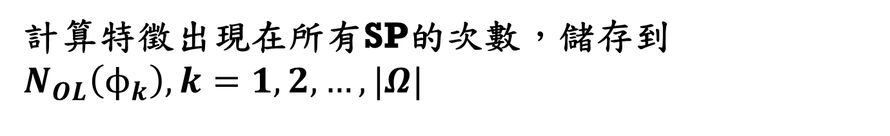
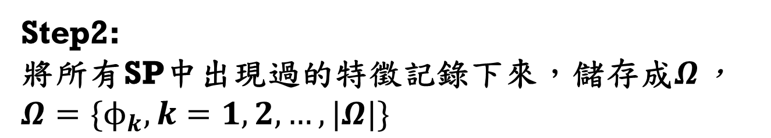
Step2:
將所有SP中出現過的特徵記錄下來，儲存成$Ω$，$Ω=\{ϕ_{k},k=1,2,…,|Ω|\}$
計算特徵出現在所有SP的次數，儲存到$N_{OL}\left(ϕ_{k}\right),k=1,2,…,|Ω|$

Slide 19






Step2
$$SP^{\left(2\right)}$$
$$Ω$$
$$N_{OL}$$
$$SP^{\left(1\right)}$$

Slide 20
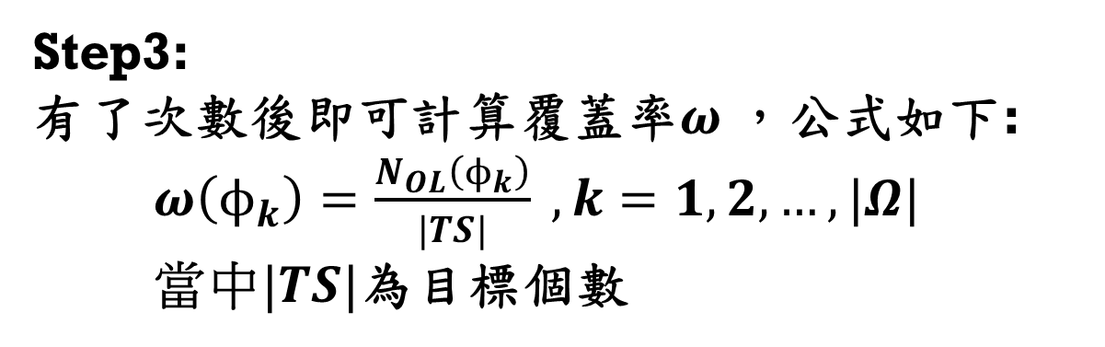
Step3:
有了次數後即可計算覆蓋率$ω$，公式如下:
$ω\left(ϕ_{k}\right)=\frac{N_{OL}\left(ϕ_{k}\right)}{|TS|} ,k=1,2,…,|Ω|$
當中$|TS|$為目標個數

Slide 21




Step3
$$Ω$$
$$N_{OL}$$
$$ω$$

Slide 22
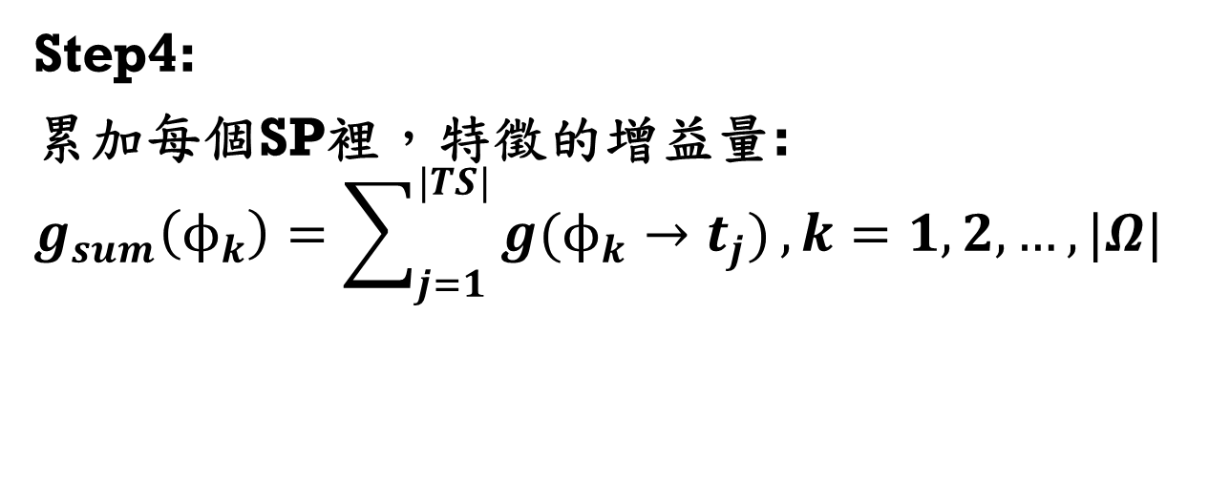
Step4:
累加每個SP裡，特徵的增益量:
$$g_{sum}\left(ϕ_{k}\right)=\sum_{j=1}^{|TS|}{g(ϕ_{k}→t_{j})},k=1,2,…,|Ω|$$

Slide 23







Step4
$$SP^{\left(2\right)}$$
$$g{(f}_{i}→t_{1})$$
$$Ω$$
$$g_{sum}$$
$$SP^{\left(1\right)}$$
$$g{(f}_{i}→t_{1})$$

Slide 24
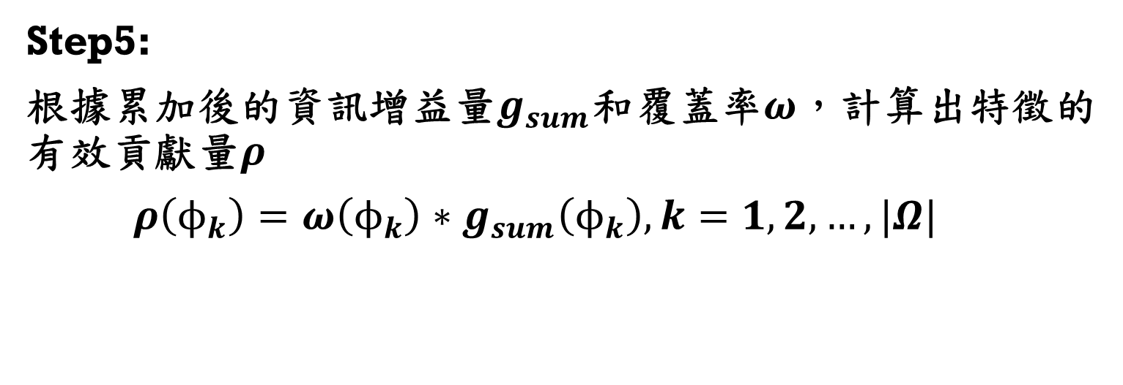
Step5:
根據累加後的資訊增益量$g_{sum}$和覆蓋率$ω$，計算出特徵的有效貢獻量$ρ$
$ρ\left(ϕ_{k}\right)=ω\left(ϕ_{k}\right)∗g_{sum}\left(ϕ_{k}\right),k=1,2,…,|Ω|$

Slide 25





Step5
$$Ω$$
$$ω$$
$$g_{sum}$$
$$ρ$$

Slide 26
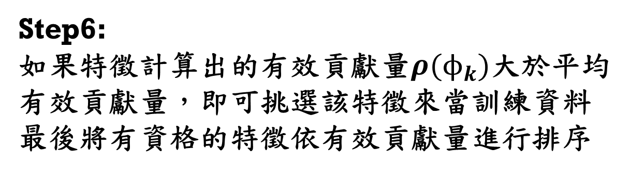
Step6:
如果特徵計算出的有效貢獻量$ρ(ϕ_{k})$大於平均有效貢獻量，即可挑選該特徵來當訓練資料
最後將有資格的特徵依有效貢獻量進行排序

Slide 27










Step6
$$Ω$$
$$ω$$
$\overline{ω}$=0.5577
$$g_{sum}$$
${\overline{g}}_{sum}$=0.0102
$$ρ$$
Threshold=0.0057
$$Qualified$$
$$ρ$$

Slide 28
Step7:
設定上下界決定要選入那些特徵當訓練資料

Slide 29





Step7
$$Qualified$$
$$ρ$$
上界:4
下界:2
$F$P
$$ρ$$
透過上下界的篩選，可得到要訓練的特徵索引

Slide 30







Multi-Target Feature Selection
CP
SP
FP
$$g{(f}_{i}→t_{1})>0$$
$$f_{22}$$
$$f_{23}$$
$$f_{26}$$
$$f_{49}$$
.
.
.
.
$$f_{1}$$
$$f_{2}$$
.
.
.
$$f_{60}$$
$$SP^{(1)}$$
$$ρ\left(ϕ_{k}\right)>\overline{ω}∗\overline{g_{sum}}$$
$$g{(f}_{i}→t_{2})>0$$
$$SP^{(2)}$$

Slide 31

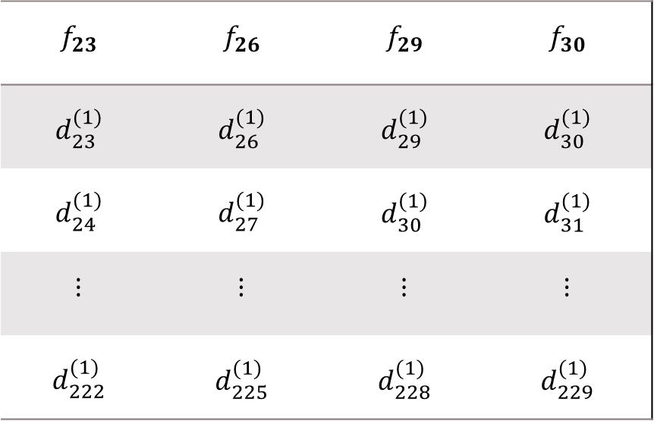

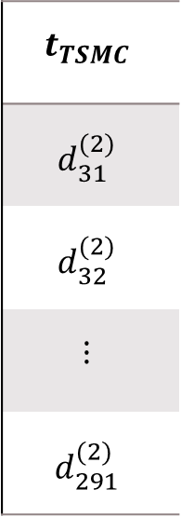

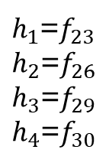
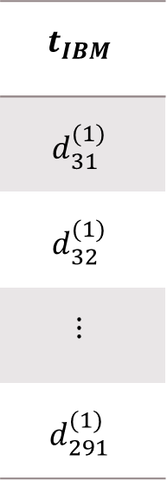
Data pair
$${\overset{⃑}{x}}_{i}={\left[\begin{matrix}h_{1} \\ h_{2} \\ h_{3} \\ h_{4}\end{matrix}\right]}_{i}$$
$h_{1}$=$f_{23}$
$h_{2}$=$f_{26}$
$h_{3}$=$f_{29}$
$h_{4}$=$f_{30}$
$${\overset{⃑}{t}}_{i}={\left[\begin{aligned}t_{IBM} \\ t_{TSMC}\end{aligned}\right]}_{i}$$
$$TD=\{\left({\overset{⃑}{x}}_{i},{\overset{⃑}{t}}_{i}\right),i=1,2,…,200\}$$
$$f_{23}$$ | $$f_{26}$$ | $$f_{29}$$ | $$f_{30}$$
$$d_{23}^{(1)}$$ | $$d_{26}^{(1)}$$ | $$d_{29}^{(1)}$$ | $$d_{30}^{(1)}$$
$$d_{24}^{(1)}$$ | $$d_{27}^{(1)}$$ | $$d_{30}^{(1)}$$ | $$d_{31}^{(1)}$$
$$⋮$$ | $$⋮$$ | $$⋮$$ | $$⋮$$
$$d_{222}^{(1)}$$ | $$d_{225}^{(1)}$$ | $$d_{228}^{(1)}$$ | $$d_{229}^{(1)}$$
$$t_{IBM}$$
$$d_{31}^{(1)}$$
$$d_{32}^{(1)}$$
$$⋮$$
$$d_{291}^{(1)}$$
$$t_{TSMC}$$
$$d_{31}^{(2)}$$
$$d_{32}^{(2)}$$
$$⋮$$
$$d_{291}^{(2)}$$

Slide 32
MODEL CONSTRUCTION 1. Structure Learning 2. Model Structure and I/O Relationship 3. Parameter Learning

Slide 33
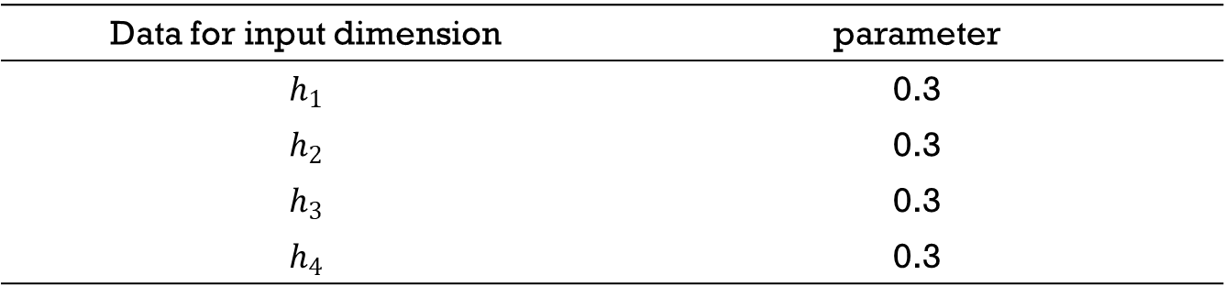
Model Construction: Structure Learning Parameter Setting of Subtractive clustering : subclust()
Data for input dimension | parameter
$$h_{1}$$ | 0.3
$$h_{2}$$ | 0.3
$$h_{3}$$ | 0.3
$$h_{4}$$ | 0.3

Slide 34





Model Construction: Structure Learning IF-Parts
Center
Gaussian
FUZZYSETs
STD
Subtractive clustering
$h_{1}$=$f_{22}$
3
Subtractive clustering
$h_{2}$=$f_{23}$
3
Subtractive clustering
$h_{3}$=$f_{26}$
3
Subtractive clustering
$h_{4}$=$f_{29}$
3
Number Of Cubes=3*3*3*3=81

Slide 35
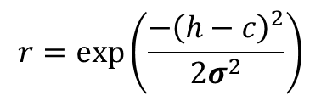
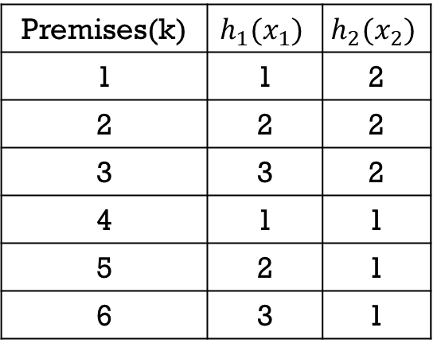



Model Construction: Structure Learning Selection of Premises
$$h_{2}(x_{2})$$
1
2
3
Premises(k) | $$h_{1}(x_{1})$$ | $$h_{2}(x_{2})$$
1 | 1 | 2
2 | 2 | 2
3 | 3 | 2
4 | 1 | 1
5 | 2 | 1
6 | 3 | 1
B2
4
5
6
B1
$$h_{1}(x_{1})$$
A1
A2
A3
Premise $k$ : IF $x_{1}=A^{(k)}$ and $x_{2}=B^{(k)}$
$$r=\exp\left(\frac{−{\left(h−c\right)}^{2}}{2σ^{2}}\right)$$
Notes:
h1孿生兄弟(x1)
h2攣生兄弟(x2)

Slide 36






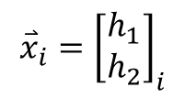



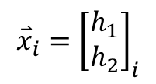
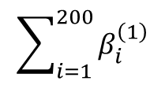
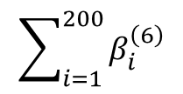

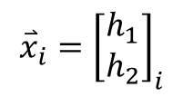


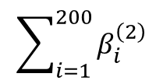

Model Construction: Structure Learning Selection of Premises
$$\overset{⃑}{h}=\left[\begin{matrix}x_{i,1} \\ x_{i,2}\end{matrix}\right]$$
$$β_{j}^{\left(k\right)}\left(\overset{⃑}{h}\right)=μ_{A^{\left(k\right)},j}\left(x_{i,1}\right)μ_{B^{\left(k\right)},j}\left(x_{i,2}\right),j=1,2,…,N$$
$$TD=\{\left({\overset{⃑}{x}}_{i},{\overset{⃑}{t}}_{i}\right),i=1,2,…,200\}$$
$$\sum_{i=1}^{200}{β_{i}^{\left(1\right)}}$$
$${\overset{⃑}{x}}_{i}={\left[\begin{matrix}h_{1} \\ h_{2}\end{matrix}\right]}_{i}$$
1
$${\overset{⃑}{β}}_{j}^{\left(1\right)}$$
$$β_{sum}^{\left(1\right)}$$
$$\sum_{i=1}^{200}{β_{i}^{\left(2\right)}}$$
$${\overset{⃑}{x}}_{i}={\left[\begin{matrix}h_{1} \\ h_{2}\end{matrix}\right]}_{i}$$
2
$${\overset{⃑}{β}}_{j}^{\left(2\right)}$$
$$β_{sum}^{\left(2\right)}$$
$$⋮$$
$$⋮$$
$$⋮$$
$$\sum_{i=1}^{200}{β_{i}^{\left(6\right)}}$$
$${\overset{⃑}{x}}_{i}={\left[\begin{matrix}h_{1} \\ h_{2}\end{matrix}\right]}_{i}$$
6
$${\overset{⃑}{β}}_{j}^{\left(6\right)}$$
$$β_{sum}^{\left(6\right)}$$
Threshold= ${mean(β}_{sum})+std(β_{sum})$

Slide 37


Model Construction: Structure Learning Selection of Premises
Threshold= ${mean(β}_{sum})+std(β_{sum})$
Number Of Cubes : 81
Number Of Cubes : 9
$β_{sum}^{\left(k\right)}$> Threshold

Slide 38
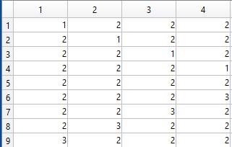
Model Construction: Structure Learning IF-Parts:Formation Matrix
Number Of Cubes : 9
Number Of Cubes : 9
透過上下界的篩選，可得到要訓練的Cubes
上界:15
下界:4

Slide 39
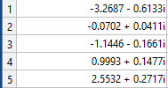



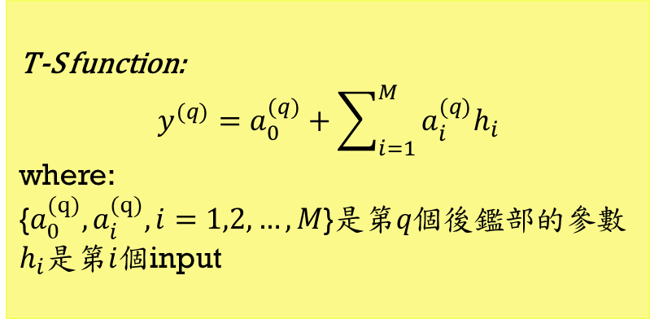



Model Construction: Structure Learning Consequences
[$h_{1}$ $h_{2}$ $h_{3}$ $h_{4}$]
Subtractive clustering
Number of aim objects(Q)
Center
STD
FCM
$${\overset{⃑}{t}}_{i}$$
T-S function:
$$y^{(q)}=a_{0}^{(q)}+\sum_{i=1}^{M}{a_{i}^{(q)}h_{i}}$$
where:
{$a_{0}^{(q)},a_{i}^{(q)},i=1,2,…,M$}是第$q個$後鑑部的參數
$h_{i}$是第$i$個input
(q)
$${\overset{⃑}{λ}}^{(q)}$$
T-S function
$q^{th}$Aim Object
$q^{th}$ THEN-Part

Slide 40


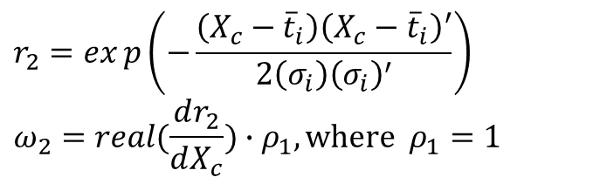


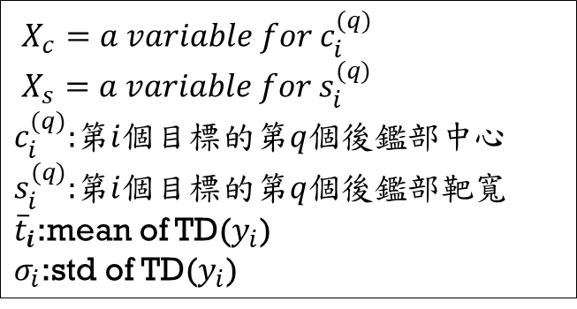
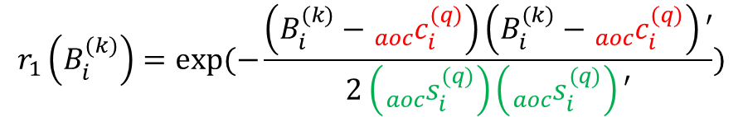

Model Construction: Structure Learning Aim Objects
$r_{1}\left(X_{c}\right)$的1次微分
$X_{c}=a variable for c_{i}^{(q)}$
$X_{s}=a variable for s_{i}^{(q)}$
$c_{i}^{(q)}$:第$i$個目標的第$q$個後鑑部中心
$s_{i}^{(q)}$:第$i$個目標的第$q$個後鑑部靶寬
${\overline{t}}_{i}$:mean of TD($y_{i}$)
$σ_{i}$:std of TD($y_{i}$)
$$λ_{i}^{(k→q)}=r_{1}\left(X_{c}\right)\exp\left(j∗ω\right)$$
$$r_{1}\left(B_{i}^{(k)}\right)=exp⁡(−\frac{\left(B_{i}^{(k)}−{{}_{aoc}^{}c}_{i}^{(q)}\right)\left(B_{i}^{(k)}−{{}_{aoc}^{}c}_{i}^{(q)}\right)′}{2\left({{}_{aoc}^{}s}_{i}^{(q)}\right)\left({{}_{aoc}^{}s}_{i}^{(q)}\right)′})$$
$${{}_{aoc}^{}c}_{i}^{(q)}=g_{2}=r_{2}exp\left(j∗ω_{2}\right)$$
$${{}_{aoc}^{}s}_{i}^{(q)}=g_{3}=r_{3}exp\left(j∗ω_{3}\right)$$
$$r_{2}=exp\left(−\frac{\left(X_{c}−{\overline{t}}_{i}\right){\left(X_{c}−{\overline{t}}_{i}\right)}^{′}}{2\left(σ_{i}\right){\left(σ_{i}\right)}^{′}}\right)$$
$$ω_{2}=real(\frac{dr_{2}}{dX_{c}})∙ρ_{1},where ρ_{1}=1$$
$$r_{3}=exp⁡(−\frac{\left(X_{s}\right)\left(X_{s}\right)′}{2(σ_{i})(σ_{i})′})$$
$$ω_{3}=real(\frac{dr_{2}}{dX_{s}})∙ρ_{2},where ρ_{2}=1$$
Notes:
${\overline{t}}_{i}$:mean of TD($y_{i}$)
$σ_{i}$:std of TD($y_{i}$)

Slide 41
MODEL CONSTRUCTION 1. Structure Learning 2. Model Structure and I/O Relationship 3. Parameter Learning

Slide 42
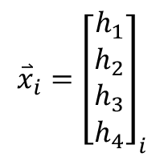







Model Construction: Model Structure and I/O Relationship Model
IF-Part
Aim
Of
Object
THEN-Part
-
+
$${\overset{⃑}{\hat{y}}}_{i}$$
+
$${\overset{⃑}{t}}_{i}=IBM+TSMC∗j$$
$${\overset{⃑}{x}}_{i}$$
Model Output
Target
$${\overset{⃑}{e}}_{i}={\overset{⃑}{t}}_{i}−{\overset{⃑}{\hat{y}}}_{i}$$
$${\overset{⃑}{x}}_{i}={\left[\begin{matrix}h_{1} \\ h_{2} \\ h_{3} \\ h_{4}\end{matrix}\right]}_{i}$$
$h_{1}$=$f_{23}$
$h_{2}$=$f_{26}$
$h_{3}$=$f_{29}$
$h_{4}$=$f_{30}$
$${\overset{⃑}{t}}_{i}={\left[\begin{aligned}t_{IBM} \\ t_{TSMC}\end{aligned}\right]}_{i}$$
$$TD=\{\left({\overset{⃑}{x}}_{i},{\overset{⃑}{t}}_{i}\right),i=1,2,…,200\}$$

Slide 43















Model Construction: Model Structure and I/O Relationship Model
M:Number of inputs K:Number of premises
Q:Number of Consequence N:Number of outputs
$$\overset{⃑}{μ }$$
$${\overset{⃑}{β }}^{(1)}$$
$${\overset{⃑}{λ}}^{(1)}$$
$${\overset{⃑}{\hat{y}}}^{(1)}$$
A1
1
1
A2
$${\overset{⃑}{λ}}^{(2)}$$
$$h_{1}$$
2
$${\overset{⃑}{β }}^{(2)}$$
$${\overset{⃑}{\hat{y}}}^{(2)}$$
2
A3
$$\overset{⃑}{\hat{y}}$$
+
$$⋮$$
$$⋮$$
B1
$$h_{2}$$
B2
$${\overset{⃑}{β }}^{(K)}$$
$${\overset{⃑}{λ}}^{(Q)}$$
$${\overset{⃑}{\hat{y}}}^{(Q)}$$
B3
K
Q
Layer1
(Inputs)
Layer2
(Fuzzy-set)
Layer3
(Premises)
Layer4
(Aim Object)
Layer5
(Consequences)
Layer6
(Outputs)

Slide 44



Model Construction: Model Structure and I/O Relationship IF-Parts(Example)
$$h_{2}(x_{2})$$
1
2
cube | $$h_{1}$$ | $$h_{2}$$
1 | 1 | 2
2 | 3 | 2
3 | 1 | 1
4 | 2 | 1
B2
Selected
Selected
3
4
B1
Selected
Selected
$$h_{1}(x_{1})$$
A1
A2
A3
Premises k : IF $x_{1}=A^{(k)}$ and $x_{2}=B^{(k)}$
$$r=\exp\left(\frac{−{\left(h−c\right)}^{2}}{2σ^{2}}\right)$$

Slide 45
Model Construction: Model Structure and I/O Relationship IF-part:Formation Matrix

Slide 46











Model Construction: Model Structure and I/O Relationship Premises (IF-Parts)
$$\overset{⃑}{h}=\left[\begin{matrix}x_{i,1} \\ \begin{aligned}x_{i,2} \\ x_{i,3} \\ x_{i,4}\end{aligned}\end{matrix}\right]$$
$$β_{j}^{\left(k\right)}\left(\overset{⃑}{h}\right)=μ_{A^{\left(k\right)},j}\left(x_{i,1}\right)∙μ_{B^{\left(k\right)},j}\left(x_{i,2}\right)∙$$
$μ_{C^{\left(k\right)},j}\left(x_{i,3}\right)∙μ_{D^{\left(k\right)},j}\left(x_{i,4}\right),j=1,2,…,N$
$$TD=\{\left({\overset{⃑}{x}}_{i},{\overset{⃑}{t}}_{i}\right),i=1,2,…,200\}$$
$${\overset{⃑}{x}}_{i}={\left[\begin{matrix}h_{1} \\ \begin{aligned}h_{2} \\ h_{3} \\ h_{4}\end{aligned}\end{matrix}\right]}_{i}$$
IF-Part
1
$${\overset{⃑}{β}}_{j}^{\left(1\right)}$$
$${\overset{⃑}{x}}_{i}={\left[\begin{matrix}h_{1} \\ \begin{aligned}h_{2} \\ h_{3} \\ h_{4}\end{aligned}\end{matrix}\right]}_{i}$$
IF-Part
2
$${\overset{⃑}{β}}_{j}^{\left(2\right)}$$
$$⋮$$
$${\overset{⃑}{x}}_{i}={\left[\begin{matrix}h_{1} \\ \begin{aligned}h_{2} \\ h_{3} \\ h_{4}\end{aligned}\end{matrix}\right]}_{i}$$
IF-Part
$$K$$
$${\overset{⃑}{β}}_{j}^{\left(K\right)}$$
$K$=9

Slide 47



















Model Construction: Model Structure and I/O Relationship Sphere Complex Fuzzy Sets
$$X_{3}$$
$$u_{x_{1}}=r∗\cos\left(θ_{2}\right)∗\cos\left(θ_{1}\right)$$
$$u_{x_{2}}=r∗\cos\left(θ_{2}\right)∗\sin\left(θ_{1}\right)$$
$$u_{x_{3}}=r∗\sin\left(θ_{2}\right)$$
1
$$(u_{x_{1}},u_{x_{2}},u_{x_{3}})$$
$$r$$
where $r=\exp\left(\frac{−{\left(h−c\right)}^{2}}{2σ^{2}}\right)$ 、$θ_{1}=\frac{dr}{dx}∙λ_{1}$ 、$θ_{2}=\frac{d^{2}r}{dx^{2}}∙λ_{2}$
$$r\sin\left(θ_{2}\right)$$
保維法
$$μ_{1}=r∗exp(j(θ_{1}+θ_{2}))$$
$$θ_{2}$$
$$X_{2}$$
$$θ_{1}$$
$$r\cos\left(θ_{2}\right)$$
$$μ_{2}=u_{x_{1}}+u_{x_{2}}∗j$$
$$r\cos\left(θ_{2}\right)\sin\left(θ_{1}\right)$$
$$r\cos\left(θ_{2}\right)\cos\left(θ_{1}\right)$$
降維法
$$μ_{3}=u_{x_{2}}+u_{x_{3}}∗j$$
$$X_{1}$$
$$μ_{4}=u_{x_{3}}+u_{x_{1}}∗j$$
$$\overset{⃑}{μ}=\left[\begin{matrix}μ_{1} \\ \begin{aligned}μ_{2} \\ μ_{3} \\ μ_{4}\end{aligned}\end{matrix}\right]$$

Slide 48












Model Construction: Model Structure and I/O Relationship SCFSs
Membership
degrees
OUTPUT
TARGET
$$μ_{1}=r∗exp(j(θ_{1}+θ_{2}))$$
${\hat{y}}_{i}^{\left(1\right)}$
$$t_{i}^{(1)}=IBM+TSMC∗j$$
$$μ_{2}=u_{x_{1}}+u_{x_{2}}∗j$$
${\hat{y}}_{i}^{\left(2\right)}$
$$t_{i}^{(2)}=target3+target4∗j$$
$$μ_{3}=u_{x_{2}}+u_{x_{3}}∗j$$
${\hat{y}}_{i}^{\left(3\right)}$
$$t_{i}^{(3)}=target5+target6∗j$$
$$μ_{4}=u_{x_{3}}+u_{x_{1}}∗j$$
${\hat{y}}_{i}^{\left(4\right)}$
$$t_{i}^{(4)}=target7+target8∗j$$

Slide 49
Model Construction: Model Structure and I/O Relationship Premises (IF-Parts)
$$\overset{⃑}{h}=\left[\begin{matrix}x_{i,1} \\ \begin{aligned}x_{i,2} \\ x_{i,3} \\ x_{i,4}\end{aligned}\end{matrix}\right]$$
$$β_{j}^{\left(k\right)}\left(\overset{⃑}{h}\right)=μ_{A^{\left(k\right)},j}\left(x_{i,1}\right)∙μ_{B^{\left(k\right)},j}\left(x_{i,2}\right)∙$$
$μ_{C^{\left(k\right)},j}\left(x_{i,3}\right)∙μ_{D^{\left(k\right)},j}\left(x_{i,4}\right),j=1,2,…,N$
$$TD=\{\left({\overset{⃑}{x}}_{i},{\overset{⃑}{t}}_{i}\right),i=1,2,…,200\}$$
$${\overset{⃑}{x}}_{i}={\left[\begin{matrix}h_{1} \\ \begin{aligned}h_{2} \\ h_{3} \\ h_{4}\end{aligned}\end{matrix}\right]}_{i}$$
IF-Part
1
$${\overset{⃑}{β}}_{j}^{\left(1\right)}$$
$${\overset{⃑}{x}}_{i}={\left[\begin{matrix}h_{1} \\ \begin{aligned}h_{2} \\ h_{3} \\ h_{4}\end{aligned}\end{matrix}\right]}_{i}$$
IF-Part
2
$${\overset{⃑}{β}}_{j}^{\left(2\right)}$$
$$⋮$$
$${\overset{⃑}{x}}_{i}={\left[\begin{matrix}h_{1} \\ \begin{aligned}h_{2} \\ h_{3} \\ h_{4}\end{aligned}\end{matrix}\right]}_{i}$$
IF-Part
$$K$$
$${\overset{⃑}{β}}_{j}^{\left(K\right)}$$
$K$=9

Slide 50









Model Construction: Model Structure and I/O Relationship Aim Objects
N層箭靶
(1)
$${\overset{⃑}{β}}^{(1)}={\left[\begin{matrix}β_{1} \\ β_{2} \\ ⋮ \\ β_{N}\end{matrix}\right]}^{(1)}$$
$${\overset{⃑}{λ}}^{(1)}$$
THEN-part
(2)
$${\overset{⃑}{β}}^{(2)}={\left[\begin{matrix}β_{1} \\ β_{2} \\ ⋮ \\ β_{N}\end{matrix}\right]}^{(2)}$$
$${\overset{⃑}{λ}}^{(2)}$$
THEN-part
$$⋮$$
$$⋮$$
$$⋮$$
$${\overset{⃑}{β}}^{(K)}={\left[\begin{matrix}β_{1} \\ β_{2} \\ ⋮ \\ β_{N}\end{matrix}\right]}^{(K)}$$
(Q)
$${\overset{⃑}{λ}}^{(Q)}$$
THEN-part

Slide 51










Model Construction: Model Structure and I/O Relationship Consequence
(THEN-parts)
$$B={\left[{\overset{⃑}{B}}^{\left(1\right)} {\overset{⃑}{B}}^{\left(2\right)}…{\overset{⃑}{B}}^{\left(K\right)}\right]}_{N×K}$$
$${{\overset{⃑}{\hat{y} }}^{(q)}}^{ }=φ^{(q)}×{\overset{⃑}{a}}^{(q)}$$
$${\overset{⃑}{B}}^{\left(k\right)}={\left[B_{1}^{\left(k\right)}B_{2}^{\left(k\right)} …B_{N}^{\left(k\right)}\right]}^{T}$$
$${\overset{⃑}{a}}^{(q)}={\left[a_{0}^{\left(q\right)} a_{1}^{\left(q\right)} …a_{M}^{\left(q\right)}\right]}_{(M+1)×1}^{T}$$
$B_{N}^{(k)}:第N個$目標中，第$k$個前鑑部的啟動強度
$a_{0}^{(q)}\sim a_{M}^{(q)}:第$q個後鑑部參數
$$L^{(q)}={\left[\begin{aligned}\begin{matrix}{{\overset{⃑}{λ}}^{\left(1→q\right)}}^{T} \\ {{\overset{⃑}{λ}}^{\left(2→q\right)}}^{T} \\ \begin{aligned}⋮ \\ {{\overset{⃑}{λ}}^{\left(K→q\right)}}^{T}\end{aligned}\end{matrix}\end{aligned}\right]}_{K×N}$$
$$H={\left[\begin{aligned}\begin{matrix}{\left({\overset{⃑}{h}}_{a}\right)}^{T} \\ {\left({\overset{⃑}{h}}_{a}\right)}^{T} \\ \begin{aligned}⋮ \\ {\left({\overset{⃑}{h}}_{a}\right)}^{T}\end{aligned}\end{matrix}\end{aligned}\right]}_{N×(M+1)}$$
$${\overset{⃑}{h}}_{a}={\left[1 (\overset{⃑}{h})\right]}^{T}$$
$$φ^{(q)}=B∙L∙H$$

Slide 52
MODEL CONSTRUCTION 1. Structure Learning 2. Model Structure and I/O Relationship 3. Parameter Learning

Slide 53


Model Construction: Parameter Learning Machine Learning
PSO
RLSE
Premises
(IF-Parts)
Consequences
(THEN-Parts)
-
+
$${\overset{⃑}{\hat{y}}}_{i}$$
+
$${\overset{⃑}{t}}_{i}=IBM+TSMC∗j$$
$${\overset{⃑}{x}}_{i}$$
Model Output
Target
$${\overset{⃑}{e}}_{i}={\overset{⃑}{t}}_{i}−{\overset{⃑}{\hat{y}}}_{i}$$
$${\overset{⃑}{x}}_{i}={\left[\begin{matrix}h_{1} \\ h_{2} \\ h_{3} \\ h_{4}\end{matrix}\right]}_{i}$$
$$TD=\{\left({\overset{⃑}{x}}_{i},{\overset{⃑}{t}}_{i}\right),i=1,2,…,200\}$$

Slide 54




Model Construction: Parameter Learning Machine Learning(PSO)
$$\left.{\overset{⃑}{V}}_{i} (t+1)=ω{\overset{⃑}{V}}_{i}(t)+c_{1}ξ_{1}({\overset{⃑}{Pbest}}_{i}(t)−{\overset{⃑}{P}}_{i}(t))+c_{2}ξ_{2}(\overset{⃑}{Gbest} (t)−{\overset{⃑}{P}}_{i}(t)\right)$$
全群最佳位置
(Gbest)
新位置
自我最佳位置
(Pbest)
透過自我最佳位置
調整方向
$${\overset{⃑}{P}}_{i}\left(t+1\right)={\overset{⃑}{P}}_{i}\left(t\right)+{\overset{⃑}{V}}_{i}\left(t+1\right)$$
透過全群最佳位置
調整方向
${\overset{⃑}{P}}_{i}\left(t\right):$the position vector of particle $i$at iteration $t$.
${\overset{⃑}{V}}_{i}\left(t\right):$ the velocity vector of particle $i$at iteration $t$. ${\overset{⃑}{Pbest}}_{i}\left(t\right)$: the best position vector of particle $i$at iteration $t$.
$\overset{⃑}{Gbest}\left(t\right)$:the best position vector of all particle at iteration $t$.
$ω、C_{1}、C_{2}$:PSO parameters
$ξ_{1}$、$ξ_{2}$:random numbers in [0,1]
慣性方向
目前位置
第$i$顆粒子

Slide 55





Model Construction: Parameter Learning Cost Function
-
+
$${\overset{⃑}{\hat{y}}}_{i}$$
+
$${\overset{⃑}{t}}_{i}=IBM+TSMC∗j$$
Model Output
Target
$${\overset{⃑}{e}}_{i}={\overset{⃑}{t}}_{i}−{\overset{⃑}{\hat{y}}}_{i}$$
$$RMSE=\sqrt{\frac{\sum_{i=1}^{n}{\left({\overset{⃑}{e}}_{i}\right)\left({\overset{⃑}{e}}_{i}\right)′}}{n}}$$
$n$=200

Slide 56



Model Construction: Parameter Learning Flowchart of the PSO-RLSE method
Initialize swarm
Start Iteration
Construct Fuzzy set
Prepare A、y
Caculate Firing-Strength
Initialize$P_{0}、 {\overset{⃑}{\text{θ}}}_{0}$
Calculate RMSE
Caculate Aim Of Object
Update$P_{k+1}$
Update Gbest、Pbest
Recursively
Update ${\overset{⃑}{\text{θ}}}_{k+1}$
Update velocity
Caculate Output
Update Position
Get Consequences parameters
No
STOP?
Yes
End

Slide 57

Model Construction: Parameter Learning Model Setting
Parameter | Value
Number of inputs | {$f_{23} f_{26} f_{29} f_{30}$ }
Number of targets (real-valued) | 2
Number of outputs (complex-valued) | 1
Number of premises (before selection) | 81
Type of premises | Sphere complex fuzzy set
Number of premises (after selection) | 9
Number of premise parameters | 48
Number of aim object | 5
Type of consequences | Takagi-sugeno
Number of consequences | 5
Number of consequence parameters | 25
Notes:
Number of Premise parameters : 4(INPUT)*3(每一個INPUT剛好都分3群)*4(Center、Std、lambda1、lambda2)=48
Number of Consequence parameters : 5*(1+4)=25

Slide 58

MODEL CONSTRUCTION: Parameter Learning
PSO parameters
Parameters | value
Swarm size | 64
Iterations | 100
$ω c_{1} 、c_{2}$ | 0.8 2.0 2.0
$ξ_{1}、ξ_{2}$ | Random in [0,1]
Velocity | 0
RLSE parameters
Parameters | value
$α$ | ${1×10}^{8}$
${\overset{⃑}{\text{θ}}}_{0}$ | 25x1 zero vector
$P_{0}$ | $α$I
I | 25x25 identify vector

Slide 59

Premises Parameters (after learning)
Table Parameters of Premises
Input | Fuzzy sets
$$h_{1}$$ | A1 |  |  |  |  | A2 |  |  |  |  | A3
 | c | $$σ$$ | $$λ_{1}$$ | $$λ_{2}$$ |  | c | $$σ$$ | $$λ_{1}$$ | $$λ_{2}$$ |  | c | $$σ$$ | $$λ_{1}$$ | $$λ_{2}$$
 | -7.4837 | -2.4629 | 0.2314 | -1.4896 |  | 5.0227 | 5.8565 | -0.4322 | 1.1944 |  | 0.1179 | 1.2586 | -1.3571 | 1.6476
$$h_{2}$$ | B1 |  |  |  |  | B2 |  |  |  |  | B3
 | C | $$σ$$ | $$λ_{1}$$ | $$λ_{2}$$ |  | c | $$σ$$ | $$λ_{1}$$ | $$λ_{2}$$ |  | c | $$σ$$ | $$λ_{1}$$ | $$λ_{2}$$
 | -5.4257 | -0.2498 | 0.5714 | -0.4747 |  | -4.1168 | -9.2394 | -0.0627 | -0.3922 |  | 3.8949 | -4.2743 | 1.0385 | -2.1150
$$h_{3}$$ | C1 |  |  |  |  | C2 |  |  |  |  | C3
 | c | $$σ$$ | $$λ_{1}$$ | $$λ_{2}$$ |  | c | $$σ$$ | $$λ_{1}$$ | $$λ_{2}$$ |  | c | $$σ$$ | $$λ_{1}$$ | $$λ_{2}$$
 | -1.5145 | 6.9056 | -1.4537 | -0.2684 |  | -9.2324 | -4.0280 | -0.5736 | 0.5729 |  | 1.1834 | -2.9370 | -0.1734 | 1.3089
$$h_{4}$$ | D1 |  |  |  |  | D2 |  |  |  |  | D3
 | c | $$σ$$ | $$λ_{1}$$ | $$λ_{2}$$ |  | c | $$σ$$ | $$λ_{1}$$ | $$λ_{2}$$ |  | c | $$σ$$ | $$λ_{1}$$ | $$λ_{2}$$
 | -7.6711 | 7.8509 | -0.0124 | 0.7904 |  | 6.5933 | -0.5543 | -0.4448 | 0.4812 |  | 9.9831 | 6.5836 | -1.5457 | -1.1439

Slide 60

Aim Object Parameters
 | Center | Spread | $${}_{aoc}^{}c$$ | $${}_{aoc}^{}s$$ | $$g_{1}$$ | $$ρ_{1}$$ | $$ρ_{2}$$
Aim object1 | -3.2687-0.6133i | 1.7558+0.3784i | 0.0622+0.0059i | 0.4762-0.1909i | 0.3853 | 1 | 1
Aim object2 | -0.0702+0.0411i | 1.7558+0.3784i | 0.9602+0.1527i | 0.4762-0.1909i | 0.9744 | 1 | 1
Aim object3 | -1.1446-0.1661i | 1.7558+0.3784i | 0.5588+0.2269i | 0.4762-0.1909i | 0.3147 | 1 | 1
Aim object4 | 0.9993+0.1477i | 1.7558+0.3784i | 0.9175-0.23788i | 0.4762-0.1909i | 0.5087 | 1 | 1
Aim object5 | 2.5532+0.2717i | 1.7558+0.3784i | 0.3467-0.1171i | 0.4762-0.1909i | 0.8169 | 1 | 1
Notes:
Radius:
0.0626
0.9724
0.6032
0.9479
0.3660

Slide 61


Consequences Parameters
$$\text{θ}\text{ =}$$

Slide 62
Training phase
Testing phase

Slide 63


Slide 64
Performance(RMSE)
 | Overall | IBM | TSMC
Training | 1.6381 | 1.5299 | 0.3339
Testing | 1.7714 | 1.6127 | 0.3561

